Slide 1
ReactJS
What the cool kids will be doing when Angular becomes old skool
Matthew Smith
December 2014

Slide 2

Rethinking the UI
Welcome to the next rabbit hole

Slide 3
Principles of ReactJS
What is this thing anyway?
React is the V in MVC
virtual DOM diff implementation for ultra-high performance
React implements one-way reactive data flow which reduces boilerplate and is easier to reason about than traditional data binding

Slide 4
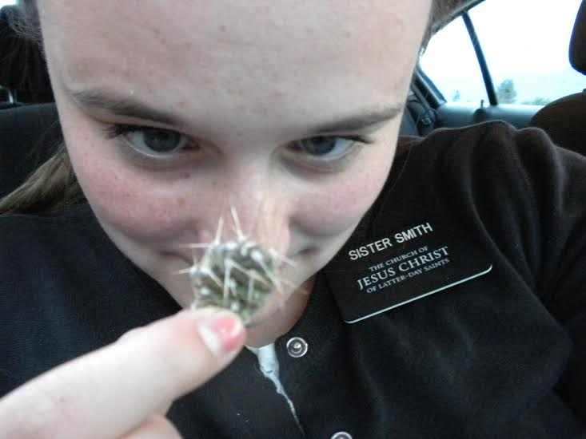
My daughter is awesome
She is coming home today!!!

Slide 5
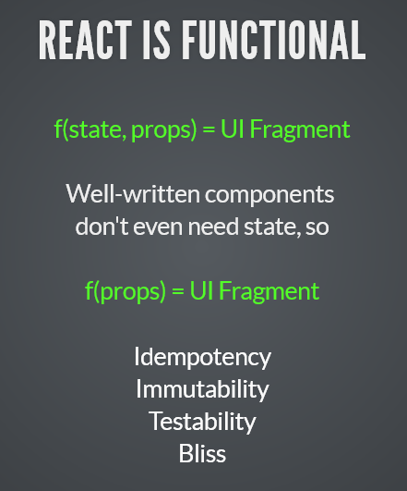
The V in MVC
No binding, no observers, no dirty checking – simple is better

Slide 6

Virtual Dom
Virtual Dom is your friend – way faster than direct DOM manipulation

Slide 7
Classic Todo List
Something to fiddle with
http://jsfiddle.net/johnthethird/NXCyC/9/
Notice how the data is independent of the DOM elements
Add only adds an element to the list, the other components are re-rendered only if the change impacts them

Slide 8
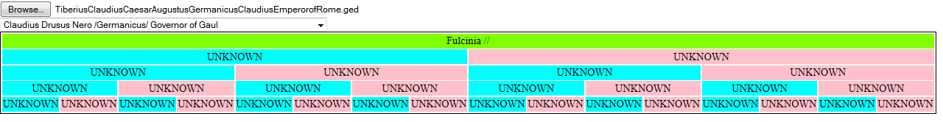
Pedigree
A test app using React and OM (cause I still hate JavaScript)
See it in action

Slide 9
HTML
This is all of it
<!DOCTYPE html>
<html>
<style>
table { border: 1px solid black; }
td { text-align: center; }
.self { background-color: Chartreuse;}
.M { background-color: cyan;}
.F { background-color: pink;}
</style>
<body>
<div id="gedcom"></div>
<div id="names"></div>
<div id="tree"></div>
<div id="message"></div>
<script src="http://fb.me/react-0.11.1.js"></script>
<script src="../out/goog/base.js" type="text/javascript"></script>
<script src="../main.js" type="text/javascript"></script>
<script type="text/javascript">goog.require("topoged.pedigree.ui");</script>
</body>
</html>

Slide 10
Data Model
Pretty simple really – map of id to {name, parents, id}
"@I52731@" {:parents ["@I52730@" "@I52790@"], :name "Emperor Augustus /Octavian/", :id "@I52731@"},
"@I52727@" {:parents ["@I124148@" nil], :name "Creticus /Creticus/ Praetor of Rome", :id "@I52727@"},
"@I52788@" {:parents ["@I52787@" "@I52789@"], :name "Gaius /Marius/", :id "@I52788@"},
"@I124223@" {:name "Amelia Lepida //", :id "@I124223@"},
"@I52751@" {:name "Julia Aggripina /Caesar/", :id "@I52751@"},
"@I52794@" {:name "Valeria /Messalina/", :id "@I52794@"},
"@I52722@" {:parents ["@I52727@" nil], :name "Mark /Antony/ the Triumvir", :id "@I52722@"},
"@I124229@" {:name "Tiberius Claudius /Nero/", :id "@I124229@"},

Slide 11
Drop Down List
ClojureScript is cool
(om/root
(fn [app owner]
(let [n (names (:model app))]
(om/component
(apply dom/select #js {:onChange jj}
(map (fn [[text value]]
dom/option #js {:value value :key value} text)) n)))))
app-state
{:target (. js/document (getElementById "names"))})

Slide 12
Process
Change app-state
Execute the components
Write to the DOM only those that have changed

Slide 13
Credit where credit is due
Learn More:
http://facebook.github.io/react/
http://slides.com/johnlynch/reactj
https://github.com/swannodette/om
https://github.com/m0smith/topoged.pedigree

