Slide 1
Ant Colony Simulation
Creating a multi-threaded functional application in Clojure
Matthew Smith
May 2015

Slide 2

Rethinking Multi-Threaded Applications
Welcome to the next rabbit hole

Slide 3
Enough Clojure to get started
What is this Clojure thing anyway?
Clojure is
Functional
Lisp-ish but with fewer parenthesis
Runs on the JVM (and CLR and Javascript)
Immutable data structures
Built-in threading contructs
Designed for a multi-core world

Slide 4
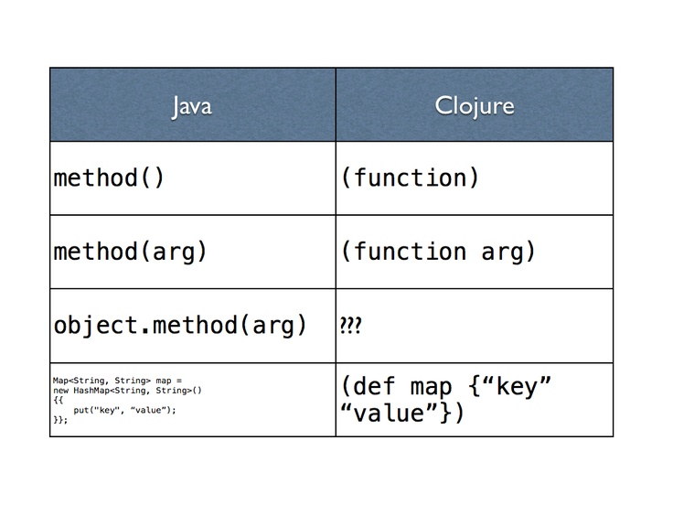
Enough Clojure to get started
Clojure syntax
(.method object arg)

Slide 5
Enough Clojure to get started
Interact and manipulate the running system
REPL
Read
Eval
Print
Loop

Slide 6
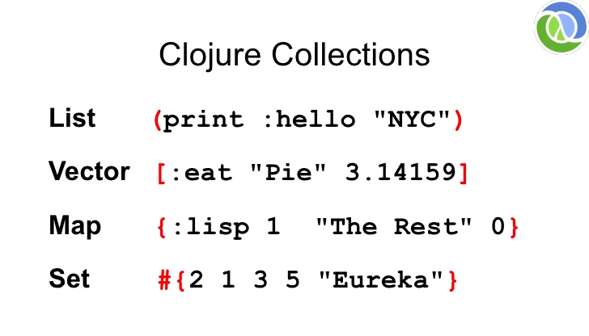
Enough Clojure to get started
Overview of Collections

Slide 7
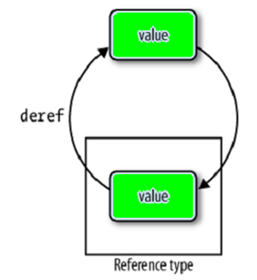
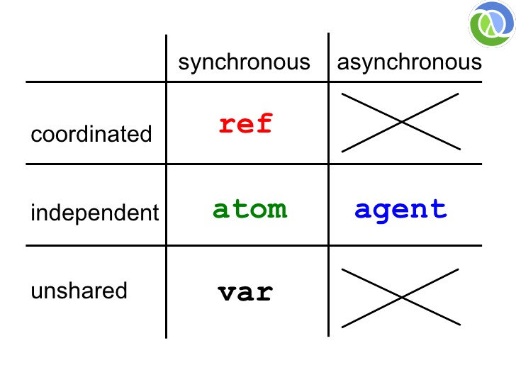
Enough Clojure to get started
What if I want to change a value?
Ref:
should a transaction have a conflict while running, it is automatically retried

Slide 8
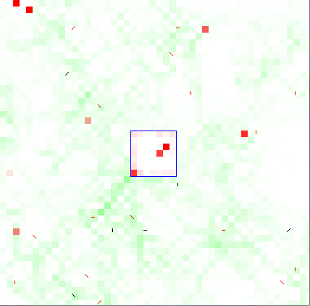
Ant colony Simultaion
Overview
Home
Food
Ants
Phenemones

Slide 9
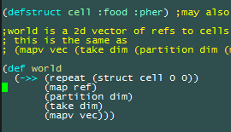
Creating the world the lazy way
Using lazy sequences to create the world
Repeat – create an infinite sequence of
Map – lazily apply a function to each element of a sequence, creating a new sequence
Partition – (1 2 3 4) ( (1 2) (3 4))
Take – Only take the first n elements of a sequence
Mapv and vec – convert to vectors

Slide 10
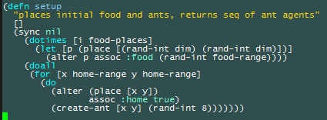
Setup the world
Sync and alter are the friends of ref
Sync and alter – transaction
Assoc – Map.put()
Dotimes = for(int i = 0; i < food-places; ++i) {}
For = nested for loops in java
For( int x : home-range) for (int y : home-range) {}
Place – ref at location

Slide 11
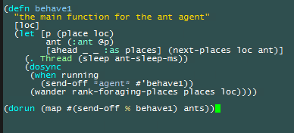
Wandering Ants
Aimless ants with nothing to do
:ant – keywords are functions on maps
Agent
Value: deref with @
Command queue – send-off
Places – where an ant might want to go

Slide 12
Credit where credit is due
Learn More:
http://facebook.github.io/react/
http://slides.com/johnlynch/reactj
https://github.com/swannodette/om
https://github.com/m0smith/topoged.pedigree

