Slide 1
Exploit Development
Defeating NX and ASLR

Slide 2
Bugs & Exploitation The Harsh Truth
The bug
NX/DEP
ASLR ( & PIE )
Then what?
Alone, DEP is not a big problem,
But, ASLR
What do we need?
Notes:
sysctl kernel.randomize_va_space
watch cat /proc/self/maps
http://www.trapkit.de/tools/checksec.sh

Slide 3
NX bit (aka DEP)
Stack is not executable
Execute somewhere else
Libs (“return-to-libc”), .text

Slide 4
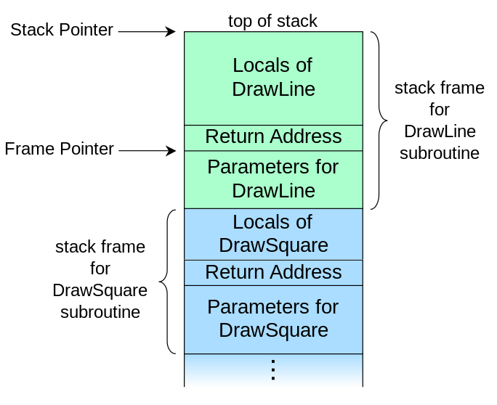
The stack
Void DrawSquare(int pars){
//blabla
DrawLine(int*pars);
return
}

Slide 5
Return Oriented Programming
ret => pop eip
A stack-controlled jmp
A ROP gadget: <any instruction> + ret
When ret is executed the next address to jump to is fetched from the stack
=> ROP Chaining

Slide 6
Chaining
Example of concatenating gadgets in chains
 | Stack address | Stack Value
Before RET, ESP points here -> | 0010F730 | 10026D56 (pointer to POP EAX + RET)
 | 0010F734 | 50505050 (this will be popped into EAX)
 | 0010F738 | 1002DC24 (pointer to ADD EAX,80 + POP EBX + RET)
 | 0010F73C | DEADBEEF (this will be popped into EBX, padding)
 | …. | …and so on

Slide 7
Finding gadgets
msfrop
mona.py (immunity plugin, windows only but awesome)
objdump –d <exec>|egrep –B <n> ret ( might do if you’re really desperate )

Slide 8
ROP payloads
Ok, what can I do with ROP?
A common technique:
Allocate new memory area (mmap/VirtualAlloc) as RWX
Write the shellcode into it (read/memcpy)
Jump into shellcode
Plenty more techniques here (windows only but general ideas can be reused):
https://www.corelan.be/index.php/2010/06/16/exploit-writing-tutorial-part-10-chaining-dep-with-rop-the-rubikstm-cube/

Slide 9
Calling functions
In theory, it’s pretty simple…
Just set up the stack like this:
 | Stack address | Stack Value
Calling func(&var, 1); -> | 0x0010F730 | 0x10026D56 (address of func() )
 | 0x0010F734 | 0x10101010 (ret address after func() exits, next gadget?)
 | 0x0010F738 | 0x0010f630(address of var)
 | 0x0010F73C | 0x00000001 (1, this is easy)
 | …. | …whatever
In practice, you might not know any of these addresses

Slide 10
Memory Disclosure
What’s that?
Why:
Call system libraries in ROP payload, bypass ASLR
Necessary if everything is randomised
How:
Stacktraces
Format string bugs
Can you “cause” it?
Notes:
Format string exception

Slide 11
Using leaks
I’ve got a memory address, then?
Leak one or few addresses for known locations, calculate the rest by offset
-> dependent on the version of the library
Leak big chunks of memory, extract gadgets and addresses directly
Possible to dynamically build ROP payload on the fly from template
More reliable, but technically harder
You might not have full control on the leak

Slide 12
Caveats
Libc/win32 api versions hell
https://community.rapid7.com/community/metasploit/blog/2012/10/03/defeat-the-hard-and-strong-with-the-soft-and-gentle-metasploit-ropdb
Who cleans up the stack?
Notes:
dpkg -l libc6
dpkg -l libc6:i386

