Slide 1
Deep Learning Algorithms and Methods
Lecture 4
Artificial Neural Networks Mathematical Blocks

Slide 2
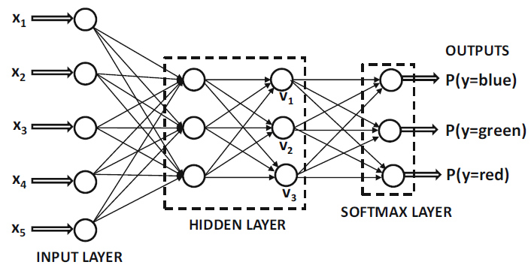

Choice and Number of Output Nodes
For k-way classification, k output values can be used, with a softmax activation function with respect to outputs v = [v1, . . . , vk] at the nodes in a given layer
The three outputs correspond to the probabilities of the three classes, and they convert the three outputs of the final hidden layer into probabilities with the softmax function
The use of softmax with a single hidden layer of linear activations exactly implements a model, which is referred to as multinomial logistic regression

Slide 3
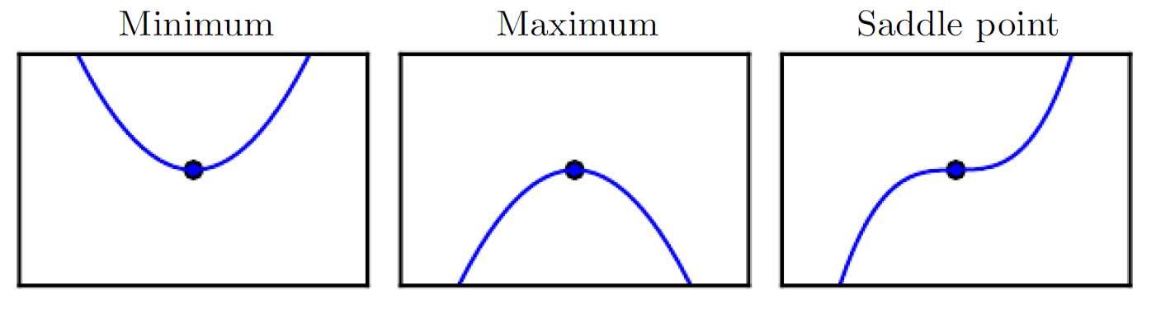
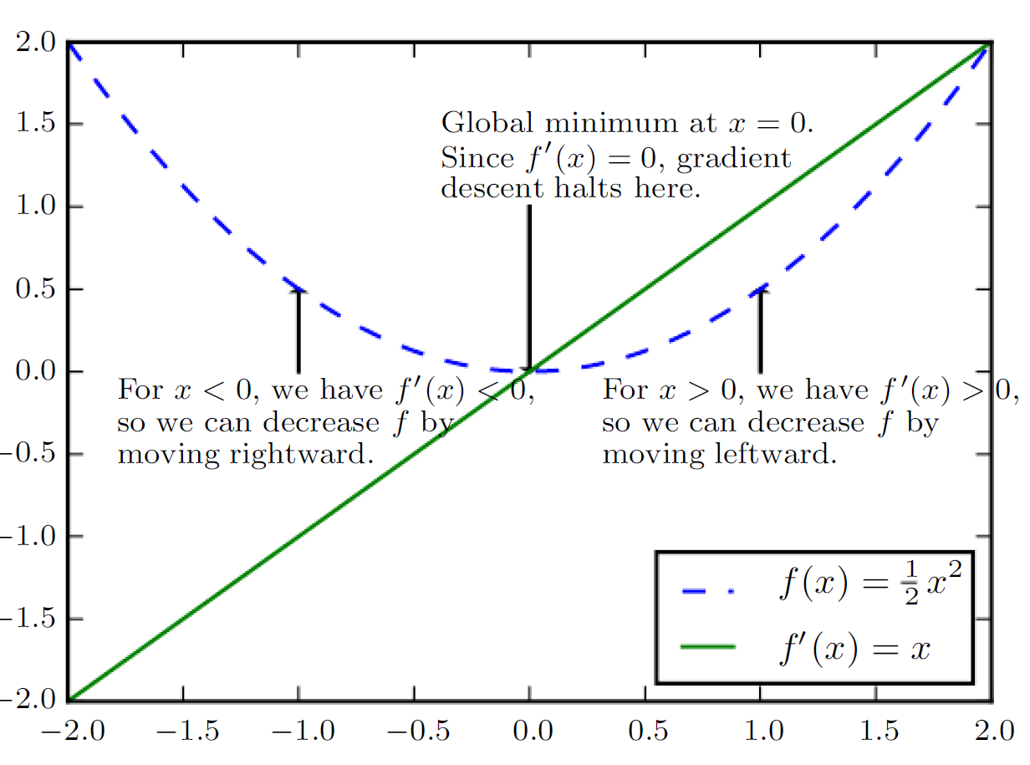
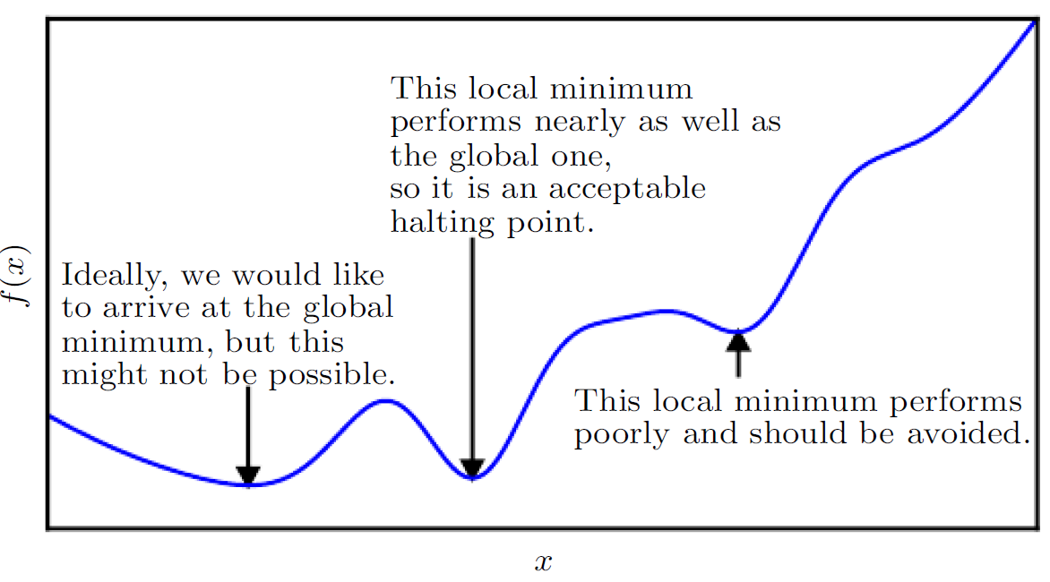
Gradient-Based Optimization (but there are more…)
We can thus reduce f (x) by moving x in small steps with opposite sign of the derivative. This technique is called gradient descent
Goodfellow, I., Bengio, Y., Courville, A., & Bengio, Y. (2016). Deep learning (Vol. 1). Cambridge: MIT press.

Slide 4
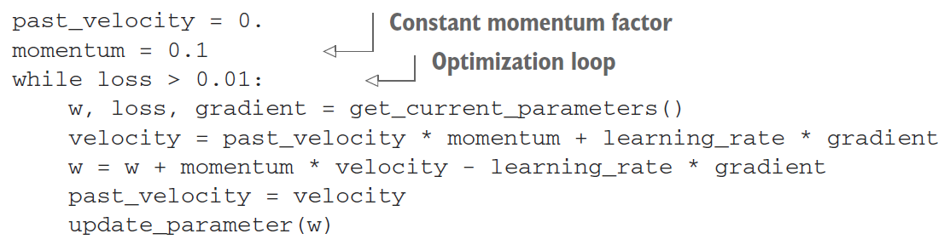
Stochastic gradient descent
Draw a batch of training samples x and corresponding targets y.
Run the network on x to obtain predictions y_pred.
Compute the loss of the network on the batch, a measure of the mismatch between y_pred and y.
Compute the gradient of the loss with regard to the network’s parameters (a backward pass).
Move the parameters a little in the opposite direction from the gradient—for example W -= step * gradient—thus reducing the loss on the batch a bit.
Adding Momentum

Slide 5
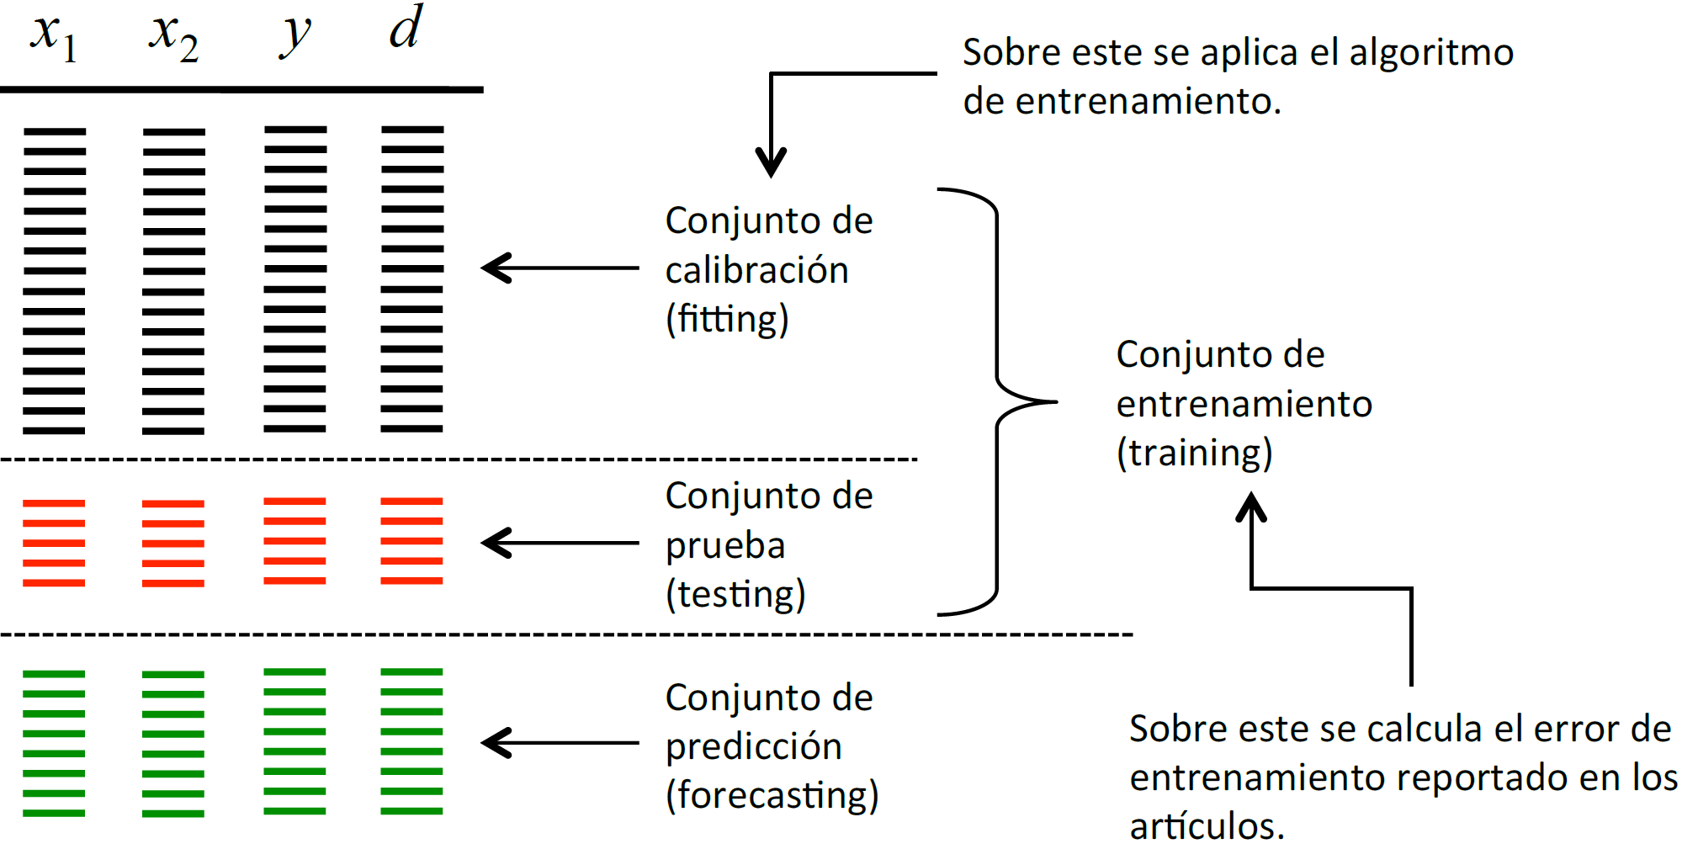
Data Partitioning
Training is performed over this subset
Fitting subset
Training set
Testing subset
Forecasting set
The error is calculated over this set and is reported

Slide 6
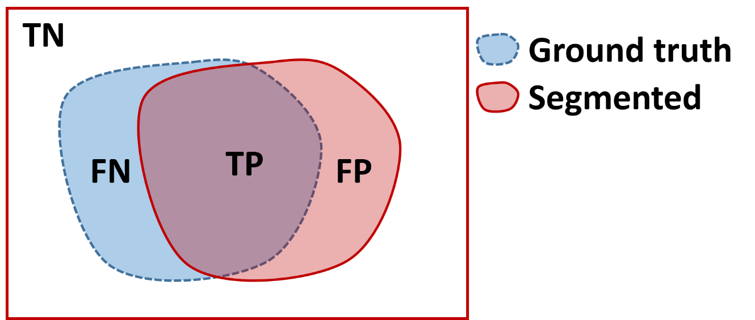
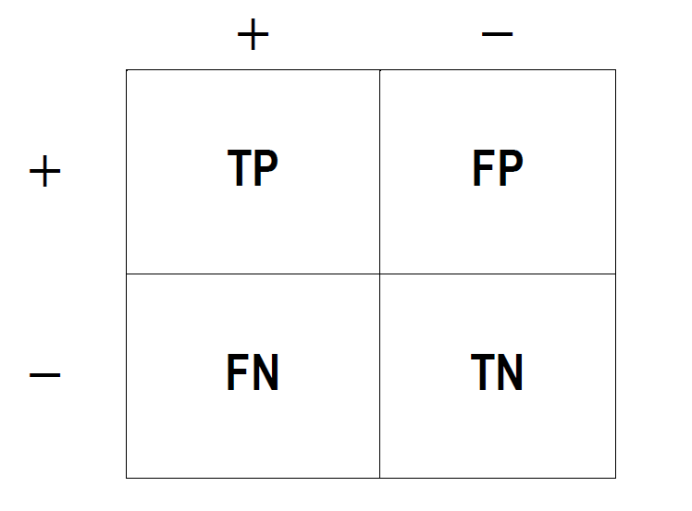
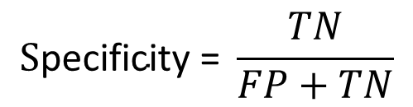
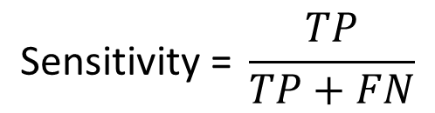
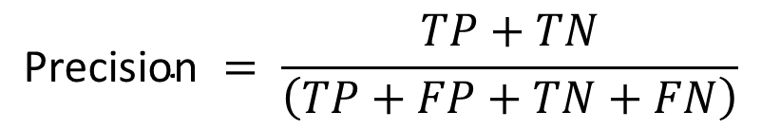
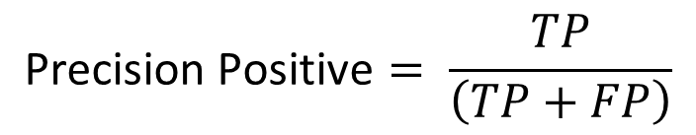
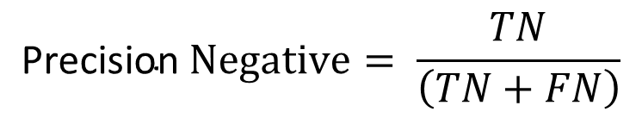
Classification Metrics
$$\text{Precision} = \frac{TP+TN}{\left(TP+FP+TN+FN\right)}$$
Predicted
$$\text{Precision} \text{Positive}= \frac{TP}{\left(TP+FP\right)}$$
$$\text{Precision} Negative= \frac{TN}{\left(TN+FN\right)}$$
$$\text{Sensitivity}\text{ = }\frac{TP}{TP+FN}$$
$$\text{S}\text{pecificity}\text{ = }\frac{TN}{FP+TN}$$

Slide 7
Techniques to select the number of cell in the hidden layer
Fixed cells number
Constructive Methods: Start with 0 and add 1 cell
Destructive Methods: Start with a large number of cells and then remove

Slide 8
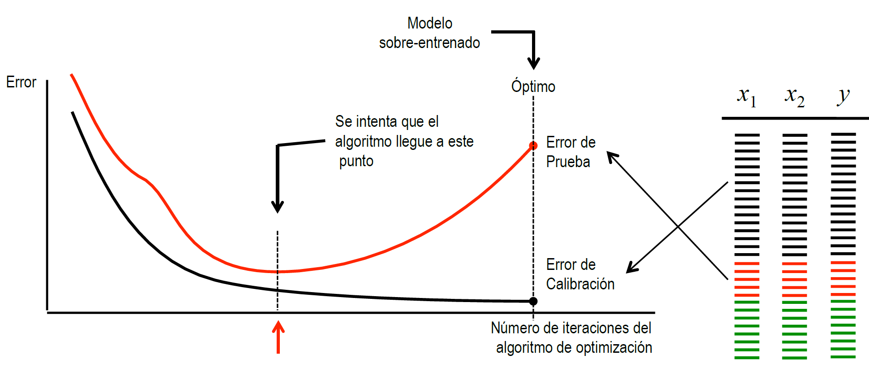
Fixed Cells Number
A fixed large number of cells is selected (possible overfitting).
An over-fitted NN will have some large weights and some small weights
Overfitted Model
Optimal Value
Ideal Number of Iterations
Test Error
Train Error
Optimization algorithm iterations

Slide 9
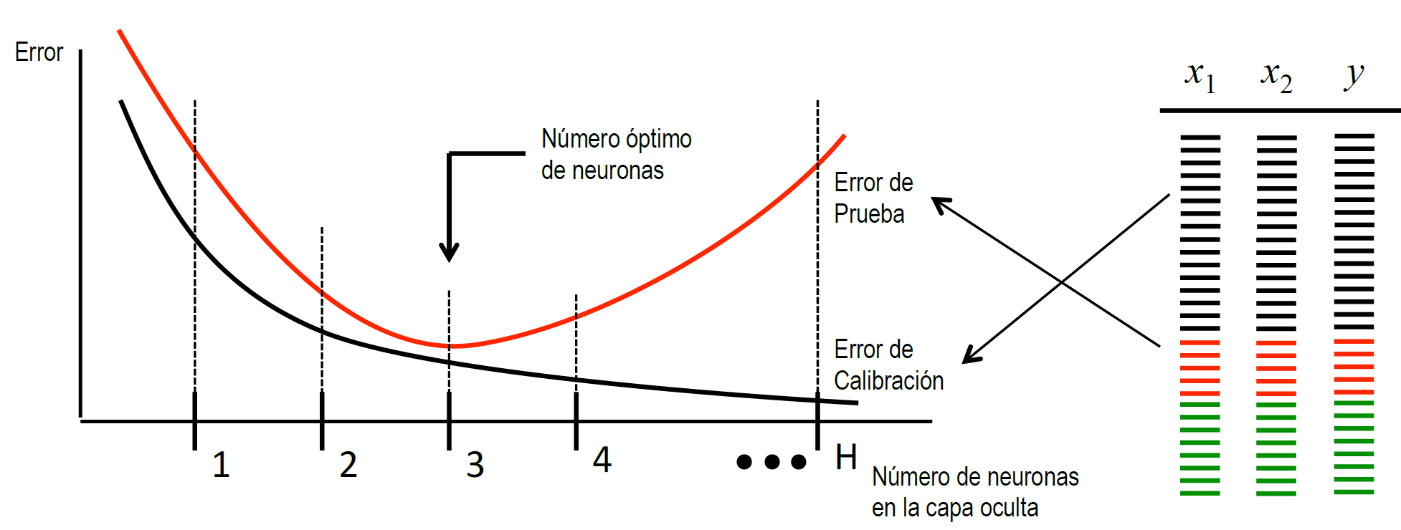
Constructive Methods
Ideal Number of Cells
Test Error
Train Error
Number of cells sin the hidden layer
Start with 0 and add 1 cell

Slide 10
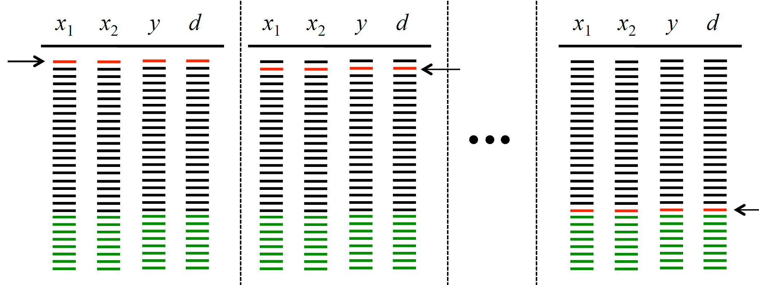
Constructive Methods: Leave-one out
Example.
There are 20 patterns for training:
Patterns 2-20 are used for fitting and 1 for testing
Patterns 1, 3-20 are used for fitting and 2 for testing
Patterns 1, 2, 4-20 are used for fitting and 3 for testing
And so on.
The cross-validation error (leaving-one-out in this case) is calculated as the average of the 20 errors of testing.
The number of cells that minimizes the average error of testing is chosen.

Slide 11
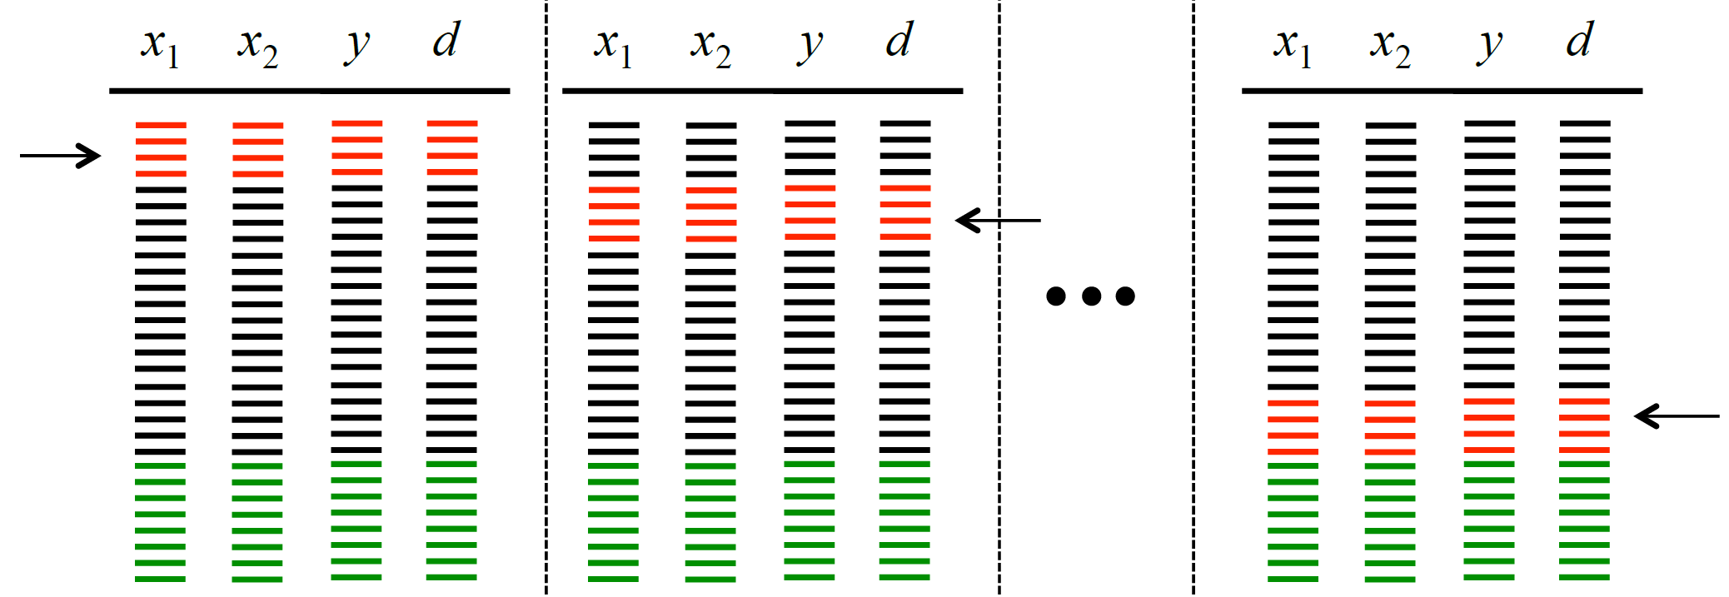
Constructive Methods: Leave-N out

Slide 12
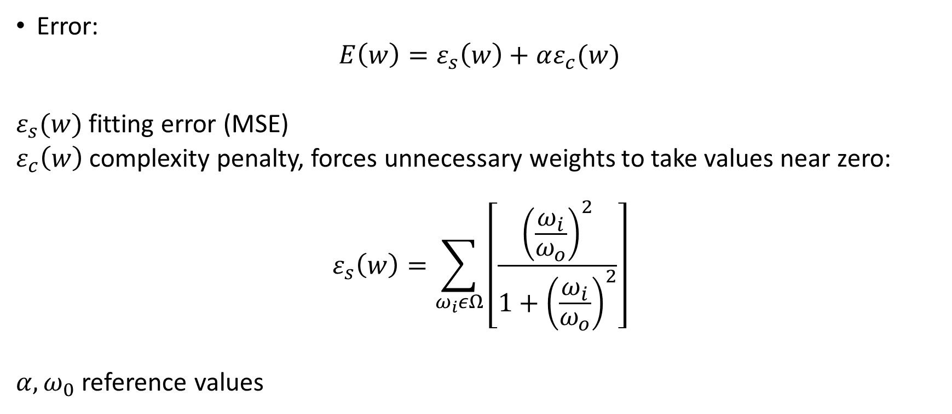
Destructive Methods: Weight Elimination
Error:
$$E\left(w\right)=ε_{s}\left(w\right)+αε_{c}(w)$$
$ε_{s}(w)$ fitting error (MSE)
$ε_{c}\left(w\right)$ complexity penalty, forces unnecessary weights to take values near zero:
$$ε_{s}\left(w\right)=\sum_{ω_{i}εΩ}{\left[\frac{{\left(\frac{ω_{i}}{ω_{o}}\right)}^{2}}{1+{\left(\frac{ω_{i}}{ω_{o}}\right)}^{2}}\right]}$$
$α, ω_{0}$ reference values

Slide 13
Data Preparation
Each class must be adequately represented in the data set. All classes must appear in the data set and have a balanced number of examples
For each class, the training patterns must show their real variation. This is especially important when defining the decision boundary between classes
The classes should be balanced. Avoid having many examples of one region and few of another

Slide 14
Some Python…

Slide 15
Range
>>> list(range(10))
[0, 1, 2, 3, 4, 5, 6, 7, 8, 9]
>>> list(range(1, 11))
[1, 2, 3, 4, 5, 6, 7, 8, 9, 10]
>>> list(range(0, 30, 5))
[0, 5, 10, 15, 20, 25]
>>> list(range(0, 10, 3))
[0, 3, 6, 9]
>>> list(range(0, -10, -1))
[0, -1, -2, -3, -4, -5, -6, -7, -8, -9]
>>> list(range(0))
[]
>>> list(range(1, 0))
[]

Slide 16
String Methods
find() : Return the lowest index in the string where substring
Note To check if an substring exists in the string
'Py' In 'Python‘
format()
"The sum of 1 + 2 is {0}".format(1+2)
Check types:
isalnum()
isalpha()
isascii()
isdecimal()
isdigit()

Slide 17
String Methods
strip([chars]):
Return a copy of the string with the leading and trailing characters removed
rstrip() lstrip()
split([chars]):
>>> '1,2,3'.split(',')
['1', '2', '3']
>>> '1,2,3'.split(',', maxsplit=1)
['1', '2,3']
>>> '1,2,,3,'.split(',')
['1', '2', '', '3', '']

Slide 18
List
>>> Days = ["Sunday", "Thursday"]
>>> print(Days)
['Sunday', 'Thursday']
Access By Index
>>> print(Days[1])
Thursday
Add New Element
>>> Days.append("Friday")
>>> print(Days)
['Sunday', 'Thursday', ‘Friday']

Slide 19
Iterate
>>> for d in Days:
print(Days)
>>> for I,d in enumerate(Days):
print(I,d)
List Length
>>> print(len(Days))
Insert New Element
>>> Days.insert(0, "Saturday")
>>> print(Days)
['Saturday', 'Sunday', 'Thursday', ‘Friday']

Slide 20
remove
>>> Days.remove("Sunday")
Remove From Specific Location
>>> del Days[1]
>>> print(Days)
['Saturday']
pop
>>> Days.pop()
>>> print(Days)
['Saturday', 'Sunday', 'Thursday']
Clear
>>> print(Days.clear())

Slide 21
File
Write on a file
r = open('Days.txt','w')
r.write('Saturday\n')
r.write('Sunday\n')
r.write('Monday\n')
r.write('Tuesday\n')
r.write('Wednesday\n')
r.write('Thursday\n')
r.write('Friday\n')
r.close()
read a file
r = open('Days.txt',‘r')
r.readline()
r.readlines()
r.read()
read a file
for line in open('Days.txt'):
print(line)

Slide 22
Dictionary | Hash Table
Dict = {}
Dict[“a”] = [1,2,3,4]
Dict[“b”] = [1,2,3]
Dict[“c”] = [1,2]
Iteration in a Dictionary
for key,val in Dict.items():
print(key , “:”, val)

Slide 23
Using Python Packages

Slide 24
Importing Data in Python - Text Files
>>> import numpy as np
>>> import pandas as pd
>>> filename = 'huck_finn.txt‘
>>> file = open(filename, mode='r') Open the file for reading
>>> text = file.read() Read a file’s contents
>>> print(file.closed) Check whether file is closed
>>> file.close() Close file
>>> print(text)

Slide 25
Importing Data in Python - Flat Files
String used to separate values
Skip the first 2 lines
Read the 1st and 3rd column
The type of the resulting array
>>> filename = ‘mnist.txt’
>>> data = np.loadtxt(filename, delimiter=',', skiprows=2,usecols=[0,2], dtype=str)

Slide 26
Importing Data in Python – CSV Files
Number of rows of file to read
Row number to use as col names
Delimiter to use
Character to split comments
String to recognize as NA/Na
>>> filename = 'winequality-red.csv'
>>> data = pd.read_csv(filename, nrows=5, header=Nonesep='\t', comment='#', na_values=[""])

Slide 27
Exploring Your Data
Numpy Array
Pandas
>>> data_array.dtype
#Data type of array elements
>>> data_array.shape
#Array dimensions
>>> len(data_array)
# Length of Array
>>> df.head()
Return first DataFrame rows
>>> df.tail()
Return last DataFrame rows
>>> df.index Describe index
>>> df.columns
Describe DataFrame columns
>>> df.info() Info on DataFrame
>>> data_array = data.values
Convert a DataFrame to an a NumPy array

