Slide 1
Backpropagation
Lecture 5

Slide 2
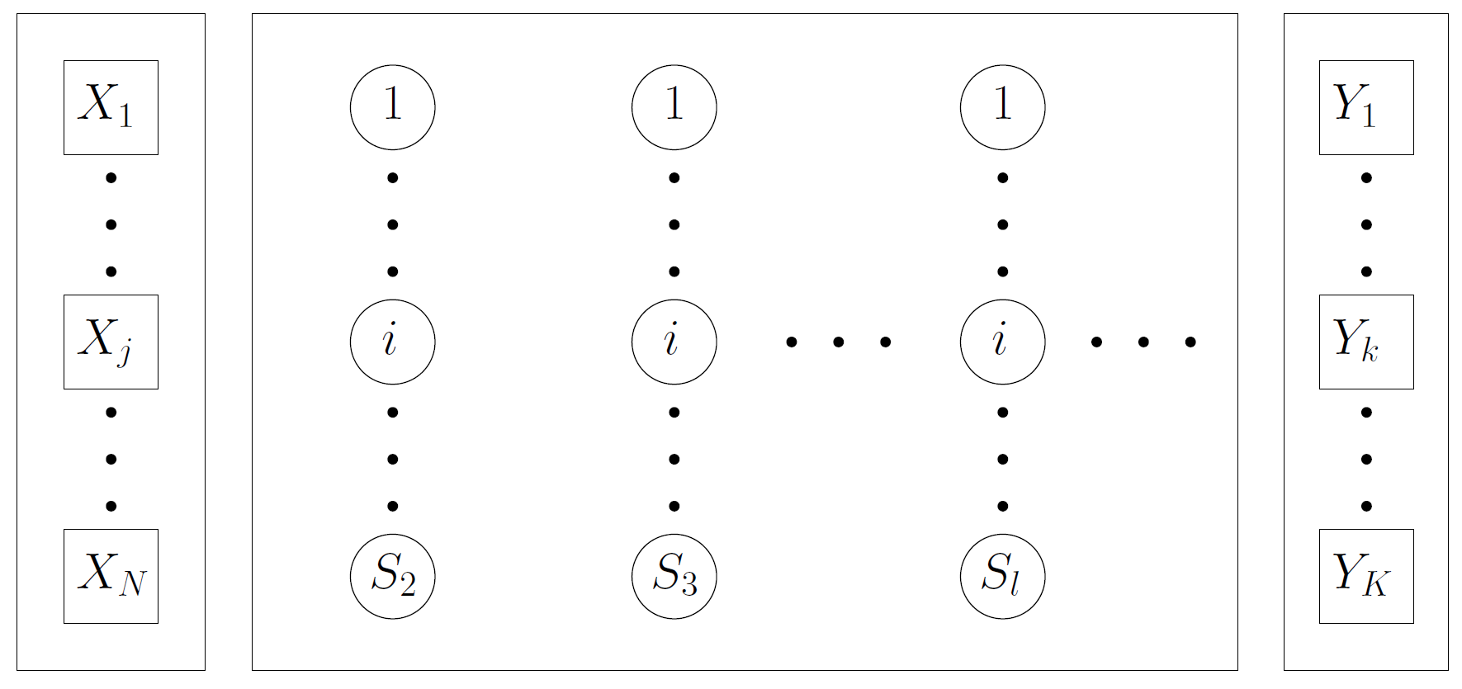
Input Layer
l = 1
Hidden Layers
l = 2,3,… L-1
Output Layer
l = 1

Slide 3
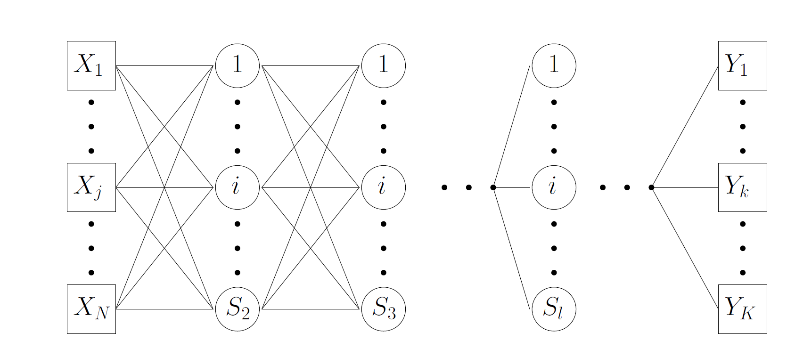
Fully Connected

Slide 4
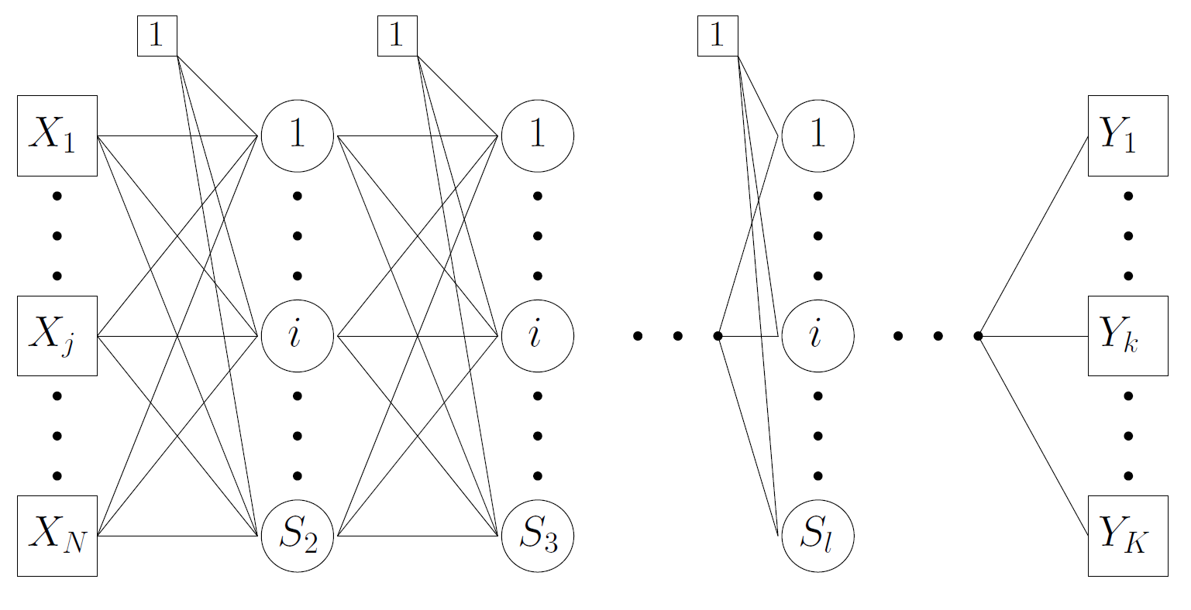
Bias

Slide 5
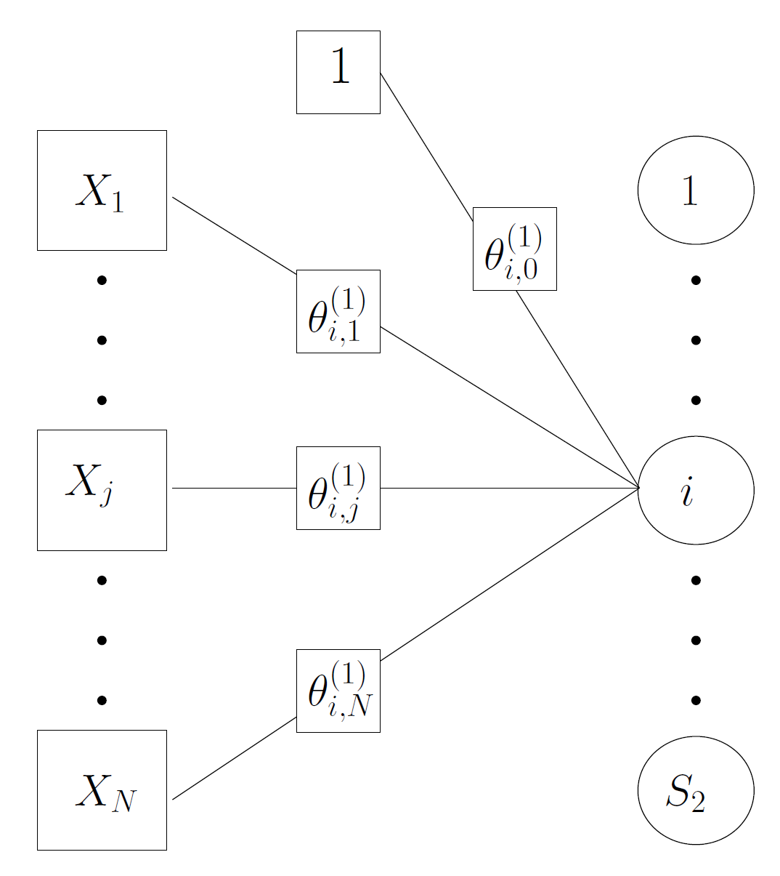

Let’s look at one layer…
Input Layer
l = 1
Hidden Layer
l = 2

Slide 6
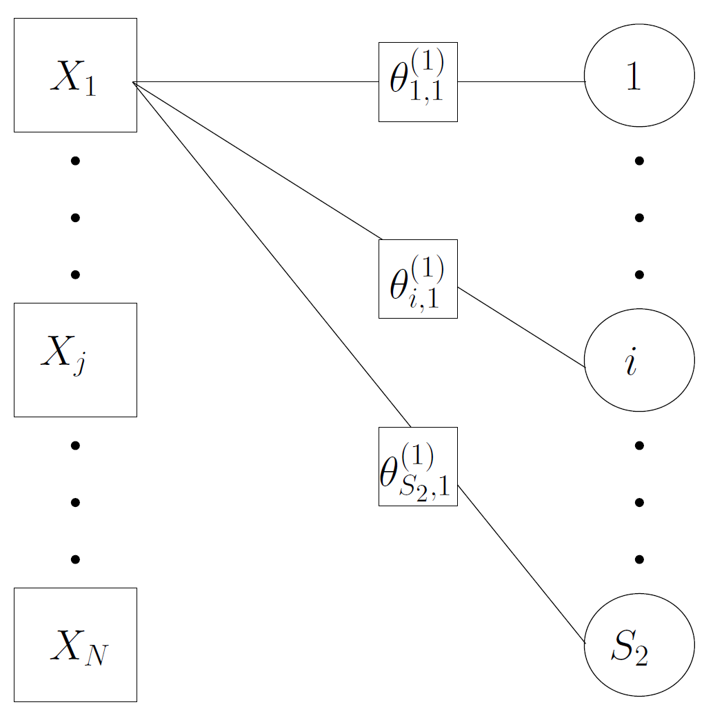
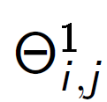
Matrix : Weights of the input j with the neuron i of the hidden layer l=2
Input Layer
l = 1
Hidden Layer
l = 2

Slide 7
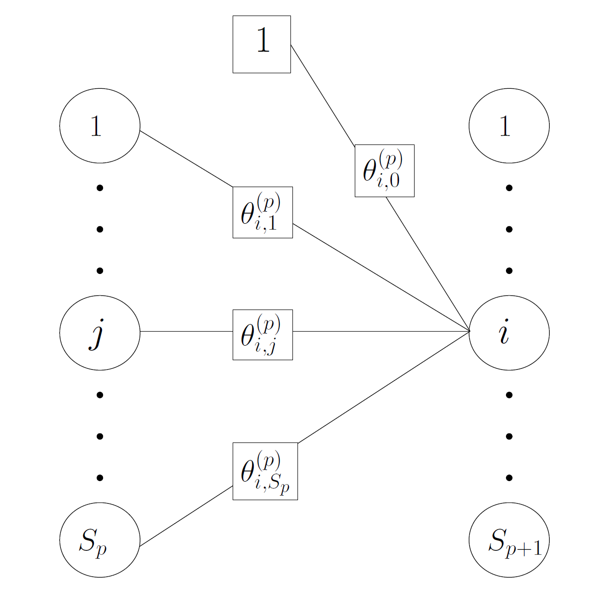

Between hidden layers
Hidden Layer
p
Hidden Layer
p+1

Slide 8
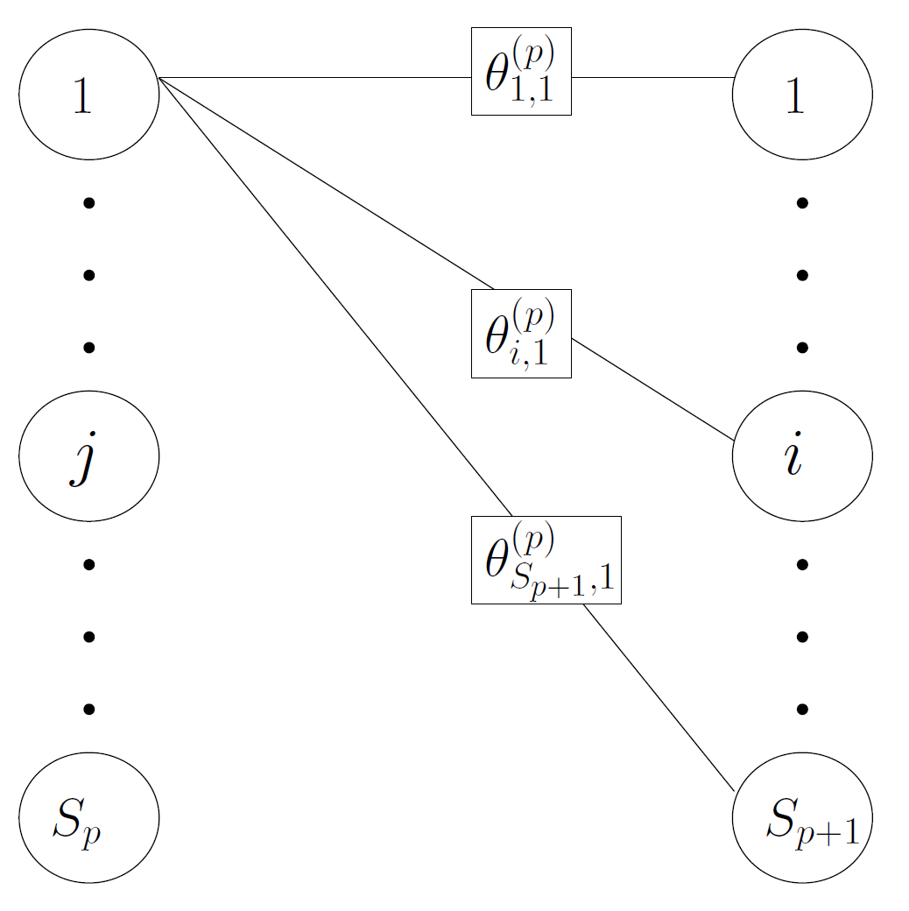
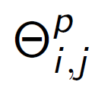
Matrix : Weights of the input j with the neuron i of the hidden layer l=p+1
Hidden Layer
p
Hidden Layer
p+1

Slide 9
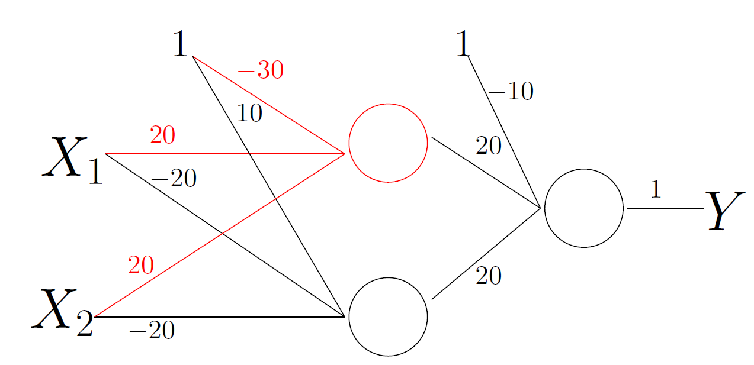


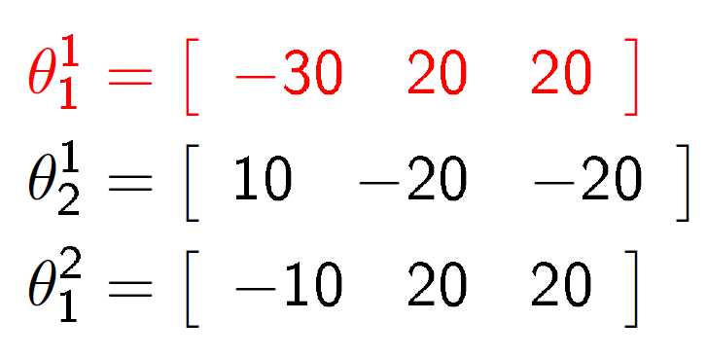
and

Slide 10
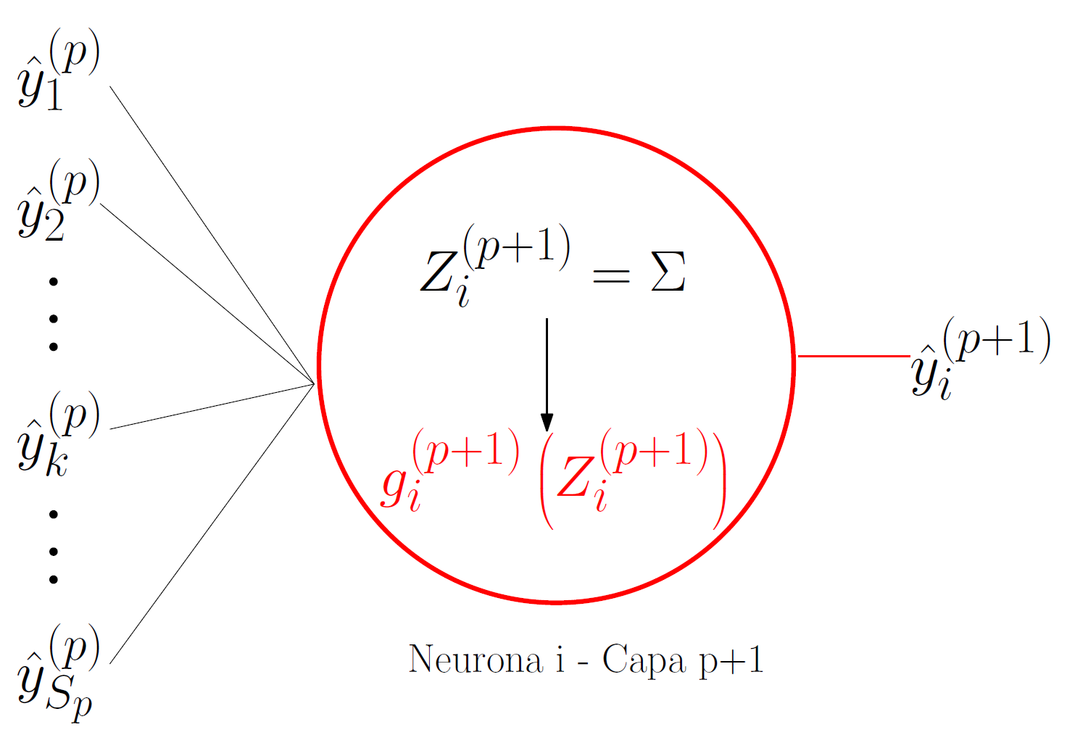

Neurons
Neuron i – Layer p+1

Slide 11
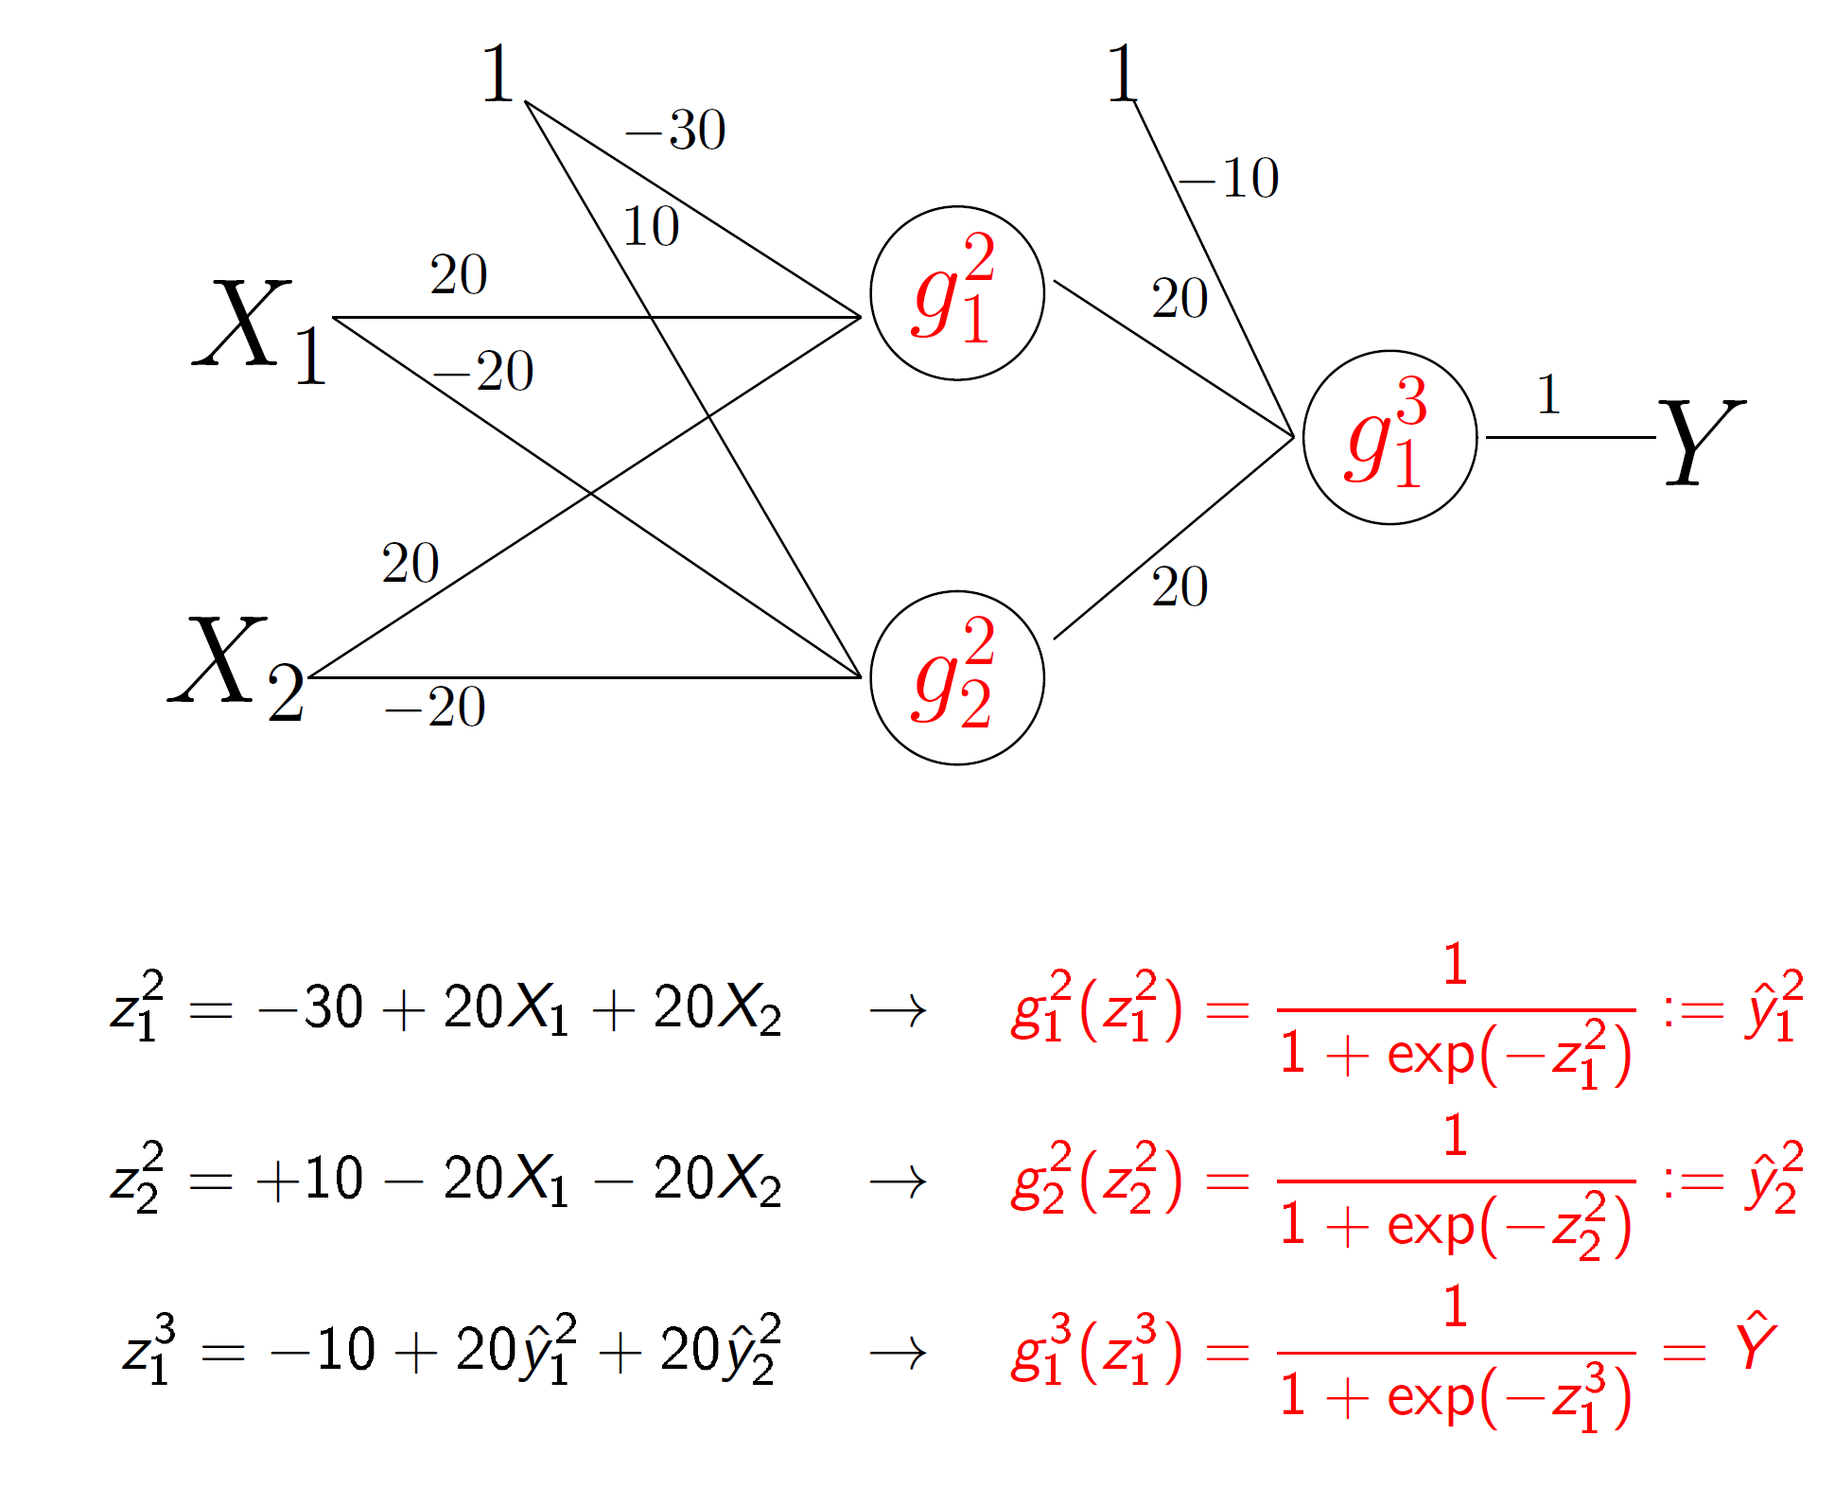

Slide 12


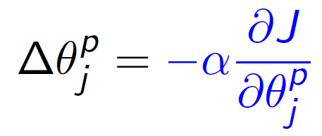
Training
Cost Function:
Let us use gradient descent to update the weights:

Slide 13
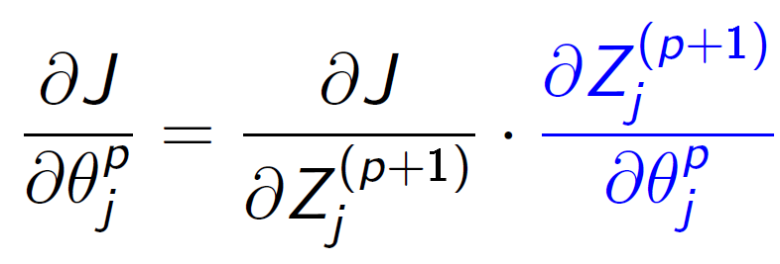

Using the chain-rule
then

Slide 14

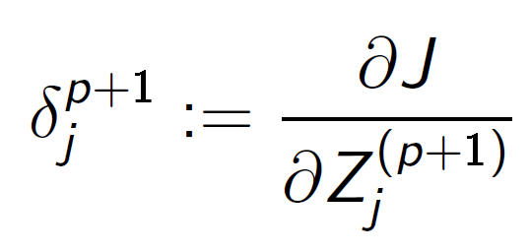

where
In the last layer we have

Slide 15
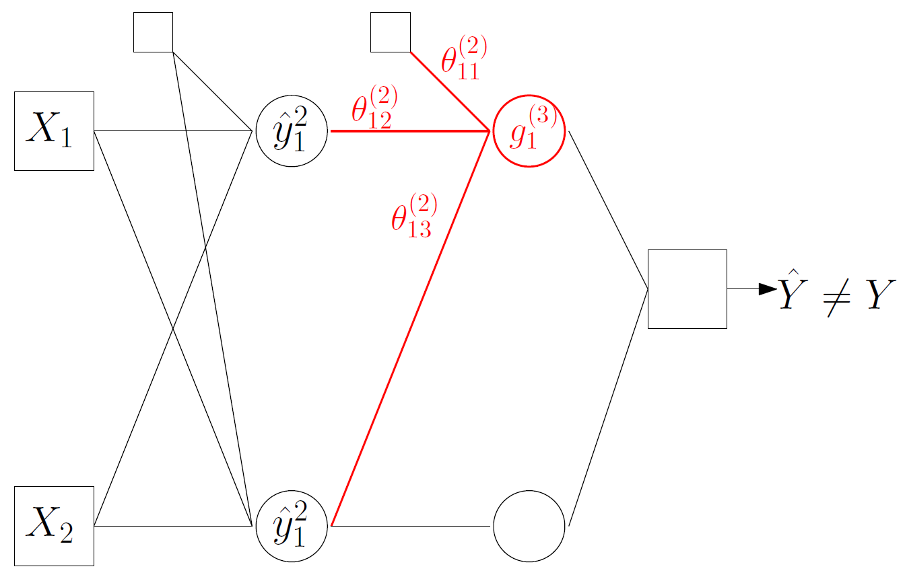


Slide 16
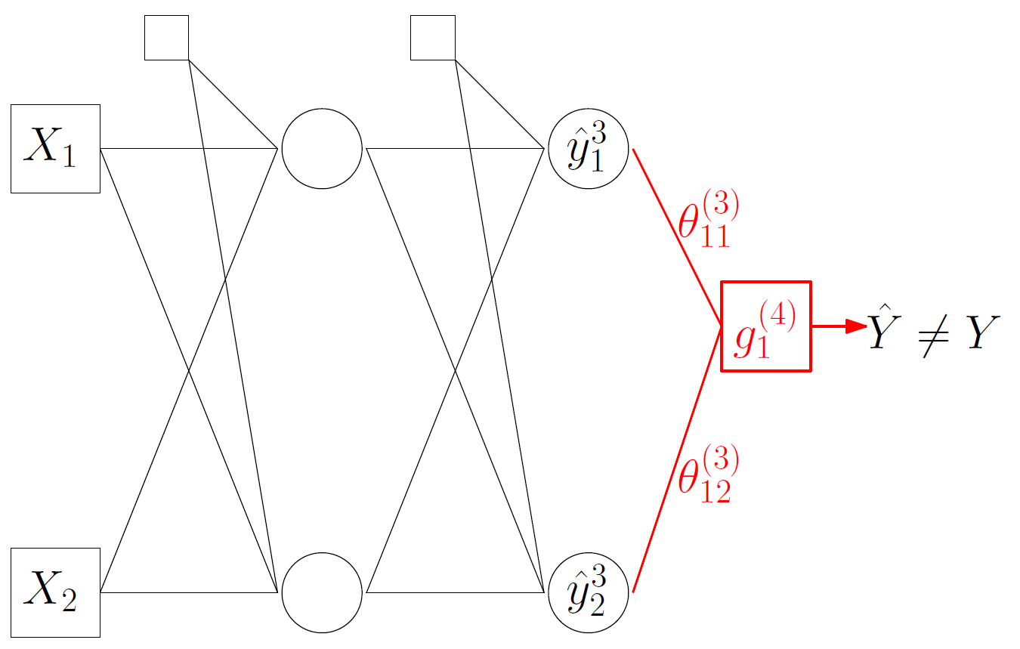


Slide 17


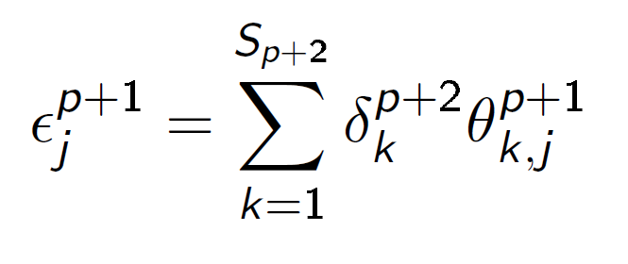
Compute the Gradient
for the mid layers (p≠L-1)
where

Slide 18


