Slide 1
Data Center Networking
Project Presentation
Brajesh Kushwaha
Vishal Parekh

Slide 2
Slim Ring

Slide 3
Agenda
Objectives & Related Work
Slim Ring Topology
SDN and Affinity Networking
Evaluation
Conclusion

Slide 4
Objectives
Low latency
Lower cost
Less wiring
Lesser OPEX
Easy expandability
Supports application level priority
Notes:
Easy expandability- in fat tree to increase beyond 27k host we need to upgrade the entire data center from 48 port to 64port switches.
Low latency -
Lower cost – building the data center
Less wiring
Lesser OPEX – power costs
Easy expandability – one more switch /host?
Supports application level priority -SDN

Slide 5
Related Work
Fat Tree
Helios
Jellyfish
c-Through
DCell
BCube
and many more
Notes:
Many topologies than why need one more work?

Slide 6
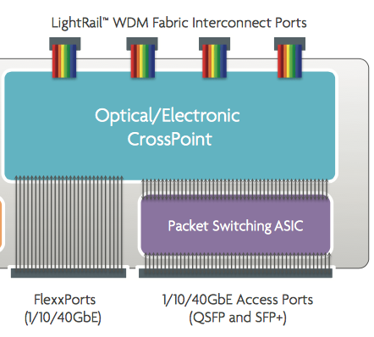
Plexxi Switch
Notes:
Our motivation is from this Plexxi switch. Which has developed by the company Plexxi based out of Cambridge Massachusetts.
It is a hybrid and has electrical and optical ports which we be going over in greater detail in the next few slides.
The small form-factor pluggable (SFP) is a compact, hot-pluggable transceiver
4 Light Rails
The optical interfaces support 10km single-mode WDM optics
With 120Gbps full duplex uplink capacity per interface (total 480Gbps FDx per chassis
16 Flexx Ports (4xQSFP+ and 12xSFP+)
Access ports (480GigE)
1:1 Oversubscription
Flexx Ports have 11Gbps capacity

Slide 7
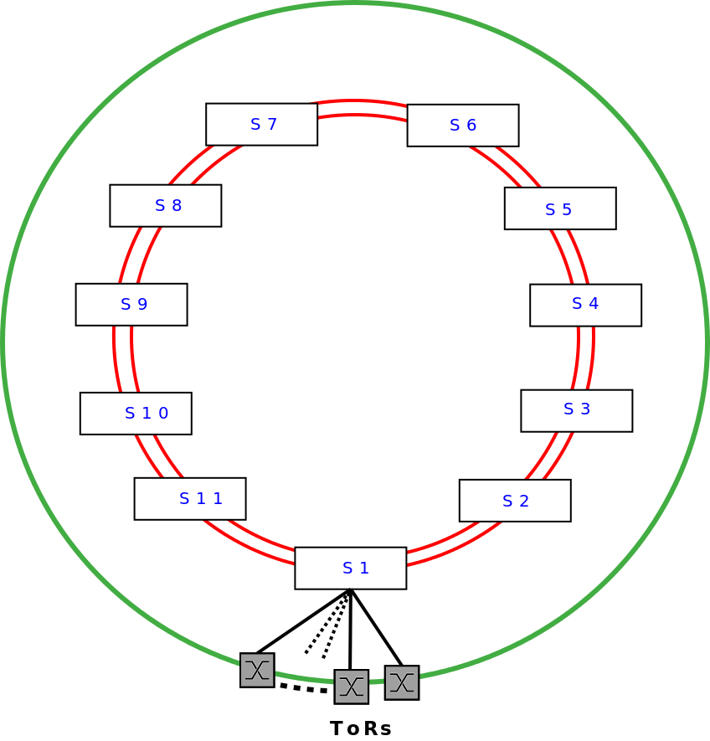
Topology of Slim Ring
Composed of three parts
Inner Ring – Optical
Outer Ring – Electrical
SDN Controller
Notes:
SDN Controller for traffic management

Slide 8
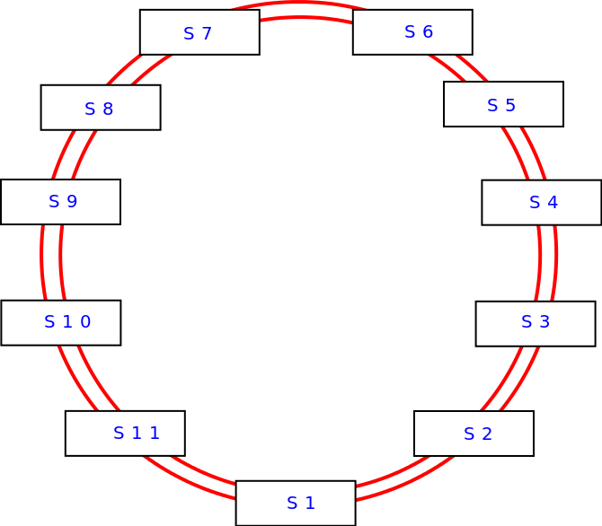
Topology: Inner Ring The Optical Ring Physically
Notes:
Image of Ring

Slide 9
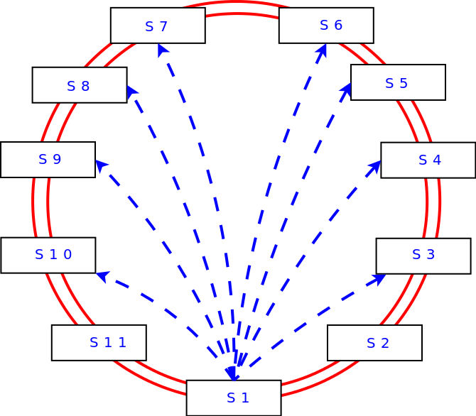
Topology: Inner Ring The Optical Ring Logically
This is now a full mesh
Notes:
From s1 to s2 there are 6 strand. But not all strands terminate at s2 but just two of them.
The rest terminate at different Plexxi switches creating a full mesh.
Paths – now from s1 to s4 =
S1-s4
S1-s2-s4
S1-s3-s4
Etc….

Slide 10
Topology Outer Ring The Electrical Ring
TORs connect to the Plexxi switches
Notes:
Image of Outer Ring

Slide 11
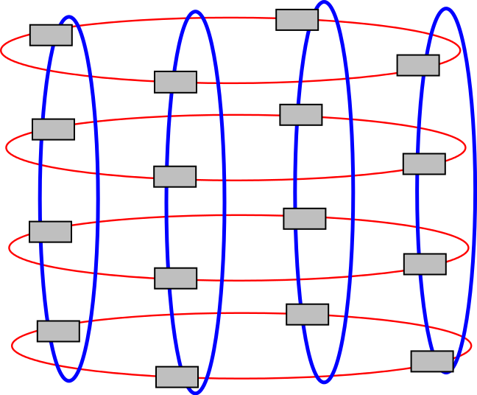
Rings of Rings
S13
S16
S1
Notes:
A simple Image of Ring of Rings
Say forming a Torus

Slide 12
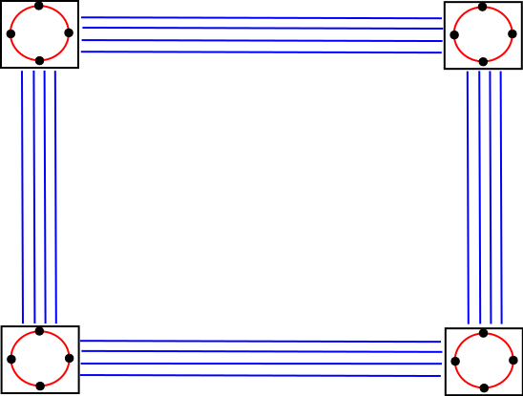
Deployment
Top Down View
Notes:
Basically speak about ease of deployment
How it can be used in pods…

Slide 13
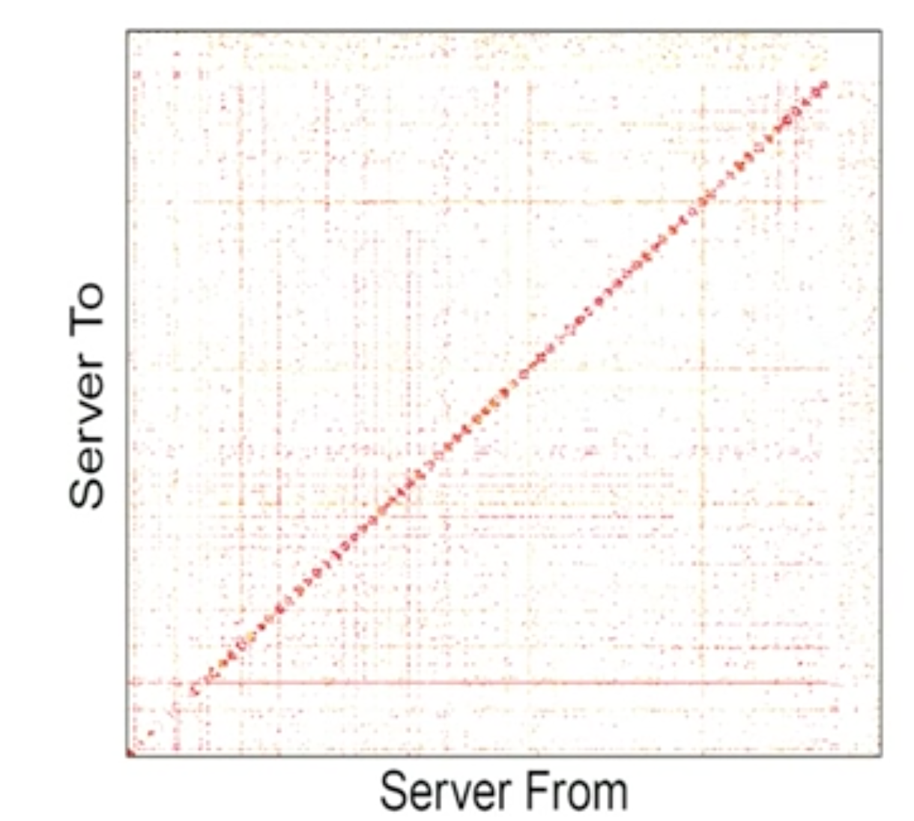
Traffic Patterns in Data Centers
The Nature of Datacenter Traffic: Measurements & Analysis by S Kandula - ‎2009
Notes:
Microsoft paper
Work-Seeks-Bandwidth and Scatter-Gather patterns
in datacenter trac as seen in a matrix of log exchanged
between server pairs in a representative 10s period.

Slide 14
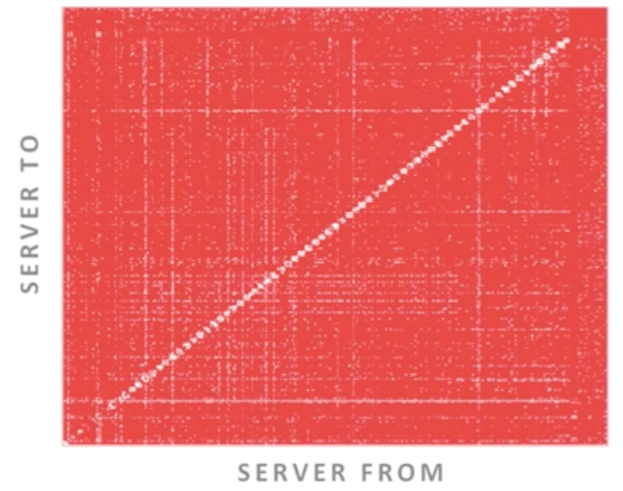
Wasted Bandwidth
The Nature of Datacenter Traffic: Measurements & Analysis by S Kandula - ‎2009

Slide 15
SDN Controller & Affinity Networking
Affinity is a metric defining the extent of communication between two hosts.
All switches have an OpenFlow Agent and communicate to the SDN Controller out of band.
High bandwidth optical paths are reserved for pairs with high affinity by the SDN controller.

Slide 16
Algorithm for Affinity Networking Electrical Switches
Each electrical switch has an OpenFlow Agent (OFA)
Each OFA periodically transmits the throughput and latency per host pair to the SDN controller
Loop1
Loop2 for time t:
Increase count on receiving packets
from host x(i) to host y(i) and have
the latency information required
End Loop 2
Send the cumulative data i.e. <host pair,
# of packets, t1,t2 ,latency> in time
interval of t1 and t2 to the controller
End Loop 1

Slide 17
Algorithm for Affinity Networking SDN Controller
Receives the throughput and latency for each pair of hosts
Decides to allocate a path honoring the latency (more priority to the pair with high affinity).
The allocations for a given latency paths are done greedily based on the host pair affinity.
Loop Forever:
Get Information <host pair, # of packets,
t1,t2 ,latency> from all the TORs
K= ∑ #of packets
For each host pair
Affinity(t) = α* (# of Packets/K) + (1-α) *
Affinity(t-1)
Sort all the Affinities at time t
Loop For each Affinity at time t
Assign path based on latency required if
bandwidth available on P[i]
Decrease the bandwidth on P[i] by required
bandwidth
End Loop
Send Information to the switches
Sleep for time period T
End Loop

Slide 18
Assignment of IP’s
For N=11
Free[15] . Ring Number[4]. Plexxi Switch Number[4]. TOR Number[4]. Host Number[5]
{} {11} {11} {24} {20}
10.254.0.0 to 10.254.255.255
Notes:
This is for N=11

Slide 19
Evaluation
Throughput
Path length
Cost comparison
Wiring cost
Power and heating costs
Ring size and Ring of Rings effects

Slide 20
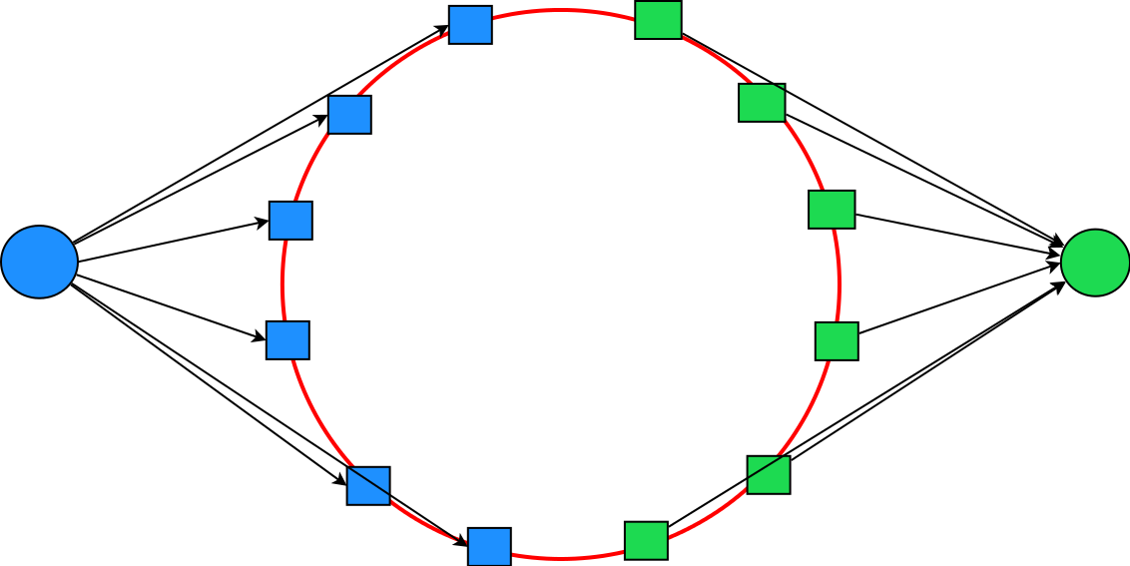
Evaluation- (1) Using Ford-Fulkerson
Half the nodes are chosen as sources and the other half as sinks
The problem of finding the total throughput develops into the famous Ford-Fulkerson’s algorithm.
Created a topology matrix and applied Ford Fulkerson on it to get the estimated throughput.
Notes:
Less because of haven't considered all the paths in ns3(too complex)

Slide 21
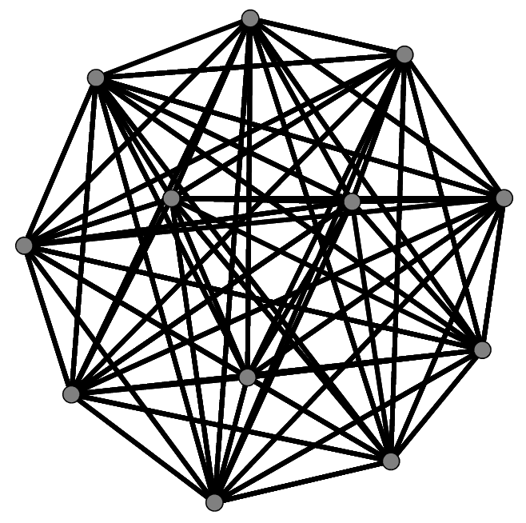
Evaluation- (1) Using ns3
Mesh for simulating inner ring of size 12
Notes:
Less because of haven't considered all the paths in ns3(too complex)

Slide 22
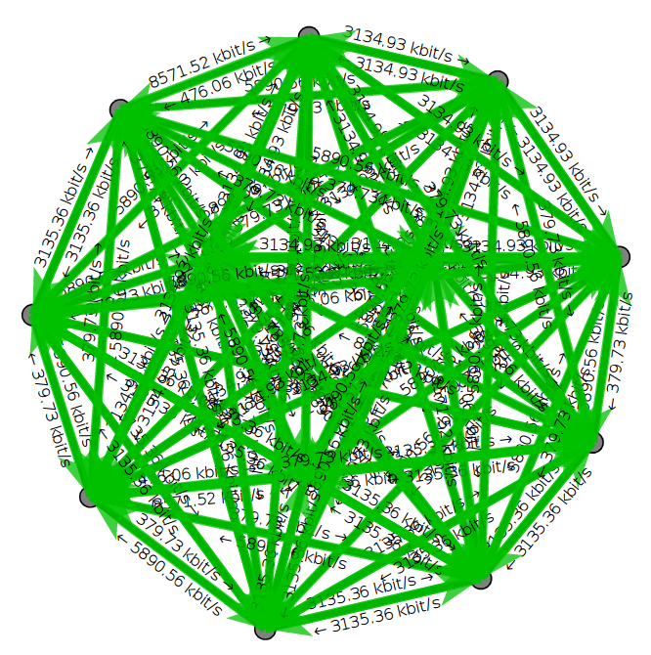
Evaluation- (1) Using ns3
All to All Pairwise TCP communication
Notes:
Less because of haven't considered all the paths in ns3(too complex)

Slide 23
Evaluation- (1)Throughput
N | Slim Ring Theoretical (Using Ford-Fulkerson) | Slim Ring (Using ns3)
6 | 73 | 59.31
8 | 90 | 79.09
10 | 108 | 90.20
12 | 126 | 106.97
14 | 145 | 124.13
*All Units are in Gbps
Notes:
Less because of haven't considered all the paths in ns3(too complex)

Slide 24
Evaluation- (2)Path length
Path Length | Slim Ring | Jellyfish | Fat tree
2 | 0.0006 | 0.05 | 0.01
3 | 0.001 | 0.05 | 0
4 | 0.002 | 0.3 | 0.05
5 | 0.1 | 0.6 | 0
6 | 0.89 | 0 | 0.9
7 | 0 | 0 | 0
Average Path Length | 5.84 | 4.45 | 5.52
*Multiple Optical to Optical switch hops are considered as one hop
Notes:
Info fro Jellyfish paper
Mention Advantages of how path length is Optical is faster than electrical (Try to score over Jelly if possible… analyze-----------------TODO)
Slim (for 27,440 hosts)
2 = Using outer ring only neighbours (2)
3 = 5 under same plexxi + 1 neighbour (outer ring) = 6
4 = 89 (for all other plexxi in your ring) (14*4-2-6) + 91 (your ring in ring of rings : 13*7) = 180
5 = 14*14*7 - remaining - 1 = 1183

Slide 25
Evaluation- (3)Cost comparison
For 65k hosts
Equipment | Slim Ring ( 2:1 ) N=15 | Fat Tree
Electrical Switch | 6,480 | 24,575
Optical Switch | 10,350 | 0
Total | 16,830 | 24,575
Savings | 7746 (31%)
*All Figures are in thousands of dollars
Notes:
Fat tree
k = 64 => 65k hosts (k^3/4)
Cost: 5k^2/4 * 75*64 (5k^2/4 switches and per port switch cost = 75 => 75*64 = 4.8K)
Slim ring
N=15; B=150G
15*15*46k = 10,350 K (optical cost)
8 ToR * 15*15 = 1800 ToRs
1800*3.6 K = 6480 K (electrical cost)

Slide 26
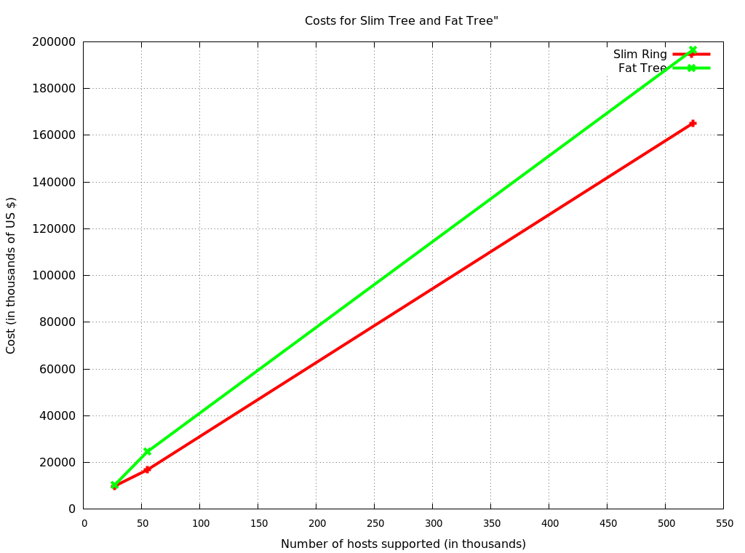
Evaluation- (3)Cost comparison

Slide 27
Evaluation- (4)Wiring
For 65k hosts
Slim Ring (Ring of Rings) (2:1) | Fat Tree
Optical Cables = 450 | Edge to aggregation = k^3/4
Electrical wires = 10800 | Aggregation to Core = k^3/4
 | Total = k^3/ 2 = 87,380
Total = 11,250 | Total = 87,380
Fat tree requires 8 times the number of wires
Notes:
Add Graph for Wiring Costs
Avg. wire length for slim ring is much smaller than that of fat tree since electrical wires are only between ToRs and plexxi switches
SlimRing
16*15 + 16*15*2 = 720 Outer ring
15 Optical Inner ring
Ring of rings:
Inner Ring: 15 Optical Cables
Outer Ring: 720 electrical wires
Optical = 15*15*2 = 450
Electrical = 720*15 = 10.8K
Fat tree
Edge to Aggregation = (k/2)^2[per pod) * k (Pods) = k^3 /4
Aggregation to Core (k/2)^2 core switches each connection to k pods = k^3 /4
Total = k^3/2

Slide 28
Evaluation- (5) Power and heating costs
For 27.5k Hosts
 | Slim Ring(1:1) | Fat Tree
Electrical Switches | 540kW | 1536kW
Optical Switches | 45kW | 0
Total | 585kW | 1536kW
Power Consumption is 67% lesser
Notes:
Say about how much that extra cost of consumption can buy
Fat tree
2.5*48 + base cost(180) = 300
Slim ring
400 = 325 electrical + 75 optical transceivers (original)
200 = 125 elec + 75 optical (for N = 15)

Slide 29
Evaluation- (6a)Rings Size and Ring of Rings effects
For N=15
Type (Only one Ring) | Throughput per pair(Gbps)
Only one source/destination | 640
Two sources/destination | 600
Three sources/destination | 570
Four sources/destination | 540
Throughput is Decreasing as more nodes are communicating in the ring
Notes:
Nobody is communicating on other rings
For N=15

Slide 30
Evaluation- (6b)Rings Size and Ring of Rings effects
For N=15
Type | Throughput (Gbps)
High Communication on each of the rings | 85
Medium Communication on each of the rings | 260
Low Communication on each of the rings | 342
Throughput is Increasing as fewer nodes are communicating in other rings
Notes:
Low= 1,2,1,2,…
Medium= 4,3,4,3,4,3,4,…
High =7,5,7,5,7,5,7,5,7,5,…
For N=15

Slide 31
Advantages of Slim Ring
Low latency
Lower Cost
Less Wiring
Low OPEX
Easy Expandability
Priority for applications
One Plexxi Switch goes down does not bring entire ring down
For short flows to adjacent neighbours the outer electrical ring can be used
Notes:
Basically meet all our original assumptions

Slide 32
Disadvantages of Slim Ring
Doesn’t have Full bisection bandwidth on default topology
Initial cost of incorporating the optical network is high
Plexxi Switch is highly important. Once it goes down all the ToRs under need to use outer ring

Slide 33
Future Work
Further analysis of fairness for short and long flows
Exact throughput using Multi-commodity flow problem
SDN/Openflow simulation through ns3

Slide 34
Questions ?

