Slide 1
William Weller
ELEC3885 Group Design Project
Design, Simulation, Fabrication and Measurement of a 2×2 Corporate-Fed Microstrip Patch Antenna Array for S-Band LEO Satellite Reception
Notes:
Hi,
Welcome to my presentation where I will present the design, simulation, fabrication and measurement of my 2x2 Corporate-Fed Microstrip Patch Antenna Array for S-Band LEO satellite recpetion

Slide 2
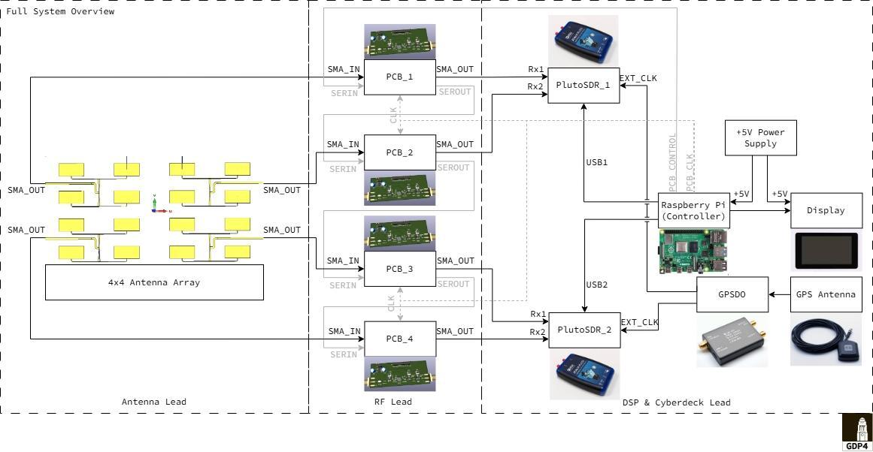
System Integration
Electronically steered antenna telemetry receiver system
Notes:
The antenna that was made plays into the larger electronically steered antenna telemetry receiver system, a full-stack integration that enables fast-steering, multi-beam operation, and calibration. The antenna and RF front-end handle the physical steering and signal conditioning, while the digital layer provides the intelligence and data handling.
A wireless communications system consists of 3 different sections; the transceiver, several front-end modules, and antennas. Traditionally, they were all designed separately; however, this will no longer be feasible for 6G due to the significant interconnect losses.
For a whole system integration, this would involve bringing the whole antenna into an electronically steered antenna system, which would encompass the antenna array, the RF front-end layer, and the digital layer.
Electronically Steered Antenna systems refer to an array of antenna elements where the beam is steered by electronically controlling phase and/or amplitude at each element (or subarray), without any mechanical movement.
This full-stack integration is what enables fast-steering, multi-beam operation, and calibration. The antenna and RF front-end handle the physical steering and signal conditioning, while the digital layer provides the intelligence and data handling.
Future work could involve turning the 2x2 Antenna Array into a 4x4 Antenna Array to increase the gain.
However, for truly state-of-the-art improvements, extending the microstrip array towards Antenna in Package style integration with hybrid beamforming elements would be a strong future direction.
It would be most useful for fabrication and measurement (not just simulation).
This could also involve performing antenna testing and validation

Slide 3
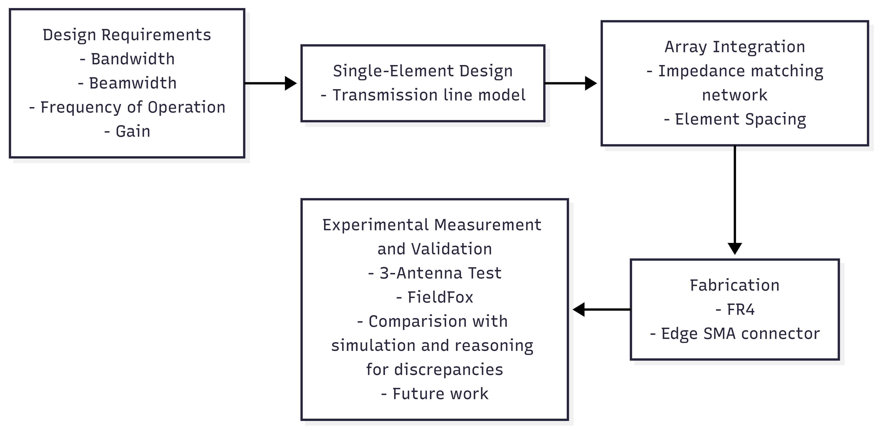
Contents
Usefulness of Antennas
Antenna Development Cycle
Design Requirements
Materials (Patch/Ground Material, Substrate Material)
S11
Measurement/Validation
Future Work
Substrate
AiP
Antenna Array Development Roadmap
Notes:
The presentation will be structured as follows: 1. We will begin with understanding why antennas are useful
2.. An overview of the antenna design process for the antenna from the design requirements, to a single-element design, to array integration, fabrication, and experimental measurement and validation.
3. Finally, we will conclude with comparisons between experimental and simulated measurements and make suggestions for future work (better testing environments, homogeneous substrate, and how to turn it into real product that would be comparable to the state of the art.

Slide 4
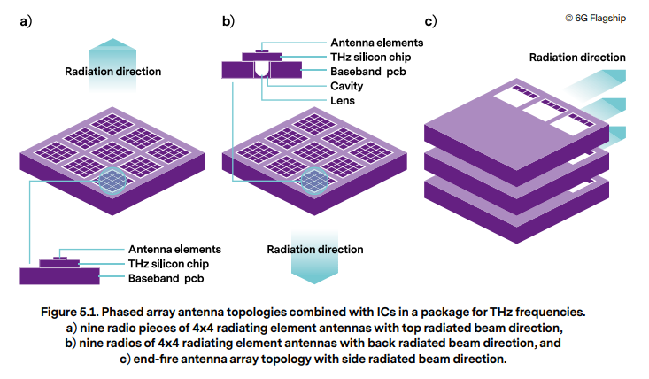

Use of Antennas
An interface between radio waves and electric currents
Anyone that uses high frequencies and wireless connections
Telecommunications and AI – Antennas for 6G (uM-MIMO) terrestrial communications, Edge AI, Starlink
Notes:
Antennas are the interface between radio waves propagating through space and electric currents moving in metal conductors. They are required by any radio receiver or transmitter to couple its electrical connection to the electromagnetic field.
In 6G communication systems, highly integrated ultra-Massive MIMO (uM-MIMO) will employ thousands of antenna elements to increase capacity, with antenna arrays duplicated over several places in the device to avoid blockage, delivering ultra-fast data speeds with very low latency.
References:
- https://www.keysight.com/gb/en/assets/7121-1085/article-reprints/RF-Enabling-6G-Opportunities-and-Challenges-from-Technology-to-Spectrum.pdf

Slide 5
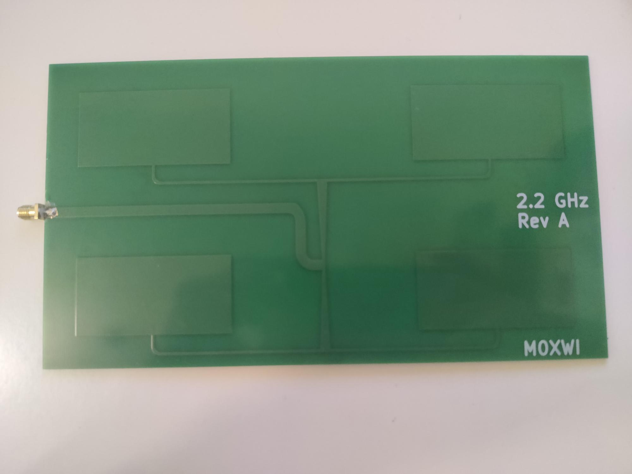

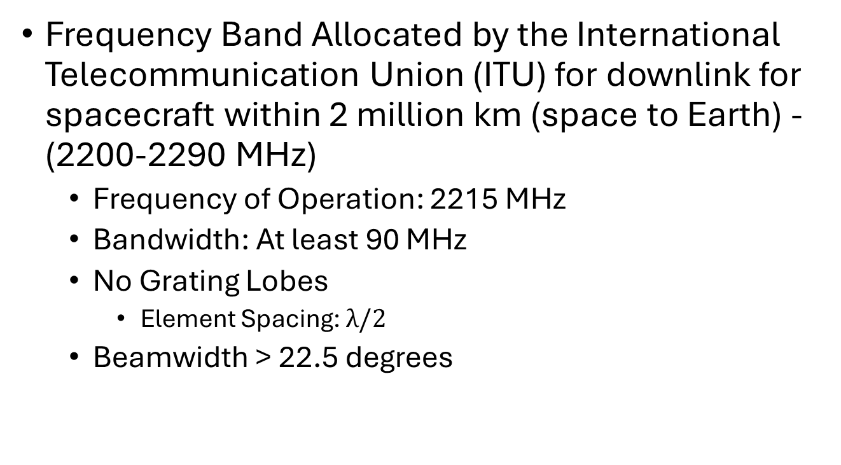
Antenna Design Requirements
Frequency Band Allocated by the International Telecommunication Union (ITU) for downlink for spacecraft within 2 million km (space to Earth) - (2200-2290 MHz)
Frequency of Operation: 2215 MHz
Bandwidth: At least 90 MHz
No Grating Lobes
Element Spacing: $λ/2$
Beamwidth > 22.5 degrees
Manufactured Microstrip Patch Antenna Array
JASON-3 Satellite
Notes:
The frequency band (2200-2290 MHz) is allocated by the International Telecommunication Union (ITU) for downlink for spacecraft within 2 million km.
For this project, we decided we wanted to receive the JASON-3. The JASON-3 is a satellite altimeter. JASON-3’s mission type is oceanography which is to say it supplies data on sea level rise, sea surface temperature, ocean temperature circulation and climate change. This is thanks to JASON-3’s Poseidon-3B instrument, a nadir-looking radar altimeter. By gathering space science data from these missions, it enables better models for forecasting to protect critical infrastructure, and become a more resilient society, better prepared to manage the risks.
To design the antenna, the following requirements will need to be satisfied: - Frequency of operation: 2215 MHz - Bandwidth: > 90 MHz - Element spacing $λ/2$
- Beam width > 22.5 degrees

Slide 6


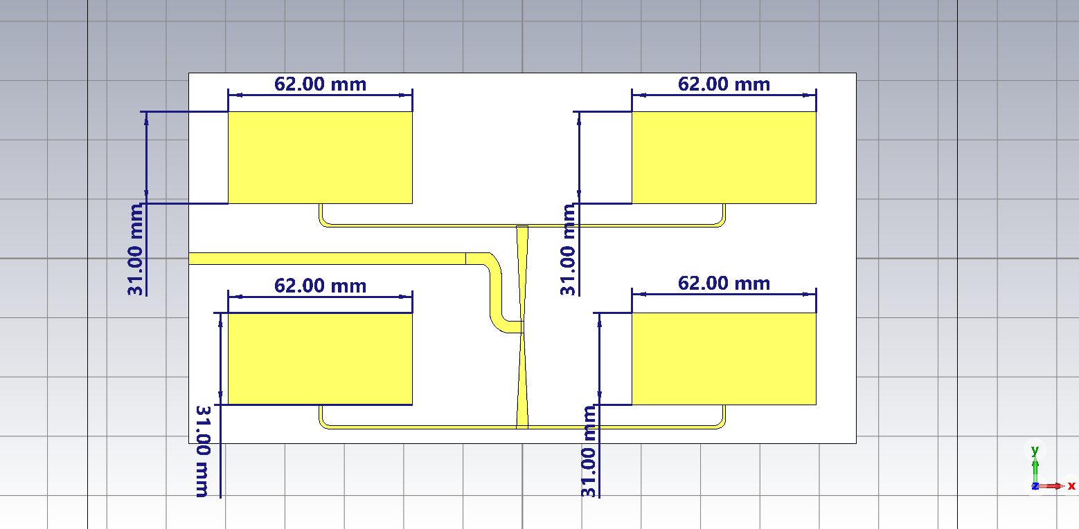



Single-Element Design
1. Balanis Antenna Theory: Analysis and Design
2. Pozar: Microwave Engineering
Single-Element Dimensions
Requirements: 2215 MHz, Edge input impedance = 100 Ohms
Notes:
The aim was to have the patch resonant on 2215 MHz with an edge input impedance of 100 Ohms. This was to ensure that we would be on the right frequency and ensure a tapered impedance transformation network that would progressively taper between 100 Ohms and 50 Ohms leading to a wider bandwidth than other fixed-frequency impedance transformers like the inset or quarter-wave.
The single-element design relies on the transmission-line model of the antenna, which describes the rectangular microstrip patch as two radiating slots separated by a low-impedance transmission line.

Slide 7


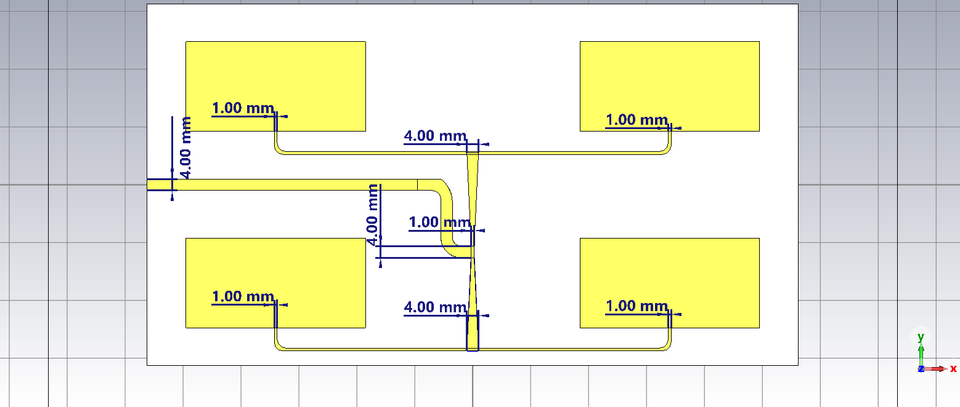
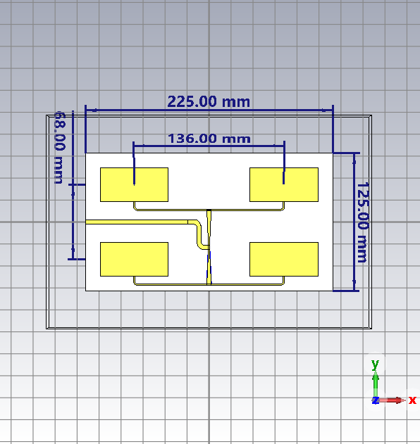


Antenna Array Integration
Linear taper impedance formula
Feed network and element spacing
4. Hammerstad and Jensen model equations
Corporate feed network with linear tapered impedance transformers
Grating-lobe condition formula
3. Mailloux, Phased Array Antenna Handbook
Requirements: 100 Ohms Antenna Edge -> 50 Ohms SMA edge , No grating lobes
Antenna Element Spacing
Notes:
To increase the gain of the antenna, the antenna was expanded to a 2x2 array.
The design was designed to minimize grating lobes, have a maximum scanning of at 90 broadside, to ensure smooth continuous scanning, and combine the gains of the antenna, a corporate feed network with linear tapered impedance transformers was used.
Regarding the minimisation of grating lobes, a half wavelength element spacing was used as it provide a good balance between grating lobes and mutual coupling between the patches. It provides a scanning of ±45° over the boresight. This aligns well with the 22.5 degrees step size of the phase shifters .
Using Hammerstad and Jensen model equations, the width of the microstrip impedance transformers were calculated to be 1mm for the 100 Ohm match, and 4 mm for the 50 Ohm match. The length of the tapers were maximised for the size, as smoother impedance transitions minimise reflections over the frequency range.

Slide 8
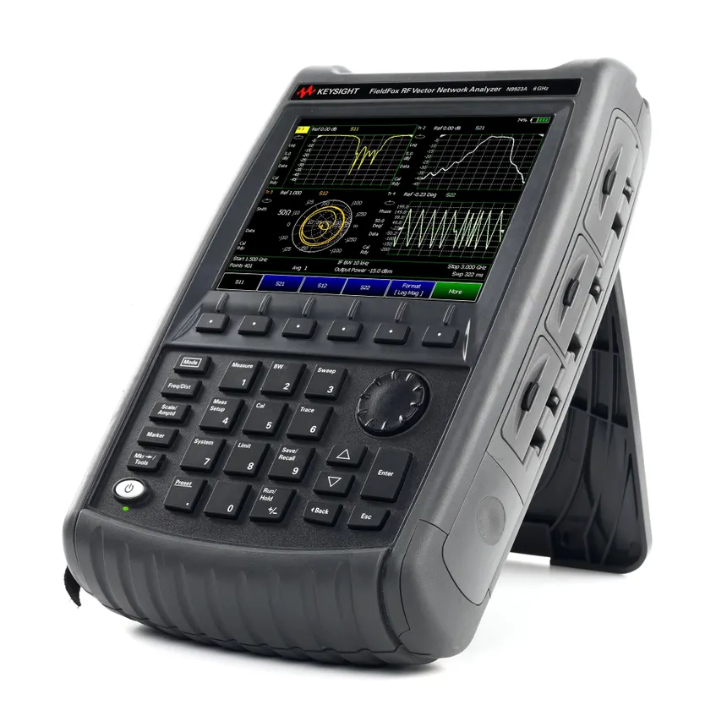
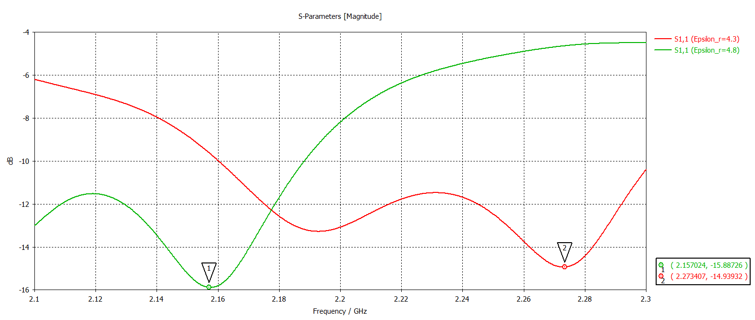
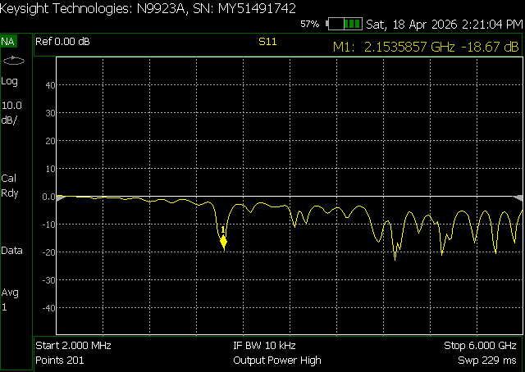
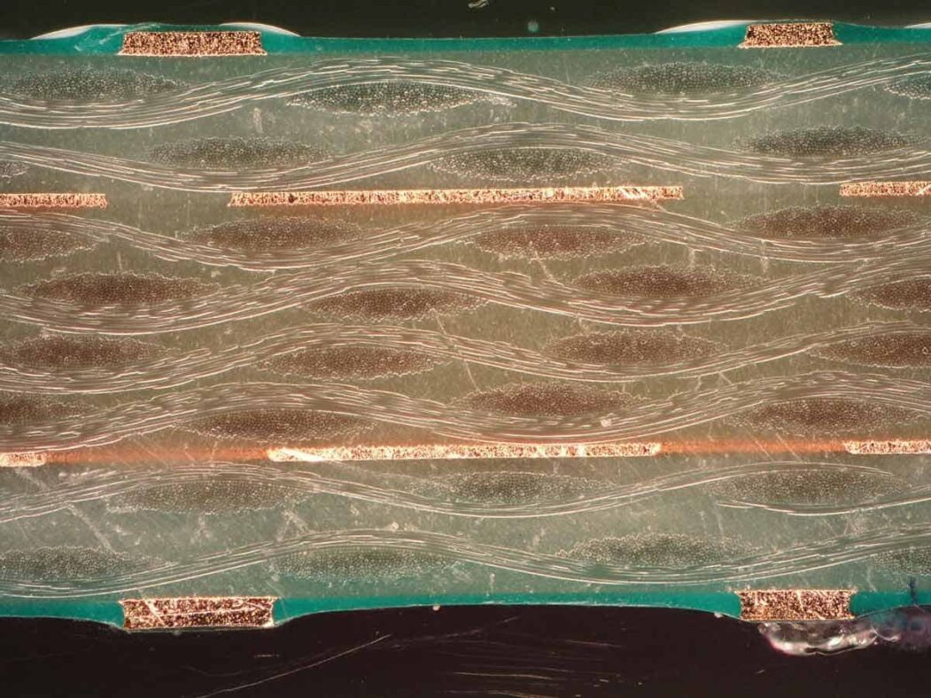
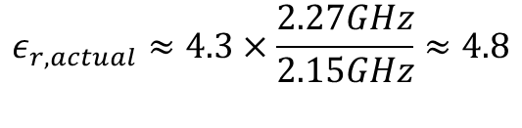

Experimental Setup
$$ε_{r,actual}≈ε_{r,design}×\frac{f_{design}}{f_{measured}}$$
$$ε_{r,actual}≈4.3×\frac{2.27GHz}{2.15GHz}≈4.8$$
1D measurements (S11)
FR4 Substrate Material Selection
Glass-weave Styles
Local Anisotropy
Extracted dielectric constant adjustment
Antenna Array S11 2.153 GHz (-18.67 dB)
FR4 cross section glass fibre weave
Notes:
The antenna was first validated using 1D measurements to determine its resonant frequency and impedance bandwidth. This simply involved connecting the antenna directly up to port 1 of the VNA, without any setup needed.
The antenna was experimentally measured and validated using the FieldFox N9923A. The measured S11 parameter occurred at a resonance of 2.153 GHz, 117 MHz below the simulated resonance of 2.27 GHz. Using the property that the frequency is inversely proportional to the square root of the dielectric constant, it is determined that the dielectric constant of the FR4 substrate is 4.8.

Slide 9


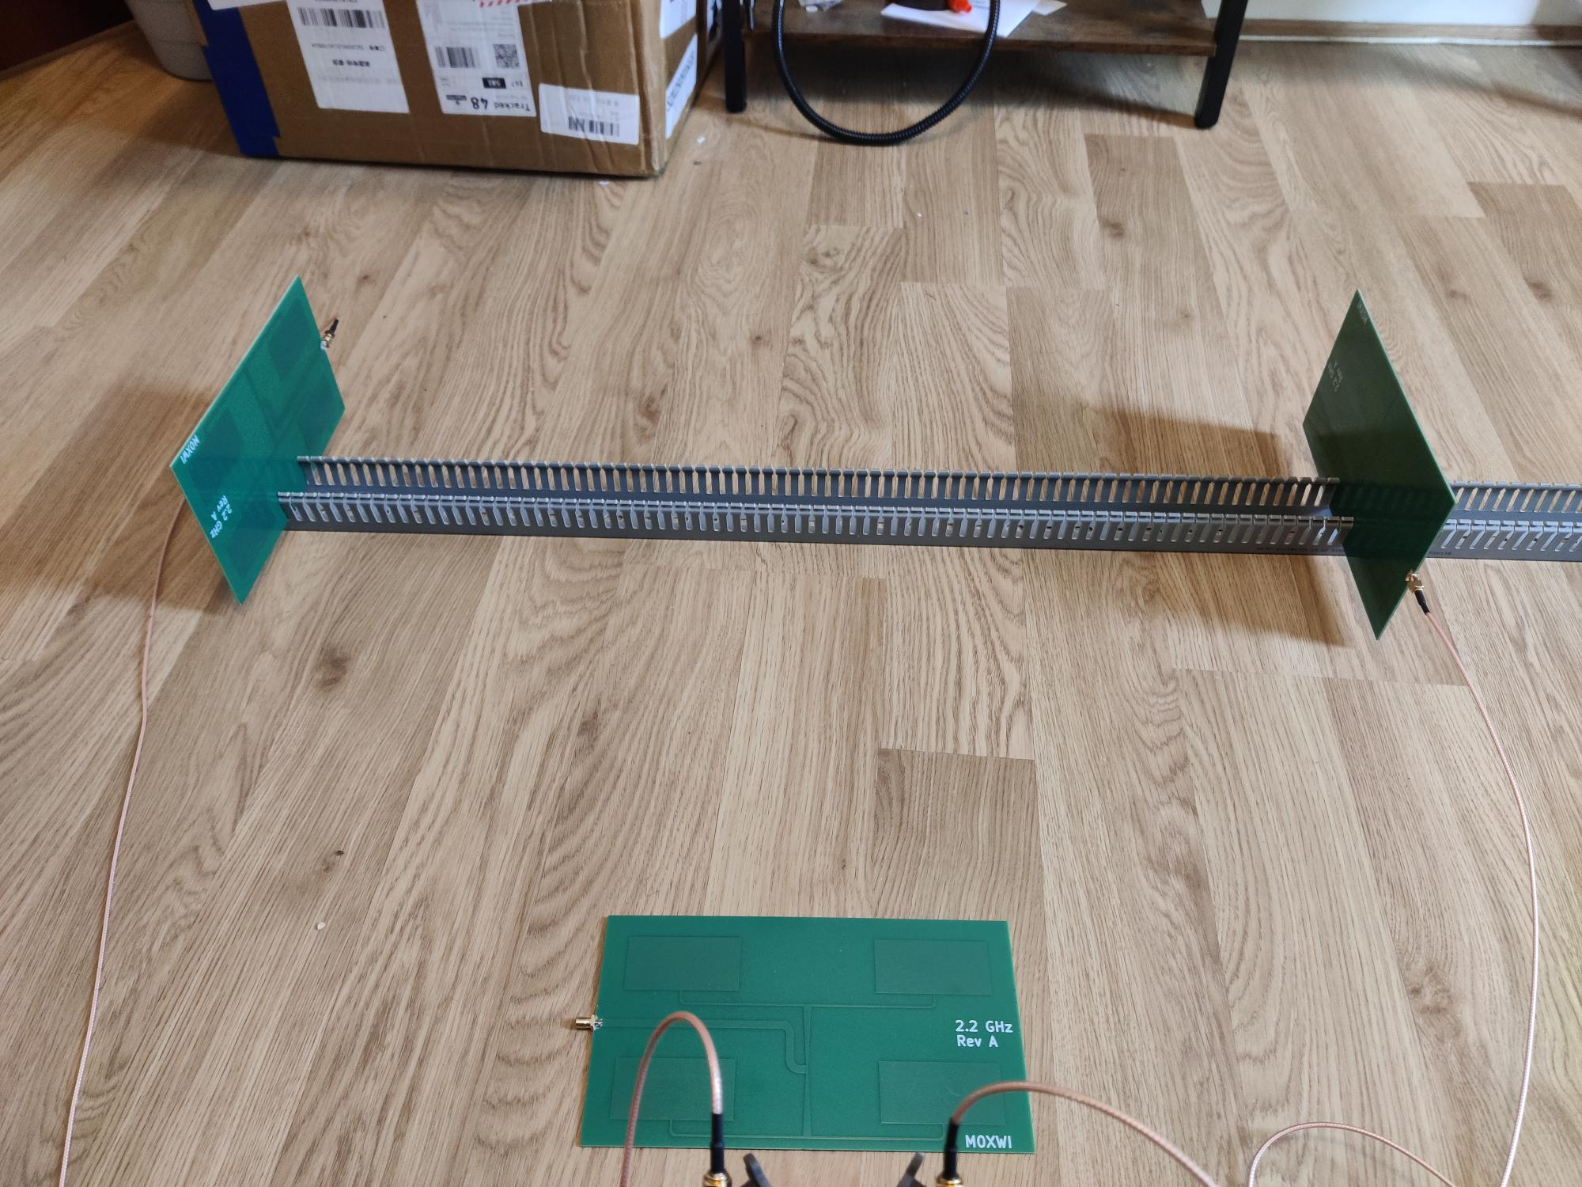

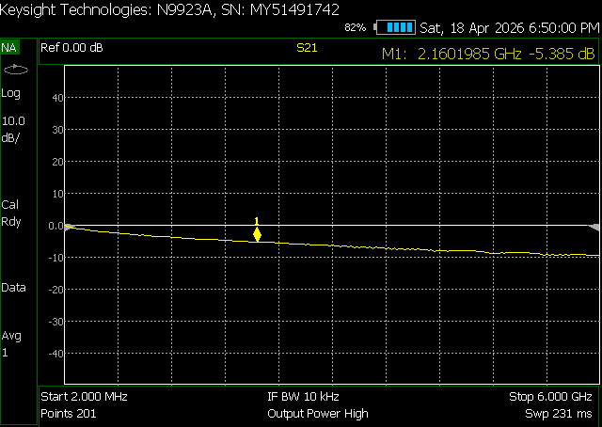

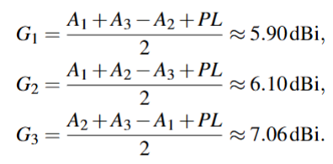

Experimental Setup
3-Antenna Test
Gain
Friis formula
Sources of errors
AUT1
AUT2
d
AUT3
Measured Thru Cable and Connector Losses (-5.385 dB)
Distance between antennas: Farfield Rayleigh Criterion 80 cm
Notes:
Following the 1D measurements, I wanted to measure the gain. Using the 3-Antenna Method, which is an absolute gain measurement technique, not needing a standard gain antenna. From the S21 measurements, I calculated the gains of the antenna which came out to be 6.353, 0.8 dB greater than the simulation, this would likely be due to the constructive interference from multipathing, and ground reflections. As this set-up was very much subject to environmental conditions, these 3D measurements should be taken as coarse measurements.

Slide 10
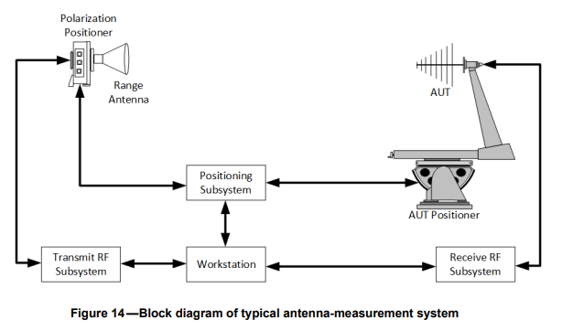
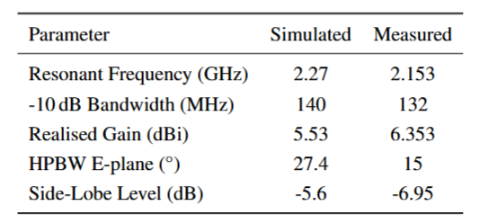
Conclusions
Comparison with measured and simulated results
How the design meets the requirement
Manufactured Microstrip Patch Antenna Array
Microstrip Patch Antenna Array Characteristics
Notes:
Why is the resonant frequency, impedance bandwidth, gain, HPBW, SLL different?
The test was performed inside my flat, which meant that there were measurement environment effects that I had not accounted for such as multipathing and ground reflections, which could have constructively interfered in the main beam direction, artificially boosting measured gain, and residual reflections sharpening the main beam.
In an anechoic chamber with fully lined high-performance RF absorbers reflections would have been minimized.
My HPBW E-plane angle would be different, as I used a protractor to measure my angle, for real antenna measurement systems, a 2- or 3- axis rotator positioning subsystem would be used be used to ensure precise positioning and alignment of the antennas. A workstation with specialised software for data acquisition and control the instrumentation would be used for mapping the far field patterns.
How does the design meet the requirement?
As the full structure includes the patches, corporate feed network, and substrate, the simulations should account for coupling between patches and the feed network.

Slide 11
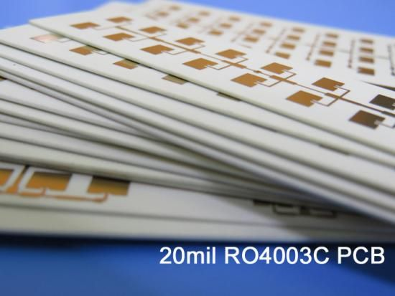
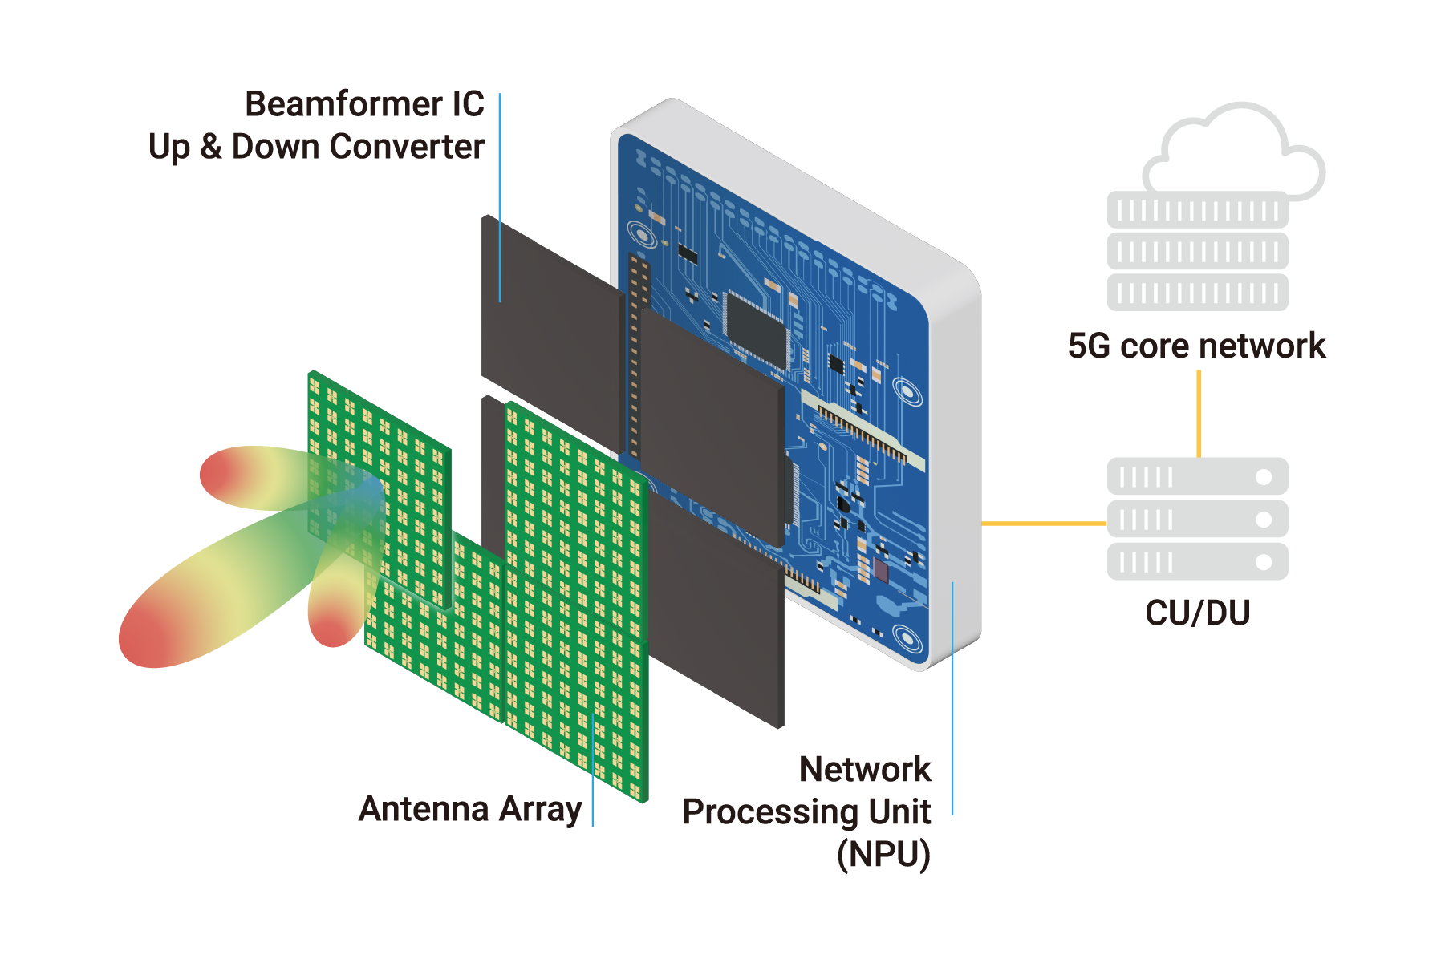

Future Work (Fabrication and Implementation)
Corrected Dielectric Constant ($ε_{r}= 4.8$)
Antenna-in-Package (AiP)
Rogers substrate
mmWave Antenna-in-Package
Notes:
Regarding future work, the most significant issue was the frequency shift which would be fixed by using a more homogeneous and standardised substrate like Rogers 4003C. This would avoid the need to characterize the substrate.
Another thing that could be done is to move to an Antenna in Package (AiP) integrating the RF and beamformers in the same package as the antenna to reduce interconnect and cabling losses.
Standalone PCB-based arrays suffer from feed network losses, long interconnects between RFICs and antennas,
Phased Array Antenna are essential for 5G and 6G mmWave.
Antenna-in-Package (AiP) technology is critical for product commercialization. The antenna is physically on top of the transceiver (RFIC), all enclosed together in one package, rather than being separate components. Very thin interconnects.
Antenna-on-Chip (AoC) technology is for even higher frequencies typically >100 GHz. The antenna, and all the other active circuits (transistors, and circuits) are all on the same silicon chip die.
Antenna in Package and Antenna on Chip is used by anyone that uses high frequencies and wireless connections.
https://tmytek.com/solutions/mmwave-antenna-in-package-solution
https://tmytek.com/files/TMYTEK_SF_One-Stop+Shop+AiP+Solution+for+5G+mmWave+O-RU_GL.pdf

Slide 12
References
C. A. Balanis, Antenna Theory: Analysis and Design, 4th ed. John Wiley & Sons, 2016. (
D. M. Pozar, Microwave Engineering, 4th ed. Hoboken, NJ: Wiley, 2012. (Edge Input Impedance)
R. J. Mailloux, Phased Array Antenna Handbook, 3rd ed. Artech House, 2018
E. Hammerstad and O. Jensen, “Accurate models for microstrip computer-aided design,” in 1980 IEEE MTT-S International Microwave Symposium Digest, 1980, pp. 407–409

