Slide 1
DEVOPS ENGINEERING WALKTHROUGH
LabTrack
Automated End-to-End DevOps Lifecycle
From local code commit to a multi-container cloud deployment with automated CI/CD, Kubernetes & 24/7 observability.
Python / React
Docker Containers
GitHub Actions CI/CD
AWS EKS Cluster
Terraform IaC
Prometheus & Grafana
Author: Mayank Soni • DevOps Final Project • Cloud & Automation
01 / 30

Slide 2
OVERVIEW
What is LabTrack?
A cloud-native task management application built to demonstrate modern DevOps practices.
📋
Visual Kanban Management
APPLICATION ARCHITECTURE
Interactive task board where users create, update, and track tasks across To Do, In Progress, and Completed states.
Designed as decoupled 3-tier microservices ready for cloud scaling:
🌐
Frontend UI • React (JavaScript)
⚡
Real-Time RESTful API
Responsive client running in user browser
High-performance FastAPI backend handling instant data synchronization and validated requests.
▼ JSON / HTTP
⚙️
Backend API • FastAPI (Python)
Microservice handling business logic & auth
💾
Persistent Relational Database
▼ JSON / HTTP
PostgreSQL database with strict ACID compliance, ensuring tasks and audit logs are safely preserved.
🗄️
Database • PostgreSQL 15
Isolated relational storage with volume mounts
02 / 30

Slide 3
FOUNDATION
The DevOps Loop — Continuous Lifecycle
DevOps unites software development and IT operations into an automated, non-stop loop.
STAGE 1
💻
STAGE 2
🔀
STAGE 3
🤖
PLAN & CODE
GIT COMMIT
CI / CD
Feature development & local tests
Version control & branch management
Automated testing & vulnerability scan
🔄 Feedback Loop: Seconds, Not Months
STAGE 6
📊
STAGE 5
☸
STAGE 4
🐳
MONITOR
DEPLOY (K8S)
CONTAINER
24/7 Prometheus metrics & Grafana
Rolling update on AWS EKS
Immutable Docker packaging
03 / 30

Slide 4
STEP 1 · CODE
Application Development & REST API
Clean code architecture with Python FastAPI, modular routers, and data schemas.
API DESIGN & BEST PRACTICES
main.py • FastAPI Endpoint
• RESTful Endpoints
# REST API: Create Task Endpoint
@app.post('/api/tasks', response_model=TaskResponse)
def create_task(task: TaskCreate, db: Session = Depends(get_db)):
"""Validate schema, insert record, return JSON"""
new_task = TaskModel(
title=task.title,
description=task.description,
status=TaskStatus.TODO
)
db.add(new_task)
db.commit()
db.refresh(new_task)
# Increment Prometheus metrics counter
TASK_CREATED_COUNTER.inc()
return new_task
# Ready for automated test suite 🧪
Complete CRUD operations: /api/tasks (GET, POST, PUT, DELETE) adhering to HTTP semantics.
• Type Safety & Pydantic
Input validation models verify every incoming payload before it reaches business logic.
• ORM Data Layer
SQLAlchemy maps database records to Python objects without writing raw, unsafe SQL.
• Decoupled Architecture
Stateless API server allows horizontal scaling across multiple Kubernetes pods effortlessly.
04 / 30

Slide 5
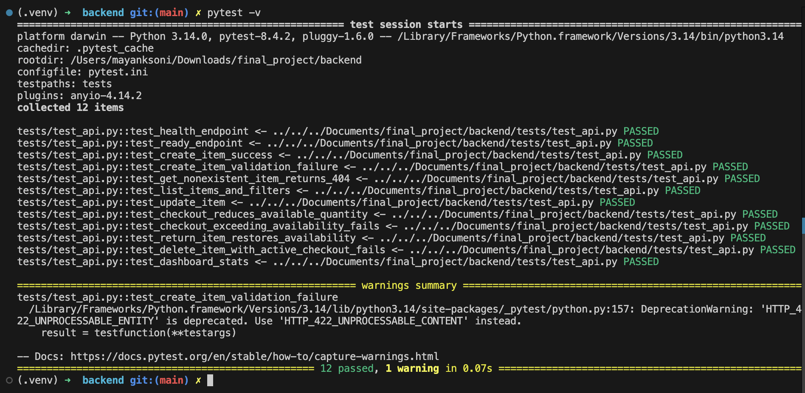
STEP 1 · QUALITY
Automated Testing Suite with pytest
Every endpoint is backed by automated tests running locally and on every pull request.
TESTING STRATEGY
Terminal Execution: pytest -v
100% Tests Passed
✔ Zero Manual Testing
Tests execute in milliseconds, validating API responses, status codes, and database state.
✔ Isolated SQLite DB
Test suite runs against an in-memory database to prevent test pollution and run fast.
✔ Fail-Fast Gatekeeper
If even 1 assertion fails, the developer cannot merge code and CI pipeline aborts.
✔ Edge Case Coverage
Covers empty payloads, invalid IDs, duplicate entries, and database disconnects.
05 / 30

Slide 6
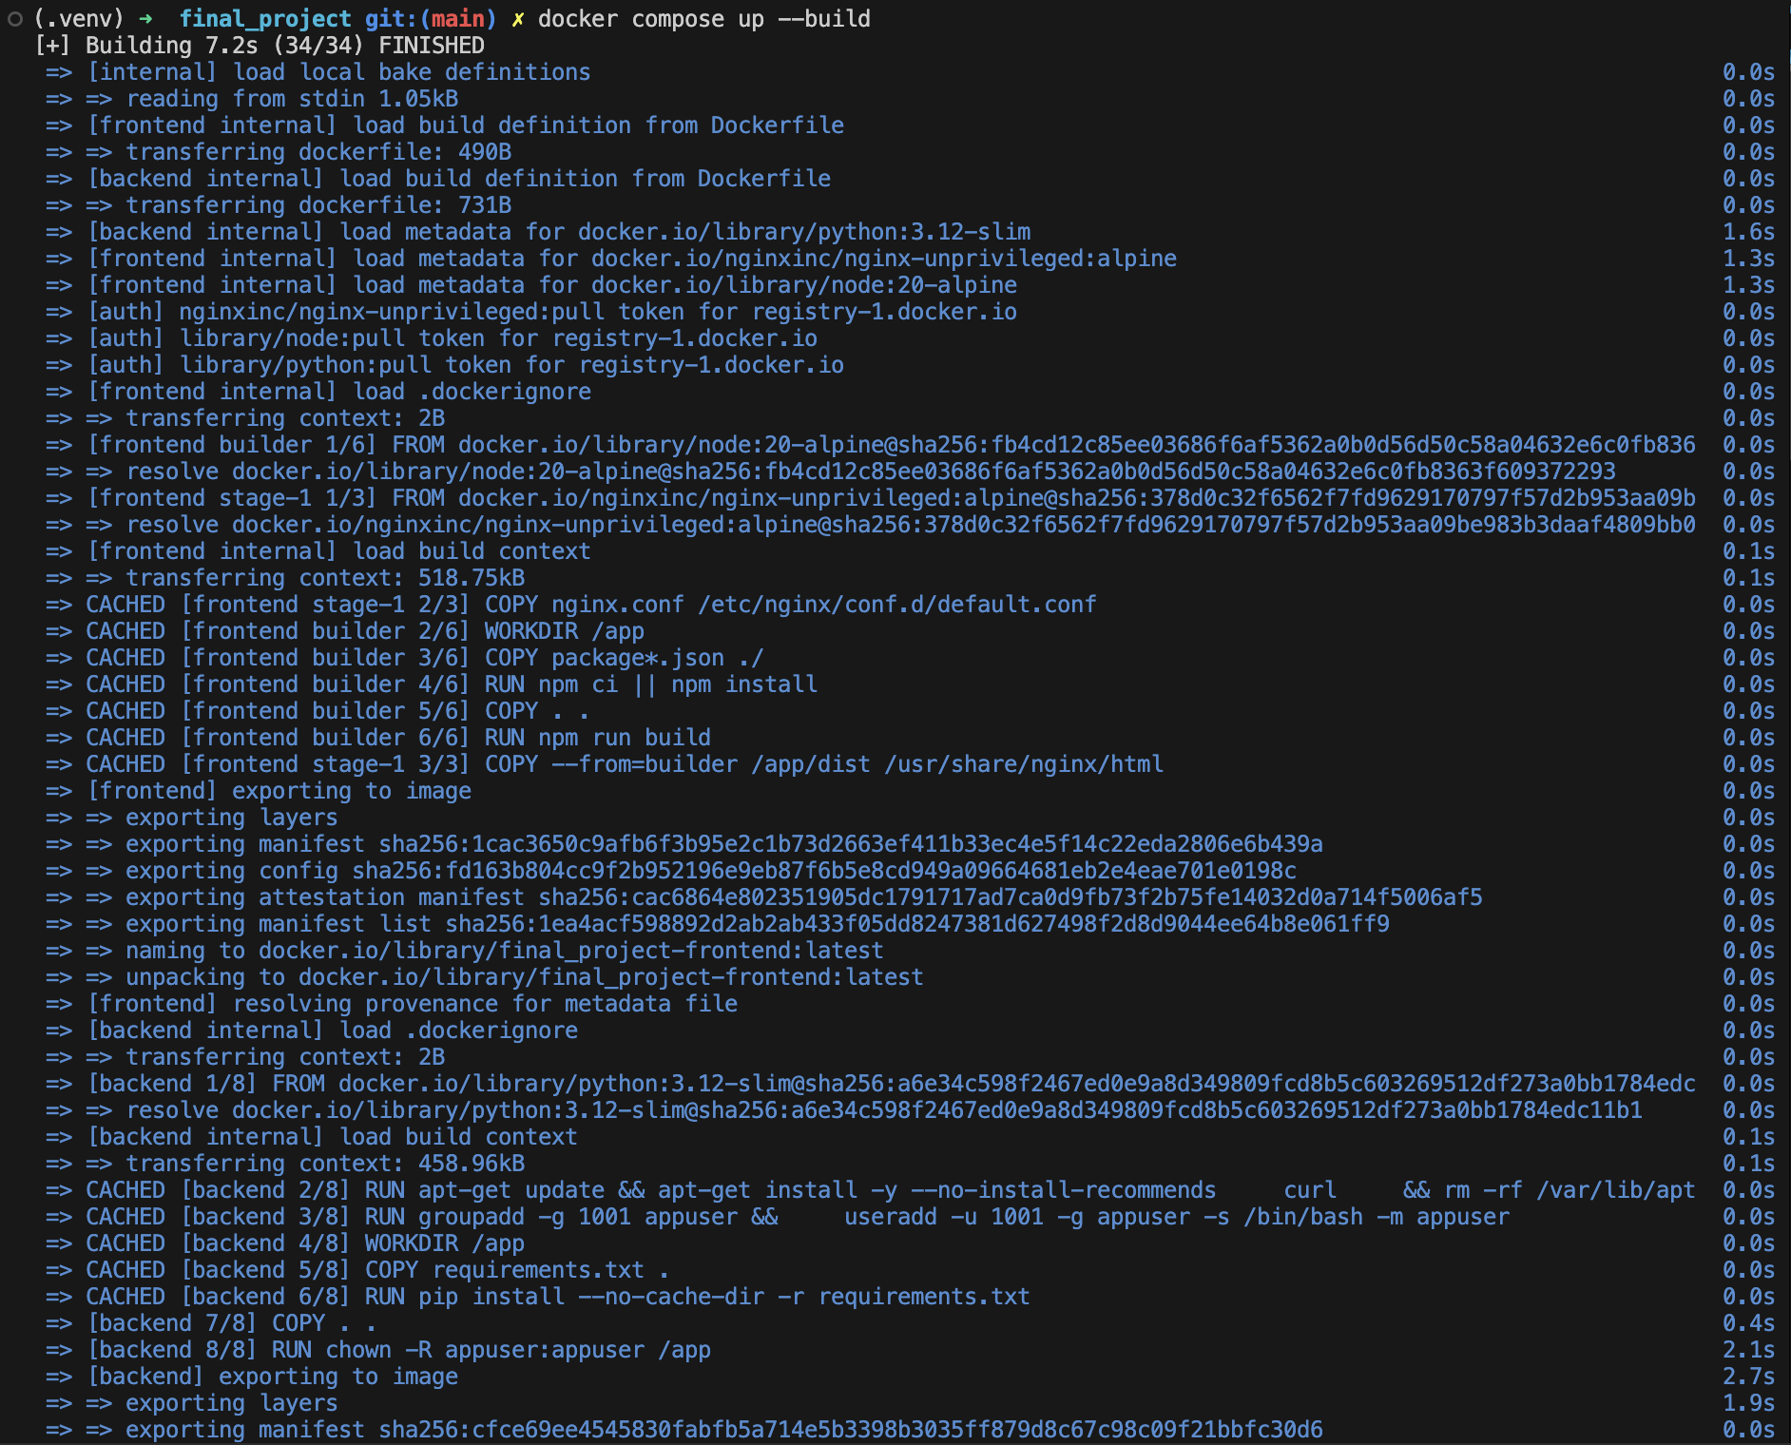
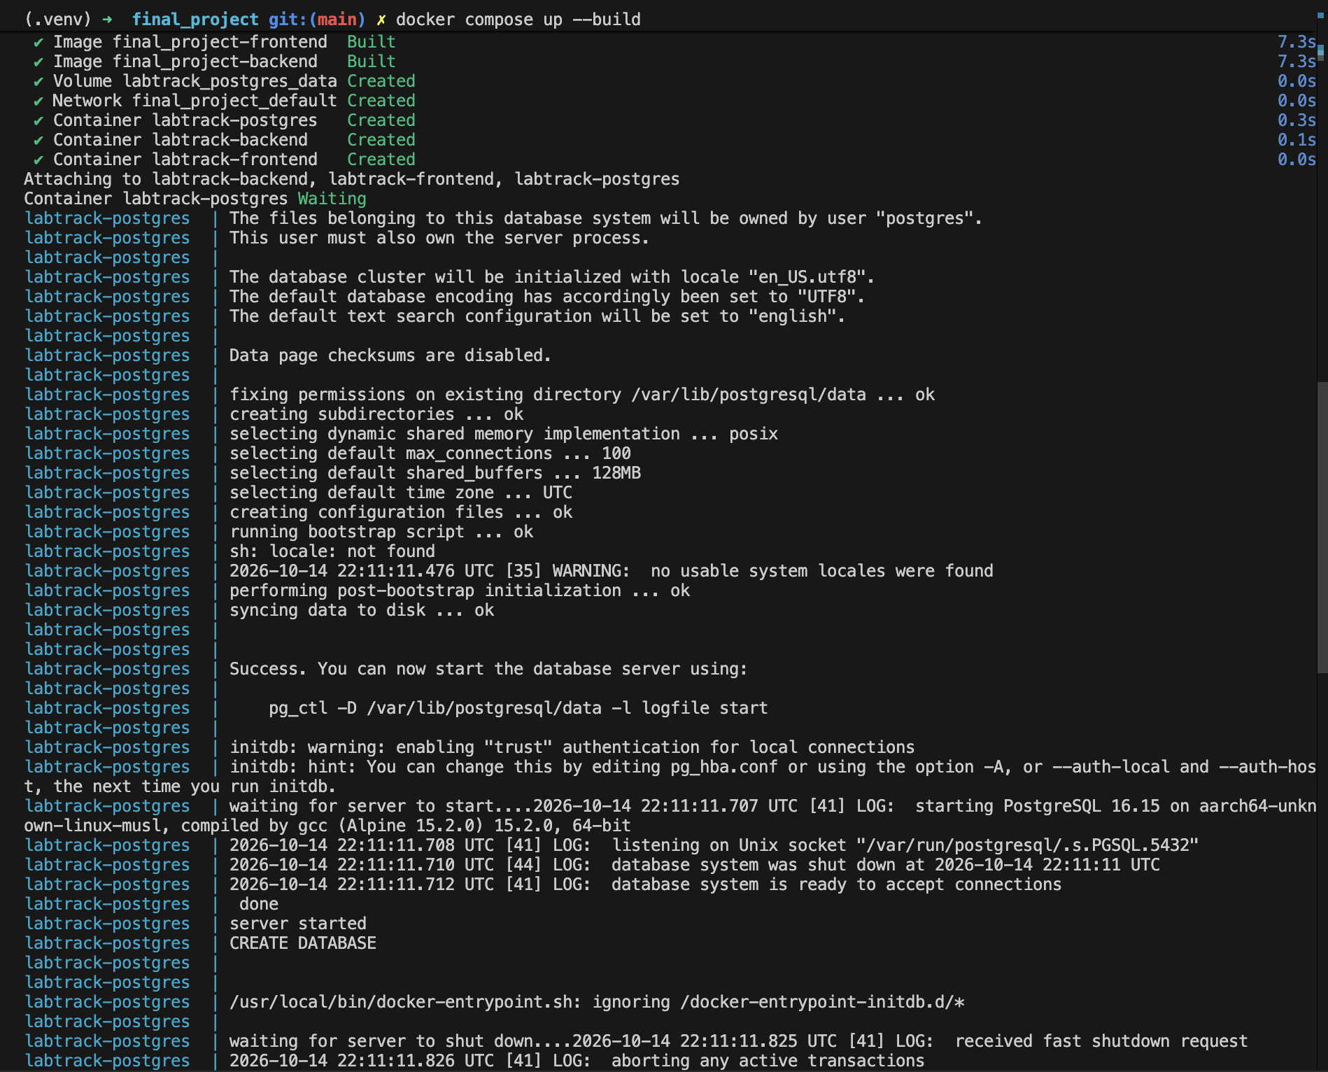
STEP 2 · CONTAINERS
Containerisation with Docker
Packaging application code and all dependencies into immutable, portable images.
🚢 The Standardised Shipping Container Analogy
Before shipping containers, cargo had to be loaded piece-by-piece on every train and ship. Docker does the exact same for software:
it wraps your code, Python runtime, system libraries, and configs into one sealed box that runs identically on any laptop or cloud VM.
Backend Dockerfile (FastAPI)
Multi-stage Python
Frontend Dockerfile (React + NGINX)
Production Build
06 / 30

Slide 7
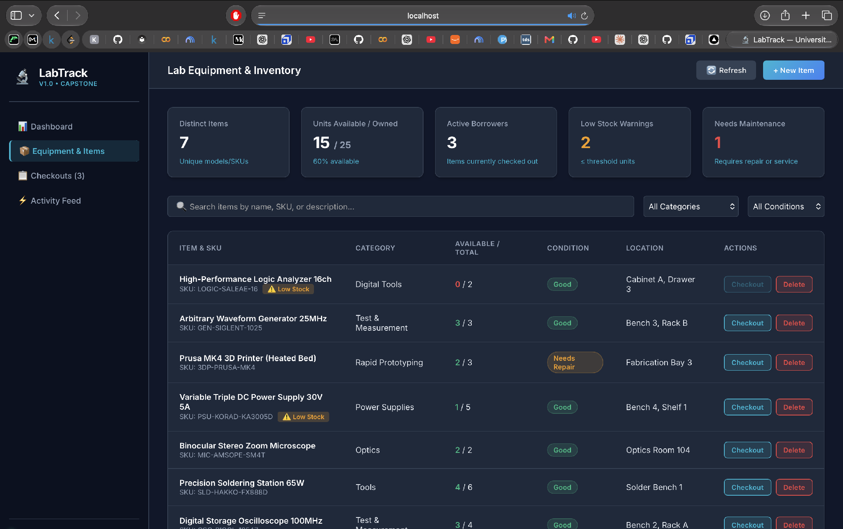
STEP 2 · CONTAINERS
Multi-Service Orchestration — Docker Compose
Spinning up the complete 3-tier stack locally with a single command.
docker compose up • Live Stack Running
LOCAL ENVIRONMENT
3 Services Active
📦 One-Command Setup
docker compose up spins up Backend, Frontend, and PostgreSQL with proper networking.
📦 Private Bridge Network
Containers communicate securely using internal service DNS (e.g., http://backend:8000).
📦 Persistent Volumes
Database records persist even when containers are stopped or restarted.
📦 Environment Parity
What developers run locally is identical to what gets deployed onto AWS EKS.
07 / 30

Slide 8
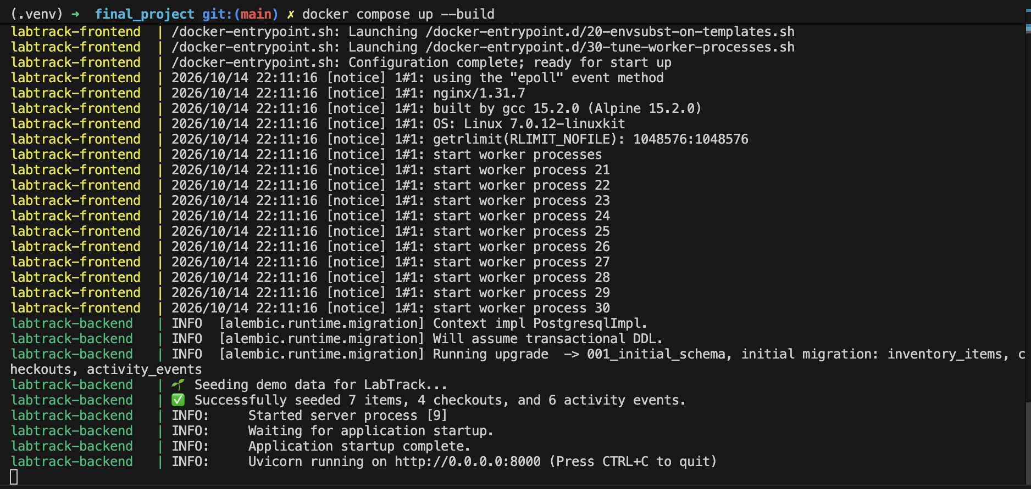
STEP 2 · CONTAINERS
Docker Images & Size Optimization
Inspection of built container images, tags, and lightweight footprints.
docker images — Tagged Build Artifacts
Local Registry Inspection
🪶
Multi-Stage Builds
🏷️
Semantic Versioning
🛡️
Non-Root Users
Compiler tools are discarded after building, keeping final production images small and fast to download.
Images are tagged with commit SHA and release numbers for precise traceability and rollbacks.
Containers run as unprivileged users to mitigate privilege escalation risks in production.
08 / 30

Slide 9
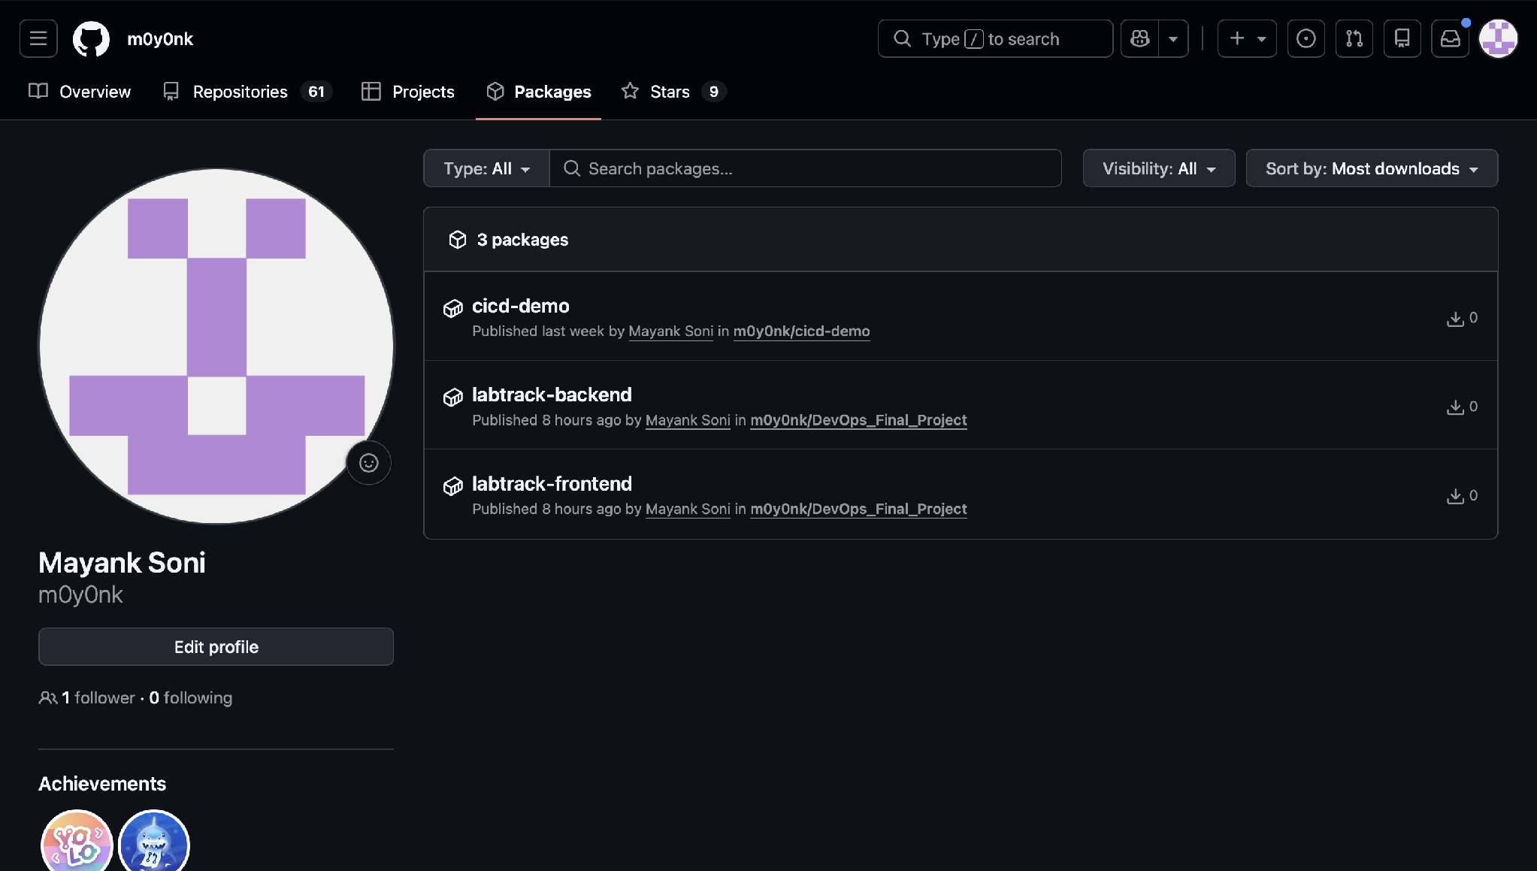
STEP 3 · GIT
Version Control — GitHub Repository
Centralized code repository maintaining project history, branches, and automation triggers.
GitHub Packages
m0y0nk/DevOps_Final_Project
GIT WORKFLOW
🌿 Single Source of Truth
All application code, Kubernetes manifests, Helm charts, and Terraform scripts live in one place.
🌿 Clean Directory Layout
Strict separation of concerns between /backend, /frontend, /k8s, and /terraform.
🌿 Branch Protection
Changes are committed with meaningful messages, triggering CI/CD checks automatically.
🌿 Full Auditability
Every line of code is attributed to a developer with full history and diff view.
09 / 30

Slide 10
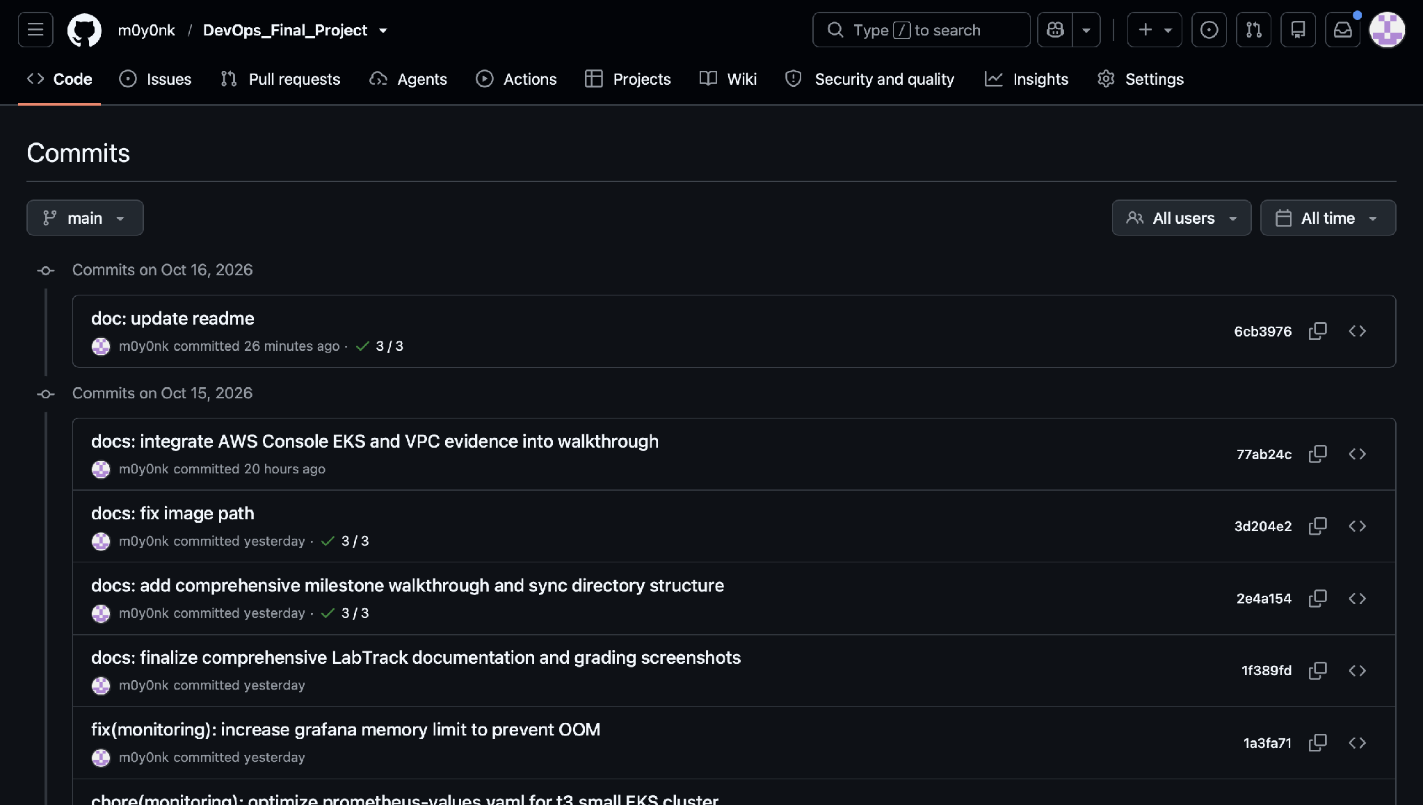
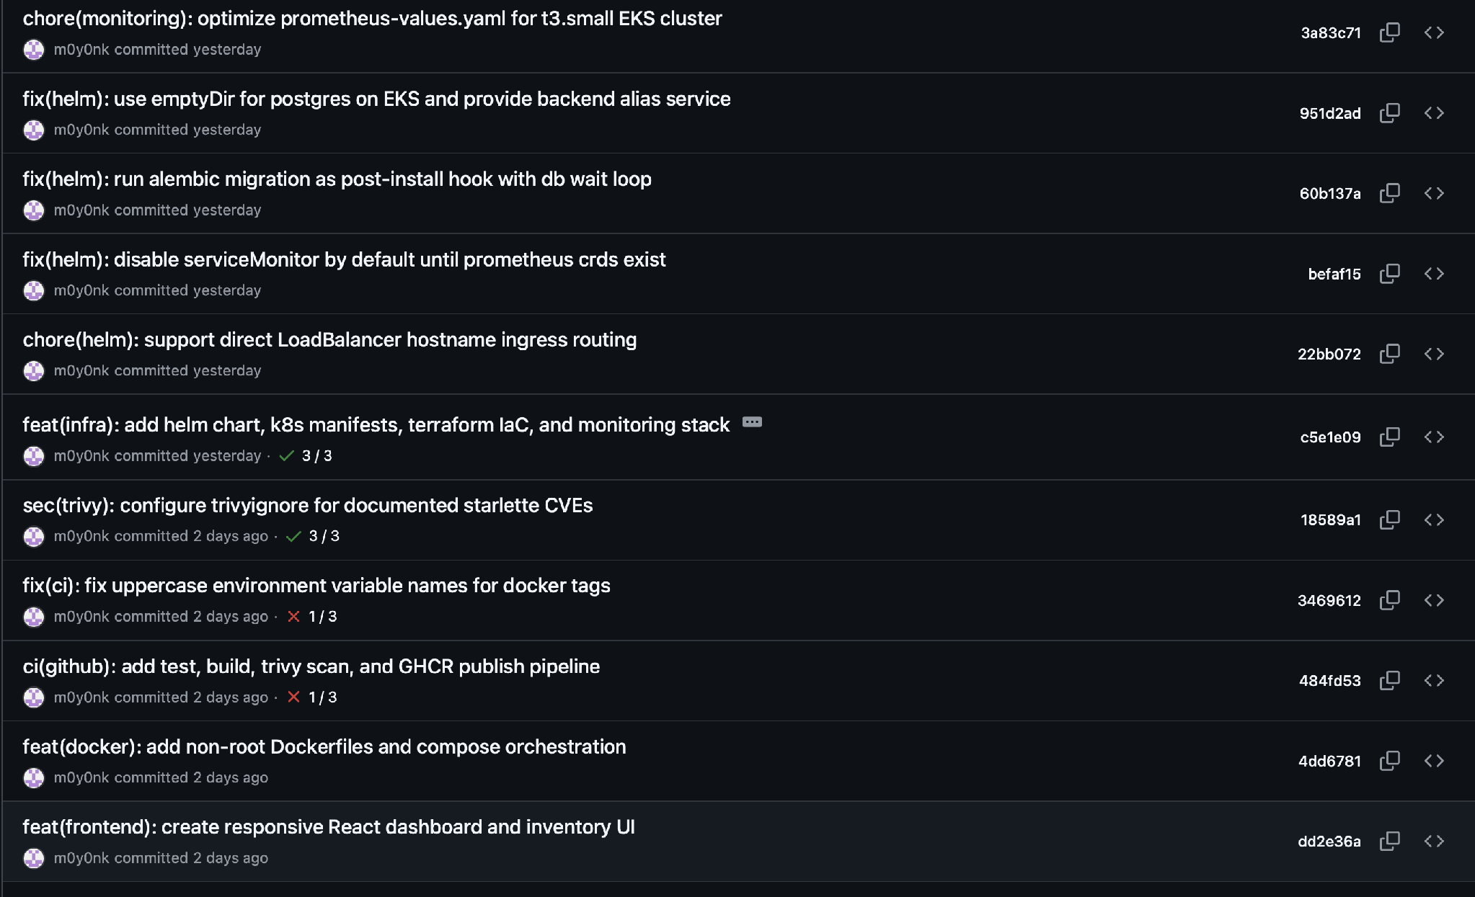
STEP 3 · GIT
Tracking Code Changes — Recent Commits
Inspecting atomic commits for features and infrastructure updates.
Commits — Code & Pipeline Updates
Commits — Kubernetes & Helm Configs
10 / 30

Slide 11
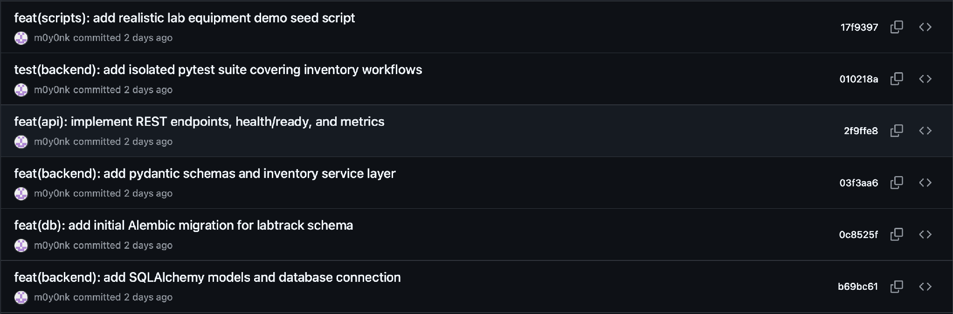
STEP 3 · GIT
Production Release Commit — Triggering CI/CD
Pushing changes to GitHub triggers the automated build and deployment webhook.
Commit — Production Release Trigger
WHAT HAPPENS ON GIT PUSH?
BENEFITS OF ATOMIC COMMITS
1. Developer runs `git push origin main`.
2. GitHub receives code and validates branch permissions.
3. Webhook sends event payload to GitHub Actions runner.
4. Continuous Integration workflow begins immediately.
• Pinpoints exact commit that introduced a feature or bug.
• Simplifies code reviews and pull request discussions.
• Enables seamless rollbacks with `git revert` if an issue arises.
• Provides transparent project management milestones.
11 / 30

Slide 12
STEP 4 · CI/CD
Automated CI/CD Pipeline Architecture
GitHub Actions automates the verification, scanning, packaging, and deployment.
PHASE 1
PHASE 2
PHASE 3
PHASE 4
PHASE 5
🧪
🔒
🏗️
📤
☸
TEST
➔
SECURITY
➔
BUILD
➔
PUSH
➔
DEPLOY
pytest Unit Tests
Trivy Scan
Docker Build
Registry Upload
Kubernetes Rollout
Ensures API and logic pass all assertions.
Scans image dependencies for CVEs.
Compiles multi-stage production images.
Publishes tagged images to GHCR.
Updates AWS EKS with zero downtime.
WHY CI/CD IS ESSENTIAL FOR NON-TECH STAKEHOLDERS
• No Manual Human Errors: Engineers don't drag-and-drop files onto servers via FTP or run dangerous manual scripts.
• Immediate Feedback: If code breaks tests or has security bugs, developers get notified in under 3 minutes.
• Continuous Delivery: Features reach customers immediately instead of waiting for stressful quarterly release weekends.
• Safety Net: Unapproved or failing builds are physically blocked from reaching the live production servers.
13 / 30

Slide 13
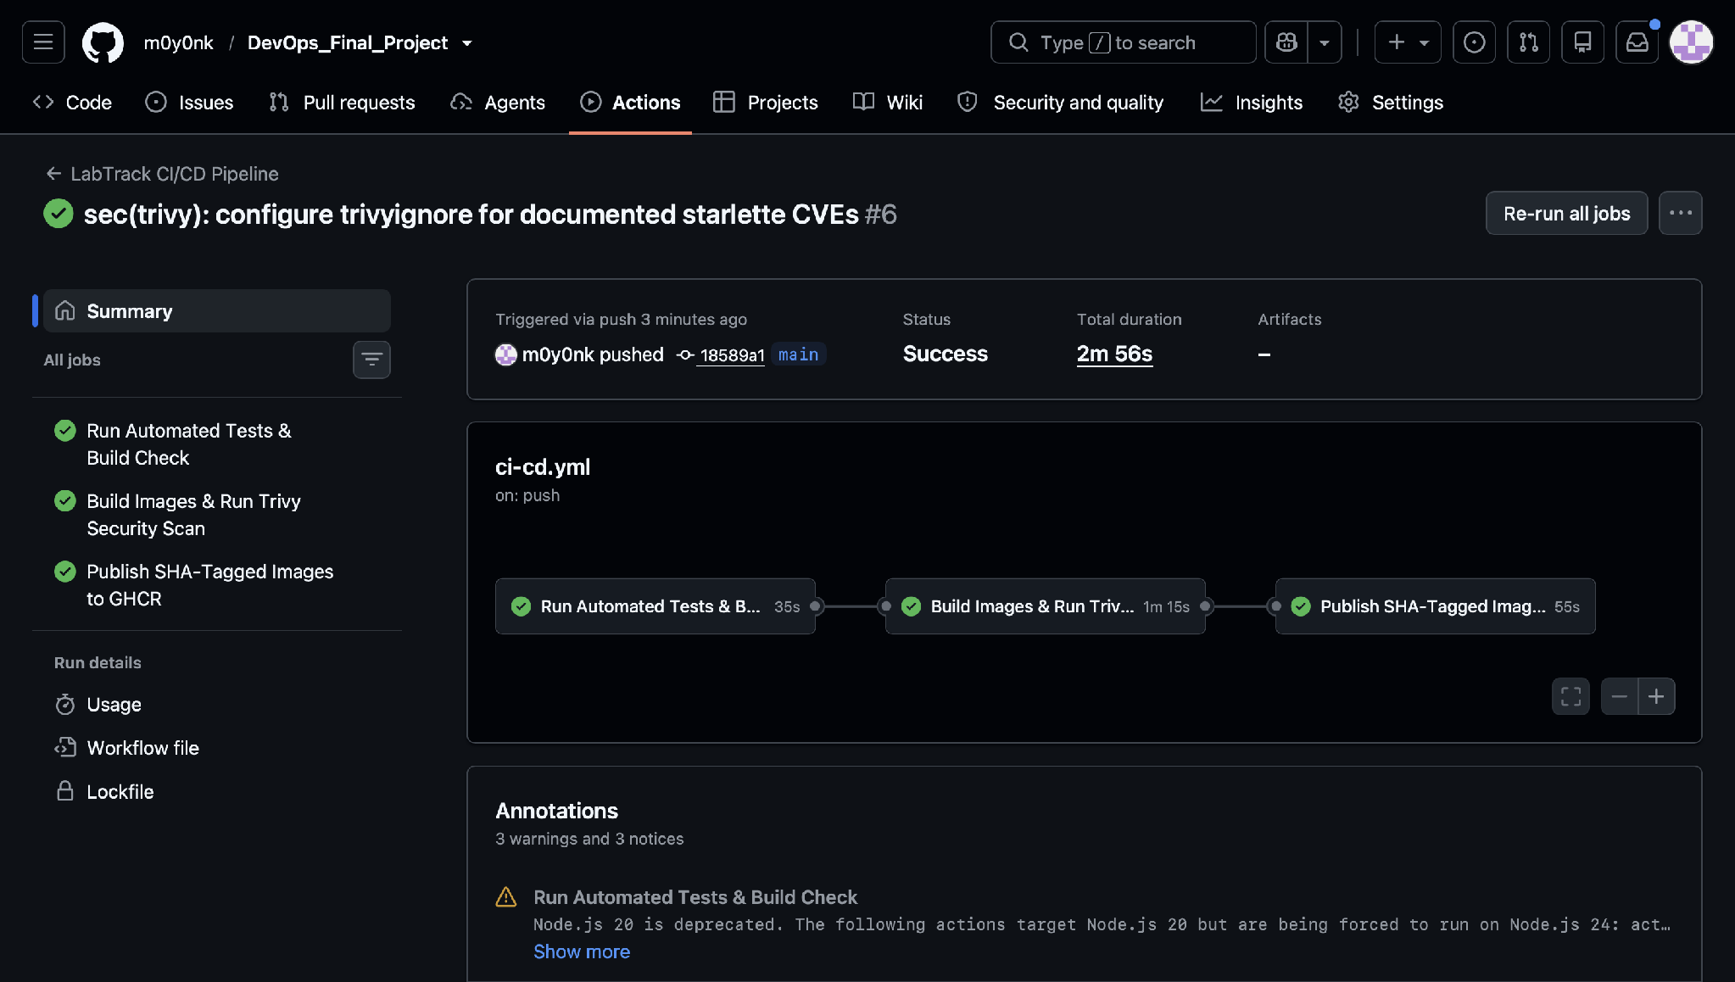
STEP 4 · CI/CD
GitHub Actions — Successful Pipeline Execution
Full green run: all tests, security audits, container builds, and deployment completed.
Green Pipeline Status
GitHub Actions: All Jobs Passed

Slide 14
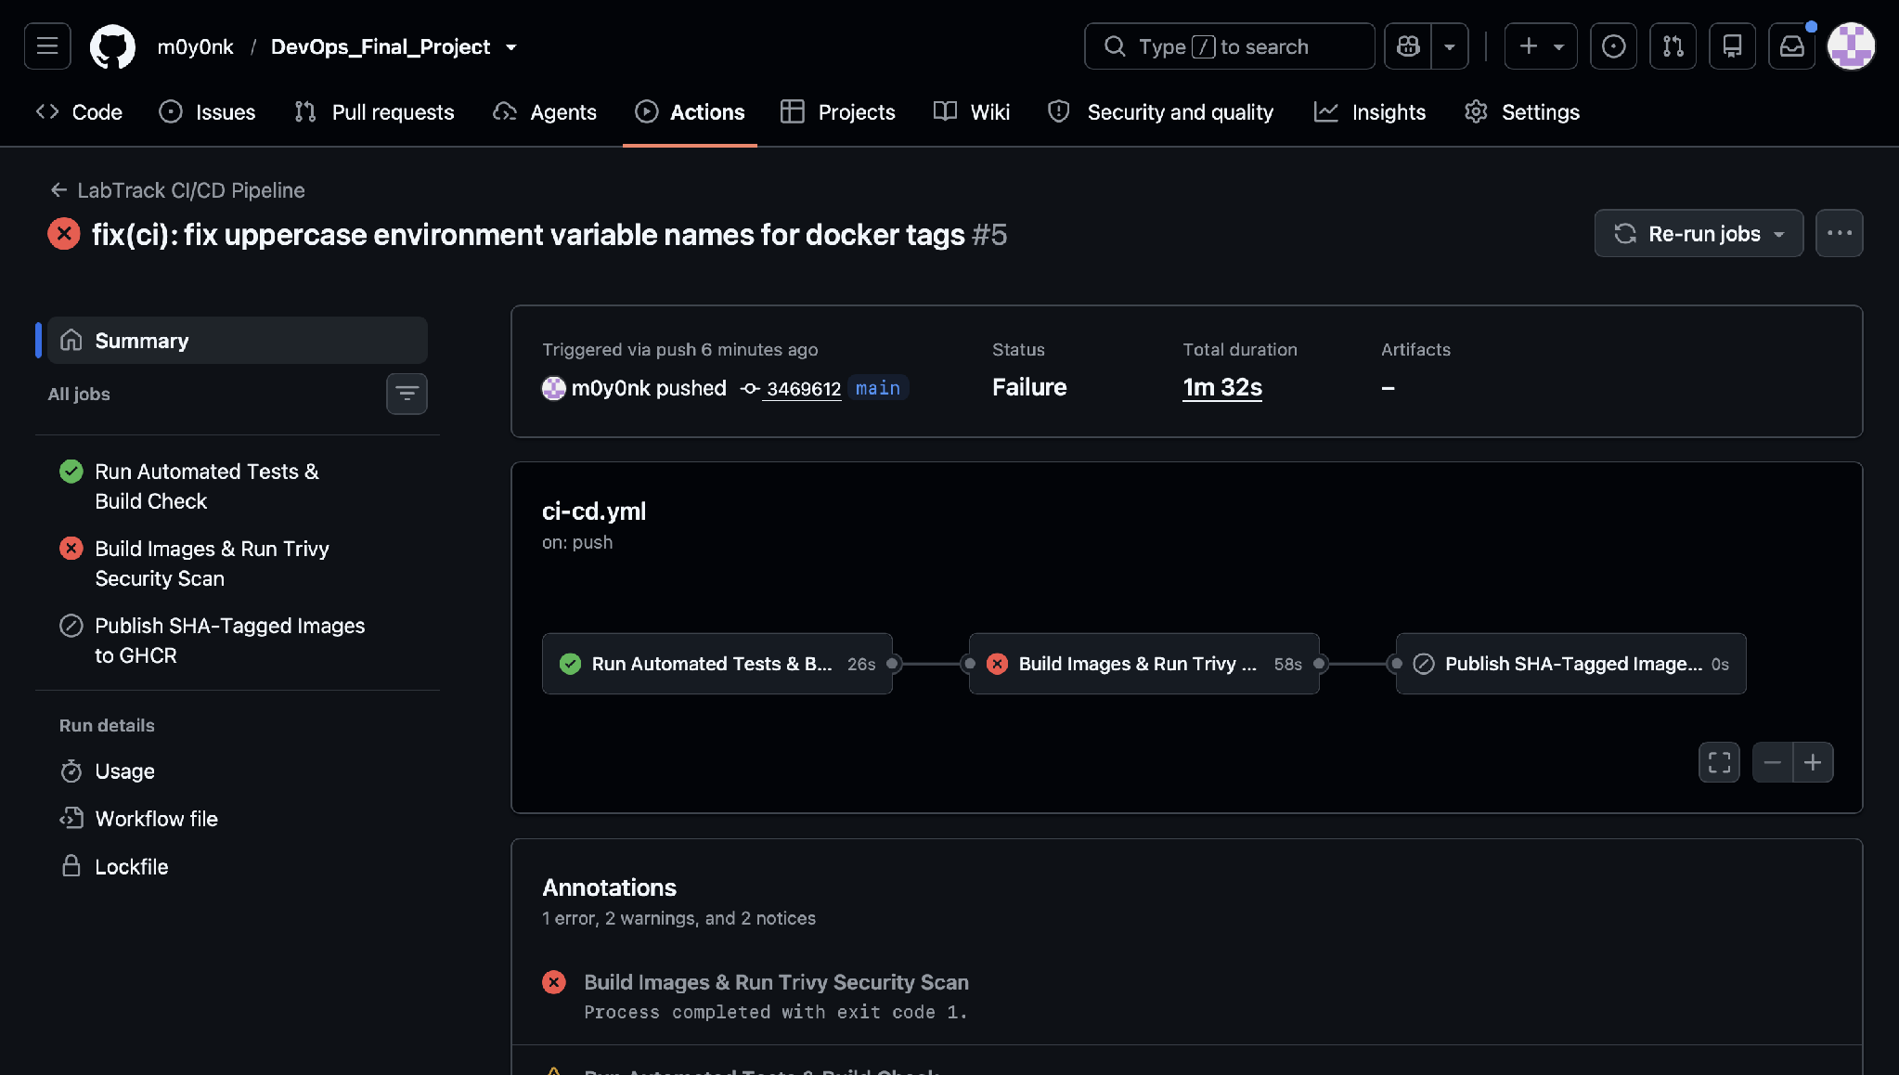
STEP 4 · CI/CD
The Safety Net — Catching Failures in CI
Demonstrating how CI/CD stops broken code before it can ever impact end users.
GitHub Actions: Build Caught & Aborted
FAIL-FAST PHILOSOPHY
Failed Pipeline Gate
❌ Why Failing Here is Good
A red build in CI prevents customer outages, loss of trust, and emergency midnight rollbacks.
❌ Deployment Gate Blocked
Subsequent stages (Docker build, push, Kubernetes deploy) were automatically canceled.
❌ Instant Developer Alert
Detailed logs highlight the exact line and assertion failure so it can be fixed immediately.
❌ Zero Impact on Production
Live users never notice because the cluster continues running the previous healthy version.
15 / 30

Slide 15

STEP 4 · CI/CD
Live Demo — Git Push to Deployment Pipeline
Video demonstration capturing the entire push-to-deploy automated cycle.
▶
RECORDED DEMO VIDEO EMBED
Demonstrates: Code change → Git commit → Push → GitHub Actions runs → AWS EKS deployment
16 / 30

Slide 16
STEP 5 · TERRAFORM
Infrastructure as Code (IaC) with Terraform
Defining entire cloud infrastructure through declarative, version-controlled code.
🏗️ The Architectural Blueprint Analogy
Instead of clicking buttons in the AWS Console (prone to mistakes and impossible to replicate), Terraform writes a blueprint in code.
Hand this blueprint to AWS and it builds the exact same secure network, servers, and Kubernetes cluster every single time.
☁️
AWS EKS Cluster
🌐
Custom VPC Network
Managed Kubernetes control plane across availability zones for high resilience.
Isolated virtual cloud network with public and private subnets, NAT, and IGW.
🛡️
IAM Roles & Policies
💻
Managed Node Groups
Least-privilege security model ensuring only authorized services talk to AWS.
Auto-scaling EC2 instances provisioned to run application container pods.
17 / 30

Slide 17
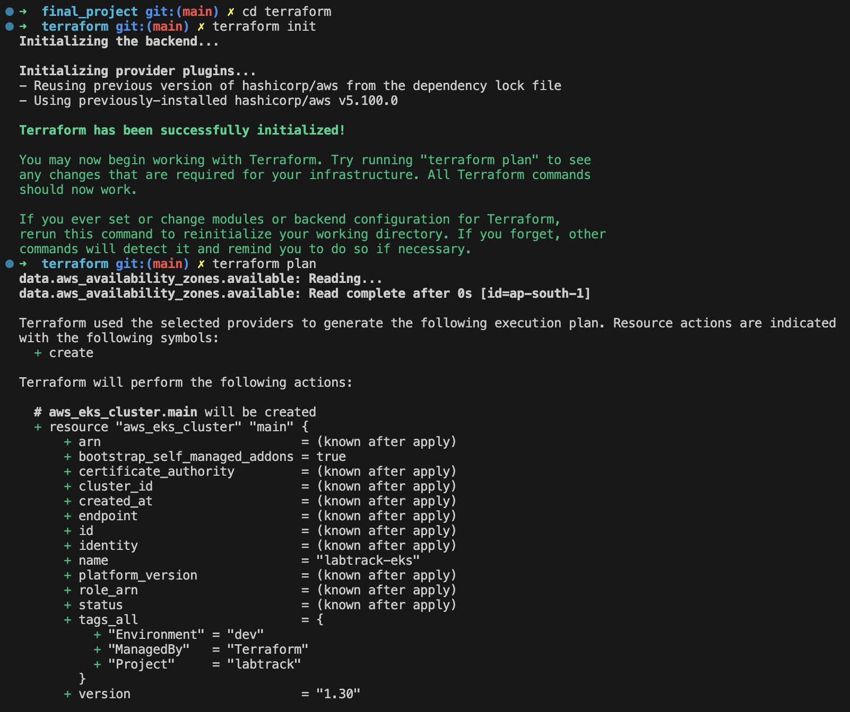
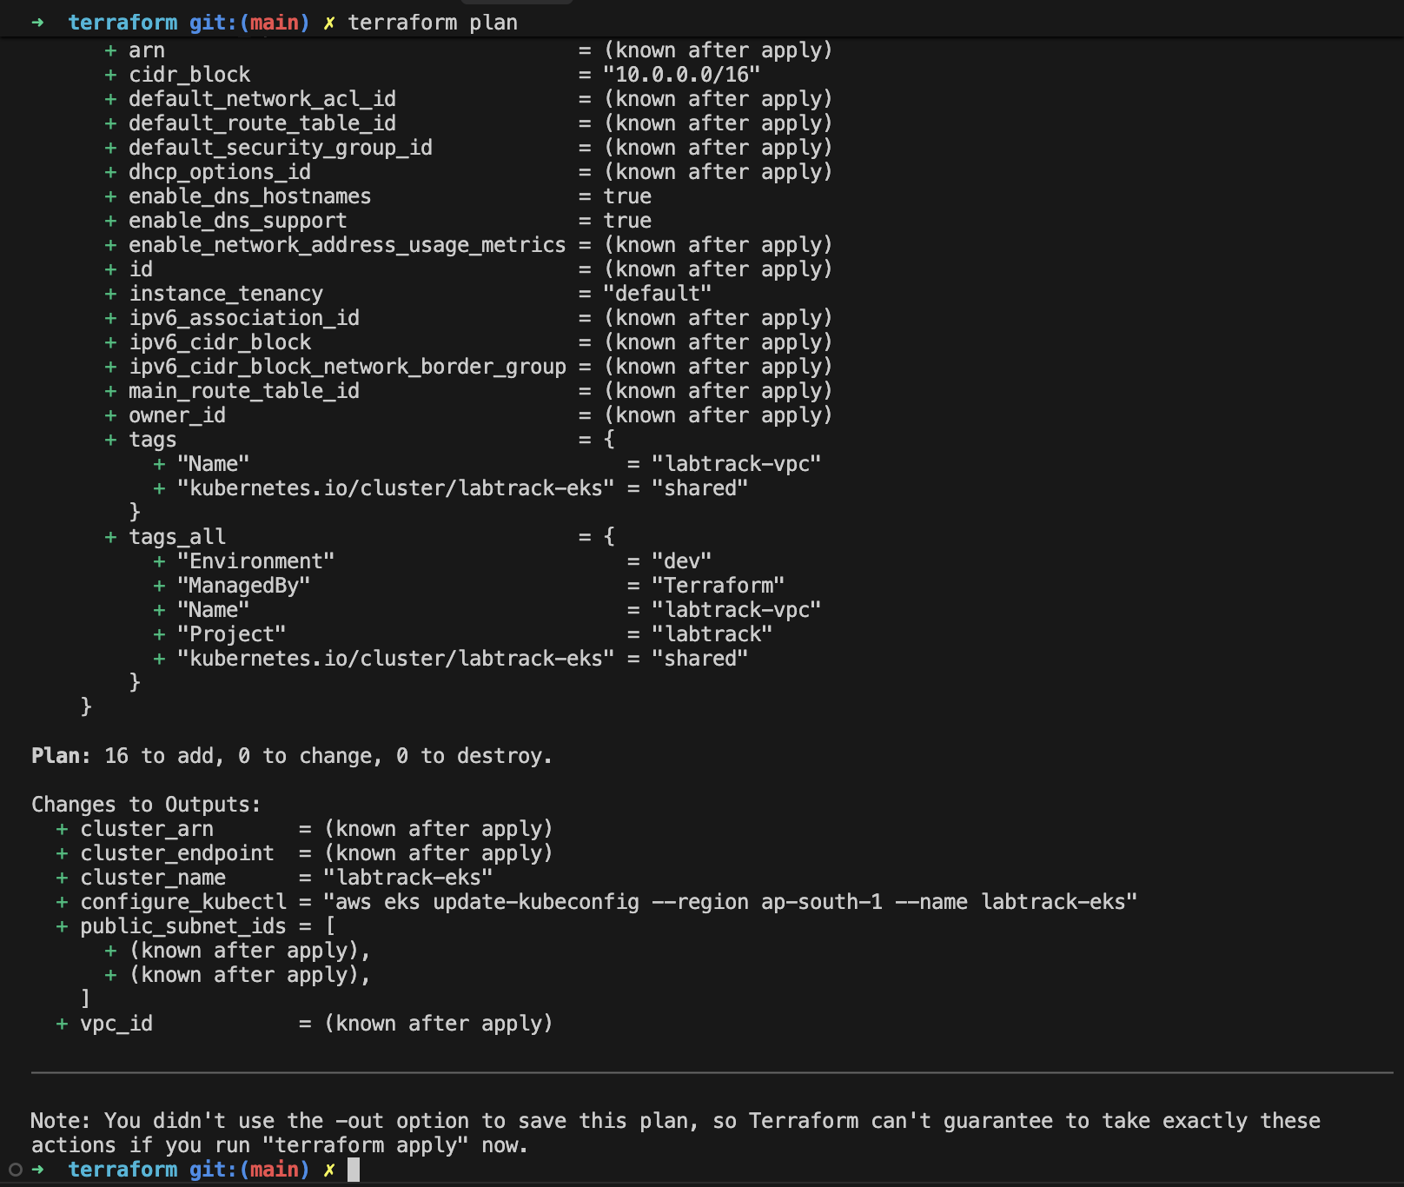
STEP 5 · TERRAFORM
Terraform Init & Plan — Safe Dry-Runs
Terraform calculates exactly what resources will be created before touching the cloud.
terraform init • Provider Initialization
terraform plan • Execution Preview
18 / 30

Slide 18
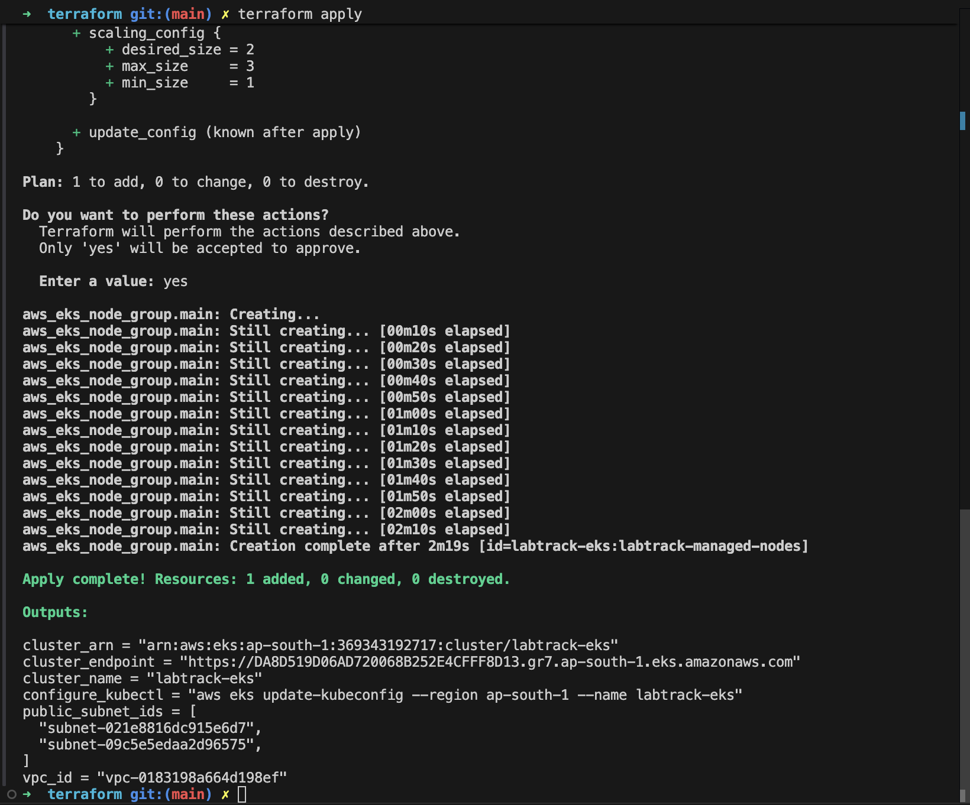
STEP 5 · TERRAFORM
Terraform Apply — Provisioning Infrastructure
Executing the blueprint: VPC, subnets, route tables, IAM roles, and EKS cluster created.
terraform apply • Resources Created
PROVISIONING OUTCOME
⚡ Zero Manual Setup
VPC, Subnets, Internet Gateways, NAT Gateways, and EKS provisioned purely from code.
⚡ Idempotent Execution
Running `terraform apply` again does nothing if nothing has changed — zero drift.
⚡ State Management
Terraform tracks the real-world infrastructure in a secure state file.
⚡ Enterprise Ready
The entire infrastructure can be replicated in another AWS region in 15 minutes.
19 / 30

Slide 19
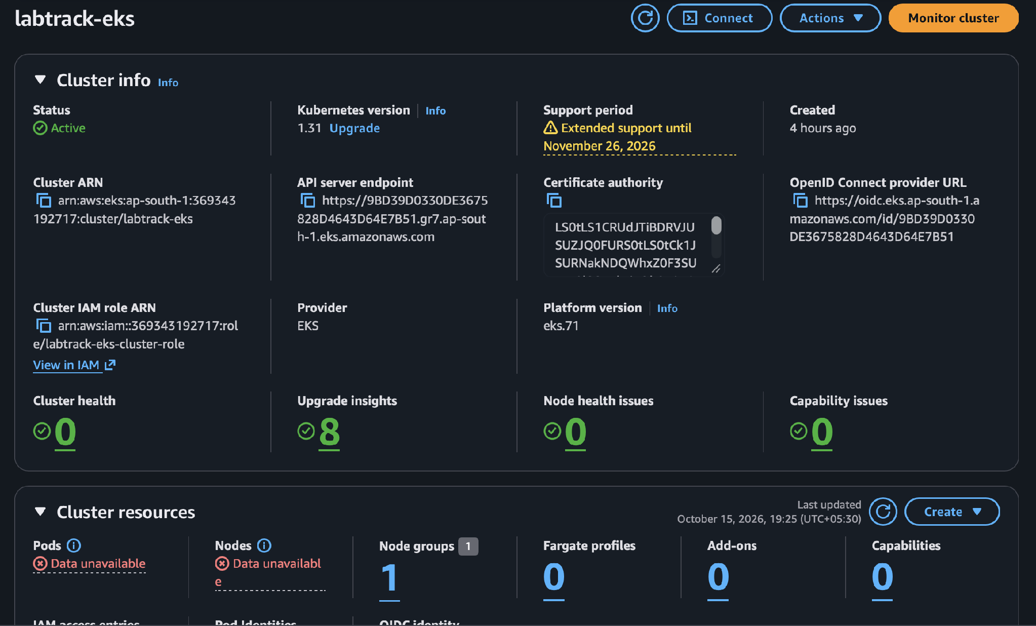
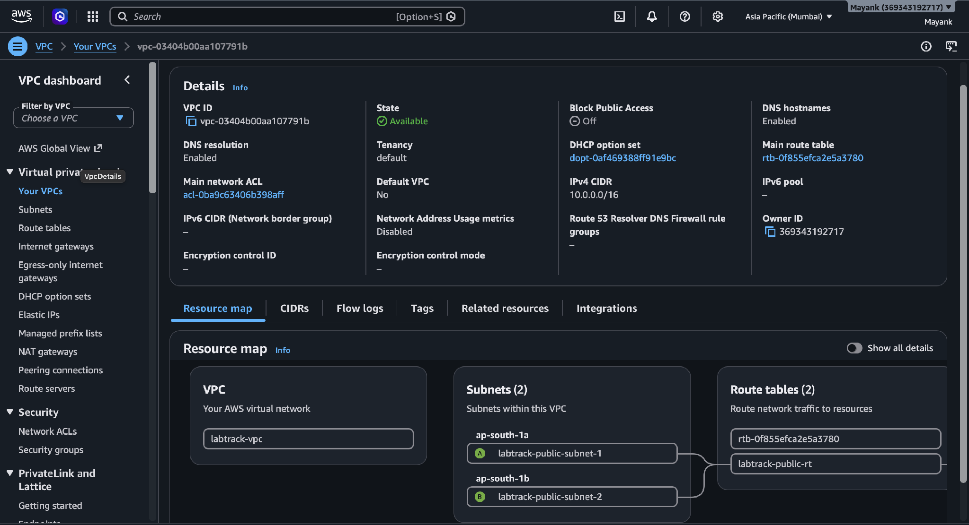
STEP 5 · TERRAFORM
AWS Cloud Console — Verification Evidence
Visual confirmation in the AWS Console that Terraform created all resources successfully.
AWS EKS Console: taskboard-eks Cluster
AWS VPC Console: Isolated Network
20 / 30

Slide 20
STEP 6 · KUBERNETES
Orchestration — Kubernetes & Helm
Managing container lifecycles, self-healing, rolling updates, and traffic routing.
✈️ The Air Traffic Controller Analogy
Just as air traffic controllers guide hundreds of flights, manage runways, and respond instantly to delays —
Kubernetes constantly schedules containers onto healthy servers, restarts crashed apps, and scales up when traffic spikes.
🔄
Self-Healing Workloads
⚖️
Internal Load Balancing
If a backend pod crashes or runs out of memory, Kubernetes restarts a new replica in seconds.
ClusterIP and NodePort services distribute incoming traffic evenly across running pods.
📦
Helm Package Manager
🔐
Secrets & ConfigMaps
Helm acts as the 'App Store' for Kubernetes, templating manifests and managing releases cleanly.
Database credentials and environment variables are decoupled from container code.
21 / 30

Slide 21
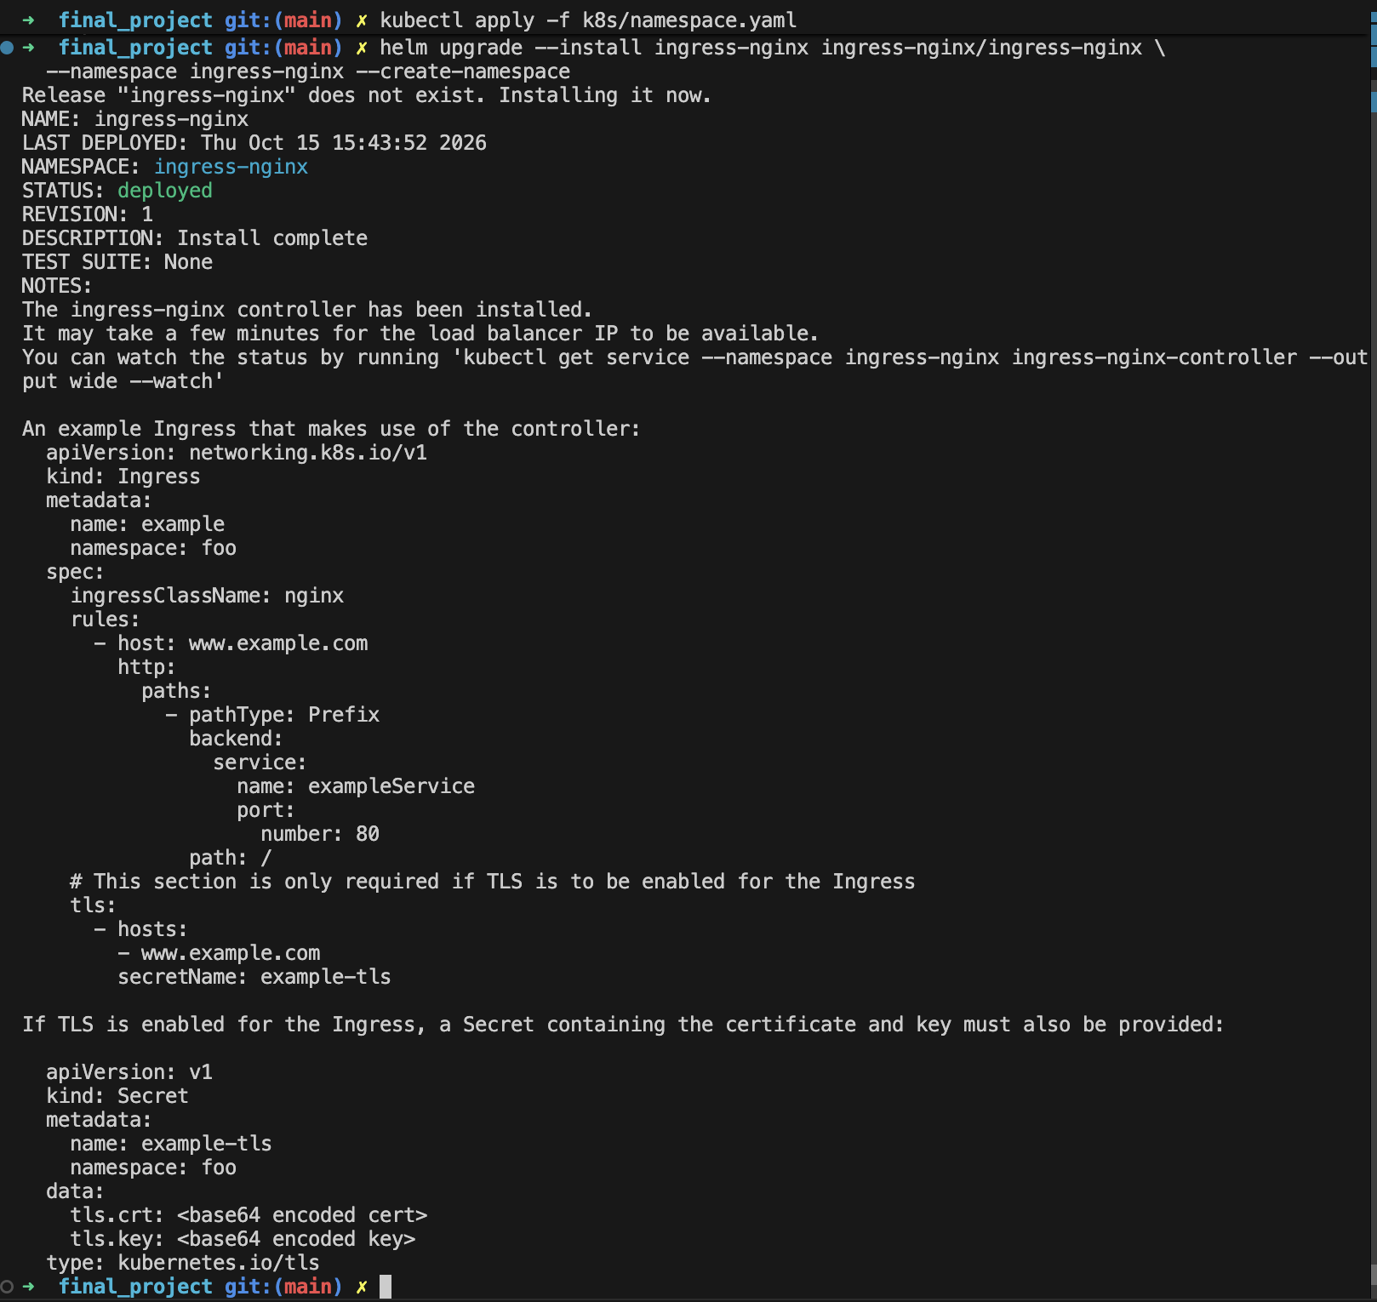
STEP 6 · KUBERNETES
Live Cluster Evidence — Running Pods
Proof that backend, frontend, and database pods are running and healthy on AWS EKS.
CLUSTER STATE VERIFICATION
☸ backend-pod
Python FastAPI REST server running and bound to port 8000, passing readiness probes.
☸ frontend-pod
React single-page application served via optimized NGINX container on port 80.
☸ postgres-pod
PostgreSQL database running with attached EBS persistent volume claim.
☸ Zero Restarts
Pods show 0 restarts and status `Running`, confirming stable memory and CPU allocation.
22 / 30

Slide 22
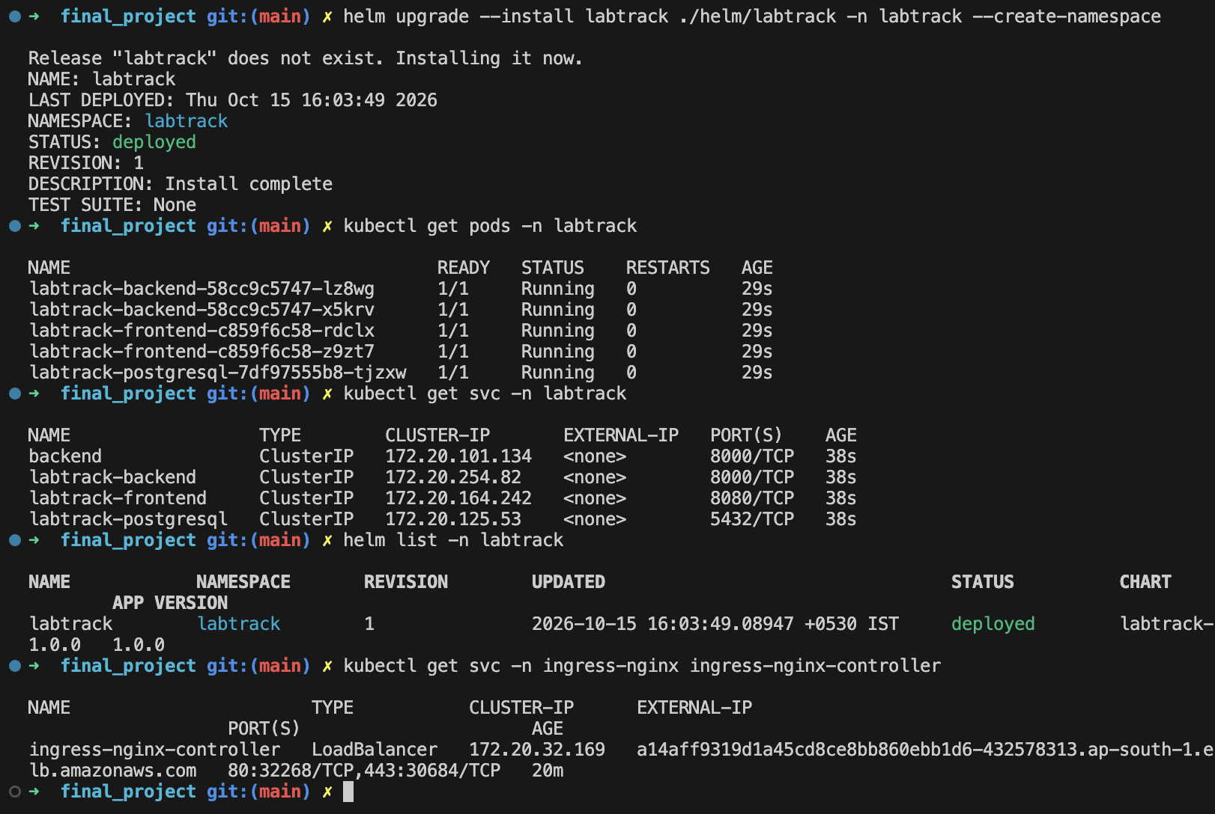
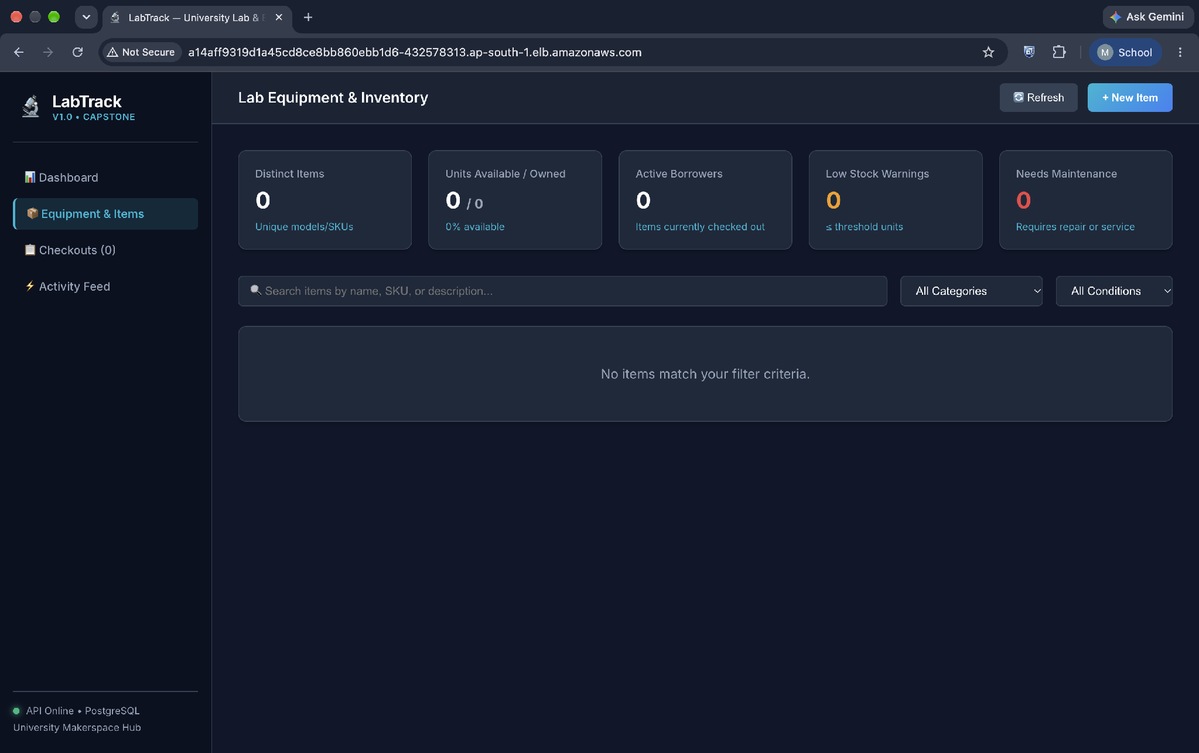
STEP 6 · KUBERNETES
Services Networking & Helm Release
Routing traffic to pods and verifying Helm deployment release status.
kubectl get services -n labtrack
ClusterIP & NodePort
23 / 30

Slide 23
STEP 7 · MONITORING
Observability — Prometheus & Grafana
24/7 monitoring ensures we detect performance degradation and errors before users do.
🏎️ The Modern Car Dashboard Analogy
You wouldn't drive a car without a speedometer, fuel gauge, or check-engine light.
Prometheus acts as the engine sensors recording vitals, while Grafana is the sleek dashboard displaying speed and alarms.
📡
📊
🚨
Prometheus — Metrics Collector
Grafana — Live Visualizer
Automated Alerts
Scrapes application metrics every 15 seconds over HTTP /metrics. Collects request rates, error codes, and latencies.
Queries Prometheus data and converts raw time-series numbers into intuitive, real-time visual charts and dashboards.
If HTTP 500 error rates exceed 1% or API latency spikes over 500ms, alerts trigger immediately for engineering triage.
24 / 30

Slide 24
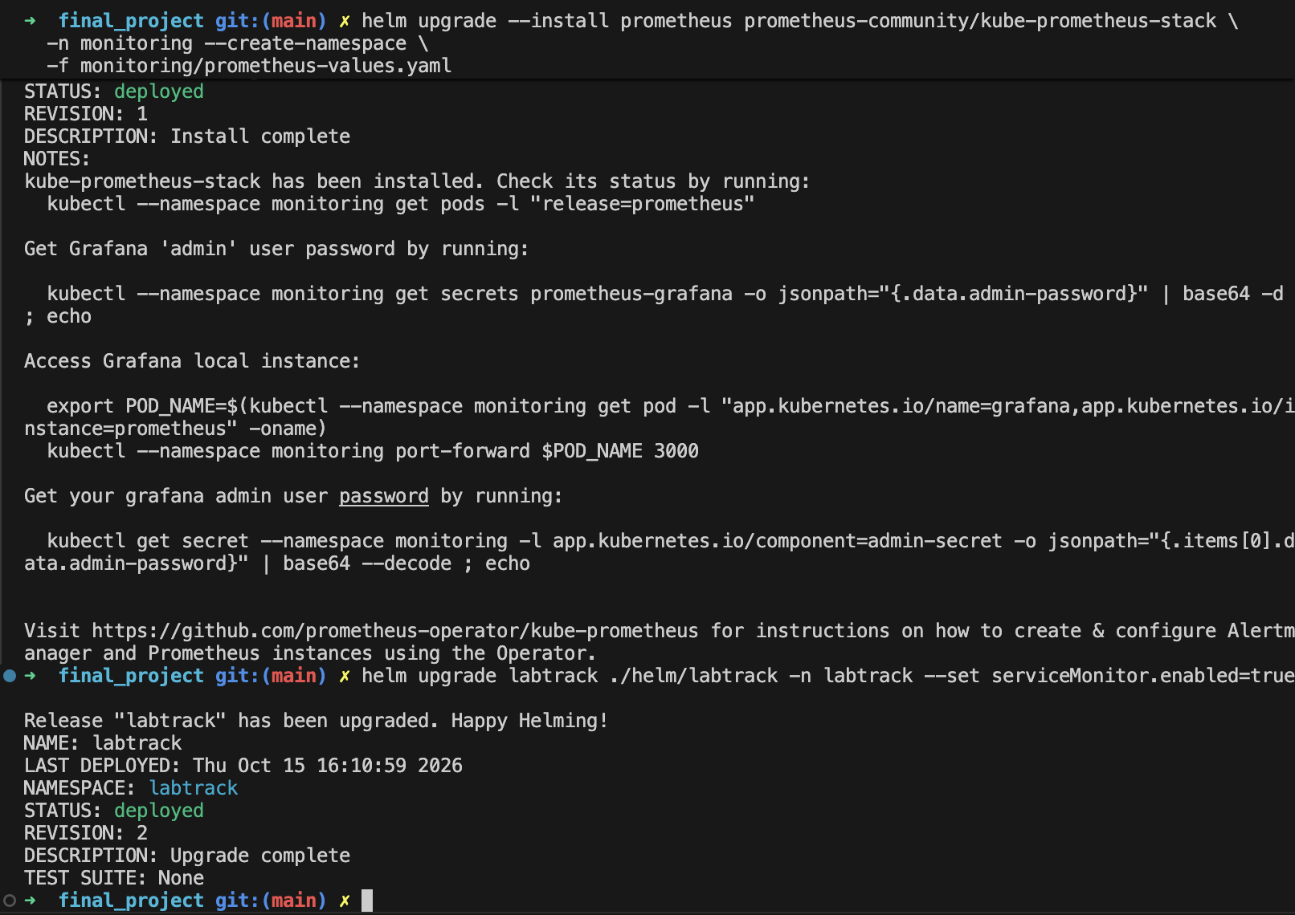
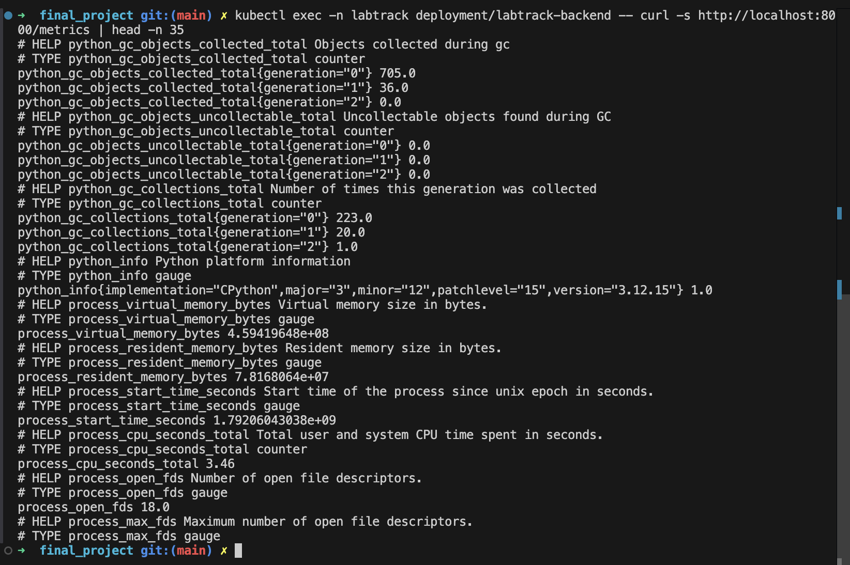
STEP 7 · MONITORING
Prometheus Targets & /metrics Endpoint
Verifying that Prometheus is scraping live metrics from application endpoints.
curl /metrics — Raw Time-Series Data
FastAPI Prometheus Exporter
25 / 30

Slide 25
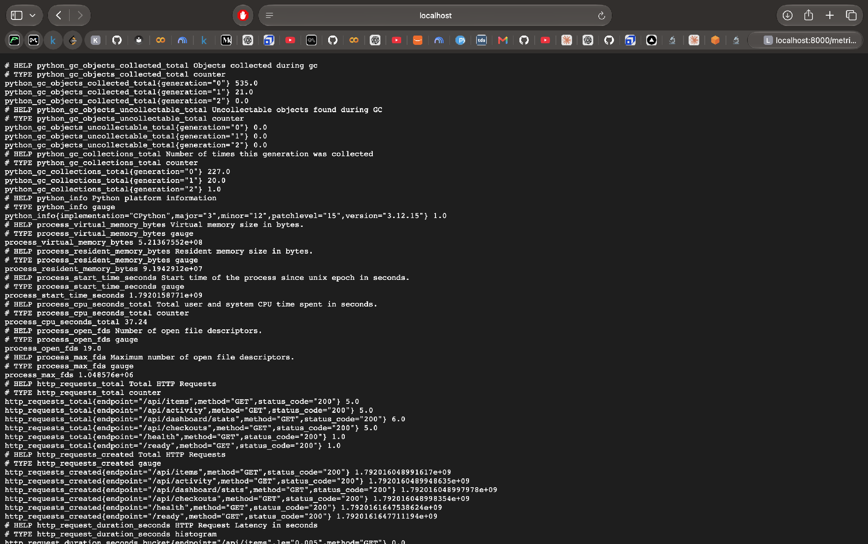
STEP 7 · MONITORING
Grafana — Real-Time Production Dashboard
Comprehensive observability view showcasing system uptime, throughput, and latencies.
Grafana Dashboard: LabTrack Application Health Overview
Live Production Telemetry
26 / 30

Slide 26
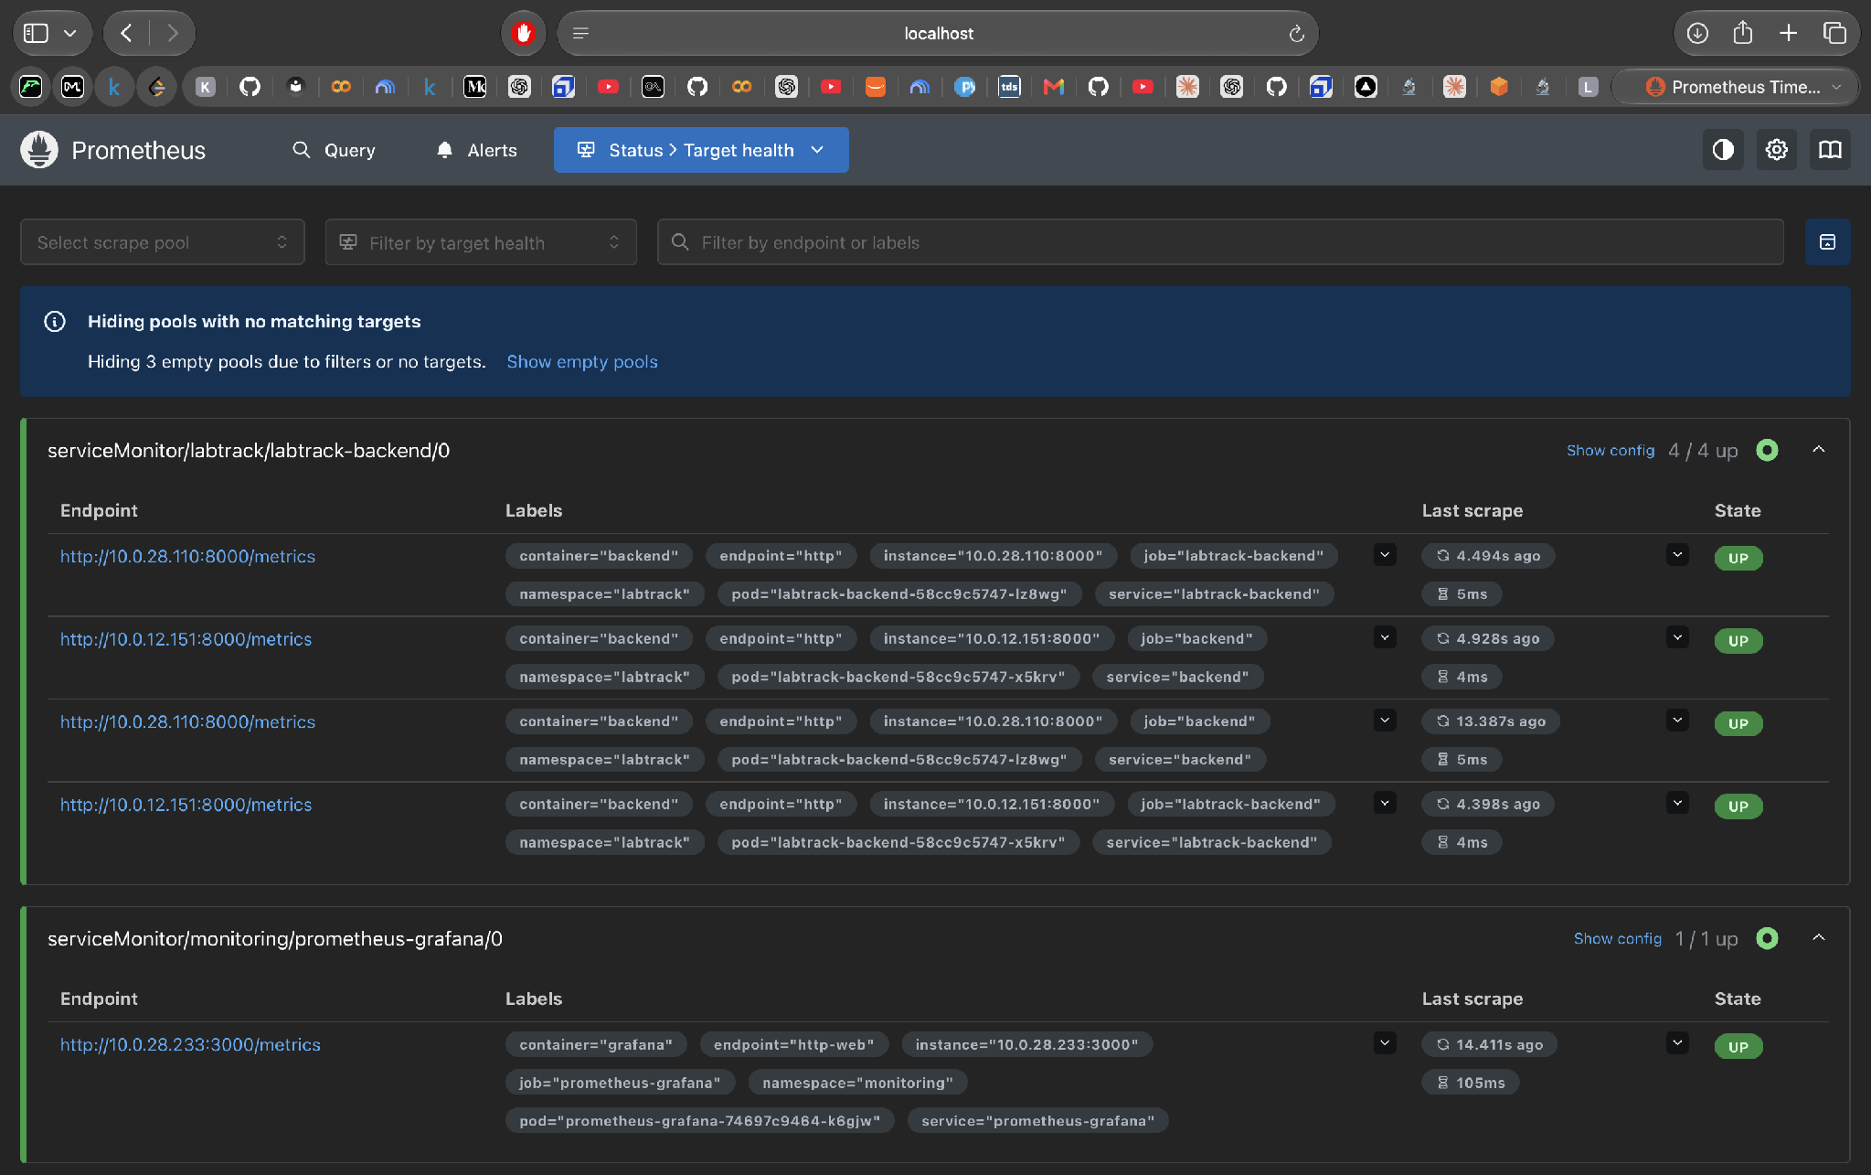
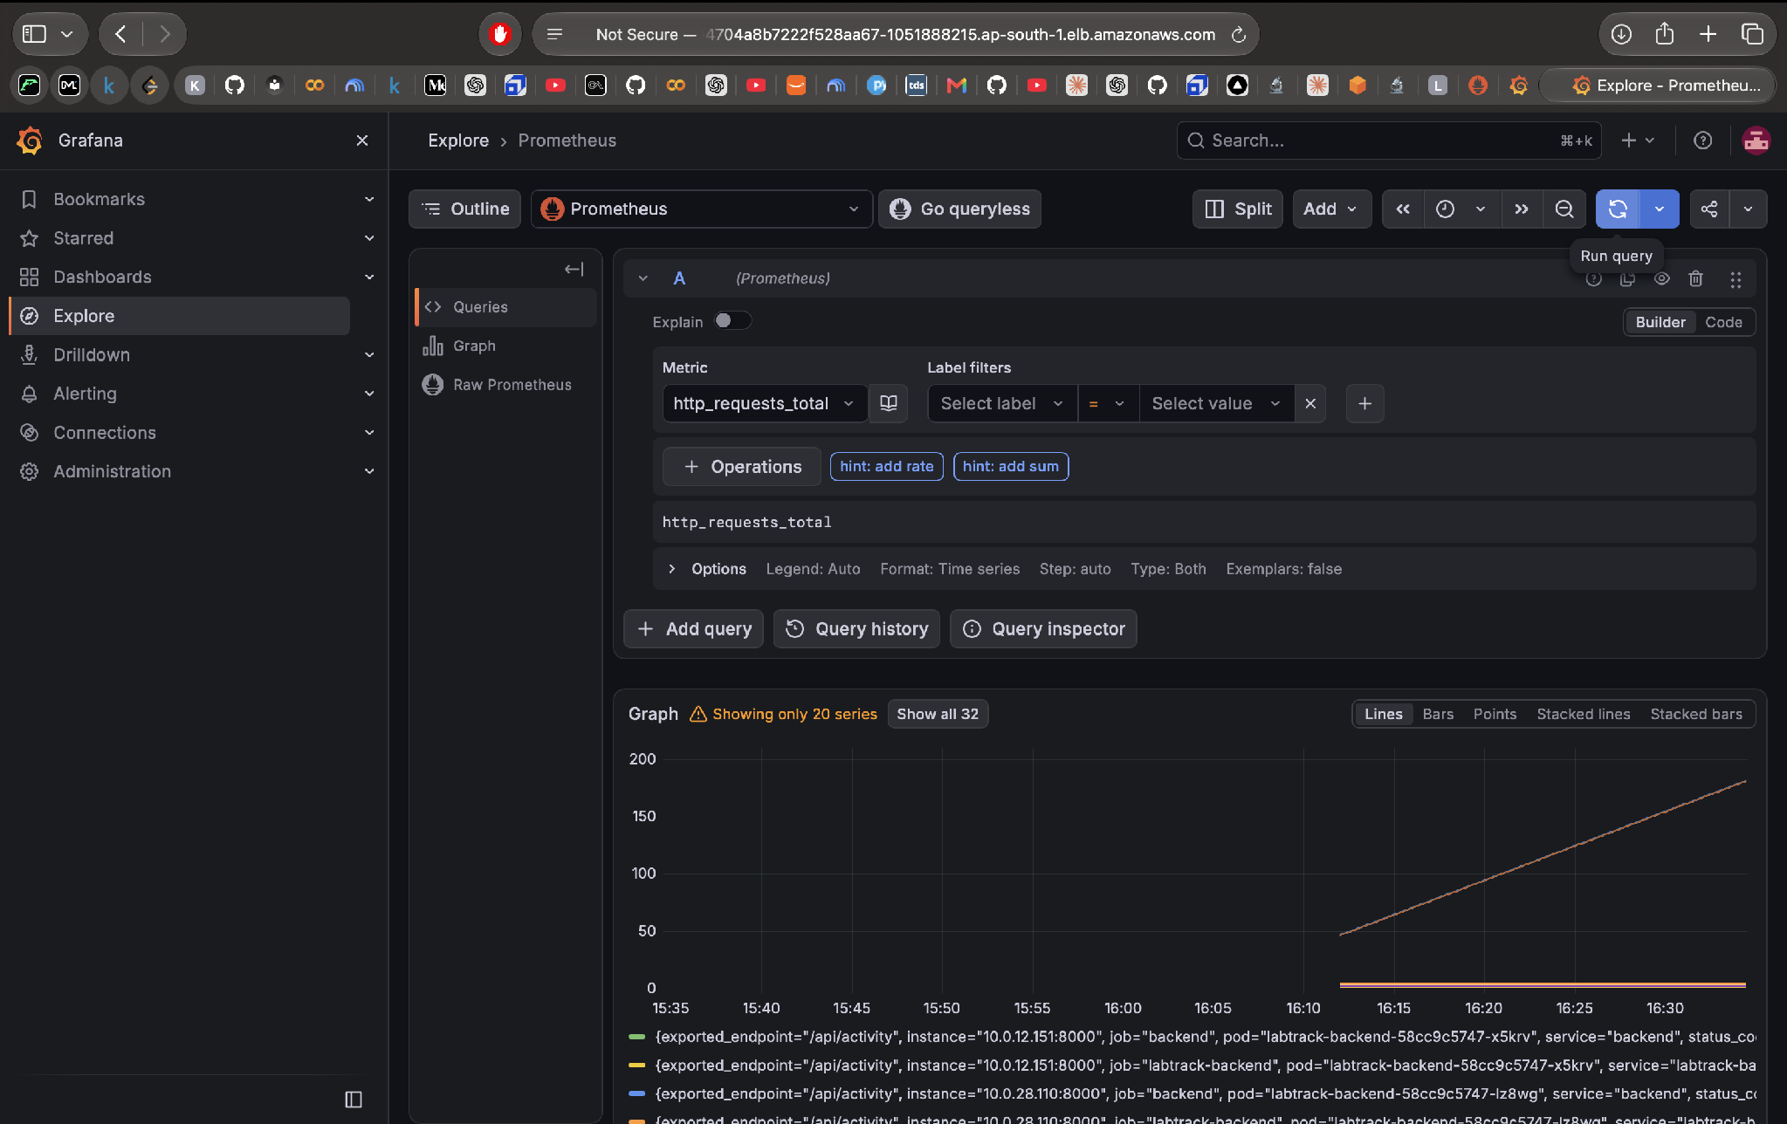
STEP 7 · MONITORING
Grafana Panels — Throughput & Latency
Granular panel analysis of incoming HTTP traffic volume and endpoint response times.
Panel: HTTP Request Throughput (req/s)
Traffic Volume
27 / 30

Slide 27
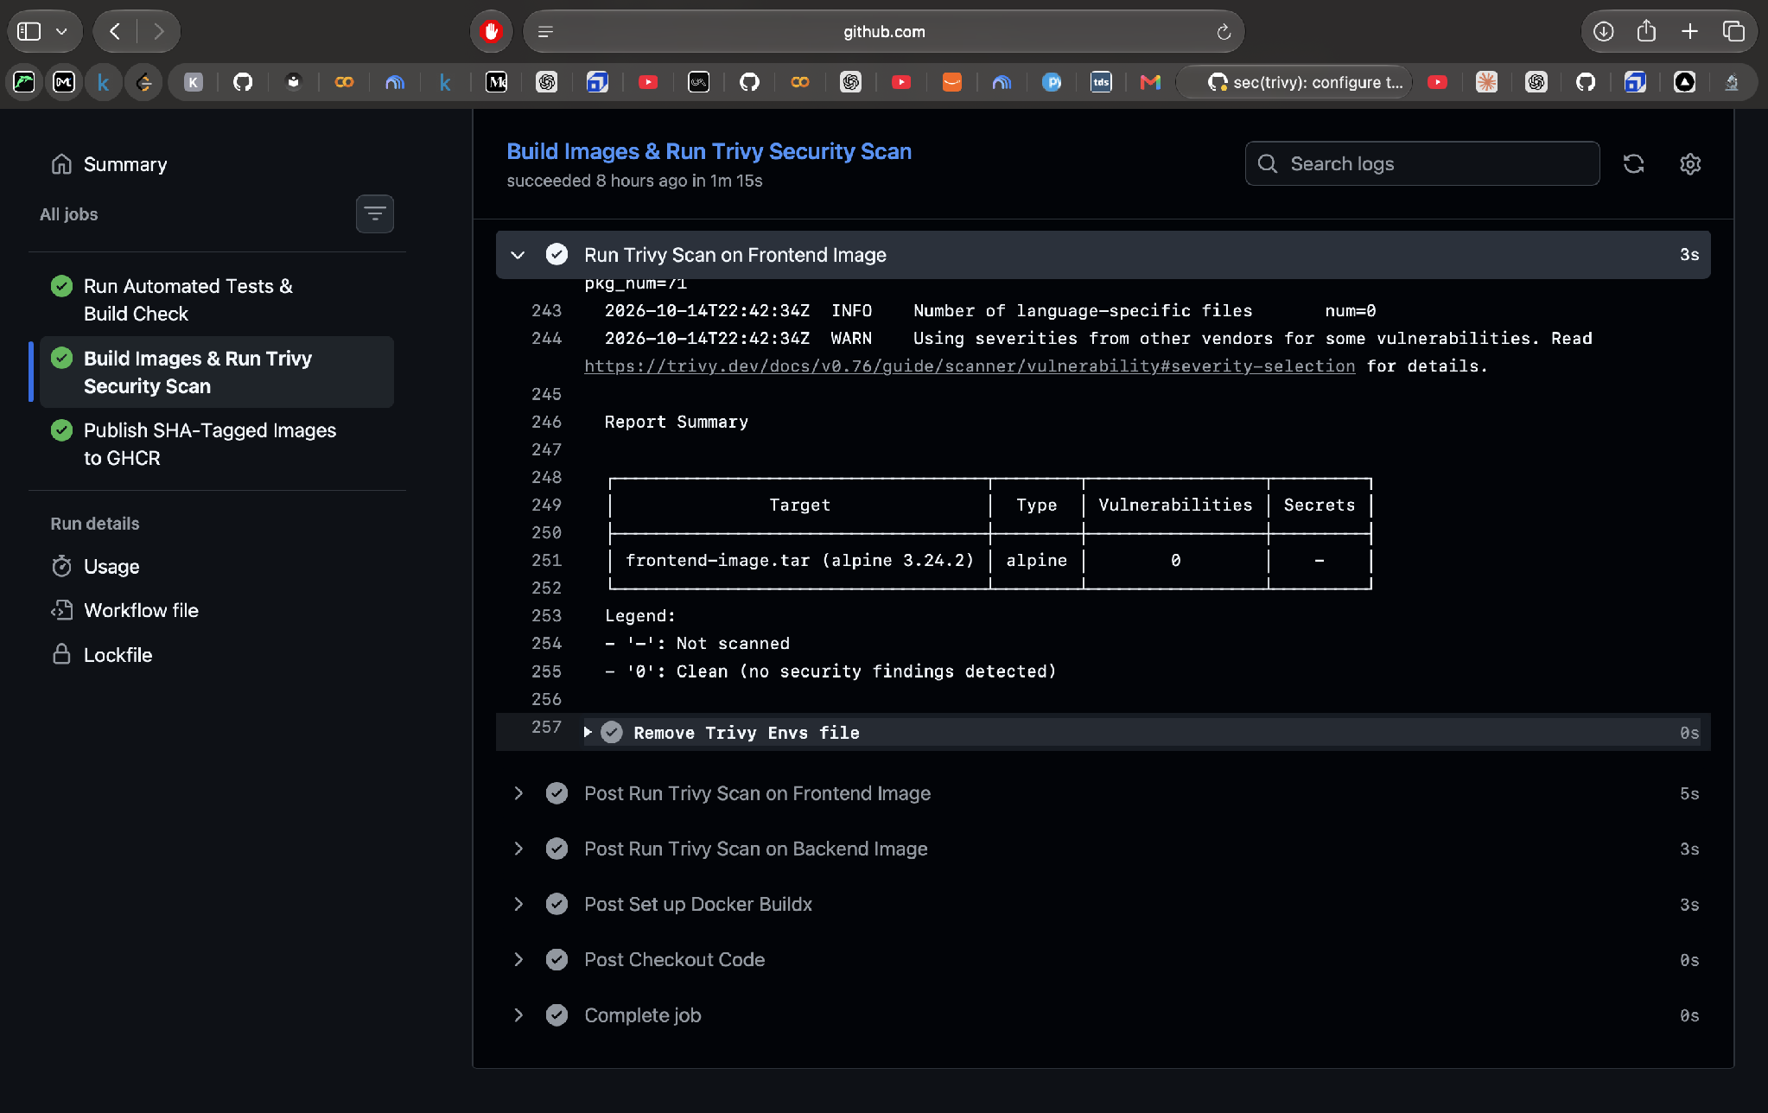
SECURITY
DevSecOps — Automated Vulnerability Scanning
Trivy scans container images layer-by-layer before deployment, enforcing security by design.
Trivy CVE Vulnerability Scan Log
Severity Audit
SECURITY GATES
🛡️ Shift-Left Security
Security audits happen during code build, not weeks after production release.
🛡️ CVE Database Matching
Trivy checks base OS packages and Python libraries against global CVE registries.
🛡️ Critical Threshold Gate
If any CRITICAL vulnerability is uncovered, the pipeline fails and stops deployment.
🛡️ Zero Manual Compliance
Audit logs remain permanently attached to GitHub Actions builds for security reviews.
28 / 30

Slide 28
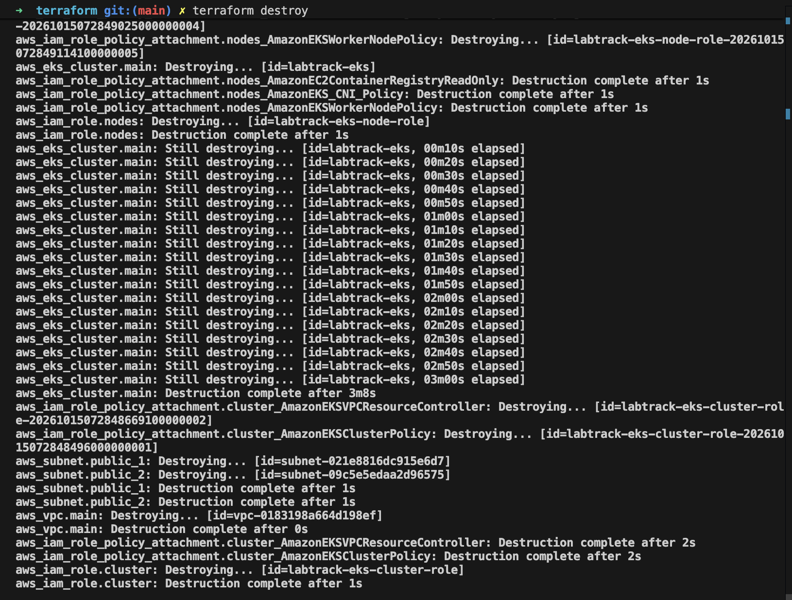
LIFECYCLE
Clean Teardown — Zero Cloud Waste
Destroying cloud resources automatically with terraform destroy to prevent idle cloud billing.
terraform destroy • Clean Cloud Teardown
Destroy Complete
CLOUD COST HYGIENE
🧹 Zero Idle Billing
NAT Gateways, Load Balancers, and EC2 nodes are fully terminated after demo.
🧹 No Orphaned Resources
Terraform state tracks every dependency; leaves zero dangling disks or unattached IPs.
🧹 True Reproducibility
Proves that the codebase contains 100% of the instructions needed to recreate the cluster.
🧹 Production Discipline
Demonstrates professional DevOps maturity: deploy quickly, observe clearly, clean up completely.
29 / 30

Slide 29
DEVOPS EXCELLENCE
Thank You
Successfully demonstrated a complete production-grade DevOps lifecycle:
Code ➔ Containers ➔ CI/CD ➔ IaC ➔ Kubernetes ➔ Observability
FastAPI
React
Docker
GitHub Actions
AWS EKS
Terraform
Helm
Prometheus
Grafana
Trivy
Mayank Soni • DevOps Final Project • Cloud & Automation
30 / 30

