Slide 1
Getting Started with MongoDB (Python Edition)

Slide 2
Import Example Dataset
Python Driver (PyMongo)

Slide 3
Import Example Dataset
Retrieve the restaurants data.
Retrieve the dataset from https://raw.githubusercontent.com/mongodb/docs-assets/primer-dataset/dataset.json and save to a file named primer-dataset.json.

Slide 4
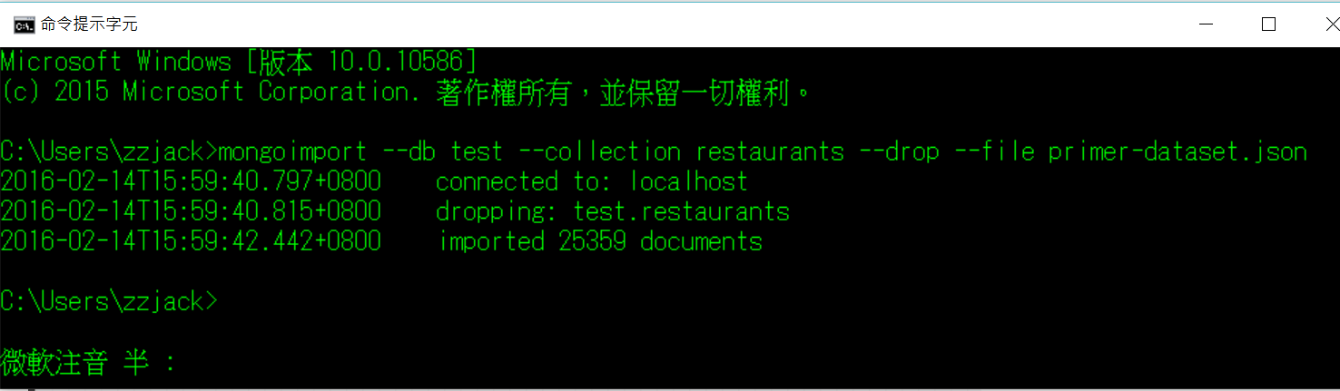
Import data into the collection.
use mongoimport to insert the documents into therestaurants collection in the test database.

Slide 5
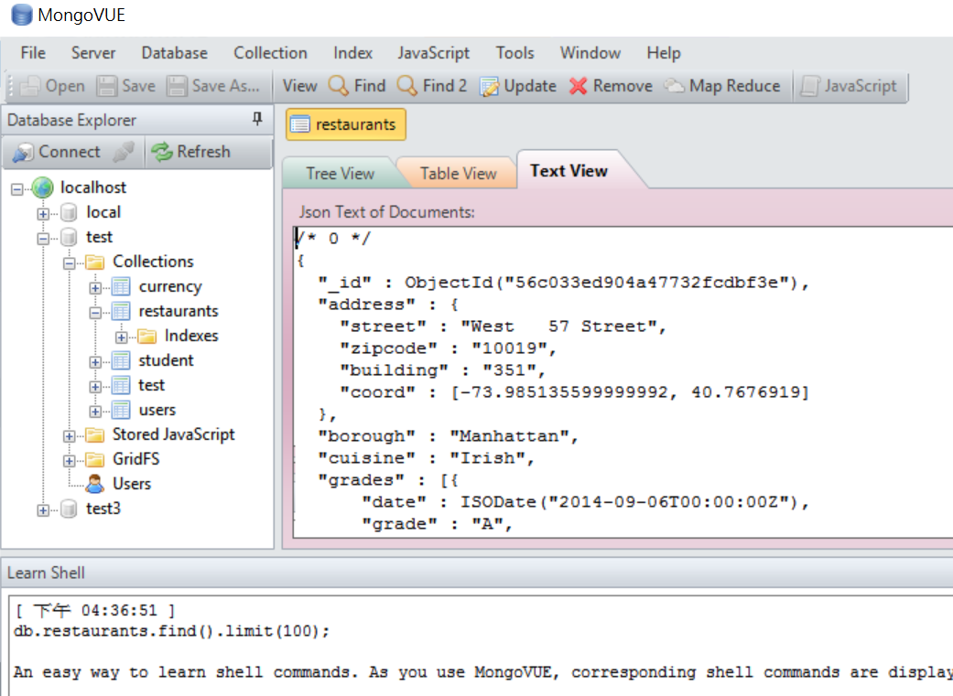
檢視結果

Slide 6
Python Driver (PyMongo)
PyMongo is a Python distribution containing tools for working with MongoDB, and is the recommended way to work with MongoDB from Python.

Slide 7
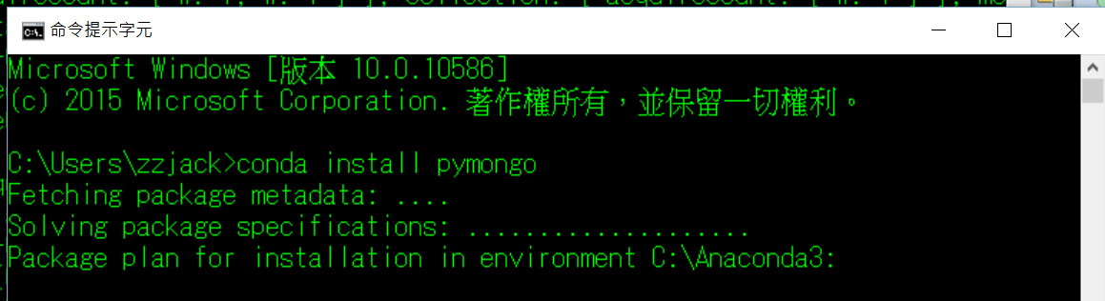
1. Install PyMongo
Windows¶
Use MS Windows installers from https://pypi.python.org/pypi/pymongo/.
Conda

Slide 8


2. Import pymongo
3. Create a Connection
If you do not specify any arguments to MongoClient, then MongoClient defaults to the MongoDB instance that runs on the localhost interface on port 27017.

Slide 9
4. Access Database Objects
5. Access Collection Objects

Slide 10
Query for All Documents in a Collection
To return all documents in a collection, call the find() method without a criteria document.
cursor = db.restaurants.find()

