Slide 1


COMP2521 – 2021 T1 – Wk. 1
MINH NGUYEN

Slide 2
Introductions
About Me
3rd Year Computer Science student
Contact
duy.m.nguyen@student.unsw.edu.au
Introducing ourselves
Name, Degree, why you chose your degree

Slide 3
Overview of COMP2521
Notes:
Data Structures
What? A way in which we organise data (many different ways) - changes the way we can insert / delete / manipulate– how fast? Memory?
Why? Different problems can be solved more effectively depending on the data structure?
Inserting something example – comparing linked lists to arrays

Slide 4
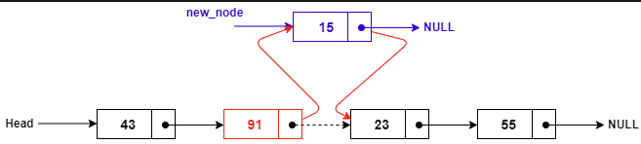
Expanding on Abstract data types from 1511 ….
e.g. Linked Lists
Explore more Abstract data types
- Why we use one over another … (e.g. time complexity)
- how to implement them …
- how to use useful algorithms involving them

Slide 5
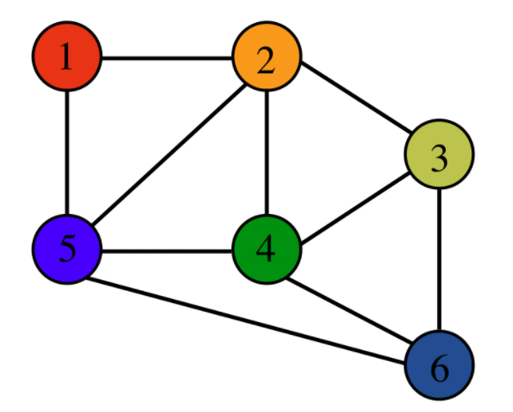
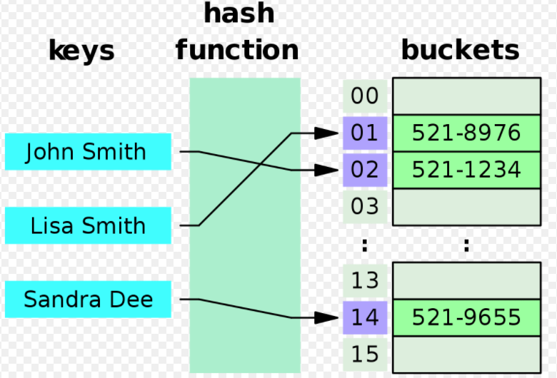
Some data structures in 2521
Graphs
Binary search tree
Hash Table
Notes:
Algorithms – core algorithms that operate on these different data structures.
e.g. linked lists insertion -> graph insertion
- Dijkstra's algorithm – shorted path from a to b
Add another slide giving example / usefulness (google maps and graphs) (how tf would you use a linked list / array)

Slide 6
New C Syntax
Notes:
Stuff C related that might come up more often in 2521, not used as much in 1511 that may be useful.

Slide 7
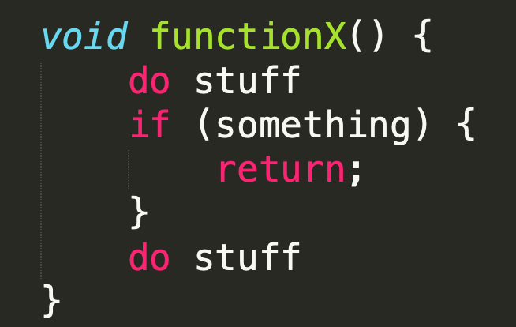
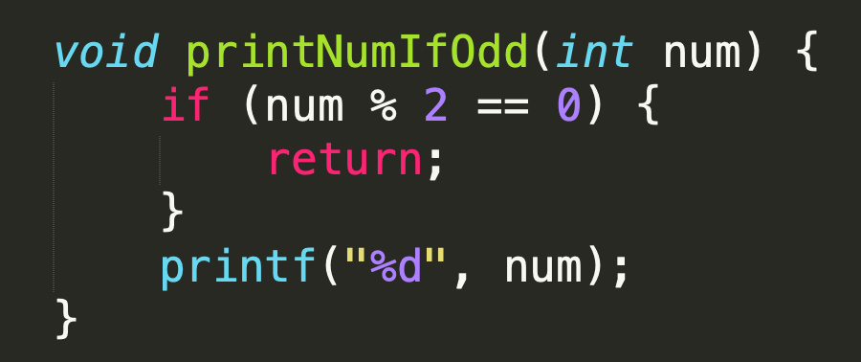
Exiting Function (Return)
Notes:
(fix this slide, int function must return an int)

Slide 8
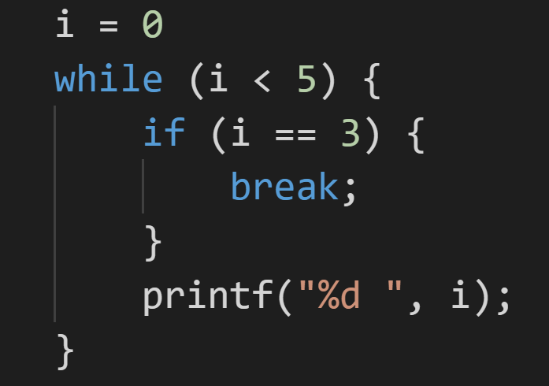
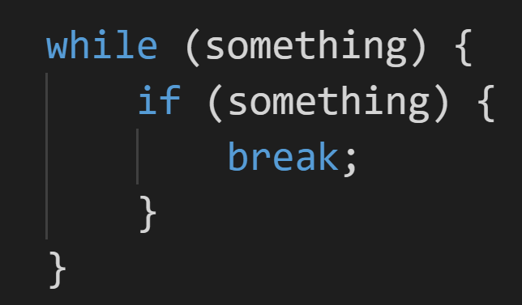
Exiting Loop (Break)

Slide 9
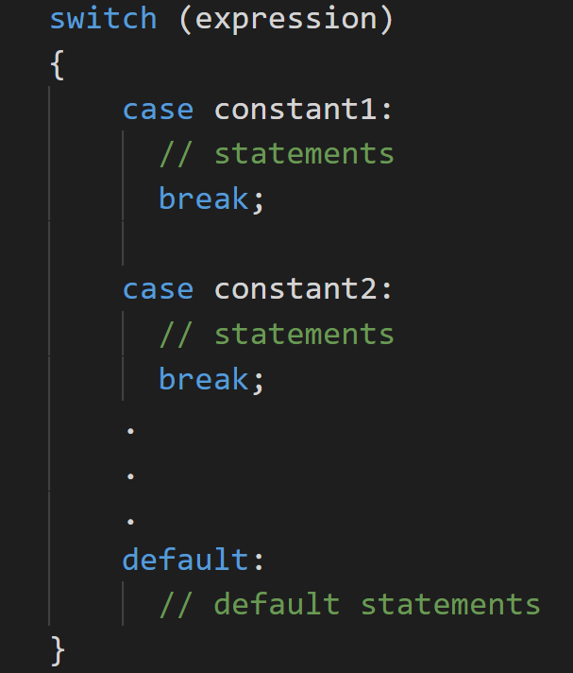
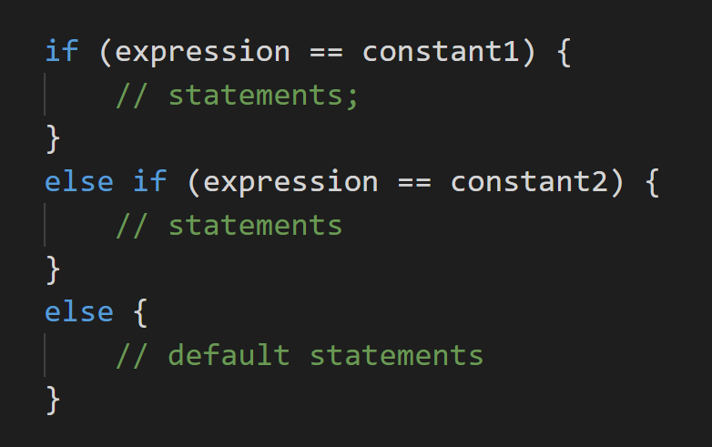
Switch Statements

Slide 10
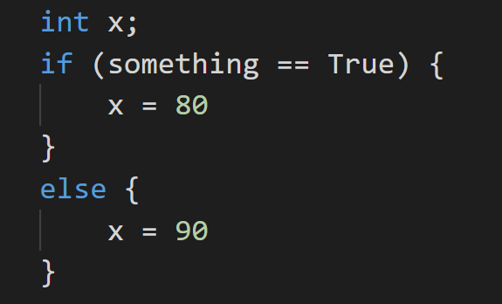
Ternary Statement (?:)

Slide 11
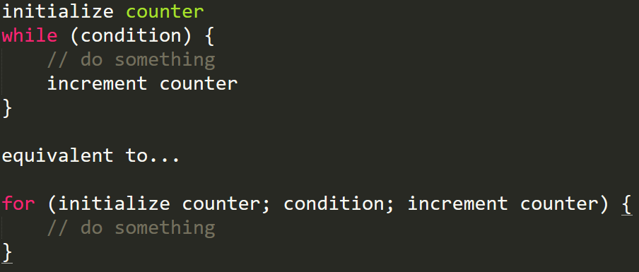
For Loop

Slide 12
C Revision

Slide 13
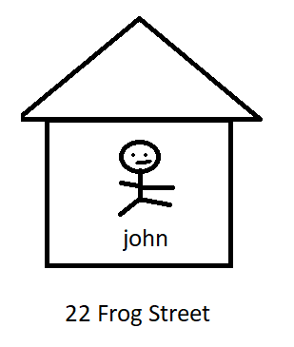
Pointers
Data type that “points” to something else
Stores the address of something else
- Can access/change value by “dereferencing”
Notes:
Int * is a type!
Int * can only store addresses that point to an integer Int can only store an integer

Slide 14
Int X = 100
&X = 0x0001123
Int *Y = &x
X = 100
Y = 0x0001123
Print(Y) = 100
*(Y) = 200
X = 200
Notes:
&X = address of X
Y points to address of X
*(Y) is dereferencing – showing what Y points to

Slide 15
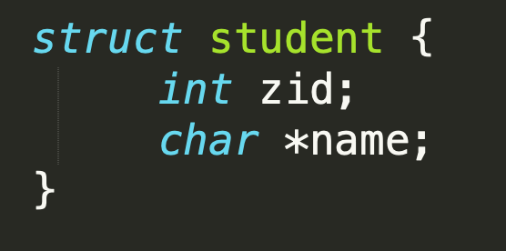

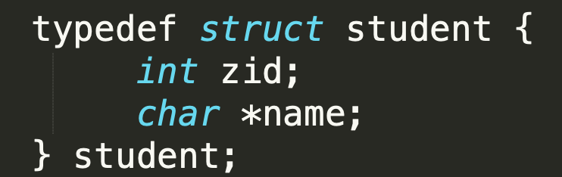

Structs and Typedefs
Notes:
Wen you want to create your own datatypes

Slide 16
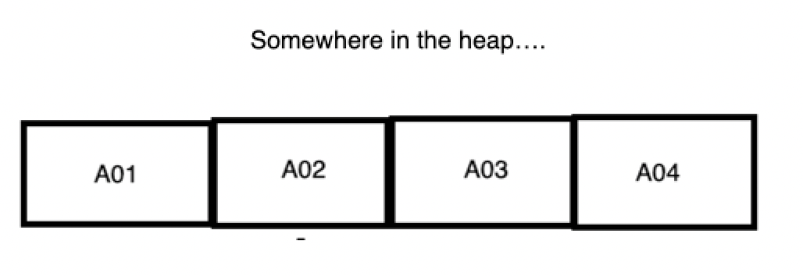
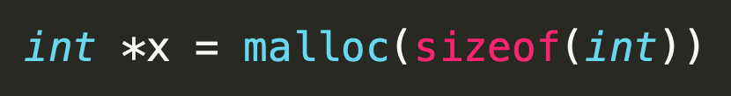
Malloc
X = A01
(*X) = 150
Notes:
- Malloc(n) -> allocates n bytes of memory, returns a pointer to the first byte of the allocated memory block

Slide 17
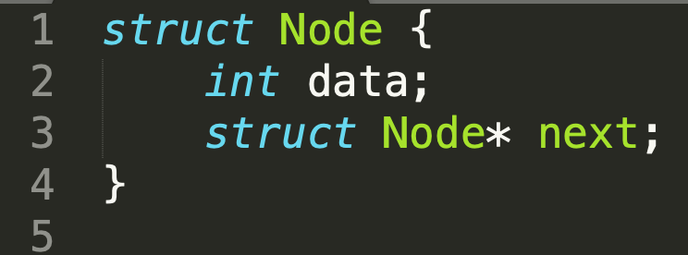
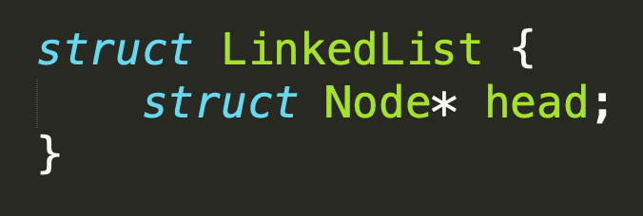
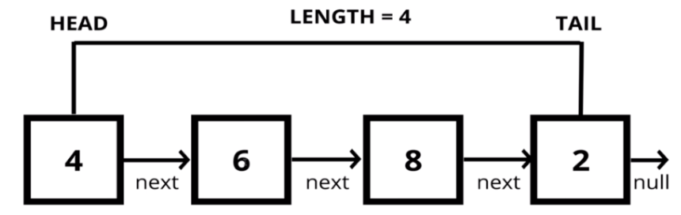
Linked Lists
To access elements in a struct Node *
e.g. struct Node *x
equivalent to
*(x).data x->data
*(x).next x->next

Slide 18
Help
Email - duy.m.nguyen@student.unsw.edu.au
Ask in lab / tutorial
Notes > Forums (look / ask) > email me / tutor

