Slide 1
DROIDKAIGI 2026 · TOKYO
Android Platform / Audio Techniques
Android Gets a Voice
Building Real-Time Agents
CONNECT
LinkedIn:
https://www.linkedin.com/ln/mark-j-wickham
ASSETS
Github:
https://www.github.com/m15-ai/droidkaigi2026
Mark Wickham
Notes:
Hello everyone!
I’m Mark Wickham, from Dallas Texas.
I am very happy to come to Tokyo and meet you, and talk about Android Voice systems.
My session is “Android Gets A Voice!”
Just a quick background on myself, I worked in Beijing for many years as the Engineering Manager at Motorola.
That is when I got introduced to mobile development and Android --- since the very beginning.
Two important things before we get started,
First, I invite you to Connect with me on LinkedIn. Here is my account
And Second, here is the link is the Github Repository for ALL of this session assets.
It includes the slides, the important files, and all of the complete code for the 3 Android apps we will build.
[Exit and show the Github page]
This is the high level Github repository.
We can see a summary of all the repositories here. Also, these slides are included in the slides folder.
The presentation time is very short., I have to keep a fast pace to get through all the materials, but I’m happy to help you after this session if you have any questions.
So, Let’s get started !!

Slide 2
The Future is Voice …
Voice input is 4x faster than typing
Voice carries emotion
Voice is immediately recognizable
Voice is simple, only need a mic and speaker
Powerful LLM’s can chat with us
Coding agents — it’s now easy to create complex software
… and our Android devices provide the perfect platform to express it !
DroidKaigi 2026 · Tokyo
2
Notes:
I am passionate about voice systems. I have been building them for many years.
I believe that Voice is the future, and there are several important reasons I wish to share with you.
Voice input is 4 times faster than typing.
Voice can carry emotion
Voice is immediately recognizable
Voice is simple, we only need a mic and a speaker
LLM, an exciting new development
Coding agents make it simple to create the complex systems
And the best part …. Our ANDROID devices are the perfect platform to realize these systems.

Slide 3

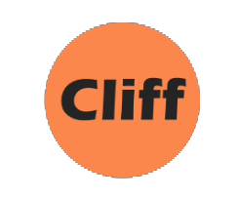
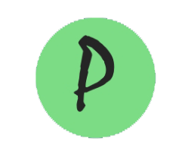
What We Will Cover
①
Coding Approach
③
Three Voice Architectures
Coding Agents
Voice Requirements Markdown Template
Google Voice Pipeline
Completely on-device No Cloud, No Network.
Local
Cloud
API key management
WebSocket streaming
Multi-Lingual (Japanese)
②
Voice Fundamentals
Pipelines, Latency, Streaming
Streaming, Echo cancel
Connectivity, Barge-In
Agentic
Android Pipecat Client WebRTC streaming “Homer” OpenClawAgent
Notes:
Here is our AGENDA, there are 3 parts
Part 1 includes my Coding Approach: I will describe how I create Android Voice apps using coding agents and markdown templates
Part 2 is the Voice Fundamentals: I will introduce you to the important fundamentals of voice systems
Part 3 includes 3 complete voice architectures and we will create an Android app to demonstrate each one.
The first app is GVP, which stands for Google Voice pipeline.
It is a completely on device voice system which does not require any external device connection.
It is amazing that we have the capability to create his system LOCALLY.
The second app is called Cliff. It’s named after my Grandfather.
Cliff is a CLOUD based voice app which uses state of the art cloud models to accomplish the voice pipeline functions.
Moving functions to the cloud allows us to create more powerful voice systems, because we can use stronger LLM Models.
I will show you how to implement the required network functions, including security token management considerations.
And we will speak to Cliff in Japanese, to demonstrate multilanguage agents.
The 3rd app is called Pipecat Client, or Pica. Pipecat is a powerful audio framework.
The Pica app will let us create powerful AI voice Agents on Android.
Our Pica agent will be Homer, a baseball expert who loves the MLB., the Dodgers, and Shohei,
When we speak to Homer, we will ask him how the Dodgers played last night.
The complete code for each of the 3 apps is on the Github. If one of these approaches matches your requirements, you can easily adapt them for your own use case.
So, let get started!

Slide 4
Coding Approach
DroidKaigi 2026 · Tokyo
Notes:
I want to introduce you to my coding approach. It’s such a fast-moving area in Android Development with the rise of the very helpful coding agents.
EXCITING NEWS: We are living in a new world where we no longer have to write code ourselves.
Everyone has their own approach.
This is how I build Android voice apps. I built all 3 of the Android voice apps for this session using this approach.
I didn’t directly write the code myself; I simply told my coding agent what to write using a detailed markdown file template I created for voice systems.
In Android Studio, I ask Claude, my coding agent to “SCAFFOLD” the app from my markdown file.
Of course you could also use Code or Gemini or even open source models to write your code.
With these new coding agents, everyone is figuring out their own way forward,
I encourage you to discover your approach by talking and sharing with other developers.

Slide 5
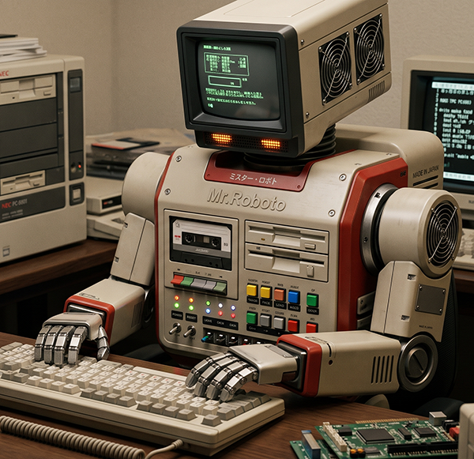
Coding Agents: Architect, Don't Code
Our job shifts from writing code to making decisions.
My process to create Voice Apps on Android
①
Define requirements using structured template
②
Feed the template to your coding agent
③
Ask the Agent to “scaffold” the App
④
Review & iterate
Android_Voice_App_Requirements_Template.md
We can realize a working app in just a few hours !
Notes:
AI Coding Agents help us to be more PRODUCTIVE.
With helpful coding agents, we can think of ourselves as SOFTWARE ARCHITECTS
Our job is to guide the coding agent.
Here is the 4 step approach I follow:
Step 1 : Define the requirements
Step 2: Feed the requirements to your coding agent
Step 3: The Agent Scaffolds the App in Android Studio.
Step 4: Review and iterate
Using this approach, I have been able to build working app in just a couple hours.
After you have 1 app working, you can use that as a base for future apps.
Now let’s take a look at the Markdown file.

Slide 6
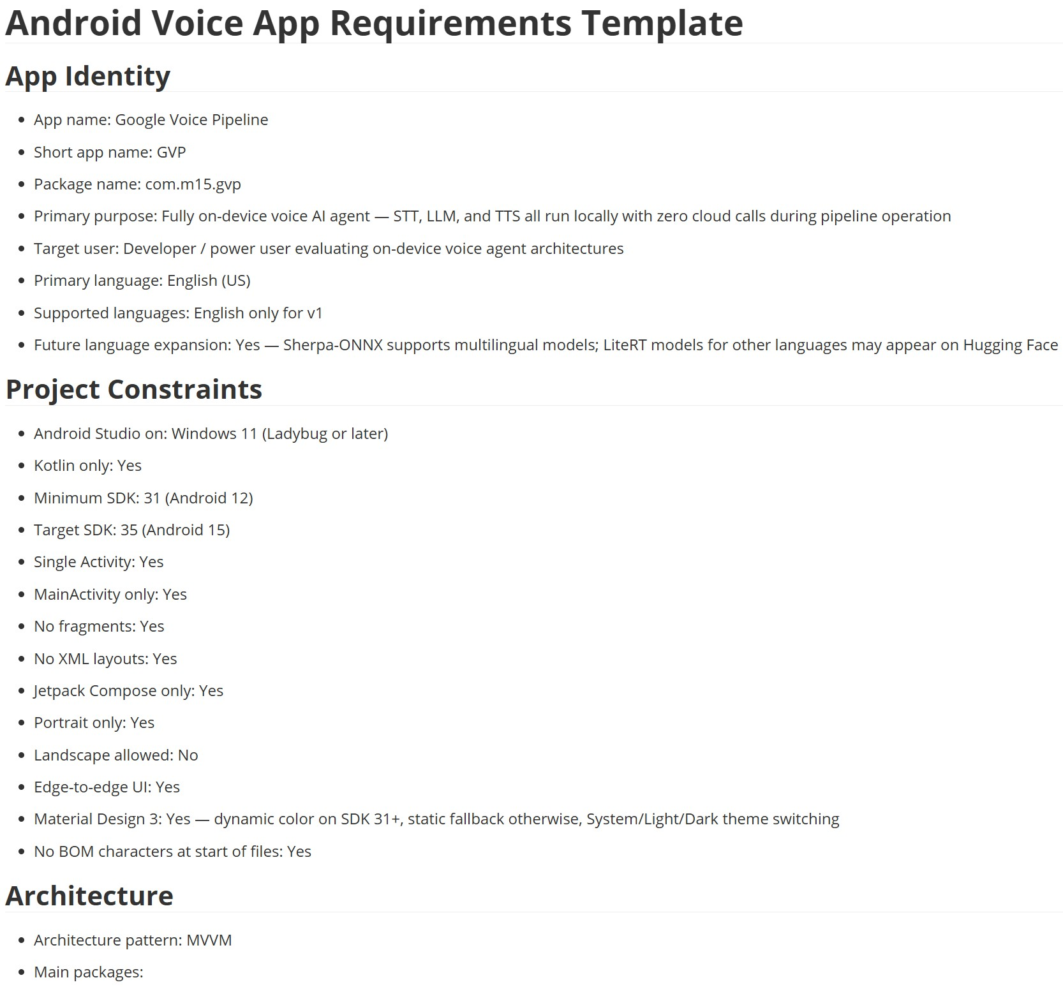
Android_Voice_App_Requirements_Template.md
Notes:
Here is a snapshot of the GVP app requirements markdown template file.
It’s a Markdown file with the .md extension.
Let’s take a closer look at the most important parts.
[Exit to the Github desktop]
Let me open the markdown file, and I will point out some of the important sections.
You can see in this GVP version, I have ALL of the sections are completed.
You don’t need to complete all of the sections to be able to get your coding agent to SCAFFOLD your new voice app.
If you have a basic idea of what your want your voice app to do, you can just complete those partial sections, and your coding agent will be able to scaffold your app in Android Studio.
When you have an idea for a new app, try to complete as much as you can.
I recommend completing the App Identity, Project, and Architecture sections at the top.
Notice for the Architecture: I always use MVVM, which stands for Model View, View Model.
It is also very helpful if you can complete the Voice Pipeline sections, which includes the STT, the LLM, and the TTS.
We will discuss those next in … [Next Slide] … Voice Fundamentals

Slide 7
Voice Fundamentals
DroidKaigi 2026 · Tokyo

Slide 8
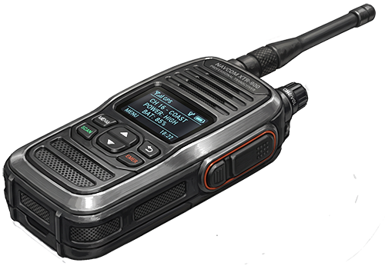
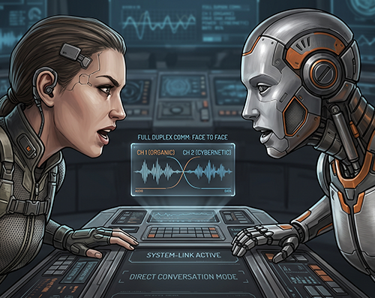
Realtime Voice ▬
“Feels Like a Real Conversation”
Turn-Based Voice
The shift to REAL-TIME
✗ Tap to speak ✗ Wait for recognition ✗ Wait for LLM response ✗ Wait for TTS playback ✗ No interruption possible
✓ Continuous Streaming — no wait
✓ Full Duplex ✓ Token-Streaming LLM responses ✓ Low-latency TTS playback ✓ Full Barge-In / interruption
Concept | Description
WebSocket | A consistent two-way connection for continuously streaming audio, transcripts, and AI responses.
WebRTC | A real-time media protocol optimized for low-latency and voice communications
Packets | Delta packets are incremental updates of text or audio, streamed as the model generates it. Final packets are the completed stable result, such as a completed transcription or LLM response.
Turn Detection | Detecting when the user has completed speaking and the agent can process.
AEC | Automatic Echo Cancellation, Hardware implementation cancels the speaker output from mic input
Barge-in | The ability for our pipeline to detect and handle interruptions.
Notes:
Let’s define what we mean by REALTIME STREAMING FULL DUPLEX VOICE
Everyone can remember the “Walkie Talkie” – which enabled half duplex radio communications.
“Walkie Talkie” is a PTT system, You had to “Push-to-Talk”.
When we build modern voice systems, we are shifting from TURN-BASED voice to REAL-TIME voice.
We want to build systems the “FEEL LIKE A REAL CONVERSATION”
To STREAM audio, we need some special protocols and concepts:
WebSocket and WebRTC are streaming protocols we can use for voice systems.
These protocols pass packets over a network at high speed, we can refer to these as Delta, and Final packets.
You will see, the Cliff app uses WebSockets, The Pica app uses WebRTC. The GVP app is LOCAL and lives complete on device.
Turn Detection is an important part of the voice system, it determines when we send prompts to the LLM for processing.
AEC is how we prevent the speaker output from leaking back into the microphone. In our apps it is implemented by the Android device, and the Pipecat protocol, we’ll talk more about that later.
Barge-in is how we listen for interruptions and take action to stop any TTS output from playing. This contributes to the “Feels like a real conversation”

Slide 9

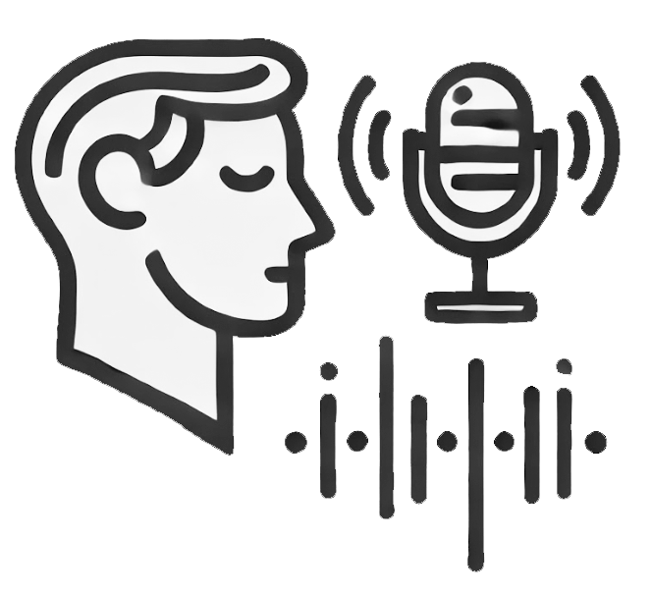



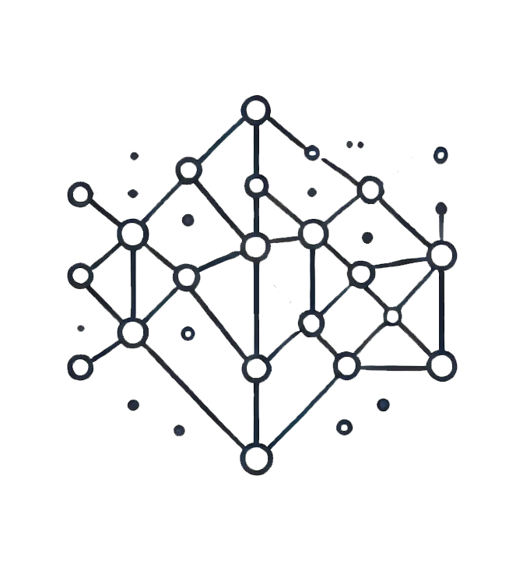
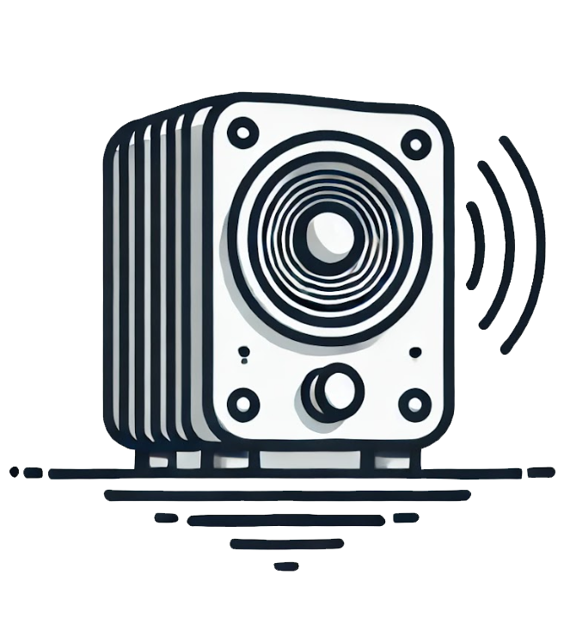
Conversational AI Architecture (Realtime, Full Duplex, Streaming)
Voice In
Speech-to-Text
Open Claw Hermes Agent
Text-to-Speech
LLM
Audio data (AudioTrack)
ML Kit Gen AI
Sherpa-ONNX
Whisper OpenAI
Deepgram
VOSC
Audio data (AudioRecord) (16 kHz PCM)
Streaming “Deltas” of User’s Text
Eleven Labs
Cartesia
Piper
Android TTS
Streaming “Deltas” of LLM Response
• Latency • Accuracy • Turn Detection
OpenAI
Anthropic
Google Nano (AICore)
Media Pipe
XAI Local (Ollama)
• Voice Characteristics
Model
Agent Framework
• Key Concern
• Latency • Capability • Cost
Voice Out
DroidKaigi 2026 · Tokyo
Notes:
This is the Conversational AI Architecture.
Each of the 3 apps I will present follow this basic Architecture.
We call this approach a “Pipeline” architecture.
In the diagram, the AI MODELS are shown in GREEN boxes, and the AGENTIC FRAMEWORK is shown in BLUE.
Starting top left, VOICE IN, is captured by the microphone on the Android device by the AudioRecord class, and is sent to the Speech-to-Text model.
The STT model converts the audio to text, which is then sent to the LLM.
When we communicate to LLM;s we submit PROMPTS, and we receive back COMPLETIONS.
The COMPLETION text is sent to the TTS model which returns audio we can play on the Android device using the AudioTrack class.
The TEXT and AUDIO flow through this system in the form of Delta Packets.
Key Concerns are highlighted below of the 3 models.:
For STT, we are mostly concerned about Latency, Accuracy, and Turn Detection
For LLM, we are mostly concerned about Latency and Capability
For TTS, we are mostly concerned with Voice Selection to match our user application.
You can see that Latency is a COMMON concern.

Slide 10
VOICE PIPELINE PERFORMANCE
Latency
Stage | Time (ms)
Hardware Mic Capture | 40
Opus Encoding | 21
Network Stack & Transmit | 10
Packet Handling | 2
Jitter Buffer & Opus Decoding | 41
Transcription (STT) & Endpointing | 300
LLM TTFT | 650
Sentence Aggregation | 20
TTS TTFB | 120
Opus Encoding | 21
Packet Handling | 2
Network Stack & Transmit | 10
Jitter Buffer & Opus Decoding | 41
Hardware Speaker Output | 15
Total | 1293
Makes or breaks your voice app — the true feel of the experience.
TTFT = Time to First Token
Target for voice systems —
~1,000 ms
Each Demo App has a Latency
Class to measure this Critical Value
Source: "Voice AI and Voice Agents" — Pipecat
Notes:
Let’s talk about Latency.
Latency is the single most important benchmark for voice systems.
It can “make or break” our voice app.
On the right side of this slide is a typical expected latency profile for a complete “turn” of a voice app.
You can see that the 3 largest contributions are the 3 models, STT, LLM, and TTS.
We will define the concept of TTFT, or Time to First Token.
TTFT is the measured time between when the STT detects a turn, Sending token to the LLM, and when the LLM sends back its first completion token.
It is the 2 combined Blue Colored cells in the chart.
The goal is a TTFT target of 1,000 mill-sec.
Each of the 3 Apps I am presenting has a latency class to measure the TTFT.
Next, let’s take a closer look at the role of the LLM in Latency.

Slide 11
CHOOSING YOUR MODEL
LLM — the Voice AI Brain
LLM | Median TTFT (ms) | Cost/ 3-Min
GPT-4.1 | 536 | $0.32
GPT-5.1 | 739 | $0.10
Gemini 2.0 Flash | 380 | $0.004
Gemini 2.5 Flash | 597 | $0.002
Gemini Nano |  | —
Llama 4 Maverick | 290 | —
Claude 4.5 Haiku | 637 | $0.006
Claude 3.7 Sonnet | 1,410
Claude 4.6 Sonnet | 850 | $0.018
Kimi 2.6 Cerebrus | 452
Grok-4-fast
Qwen
Nemotron 3 Ultra | 541
The LLM is the perceived intelligence of your Agent.
Most widely used models for voice agents are GPT-4.1, GPT-5.1, and Gemini 2.5 Flash.
Avoid Reasoning models.
Not all models are optimized for latency (Sonnet 3.7 ☹).
It’s Always a Tradeoff
Source: "Voice AI and Voice Agents" — Pipecat
DroidKaigi 2026 · Tokyo
Notes:
The LLM is the Brain of our Voce AI System.
There are many popular models we can choose from.
As I mentioned before, the most important factors when choosing your LLM are Latency and Capability.
Of course, there is a third factor we should consider, Cost.
The chart on the right shows some of the popular models and their latency and cost estimates.
Keep in mind, the costs shown here are only for the LLM, you also should consider the cost for your STT and TTS models, which are generally lower.
When choosing the LLM Model, It’s always a TRADEOFF: A more powerful model generally means higher cost and slower latency.
Compare the Claude 4.5 and Claude 4.6 models, 4.5 Haiku is 1/3 the cost and has a faster TTFT, but of course, it’s not as powerful.
When we implement “Homer” the Baseball agent, I will choose GPT-4.1 because of its power.

Slide 12
Architecture Tradeoffs
Dimension | Local (GVP) | Cloud (Cliff) | Agentic (Pipecat)
Pipeline runs | On device | Cloud providers | Pipecat server
Network | None (fully offline) | Always (WebSocket + HTTPS) | Always (P2P WebRTC)
STT | ML Kit GenAI, Sherpa-ONNX | Deepgram flux-general-multi | Deepgram Nova-3 (server)
LLM / Brain | AI Core Nano, MediaPipe(LiteRT) | Claude Sonnet 4.5/4.6 | OpenClaw (GPT4-1)
TTS | Android TextToSpeech | Deepgram Aura-2 | Cartesia Sonic-2
Latency | Sub-650ms (device HW) | ~700-1500ms (network) | ~850ms (GPU baseline) + Tools
Target | minSdk = 31 | minSDK = 26 | minSDK = 26
Auth model | None needed | Ephemeral tokens | None (trusted network)
Best for | Privacy, offline, zero cost | Best quality, production | Agent frameworks, tool calls, memory
Client complexity | Full pipeline on device | WebSocket + SSE streaming | Thin — mic + speaker only
Common:
UI—Compose+Material 3, State—Kotlin Coroutines+Flow, MVVM, Audio—AudioRecord + AudioTrack, Storage—Room DB + SharedPrefs
The right solution depends on YOUR requirements.
Notes:
Now, let’s prepare for the 3 app with a summary.
This is a review of the key Architecture Trade-offs for each app..
KEY POINT: The RIGHT SOLUTION depends on YOUR requirements.
We will use a different Network strategy for each of the 3 apps.
GVP has No Network, Cloud uses WebSockets, and Agent uses WebRTC
We will use a different vendor’s LLM for each of the 3 apps.
Local uses Gemini, Cloud uses Anthropic, and Agent uses X/Grok
For the output voice (TTS) we will use Deepgram for Cliff, and Cartesia for Agent.
Notice we can achieve the LOWEST LATENCY on the GVP Local architecture, but at the expense of LLM Model capability.
And notice that when we use a Cloud approach for Cliff, we have to handle Token Security.

Slide 13
Local (GVP)
Completely on-device — no cloud, no network, no problem
STT
LLM
TTS
ML Kit GenAI (expr) Sherpa-ONNX (multi)
Google AI Core Nano Google ML-Kit MediaPipe
Android TTS
DroidKaigi 2026 · Tokyo
Notes:
Introducing the GVP app. It runs the voice pipeline completely on-device.
The GVP app is like a Swiss Army knife for on-device voice pipeline. It has many useful tools you can experiment with on your device.
This app represents my attempt to create the highest quality completely on-device voice pipeline possible.
Here we can see the main components of the pipeline, STT, LLM, and TTS.
The STT has 2 options, MLKit which is experimental and only on specific devices, and Sherpa which can run on most devices.
The LLM has 2 options depending on your device capability: Google Nano, or ML-Kit Media Pipe
The TTS uses Android TTS
To take a closer look at how we can configure this app, Let’s take a look at the Settings Screen of the app.

Slide 14
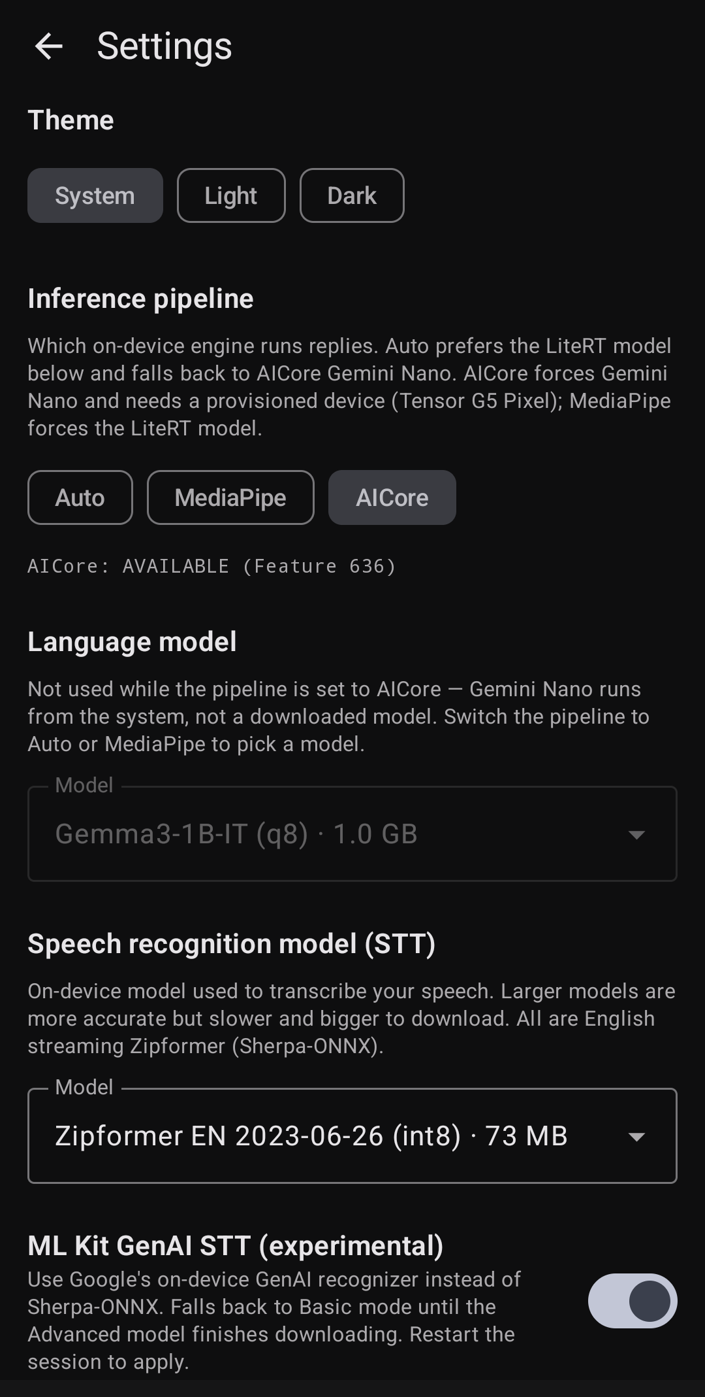
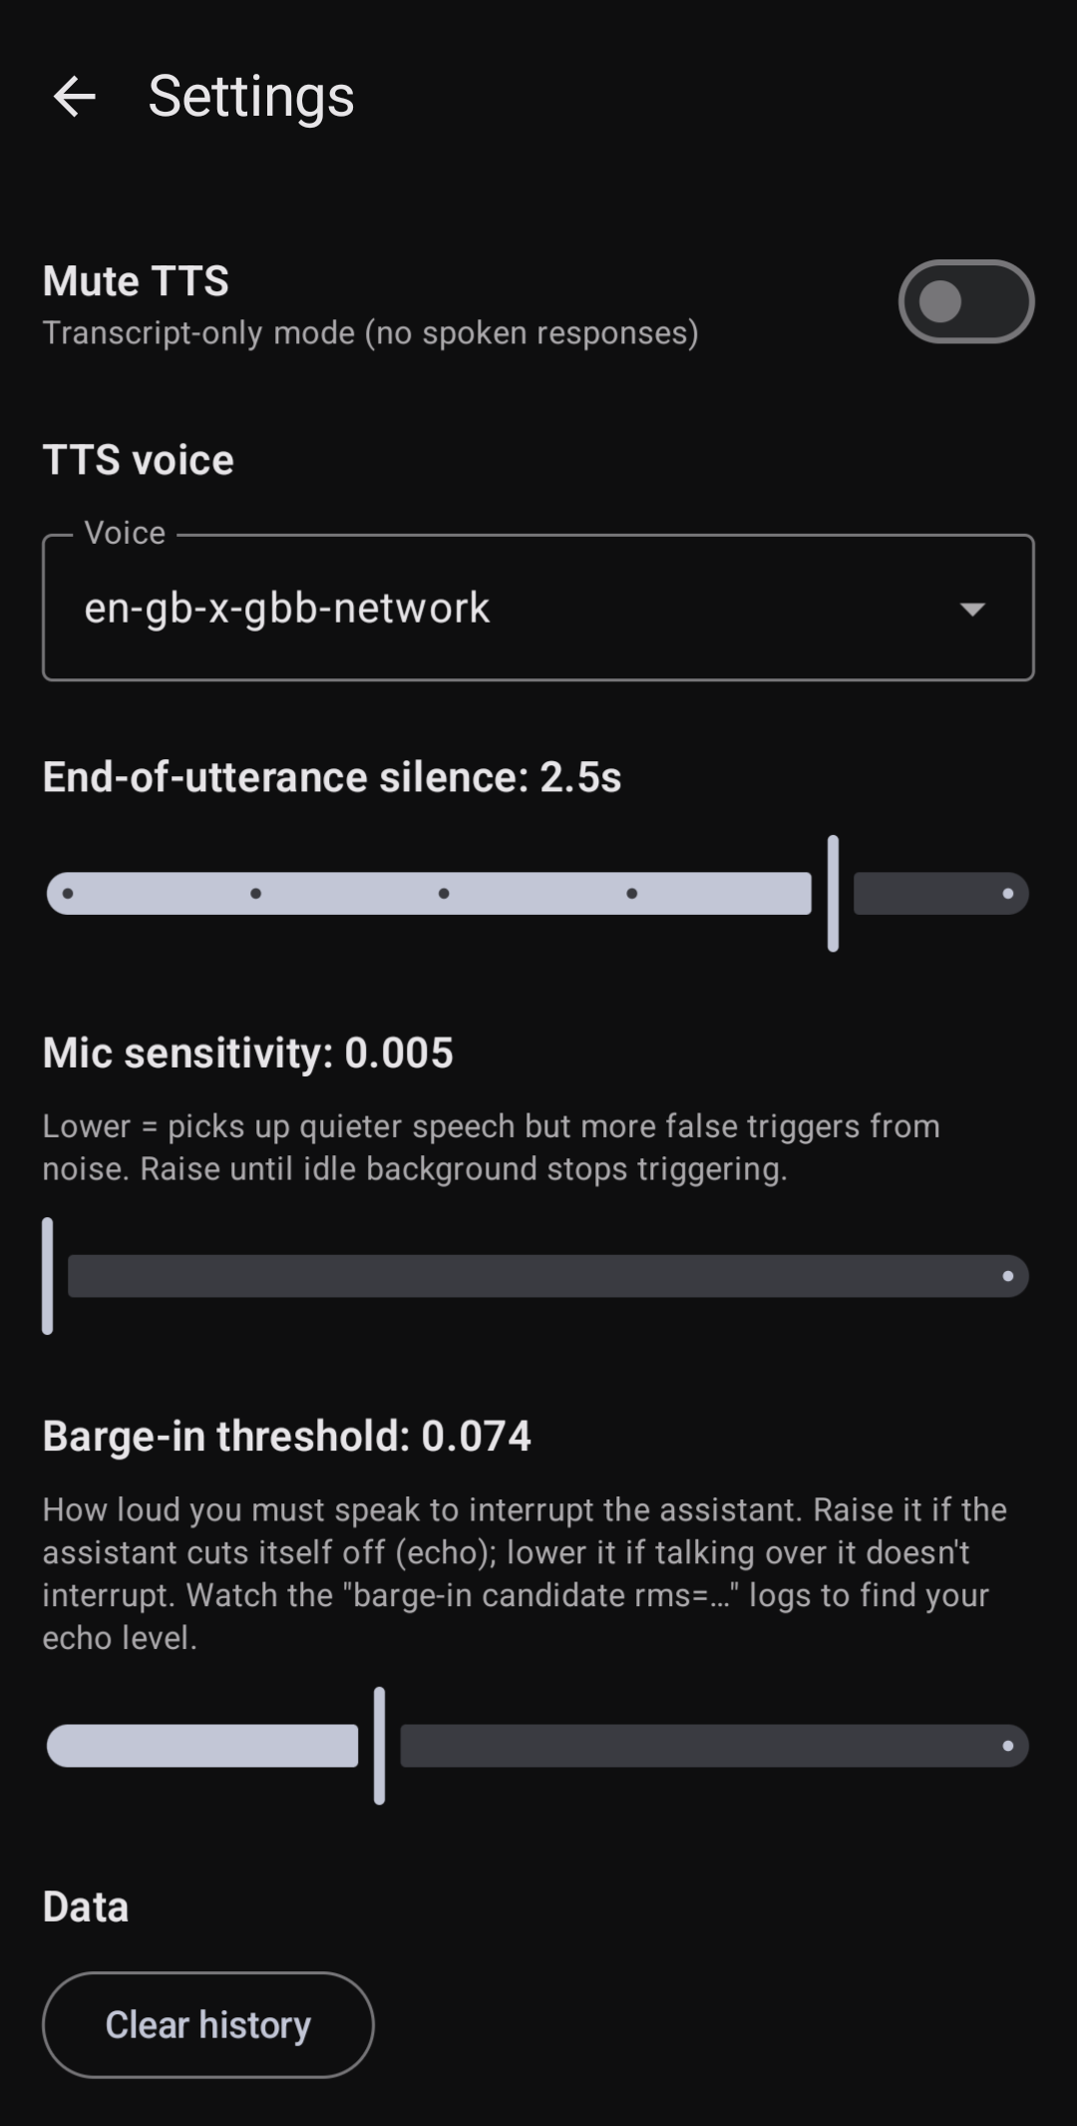
GVP App Settings
Text-to-Speech
Android TTS Selectable Voice
Inference Pipeline (LLM)
AICore for Nano (Pixel/G5)
MediaPipe Downloadable Models
Speech-to-Text
Sherpa/ONNX Selectable Models
ML Kit GenAI (Pixel/G5)
DroidKaigi 2026 · Tokyo
Notes:
Here is the Settings screen for the app --- You can see, there are many settings here.
The GVP app is the most complex of the 3 apps --- that is because everything is on device and the app supports downloadable models.
First the Inference Settings (LLM):
I am running this app on my Google Pixel 10 which has the Google Tensor G5 processor.
You can see, my device has the “AI Core: AVAILABLE (Feature 636)” indication. This is an internal Google feature number.
The app will automatically allow you to choose AICore LLM if this feature is available.
If your device cannot run AICore, you can select MediaPipe, and then download a model of your choice., such as Qwen, Phi, or Gemma3.
If you want to use Gemma3, you will need to supply a Huggingface token to validate the license agreement. The app will automatically down the model for you.
Next, the STT settings:
If you have the Pixel with G5, you can select the ML Kit STT (experimental) STT model. It works really well on device.
If not, you can choose the Sherpa/ONXX and select your model for download.
The larger models are more accurate.
And Lastly, we have the TTS settings.
This is where we select the output voice.
These voices are maintained by the Android TTS library.
At the very bottom, we have the Barge-In slider settings, Mic Sensitivity, and Bargi-in Threshhold.
These barge-in settings are device dependent, so they don’t always work great, we will see a much better barge-in performance with the cloud apps.

Slide 15
GVP App Overview
Fully Local On-Device Voice Pipeline
A complete voice loop — STT, LLM, TTS — running entirely offline on a stock Android phone.
KEY CONCEPTS
• Zero Cloud Calls — Complete STT → LLM → TTS loop runs entirely on-device.
• Privacy & Offline First — Voice and transcripts never leave the handset.
• 622 ms TTFT — Measured time-to-first-token on Pixel 10 (Tensor G5).
• Two On-Device LLMs — MediaPipe/LiteRT (any device) or Gemini Nano/AICore (Pixel).
• Model Catalog — LLMs (Qwen 0.5B/1.5B, Phi-4-mini, Gemma 1B, Gemini Nano) Downloads persist. Zero API costs after model download.
THE TRADEOFFS
• LLM Quality — Limited by on-device model size.
• Requires Expensive High-End Device — GPU and Memory for model weights
Notes:
Before we run the Demo, let’s review the key app Concepts.
Here are the HIGHLIGHTS of the GVP app on-device approach:
Zero Cloud calls
Privacy First
Fast TTFT, often < 700 ms.
Choice of LLMS is available
There are 2 main TRADEOFFS we have to accept with this on-device architecture:
1) The LLM quality is not the best, because we are limited by device capability.
However, I find the Gemini Nano model is really quite surprising, as we will see in the demo.
2) This solution using AICore and MlKit cannot run on low-end devices.
I will run the demo on my Pixel 10 so we can see them in action.

Slide 16
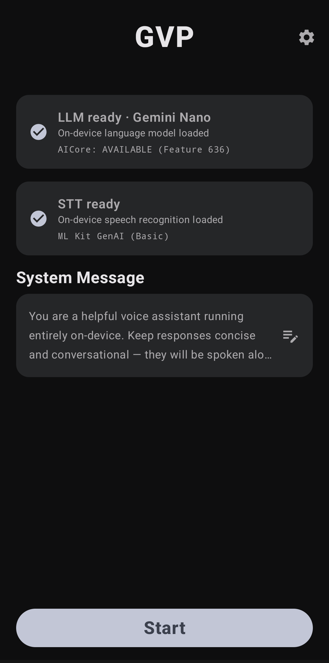
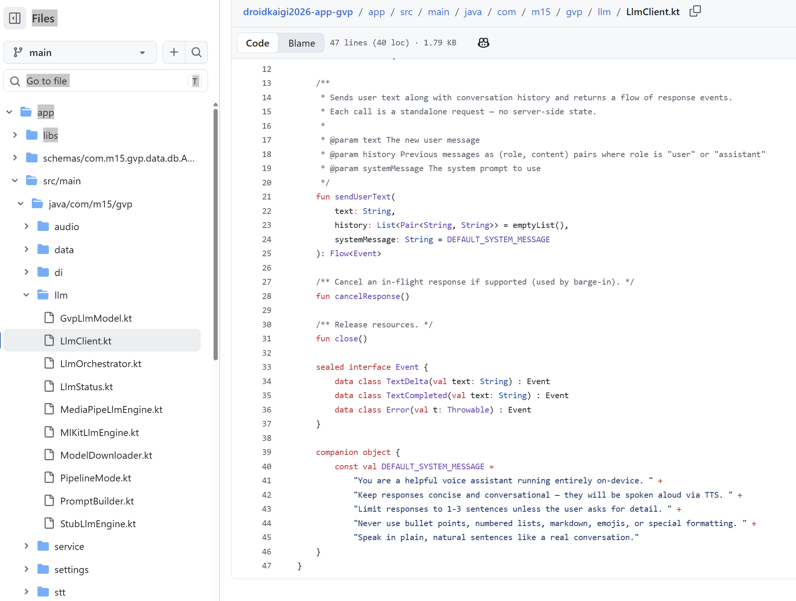
GVP App Demo and Code Review
README.md – Docs
VoiceAgentService.kt – Service
MlKitGenAiSttEngine.kt – STT
MlKitLlmEngine.kt – LLM LLMClient.kt – LLM System Message
Notes:
Let’s demo the first, and then review some of the code.
[DEMO : SWITCH to Pixel 10 connection]
Let me launch the app on my Pixel 10
Let me tap into the settings so you can see that I have Inference = AICore STT = ML Kit GenAI TTS output Voice = en-gb-x-gbb-network
Back in the main screen, let me show you the System Message we will be using: a helpful voice assistant the responds accordingly, short responses, in English.
Now I’ll start the conversation.
[ Mark has a conversation with the Assistant in English. ]
You can see, It’s a very impressive local voice assistant!
Next, let’s take a look at some of the key files in the project.
[ Switch to the Github Repository ]
Here is the README.md file. It has some detailed information for the project you can read about.
Now lets lets at the overall file structure
The file structure follows the typical layout for MVVM architecture.
Let me show you how the App uses a background Service to record from the Microphone
Service/VoiceAgentService.kt
The STT configuration and processing is handled by the files in the stt/ folder: stt/SherpaSttEngine.kt stt/MlKitGenAiSttEngine.kt
You can see LLM related classes in the llm/ folder
The AI Core Nano model is handled by this class.
llm/MlKitLlmEngine.kt
The initial system message is defined in this class:
Llm/LLMClient.kt
[ Switch to the slides --- Cliff App is next ]

Slide 17
Cloud (Cliff)
State of the Art Cloud Models
STT
LLM
TTS
Deepgram Flux Websockets Streaming
Claude Sonnet 4
Deepgram Aura-2 Websockets Streaming
Security with server tokens
Multilingual (Japanese)
DroidKaigi 2026 · Tokyo
Notes:
On device Voice is very powerful and has a promising future, especially as our devices become more powerful.
Now, let’s move onto the Cloud based solution … Introducing the Cliff App
For the Cliff app, we are going to MOVE all 3 of the key pipeline components into the Cloud.
I will be using Deepgram as the model provider for STT and TTS.
I often use Deepgram and Catesia for these models because I think they have some of the best models.
For the STT, we will use the Deepgram FLUX model, it does a GREAT job.
For the TTS, we will use one of the Deepgram Aura-2 voices, actually we will use a Japanese voice.
And for the LLM model, we will use Claude Sonnet 4, you can recall from the earlier slide, it had good latency performance.

Slide 18
Cliff App Overview
State-of-the-Art (SOTA) Cloud Pipeline
Best-in-class cloud models with full-duplex streaming.
KEY CONCEPTS
• Full-Duplex Streaming — STT, LLM, and TTS all stream concurrently.
• Sub-Second TTFT — Live TTFT readout (e.g. TTFT 842 ms).
• Multilingual Support — Japanese end-to-end.
• Real Barge-In — Interruptions cancel in-flight LLM response and cancel audio.
• Stateless by Design — Drives Claude’s plain Messages API, No session management.
• No API Keys on Device — Backend manages Deepgram and Claude tokens.
• Compose Audio Orb — Reactive orange orb driven by max(ttsLevel, micLevel).
Notes:
First, let’s take a look at the Cliff App Overview.
By the Way, Cliff was the name of my Grandfather, and he was a good story teller.
The Key Concepts:
Just like the GVP app, the Cliff app also implements Full Duplex Streaming.
The latency performance is very good, I would often see TTFT less than 800ms. You can see the latency of each turn displayed in the app.
We will implement Japanese in the Cliff app, I will show you the key code for this later. We have to change the STT and the TTS.
Barge-in is supported directly by the Deepgram STT models, it works GREAT!
The app is Stateless, we will directly define the System Message and call the LLM API.
The most important concept of using Cloud-based models is managing access tokens.
No API Keys on the device.
We can’t hold tokens in the APK, so we have to manage then from a backend server.
I will show you how we can implement this.
And finally, I will show you the Audio Orb implementation. Cliff uses an ORB design.

Slide 19
Security – Managing API Keys
API Key Lookup
The APK never holds long-lived API keys for the speech providers.
No app update to rotate
Master keys live in the backend's env file.
Phone
POST /claude/token
X-Cliff-Key header
►
Backend Server
Returns the API key
Ephemeral Tokens
Backend server mints short-lived tokens on demand. The APK holds nothing useful.
Token Lifetime - 10 mins
Expires before it's worth abusing.
Phone
POST /deepgram/token
X-Cliff-Key header
►
Backend Server
Validates API key.
Calls provider with sk_...
►
Deepgram/Cartesia
Return JWT (TTL=600s)
Notes:
Let’s talk about API Key Security.
The Cliff app uses cloud models, so we need API keys, and we need to manage those keys securely.
The most important rule-- NEVER hold API keys in the Android APK itself, because we don’t want them to be exposed.
The Cliff app uses 2 common approaches to manage API keys.
In the first Method--- call the backend server once at Startup to obtain the required API key.
Cliff uses this method to acquire the Claude API key. We need it to use the Sonnet or Haiku LLM models.
The 2nd method is even better, we can use Ephemeral Tokens, which are temporary, short-lived tokens.
Cliff uses this method to obtain tokens for the Deepgram STT and TTS models.
Not all of the providers support ephemeral Tokens, so check your provider. Always use ephemeral token is they are available.
We will look at the backend server code (Python) to implement these token lookups on the server.

Slide 20
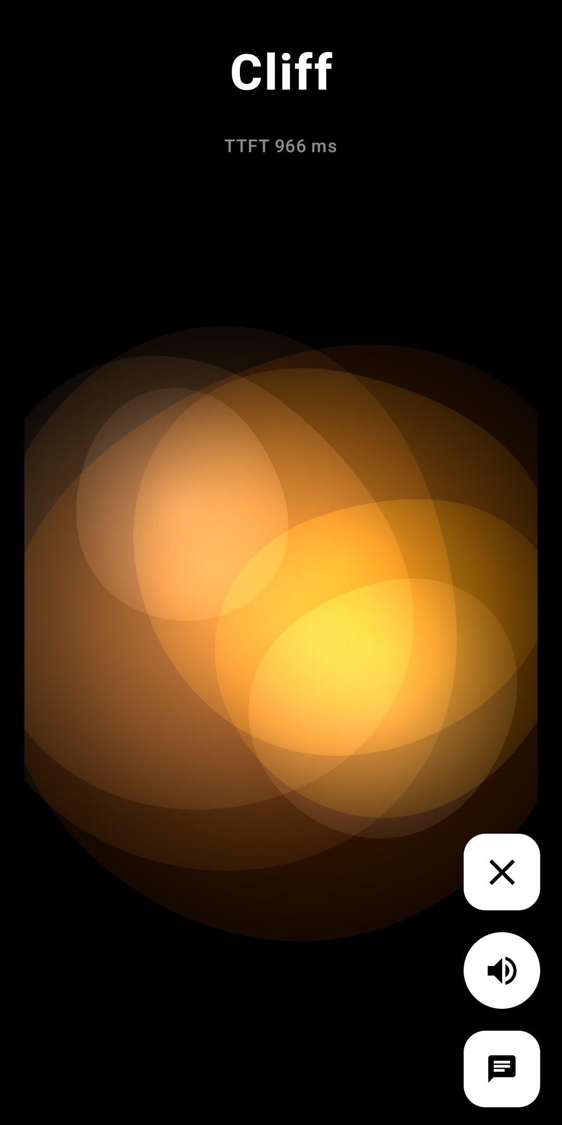
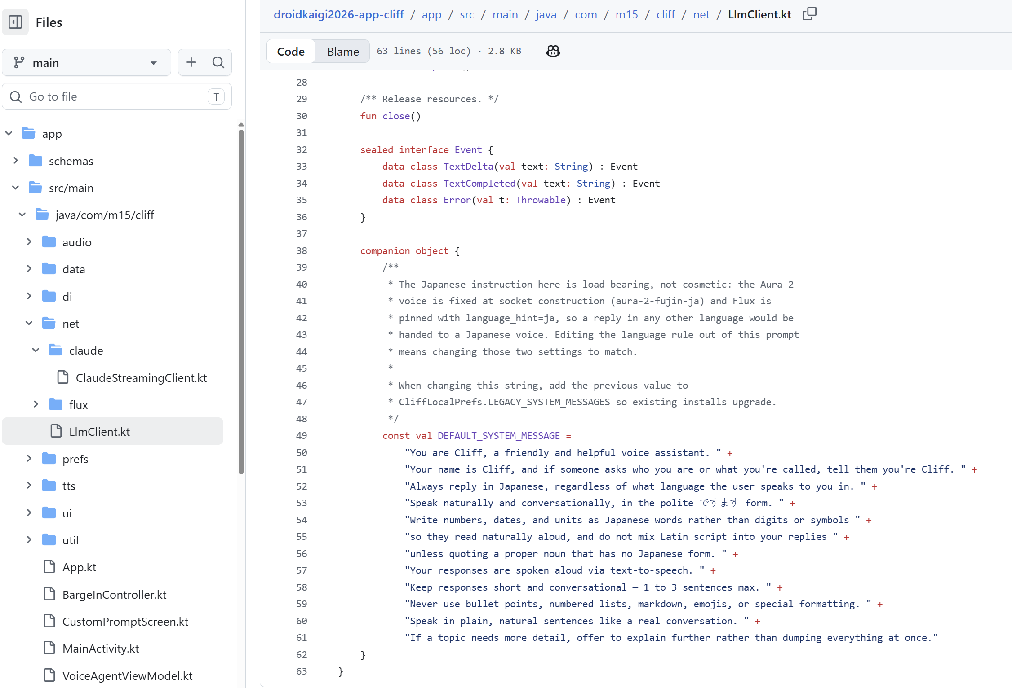
Cliff App Demo and Code Review
README.md – Docs
FluxClientImpl.kt – Deepgram Flux STT
LlmClient.kt – Claude LLM
DeepgramTtsClient.kt – Deepgram TTS
cliff_server.py – Backend
Notes:
Next, Lets do the Cliff Demo, and then look at some code.
I am running the Cliff demo on my Sony Xperia1 device.
Cliff app does not need the Pixel’s AI Core and hardware constraints. It can run on any connected Android device.
When I start Cliff, you will first see the system message, instructing the LLM that we are working in Japanese language.
I will press the START button to begin.
I will say “Kohnichiwa” and we will hear Cliff’s response.
Then I will speak in English and ask Cliff what his name is.
Then I will ask Cliff to tell me a story, and I will interrupt him to show the Barge-in feature.
[ Conversation with the Assistant. ]
There is a toggle in the app to switch between the visualization and the text display.
At the top of the display, we have the TTFT status so we can see how well the system is performing.
Pressing the ‘X’ takes us back to the main screen.
Next, let’s take a look at some of the key files in the project.
[ Show the Cliff Github Repo Files ]
This is the Cliff Repository on Github.
Again, there is a detailed README.md file in the repo.
The Cliff file structure also follows the MVVM architecture.
I want to show you the important files which enable the Japanese language:
Deepgram’s STT model is called Flux. FluxClientImpl.kt implements the STT.
For the Japanese input, we need a multi-language model, so we swap out the English model to a multi language model
This is a “MULTI” model, so it can still understand when I speak in English. The “Hint” helps the model know to favor Japanese.
Next let’s look at the LLM Client which implements Claude as the LLM.
LlmClient.kt
The LLM follows the system prompt.
And finally, we need to make Cliff speak Japanese, so we need to update the DeepgramTtsClient.kt
We set the voice to a Japanese voice — Aura-2 uzume
The Aura-2 voice is fixed when the socket opens.
Finally, let’s take a look at the server code to handle the Token management.
cliff_server.py –
This is a simple server implementation in Python that can handle the Token requests from the app.
You can run this server code on any reachable connected device.
I am running the server for cliff on my Raspberry Pi5 box, it is right here [ show the box to the attendees ]

Slide 21
Agentic Voice (Pipecat)
Voice AI is no longer just inference. We make it more powerful by adding
orchestration, memory, and tool calling.
DroidKaigi 2026 · Tokyo
Notes:
Next up, let’s take a look at how we can access AI Agents using Voice on Android.
Introducing the Pipecat App, named after the protocol we will be using to move voice between a backend server.
With Agentic Voice, our apps become much more powerful by adding memory and tool calls.

Slide 22
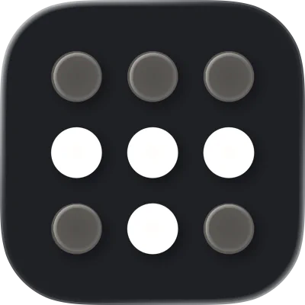
Agentic Voice Architecture
Android App Pipecat Client Capture mic audio, Play TTS, Render UI, Maintain session
OpenClaw/Hermes Agentic AI on the Server Run agents, manage state, connect tools, guard credentials, and evolve frameworks.
Pipecat Thin Transport Open Source, Real-time audio transport. WebRTC
MCP Model Context Protocol AI apps to connect to tools and data sources.
Connecting your Android device with backend server
Tailscale Mesh Network (Recommended)
Install on any device or server Works across Wi-Fi, cellular, and public network
Free tier covers most hobby and small-team projects
Alternatives:
Self-hosted VPN (WireGuard, OpenVPN) Tunnels (ngrok, Cloudflare Tunnel)
Notes:
The LLM’s are smart, but they lack two important functions for truly useful Agentic Voice AI: memory and tool calling.
Two of the most powerful Agentic frameworks are OpenClaw and Hermes Agent,
These are Open Source frameworks, written almost entirely in Python.
For that reason, it is best to run them on the external server. I will be running them on my Raspberry Pi5 [ Show the attendees the Pi5 ]
I actually have more than 10 agents running on this little box.
So, we need a transport protocol that can easily handle real-time, streaming, full-duplex voice.
That is where Pipecat comes in.
Pipecat is an open-source BSD licensed, vendor-neutral framework for real-time voice and multimodal AI pipelines.
MCP is a popular protocol to connect with APIs and Data Sources. Notice in the drawing, this function is handled by the Agentic Framework such as OpenClaw or Hermes.
Sometime developers choose to pull this functionally up onto the Android device, but I find it easier to create Android Voice Agents if we locate this important function with the Agent Framework on the server.
There is one additional consideration.
We need a connectivity solution to connect our Android device with our backend server or edge devices.
I use Tailscale because it is very simple and effective for building AI Assistants.
You don’t have to use Tailscale, there are alternative approaches as shown at the bottom of the slide.

Slide 23


Agent Frameworks
Pipecat transport is supported by both OpenClaw and Hermes.
Easy to access tool calls, persistent memory, and skills.
We can access multiple agents by PORT from the client.
OpenClaw
Hermes
Personal AI Assistant
Self-Improving Agent
• Tool calls (web, files, code) • Plugin / skills ecosystem • Multi-modal interfaces • Large voice community
• Persistent memory, learning • Auto-creates skills from use • Long-running agent loops • Self-improving over time
Pipecat demo implements a Baseball Agent called “Homer” on OpenClaw
Notes:
Let’s take a closer look at the Agent Frameworks.
These are the two frameworks I use when building Voice Agents: OpenClaw and Hermes.
Both are very successful Open Source projects.
They are both Python based.
They both support Pipecat, so we can have a low-latency seamless experience from Android.
We can’t cover them in detail here, but I have listed some of the important features.
OpenClaw is very useful as a Personal AI Assistant.
Hermes Agent is very good if you wish to build a self-improving agent.
We will be using the Pipecat client to access an OpenClaw agent who is configured as a Baseball expert, so we can follow MLB scores and our favorite player, LA Dodgers #17 Shohei Ohtani.

Slide 24
Pipecat Client App Overview
Agent Integration with Server-Side Brain
The phone is the mic and speaker. All intelligence lives on a Pipecat server.
KEY CONCEPTS
• Phone is just a Mic + Speaker — All intelligence (STT, LLM, TTS, turn-taking, barge-in) lives on the Pipecat server.
• Simple Architecture — No Token Management. Connect by POSTing an SDP offer to /api/offer. Pure P2P WebRTC.
• Entire SDK in One File — PicaVoiceClient.kt.
• Instant Barge-In — Stops local playback the instant you speak
• Agent Integration — Server-side brain, Agent framework — OpenClaw or Hermes. Tool calls and memory built in. Huge Python support for Agentic AI available on the server side.
• AEC3 echo cancellation — Free from libwebrtc on both ends.
Notes:
Now, before we show the demo and code, lets take an overview of the Pipecat Client App.
This is the most simple app of all three --- the Android device is just a Mic + Speaker.
All the intelligence lives on the Pipecat server.
This architecture has a Big Advantage --- there are ZERO API or tokens to worry about on the Android device, we just POST over WebRTC using Pipecat.
The entire application resides in one file, PicaVoiceClient.kt, much simpler than the other apps.
The Agent Framework lives on the server and there is a HUGE python support for Agentic AI.
One of the best things about Pipecat, it is a well-tested superior audio protocol.
Many huge companies rely on and contribute to Pipecat for their Audio pipelines.
With Pipecat, Barge-in and Echo Cancellation work GREAT.
So, let’s run the HOMER demo and then look at some code.

Slide 25
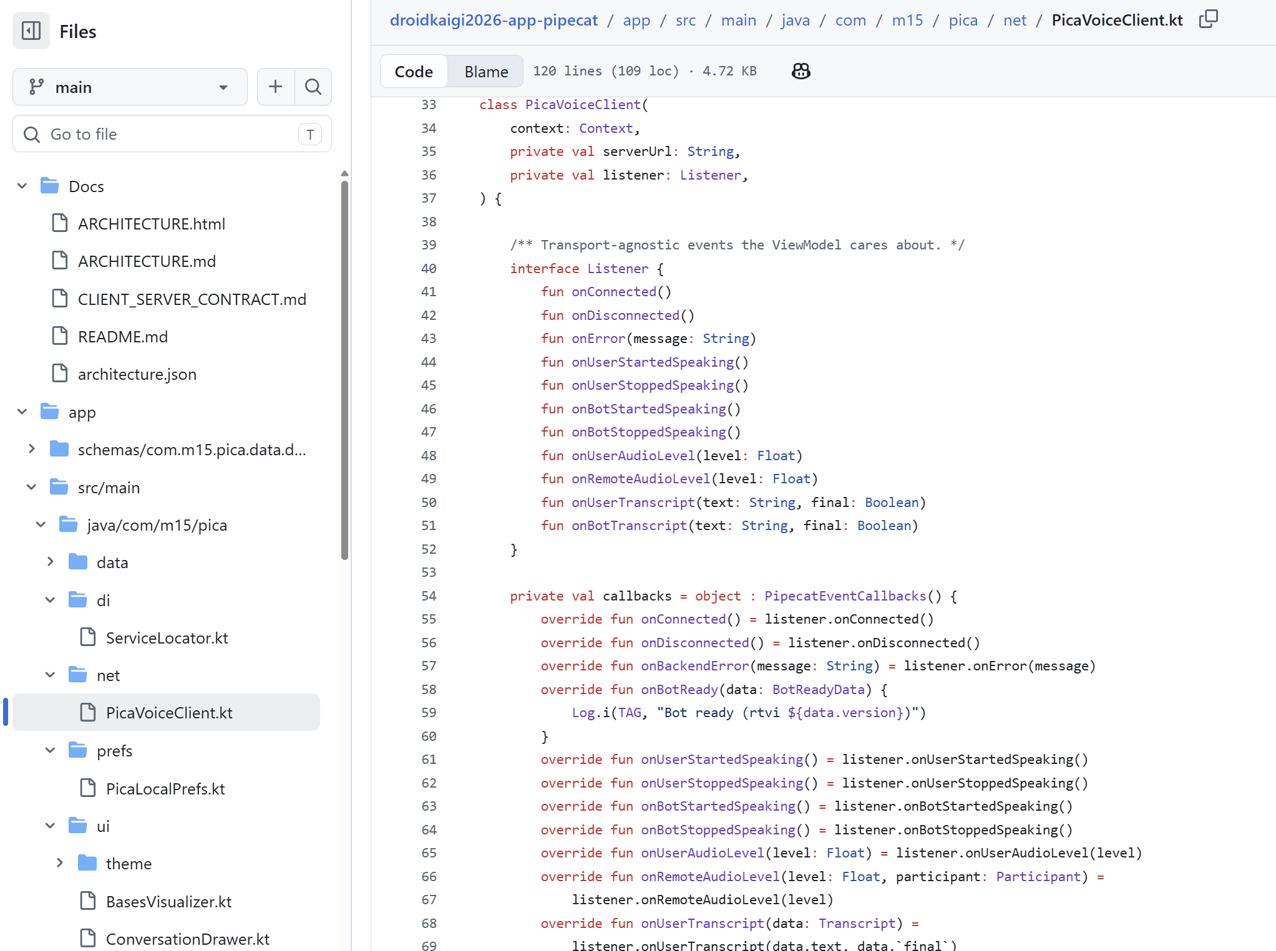
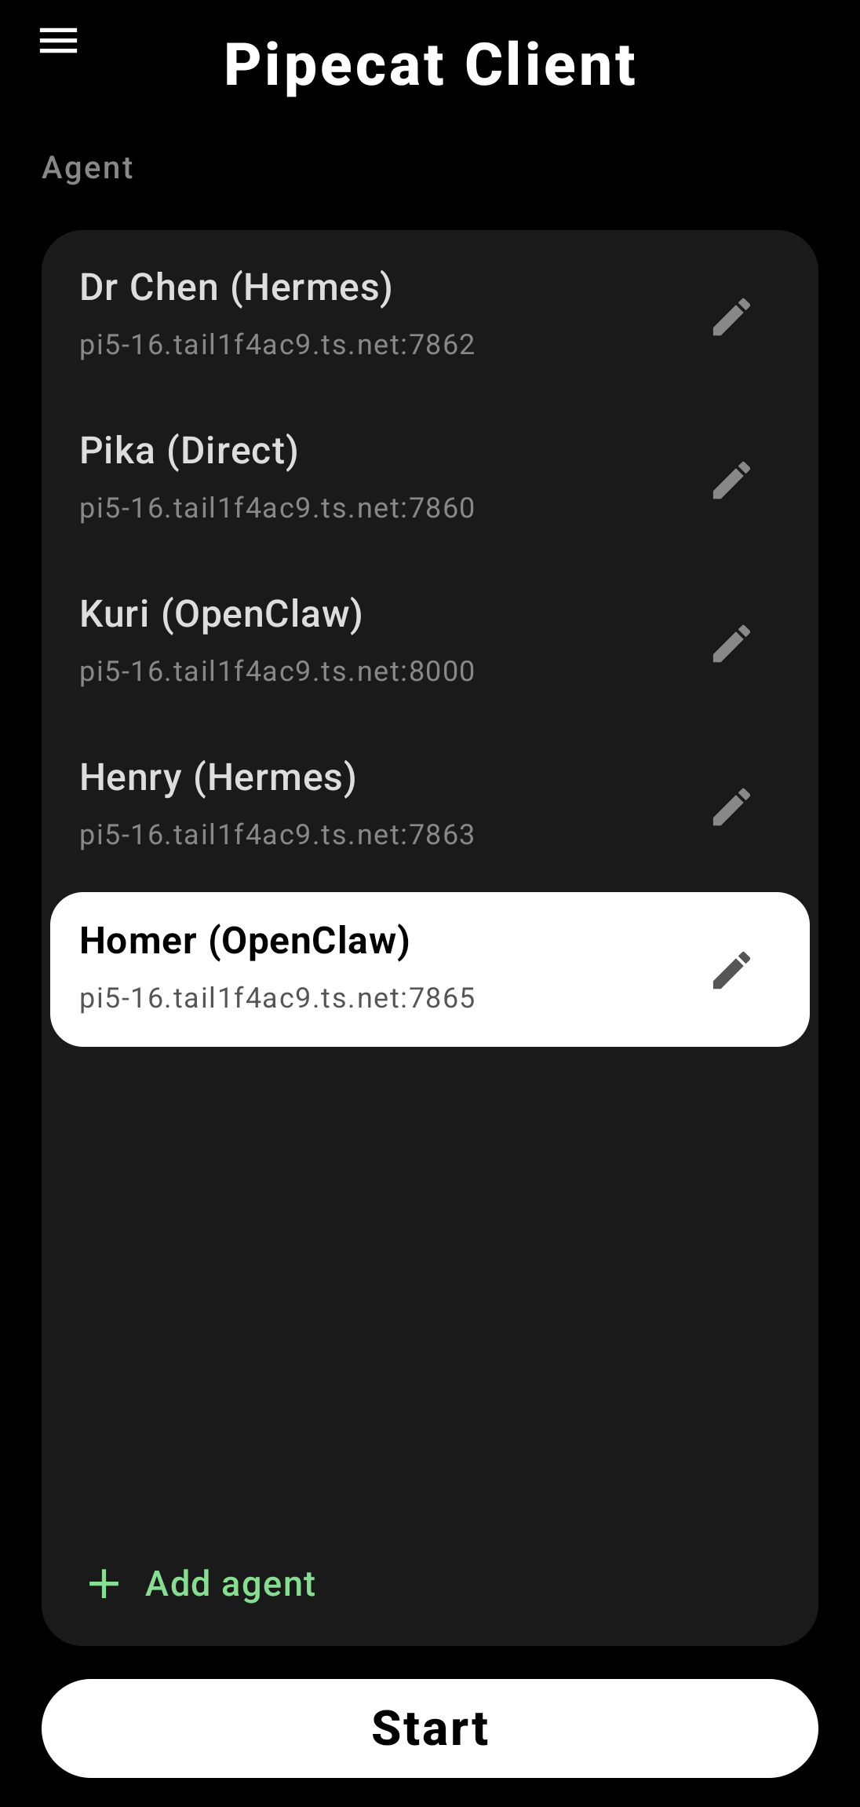
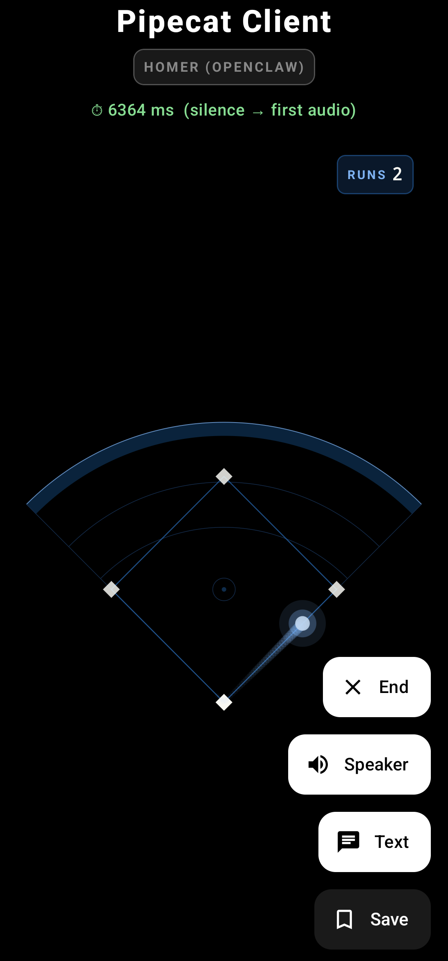
Pipecat Client App Demo and Code Review
README.md – Docs
PicaVoiceClient.kt – Pipecat
BasesVisualizer.kt - Visualizer
Homer OpenClaw Server Repo:
Skills/mlb.py
Workspace/Soul.md Workspace/Identity.md
Workspace/Agents.md
Notes:
You can see from the left screenshot, the App supports multiple connections.
It can connect to MANY agents you define on the server.
We simply choose and Agent we want to talk to and press “Start”.
We can also Edit and Agent’s connection parameters or add a new agent.
Let me show you Homer’s parameters before we chat with him.
You can see, the parameters tell the client which server + port to connect to.
Also, we can specify the visualization. Of course, for Homer we will use the Baseball Bases visualization.
Now, let me start the connection. Remember, the agents are on my Raspberry Pi5 box.
Homer will speak to us first. With OpenClaw, it can take longer to respond (the TTFT), so we have the system implement a “typing” sound so we know it is working.
[ Start the Homer conversation ]
[ Finish the Homer conversation ]
You can see, Homer is very smart about MLB and the Dodgers.
Recall, our LLM is GPT-4.
If you ask GPT-4 about Shohei, it still thinks he plays for the Angels. But Homer knew Shohei plays for the Dodgers now.
OK, Let’s look at some key code for this Android App and backend server. There is a REPO for both the App and the Server
[ Show the Android App Github Repo ]
This is the README.md file for the Android App, it is very detailed.
The main file is PicaVoiceClient.kt, this is where all of the connection logic lives.
You can see the Android App is very simple.
Now let’s explore the OpenClaw brain Github repository.
[ Show the Homer OpenClaw Server Github repo ]
Again, the repo has a detailed README.md file, this is helpful if you need to set up your backend OpenClaw server.
First, in the Workspace directory, are the important Homer personality instructions. We have the Soul.md, Identity.md, and Agents.md
And finally, we can inspect the Skills/mlb.py script. This is how Homer gets his current information from the free MLB API.
Now, let’s say goodbye to Home and then wrap things up. Let’s ask him if Shohei can hit a Home Run tonight !!

Slide 26
Key Takeaways
Architect, Don’t Code
1
①
Coding agents write the code
Three Architectures, Match Your Requirements
②
Local, Cloud, Agentic
Ephemeral Tokens Beat Secret-Stuffing
3
③
No API keys in the APK
Powerful Agentic Frameworks
④
Best in class open-source python — OpenClaw and Hermes
Notes:
We did it, we completed 3 voice pipeline architectures, Local, Cloud, and Agentic.
Let’s review the key takeaways:
We learned that it is important to architect, not code.
Let the coding agents write the code, while always inspecting it and understanding what it is writing.
We covered 3 voice pipeline architectures, Local, Cloud, and Agent.
Choose the one the best matches your requirements.
Always protect your API keys. Never place them in your Android app APK.
Use the backend server to protect and manage your API keys. Short-lived Ephemeral tokens are the best approach.
Use powerful Agentic Interfaces such as OpenClaw and Hermes for the best user experience. They support Memory and Tool Calling. In this case we leverage Python on the server and keep our android app as the simple voice client.

Slide 27
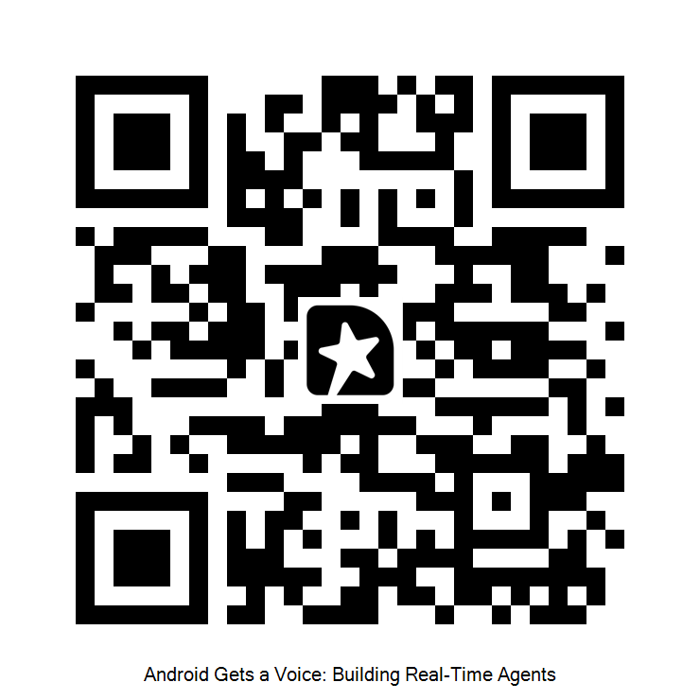
Thank You
DroidKaigi 2026 · Tokyo
Notes:
That concludes the presentation !
T H A N K Y O U T O K Y O !!

