Slide 1
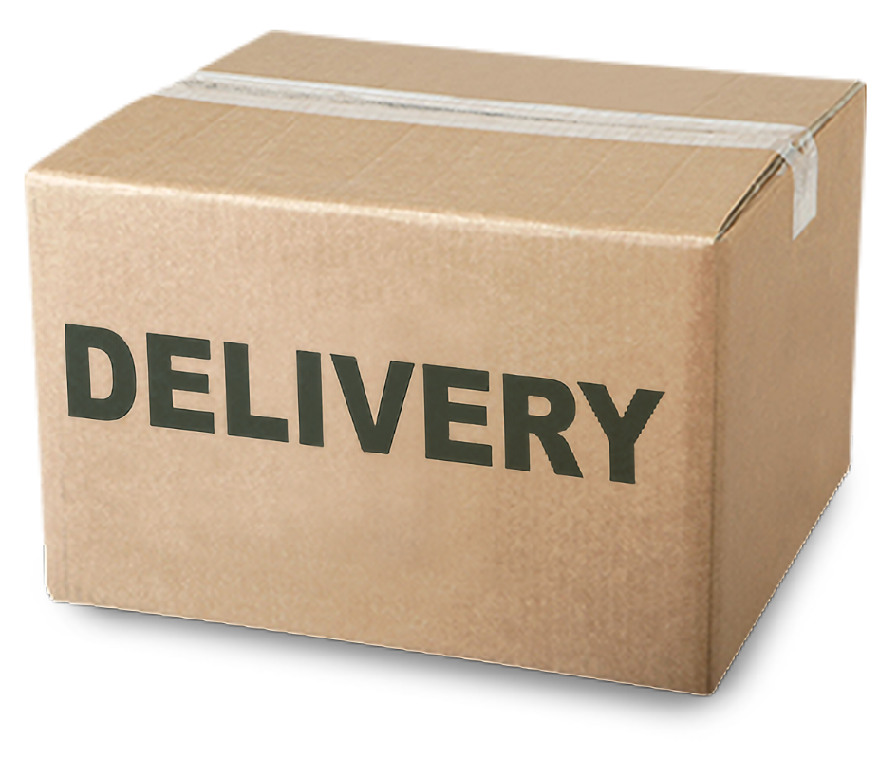
Is Time Specific Delivery Scheduling Profitable?
By: Matt Held & Kevin Broderick

Slide 2
Data Source

Slide 3

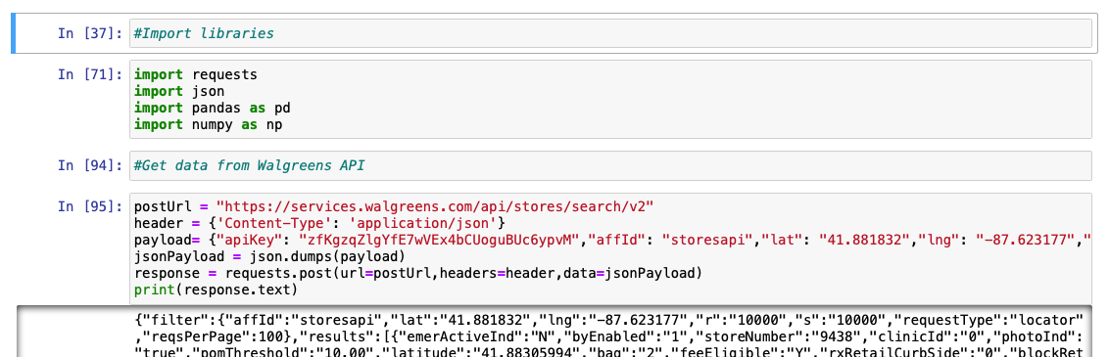
Dataset
Pulled from Walgreens API
Picked Chicago, IL as location to grab from as there were the most Walgreens stores around that area (API limits how far reach)

Slide 4
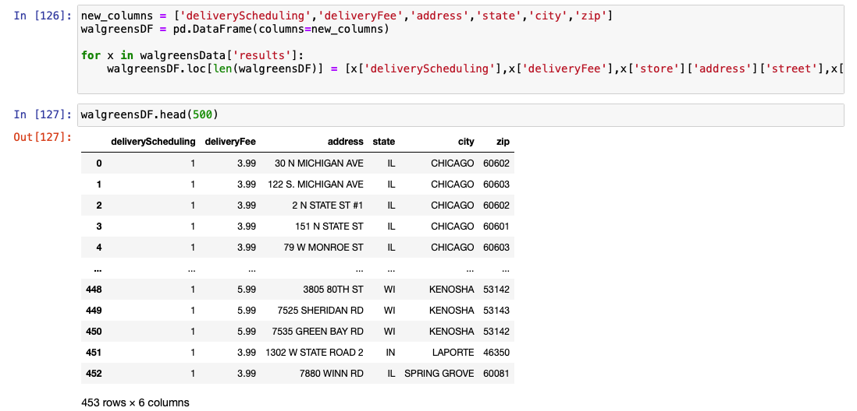
Importing Data Into Pandas Dataframe

Slide 5
Exploration Question

Slide 6
Question
Does the delivery scheduling option result in consumers paying a higher delivery fee?
(is it worth having Walgreens IT department create these time specific scheduling features for all stores in 48000-60800 zip code range?)
Delivery Scheduling (think Uber Eats delivery vs “arrives before 8pm”)
In JSON Response:
'deliveryScheduling': '0’, (0 or 1)
'deliveryFee': '5.99’, (various dollar amounts)

Slide 7
Zip Code Range
48000-60800
Covers stores in IL and WI
Covers major Chicago downtown locations

Slide 8
Data Preprocessing

Slide 9
Limited What We Put Into Dataframe (Eliminated Irrelevant Columns/Values)

Slide 10
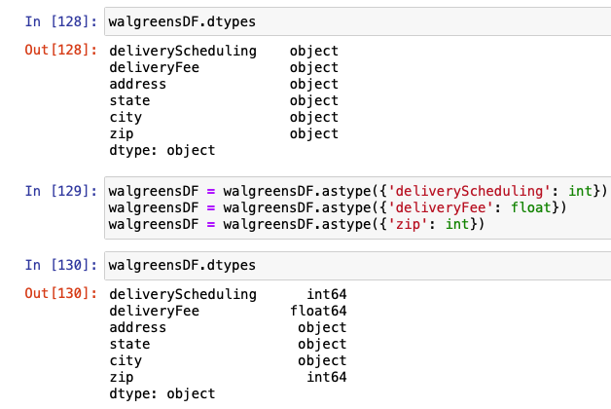
Fix Datatypes (Numbers NOT String/Char/Objects)

Slide 11
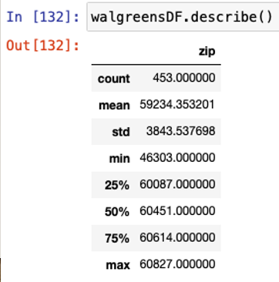
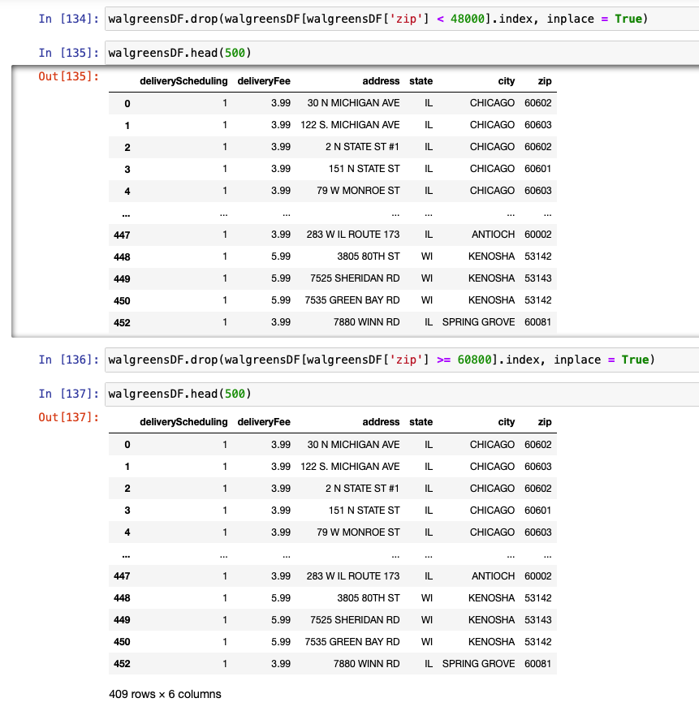
Only Zip Codes From 48000 To 60800

Slide 12
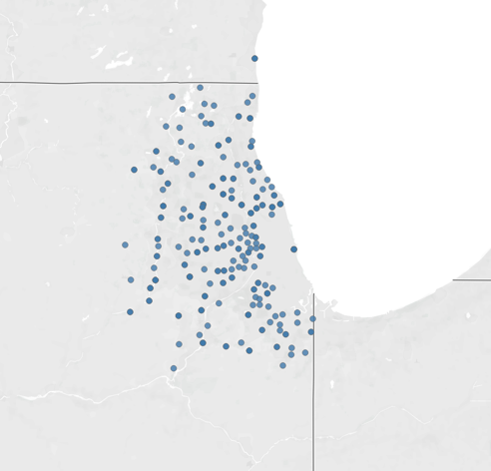
Zip Code Range Map

Slide 13
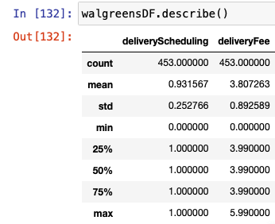
Our data was based on standards that Walgreens sets. No outliers as seen below

Slide 14
Visuals

Slide 15
Needed To Export Dataframe To CSV for Tableau

Slide 16
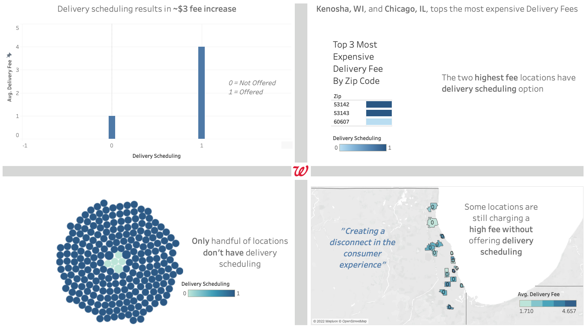

Slide 17

Questions?

