Slide 1



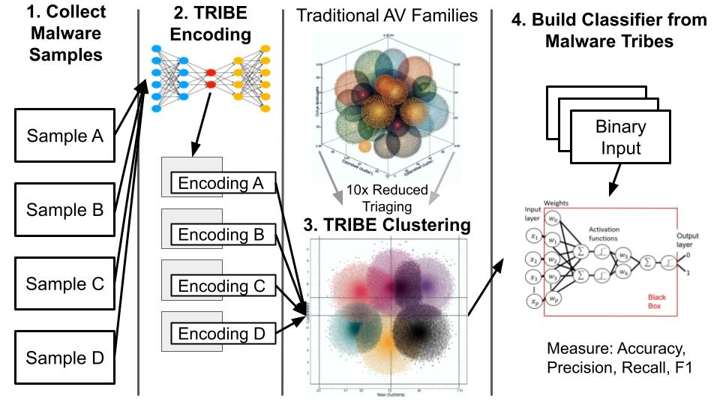
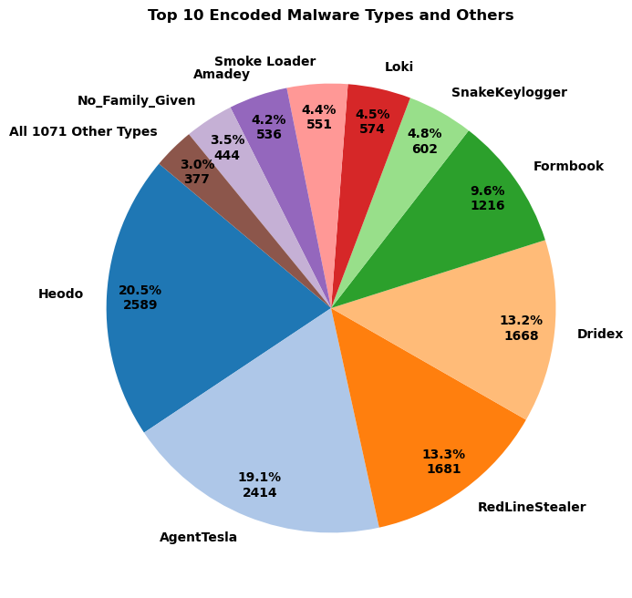
A Quest Called TRIBE:
MIDN 1/C:
Michael Chen, John Jenness, Justin Liaw, Chris Kim
Advisors:
Dr. Dane Brown, Cyber Science
CDR. Edgar Jatho, Computer Science
Clustering Malware Families for Enhanced Triage and Analysis
Abstract
Methodology
Results
Polymorphic and mutational malware has increased extraneous antivirus labels, complicating triage responses for Security Operation Centers. We propose to build an autoencoder to classify malware into Tribal Relation Inferential Binary Encoder (TRIBE) clusters, reducing malware family classifications and improving efficiency.
A transformer-based autoencoder was successfully created and validated with reconstruction loss averaging 0.06487.
A malware corpus consisting of over 400,000 malware files was assembled, analyzed and tested on. Subsets of the data were saved and exported to the GitHub repository.
Initial clustering results show a reduction in clusters.
Research Goals
Create a transformer-based autoencoder to prove efficacy of autoencoders on malware datasets
Creation of well-documented malware corpus to allow future research
Creation of Tribe Clusters that reduce the total amount of malware families.
Reach Goal
Validation of TRIBES as useful for malware triage.
1. Collect Samples from MalwareBazaar
2. Build an encoder based on a transformer that takes in bytes as vocabulary
3. Cluster through UMAP and DBSCAN
3a. Validate the clustering into meaningful TRIBEs
4. Create classifier from existing encoder and TRIBEs
Conclusions
A transformer-based autoencoder that achieved high reconstruction accuracy on a set of never-before-seen malware was constructed and tested.
A dataset of over 5000 unique malware families were analyzed, stripped, and are ready for distribution.
25,000 malware encodings were created and clustered with initial clustering yielding promising results.
Malware Corpus
Counts:
439,970 Windows malware files reduced to .text section:
383,079 .exe (87%)
56,891 .dll (13%)
Size breakdown:
1.3MB mean size
25th percentile: 236KB
492KB median size
75th percentile: 891KB
*Due to a GPU availability of 48GB, we truncated the files to their first 2KB
Technical Specification
Model: Transformer-based autoencoder for binary file reconstruction.
Key Components:
Encoder: Extracts features, compresses data into a 64-dimensional latent vector.
Decoder: Reconstructs sequences using cross-attention mechanisms.
Features: Handles variable-length data with attention masks; uses gradient accumulation for memory efficiency.
Applications: Malware analysis, binary compression, feature extraction.
Future Work
Ongoing: - Validation of malware clusters to
ensure utility.
- Productization of dataset and tool
Research: - Explore utility of autoencoders in fields of encryption, compression,
and cloud computing.
“The views expressed in this presentation are those of the author(s) and do not reflect the official policy or position of the U.S. Naval Academy, Department of the Navy, the Department of Defense, or the U.S. Government.”
Notes:
Abstract: In recent years an increase in polymorphic and mutational malware has been noted by traditional antivirus (AV) software. These traditional AVs are often unable to classify obfuscated malware that should be in the same family leading to a large number of unnecessary malware families. We propose using a transformer-based

Slide 2


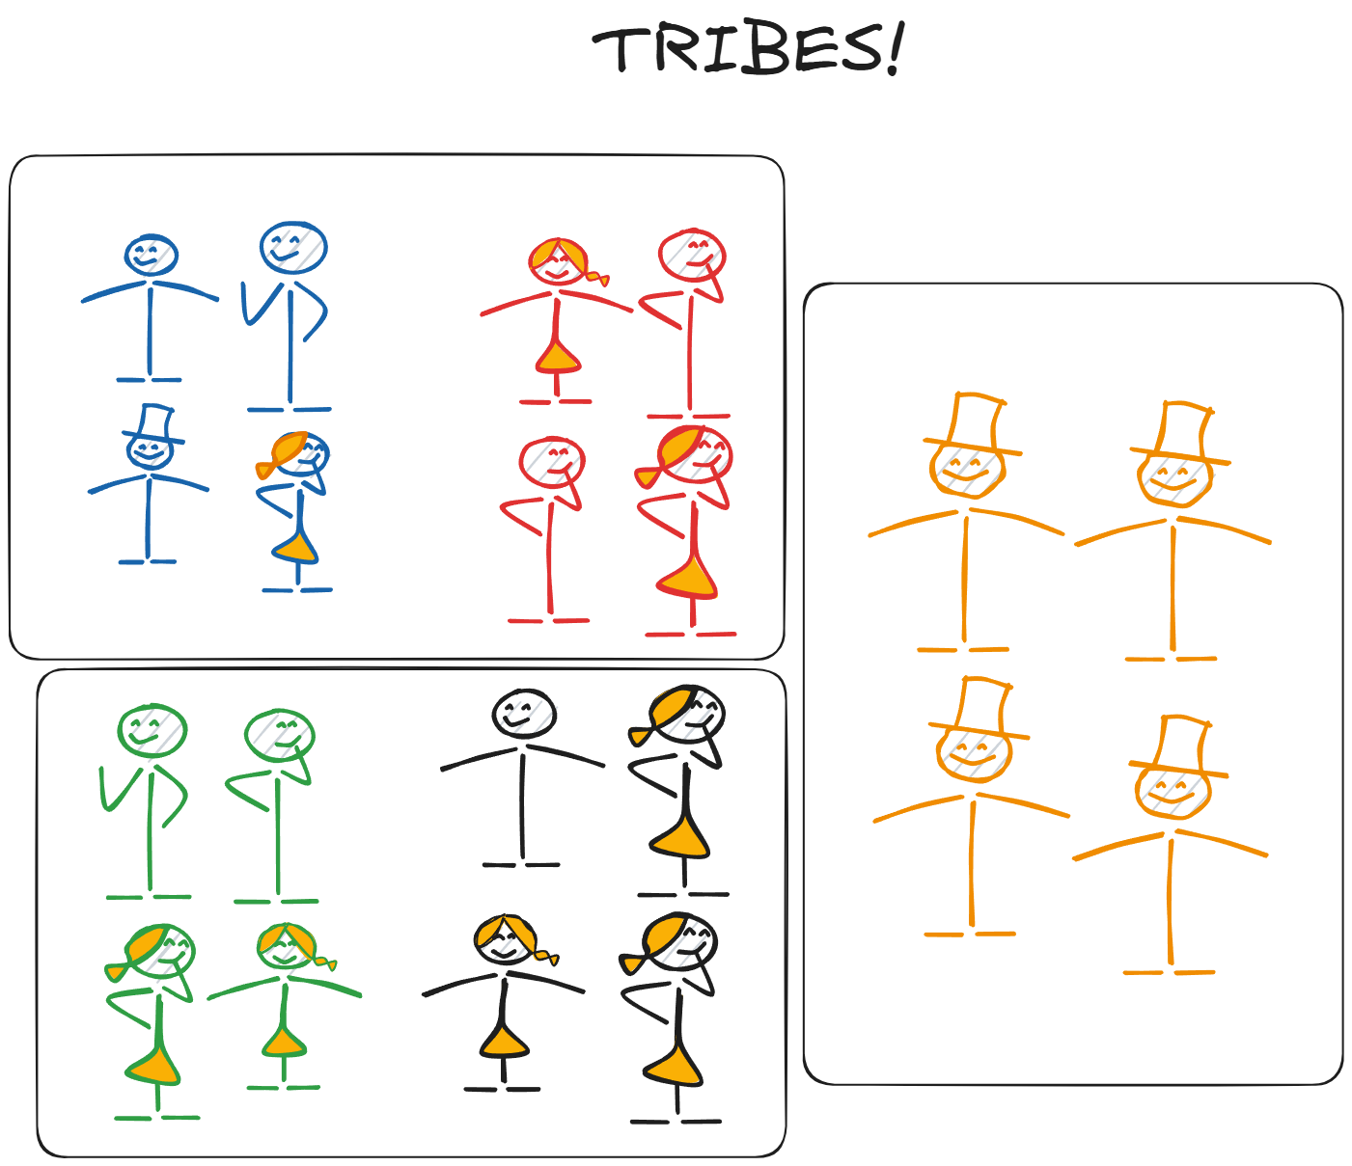

A Quest Called TRIBE:
MIDN 1/C: Michael Chen, John Jenness, Chris Kim, Justin Liaw
Dr. Dane Brown, Cyber Operations
CDR. Edgar Jatho, Computer Science
Clustering Malware Families for Enhanced Triage and Analysis
Insert
Department
Logo
Abstract
Methodology
Polymorphic and mutational malware has increased extraneous antivirus labels, complicating triage responses for Security Operation Centers. We propose to build an autoencoder to classify malware into Tribal Relation Inferential Binary Encoder (TRIBE) clusters, reducing malware family classifications and improving efficiency.
1. Collect Samples from MalwareBazaar
2. Build an encoder based on a transformer that takes in bytes as vocabulary
3. Cluster through UMAP and DBSCAN
4. Create classifier from existing encoder and TRIBEs
Malware Corpus
Conclusions
439,970 Windows malware files reduced down to .text section:
383,079 .exe (87%)
56,891 .dll (13%)
Size breakdown:
1.3MB mean size
25th percentile: 236KB
492KB median size
75th percentile: 891KB
*Due to a GPU availability of 48GB, we truncated the files to their first 2MB
We trained a transformer-based autoencoder that achieved 100% reconstruction accuracy on a set of never-before-seen malware.
There are over 5000 different families of malware from a traditional source that we analyzed.
We seek to cluster over 25,000 malware encodings to formulate the TRIBE encodings, validated by internal and external metrics.
GitHub
Notes:
Abstract: In recent years an increase in polymorphic and mutational malware has been noted by traditional antivirus (AV) software. These traditional AVs are often unable to classify obfuscated malware that should be in the same family leading to a large number of unnecessary malware families. We propose using a transformer-based

Slide 3

A Quest Called TRIBE:
MIDN 1/C Michael Chen, John Jenness,
Justin Liaw, Chris Kim
Advisor: Dr. Dane Brown, Cyber Operation
Advisor: CDR. Edgar Jatho, Computer Science
Clustering Malware Families for Enhanced Triage and Analysis
Abstract
Methodology
Results
Polymorphic and mutational malware has increased extraneous antivirus labels, complicating triage responses for Security Operation Centers. We propose to build an autoencoder to classify malware into Tribal Relation Inferential Binary Encoder (TRIBE) clusters, reducing malware family classifications and improving efficiency.
A transformer-based autoencoder was successfully created and validated with reconstruction loss averaging 0.06487.
A malware corpus consisting of over 800,000 malware files was assembled, analyzed and tested on. Subsets of the data were saved and are will be exported to the GitHub repository.
Initial clustering results show a reduction in clusters.
Research Goals
Create a transformer-based autoencoder to prove efficacy of autoencoders on malware datasets
Creation of well-documented malware corpus to allow future research.
Creation of Tribe Clusters that reduce the total amount of malware families.
Reach Goal
Validation of TRIBES as useful for malware triage.
Conclusions
1. Collect Samples from MalwareBazaar
2. Build an encoder based on a transformer that takes in bytes as vocabulary
3. Cluster through UMAP and DBSCAN
4. Create classifier from existing encoder and TRIBEs
We trained a transformer-based autoencoder that achieved 100% reconstruction accuracy on a set of never-before-seen malware.
There are over 5000 different families of malware from a traditional source that we analyzed.
We seek to cluster over 25,000 malware encodings to formulate the TRIBE encodings, validated by internal and external metrics.
Malware Corpus
Technical Specification
439,970 Windows malware files reduced to .text section:
383,079 .exe (87%)
56,891 .dll (13%)
Size breakdown:
1.3MB mean size
25th percentile: 236KB
492KB median size
75th percentile: 891KB
*Due to a GPU availability of 48GB, we truncated the files to their first 2MB
Model: Transformer-based autoencoder for binary file reconstruction.
Key Components:
Encoder: Extracts features, compresses data into a 64-dimensional latent vector.
Decoder: Reconstructs sequences using cross-attention mechanisms.
Features: Handles variable-length data with attention masks; uses gradient accumulation for memory efficiency.
Applications: Malware analysis, binary compression, feature extraction.
The clusters need to be hand validated and analyzed
The data needs to be packaged for distribution
The autoencoder needs to be productized.
Future Work
“The views expressed in this presentation are those of the author(s) and do not reflect the official policy or position of the U.S. Naval Academy, Department of the Navy, the Department of Defense, or the U.S. Government.”
Notes:
Abstract: In recent years an increase in polymorphic and mutational malware has been noted by traditional antivirus (AV) software. These traditional AVs are often unable to classify obfuscated malware that should be in the same family leading to a large number of unnecessary malware families. We propose using a transformer-based

Slide 4
A Quest Called TRIBE:
MIDN 1/C Michael Chen, John Jenness,
Justin Liaw, Chris Kim
Advisor: Dr. Dane Brown, Cyber Operation
Advisor: CDR. Edgar Jatho, Computer Science
Clustering Malware Families for Enhanced Triage and Analysis
Abstract
Methodology
Results
Polymorphic and mutational malware has increased extraneous antivirus labels, complicating triage responses for Security Operation Centers. We propose to build an autoencoder to classify malware into Tribal Relation Inferential Binary Encoder (TRIBE) clusters, reducing malware family classifications and improving efficiency.
1. Collect Samples from MalwareBazaar
2. Build an encoder based on a transformer that takes in bytes as vocabulary
3. Cluster through UMAP and DBSCAN
4. Create classifier from existing encoder and TRIBEs
Conclusions
We trained a transformer-based autoencoder that achieved 100% reconstruction accuracy on a set of never-before-seen malware.
There are over 5000 different families of malware from a traditional source that we analyzed.
We seek to cluster over 25,000 malware encodings to formulate the TRIBE encodings, validated by internal and external metrics.
Technical Specification
Malware Corpus
439,970 Windows malware files reduced down to .text section:
383,079 .exe (87%)
56,891 .dll (13%)
Size breakdown:
1.3MB mean size
25th percentile: 236KB
492KB median size
75th percentile: 891KB
*Due to a GPU availability of 48GB, we truncated the files to their first 2MB
Future Work
“The views expressed in this presentation are those of the author(s) and do not reflect the official policy or position of the U.S. Naval Academy, Department of the Navy, the Department of Defense, or the U.S. Government.”
Notes:
Abstract: In recent years an increase in polymorphic and mutational malware has been noted by traditional antivirus (AV) software. These traditional AVs are often unable to classify obfuscated malware that should be in the same family leading to a large number of unnecessary malware families. We propose using a transformer-based

Slide 5
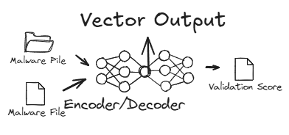


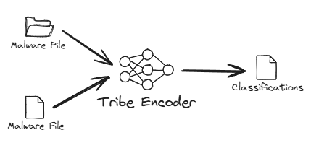
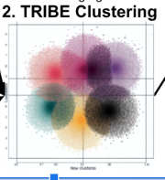




A Quest Called TRIBE:
MIDN 1/C: Michael Chen, John Jenness, Chris Kim, Justin Liaw
Dr. Dane Brown, Cyber Operations
CDR. Edgar Jatho, Computer Science
Clustering Malware Families for Enhanced Triage and Analysis
Insert
Department
Logo
Abstract
Methodology
Conclusions
We propose to use an autoencoder to classify malware binaries.This novel approach will classify malware into Tribal Relation Inferential Binary Encoder (TRIBE) clusters which will reduce the total number malware family classifications in order to improve malware triage.
Obtain large set of labeled executable malware binaries
2. Create autoencoder
(sequence-to-sequence & transformer based)
We hope to find that by utilizing an unsupervised autoencoder we can “see” around the obfuscation presented by polymorphism and mutation in order to reduce the total number of classification malware can be grouped into and create an efficient classification tool.
4. Build a transformer-based malware classifier using the TRIBES
3. Determine the most optimal groupings of TRIBES
Future Work
Integration of recommended course of action based on classification
User based modification of autoencoder and end-product trainability.
Importance
Polymorphic and mutational malware has led to the rise in number of extraneous antivirus labels[11]. Our goal is to reduce the time it takes for Security Operation Centers (SOCs) to triage malware by optimizing labels and producing an encoder-based classification tool.
5.Productizing the Classifier
Acknowledgement
48GB Nvidia GPU provided by USNA
Product Details
Our end deliverable will be a Dockerized command line tool that can take in binary files and returns the classification of each binary. This tool will arrive pre-trained.
GitHub
References
Notes:
Abstract: In recent years an increase in polymorphic and mutational malware has been noted by traditional antivirus (AV) software. These traditional AVs are often unable to classify obfuscated malware that should be in the same family leading to a large number of unnecessary malware families. We propose using a transformer-based

Slide 6
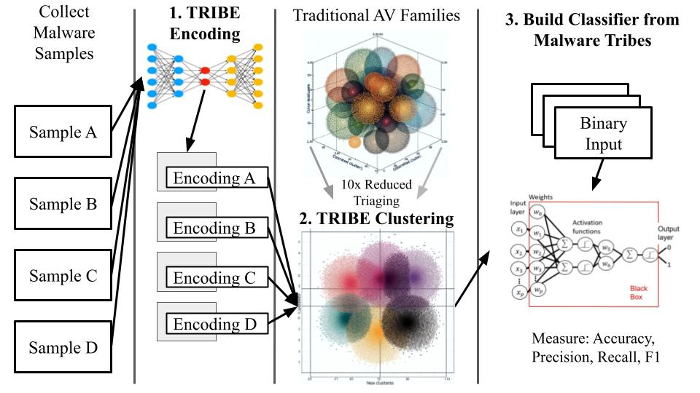
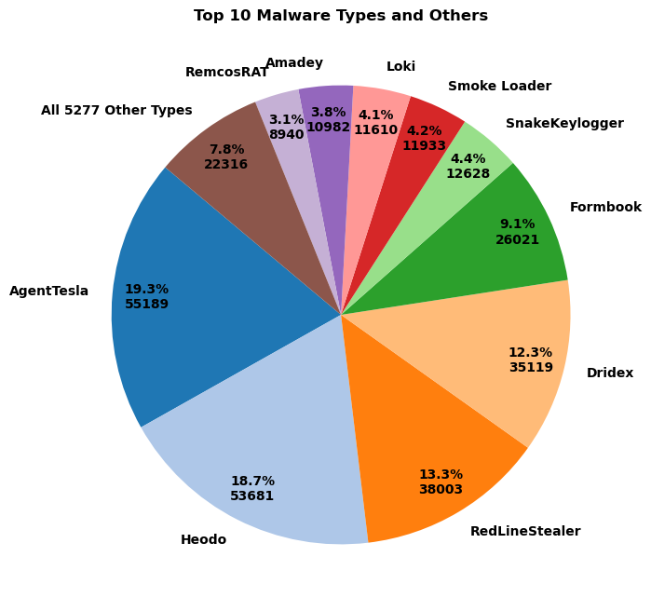
A Quest Called TRIBE:
MIDN 1/C: Michael Chen, John Jenness, Chris Kim, Justin Liaw
Dr. Dane Brown, Cyber Operations
CDR. Edgar Jatho, Computer Science
Clustering Malware Families for Enhanced Triage and Analysis
Insert
Department
Logo
Abstract
Problem
Methodology
We propose to use an autoencoder to classify malware binaries.This novel approach will classify malware into Tribal Relation Inferential Binary Encoder (TRIBE) clusters which will reduce the total number malware family classifications in order to improve malware triage.
Polymorphic and mutational malware has increased the number of extraneous antivirus labels. Our goal is to reduce the time it takes for Security Operation Centers (SOCs) to triage malware by optimizing labels and producing an encoder-based classification tool.
Malware Corpus
439,970 Windows malware files reduced down to .text section
383,079 .exe (87%)
56891 .dll (13%)
Size breakdown:
1.3MB mean size
25th percentile: 236KB
492KB median size
75th percentile: 891 KB
*Due to a GPU availability of 48GB, we truncated the files to their first 2MB
Conclusions
We trained a transformer-based autoencoder that
GitHub
Notes:
Abstract: In recent years an increase in polymorphic and mutational malware has been noted by traditional antivirus (AV) software. These traditional AVs are often unable to classify obfuscated malware that should be in the same family leading to a large number of unnecessary malware families. We propose using a transformer-based

Slide 7
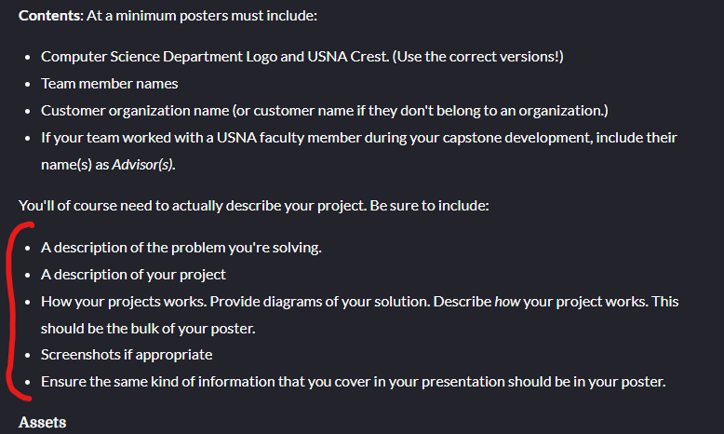
Abstract

Slide 8
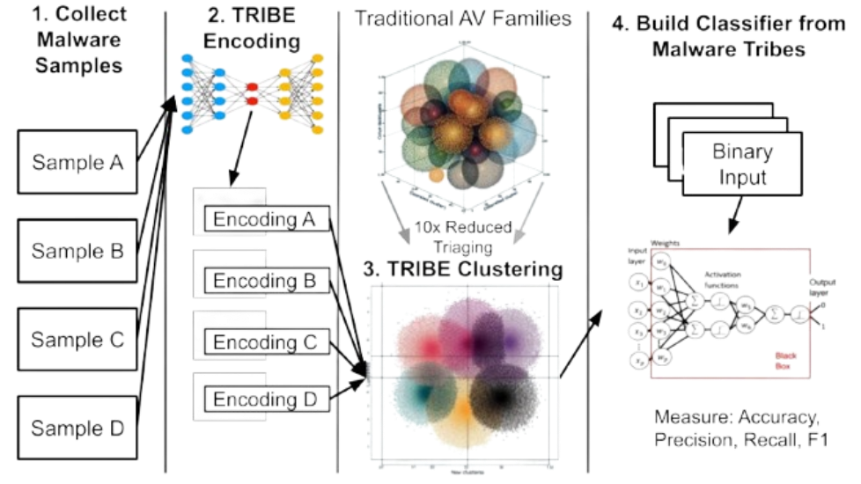

Slide 9
Malware Corpus
number of malware downloaded (source)
% of exe/dll
number of families (labels, examples)
Mean,median,q1,q3 (25percentile)
stripping to make safe (only .text)
truncated at 2MB
gpu availability (48G)
439970 Windows malware files reduced to their .text
383079 .exe
56891 .dlls
mean size: 1.3 MB
median size: 492 KB
25th percentile size: 236 KB
75th percentile size: 891 KB

Slide 10
Methodology

