Slide 1
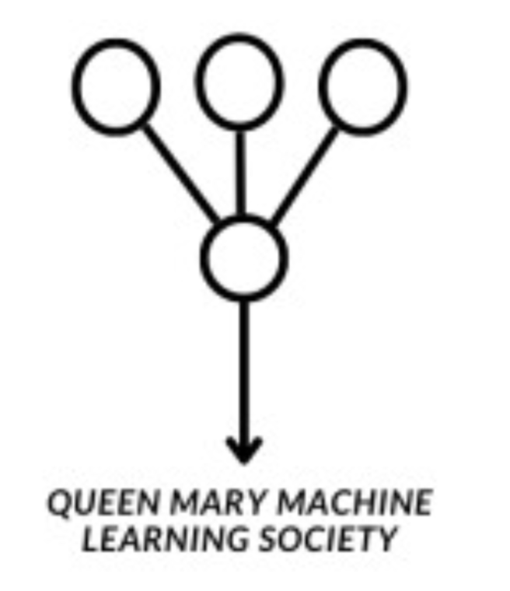
Introduction to Machine Learning (ML)

Slide 2
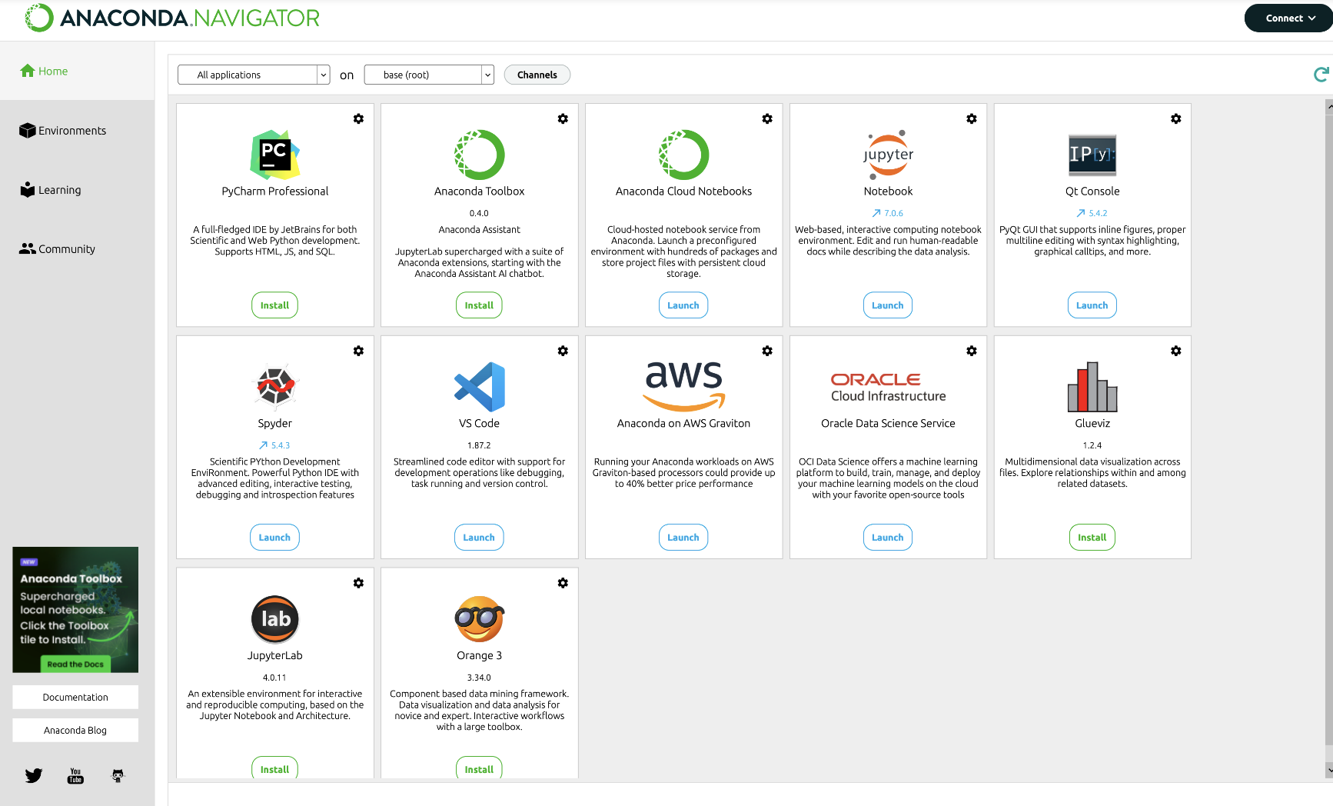

Software / Python

Slide 3
What is Machine Learning ?
“ Machine learning is the science of getting computers to act without being explicitly programmed ” - Andrew Ng

Slide 4
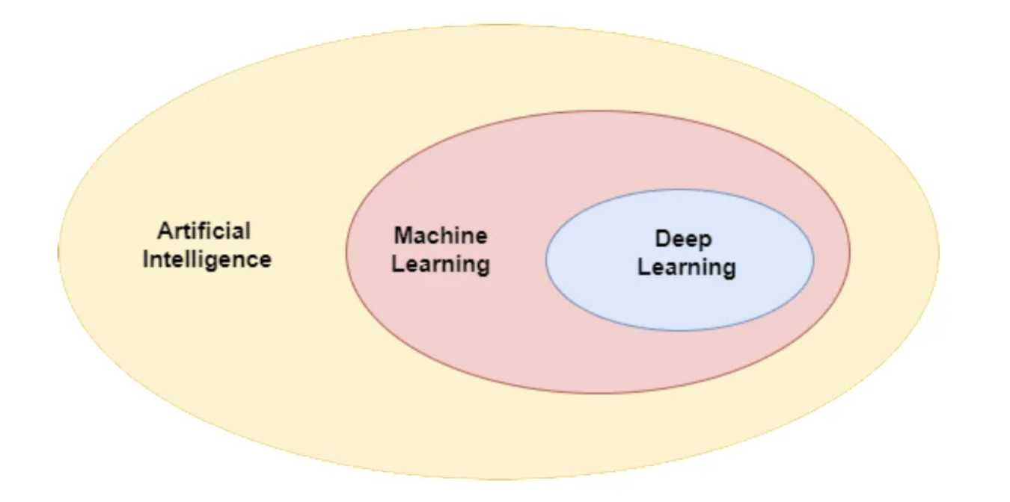
Artificial Intelligence and AI

Slide 5
What is Artificial Intelligence?
“Artificial intelligence (AI) is the broader field focused on creating machines capable of performing tasks that mimic human intelligence, such as reasoning, planning, and language understanding. Machine learning (ML), a subset of AI, specifically involves algorithms that enable machines to learn from data and improve automatically, without explicit programming for each task.” - GPT-4o

Slide 6
Structure of the course (for now)
Supervised Learning
Simple Linear Regression
Multiple Linear Regression
Logistic regression
Regularization Techniques
Deep Learning
Neural Networks
Convolutional Neural Networks
Transformers and Large Languages Models (LLMs)
Unsupervised Learning
Reinforcement Learning (RL)

Slide 7
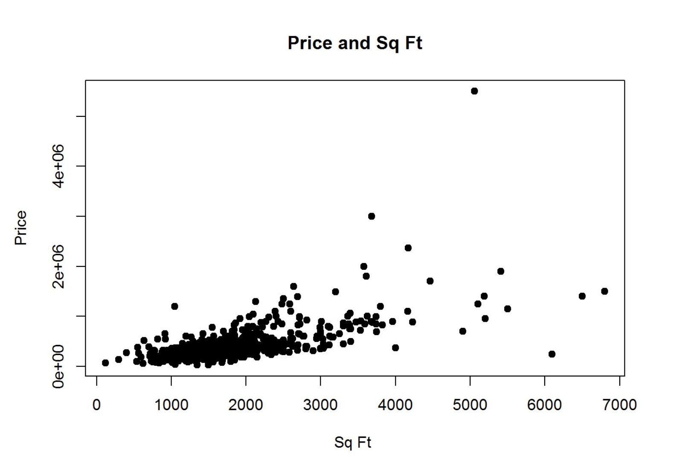
Supervised Learning

Slide 8
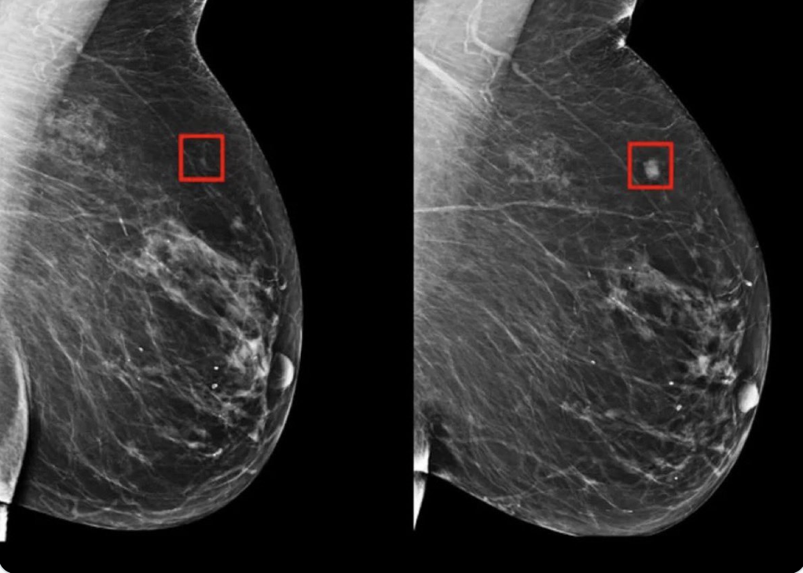
Cancer Detection 5 Years in Advance
https://jamanetwork.com/journals/jamanetworkopen/fullarticle/2824353#:~:text=In%20this%20retrospective%20population%2Dbased,to%206%20years%20before%20diagnosis.

Slide 9
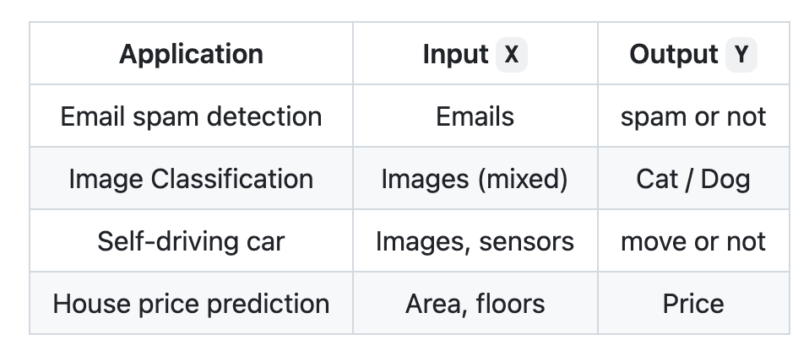
Applications

Slide 10
A couple background questions…

Slide 11
Let’s Get Our Hands Dirty

