Slide 1


How PKI Works
Michelle Nesbitt
SEC 3301
This Photo by Unknown Author is licensed under CC BY-SA
This Photo by Unknown Author is licensed under CC BY-SA
Notes:
Instructions
This presentation will highlight your understanding of public key infrastructure (PKI). Imagine that you were asked to present to a group of new hires at your organization about how PKI works. Create a seven-slide PowerPoint presentation, and explain how PKI works.
Slide requirements are listed below.
Slide 1: Title slide
Slide 2: PKI introduction slide (short paragraph)
Slides 3-4: How messages are sent using PKI (use graphics and text)
Slides 5-6: How messages are received using PKI (use graphics and text)
Slide 7: Reference slide (list at least two references)
Utilize graphics in your PowerPoint slides by using the "Insert" tab and clicking on "Online Pictures."
Use the slide notes function to provide a full description of the slides, explaining PKI
as if the individuals you are briefing do not know anything about PKI.
All sources should be cited in-text and included on the reference slide.

Slide 2
PKI (Public Key Infrastructure)
Framework for secure communication
Digital keys are used for encryption and decryption
Examples:
Certificates for logins and authentications
Use of certificates for secure websites (Meyers & Jernigan, 2021)
Email certificates
Programs and utilities encryption

Slide 3



Sending with PKI
Issue certificates
Issues certificates to users or servers (i.e. Secure e-mail)
Certificate Authority
This Photo by Unknown Author is licensed under CC BY-NC
Business / Domain

Slide 4
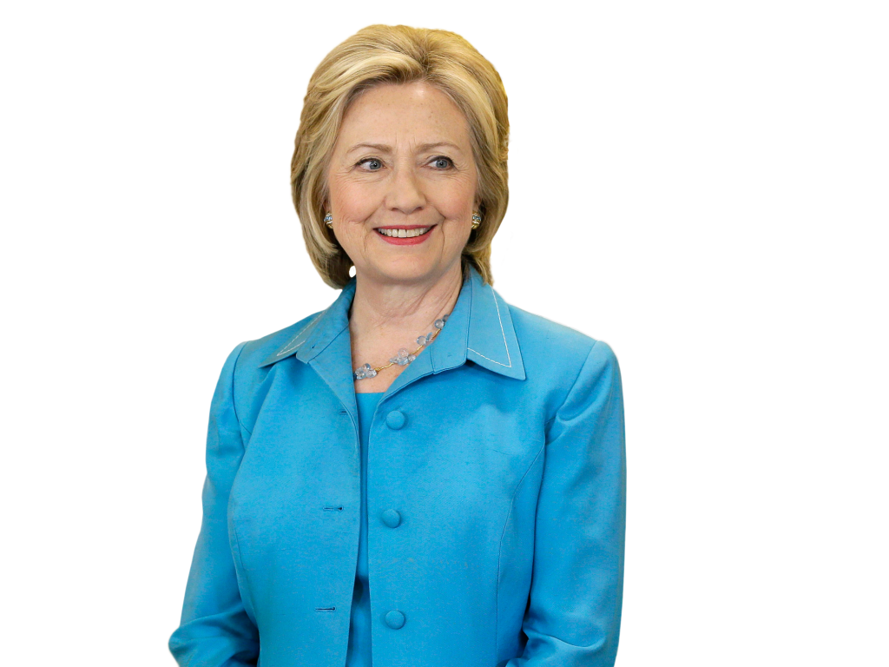

Sending with PKI
See if certificates valid checks CA
Certificate Authority
Sends public key
This Photo by Unknown Author is licensed under CC BY-NC
User has a Public Key/Private Key Pair
Send a message Requests end user’s public key
This Photo by Unknown Author is licensed under CC BY-NC
This Photo by Unknown Author is licensed under CC BY-NC

Slide 5

Receiving with PKI
Certificate Authority
This Photo by Unknown Author is licensed under CC BY-NC
User receives destination’s public key and encrypts the message. The message is then sent.
Decrypts the message with the private key.
CA keeps track of all valid or invalid certificates
This Photo by Unknown Author is licensed under CC BY-NC
This Photo by Unknown Author is licensed under CC BY-NC

Slide 6
Receiving with PKI
This Photo by Unknown Author is licensed under CC BY-NC
User has a Public Key/Private Key Pair
Certificate Authority
Sends public key
See if certificates valid checks CA
Decrypted with recipients private key
Send a message. Requests end user’s public key
This Photo by Unknown Author is licensed under CC BY-NC
This Photo by Unknown Author is licensed under CC BY-NC

Slide 7
References
Meyers, M., & Jernigan, S.(2021). Mike Meyers’ CompTIA Security+ Certification Guide, Exam SY0-601. (3rd ed.). McGraw-Hill Education. https://learning.oreilly.com/library/view/mike-meyers-comptia/9781260473704/ch00_fm03_title.xhtml

