Slide 1
Search Engines and Tries
Adapted from Dr. Angelo Dalli’s “Search Engines and Tries”
UoM (2008)

Slide 2
Search Engines

Slide 3
USER
GENERAL SEARCH PROCESS
DATA
INFORMATION NEED
DOCUMENTS
QUERY
RESULT
QUERY PROCESSING & SEARCHING & RANKING
INDEXING
INDEX
INFORMATION RETRIEVAL SYSTEM

Slide 4
Possible Approaches
  1. String matching (linear search in documents)
  - Slow
  - Difficult to improve
  2. Indexing (*)
    - Fast
    - Flexible to further improvement

Slide 5
Main problems in IR
Document and query indexing
  How to best represent their contents?
Query evaluation (or retrieval process)
  To what extent does a document correspond to a query?
System evaluation
  How good is a system?
  Are the retrieved documents relevant?
  (precision)
  Are all the relevant documents retrieved? (recall)

Slide 6
Document Indexing
Goal = Find the important meanings and create an internal representation
Factors to consider:
  Accuracy to represent meanings (semantics)
  Exhaustiveness (cover all the contents)
  Facility for computer to manipulate
What is the best representation of contents?
  Char. string (char trigrams): not precise enough
  Word: good coverage, not precise
  Phrase: poor coverage, more precise
  Concept: poor coverage, precise
Coverage
(Recall)
Accuracy
(Precision)
String Word Phrase Concept

Slide 7
Retrieval Process
Text
user need Text
logical view logical view
user feedback
query inverted file
retrieved docs
ranked docs
User
Interface
Text Operations
Query
Operations
Indexing
DB Manager
Module
Searching
Index
Text
Dababase
Ranking

Slide 8
Stopwords / Stoplists
Function words do not bear useful information for IR. Examples: of, in, about, with, I, although, …
Stoplist: contain stopwords, not to be used as index
  Prepositions
  Articles
  Pronouns
  Some adverbs and adjectives
  Some frequent words (e.g. document)
The removal of stopwords usually improves effectiveness
A few “standard” stoplists are commonly used

Slide 9
Anatomy of a Search Engine
Seminal paper by Larry Page and Sergey Brin describing the structure of the Google (then known as BackRub) search engine
Data structures will be explained during lecture
Lots of Data Structures and Algorithms optimised for efficiency: Hash tables, tries, B-trees, lexicons, merge sorting, parsers, dynamic programming, etc.
Interested students should download the paper!

Slide 10
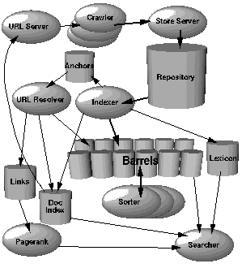
ANATOMY OF A SEARCH ENGINE

Slide 11
System Evaluation
Efficiency: time, space
Effectiveness:
  How is a system capable of retrieving relevant documents?
  Is a system better than another one?
Metrics often used (together):
  Precision = retrieved relevant docs / retrieved docs
  Recall = retrieved relevant docs / relevant docs
  relevant retrieved
retrieved & relevant

Slide 12
TRIE Data Structures

Slide 13
Problem
Store this collection of words in a memory efficient way :
{abacus, abode, dreaded, dust, dusty, planar, east}
How to proceed?

Slide 14
We know Arrays!!
a
b
a
c
u
s
= 6 slots
Can we use fewer slots?
Let’s see how many redundant
slots we are using here!
a
b
o
d
e
= 5 slots
d
r
e
a
d
e
d
= 7 slots
d
u
s
t
= 4 slots
d
u
s
t
y
= 5 slots

Slide 15
Idea?
Can we come up with a solution where we can take advantage of the common letters in the words?
It would be great if we can reduce the redundancy, and use the same letter for more than one word!

Slide 16
Problem
Draw a trie corresponding to the collection of words:
{abacus, abode, dreaded, dust, dusty, planar, east}

Slide 17
Trie
Store characters in each node, not keys
Use characters of the key to guide the search process
From retrieval, but pronounced “try”

Slide 18
Example
g
s
t
o
i
h
u
go
e
n
m
she
Make sure the word
“she” is not found…
…unless it has been
explicitly inserted!
sun
d
l
e
shed
time
l
shell

Slide 19
Applications
Spell checkers
Data compression
Computational biology
Routing tables for IP addresses
Storing/Querying XML documents
… and many other

Slide 20
T.insert(“tick”)
g
s
t
o
i
h
u
go
e
n
c
m
sun
d
l
e
k
shed
tick
time
l
shell
place a marker

Slide 21
T.insert(“tick”)
g
s
t
o
i
h
u
go
e
n
c
m
sun
d
l
e
k
shed
tick
time
l
shell

Slide 22
T.search(“group”)
g
s
t
o
null
i
h
u
Failure
return false
go
e
n
c
m
sun
d
l
e
k
shed
tick
time
l
shell

Slide 23
T.search(“timer”)
g
s
t
o
i
h
u
go
e
n
c
m
sun
d
l
e
k
shed
tick
time
l
Failure
return false
null
shell

Slide 24
T.search(“she”)
g
s
t
o
i
h
u
go
e
n
c
m
String found.
But no marker!
sun
Failure
return false
d
l
e
k
shed
tick
time
l
shell

Slide 25
T.search(“shed”)
g
s
t
o
i
h
u
go
e
n
c
m
sun
String found.
Marker found!
d
l
k
e
shed
tick
time
Success
return true
l
shell

Slide 26
Indexed Search Tree (Trie)
Special case of tree
Applicable when
  Key C can be decomposed into a sequence of subkeys C₁, C₂, … C_{n}
  Redundancy exists between subkeys
Approach
  Store subkey at each node
  Path through trie yields full key
Example
  Huffman tree
C₁
C₂
C₃
C₃
C₄

Slide 27
Tries
Useful for searching strings
  String decomposes into sequence of letters
  Example
    “ART” ⇒ “A” “R” “T”
Can be very fast
  Less overhead than hashing
May reduce memory
  Exploiting redundancy
May require more memory
  Explicitly storing substrings
A
R
S
E
T
“ART”

Slide 28
Types of Tries
Standard
  Single character per node
Compressed
  Eliminating chains of nodes
Compact
  Stores indices into original string(s)
Suffix
  Stores all suffixes of string

Slide 29
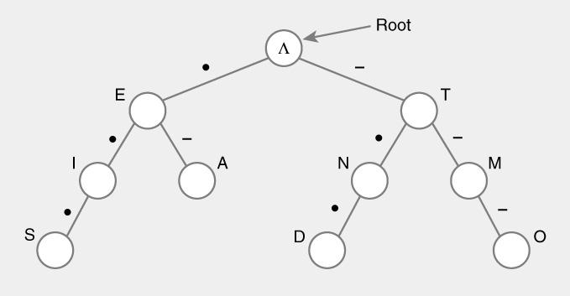
Standard Tries
Approach
  Each node (except root) is labeled with a character
  Children of node are ordered (alphabetically)
  Paths from root to leaves yield all input strings
Trie for Morse Code

Slide 30
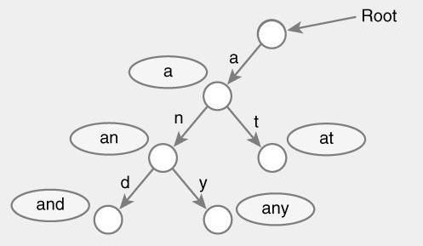
Standard Trie Example
For strings
  { a, an, and, any, at }

Slide 31
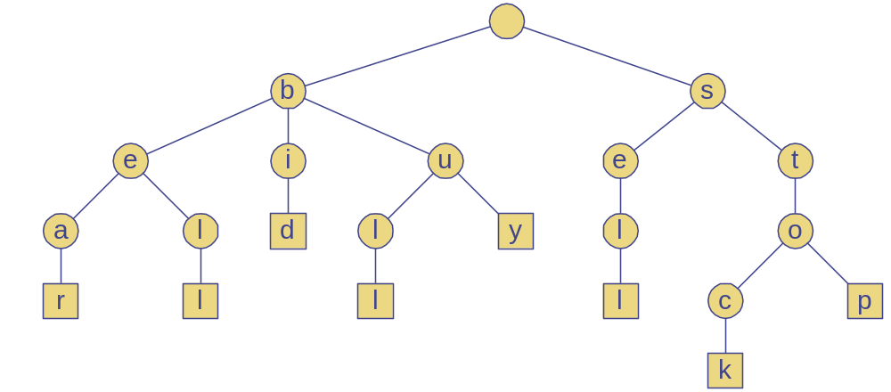
Standard Trie Example
For strings
  { bear, bell, bid, bull, buy, sell, stock, stop }

Slide 32
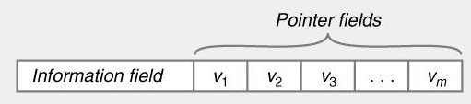
Standard Tries
Node structure
  Value between 1…m
  Reference to m children
    Array or linked list
Example
  Class Node {
    Letter value; // Letter V = { V₁, V₂, … V_{m} }
    Node child[ m ];
  }

Slide 33
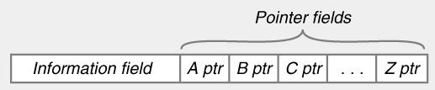
Standard Tries
Efficiency
  Uses O(n) space
  Supports search / insert / delete in O(d×m) time
  For
    n total size of strings indexed by trie
    d length of the parameter string
    m size of the alphabet

Slide 34
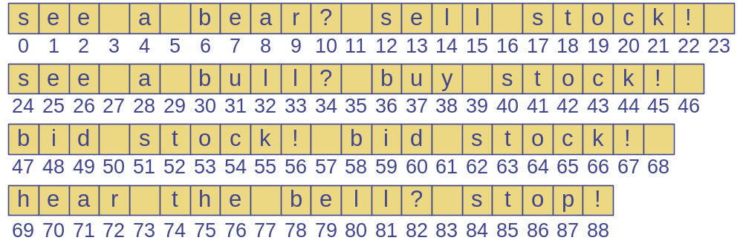
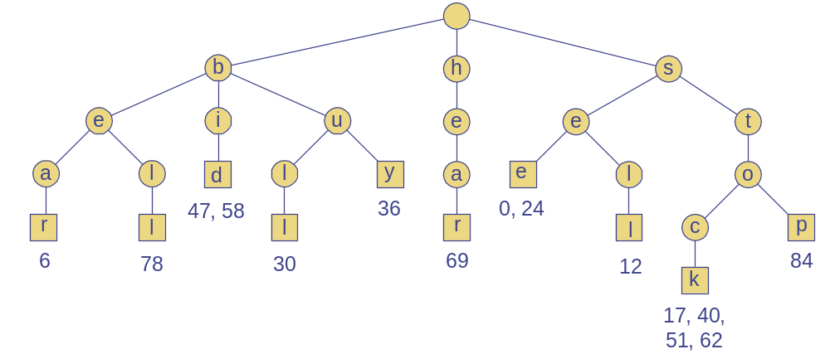
Word Matching Trie
Insert words into trie
Each leaf stores occurrences of word in the text

Slide 35
Compressed Trie
Observation
  Internal node v of T is redundant if v has one child and is not the root
Approach
  A chain of redundant nodes can be compressed
    Replace chain with single node
    Include concatenation of labels from chain
Result
  Internal nodes have at least 2 children
  Some nodes have multiple characters

Slide 36
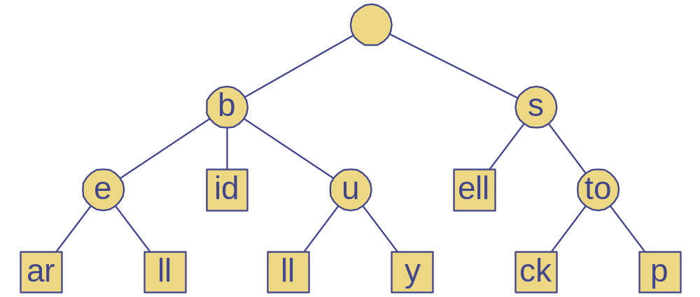
Compressed Trie
Example

Slide 37
Compact Tries
Compact representation of a compressed trie
Approach
  For an array of strings S = S[0], … S[s-1]
  Store ranges of indices at each node
    Instead of substring
  Represent as a triplet of integers (i, j, k)
    Such that X = s[i][j..k]
  Example: S[0] = “abcd”, (0,1,2) = “bc”
Properties
  Uses O(s) space, where s = # of strings in the array
  Serves as an auxiliary index structure

Slide 38
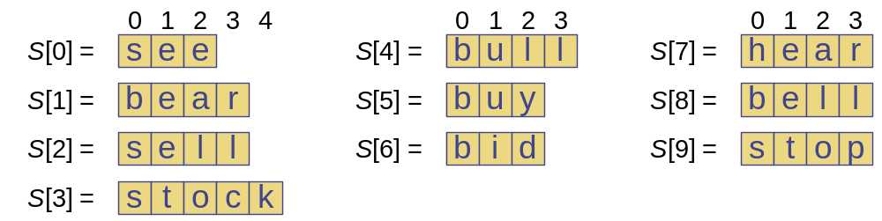
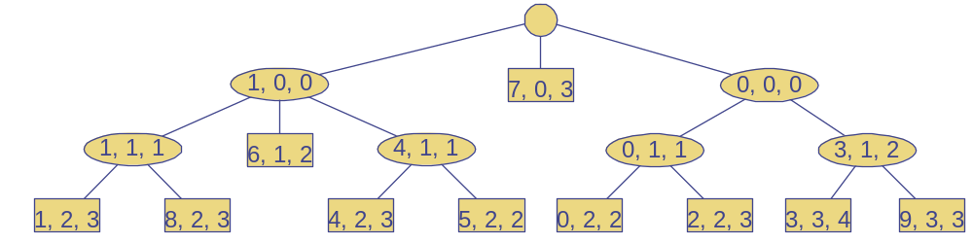
Compact Representation
Example

Slide 39
Tries and Search Engines
Search engine index
  Collection of all searchable words
  Stored in compressed trie
Each leaf of trie
  Associated with a word
  List of pages (URLs) containing that word
    Called occurrence list
Trie is kept in memory (fast)
Occurrence lists kept in external memory
  Ranked by relevance

