Slide 1
Search Engines and Tries
Adapted from Dr. Angelo Dalli’s “Search Engines and Tries”
UoM (2008)

Slide 2
Search Engines

Slide 3
USER
GENERAL SEARCH PROCESS
DATA
INFORMATION NEED
DOCUMENTS
QUERY
RESULT
QUERY PROCESSING & SEARCHING & RANKING
INDEXING
INDEX
INFORMATION RETRIEVAL SYSTEM

Slide 4
Possible Approaches
  1. String matching (linear search in documents)
  - Slow
  - Difficult to improve
  2. Indexing (*)
    - Fast
    - Flexible to further improvement

Slide 5
Main problems in IR
Document and query indexing
  How to best represent their contents?
Query evaluation (or retrieval process)
  To what extent does a document correspond to a query?
System evaluation
  How good is a system?
  Are the retrieved documents relevant?
  (precision)
  Are all the relevant documents retrieved? (recall)

Slide 6
Document Indexing
Goal = Find the important meanings and create an internal representation
Factors to consider:
  Accuracy to represent meanings (semantics)
  Exhaustiveness (cover all the contents)
  Facility for computer to manipulate
What is the best representation of contents?
  Char. string (char trigrams): not precise enough
  Word: good coverage, not precise
  Phrase: poor coverage, more precise
  Concept: poor coverage, precise
Coverage
(Recall)
Accuracy
(Precision)
String Word Phrase Concept

Slide 7
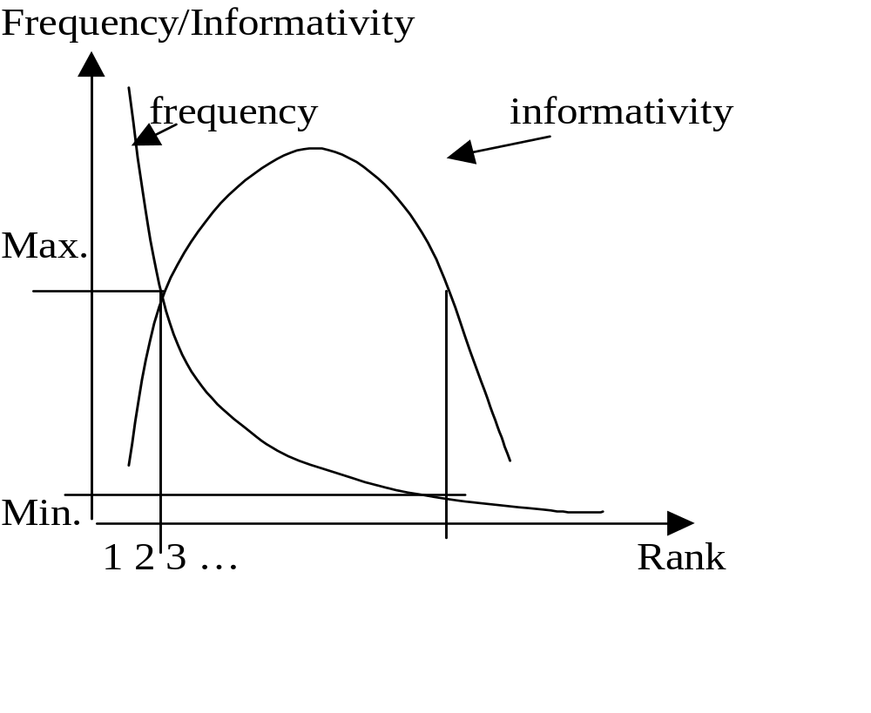
Keyword Selection and Weighting
How to select important keywords?
  Simple method: using middle-frequency words

Slide 8
TF * IDF Weighting Schema
tf = term frequency
  frequency of a term/keyword in a document
The higher the tf, the higher the importance (weight) for the doc.
df = document frequency
  no. of documents containing the term
  distribution of the term
idf = inverse document frequency
  the unevenness of term distribution in the corpus
  the specificity of term to a document
The more the term is distributed evenly, the less it is specific to a document
weight(t,D) = tf(t,D) * idf(t)

Slide 9
Retrieval Process
Text
user need Text
logical view logical view
user feedback
query inverted file
retrieved docs
ranked docs
User
Interface
Text Operations
Query
Operations
Indexing
DB Manager
Module
Searching
Index
Text
Dababase
Ranking

Slide 10
Stopwords / Stoplists
Function words do not bear useful information for IR. Examples: of, in, about, with, I, although, …
Stoplist: contain stopwords, not to be used as index
  Prepositions
  Articles
  Pronouns
  Some adverbs and adjectives
  Some frequent words (e.g. document)
The removal of stopwords usually improves effectiveness
A few “standard” stoplists are commonly used

Slide 11
Anatomy of a Search Engine
Seminal paper by Larry Page and Sergey Brin describing the structure of the Google (then known as BackRub) search engine
Data structures will be explained during lecture
Lots of Data Structures and Algorithms optimised for efficiency: Hash tables, tries, B-trees, lexicons, merge sorting, parsers, dynamic programming, etc.
Interested students should download the paper!

Slide 12
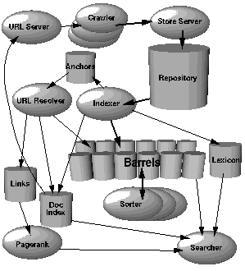
ANATOMY OF A SEARCH ENGINE

Slide 13
System Evaluation
Efficiency: time, space
Effectiveness:
  How is a system capable of retrieving relevant documents?
  Is a system better than another one?
Metrics often used (together):
  Precision = retrieved relevant docs / retrieved docs
  Recall = retrieved relevant docs / relevant docs
  relevant retrieved
retrieved & relevant

Slide 14
Test Corpus
Compare different IR systems on the same test corpus
A test corpus contains:
  A set of documents
  A set of queries
  Relevance judgment for every document-query pair (desired answers for each query)
The results of a system is compared with the desired answers.

Slide 15
IR on the Web
No stable document collection (spider, crawler)
Invalid document, duplication, etc.
Huge number of documents (partial collection)
Multimedia documents
Great variation of document quality
Multilingual problem

Slide 16
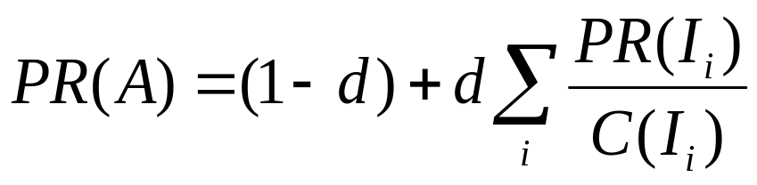
PageRank in Google
I₁
A
B
I₂
Assign a numeric value to each page
The more a page is referred to by important pages, the more this page is important
d: damping factor (0.85)
Many other criteria: e.g. proximity of query words
  “…information retrieval …” better than “… information … retrieval …”

Slide 17
Final remarks on IR
IR is related to many areas:
  NLP, AI, database, machine learning, user modeling…
  library, Web, multimedia search, …
Relatively weak theories
Very strong tradition of experiments
Many remaining (and exciting) problems
Difficult area: Intuitive methods do not necessarily improve effectiveness in practice

Slide 18
TRIE Data Structures

Slide 19
Problem
Store this collection of words in a memory efficient way :
{abacus, abode, dreaded, dust, dusty, planar, east}
How to proceed?

Slide 20
We know Arrays!!
a
b
a
c
u
s
= 6 slots
Can we use fewer slots?
Let’s see how many redundant
slots we are using here!
a
b
o
d
e
= 5 slots
d
r
e
a
d
e
d
= 7 slots
d
u
s
t
= 4 slots
d
u
s
t
y
= 5 slots

Slide 21
Idea?
Can we come up with a solution where we can take advantage of the common letters in the words?
It would be great if we can reduce the redundancy, and use the same letter for more than one word!

Slide 22
Problem
Draw a trie corresponding to the collection of words:
{abacus, abode, dreaded, dust, dusty, planar, east}

Slide 23
Trie
Store characters in each node, not keys
Use characters of the key to guide the search process
From retrieval, but pronounced “try”

Slide 24
Example
g
s
t
o
i
h
u
go
e
n
m
she
Make sure the word
“she” is not found…
…unless it has been
explicitly inserted!
sun
d
l
e
shed
time
l
shell

Slide 25
Applications
Spell checkers
Data compression
Computational biology
Routing tables for IP addresses
Storing/Querying XML documents
… and many other

Slide 26
T.insert(“tick”)
g
s
t
o
i
h
u
go
e
n
c
m
sun
d
l
e
k
shed
tick
time
l
shell
place a marker

Slide 27
T.insert(“tick”)
g
s
t
o
i
h
u
go
e
n
c
m
sun
d
l
e
k
shed
tick
time
l
shell

Slide 28
T.search(“group”)
g
s
t
o
null
i
h
u
Failure
return false
go
e
n
c
m
sun
d
l
e
k
shed
tick
time
l
shell

Slide 29
T.search(“timer”)
g
s
t
o
i
h
u
go
e
n
c
m
sun
d
l
e
k
shed
tick
time
l
Failure
return false
null
shell

Slide 30
T.search(“she”)
g
s
t
o
i
h
u
go
e
n
c
m
String found.
But no marker!
sun
Failure
return false
d
l
e
k
shed
tick
time
l
shell

Slide 31
T.search(“shed”)
g
s
t
o
i
h
u
go
e
n
c
m
sun
String found.
Marker found!
d
l
k
e
shed
tick
time
Success
return true
l
shell

Slide 32
Indexed Search Tree (Trie)
Special case of tree
Applicable when
  Key C can be decomposed into a sequence of subkeys C₁, C₂, … C_{n}
  Redundancy exists between subkeys
Approach
  Store subkey at each node
  Path through trie yields full key
Example
  Huffman tree
C₁
C₂
C₃
C₃
C₄

Slide 33
Tries
Useful for searching strings
  String decomposes into sequence of letters
  Example
    “ART” ⇒ “A” “R” “T”
Can be very fast
  Less overhead than hashing
May reduce memory
  Exploiting redundancy
May require more memory
  Explicitly storing substrings
A
R
S
E
T
“ART”

Slide 34
Types of Tries
Standard
  Single character per node
Compressed
  Eliminating chains of nodes
Compact
  Stores indices into original string(s)
Suffix
  Stores all suffixes of string

Slide 35
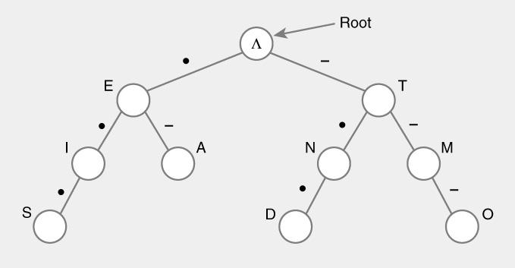
Standard Tries
Approach
  Each node (except root) is labeled with a character
  Children of node are ordered (alphabetically)
  Paths from root to leaves yield all input strings
Trie for Morse Code

Slide 36
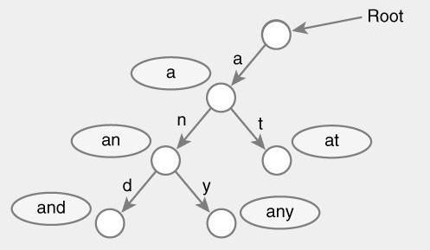
Standard Trie Example
For strings
  { a, an, and, any, at }

Slide 37
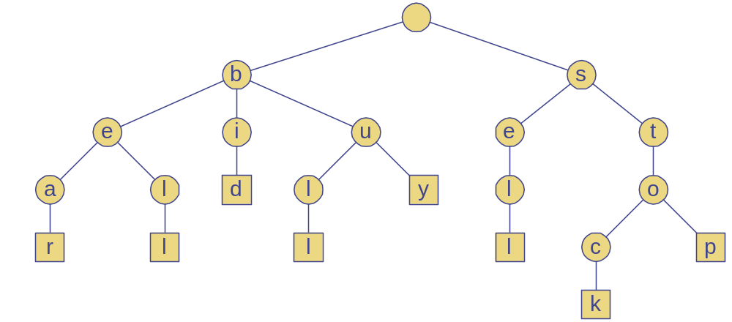
Standard Trie Example
For strings
  { bear, bell, bid, bull, buy, sell, stock, stop }

Slide 38
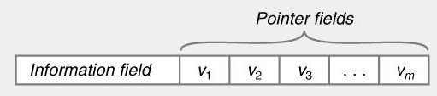
Standard Tries
Node structure
  Value between 1…m
  Reference to m children
    Array or linked list
Example
  Class Node {
    Letter value; // Letter V = { V₁, V₂, … V_{m} }
    Node child[ m ];
  }

Slide 39
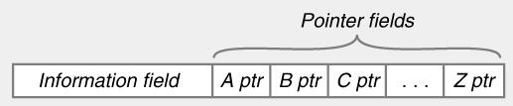
Standard Tries
Efficiency
  Uses O(n) space
  Supports search / insert / delete in O(d×m) time
  For
    n total size of strings indexed by trie
    d length of the parameter string
    m size of the alphabet

Slide 40
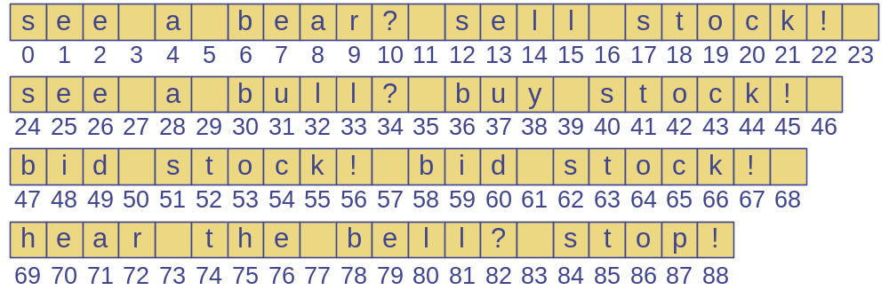
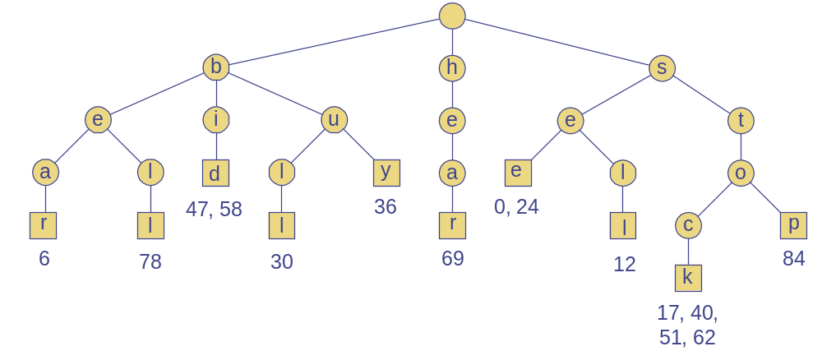
Word Matching Trie
Insert words into trie
Each leaf stores occurrences of word in the text

Slide 41
Compressed Trie
Observation
  Internal node v of T is redundant if v has one child and is not the root
Approach
  A chain of redundant nodes can be compressed
    Replace chain with single node
    Include concatenation of labels from chain
Result
  Internal nodes have at least 2 children
  Some nodes have multiple characters

Slide 42
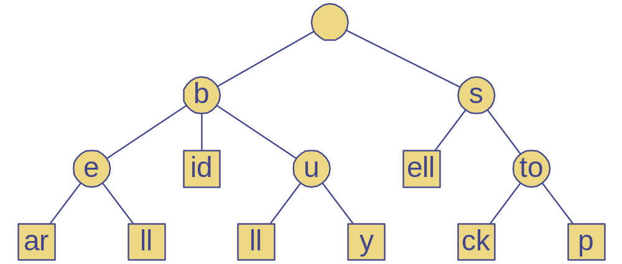
Compressed Trie
Example

Slide 43
Compact Tries
Compact representation of a compressed trie
Approach
  For an array of strings S = S[0], … S[s-1]
  Store ranges of indices at each node
    Instead of substring
  Represent as a triplet of integers (i, j, k)
    Such that X = s[i][j..k]
  Example: S[0] = “abcd”, (0,1,2) = “bc”
Properties
  Uses O(s) space, where s = # of strings in the array
  Serves as an auxiliary index structure

Slide 44
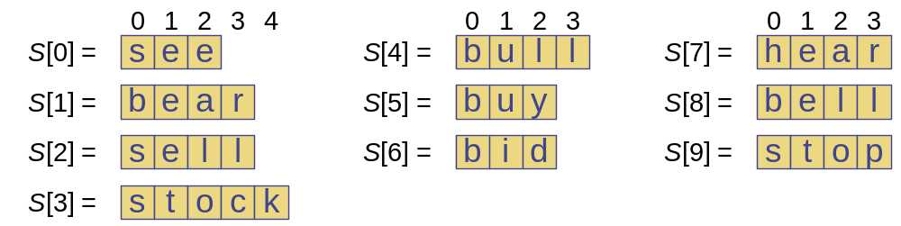
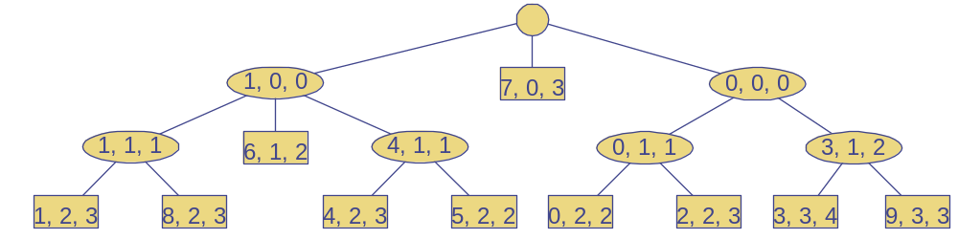
Compact Representation
Example

Slide 45
Tries and Search Engines
Search engine index
  Collection of all searchable words
  Stored in compressed trie
Each leaf of trie
  Associated with a word
  List of pages (URLs) containing that word
    Called occurrence list
Trie is kept in memory (fast)
Occurrence lists kept in external memory
  Ranked by relevance

