Slide 1
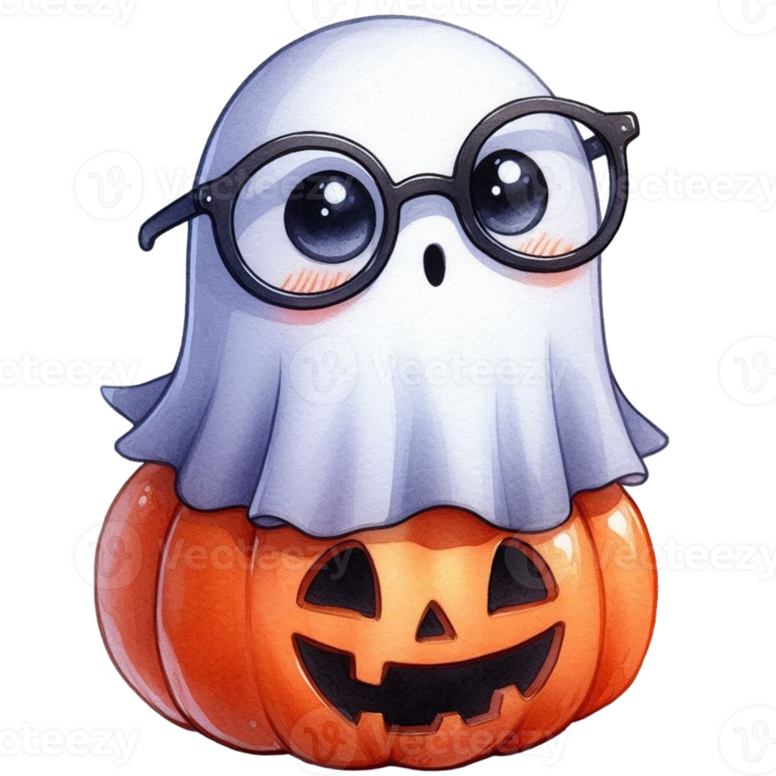

MISTWORKS

Slide 3
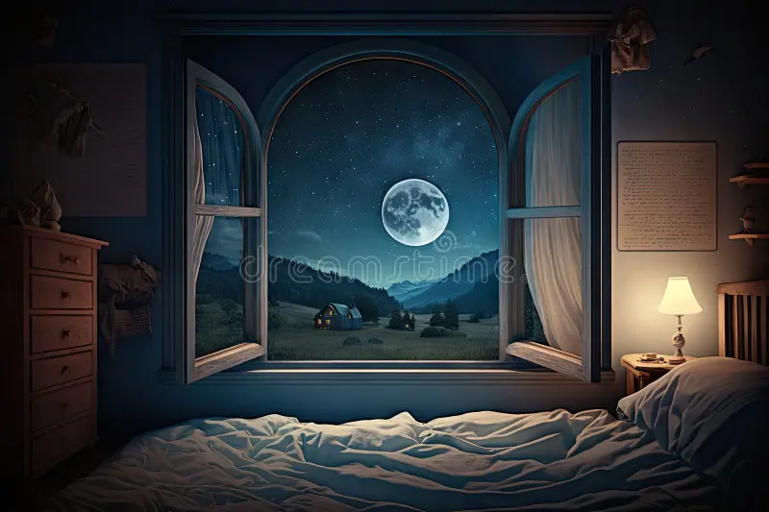

If you are reading this, then I am knee deep in trouble and probably will need some help. These might be my…
Last Words
→Start
– Credits
– Exit

Slide 4
L
O
A
D
I
N
G

Slide 5
Asset Sources
https://es.vecteezy.com/png/49994079-un-dibujos-animados-fantasma-vistiendo-lentes-y-un-calabaza
Ghost Image https://www.youtube.com/watch?v=f2G449M-Mp8 Ghost SFX https://www.youtube.com/watch?v=PqCfH6dv948
Type SFX
https://www.vecteezy.com/png/46829315-old-typewriter-isolated-on-transparent-background
Typewriter Image https://www.youtube.com/watch?v=Am7YlqM6WCc
Night ambient SFX

