Slide 1


App Shiny machine learning
Komi – Azat – Lucas – Mamadou - Soheil
Didier Morel

Slide 2
Table of contents
Context presentation
Expected rendering
Organization
First step
Komi Agblodoe - Azat Aleksanyan - Lucas Chabeau – Mamadou Diamban – Soheil Salmani
Didier Morel

Slide 3
3
Context
App
Organization
Project proposed by
Didier MOREL, Data Scientist @ BD
Becton, Dickinson and Company is an American medical technology company
Offers innovative solutions
Komi Agblodoe - Azat Aleksanyan - Lucas Chabeau – Mamadou Diamban – Soheil Salmani
Didier Morel

Slide 4
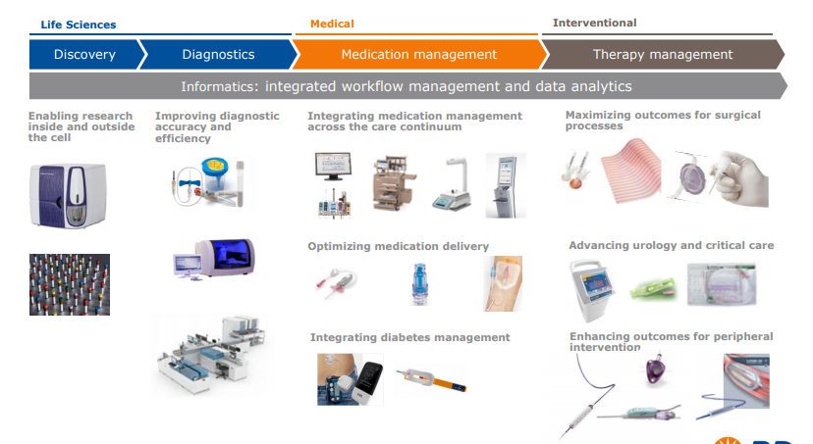
4
Context
App
Organization
BD’s workflow and our integration
Komi Agblodoe - Azat Aleksanyan - Lucas Chabeau – Mamadou Diamban – Soheil Salmani
Didier Morel

Slide 5

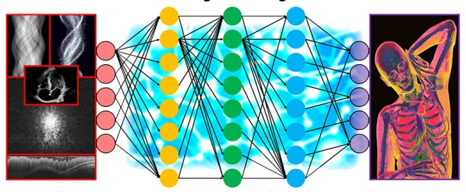
5
Context
App
Organization
ML and healthcare industry
“ Machine learning is swiftly infiltrating many areas within the healthcare industry, from diagnosis and prognosis to drug development and epidemiology, with significant potential to transform the medical landscape. ” © nature.com
Komi Agblodoe - Azat Aleksanyan - Lucas Chabeau – Mamadou Diamban – Soheil Salmani
Didier Morel

Slide 6
6
Context
App
Organization
Presentation of the application
Develop a Shiny application to test and compare ML algorithms over any kind of dataset
Komi Agblodoe - Azat Aleksanyan - Lucas Chabeau – Mamadou Diamban – Soheil Salmani
Didier Morel

Slide 7
7
Context
App
Organization
Issues
Extract the data from its source (.txt, .csv, Excel, etc.)
Different code for each format
Identify the type of each variable
Can be tedious to do that manually for a large dataset with lots of variables
Manage missing values
Several methods exist to deal with missing values
Komi Agblodoe - Azat Aleksanyan - Lucas Chabeau – Mamadou Diamban – Soheil Salmani
Didier Morel

Slide 8
8
Context
App
Organization
Issues
Select ML algorithm and his settings (called hyperparameters)
Many differents types of ML methods exist
Often, we don't know which algorithm to choose until we test some of them
Launch the training phase
Can be long and it takes time if we test different ML methods with different hyperparameters
Analyze the quality of the model
Komi Agblodoe - Azat Aleksanyan - Lucas Chabeau – Mamadou Diamban – Soheil Salmani
Didier Morel

Slide 9
9
Context
App
Organization
The need
A graphical interface : the user doesn't need to code
Flexible way to :
Import data and to do the data preprocessing
Select the method to deal with missing values
Identify each type of variable automatically
Choose ML algorithms and hyperparameters we want to test and compare
Generate a quick analytical report of the results (with tables and graphics)
Komi Agblodoe - Azat Aleksanyan - Lucas Chabeau – Mamadou Diamban – Soheil Salmani
Didier Morel

Slide 10
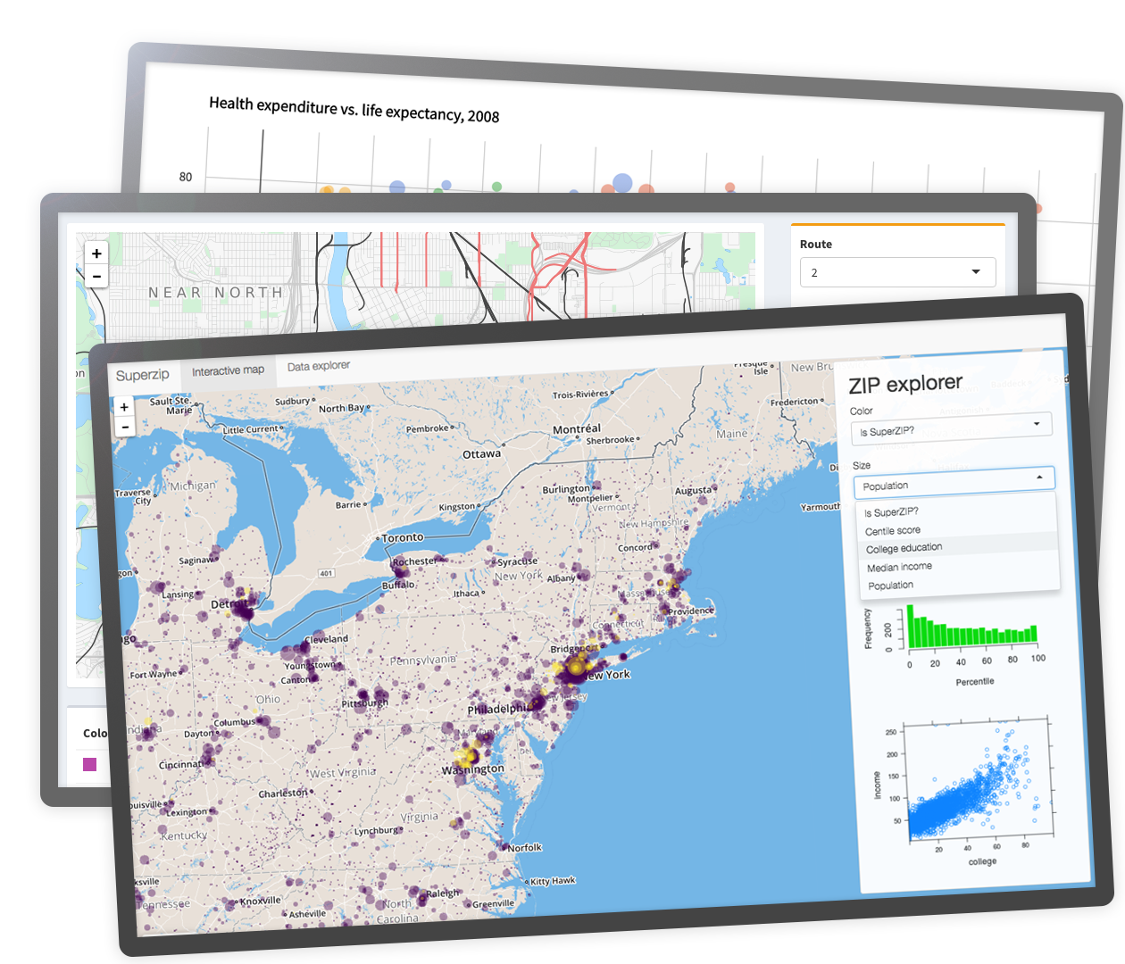
10
Context
App
Organization
Graphical interface with Shiny
Shiny is an R package that makes it easy to build interactive web apps straight from R.
Komi Agblodoe - Azat Aleksanyan - Lucas Chabeau – Mamadou Diamban – Soheil Salmani
Didier Morel

Slide 11
11
Context
App
Organization
Features
The application must be compatible with any type of dataset (CSV, Excel, etc.)
The application can detect automatically each type of variable for a dataset
The user can select easily the set of variables to consider
The user can choose easily a list of ML algorithms and hyperparameters to use for a dataset
After the process, the application can generate a quick analytical report of the results and export it
Komi Agblodoe - Azat Aleksanyan - Lucas Chabeau – Mamadou Diamban – Soheil Salmani
Didier Morel

Slide 12
12
Context
App
Organization
Algorithms used
Machine Learning
Selection of important variables
Different algorithms
Library caret
Komi Agblodoe - Azat Aleksanyan - Lucas Chabeau – Mamadou Diamban – Soheil Salmani
Didier Morel

Slide 13
13
Context
App
Organization
Planning
Analysis phase (functional) or design
Implementation or programing phase
Delivery phase
Komi Agblodoe - Azat Aleksanyan - Lucas Chabeau – Mamadou Diamban – Soheil Salmani
Didier Morel

Slide 14
14
Context
App
Organization
Analysis phase
Identify the context
Determine needs and constraints
Determine design parameters
Prepare specifications
Komi Agblodoe - Azat Aleksanyan - Lucas Chabeau – Mamadou Diamban – Soheil Salmani
Didier Morel

Slide 15
15
Context
App
Organization
Implementation / programing phase
Algorithms
Version management
Unit tests
Involving
Komi Agblodoe - Azat Aleksanyan - Lucas Chabeau – Mamadou Diamban – Soheil Salmani
Didier Morel

Slide 16
16
Context
App
Organization
Delivery phase
Validation
Software documentation
Komi Agblodoe - Azat Aleksanyan - Lucas Chabeau – Mamadou Diamban – Soheil Salmani
Didier Morel

Slide 17
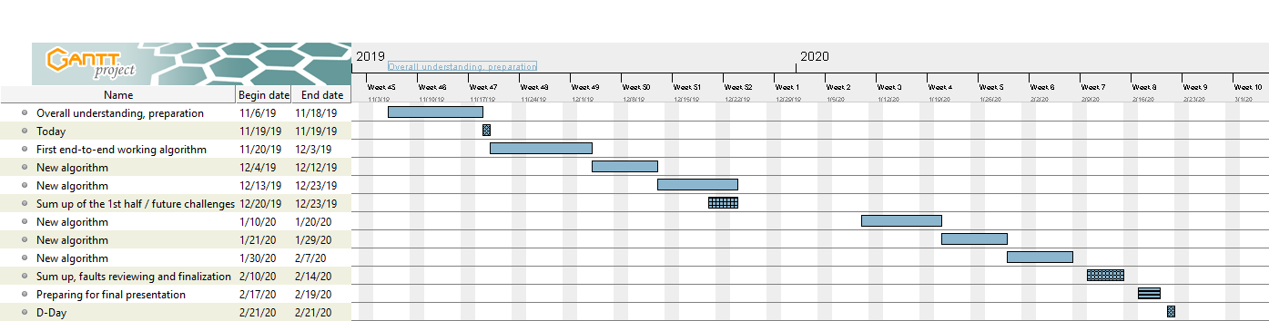
17
Context
App
Organization
Gantt
Komi Agblodoe - Azat Aleksanyan - Lucas Chabeau – Mamadou Diamban – Soheil Salmani
Didier Morel

Slide 18
18
Structure of app
ui.r
(Interface)
server.r
(Computing)
Komi Agblodoe - Azat Aleksanyan - Lucas Chabeau – Mamadou Diamban – Soheil Salmani
Didier Morel

Slide 19
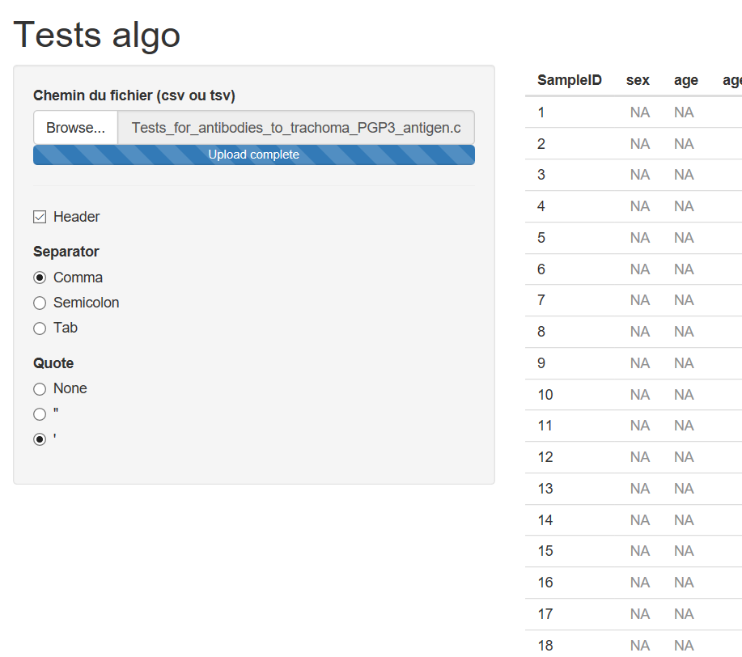
19
Data uploading
csv / tsv
flexible
First limit with big datasets
Komi Agblodoe - Azat Aleksanyan - Lucas Chabeau – Mamadou Diamban – Soheil Salmani
Didier Morel

Slide 20
Thanks for your attention.
Have you got any questions?
Komi Agblodoe - Azat Aleksanyan - Lucas Chabeau – Mamadou Diamban – Soheil Salmani
Didier Morel

