Slide 1

E-COMMERCE
MBA(BA)
Session I: INTRODUCTION

Slide 2
Education is not the learning of facts, but training of the mind to think
Albert Einstein

Slide 3
Dr. Parvathi Jayaprakash
Post Doctoral Research Fellow, Centre for Society and Policy, IISc
Research Interests: Data Policy, Digital Healthcare, Sustainable Development, ICT 4 Society
Teaching Interests: Business Analytics, Spreadsheet Modelling, Marketing Analytics, Management Information Systems

Slide 4

This Photo by Unknown Author is licensed under CC BY-SA

Slide 5
Business Analytics?
What according to you is
Why are you interested in this specialization?

Slide 6

Aren’t these sites familiar ??

Slide 7

E-COMMERCE
Electronic commerce or internet commerce
Buying and selling of goods or services using the internet,
the transfer of money and data to execute these transactions.
This Photo by Unknown Author is licensed under CC BY-NC

Slide 8
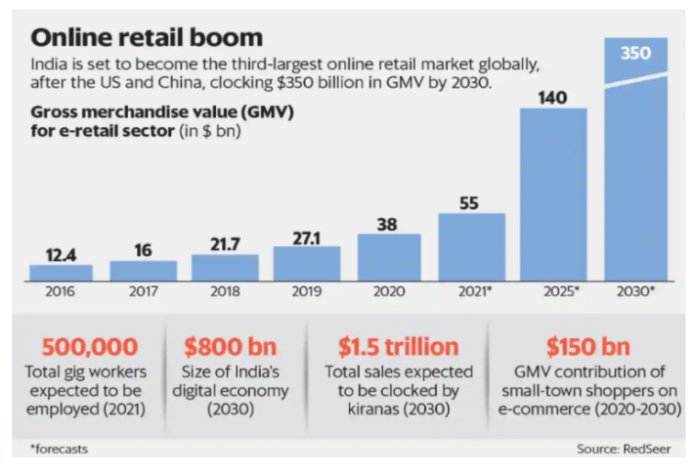

Slide 9
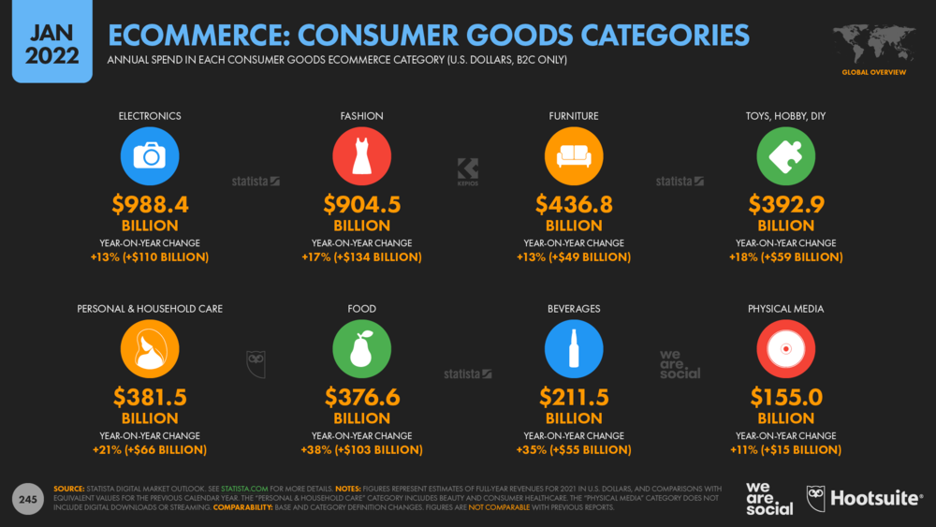

Slide 10
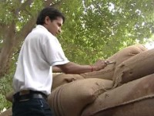
ITC e-Choupal
Notes:
https://www.youtube.com/watch?v=to5_HxvrZMs

Slide 11
COURSE OUTLINE

Slide 12
ASSESSMENTS
Class Participation + Quizzes (Individual) 20 Marks
In Class Presentations (Group/Individual) 20 Marks
Mid Term (Individual) 30 Marks
Project (Group) 30 Marks
End Term Examination

Slide 13
REFERENCE BOOKS
E-Commerce: An Indian Perspective by P. T. Joseph
Ecommerce Analytics Analyze and Improve the Impact of Your Digital Strategy by Judah Phillips

Slide 14
EXPECTATIONS
ON time to class
ON time submission of tasks
Be attentive and participative in class
Learn from peers and from the faculty in the class
Avoid visiting the faculty for revisiting evaluation components or groups
Dynamic groups- be comfortable with the cohort

Slide 15

Choose any industry of your choice
List down the number of e-commerce players in the market
Select any e-commerce player of your choice from that list.
Understand the business model
Learn their marketing strategy
Explore the e-commerce site, list down what worked for you and what did not work for you

Slide 16
Thanks!
ANY QUESTIONS?
You can find me at:
parvathi.pdf@gmail.com

