Slide 1
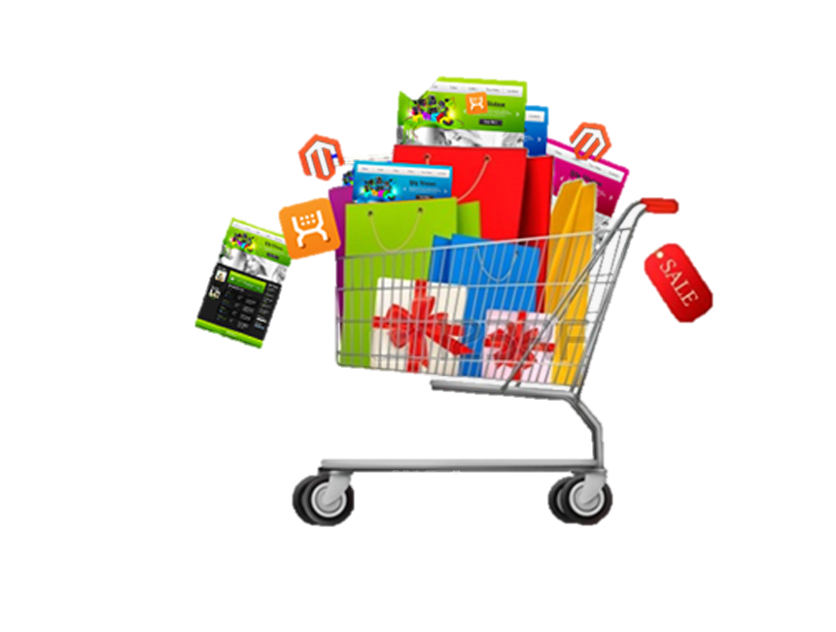
E-COMMERCE
MBA(BA)
Session 3: Business Models for e-Commerce

Slide 2
What is Business Model?
A plan for the successful operation of a business and how it relates to existing products or services in the industry.
It also encompasses the revenue sources as well as the potential customer base.

Slide 3
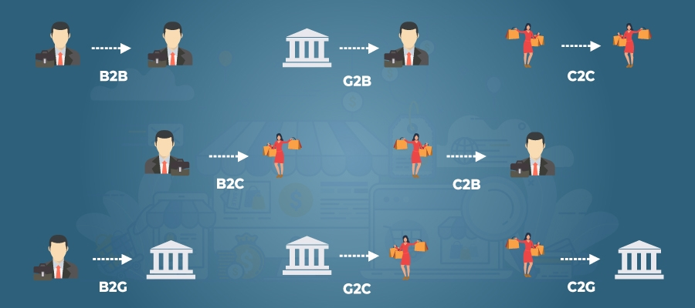
BM according to transacting parties

Slide 4
B2B
When a mobile app development company is offering its IT solutions to some real estate companies seeking to build an app for their client base, in this situation, the mobile app company advertises its service on their website while real estate companies that are interested can request a price quotation through the same channel.
Notes:
TCS
Indian Mart
Accenture
IBM
Tech Mahindra
EasyLeadz
Leadzen
LeadNXT
UpLead

Slide 5
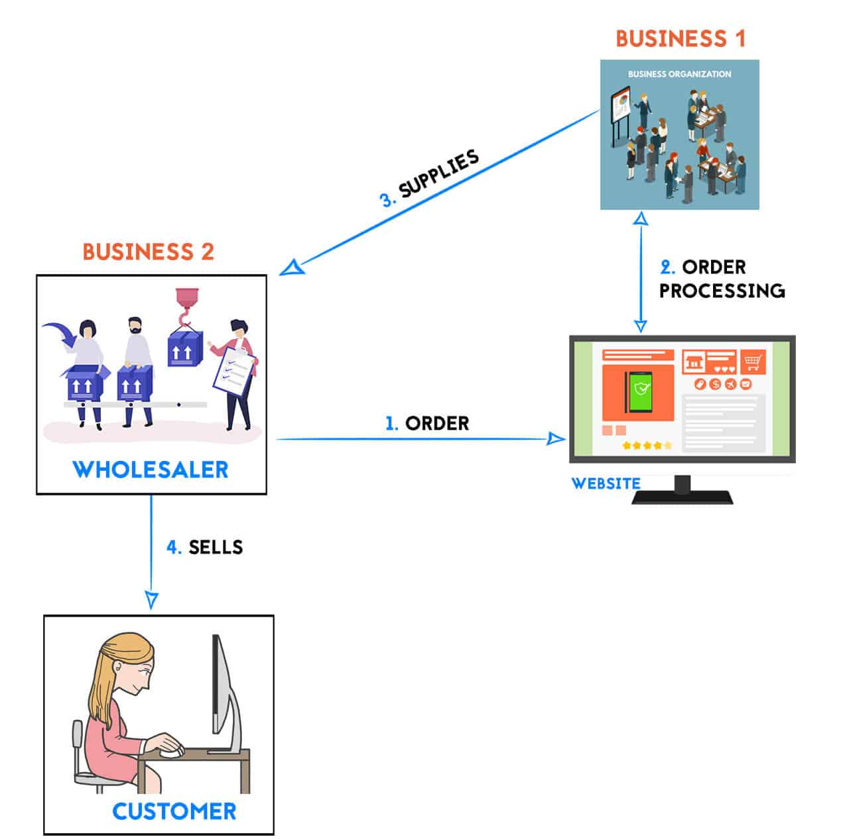
B2B

Slide 6
B2B Model
PROs
The B2B market is predictable as well as stable.
There is greater customer loyalty than in other models of eCommerce
B2B features lower operating costs after the initial setup since most processes are automated and valid for a long time.
One can generate a sustainable and reasonably high-profit margin from repeat clients.
CONs
B2B often requires substantial capital to set up.
Costs include business registration, branding, and setting up a physical or virtual office.
There is a smaller pool of customers when compared to other models.
Since B2B marketing targets businesses, sales take a longer time to convert
Smaller customer base might result in giving huge discounts for bulk purchase, resulting in lower profit of the seller.

Slide 7
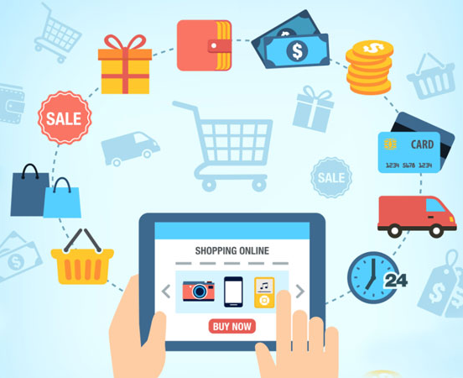
B2C
A traveling agency that provides ticket and travel insurance policies to clients.
A digital education website such as CodeAcademy that lets users learn basic computer programming for free.
Notes:
All major online retail stores like Amazon and payment processors like PayPal.

Slide 8
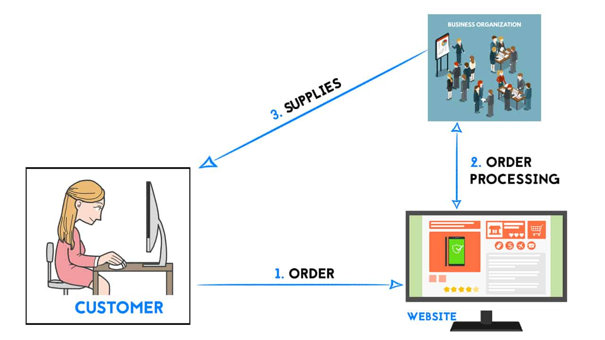
B2C

Slide 9
B2C Model
PROs
Reasonably low startup capital when compared to other eCommerce models can leverage advantages of transaction models.
Wide range of audiences with known purchase patterns and behavior.
Better flexibility since the platform is the channel for efficiently collating market demand in real time.
Easier to tempt B2C eCommerce shoppers to practice impulse buying.
This strategy allows small and medium-sized firms to expand swiftly.
CONs
The B2C space is highly competitive with most firms already boasting a majority of the market share.
The market is continually evolving and requires upgrades more frequently than in other models.
The website must be able to process several orders simultaneously.
Low order values keep the profit margin lower than on a B2B website.
Repeat business is hard to come by, thus you should spend more on web advertising.

Slide 10

C2B
A sports blogger who bills a gaming company to promote their services on his blog
Social media managers, content creators, brand managers, programmers, and many other services providers working online for a company.
Social media users filling in surveys.
Notes:
Cars24
A photographer selling his images on websites such as Fotolia or 123rf.

Slide 11
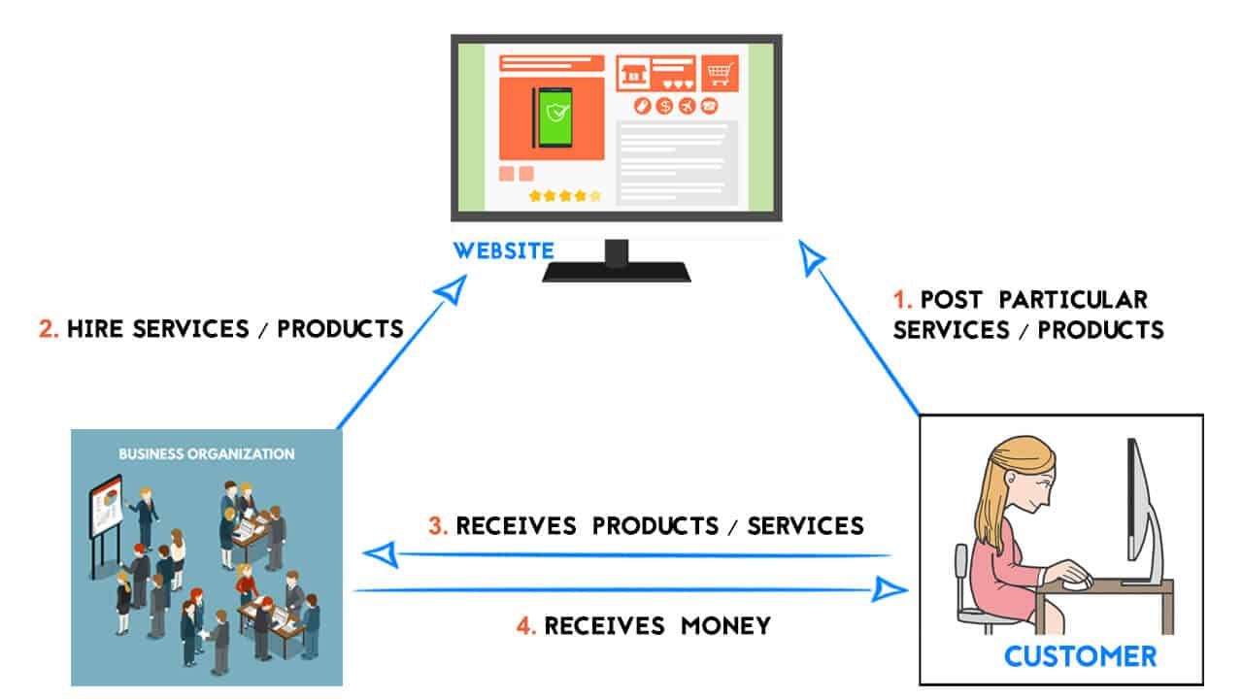
C2B

Slide 12
C2B Model
PROs
It generates employment chances and serves as a fantastic platform for people who wish to make money off of their skills or effort. This business model has introduced innovation and altered how businesses operate.C2B e-commerce has opened up a new revenue stream for companies, which is one of its main benefits. Additionally, this distinctive approach enables clients to communicate directly with company establishments thanks to the development of the internet. Even a few years ago, this was virtually impossible.
CONs
Fulfillment-related problems exist. There can be problems with responsiveness, delivery delays, etc. This dispersed industry lacks a set cost as well.
Business organisations suffer as a result. Another factor contributing to the unreliability of this model is a loss of privacy or information.
Information leaks can potentially cause a great deal of uncertainty. This paradigm is frequently misapplied, which is still another significant drawback.

Slide 13
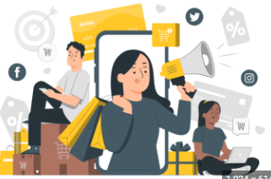
C2C
a third-party website would be an auction platform which brings seller and buyers together.
Notes:
eBay; Olx

Slide 14
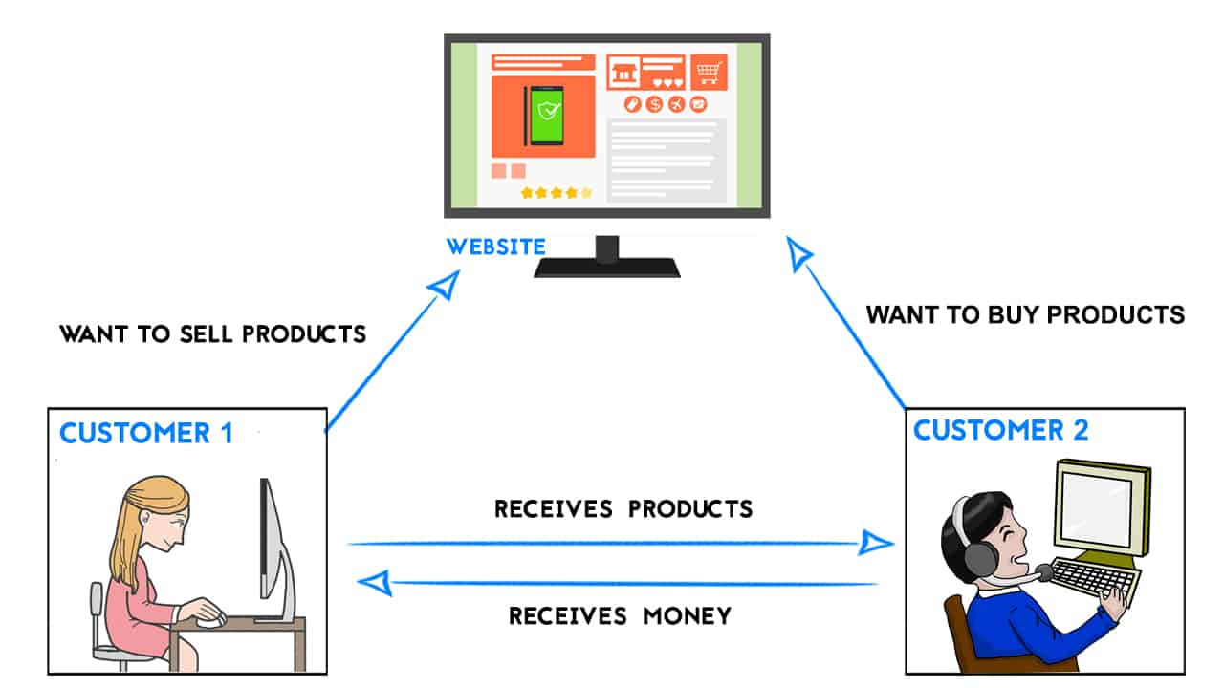
C2C

Slide 15
C2C Model
PROs
There are usually no upfront costs to get one product listed on a third-party C2C website.
With C2C, the products gallery is unlimited since different customers are on board and selling various items scattered across different niches.
By cutting out the intermediary (wholesalers and retailers), merchants can increase their profit margins while consumers can discover lower costs.
For those who trade in rare collectibles or used goods that are challenging to locate through conventional businesses, the C2C model is appropriate.
CONs
The cost charged for each sale using the C2C eCommerce model on a third-party site like eBay may eat into the profit of the merchant.
C2C poses a high level of risk in terms of product quality than other eCommerce business models. Under C2C, most transactions require that both parties trust it each other.
There are higher rates for fraud, as in is not regulated as a B2C
Users may end up buying goods at inflated prices which is not a good economic decision.

Slide 16
B2G
An online marketing agency is contracted by a sitting government to manage its political campaign by broadcasting promotional material to the masses across social media and other digital channels.
A government using a virtual workspace software designed by a creative agency.
The situation in Ohio where the State’s tax department hired the service of a third-party business to collect and convert tax payments from cryptocurrencies to fiat.
Notes:
Senseware is an internet solution service provider, with the main product being a complete IoT Technology Stack. In detail, Senseware’s service provides modular connectivity for the digitization of assets in the physical environment.
Mark43 is also a company specializing in providing technology solutions. Their most successful B2G mission was to optimize the police cloud data system, allowing them to process data more quickly.

Slide 17
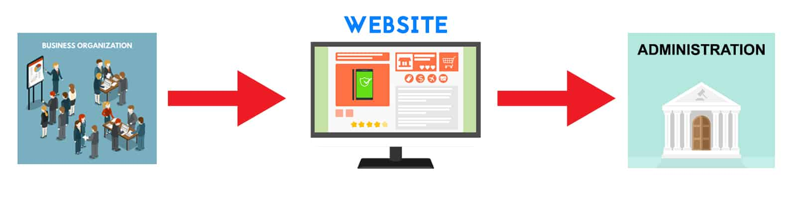
B2G

Slide 18
B2G Model
PROs
It is more durable than most other eCommerce business concepts and has a high profit margin.
B2G companies can benefit from tax advantages not available to other eCommerce retailers.
It improves public administration's adaptability and effectiveness.
This could provide smaller businesses a competitive advantage in business-to-business transactions, or at the very least balance out some of the benefits that large, well-established government contractors may currently have.
CONs
A change in government could have a negative impact on a B2G provider of goods or services.
Often, starting off costs a lot of money.
Additionally, it can limit a company's ability to operate outside of a particular region, defeating the main goal of eCommerce transactions—the distribution of goods and services without restriction—therefore.

Slide 19
G2C
A State’s tax agency deciding to ditch paper tax filing and instead introduce an electronic tax filing portal.
A State creating an information-sharing platform to allow citizens to get the latest information possibly because of a suspected natural disaster.
An electronic voting app for citizens to participate in an election without having to visit the polling unit or filing paperwork.

Slide 20
G2C Model
PROs
Cheaper access to the government’s amenities
The convenience of carrying out transactions without having to travel to the physical offices
The information is made easily available to everyone
Encourages citizens to use technology
Governance is more efficient and faster
CONs
The lack of proper infrastructure can make accessing the G2C portals difficult
The general population needs to be made aware of these services so that they can make use of them

Slide 21
C2G
programs are meant to make it easier for citizens and consumers of public services to communicate with the administration.
This covers interactions, including the delivery of public services and participation in consultation and decision-making processes.
Registration for birth, marriage, or death certificates through online portals
Passport and Driver’s Licence registration can also be done very conveniently through online portals

Slide 22
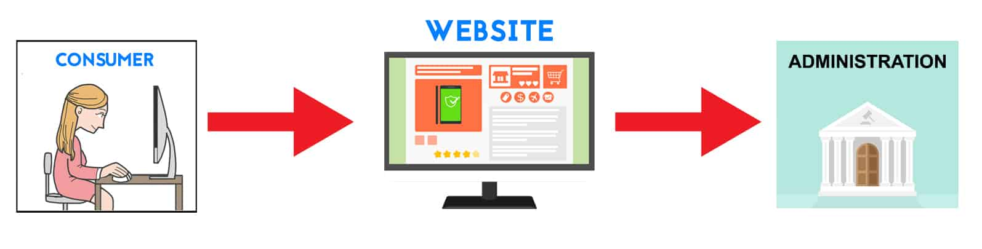
C2G
Notes:
Picture Source: https://www.ecomsay.com/types-of-ecommerce-business-models/

Slide 23
C2G Model
PROs
It makes public administration more flexible and efficient.
It encourages public knowledge of internet-based technology.
There is enormous profit potential for third parties contracted to handle C2G transactions.
CONs
A lack of internet service in some regions could restrict the performance of C2G eCommerce.
Public awareness and education programs may be needed to introduce the populace to such systems.

Slide 24
G2B
Business licenses, permits, and regulation updates
Electronic auctions
Tax, social insurance payments, and reporting
Electronic forms
Online application submission functionalities
Virtual business dispute resolution
Online startup registering
Notes:
refers to business-specific transactions (such as payments, selling and acquisition of goods and services, etc.) and the provision of business-focused services online.

Slide 25
G2B Model
PROs
Lower costs and barriers for interaction between governments and businesses
Reduced time for carrying out a transaction
Easier access to information
Convenient navigation through government regulations
CONs
Inequality as not everyone has access to the internet
Businesses are required to provide a lot of information to the government, which may hamper their privacy

Slide 26
Business Models according to transacting types

Slide 27
BM according to transacting type
Brokerage Model
Aggregator Model
Infomediary Model
Community Model
Manufacturer Model
Advertising Model
Subscription Model
Affiliate Model
Value Chain Model

Slide 28



Brokerage Model
Brokers are market-makers: they bring buyers and sellers together and facilitate transactions.
Those can be business-to-business (B2B), business-to-consumer (B2C),or consumer-to-consumer (C2C) markets.
A broker makes its money by charging a fee for each transaction it enables.

Slide 29

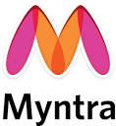

Aggregator Model
the aggregators are the connectors between the buyers and the sellers.
They are involved in the overall process of selection, organization, matching the buyers’ requirement with the particulars of the available goods, fulfillment of the orders and enabling the customers to create a value about the sellers.

Slide 30



Infomediary Model
Infomediary organizations collect Information about consumers and their consumption habits
It analyzes information carefully & categorically and supplies to various producer companies
They also assist consumers by collecting information about products and their producers
Different types of infomediary models include - Advertising networks, Audience Measurement Services Model, Incentive Marketing model, and Aggregators business model

Slide 31



Community Model
An e-business model in which different user communities share their data, opinions, photos, etc. using the websites- Facebook, flicker, Wikipedia
Feasibility/practicability of these sites depends mainly on user loyalty
Such business models earn money through advertising or voluntary donations.
The types of businesses in this category are - Open Source Model-red hat
Public Broadcasting Knowledge Networks-students, teachers

Slide 32



Manufacturer Model
Allows manufacturers/producers of various products or goods to sell their products directly to the customers
It will enable them to stay away from the middlemen such as distributors, dealers etc.
Provides efficiency, improved customer satisfaction and a better understanding of the customer preferences to the business organization

Slide 33

Advertising Model
Extension of the traditional media broadcast model
Generates good web traffic, along with advertisements which generate revenue
Can offer free / paid e-mail, chat services or forums

Slide 34

Subscription Model
An e-business in which the e-business organization charges the users for using their services
Business organizations can charge them on a daily, monthly or annual basis
The types of businesses in this category are –
Content Services model
Internet Service Providers

Slide 35
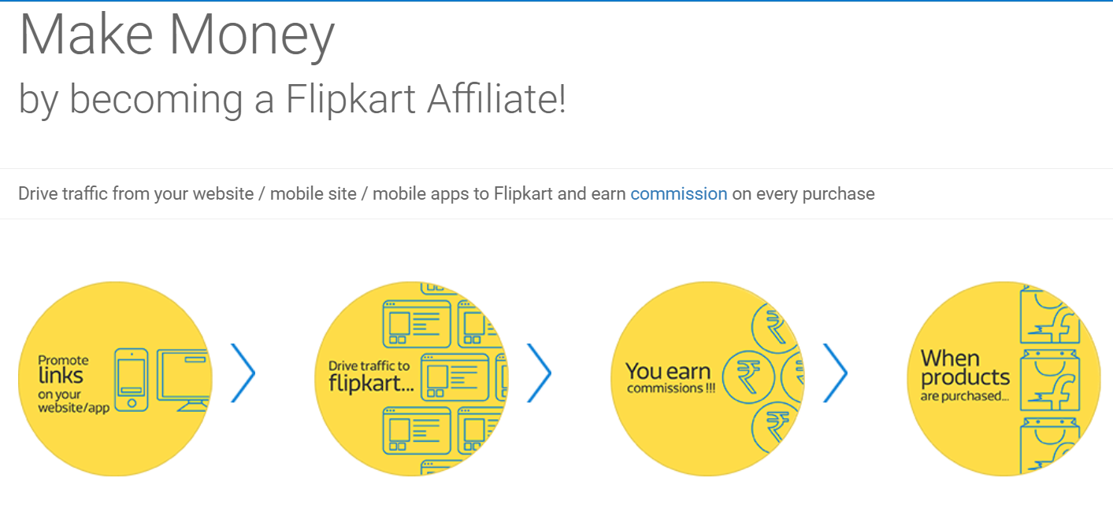
Affiliate Model
Affiliate model provides purchase chances as and when people are surfing on the Internet
It offers financial incentive or commission based on the percentage of revenue to be given to the affiliated business partners
The affiliate thus provides an opportunity to the e- business organization to add purchase point click-through
The variations in this type of business model are Pay per Click model, Banner Exchange, and the Revenue Sharing model

Slide 36
Value Chain Model
A business model that outlines the entire process of creating new products or services is known as a value chain.
The stages involved in moving a product from conceptualization to distribution.
Primarily to increase the value of a product at each stage before it is supplied to customers.
It facilitate the analysis of all operations involved in the production of a product or service, as well as the identification of cost-cutting and differentiation.
It can streamline efforts, remove waste, and boost profits by using a value chain.
Notes:
The stages involved in moving a product from conceptualization to distribution, and just about everything in between, like obtaining raw materials, manufacturing operations, and marketing activities make up a value chain for an organisation.

Slide 37
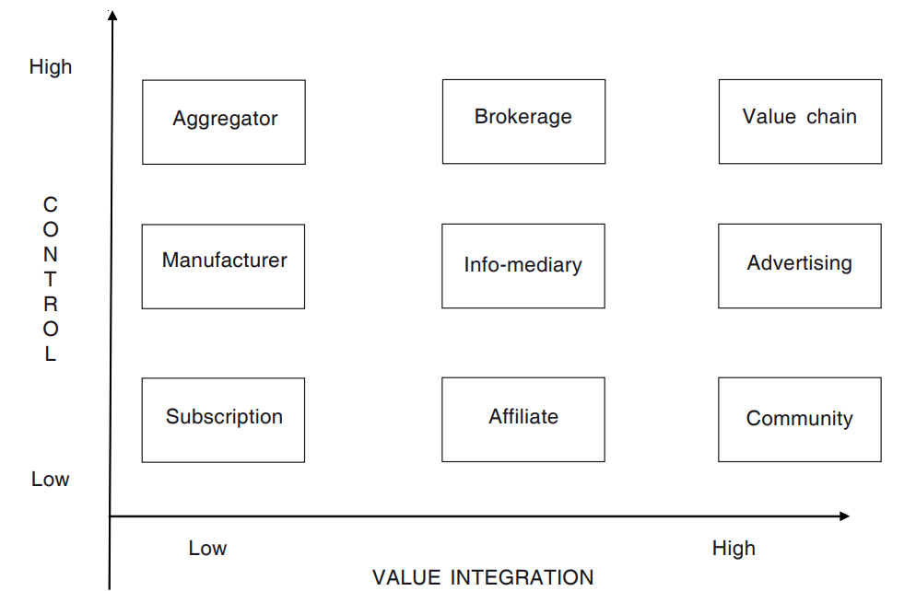
Transaction Model
Notes:
On the basis of value addition. Value addition is the addition of value to a product or service because of the opportunities that it offers on the Web.
On the basis of control. At the high end of control there is hierarchical control and at the low end there is no control, so that it is self-organizing. Normally, the control is done through the policies of the website.

Slide 38
AFTER CLASSROOM ACTIVITY
https://www.forbes.com/sites/jiawertz/2022/11/29/the-era-of-e-commerce-is-impacting-a-multitude-of-industries/?sh=67ae8255a5af
https://www.forbes.com/sites/beltway/2022/12/05/e-commerce-keeps-us-businesses-and-global-consumers-connected-through-turbulent-times/?sh=437fc17b51f2

Slide 39
Thanks!
ANY QUESTIONS?
You can find me at:
parvathi.pdf@gmail.com

