Slide 1
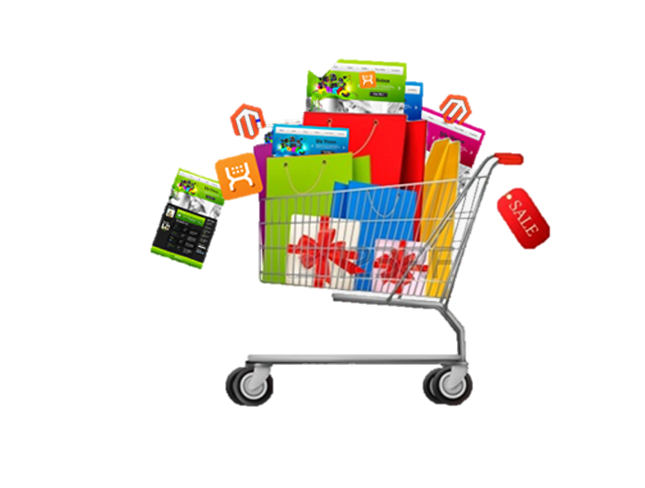
E-COMMERCE
MBA(BA)
Session 5: e-Marketing, e-CRM, e-SCM

Slide 2
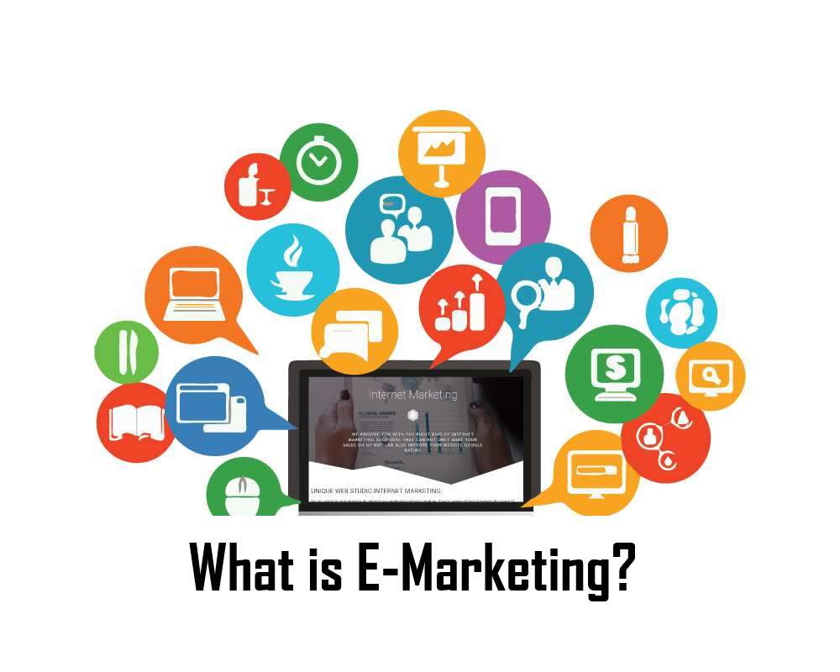

Slide 3
E-Marketing
E-marketing is the process of marketing a product or service offering using the Internet to reach the target audience on smartphones, devices, social media etc.
Also known as Internet Marketing, Web Marketing, Digital Marketing, or Online Marketing,
Encompasses all the activities a business conducts via the worldwide web with the aim of
attracting new business,
retaining current business
developing its brand identity.
Notes:
is marketing done through the internet on online channels.

Slide 4
Advantages of e-Marketing
Ability to target your customers faster and cheaper
Reduction of marketing costs through automation of electronic media
Near real-time interaction between the marketer and the end user
Ability to quantify and collect user data
One-to-one marketing experience
Increased interactivity
Ability to implement marketing strategies in a short time-frame
Ability to scale with the market
Appeal to specific interests
Geo-targeting
Notes:
In geomarketing and internet marketing, geotargeting is the method of delivering different content to visitors based on their geolocation.

Slide 5
Why is E-marketing important?
A pivotal tactic in the marketing strategy adopted by companies using several digital media channels.
The ROI can far exceed that of traditional marketing strategies.
The transparency of the internet allows the marketer to have access to analytics and data in a near real-time fashion
Allowing the marketer to make changes to align with the market’s reaction

Slide 6
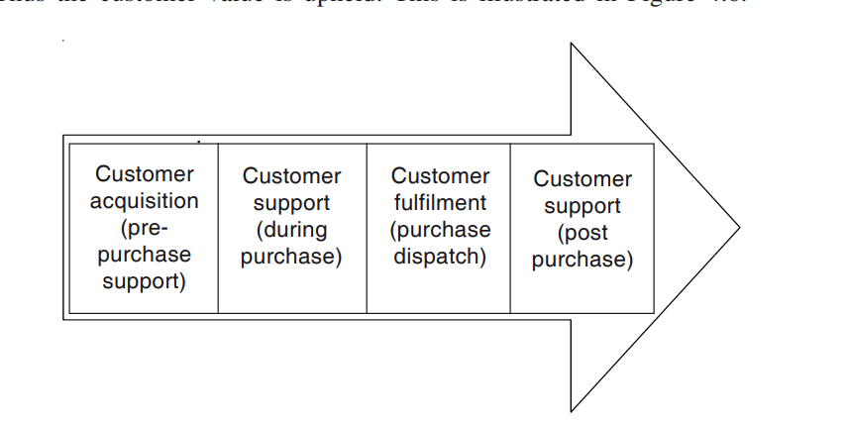
E-marketing Value Chain

Slide 7
Top e-marketing strategies
Search engine optimization (SEO)
Email Marketing
Influencer Marketing
Affiliate Marketing
Reputation Marketing
Video Marketing
Instant Message marketing
Content marketing
Pay-per-click (PPC) advertising
Business branding
Social media marketing
Conversion rate optimization
Website design
E-marketing analytics

Slide 8
Search Engine Optimisation
To outperform rivals in search results and reach your target audience
This results in an increase in sales, clients, and revenue.
Since 33% of clicks go to the top-ranking result in a search, the primary objective of SEO is to help your website rank higher.
Certain micro-strategies associated with SEO that make it so effective,
Keyword research are trigger words to determine exactly what your audience is searching online and rank a particular site higher
Internal linking ensures that all of your site pages are interconnected not just for customers but for the search engine to find new pages on the site
Page speed optimization The site pages are required to load quickly is a crucial part of creating a great user experience.
Notes:
Users want information in less than three seconds, and if it takes longer than that, you risk losing visitors to a competitor’s site.

Slide 9
Content marketing
The target keywords identified through keyword research are ideal for implementation in content.
As content is a fantastic opportunity to educate site visitors about the business such as what you do, and your products and services, you should base it on the target keywords.
Certain ideas to implement a content marketing strategy
Identify the topics that relate to your offerings that your audience may be interested in.
Produce a variety of content.
Regularly produce content and emphasize by using it across several platforms.

Slide 10
Email Marketing
By building a subscriber list or database of targeted prospects, email marketing entails promoting a good or service to them via email.
To enhance conversions, email marketers can target particular email list groups and create correspondence that is especially customised to them.

Slide 11
Influencer marketing
Influencers are people with a significant social media following who market goods or services in exchange for money.
When a business makes contact with one of these individuals and establishes a connection, influencer marketing occurs.
For producing or disseminating material about a certain company to their followers, the influencer is compensated financially or with goods and services.

Slide 12
Affiliate Marketing
Affiliate marketing is an e-marketing strategy involving three parties: the product owner, the affiliate marketer and the end consumer.
Affiliate marketers select a product and then promote it for the owner using blogs, videos or advertisements.
The consumer can buy the product online, using a link supplied by the affiliate, usually at a discounted price.
The affiliate marketer can get paid a predetermined commission on each sale.

Slide 13
Reputation marketing
Reputation marketing is an e-marketing tactic that leverages online review sites and social media to improve a company's reputation and enhance sales.
Since more people now shop online, online testimonials and referrals have grown in importance as a source of product endorsement and advice for customers.
Building a brand's reputation through reputation marketing entails motivating people to leave favourable evaluations on particular websites and social media channels.

Slide 14
Video marketing
In order to improve visibility, engagement, and revenue on digital and social channels, video marketing employs moving images.
It works in tandem with content marketing and is crucial to e-marketing, giving companies another way to connect with their customers.
Video marketing is a very powerful tool for attracting the interest and feelings of your target market and promoting your good or service.

Slide 15
Instant messaging marketing
Instant messaging marketing enables companies to quickly and successfully reach their target demographic.
Real-time chat systems are used in this marketing tactic to provide customer service, advertise discounts, and deliver notifications.
Instead of dialling a number or sending a series of emails, this kind of marketing gives clients another way to speak with a customer support agent right away.

Slide 16
Pay-per-click (PPC) advertising
This tactic is precisely what it says : pay-as-you-go advertising.
PPC enables you to advertise on websites across the internet, in search engines, and on social media platforms.
You only pay when users click your adverts.
One of the most economical emarketing techniques available is pay-per-click advertising, which involves only paying when a user clicks your advertisement rather than purchasing ad space.

Slide 17

Business branding
A company’s branding sets it apart from competitors.
Associating the business with a certain colour scheme, font, or object in the logo matters
Creative way to display the unique selling points (USPs) that no other competitors offer makes the brand distinct.
Providing users with insight into what makes the company truly unique also speaks to branding.

Slide 18
Social media marketing
Majority of sites have a messaging option that lets the business communicate with and target market directly.
Customers can contact the business directly through direct messaging,
Business can also make particular posts that speak to a very narrow segment of the target audience
another opportunity to establish a more personal connection with the customer.
Ads can be a great way to further target ideal audience on social media.
Different content on various social media posts can enable brand awareness and building traffic to the site.

Slide 19
Conversion rate optimization (CRO)
CRO services ensure that the website is in tip-top shape for conversion, analyzes copy, and helps determine the areas of improvement in the site to increase conversions
CRO motivates more customers to buy the goods and services, which boosts sales year over year.
To make sure that sponsored advertisements and landing pages are operating properly and efficiently, CRO is also essential.

Slide 20
Website design
The website is essentially the brand's home, website design is an essential component of any online marketing strategy.
All the content such as products with the prices and descriptions of your goods and services, contact forms, and much more goes there.
The objective of effective site is the one that creates an attractive presence include
Attracting visitors to the website
Making the site interesting enough so that visitors stay and explore
Convincing visitors to follow the site’s links to obtain information
Creating an impression consistent with the organization’s desired image
Building a trusting relationship with visitors
Reinforcing positive images that the visitor might already have about the organization
Encouraging visitors to return to the site

Slide 21
E-marketing analytics
To maximise the online presence effectively and identify website enhancement opportunities.
Analyzing the outcomes of each campaign is essential to make sure that the marketing methods are performing to the best of their abilities.
To apply e-marketing analytics into the company’s e-marketing strategy
Determine your company’s most important metrics.
Give the website time to perform.
If any of the metrics are lower than anticipated, you can start improving your site in the areas that affect those metrics.

Slide 22
E-Customer Relationship Management

Slide 23
CRM Definition
Customer Relationship Management (CRM) is the aligning of business strategy
with the corporate culture of the organization, along with customer information
and a supporting information technology of the customer interactions
that promote a mutually beneficial relationship between the customer and the enterprise.
Notes:
What is CRM?
What are the procedures involved in CRM?
How is technology supporting the function?
Compare with traditional methods of CRM
Advantages of eCRM?

Slide 24
E-CRM
The use of Internet-based technology, including as emails, websites, chat rooms, forums, and other channels, to accomplish CRM goals
The marketing, sales, and customer service procedures are automated through a well-organized and integrated CRM process.
An efficient E-CRM enhances client interactions, boosts process efficiency, and gives businesses the ability to personalise their offerings to cater to the demands of each consumer.

Slide 25
E-CRM contd
A typical E-CRM strategy includes
Gathering data about the customer, the transaction history, the product, the click stream, and the contents.
The customer characteristics are then analysed to produce a transactional analysis that includes the customer's profile and transactional history,
As well as an activity analysis that includes exploratory activities that display the customer's navigation, shopping cart, purchasing behaviour, and more.

Slide 26
E-CRM
The benefits of E-CRM include the following:
Improved customer relations, service and support
Matching the customers' behaviour with suitable offers
Increased customer satisfaction and loyalty
Greater efficiency and cost reduction
Increased business revenue

Slide 27
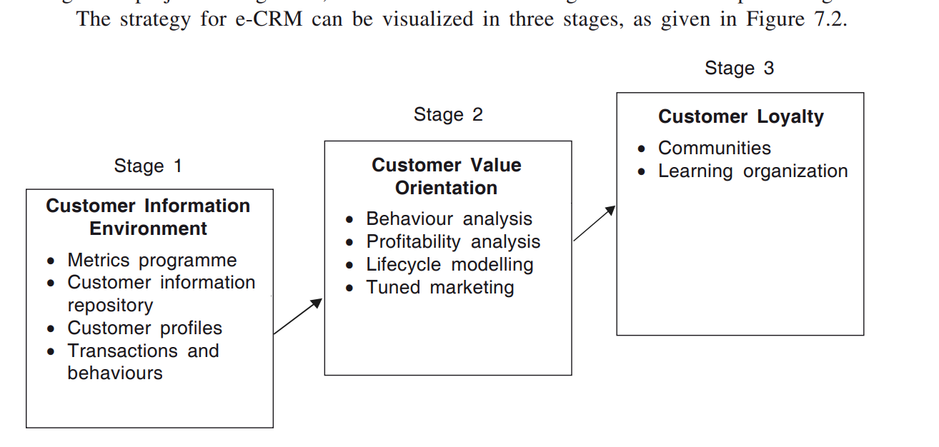
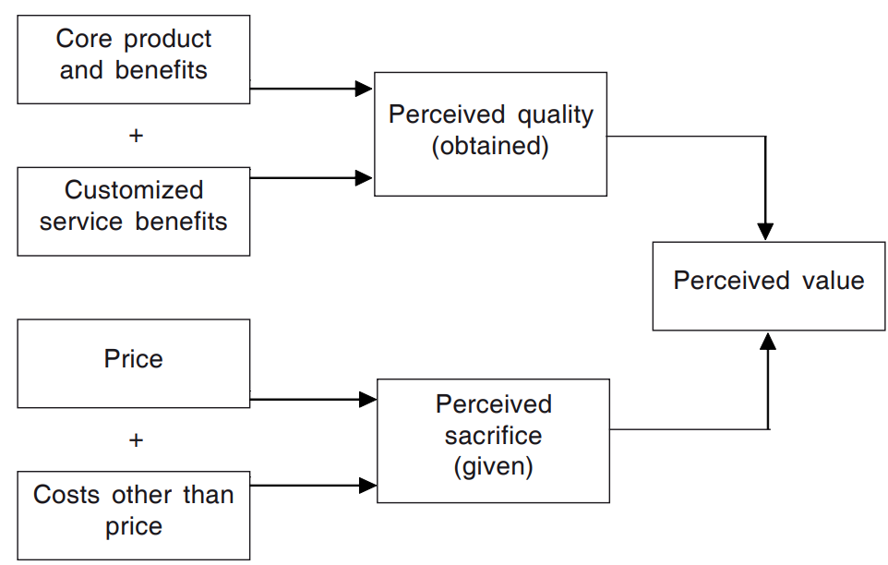
Notes:
Customer Information Environment In the first stage, building up of a customer information environment and acting on it forms the starting point. It consists of Metrics programmes, Customer information repository, and monitoring customer behaviours.
Customer Value Orientation In the second stage, operational effectiveness is the focus. Customers want value for their money. They believe that they have got value, when the perceived benefits they receive from something exceed the costs of owning it.
Customer Loyalty In the third stage, the focus is on the integration of internal process of the organization with the customer in creating a community. Moving costly customer services to the Internet is critical to staying competitive. Providing customer services on the Internet means a lot more than just having a website. With the users demanding more services via the Internet, leading companies have realized the importance of their e-services strategies on the Web.

Slide 28
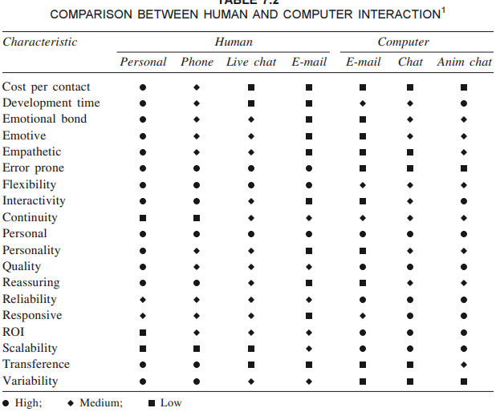
When Humans are Not Enough Or When can Technology replace them?
Notes:
Transference is, ascribing the characteristics of one person to another, often at a subconscious level. This may be the result of similarities in appearance, style of speech, or mannerisms and can be a positive or a negative factor in the sales and customer-relations process. For example, a salesman may subconsciously remind a woman of a trusted relative, and she will instinctively believe everything he says. Conversely, the same salesman could remind her of an unscrupulous salesperson she dealt with in the past, and she develops the same negative attitude towards this one
Reducing Cost Per Contact
Decreasing Development Time
Creating Emotional Bonds
Presenting Emotive Content
Displaying Empathy
Reducing Human Error
Increasing Flexibility
Improving Interactivity
Increasing Continuity
Adding a Personal Touch
Communicating Personality
Increasing Quality
Providing Reassurance
Increasing Reliability
Improving Responsiveness
Improving Return on Investment (ROI)
Increasing Scalability
Controlling Transference
Decreasing Variability

Slide 29
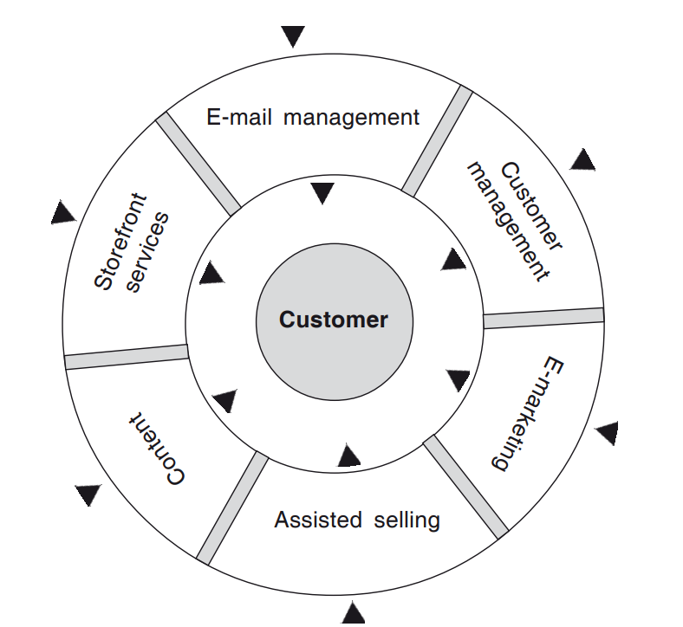
E-CRM Toolkit
Notes:
In order to bring true customer management across online business, one need the E- CRM products to fulfil the following:
Content Is the system delivering the contents a customer wants to see? How is it being managed on the IT platform?
Storefront and Merchandising Services With large numbers of visitors failing to complete transaction at the checkout, it is needed to ensure that your storefront services propel your customers to the cash point.
E-mail Management Are e-mail campaigns focussed to provide an offer that customer cannot refuse? How are these tied in with websites so that customers enjoy a seamless experience?
Customer Management Is the company managing data across all the sales and marketing functions to its best?
E-marketing How well are e-marketing efforts targeted? How well do they combine with online selling operation?
Assisted Selling how assisted selling can enhance the shopping experience and achieve business success. But what assisted selling approach will work best for any company

Slide 30
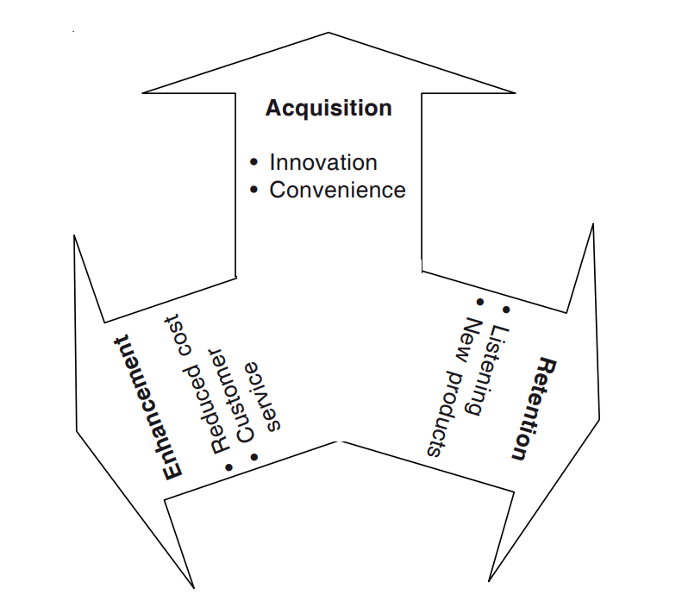
Phases of CRM

Slide 31
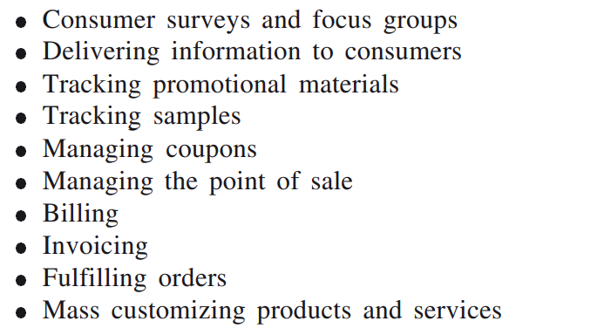
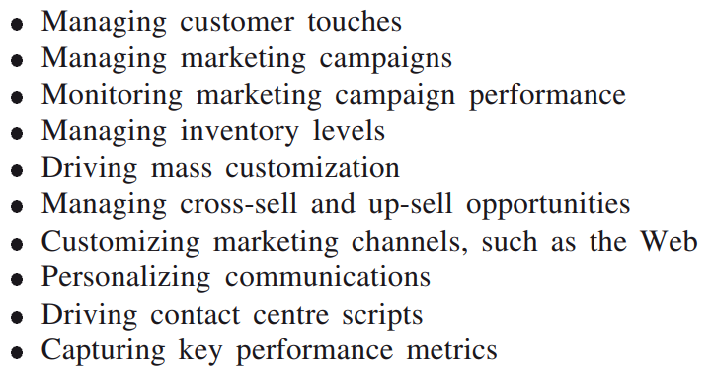
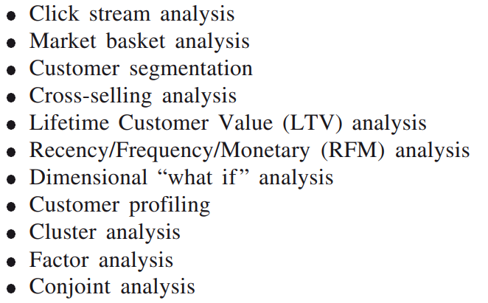
CRM capabilities
Business Operations
Business Management
Business Intelligence

Slide 32
CASE STUDY
Naukri.com
IRCTC

Slide 33
E-Supply Chain Management
Notes:
What is supply chain?

Slide 34
E-Supply Chain
Is a sequence of logistics processes,
the production of raw materials,
manufacturing of finished goods,
warehousing,
inventory management,
order fulfillment, and
last-mile delivery.
The goal is to deliver a quality product to the customers and a great experience
Every stage of the supply chain plays a key role in running a trustworthy brand.

Slide 35
E-Supply Chain Management
Oversees the inbound and outbound logistics of finished goods inventory, starting at production all the way to shipping customer orders.
A highly optimized supply chain helps to reduce costs and increase productivity, which can impact both profit margins and customer satisfaction.

Slide 36
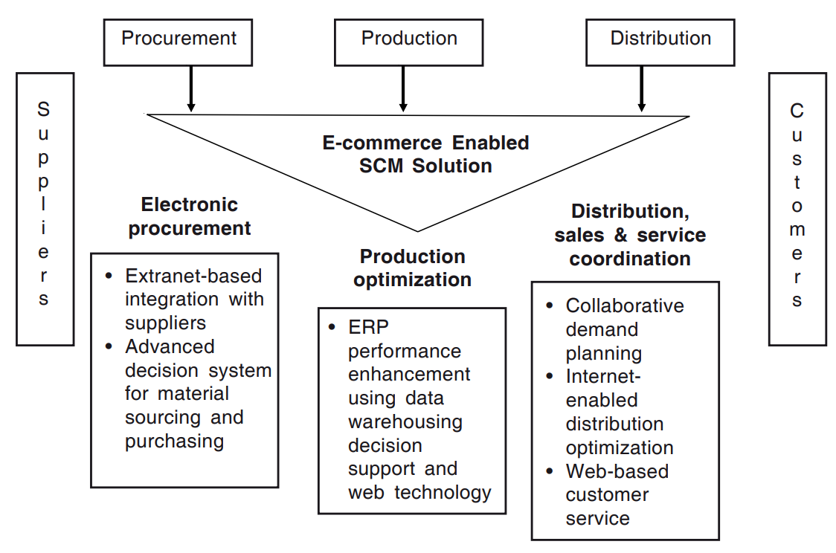
E-SCM

Slide 37

Notes:
https://youtu.be/hht6RsV7d40

Slide 38
Benefits of E-SCM
It is Web-based (client and server), not Web-enabled;
It incorporates broadcast and active messaging to proactively notify a condition that requires attention;
It supports the exchange of “real-time” information through stakeholders;
It has open Internet Application Architecture →allows for rapid deployment and scalability, combining unlimited internal/external users in a “real-time” environment;
It has an interface capability with any third party software;
It is platform independent; & a fully integrated system;
It has Web visibility and processing capability;
It is rules-based.

Slide 39
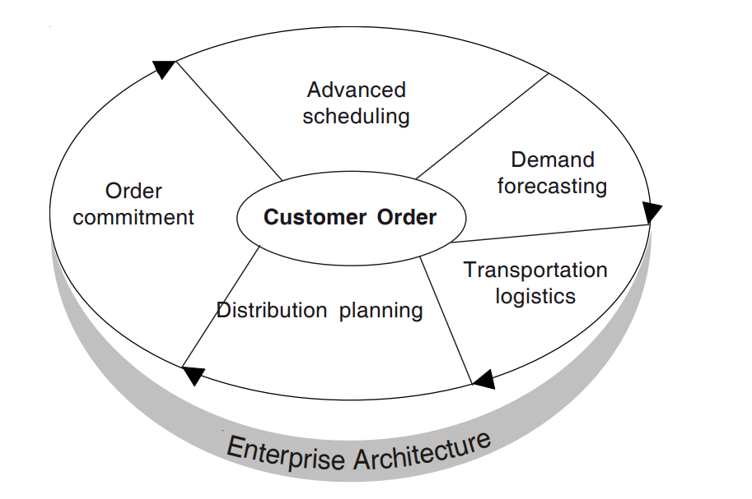
eSCM Components
Notes:
Advanced Scheduling and Manufacturing Planning Programme This automated programme provides detailed coordination of all manufacturing and supply efforts based on individual customer orders. Scheduling is based on real-time analysis of changing constraints throughout the process, from equipment malfunctioning to supply interruptions. Scheduling creates job schedules for managing the manufacturing process as well as logistics.
Demand Forecasting Programme This module supports a range of statistical tools and business forecasting techniques. It constantly takes into account changing market scenarios and economic factors while making decisions.
Transportation Logistics Programme This programme facilitates resource allocation and execution to ensure that materials and finished goods are delivered at the right time and at the right place, according to the planning schedule, at minimal cost. It considers such variables as transportation mode and availability of each mode such as airlines, trains, and trucks.
Distribution Planning Programme This is integrated with demand forecasting, manufacturing schedules and transportation logistics to reach the customer.
Order Commitment Order commitment is linked to all the other modules so that accurate delivery of goods and services can be guaranteed.

Slide 40
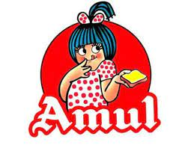
AFTER CLASS ACTIVITY

Slide 41
