Slide 1

Decorators

Slide 2
Functions as Arguments
# map(fn, iterable)
# filter(pred, iterable)
def perform_twice(fn, *args, **kwargs): fn(*args, **kwargs)
fn(*args, **kwargs)
perform_twice(print, 5, 10, sep='&', end='...') # => 5&10...5&10...

Slide 3
Functions as Return Values
def make_divisibility_test(n): def divisible_by_n(m):
return m % n == 0 return divisible_by_n
div_by_3 = make_divisibility_test(3)
filter(div_by_3, range(10))
# generates 0, 3, 6, 9
make_divisibility_test(5)(10)
# => True

Slide 4
Something Cool
def primes_under(n): tests = []
# will hold [div_by_2, div_by_3, div_by_5, …]
for i in range(2, n):
# implement is_prime using our divis. tests
if not any(map(lambda test: test(i), tests)): tests.append(make_divisibility_test(i)) yield i

Slide 5
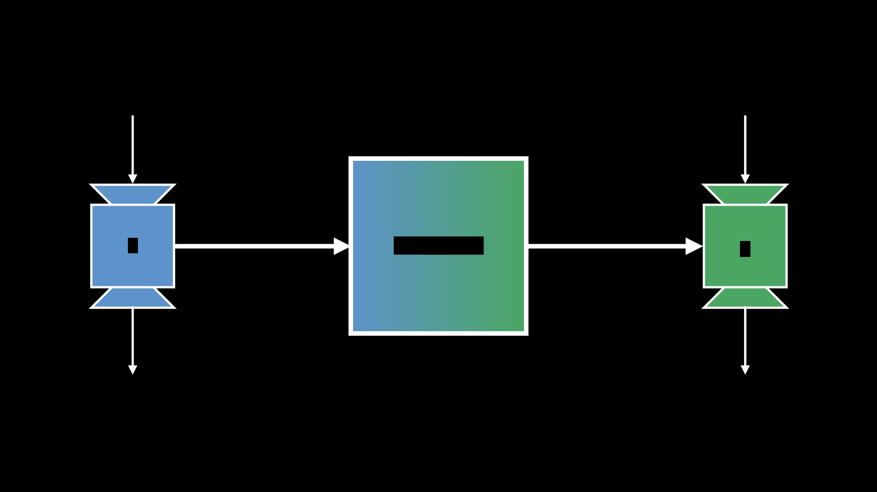
¿Por qué no los dos?
x
x'
Functions as Arguments
Functions as Return Values
f
Decorator!
g
f(x)
g(x')

Slide 6

Writing Our First Decorator
def debug(function):
def wrapper(*args, **kwargs):
print("Arguments:", args, kwargs) return function(*args, **kwargs) return wrapper
Woah <('_'<) - Pause for questions

Slide 7
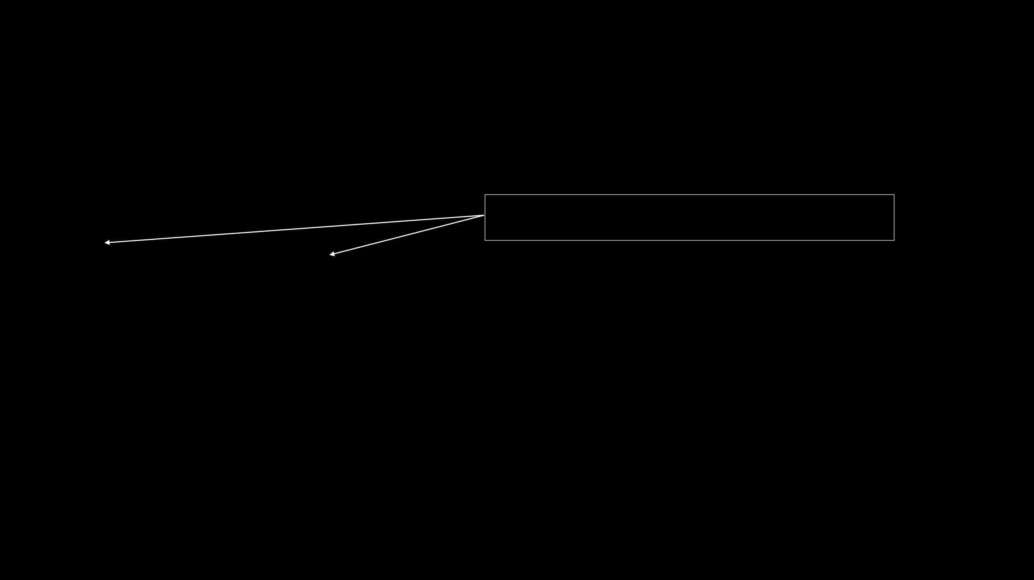
Using our debug decorator
def foo(a, b, c=1):
return (a + b) * c
It seems like overkill to say foo twice here
foo = debug(foo)
foo(2, 3)
# prints "Arguments: (2, 3) {}
# => returns 5
foo(2, 1, c=3) # prints "Arguments: (2, 1) {'c': 3}"
# => returns 9
print(foo)
# <function debug.<locals>.wrapper at 0x...>

Slide 8

Using our debug decorator
@debug
@decorator applies a decorator to the following function
def foo(a, b, c=1): return (a + b) * c
foo(5, 3, c=2) # prints "Arguments: (5, 3) {'c': 2}" # => returns 16

Slide 9
Object-Oriented Python

Slide 10

Overview
Recap of FP Classes
Instances Inheritance Exceptions

Slide 11

Recall: Programming Paradigms
Procedural
Declarative
Sequence of instructions that inform the computer what
Specification describes the problem to be solved, and
to do with the program's input
language implementation figures out the details
Examples Multi-Paradigm
Examples
C Supports several different
SQL
Pascal paradigms, to be combined
Prolog
Unix (sh) freely
Object-Oriented
Functional
Deal with collections of objects which maintain internExamplescomposes into a set of functions, each of which solely
state and support methods that query or modify this
Scalaakes inputs and produces outputs with no internal state.
internal state in some way.
C++
Python
Examples
Examples
Java
Haskell
Smalltalk
OCaml
ML

Slide 12
Objects, Names, Attributes

Slide 13
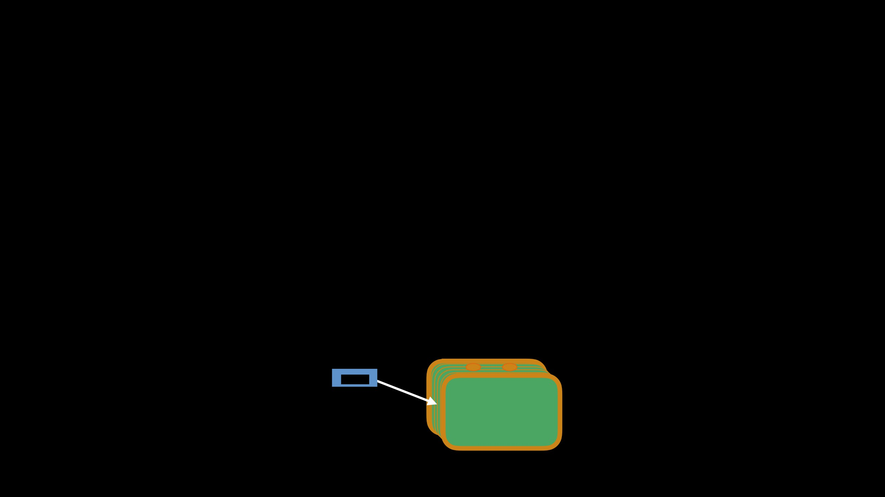
Some Definitions
An object has identity
A name is a reference to an object
A namespace is an associative mapping from names to objects An attribute is any name following a dot ('.')
name
type
object
identity

Slide 14
Classes

Slide 15

First Look at Classes
New Syntax
Class Objects
Instance Objects
Methods vs. Functions
Who says Python isn't classy?

Slide 16
Class Definition Syntax

Slide 17

The class keyword introduces a new class defintion
class ClassName: <statement>
<statement>
Must be executed
to have effect (like def)

Slide 18
Class Definitions
Statements are usually assignments or function definitions Entering a class definition creates a new "namespace" - ish Exiting a class definition creates a class object
Defining a class == creating a class object (like int, str) Defining a class != instantiating a class

Slide 19
Wait, What?

Slide 20
Class Objects vs. Instance Objects
Defining a class creates a class object
Supports attribute reference and instantiation
Instantiating a class object creates an instance object Only supports attribute reference

Slide 21

Class Objects
Support (1) attribute references
and (2) instantation

Slide 22
Class Attribute References

Slide 23

Class Attribute References
class MyClass:
"""A simple example class""" num = 12345
def greet(self):
return "Hello world!"
# Attribute References
MyClass.num
# => 12345
(int object)
MyClass.greet
# => <function f> (function object)
Warning! Class attributes can be written to by the client

Slide 24
Class Instantiation

Slide 25

Class Instantiation
Classes are instantiated using parentheses and an argument list
No new
x = MyClass(args)
Instantiating a class constructs an instance object of that class object. In this case, x is an instance object of the MyClass class object

Slide 26

Custom Constructor using __init__
class Complex:
def __init__(self, realpart=0, imagpart=0): self.real = realpart
self.imag = imagpart
Class instantiation calls the special method __init__ if it exists
# Make an instance object `c`!
c = Complex(3.0, -4.5)
c.real, c.imag # => (3.0, -4.5)
You can't overload __init__!
Use keyword arguments or factory methods

Slide 27

Instance Objects
Only support attribute references

Slide 28

Data Attributes
= "instance variables" = "data members"
c = Complex(3.0, -4.5)
c.real, c.imag # => (3.0, -4.5)
c.real = -9.2 c.imag = 4.1
Attribute references first search the instance's __dict__ attribute, then the class object's

Slide 29

Setting Data Attributes
# You can set attributes on instance (and class) objects # on the fly (we used this in the constructor!) c.counter = 1
while c.counter < 10:
c.counter = x.counter * 2 print(c.counter)
del c.counter # Leaves no trace
# prints 1, 2, 4, 8
Setting attributes actually inserts into the instance object's __dict__ attribute

Slide 30
A Sample Class
class MyClass:
"""A simple example class""" num = 12345
def greet(self):
return "Hello world!"

Slide 31
Calling Methods
x = MyClass()
x.greet()
# 'Hello world!'
# Weird... doesn't `greet` accept an argument?
print(type(x.greet))
# method
print(type(MyClass.greet))
# function
print(x.num is MyClass.num)
# True
print(x.greet is MyClass.greet)
# False

Slide 32
Methods vs. Functions

Slide 33
Methods vs. Functions
A method is a function bound to an object
method ≈ (object, function)
Methods calls invoke special semantics
object.method(arguments) = function(object, arguments)

Slide 34
Pizza
class Pizza:
def __init__(self, radius, toppings, slices=8): self.radius = radius
self.toppings = toppings self.slices_left = slices
def eat_slice(self):
if self.slices_left > 0: self.slices_left -= 1 else:
print("Oh no! Out of pizza")
def __repr__(self):
return '{}" pizza'.format(self.radius)

Slide 35
Pizza
p = Pizza(14, ("Pepperoni", "Olives"), slices=12) print(Pizza.eat_slice)
# => <function Pizza.eat_slice>
print(p.eat_slice)
# => <bound method Pizza.eat_slice of 14" Pizza>
method = p.eat_slice
method.__self__
# => 14" Pizza
method.__func__
# => <function Pizza.eat_slice>
p.eat_slice()
# Implicitly calls Pizza.eat_slice(p)

Slide 36
Class and Instance Variables

Slide 37
Class and Instance Variables
class Dog:
kind = 'Canine'
# class variable shared by all instances
def __init__(self, name):
self.name = name
# instance variable unique to each instance
a = Dog('Astro')
pb = Dog('Mr. Peanut Butter')
a.kind
# 'Canine' (shared by all dogs)
pb.kind
# 'Canine' (shared by all dogs)
a.name
# 'Astro' (unique to a)
pb.name
# 'Mr. Peanut Butter' (unique to pb)

Slide 38

Warning
class Dog:
tricks = []
def __init__(self, name): self.name = name
def add_trick(self, trick):
self.tricks.append(trick)
What could go wrong?

Slide 39
Warning
d = Dog('Fido') e = Dog('Buddy')
d.add_trick('roll over') e.add_trick('play dead')
d.tricks # => ['roll over', 'play dead'] (shared value)

Slide 40
Did we Solve It?
class Dog:
# Let's try a default argument!
def __init__(self, name='', tricks=[]): self.name = name
self.tricks = tricks
def add_trick(self, trick):
self.tricks.append(trick)

Slide 41
Hmm…
d = Dog('Fido') e = Dog('Buddy')
d.add_trick('roll over') e.add_trick('play dead')
d.tricks # => ['roll over', 'play dead'] (shared value)

Slide 42
Solution
class Dog:
def __init__(self, name): self.name = name
self.tricks = [] # New list for each dog
def add_trick(self, trick):
self.tricks.append(trick)

Slide 43
Solution
d = Dog('Fido') e = Dog('Buddy')
d.add_trick('roll over') e.add_trick('play dead')
d.tricks
# => ['roll over']
e.tricks
# => ['play dead']

Slide 44
Privacy and Style

Slide 45

Keep an Eye Out!
Nothing is truly private!
Clients can modify anything "With great power…"

Slide 46
Stylistic Conventions
A method's first parameter should always be self
Why? Explicitly differentiate instance vars from local vars Recall: method calls implicitly provide the calling object as the first argument to the class function
Attribute names prefixed with a leading underscore are intended to be private (e.g. _spam)
Use verbs for methods and nouns for data attributes

Slide 47
Single Inheritance
A class object 'remembers' its base class
If you don't specify a base class, implicitly use object
Method and attribute lookup begins in the derived class Proceeds down the chain of base classes
Derived methods override (shadow) base methods Like `virtual` in C++

Slide 48

Multiple Inheritance
"The Dreaded Diamond Pattern"

Slide 49

Multiple Inheritance
Base classes are separated by commas
class Derived(Base1, Base2, …, BaseN):
pass
Order matters!

Slide 50

Attribute Resolution
Attribute lookup is (almost) depth-first, left-to-right Officially, "C3 superclass linearization"
More info on Wikipedia!
Rarely useful
Classes have a hidden method .mro() Shows linearization of base classes

Slide 51
Attribute Resolution In Action
class A: pass
class B: pass class C: pass class D: pass class E: pass
class K1(A, B, C): pass class K2(D, B, E): pass class K3(D, A): pass class Z(K1, K2, K3): pass
Z.mro() # [Z, K1, K2, K3, D, A, B, C, E, object]

Slide 52
Magic Methods

Slide 53

Magic Methods
Python uses __init__ to build classes
We can supply our own __init__ for customization
What else can we do? Can we make classes look like:
dunderbar
iterators?
sets? dictionaries? numbers?
comparables?

Slide 54

Some Magic Methods
x = MagicClass() y = MagicClass()
Suppose MagicClass implements all of these magic methods
str(x)
# => x.__str__() # => x.__eq__(y)
x == y
x < y
# => x.__lt__(y) # => x.__add__(y) # => x.__iter__() # => x.__next__() # => x.__len__()
x + y
iter(x)
And so many more Link 1
next(x)
len(x)
el in x
# => x.__contains__(el)
Link 2
Link 3

Slide 55
Example
class Point:
def __init__(self, x=0, y=0): self.x = x
self.y = y
def rotate_90_CC(self):
self.x, self.y = -self.y, self.x
def __add__(self, other):
return Point(self.x + other.x, self.y + other.y)
def __str__(self):
return "Point({0}, {1})".format(self.x, self.y)

Slide 56
Example
o = Point()
print(o)
# Point(0, 0)
p1 = Point(3, 5)
p2 = Point(4, 6)
print(p1, p2)
# Point(3, 5) Point(4, 6)
p1.rotate_90_CC()
print(p1)
# Point(-5, 3)
print(p1 + p2)
# Point(-1, 9)

Slide 57
Case Study:
Errors and Exceptions

Slide 58

Syntax Errors
"Errors before execution"
>>> while True print('Hello world')
File "<stdin>", line 1
while True print('Hello world')
^ Error is detected at the token preceding the arrow
SyntaxError: invalid syntax

Slide 59

Exceptions
"Errors during execution"
>>> 10 * (1/0)
Traceback (most recent call last): File "<stdin>", line 1
ZeroDivisionError: division by zero
>>> 4 + spam*3
Traceback (most recent call last): File "<stdin>", line 1
NameError: name 'spam' is not defined
>>> '2' + 2
Traceback (most recent call last): File "<stdin>", line 1
TypeError: Can't convert 'int' object to str implicitly

Slide 60
And More
KeyboardInterrupt
UnboundLocalError
SystemExit
StopIteration
SyntaxError
ZeroDivisionError
AttributeError
KeyError
IndexError
NotImplementedError
TypeError
OSError
NameError

Slide 61

BaseException ├── SystemExit
├── OSError
├── SystemError ├── TypeError ├── ValueError
│ ├── BlockingIOError │ ├── ChildProcessError │ ├── ConnectionError │ │ ├── BrokenPipeError
├── KeyboardInterrupt ├── GeneratorExit
│ └── UnicodeError │ ├── UnicodeDecodeError
└── Exception
├── StopIteration
│ │ ├── ConnectionAbortedError│
├── UnicodeEncodeError
├── ArithmeticError
│ │ ├── ConnectionRefusedError│
└── UnicodeTranslateError
│ ├── FloatingPointError │ │ └── ConnectionResetError
└─ Warning
│ ├── OverflowError │ └── ZeroDivisionError ├── AssertionError ├── AttributeError ├── BufferError
│ ├── FileExistsError │ ├── FileNotFoundError │ ├── InterruptedError │ ├── IsADirectoryError
├── DeprecationWarning ├── PendingDeprecationWarning ├── RuntimeWarning
├── SyntaxWarning ├── UserWarning ├── FutureWarning ├── ImportWarning
│ ├── NotADirectoryError │ ├── PermissionError
├── EOFError ├── ImportError ├── LookupError │ ├── IndexError │ └── KeyError ├── MemoryError ├── NameError
│ ├── ProcessLookupError │ └── TimeoutError
├── UnicodeWarning ├── BytesWarning
├── ReferenceError ├── RuntimeError
└── ResourceWarning
│ └── NotImplementedError ├── SyntaxError
And Even More
│ └── UnboundLocalError ├── OSError
│ └── IndentationError │ └── TabError
Inheritance in Action!

Slide 62
Handling Exceptions

Slide 63

What's Wrong?
def read_int():
"""Reads an integer from the user (broken)""" return int(input("Please enter a number: "))
What happens if they enter a nonnumeric input?

Slide 64
Solution
def read_int():
"""Reads an integer from the user (fixed)""" while True:
try:
x = int(input("Please enter a number: ")) break
except ValueError:
print("Oops! Invalid input. Try again...") return x

Slide 65
Mechanics of try statement
1) Attempt to execute the try clause
2a) If no exception occurs, skip the except clause. Done! 2b) If an exception occurs, skip the rest of the try clause. 2bi) If the exception's type matches (/ is a subclass of ) that named by except, then execute the except clause. Done! 2bii) Otherwise, hand off the exception to any outer try statements. If unhandled, halt execution. Done!

Slide 66

Conveniences
try:
distance = int(input("How far? ")) time = car.speed / distance car.drive(time)
except ValueError as e: print(e)
Bind a name to the exception instance
except ZeroDivisionError: print("Division by zero!")
Catch multiple exceptions
except (NameError, AttributeError): print("Bad Car")
except: print("Car unexpectedly crashed!")
"Wildcard" catches everything

Slide 67
Good Python

Slide 68

Solution?
def read_int():
"""Reads an integer from the user (fixed?)""" while True:
try:
x = int(input("Please enter a number: ")) break
except:
"I'll just catch 'em all!"
print("Oops! Invalid input. Try again...") return x
Oops! Now we can't CTRL+C to escape

Slide 69
Raising Exceptions

Slide 70

The raise keyword
>>> raise NameError('Why hello there!') Traceback (most recent call last): File "<stdin>", line 1, in <module>
NameError: Why hello there!
You can raise either instance objects or class objects
>>> raise NameError Traceback (most recent call last):
File "<stdin>", line 1, in <module> NameError

Slide 71

raise within except clause
try:
raise NotImplementedError("TODO") except NotImplementedError:
print('Looks like an exception to me!')
raise
Re-raises the currently active exception
# Looks like an exception to me!
# Traceback (most recent call last):
# File "<stdin>", line 2, in <module> # NotImplementedError: TODO

Slide 72
Good Python: Using else

Slide 73

try:
except ...:
else:
Code that executes if the try clause does not raise an exception
do_something()
Why? Avoid accidentally catching an exception
raised by something other than the code being protected

Slide 74

Example: Database Transactions
try:
update_the_database() except TransactionError: rollback()
raise
else:
If the commit raises an exception, we might actually *want* to crash
commit()

Slide 75
Aside: Python Philosophy

Slide 76
Coding for the Common Case
Don't check if a file exists, then open it. Just try to open it!
Handle exceptional cases with an except clause (or two)
(avoids race conditions too)
Don't check if a queue is nonempty before popping Just try to pop the element!

Slide 77
Good Python:
Custom Exceptions

Slide 78

Custom Exceptions
class BadLoginError(Exception):
"""Raised when a user attempts to
login with an incorrect password"""
pass
Don't misuse existing exceptions when the real error is something else!
You can also override the default behavior of __init__, which binds all positional arguments to an args attribute

Slide 79
Clean-Up Actions

Slide 80

The finally clause
try:
raise NotImplementedError
The finally clause is always executed before leaving the try/… block
finally:
print('Goodbye, world!')
# Goodbye, world!
# Traceback (most recent call last):
# File "<stdin>", line 2, in <module> # NotImplementedError

Slide 81
How finally works
Always executed before leaving the try statement.
Unhandled exceptions (not caught, or raised in except) are re-raised after finally executes.
Also executed "on the way out" (break, continue, return)

Slide 82

Note: with ... as ...
# This is what enables us to use with ... as ... with open(filename) as f:
Surprisingly useful and flexible!
raw = f.read()
# is (almost) equivalent to
f = open(filename) f.__enter__()
try:
raw = f.read() finally:
f.__exit__() # Closes the file

