Slide 1
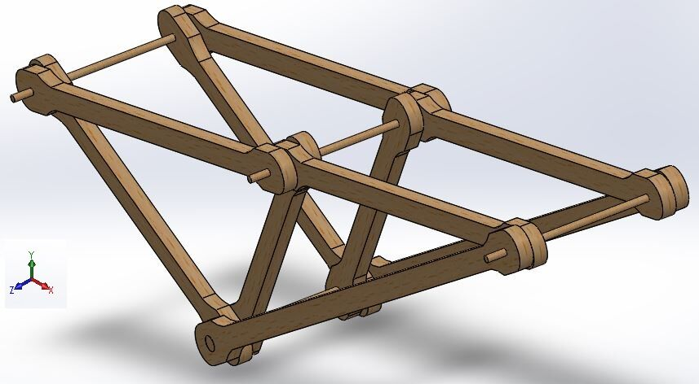
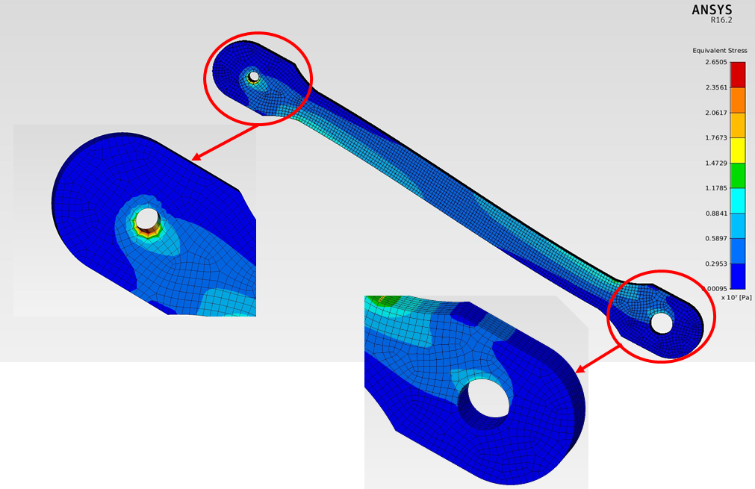
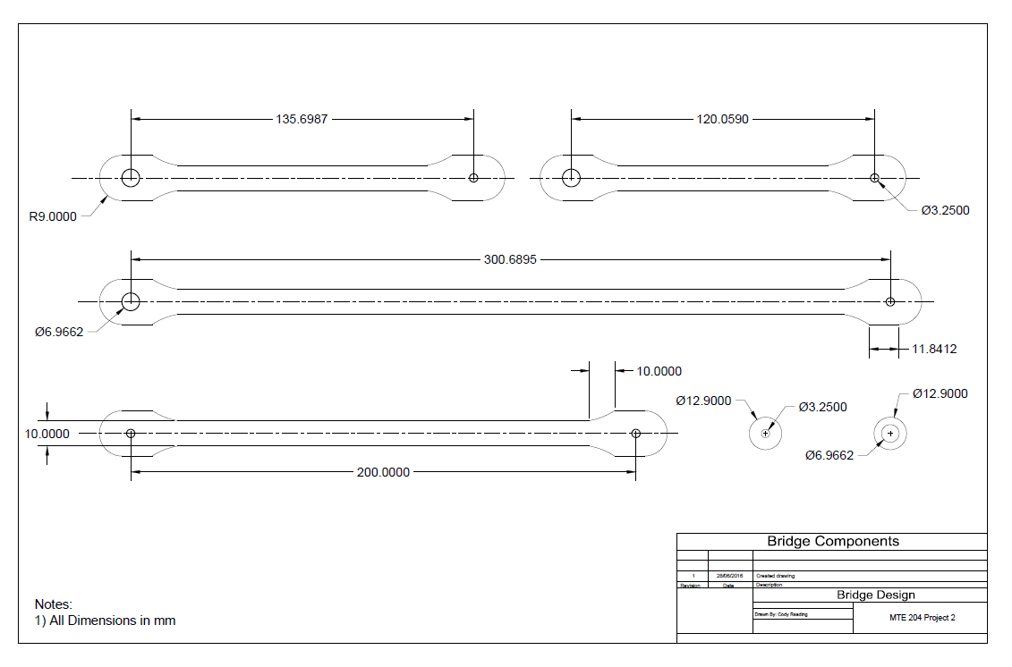
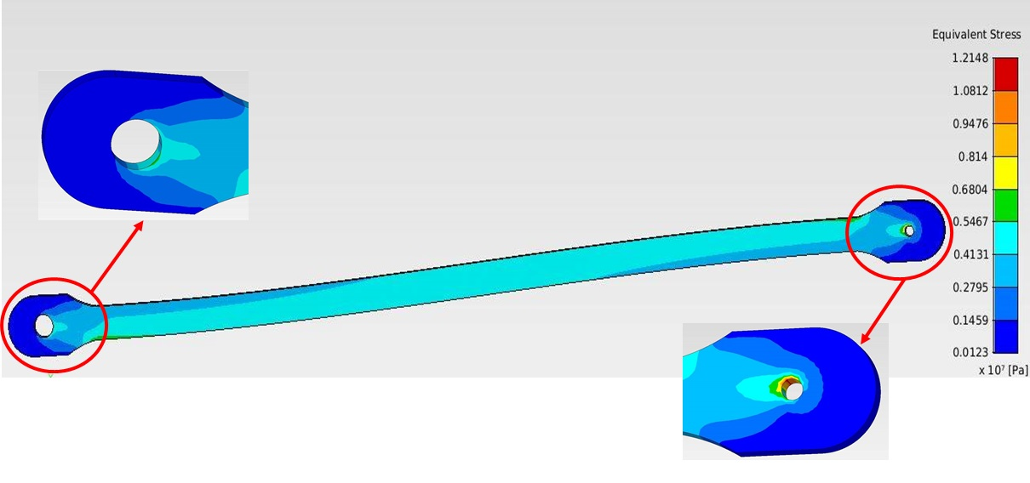
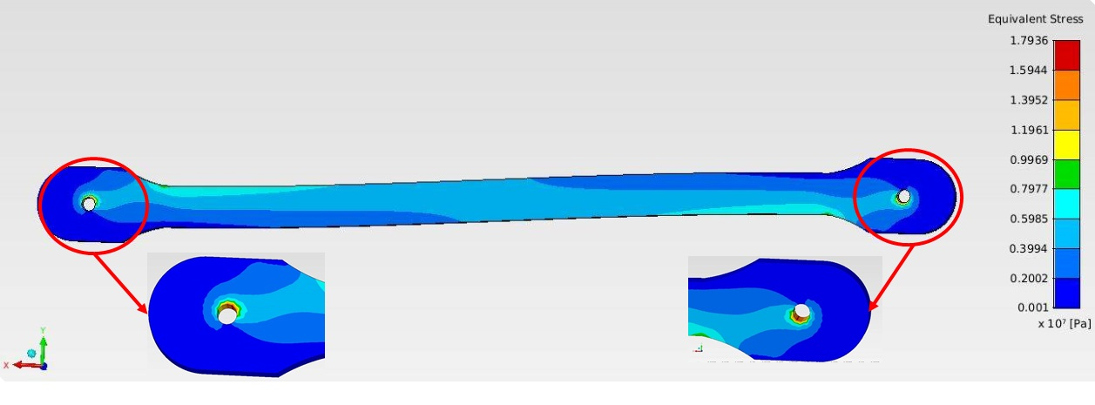
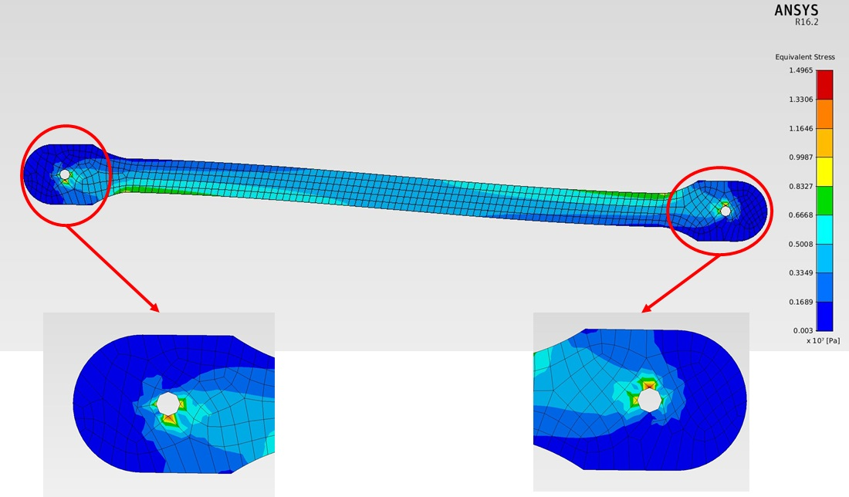
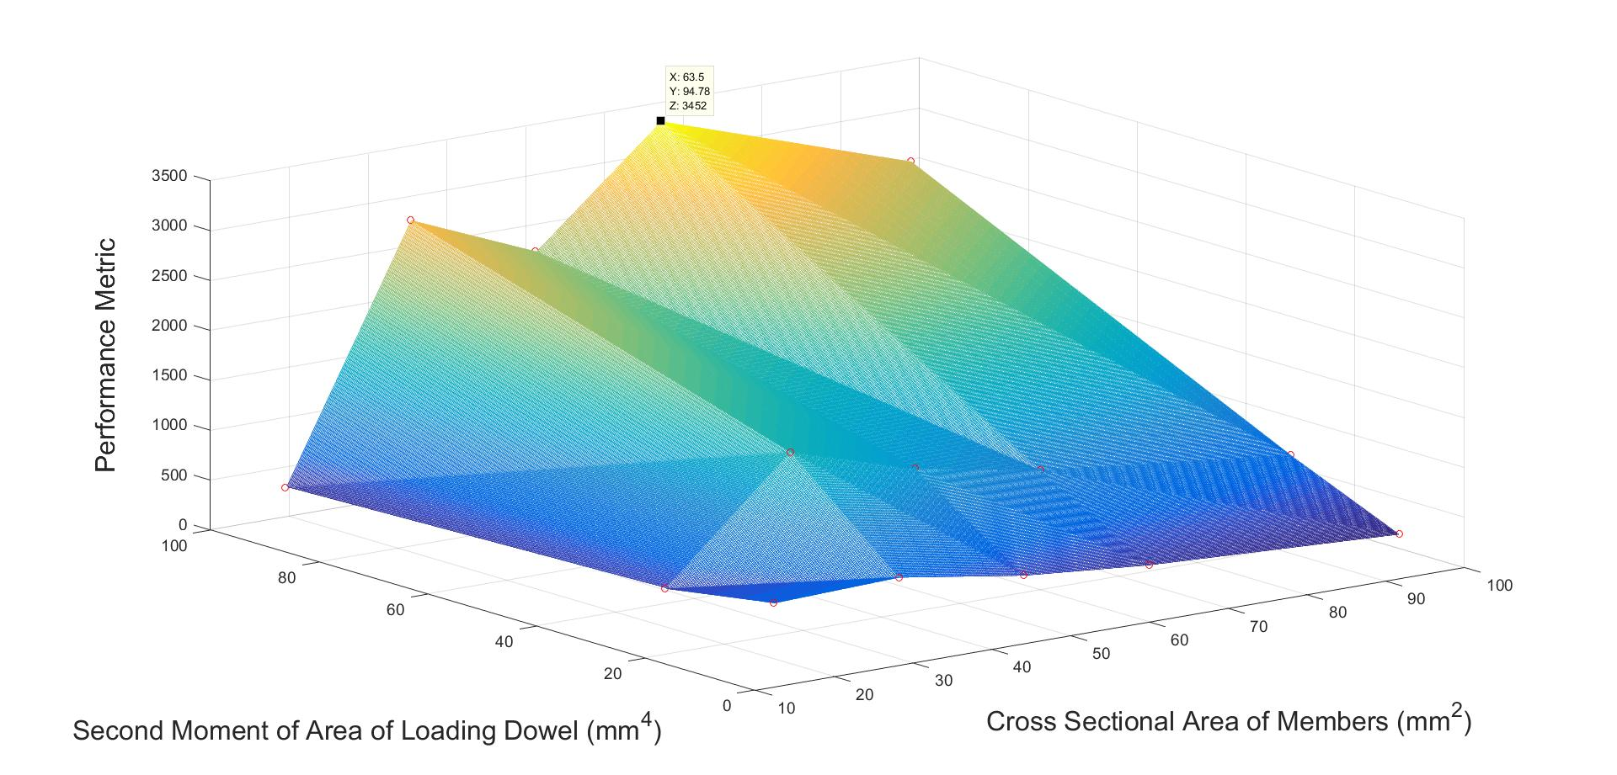
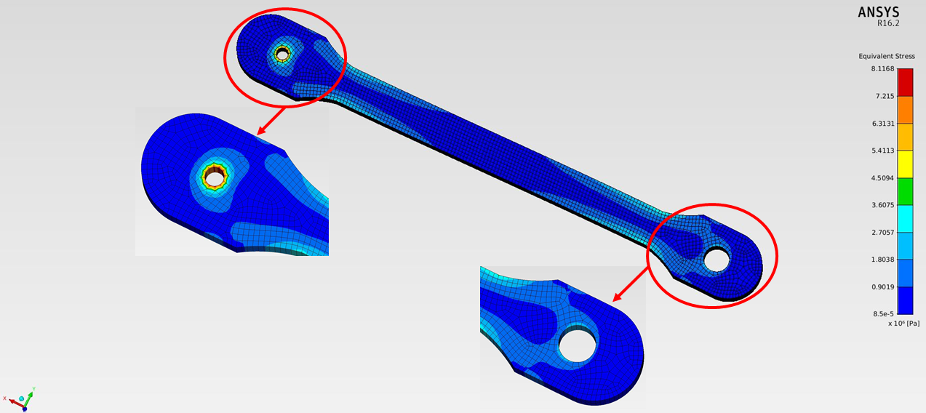
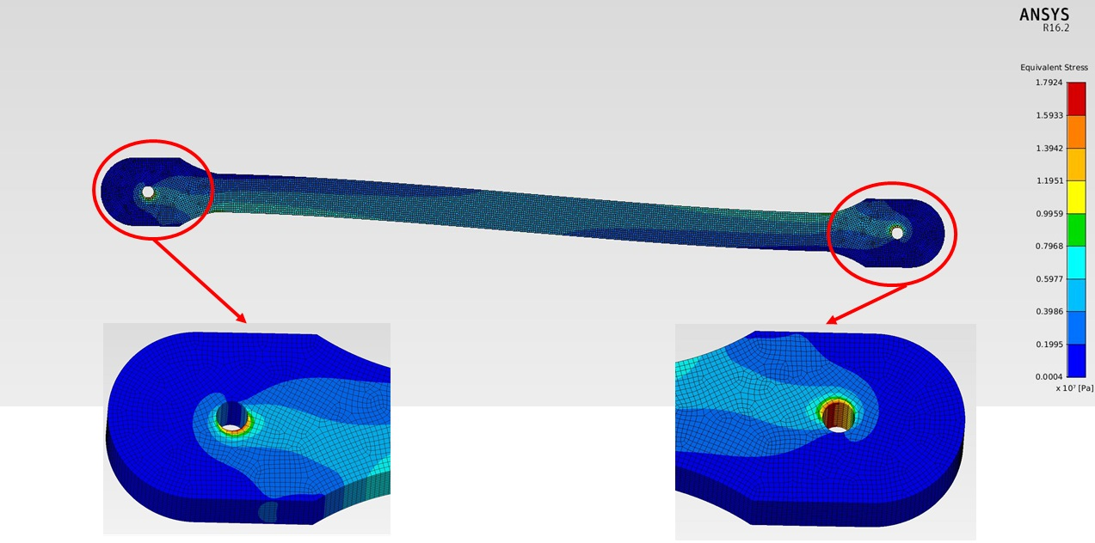
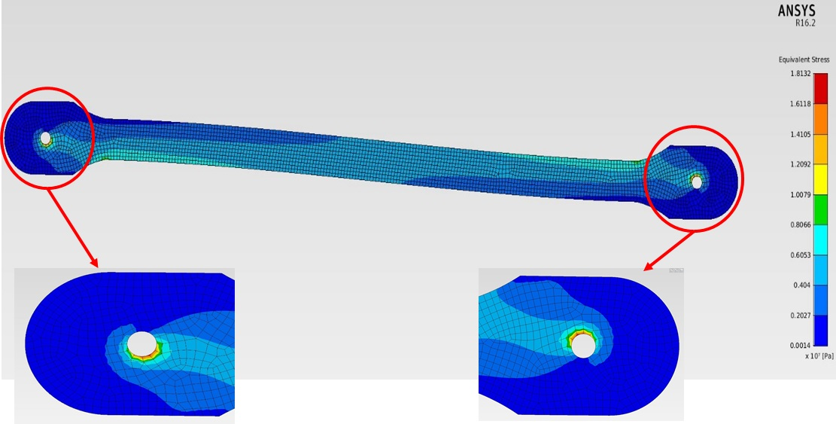
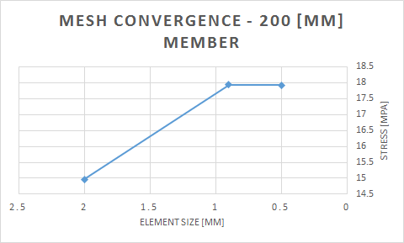
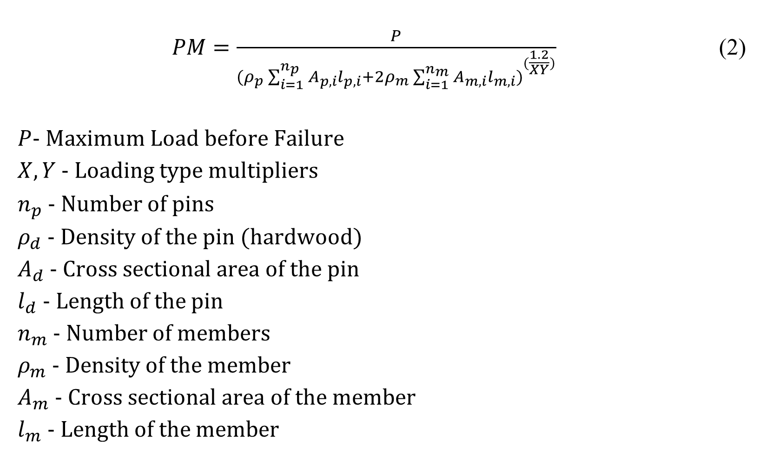

MTE 204 Bridge Project
Group 15
Raj Lad, Maharshi Patel, Cody Reading, Joshua Sayavong, Johnathan Van Gorp
Introduction
Final Design
Structural Analysis of Members
Performance Metric
Numerical methods is a powerful tool that allows individuals to discretize problems that are normally solved analytically. Through time integration, taylor series expansion and use of linear algebra, physics can be replicated by simulation through the means of computation using tools such as MATLAB and ANSYS. The following describes the iterative design process of a wooden truss bridge using tools from numerical methods.
1
1
$PM=\frac{P}{{(ρ_{p}\sum_{i=1}^{n_{p}}{A_{p,i}l_{p,i}}+2ρ_{m}\sum_{i=1}^{n_{m}}{A_{m,i}l_{m,i})}}^{(\frac{1.2}{XY})}}$ (2)
$P$- Maximum Load before Failure
$X,Y$ - Loading type multipliers
$n_{p}$ - Number of pins
$ρ_{d}$ - Density of the pin (hardwood)
$A_{d}$ - Cross sectional area of the pin
$l_{d}$ - Length of the pin
$n_{m}$ - Number of members
$ρ_{m}$ - Density of the member
$A_{m}$ - Cross sectional area of the member
$l_{m}$ - Length of the member
2
3
1
1
5
2
3
4
Objectives
2
4
The objective of this project is to create a bridge truss structure that supports the largest amount of weight relative to the bridge’s mass and optimizes performance metric.
Figure 2: 3D View of full bridge CAD assembly
Figure 6: Stress analysis of a 140 mm member with mesh size of 0.09
Component CAD Diagrams
Constraints
4
4
Convergence to Solution
Truss structure must be constructed only using two force members, connected at their ends using pin joints
All pins must allow for free rotation
A pin must be provided at most 9 cm from the center span of the structure
The length of the bridge must be 40 ± 1 cm apart
The height of the bridge must be 10 ± 0.5cm
The truss width of the bridge must be 8 ± 0,5 cm
All members must be made with the ⅛” thick balsa wood provided
All pins must be constructed using the ⅛” hardwood dowel material provided
Adhesives can only be used to build a complex cross section geometry
2
The brute force method was used with the above equation to converge to the final design. This was achieved by running multiple designs through the MATLAB solver and selecting the design that will achieve the highest PM. The equation converged to the final design due to the higher multiplier gained by loading off centre, in addition to the lower mass.
Next, the cross sectional area of the members and the second moment of area of the loading dowel were varied, and the brute force technique was used again running each case through MATLAB. (See Figure 10). The moment of inertia for the loading dowel could be varied by using more than one dowel.
$$l_{m,i}$$
Figure 7: Stress analysis of a 300 mm member with mesh size of 0.09 mm
Figure 3: AutoCAD Drawing of Truss Elements
3
5
4
Member Models with Variable Mesh
Criteria Optimal Design
1
2
3
(1)
Figure 8: Stress analysis of a 200 mm member with mesh size of 0.09 mm
Where X increases with an offset of loading horizontally, and Y increases with an offset in loading vertically
3
In order to achieve the goal of maximizing performance metric, as seen in Equation 1, many properties were considered. First of all, the truss itself must be as light as possible. Secondly, the amount of load that the truss can take must be maximized. Finally, the load should be placed furthest from the lowest centre location in order to maximize the X and Y multipliers. The factor of safety that was used is 3.
Figure 1 shows the development process than was used in this project in order to maximize performance metric.
3
2
1
2
3
Figure 11: Predicted Performance Metric from MATLAB Solver
Figure 9: Stress analysis of a 120 mm Member with mesh size of 0.09 mm
From the results, it was decided to use a member cross section area of 63.5 mm² and a loading dowel second moment of area of 94.78 mm^{4.} This was achieved by using a three dowel pin at the loading dowel and attaching two pieces of 1/8” thickness members together using adhesive. Using this, the predicted performance metric was 3452. However, testing prototypes determined that this predication was inaccurate.
Brainstorm New Design
Figure 4: 200 mm member with 0.5 mm mesh and 0.05 mm mesh
1
2
3
Simulate using MATLab
Build the Bridge
Prediction
Simulate using ANSYS
After testing, the predicted load that the truss structure should support is 11 kg. The mechanism of failure will be bending of the loading dowel. The 11 kgg load placed upon our design will yield a performance metric of 634.2.
Figure 1: General workflow for design reiteration
Figure 5: Graphical representation of mesh convergence for 200 mm member
Figure 10: Stress analysis of a 200 mm Member with mesh size of 0.09 mm

