Slide 1
Evaluation of a Wind Energy Harvesting Concept for Plug In Hybrid and Electric Vehicles
Maharshi Patel
Department of Mechanical and Mechatronics Engineering
University of Waterloo
Waterloo, Ontario, Canada
Friday, August 28, 2015
Waterloo, Ontario, Canada

Slide 2
Acknowledgements
Prof. Kaan Inal
Christopher Kohar

Slide 3
Contents
Abbreviations
Introduction
Re-cap
Problem
Solution
Feasibility test
Literature Review
BEM – Theory
CFD ANSYS
Fluid Theory
Turbulence Theory
Model
Geometry
Mesh
Turbulence Model
Results
Conclusion
Future Plans
References

Slide 4
Introduction

Slide 5
Requirement from CAFE in the next decade
Extrapolation from the current mileage achieved
Comparing Extrapolation of the current achieved mileage, to the estimated mileage proposed by CAFE

Slide 6
How Car Manufacturers Control Fuel Economy
Aerodynamics
Weight reduction
Same performance and safety for less weight
Managing their respective powertrain system
Monitoring energy consumed/generated
Looking for alternative systems

Slide 7
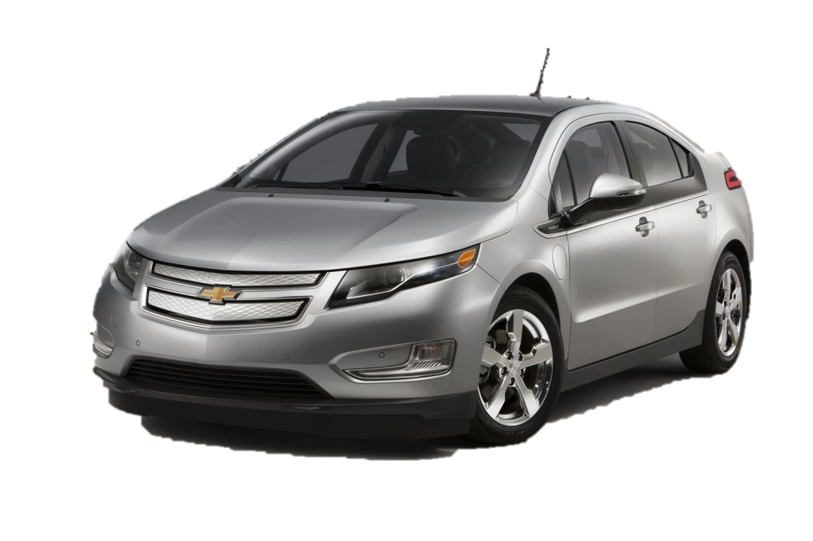
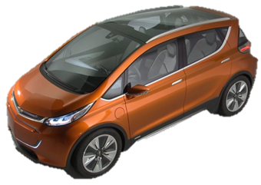
GM’s Alternative Powertrain Vehicles
[3]
[3]
Chevrolet Volt (2010) and Bolt (Concept shown in 2015 North American International Auto Show)

Slide 8
The Problem!
[3]
Plug-in Hybrid Vehicles (PHEV); Hybrid Vehicles (HV); Electrical Vehicles (EV)
Run out of electrical energy in short ranges →PHEV (30-80 km); EV (max ~300 km)
Higher charging times
PHEV, HV, and EV cars need to have better driving ranges

Slide 9
Goal Statement
New mechanical and/or electrical framework needed to improve the driving range for PHEV, HV, and EV cars
System needs to be self generating (Incorporate sustainable energy)
Charge battery modules when vehicle in motion and/or stationary

Slide 10
Constraints
Fit within the space limitation of the car
Any brand or model
Generate enough energy and power to charge the battery
Use sustainable energy source
Work when automobile is stationary and/or moving

Slide 11
Criteria
Safety
Risk to the passengers and operators of vehicle
Performance
How much energy can we extract?
How much weight will it add?
Cost
Manufacturing complexity
Maintenance and warranty
Knowledge
How well understood is the performance of the system
What tools do we need to develop to make system feasible

Slide 12
Possible Extraction Methods to Harvest Electrical Energy

Slide 13




Hydrogen Fuel Cell
Catalyst
Catalyst
Pt
Pt
Oxygen air (O₂) intake from the air
Proton Exchange Membrane (PEM)
H₂ → 2H⁺ + 2e⁻
½O₂ + 2H⁺ + 2e⁻ → H₂O
Hydrogen (H₂) gas from reservoir
Exhaust

Slide 14
Solar “voltaic” Cells (SVC)
Photoelectric Effect → light energy into electrical energy
p
n
Light – Incident Ray
Current
e⁻
e⁻
Load

Slide 15
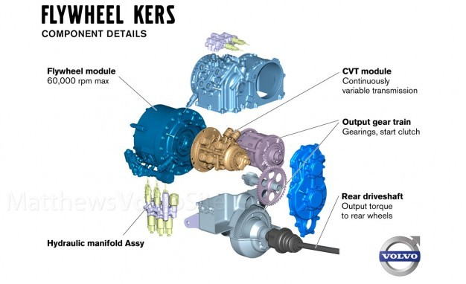
KERS

Slide 16

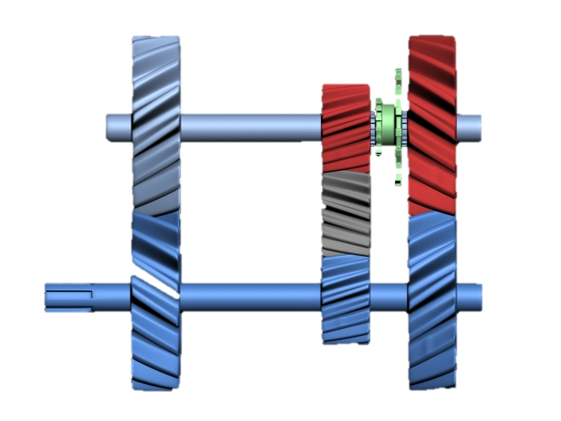
Wind Energy
Transmission/Gears
Generator
+
-
Wind (kinetic) energy is converted to electrical energy

Slide 17
Solutions: → |  |  | Hydrogen Fuel Cells |  | Solar "Voltaic" Cells |  | KERS |  | Wind
Criteria ↓ | Weight | Weight (%) | # | % | # | % | # | % | # | %
Safety | 10 | 34% | 5 | 17% | 10 | 34% | 8 | 28% | 10 | 34%
Performance | 8 | 28% | 6.5 | 22% | 4 | 14% | 7 | 24% | 6.5 | 22%
Cost | 5 | 17% | 2.5 | 9% | 3 | 10% | 4 | 14% | 5 | 17%
Knowledge Behind the Concept | 6 | 21% | 3 | 10% | 4.5 | 16% | 6 | 21% | 6 | 21%
Total: → | 29 | 100% | 17 | 59% | 21.5 | 74% | 25 | 86% | 27.5 | 95%
1 -> Lowest Concern 10 -> Highest Concern
All four designs evaluated based on the criteria given above

Slide 18
Feasibility Study
Current power and efficiency of current PHEV, HV, and EV
Chevrolet Volt: 111kW (149 bhp) @ 80 km range
Battery Size: 17.1 kWh
Establish our goal for range improvement
+ 30% range = 104km range → + 4.032 kWh of Energy Harvesting
+ 50% range = 120km range → + 7.182 kWh of Energy Harvesting
Determine energy harvesting capability
What is the maximum energy we can theoretically extract
Determine energy harvesting efficiency
Mechanical losses (friction, weight increase)
Thermodynamic losses (entropy)
Aerodynamic losses (increase in drag)
After all of this, determine if we can ACTUALLY meet our goal of improved range

Slide 19
Literature Review

Slide 20
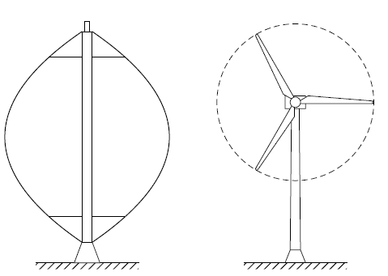
Vertical vs Horizontal Axis Wind Turbine
VAWT
HAWT

Slide 21
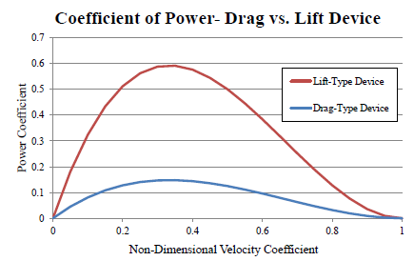
Lift vs Drag Driven turbine

Slide 22
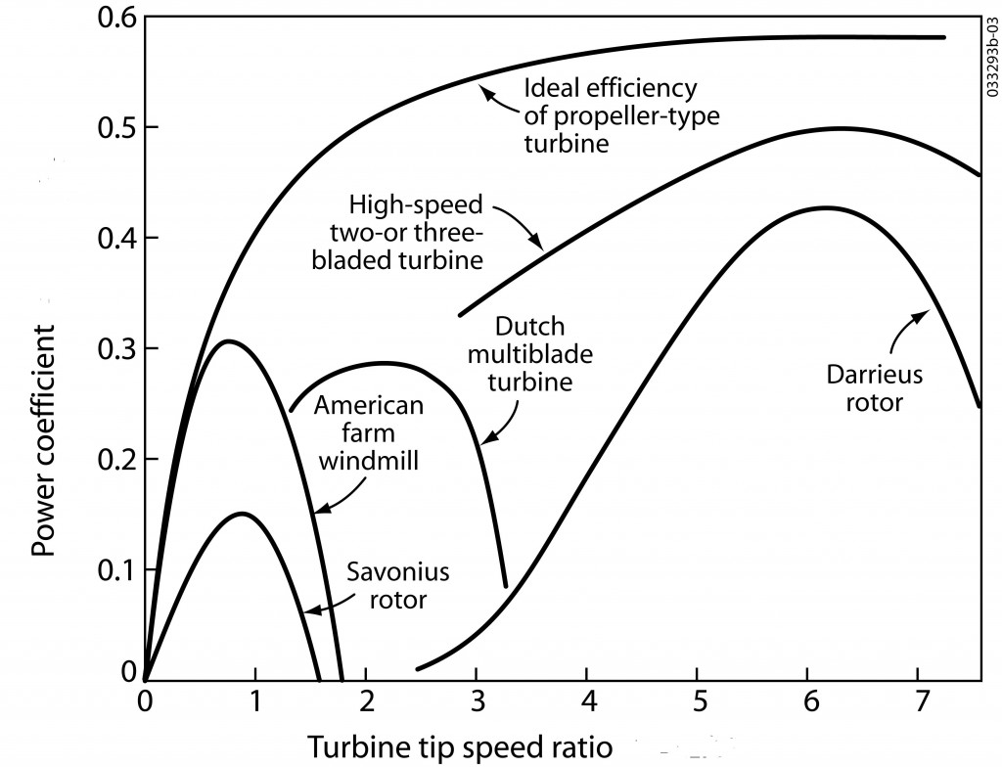
Efficiency of Different Type of Turbines

Slide 23
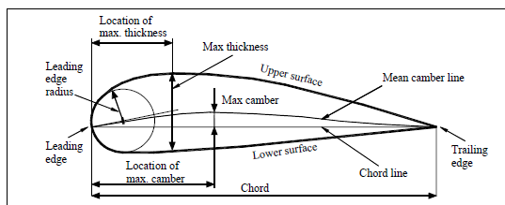
General Theory & Key Concepts
2D – Airfoil Diagram

Slide 24
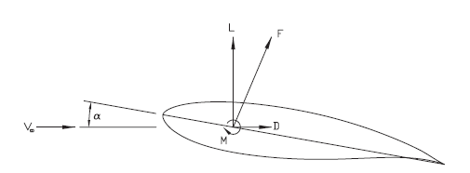



General Theory & Key Concept
$$L\left(Lift\right)=\frac{1}{2}∗C_{l}∗ρ∗V_{∞}^{2}∗c$$
$$D\left(Drag\right)=\frac{1}{2}∗C_{d}∗ρ∗V_{∞}^{2}∗c$$
$$F=L∗\sin\left(∝\right)−D∗cos⁡(∝)$$
2D – Airfoil FBD, in an ideal situation with now skin drag

Slide 25
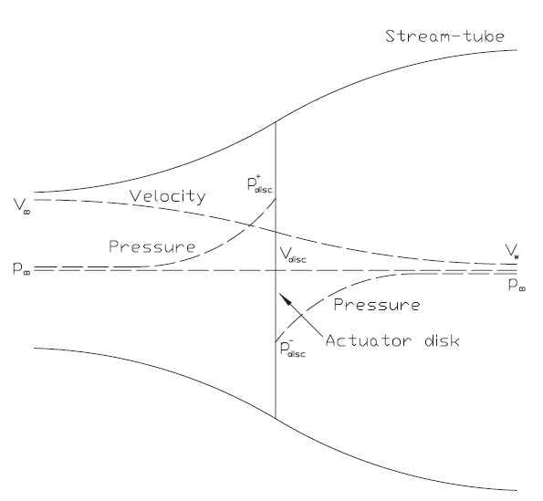



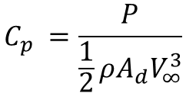

General Theory & Key Concepts
$$V_{disc}= V_{∞}\left(1−a\right), a is axial induction$$
$$P=2ρA_{d}V_{∞}^{3}a{\left(1−a\right)}^{2},{ A}_{d}= πR^{2}$$
$$C_{p} =\frac{P}{\frac{1}{2}ρA_{d}V_{∞}^{3}}$$
$$C_{T}=4a(1−a)$$
$$\frac{d}{dr}C_{p}=8\left(1−a\right)a^{′}λ^{2}{\left(\frac{r}{R}\right)}^{3}$$
$$λ=\frac{ΩR}{V_{∞ }}$$

Slide 26
General Theory & Key Concepts
Airfoil used
NREL and NACA are most common airfoil used to design the wind turbine

Slide 27
Blade Element Momentum (BEM) Theory Assumptions
Momentum Theory
Blades operate without frictional drag
A slipstream that is well defined separates the flow passing through the rotor disc from outside disc
The static pressure in and out of the slipstream far ahead of and behind the rotor are equal to the undisturbed free-stream static pressure (p1 = p3)
Thrust loading is uniform over the rotor disc
No rotation is imparted to the flow by the disc
Based on state flow

Slide 28
BEM Theory Assumptions
Blade Element
There is no interference between successive blade elements along the blade
Forces acting on the blade element are solely due to the lift and drag characteristics of the sectional profile of a blade element

Slide 29
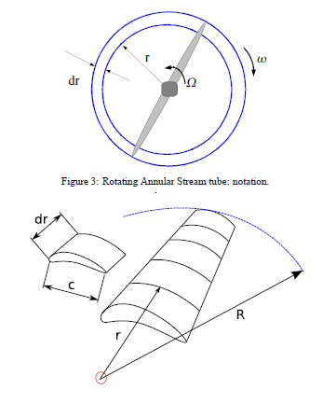
BEM Theory

Slide 30
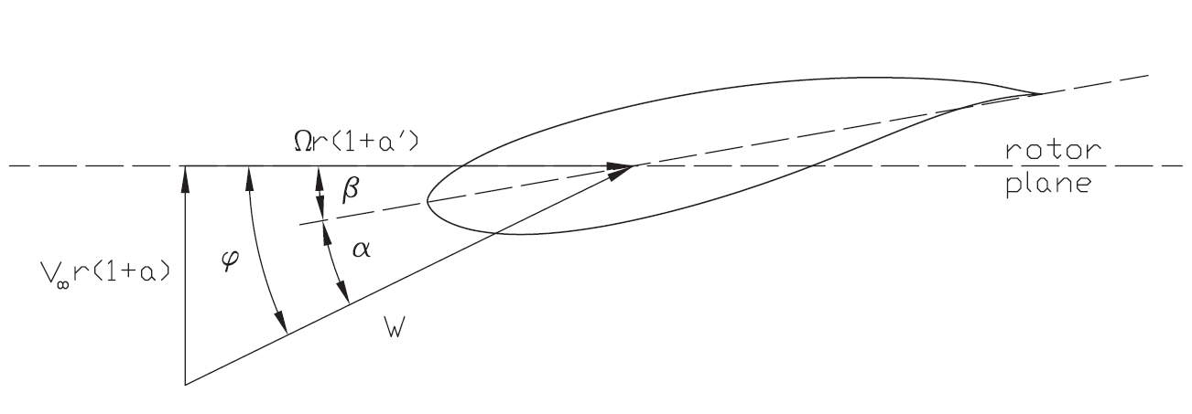
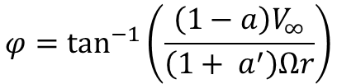

BEM – 2D Element
$$α= φ −β$$
$$φ=\tan^{−1}\left(\frac{\left(1−a\right)V_{∞}}{\left(1+ a^{′}\right)Ωr}\right)$$

Slide 31
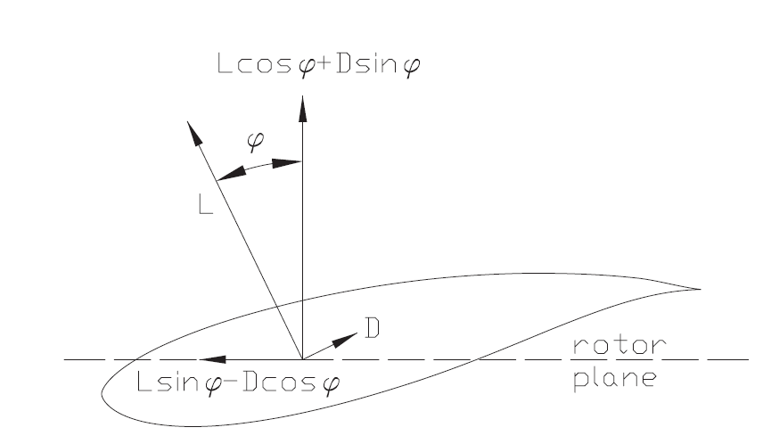
BEM – 2D Element

Slide 32

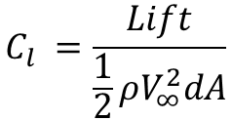



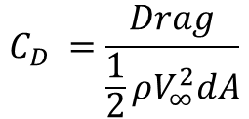



BEM – 2D Forces
$$dD=\frac{1}{2}C_{D}ρW^{2}dA$$
$${ dA}_{}=CdR$$
$$C_{l} =\frac{Lift}{\frac{1}{2}ρV_{∞}^{2}dA}$$
$$dF_{T }=dLsin\left(φ\right)−dDcos(φ)$$
$$dF_{N }=dLcos\left(φ\right)−dDsin(φ)$$
$$C_{D} =\frac{Drag}{\frac{1}{2}ρV_{∞}^{2}dA}$$
$$dT=rdF_{t}$$
$$dP =\frac{λ_{T}V_{∞}}{R_{T}}dT$$
$$dL=\frac{1}{2}C_{L}ρW^{2}dA$$

Slide 33
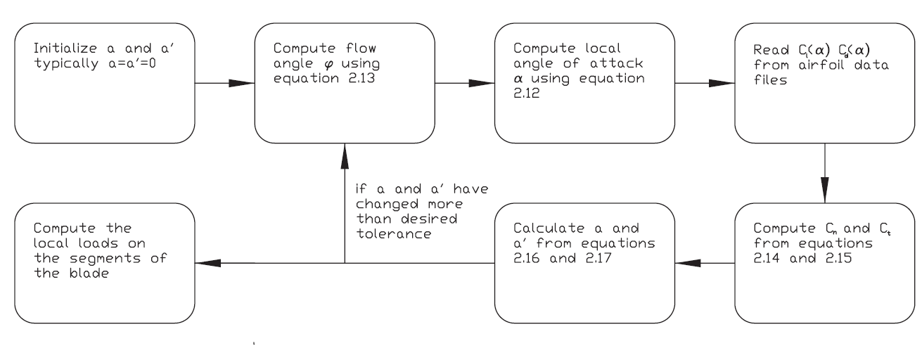
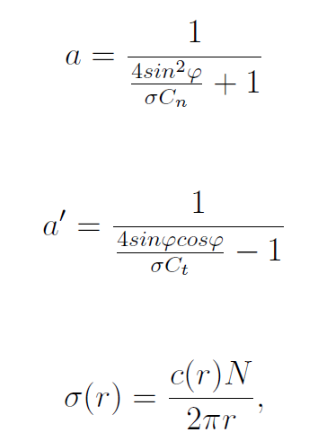
BEM a & a’ Iteration

Slide 34
Computational Fluid Dynamics (CFD) - ANSYS

Slide 35
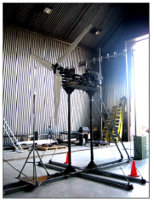
Gertz Experimental Model
Airfoil Used: N83X series
Number of Blades: 3
Designed Tip Speed Ratio (TSR): 5.4
Rotational Speed: 200 rpm
Radius: 1.65 m
Temperature: 300 K

Slide 36
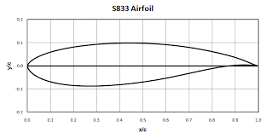
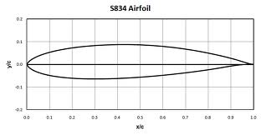
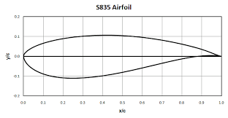
NREL S83X series

Slide 37
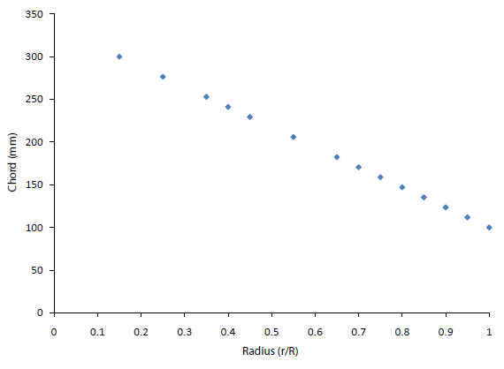
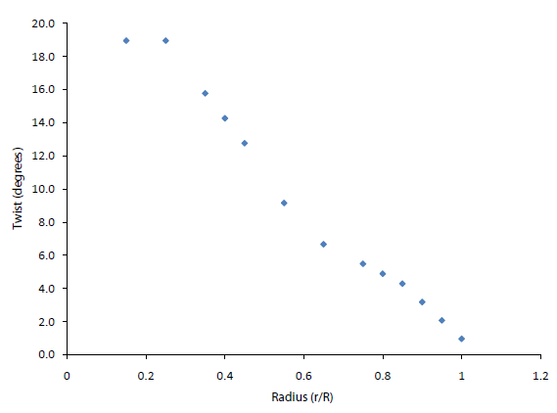
Gertz Experimental Model
Gertz chord and pitch varying throughout the blade length

Slide 38
CFD Fluent Theory Model Assumption
Fluid is Newtonian
There is only one phase present
The problem domain throughout the analysis does not change
The user has to define 2 set of parameter on what type of fluid flow
Fluid flow is assumed turbulent
The fluid is assumed incompressible

Slide 39
CFD Fluent Theory Model Generation
Reynolds (Ensemble) Average
Filtered Navier-Stokes Equation
Hybrid RANS-LES Formulation
Bossinesq Approach vs Reynolds Stress Transport Models

Slide 40

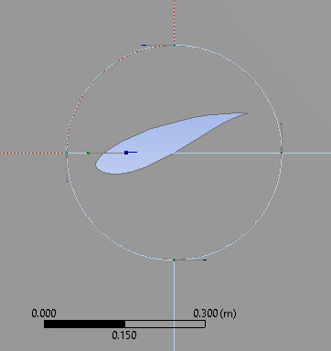


Fluent Geometry

Slide 41

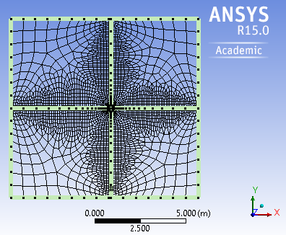
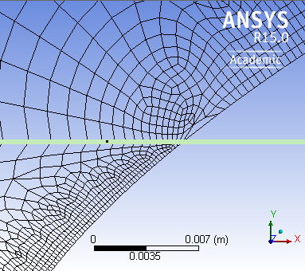
Fluent Mesh

Slide 42
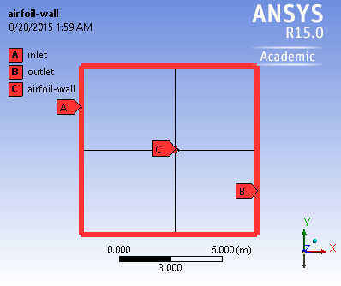
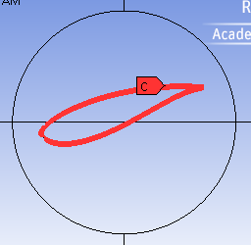
Boundary condition

Slide 43
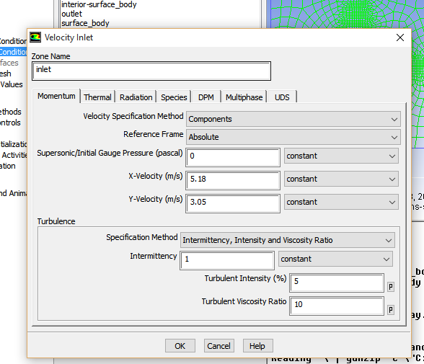
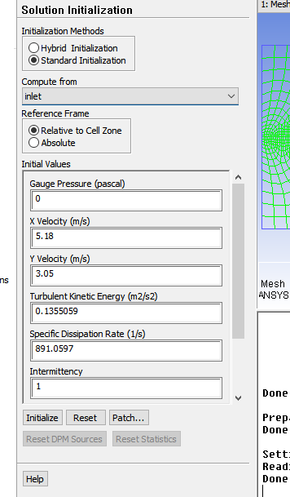
Boundary Condition

Slide 44
Turbulence Model
Transitional SST
Specially created to monitor airfoil flow
An upgrade version of k-w SST (k-omega Shear Stress Transport) models with additional 2 transport equations
k-w SST model is more accurate and reliable for a wider class of flows
Adverse pressure gradient flows
Airfoils
Transonic shock waves

Slide 45
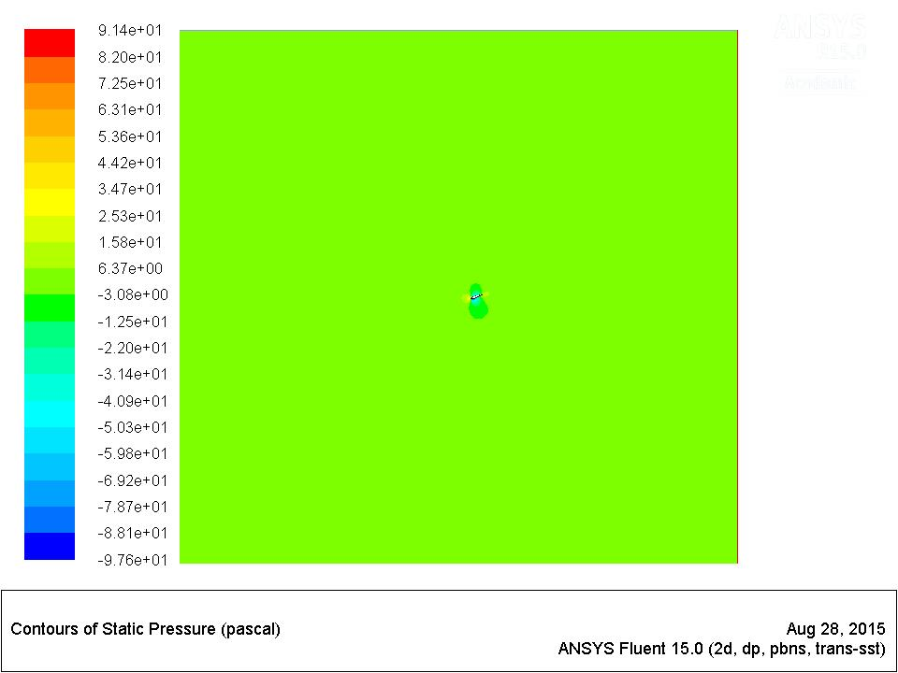
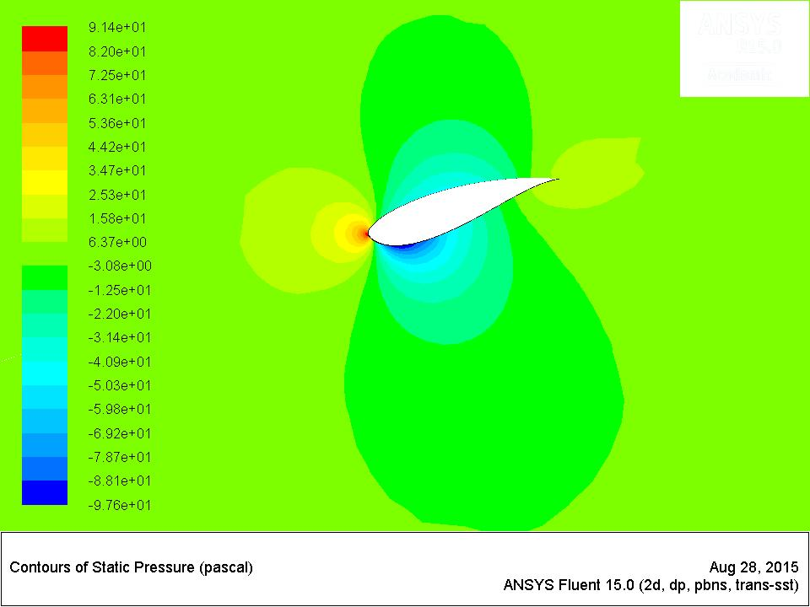
Solution

Slide 46
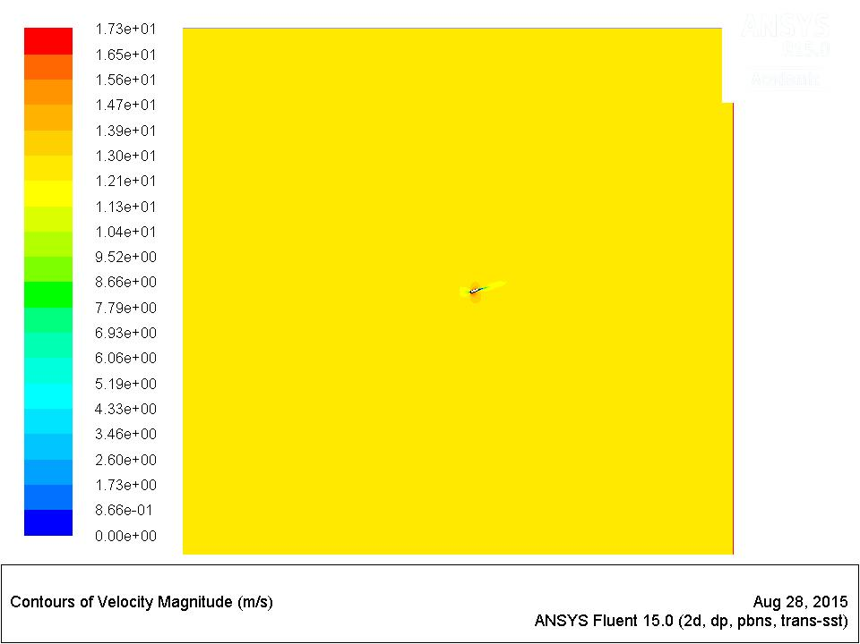
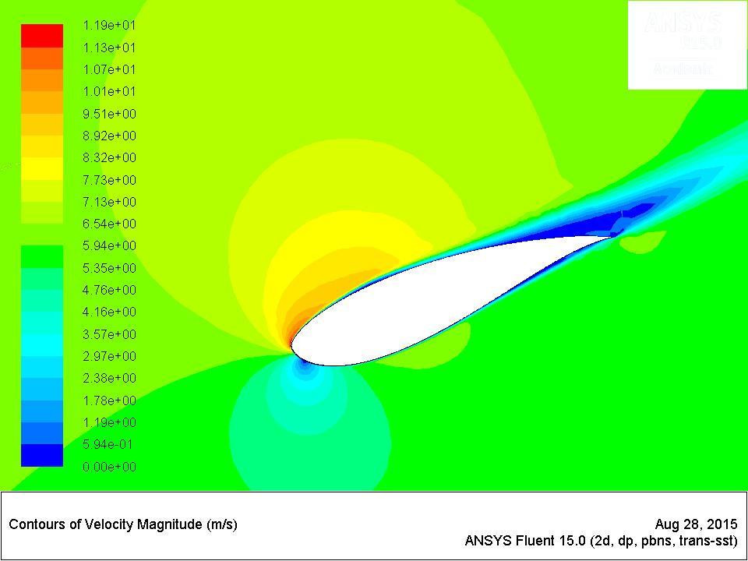
Solution

Slide 48
Conclusion

Slide 49
Conclusion
The model has less percentage error for TSR 5-8 when compared to Gertz’s Model
Cp of 0.42 is achievable on this airfoil
To get better results
Better and more structured mesh is needed
More stricter convergence method is needed

Slide 50
Future Plans

Slide 51
Future Plans
Adapt this model for the turbine that is going to be used in the car
Check if the size is feasible
Conduct Lap time simulation to see if the energy is generated

Slide 52
Questions?

Slide 53
References
Hydrogen Fuel Cells – PEM
[1] S. G. Chalk and J. F. Miller, “Key challenges and recent progress in batteries, fuel cells, and hydrogen storage for clean energy systems,” J. Power Sources, vol. 159, no. 1 SPEC. ISS., pp. 73–80, 2006.
[2] L. M. Das, R. Gulati, and P. K. Gupta, “A comparative evaluation of the performance characteristics of a spark ignition engine using hydrogen and compressed natural gas as alternative fuels,” Int. J. Hydrogen Energy, vol. 25, pp. 783–793, 2000.
[3] Department of Energy, “Hydrogen Fuel Cells Fact Sheet,” 2006.
[4] H. C. Now, F. Cell, C. Later, J. Deutch, and N. Series, “Hybrid Cars Now, Fuel Cell Cars Later Author(s): Nurettin Demirdöven and John Deutch Source:,” vol. 305, no. 5686, pp. 974–976, 2015.
[5] J. M. Ogden, M. M. Steinbugler, and T. G. Kreutz, “Comparison of hydrogen, methanol and gasoline as fuels for fuel cell vehicles: implications for vehicle design and infrastructure development,” J. Power Sources, vol. 79, no. 2, pp. 143–168, 1999.
[6] S. J. Peighambardoust, S. Rowshanzamir, and M. Amjadi, Review of the proton exchange membranes for fuel cell applications, vol. 35, no. 17. Elsevier Ltd, 2010.
[7] D. K. Ross, “Hydrogen storage: The major technological barrier to the development of hydrogen fuel cell cars,” Vacuum, vol. 80, no. 10, pp. 1084–1089, 2006.
[8] L. Schlapbach and A. Züttel, “for Mobile Applications,” vol. 414, no. November, pp. 353–358, 2001.
[9] Y. Wang, K. S. Chen, J. Mishler, S. C. Cho, and X. C. Adroher, “A review of polymer electrolyte membrane fuel cells: Technology, applications, and needs on fundamental research,” Appl. Energy, vol. 88, no. 4, pp. 981–1007, 2011.
[10] a. Yilanci, I. Dincer, and H. K. Ozturk, “A review on solar-hydrogen/fuel cell hybrid energy systems for stationary applications,” Prog. Energy Combust. Sci., vol. 35, no. 3, pp. 231–244, 2009.
Solar “Voltaic” Cells
[1] D. A. R. Barkhouse, O. Gunawan, T. Gokmen, T. K. Todorov, and D. B. Mitzi, “Device characteristics of a 10.1% hydrazine-processed Cu2ZnSn(Se,S)4 solar cell,” Prog. Photovoltaics Res. Appl., vol. 20, no. 1, pp. 6–11, 2012.
[2] M. S. Dresselhaus and I. L. Thomas, “Alternative energy technologies.,” Nature, vol. 414, no. 6861, pp. 332–337, 2001.
[3] E. Goffman, “Why Not the Sun ? Advantages of and Problems with Solar Energy,” no. December, pp. 1–16, 2008.
[4] H. B. Gray, “Powering the planet with solar fuel.,” Nat. Chem., vol. 1, no. 2, p. 112, 2009.
[5] M. a Green and K. Emery, “Solar Cell Eficiency Tables,” vol. 1, no. September 1992, pp. 25–29, 1993.
[6] P. In and T. Photovoltaic, “Introduction 1. 1.1.”
[7] a. Muller, B. Edwards, J. Kirkland, and J. Silcox, “Simulation of thermal diffuse scattering including a detailed phonon dispersion curve,” Ultramicroscopy, vol. 86, no. 3–4, pp. 371–380, 2001.
[8] B. O’Regan and M. Grätzel, “A low-cost, high-efficiency solar cell based on dye-sensitized colloidal TiO2 films,” Nature, vol. 353, no. 6346, pp. 737–740, 1991.
[9] B. K. Sovacool, “The intermittency of wind, solar, and renewable electricity generators: Technical barrier or rhetorical excuse?,” Util. Policy, vol. 17, no. 3–4, pp. 288–296, 2009.
KERS
[1] J. B. Bartolo, H. Zhang, D. Gerada, L. De Lillo, and C. Gerada, “High speed electrical generators, application, materials and design,” Proc. - 2013 IEEE Work. Electr. Mach. Des. Control Diagnosis, WEMDCD 2013, pp. 47–59, 2013.
[2] Bosch Mobility Solutions, “EN Bosch Regenerative Braking.” 2014.
[3] Z. C. Z. Chuanwei, B. Z. B. Zhifeng, C. B. C. Binggang, and L. J. L. Jingcheng, “Study on regenerative braking of electric vehicle,” 4th Int. Power Electron. Motion Control Conf. 2004. IPEMC 2004., vol. 2, pp. 836–839, 2004.
[4] Y. S. Li, Q. L. Zeng, C. L. Wang, and W. Liang, “Research on control strategy for regenerative braking of a plug-in hybrid electric city public bus,” 2009 2nd Int. Conf. Intell. Comput. Technol. Autom. ICICTA 2009, vol. 1, pp. 842–845, 2009.
[5] D. Parashar, “regenerativebrakingsystem-copy-140322013044-phpapp02,” 2014, pp. 1–34.
[6] J. W. Post, H. V. M. Hamelers, and C. J. N. Buisman, “Energy recovery from controlled mixing salt and fresh water with a reverse electrodialysis system,” Environ. Sci. Technol., vol. 42, no. 15, pp. 5785–5790, 2008.
[7] W. Rose, “White Rose Research Online,” Bilingualism, vol. 110, pp. 115–122, 2009.
[8] “Chassis Systems Control Reduce consumption . Protect the environment . Regenerative braking systems Regenerative braking systems increase range and reduce CO 2 emissions.”
[9] “2165.” .
Wind
[1] R. Billinton and G. Bai, “Generating capacity adequacy associated with wind energy,” IEEE Trans. Energy Convers., vol. 19, no. 3, pp. 641–646, 2004.
Mics.
[1] F. Armani, S. Armani, A. Armani, and R. Hill, “(19) United States (12),” vol. 1, no. 19, p. 17, 2011.
Text goes here

Slide 54
Visual Aids
[1] F. Felix, “Oil output to hit 500,000 barrels daily.” 2014.
[2] Motertrend, “2013-tesla-model-s-front-1.” 2014.
[3] Electrovelocity, “2011-chevy-volt-front.” 2010.
[4] Newcars, “2012-Nissan-LEAF-Coupe-Hatchback-SV-4dr-Hatchback-Photo-9.” .
[5] D. Parashar, “regenerativebrakingsystem-copy-140322013044-phpapp02,” 2014, pp. 1–34.
[6] R. Dervisgolu, “Solid_oxide_fuel_cell_protonic.” 2012.
[8] T. Dangkhoa, “Solar cell,” Solar Energy. pp. 1–26, 2005.
[9] “1921rpsaxq1zpjpg.” .
[10] Bosch Mobility Solutions, “EN Bosch Regenerative Braking.” 2014.
[11] F. Armani, S. Armani, A. Armani, and R. Hill, “(19) United States (12),” vol. 1, no. 19, p. 17, 2011.
[12] “mitsubishi-imiev-black-6.” .
Text goes here

Slide 55
Thank You!

