Slide 1

Structure and Beam Identification of 2D Bionic Shape
Maharshi Patel
Department of Mechanical and Mechatronics Engineering
University of Hamburg (TUHH)
Hamburg, Germany
Friday, August 14, 2017
Hamburg, Germany

Slide 2
Acknowledgements
Prof. Benedikt Kriegesmann
Julian Lüdeker (Phd. Candidate)
Olaf Ambrozkiewicz (Phd. Candidate)

Slide 3
Contents
Abbreviations
Introduction
Topological Optimization
Problem Statement
Proposed Methods
Method Implementation
NURBS Curve Derivatives
Post Processing
Results Comparisons
Parameter Fittings
Conclusion
Future Plans
References

Slide 4
Introduction

Slide 5
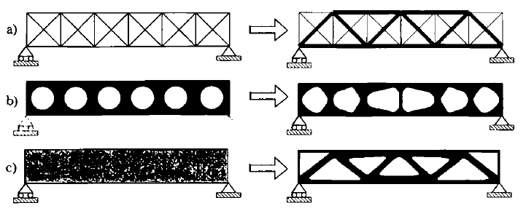
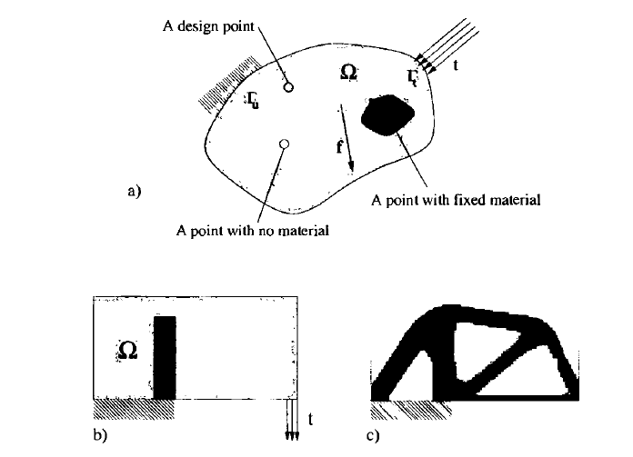
Topological Optimization (TO)
Optimizes material layout within a given design space
Maximize performance with a given set of load and boundary conditions
Application for additive manufacturing
5

Slide 6
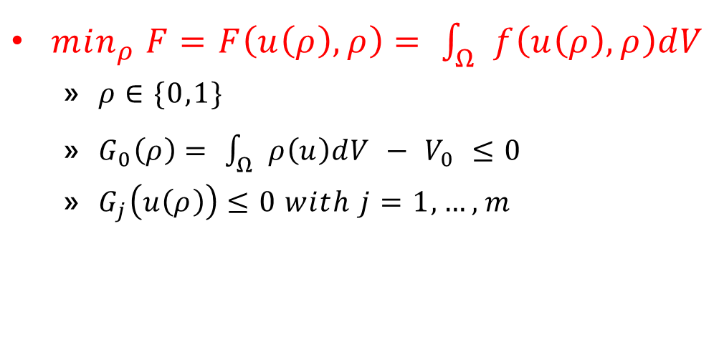
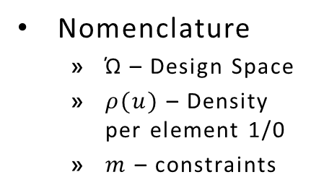
TO Formulation

Slide 7
Method Implementation NURBS MESH Derivatives

Slide 8

NURBS Mesh Derivatives
Main Functions
DensityToBionicShape
IdetifyBeams
Filterdata
Direction
BeamMatch
CenterPoint

Slide 9
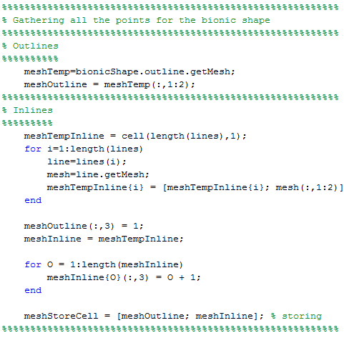
identifyBeams
Gathering points from mesh and storing it for later use

Slide 10

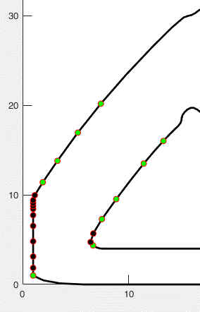
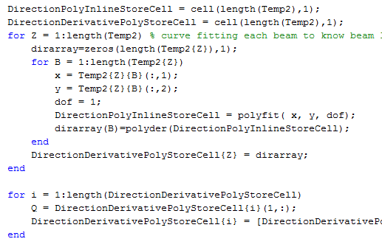
idenfifyBeams → direction
Calculates the derivative of each mesh point

Slide 11

Cont…
Determining the close points to compare the derivatives

Slide 12

Cont…
Storing of lines

Slide 13
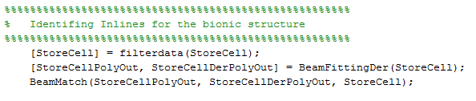
Cont → Other function calls

Slide 14

identifyBeams →filterdata
Deleting and rearranging StoreCell for later use

Slide 15

Cont…
Rearranging and removing the duplicate lines

Slide 16

Cont…

Slide 17
cont
Other function calls

Slide 18
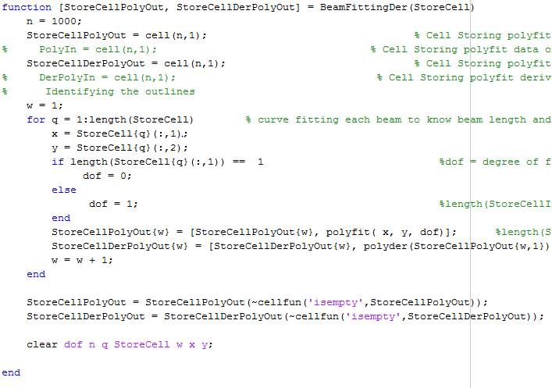
BeamFittingDer
Getting the derivative for all the lines in the bionic shape

Slide 19
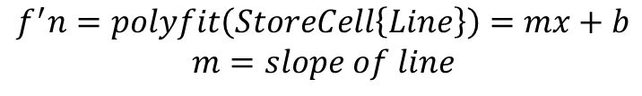
Cont…

Slide 20
Cont…
Other function calls

Slide 21

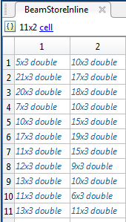
indentifyBeam →BeamMatch
Matching each to its partner and creating a beam
Plotting a patch to show the area of the beam

Slide 22
indentifyBeam →BeamMatch → CenterPoints
Finds the center points for all the lines to match the closest line

Slide 23
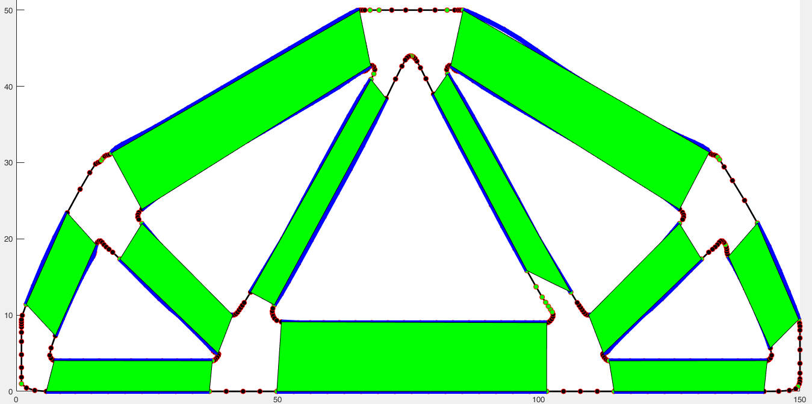
Cont…

Slide 24
Post Processing

Slide 25
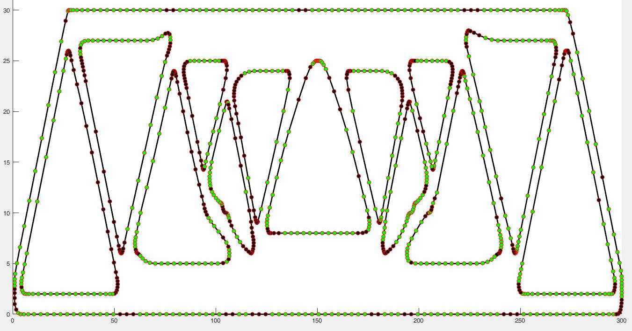

Method 1 vs Method 2 – Points Detection
NEW
OLD
Example 1: Structure 1

Slide 26


Method 1 vs Method 2 – Points Detection
OLD
Example 2: Structure 2
NEW

Slide 27
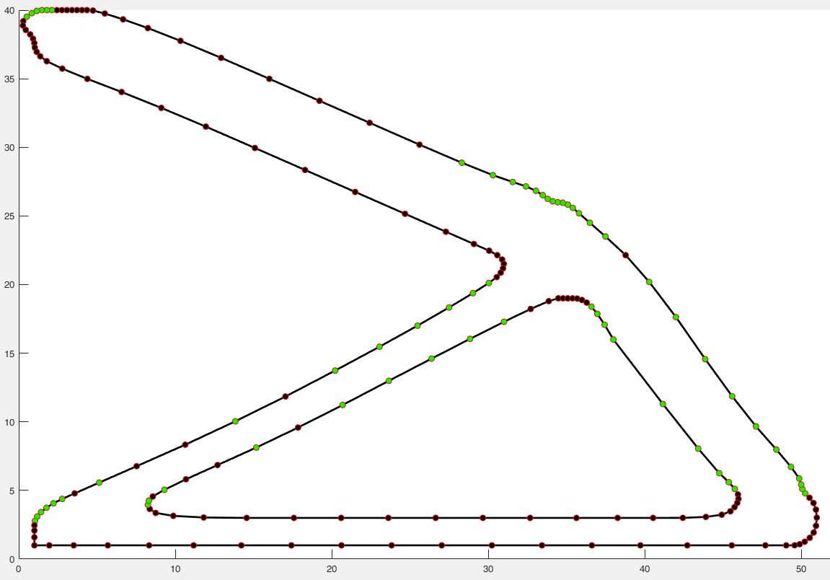
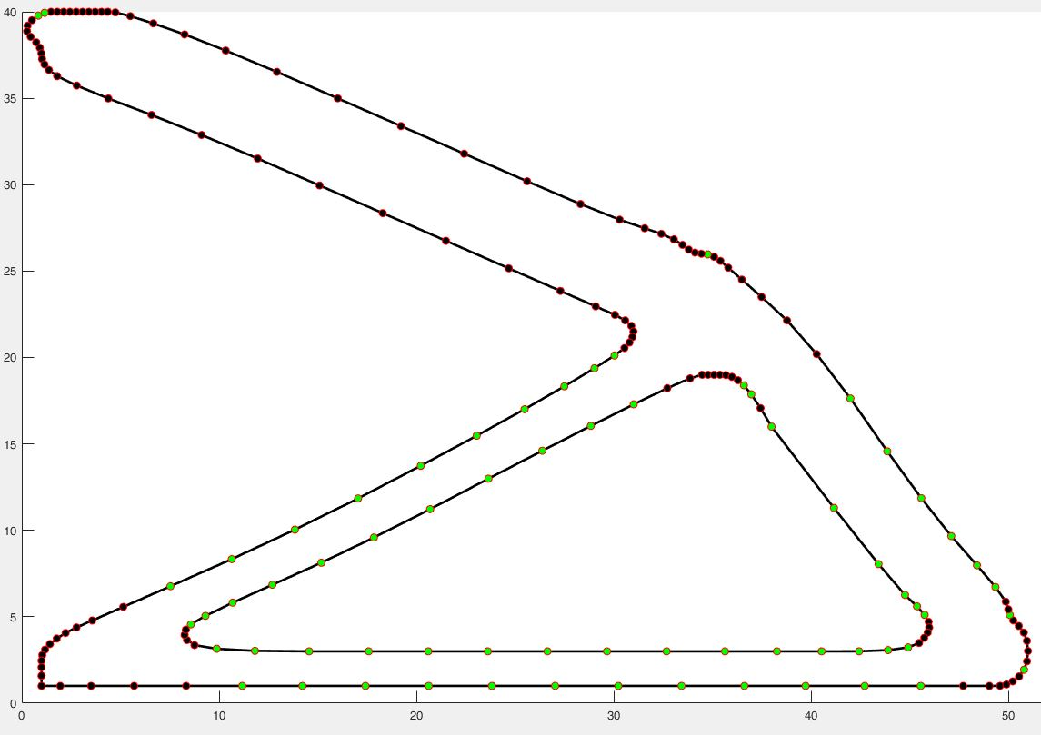
Method 1 vs Method 2 – Points Detection
OLD
NEW
Example 4: Structure 4

Slide 28
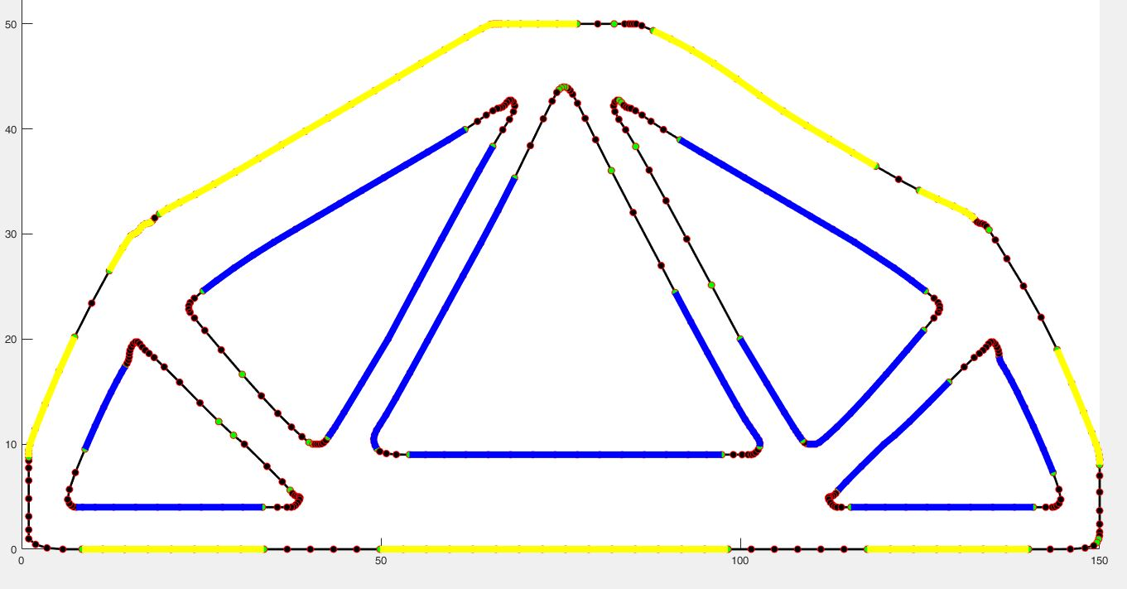
Method 1 vs Method 2 - Lines
OLD
NEW
Example 2: Structure 2

Slide 29
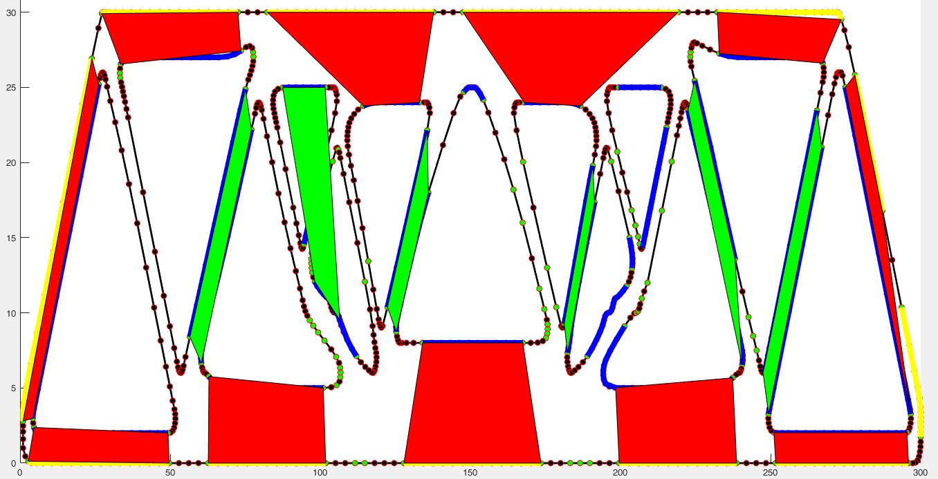
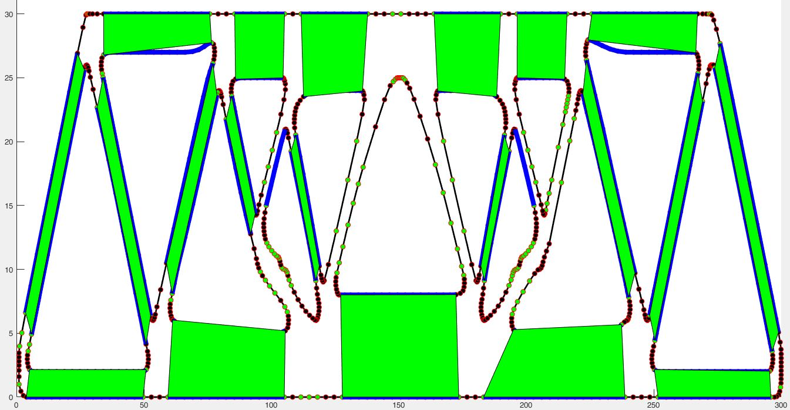
Method 1 vs Method 2 - Patch
OLD
NEW
Example 1: Structure 1

Slide 30
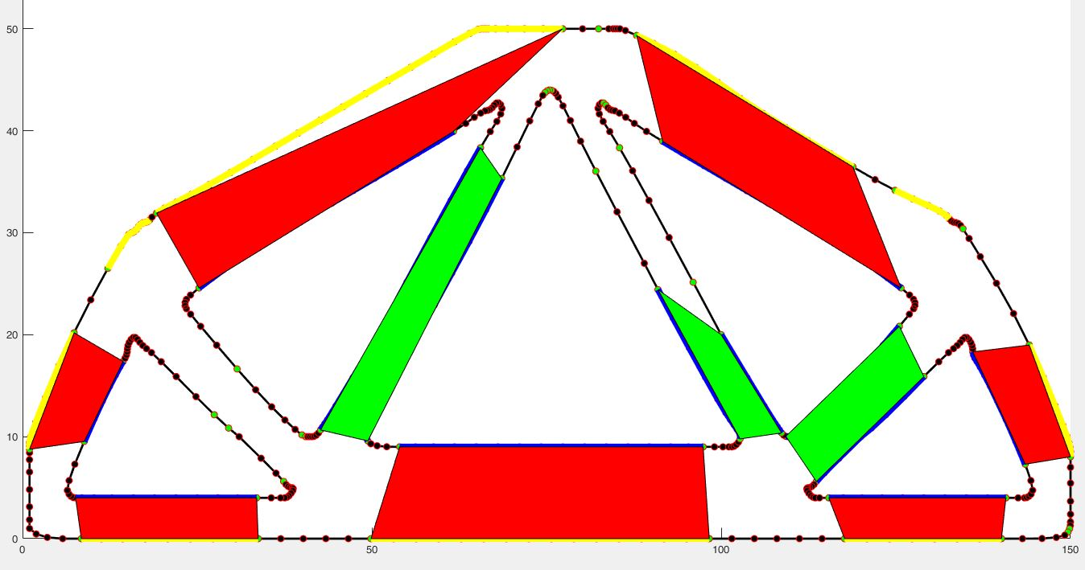
Method 1 vs Method 2 - Patch
OLD
NEW
Example 2: Structure 2

Slide 31
Method 1 vs Method 2 – Run Time
Structure Number | Method 1 (OLD) | Method 2 (NEW)
1 | 15.912 s | 14.568 s
2 | 6.959 s | 5.041 s
3 | Does Not Work (DNW) | 5.168 s
4 | DNW | 1.074 s
5 | DNW | 12.234 s

Slide 32
Conclusion

Slide 33
Conclusion
The NURBS mesh derivative method yields better results
To get better results and better runtime
Tweaking the polynomial and having a better curve fitting parameter
Optimizing the tolerance for each structure

Slide 34
Future Plans

Slide 35
Future Plans
Look for new storage array for faster process
Identifybeam function
Figure out a new way to compare lines to itself
New way to compare derivatives and construct polynomial better
Start simulating the structure on the FEM code
Start to delete elements
Compare the thickness and store elements to delete
Ham Code

Slide 36
Element Deletion

Slide 37
Questions?

Slide 38

References
Hydrogen Fuel Cells – PEM
[1] S. G. Chalk and J. F. Miller, “Key challenges and recent progress in batteries, fuel cells, and hydrogen storage for clean energy systems,” J. Power Sources, vol. 159, no. 1 SPEC. ISS., pp. 73–80, 2006.
[2] L. M. Das, R. Gulati, and P. K. Gupta, “A comparative evaluation of the performance characteristics of a spark ignition engine using hydrogen and compressed natural gas as alternative fuels,” Int. J. Hydrogen Energy, vol. 25, pp. 783–793, 2000.
[3] Department of Energy, “Hydrogen Fuel Cells Fact Sheet,” 2006.
[4] H. C. Now, F. Cell, C. Later, J. Deutch, and N. Series, “Hybrid Cars Now, Fuel Cell Cars Later Author(s): Nurettin Demirdöven and John Deutch Source:,” vol. 305, no. 5686, pp. 974–976, 2015.
[5] J. M. Ogden, M. M. Steinbugler, and T. G. Kreutz, “Comparison of hydrogen, methanol and gasoline as fuels for fuel cell vehicles: implications for vehicle design and infrastructure development,” J. Power Sources, vol. 79, no. 2, pp. 143–168, 1999.
[6] S. J. Peighambardoust, S. Rowshanzamir, and M. Amjadi, Review of the proton exchange membranes for fuel cell applications, vol. 35, no. 17. Elsevier Ltd, 2010.
[7] D. K. Ross, “Hydrogen storage: The major technological barrier to the development of hydrogen fuel cell cars,” Vacuum, vol. 80, no. 10, pp. 1084–1089, 2006.
[8] L. Schlapbach and A. Züttel, “for Mobile Applications,” vol. 414, no. November, pp. 353–358, 2001.
[9] Y. Wang, K. S. Chen, J. Mishler, S. C. Cho, and X. C. Adroher, “A review of polymer electrolyte membrane fuel cells: Technology, applications, and needs on fundamental research,” Appl. Energy, vol. 88, no. 4, pp. 981–1007, 2011.
[10] a. Yilanci, I. Dincer, and H. K. Ozturk, “A review on solar-hydrogen/fuel cell hybrid energy systems for stationary applications,” Prog. Energy Combust. Sci., vol. 35, no. 3, pp. 231–244, 2009.
Solar “Voltaic” Cells
[1] D. A. R. Barkhouse, O. Gunawan, T. Gokmen, T. K. Todorov, and D. B. Mitzi, “Device characteristics of a 10.1% hydrazine-processed Cu2ZnSn(Se,S)4 solar cell,” Prog. Photovoltaics Res. Appl., vol. 20, no. 1, pp. 6–11, 2012.
[2] M. S. Dresselhaus and I. L. Thomas, “Alternative energy technologies.,” Nature, vol. 414, no. 6861, pp. 332–337, 2001.
[3] E. Goffman, “Why Not the Sun ? Advantages of and Problems with Solar Energy,” no. December, pp. 1–16, 2008.
[4] H. B. Gray, “Powering the planet with solar fuel.,” Nat. Chem., vol. 1, no. 2, p. 112, 2009.
[5] M. a Green and K. Emery, “Solar Cell Eficiency Tables,” vol. 1, no. September 1992, pp. 25–29, 1993.
[6] P. In and T. Photovoltaic, “Introduction 1. 1.1.”
[7] a. Muller, B. Edwards, J. Kirkland, and J. Silcox, “Simulation of thermal diffuse scattering including a detailed phonon dispersion curve,” Ultramicroscopy, vol. 86, no. 3–4, pp. 371–380, 2001.
[8] B. O’Regan and M. Grätzel, “A low-cost, high-efficiency solar cell based on dye-sensitized colloidal TiO2 films,” Nature, vol. 353, no. 6346, pp. 737–740, 1991.
[9] B. K. Sovacool, “The intermittency of wind, solar, and renewable electricity generators: Technical barrier or rhetorical excuse?,” Util. Policy, vol. 17, no. 3–4, pp. 288–296, 2009.
KERS
[1] J. B. Bartolo, H. Zhang, D. Gerada, L. De Lillo, and C. Gerada, “High speed electrical generators, application, materials and design,” Proc. - 2013 IEEE Work. Electr. Mach. Des. Control Diagnosis, WEMDCD 2013, pp. 47–59, 2013.
[2] Bosch Mobility Solutions, “EN Bosch Regenerative Braking.” 2014.
[3] Z. C. Z. Chuanwei, B. Z. B. Zhifeng, C. B. C. Binggang, and L. J. L. Jingcheng, “Study on regenerative braking of electric vehicle,” 4th Int. Power Electron. Motion Control Conf. 2004. IPEMC 2004., vol. 2, pp. 836–839, 2004.
[4] Y. S. Li, Q. L. Zeng, C. L. Wang, and W. Liang, “Research on control strategy for regenerative braking of a plug-in hybrid electric city public bus,” 2009 2nd Int. Conf. Intell. Comput. Technol. Autom. ICICTA 2009, vol. 1, pp. 842–845, 2009.
[5] D. Parashar, “regenerativebrakingsystem-copy-140322013044-phpapp02,” 2014, pp. 1–34.
[6] J. W. Post, H. V. M. Hamelers, and C. J. N. Buisman, “Energy recovery from controlled mixing salt and fresh water with a reverse electrodialysis system,” Environ. Sci. Technol., vol. 42, no. 15, pp. 5785–5790, 2008.
[7] W. Rose, “White Rose Research Online,” Bilingualism, vol. 110, pp. 115–122, 2009.
[8] “Chassis Systems Control Reduce consumption . Protect the environment . Regenerative braking systems Regenerative braking systems increase range and reduce CO 2 emissions.”
[9] “2165.” .
Wind
[1] R. Billinton and G. Bai, “Generating capacity adequacy associated with wind energy,” IEEE Trans. Energy Convers., vol. 19, no. 3, pp. 641–646, 2004.
Mics.
[1] F. Armani, S. Armani, A. Armani, and R. Hill, “(19) United States (12),” vol. 1, no. 19, p. 17, 2011.
Text goes here

Slide 39
Visual Aids
[1] F. Felix, “Oil output to hit 500,000 barrels daily.” 2014.
[2] Motertrend, “2013-tesla-model-s-front-1.” 2014.
[3] Electrovelocity, “2011-chevy-volt-front.” 2010.
[4] Newcars, “2012-Nissan-LEAF-Coupe-Hatchback-SV-4dr-Hatchback-Photo-9.” .
[5] D. Parashar, “regenerativebrakingsystem-copy-140322013044-phpapp02,” 2014, pp. 1–34.
[6] R. Dervisgolu, “Solid_oxide_fuel_cell_protonic.” 2012.
[8] T. Dangkhoa, “Solar cell,” Solar Energy. pp. 1–26, 2005.
[9] “1921rpsaxq1zpjpg.” .
[10] Bosch Mobility Solutions, “EN Bosch Regenerative Braking.” 2014.
[11] F. Armani, S. Armani, A. Armani, and R. Hill, “(19) United States (12),” vol. 1, no. 19, p. 17, 2011.
[12] “mitsubishi-imiev-black-6.” .
Text goes here

Slide 40
Thank You!

