Slide 1
Linamar
Maharshi Patel

Slide 2
Projects Undertaken
Rapid Prototype
Gauge Design
Table Design
Fixture Design

Slide 3
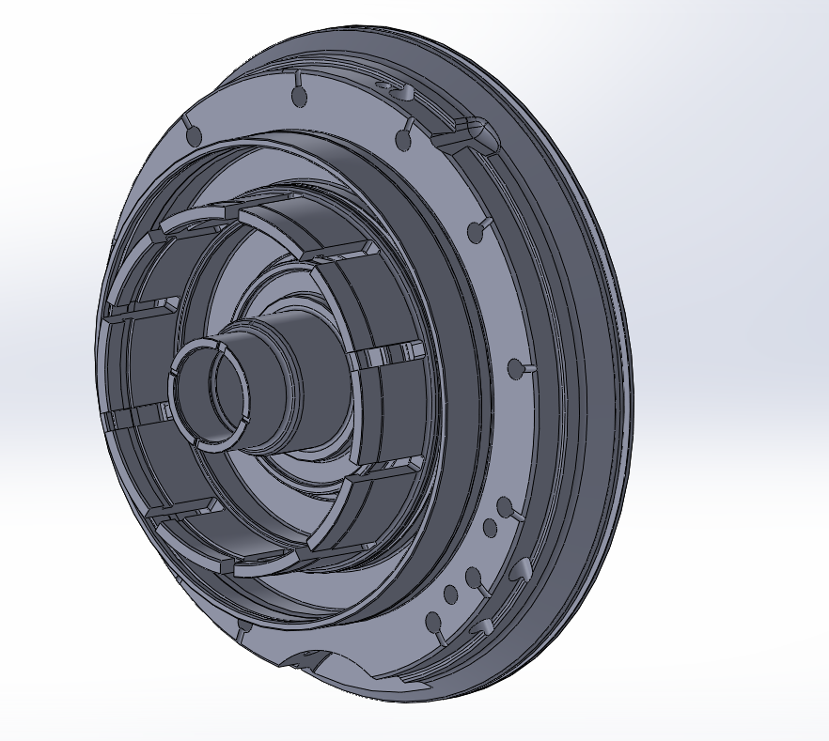
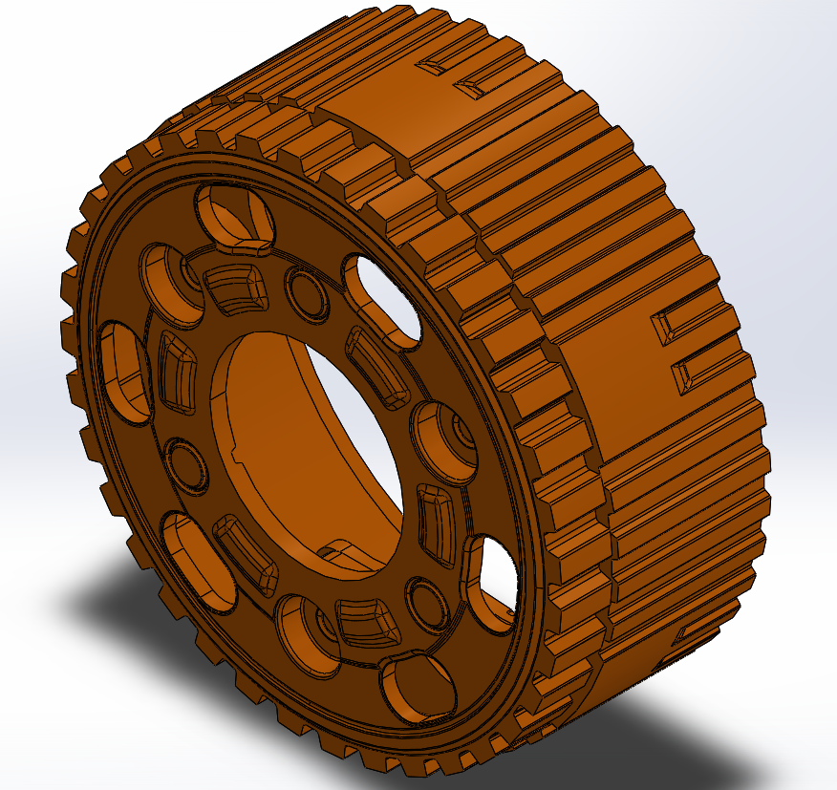
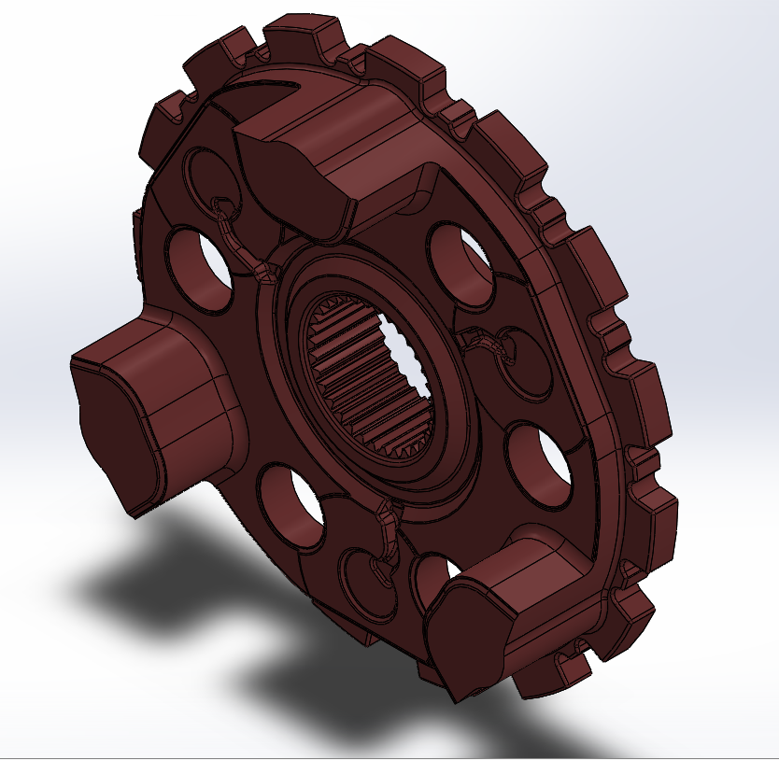
Rapid Prototyping - 9F/10R
Rapid Prototyping project for GM/Ford joint project for their 9-speed and 10-speed transmisson packages
Creating CAM Profile
Process Specification
Control Plan

Slide 4
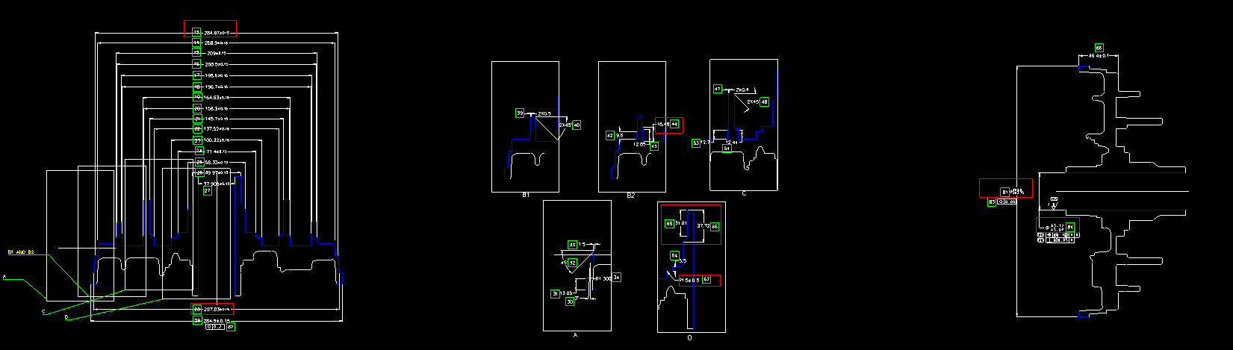
Rapid Prototyping - 9F/10R
Creating CAM Profile

Slide 5
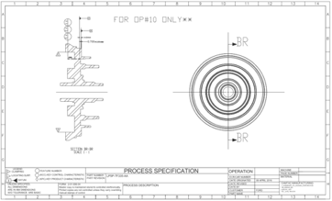
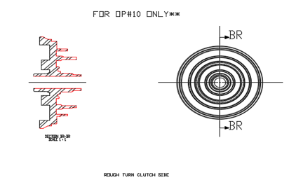
Rapid Prototyping - 9F/10R
Process Specification

Slide 6
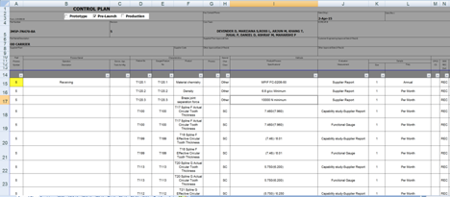
Rapid Prototyping - 9F/10R
Control Plan

Slide 7
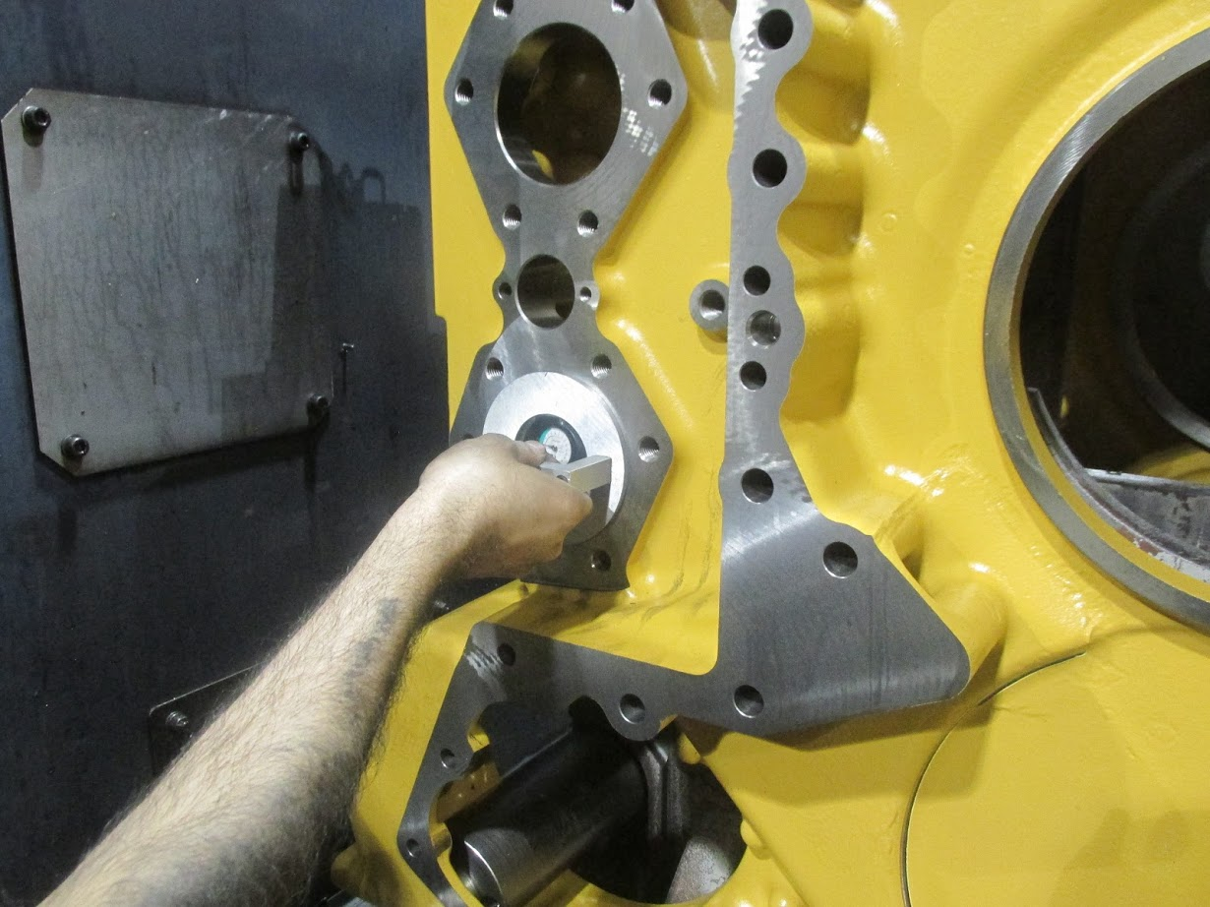
Gauge Designs
Bore Guage
Notes:
Address the accessibility issue for visually impaired people especially on how they view and understand their surroundings

Slide 8
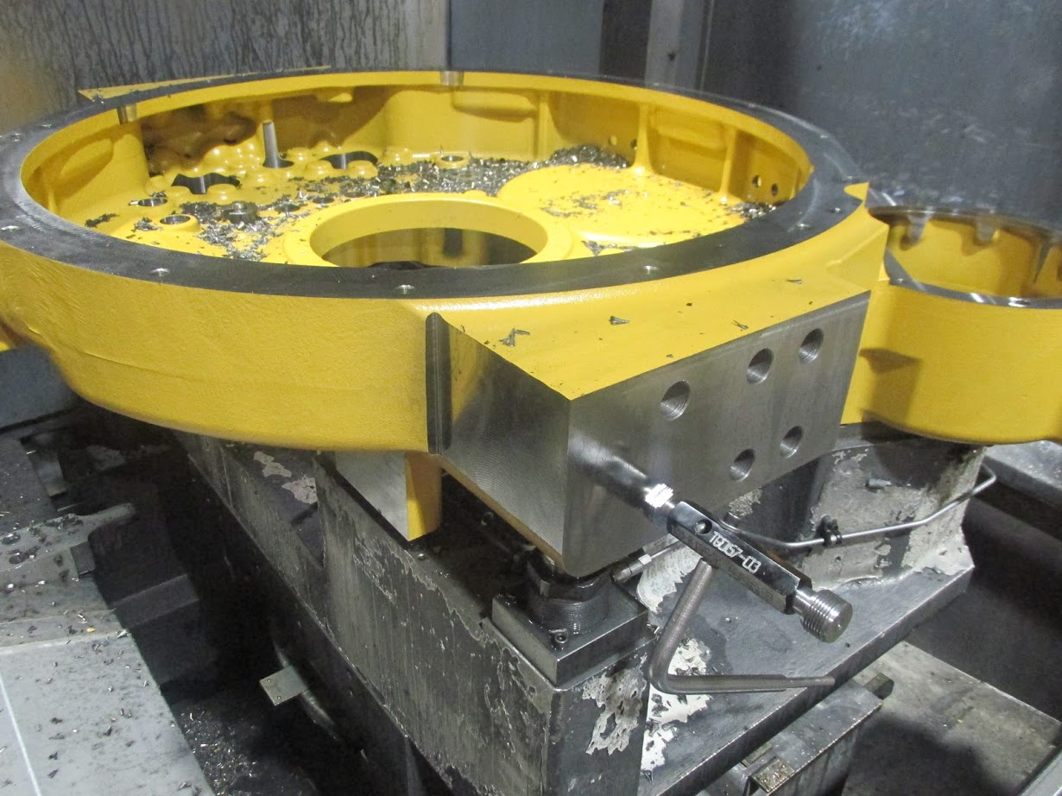
Gauge Designs
Thread Guage
Notes:
Address the accessibility issue for visually impaired people especially on how they view and understand their surroundings

Slide 9
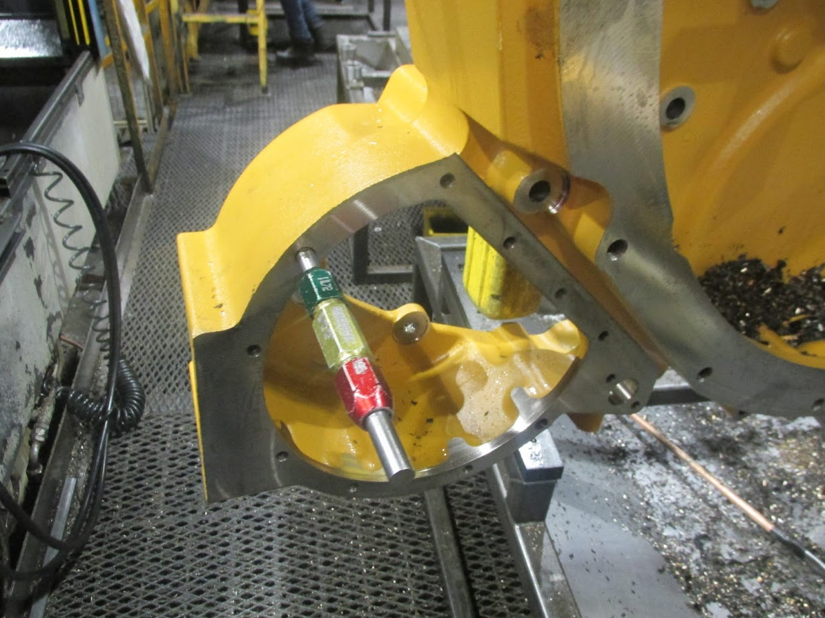
Gauge Designs
Go/NoGo Gauge
Notes:
Address the accessibility issue for visually impaired people especially on how they view and understand their surroundings

Slide 10
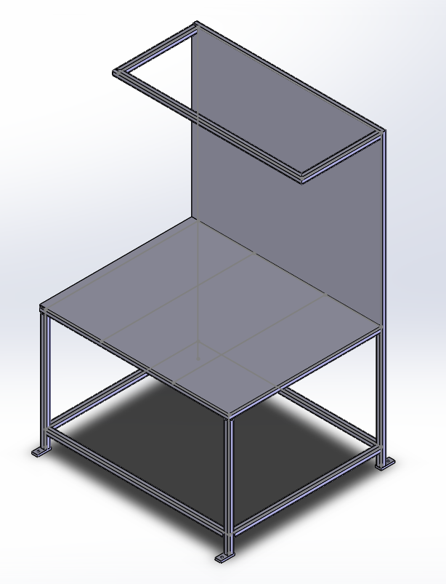
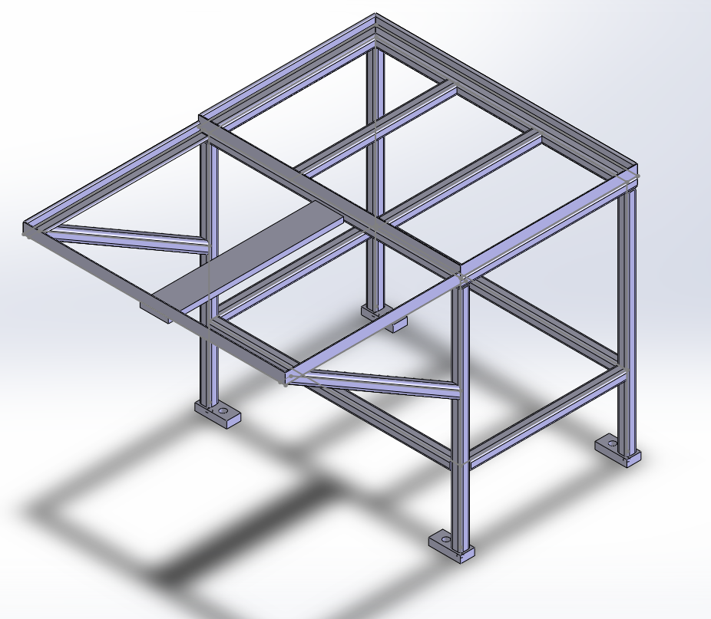
Table Designs

Slide 11
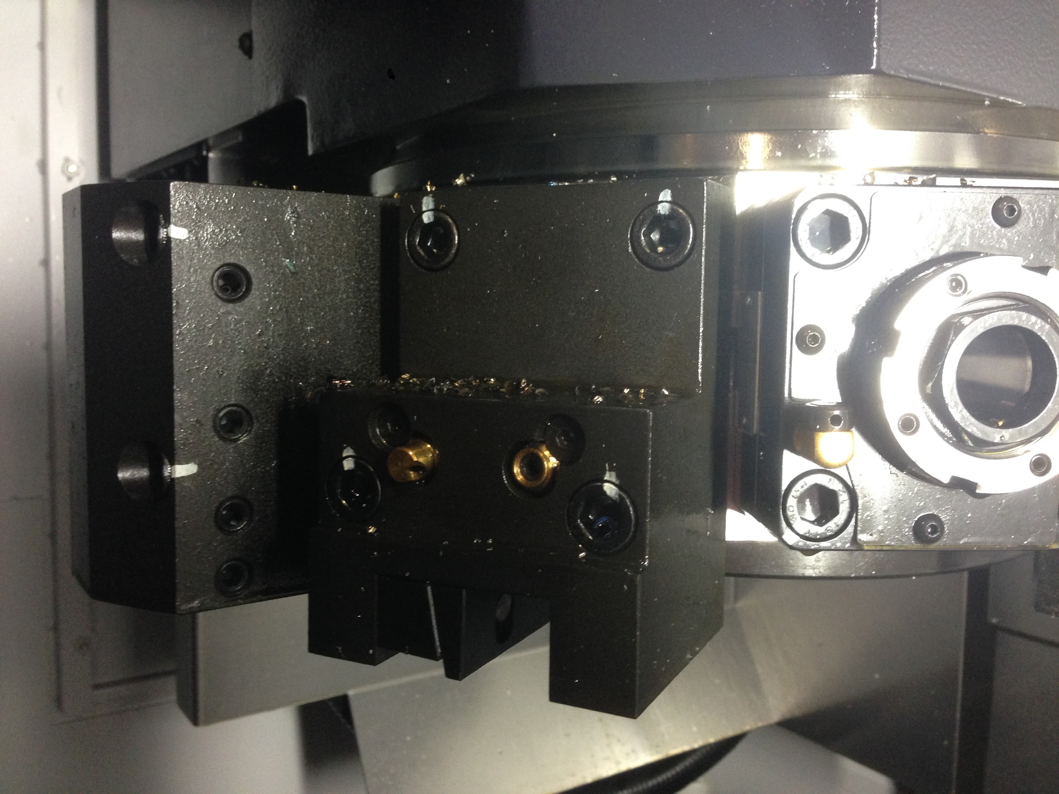
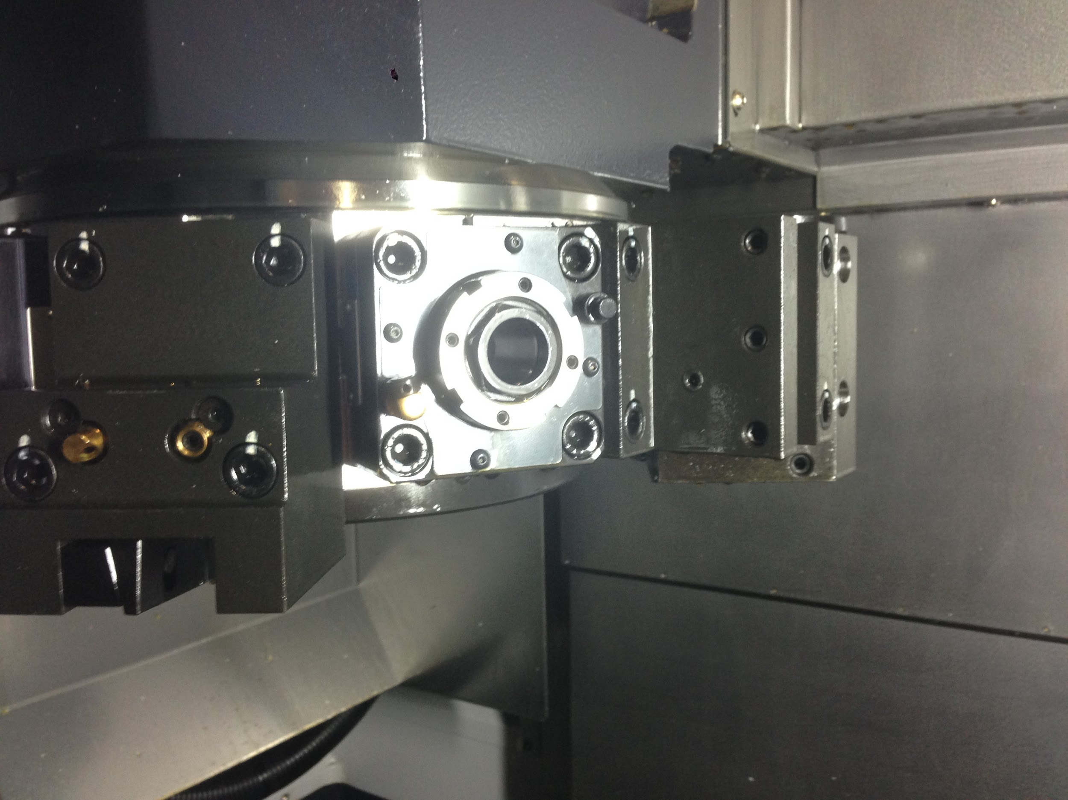
Fixture Designs

