Slide 1
🍔 Food-Graph (GNN) Project
Graph-Based Burger Calorie Analysis System
Graph Neural Network Application

Slide 2
Project Overview
A nutrition analysis system that uses graph data structures to:
Model relationships between burgers and ingredients
Calculate total calories through graph traversal
Enable complex queries on nutritional data
Visualize calorie flow and ingredient relationships

Slide 3
Key Features
8 Different Burger Types
With unique ingredient combinations
30+ Ingredients
Categorized by type (buns, proteins, cheese, etc.)
Graph-Based Architecture
Using NetworkX for relationship modeling
Advanced Queries
Find burgers by calorie range, ingredients, etc.
Visual Representations
Multiple chart types and flow diagrams

Slide 4
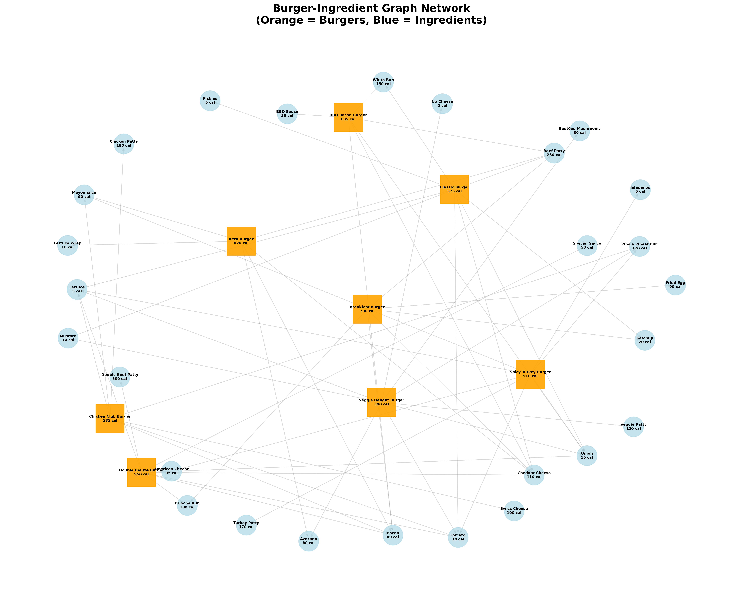
Graph Data Structure
Directed Graph Implementation:
Nodes: Burgers and Ingredients (35 total)
Edges: Burger → Ingredient relationships (59 connections)
Edge Weights: Calorie contribution values
Graph Statistics: 8 burgers, 27 unique ingredients
Average: 8 ingredients per burger

Slide 5
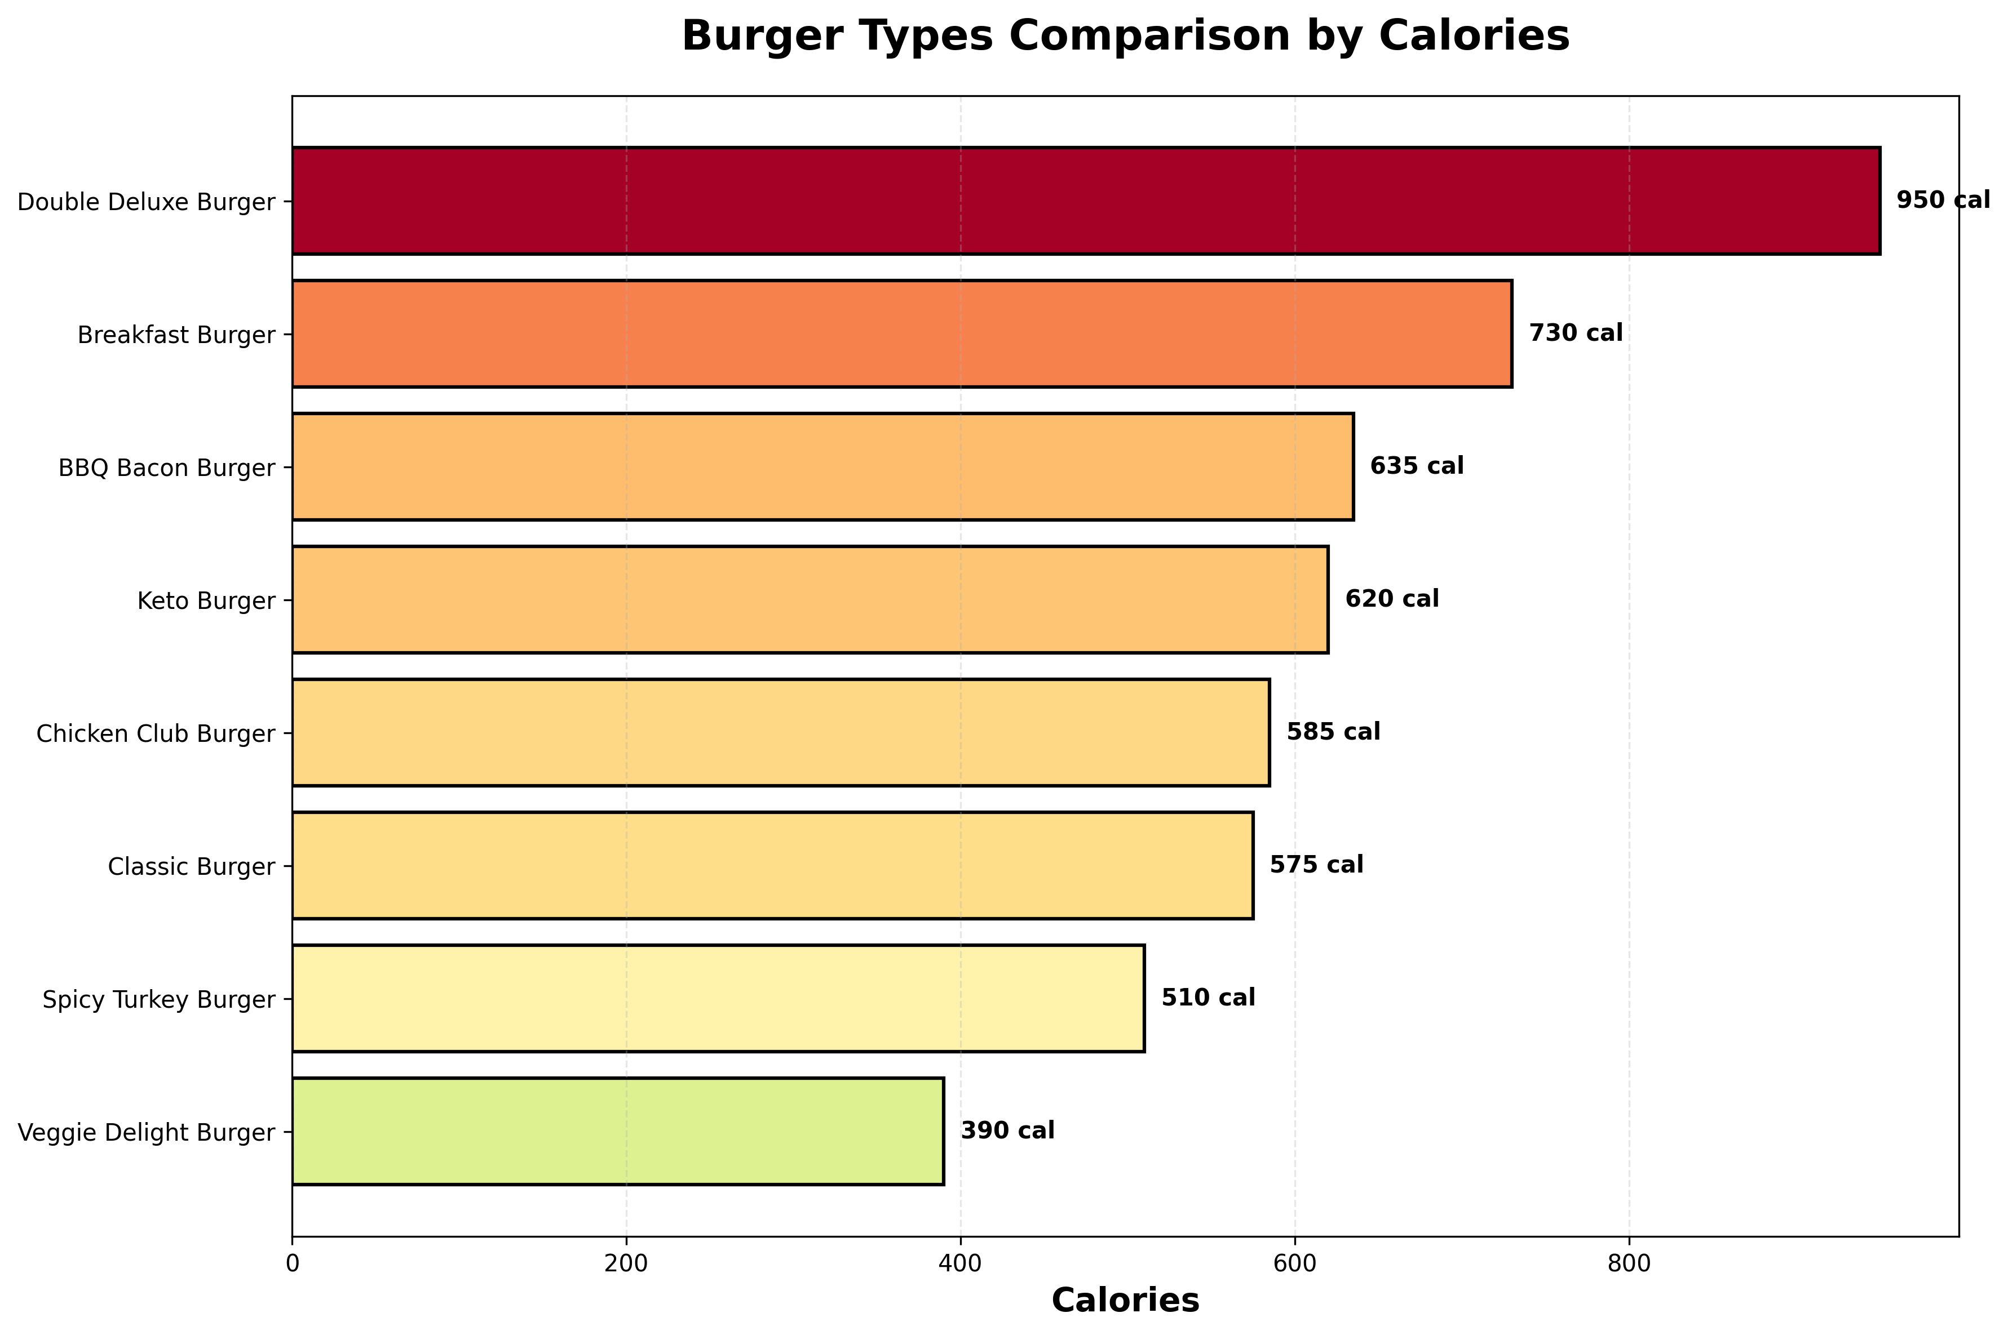
Burger Types Ranked by Calories

Slide 6
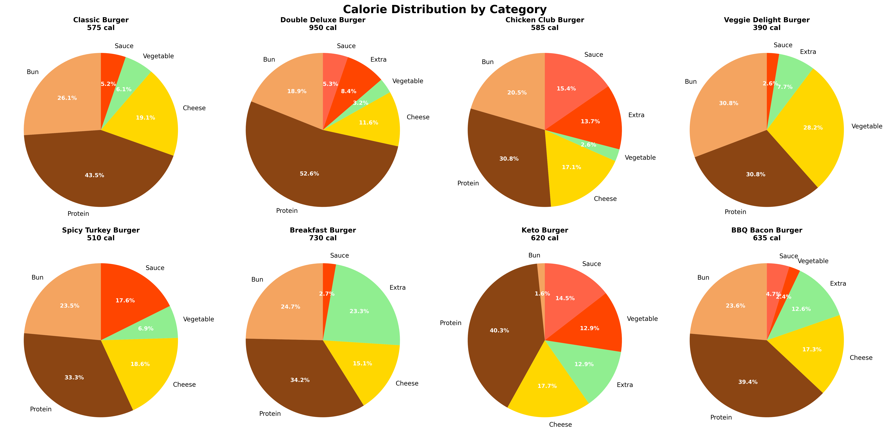
Calorie Analysis Results
Lowest Calorie: Veggie Delight Burger - 390 cal
Highest Calorie: Double Deluxe Burger - 950 cal
Average Calories: 624 cal
Calorie Range: 560 cal difference

Slide 7
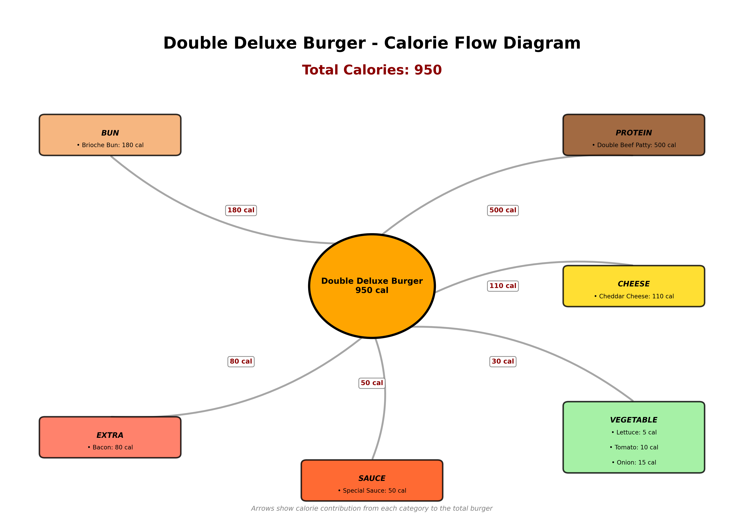
Calorie Flow Visualization

Slide 8
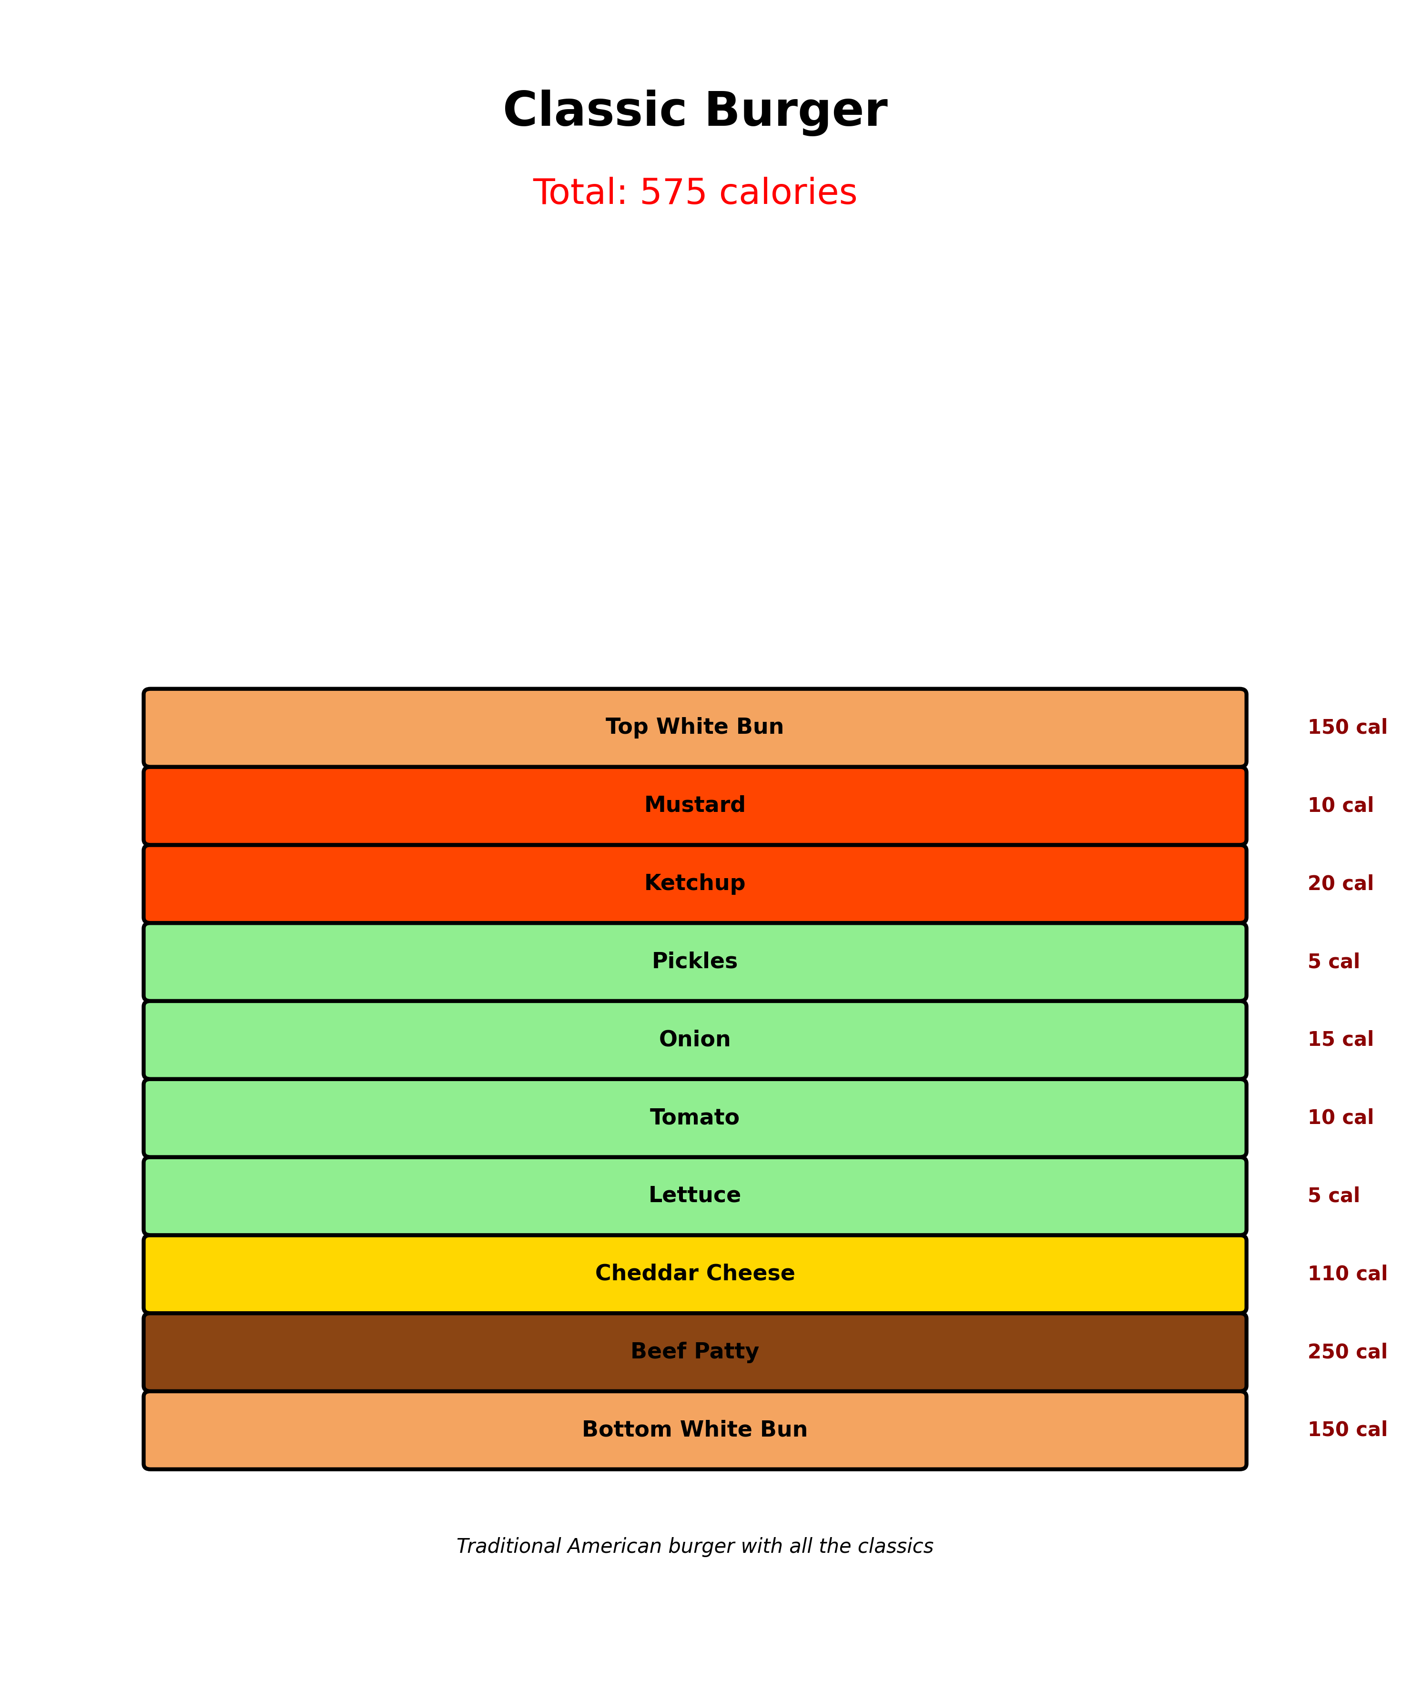
Classic Burger - Layer Breakdown

Slide 9
Technical Implementation
Technologies Used:
Python 3.12 - Core programming language
NetworkX - Graph data structure library
Matplotlib - Data visualization framework
Object-Oriented Design - Clean class hierarchies
Modular Architecture - Separated concerns

Slide 10
Graph Operations & Queries
Supported Operations:
Calculate total calories by graph traversal
Find burgers containing specific ingredients
Query burgers within calorie ranges
Compare two burgers (ingredients & calories)
Get graph statistics and insights

Slide 11
Key Concepts Demonstrated
Graph Data Structures
Modeling complex relationships
Object-Oriented Design
Clean class hierarchies
Data Aggregation
Calculating totals via traversal
Data Visualization
Multiple chart types
Nutritional Analysis
Comparing food items

Slide 12
Future Enhancements
Potential Extensions:
Add more nutritional data (protein, fat, carbs, sodium)
Implement dietary restriction filters (vegan, gluten-free)
Create interactive web interface
Add recommendation system based on preferences
Include pricing and cost optimization
Expand to other food categories

Slide 13
Conclusion
• Successfully demonstrated practical application of graph data structures
• Created comprehensive visualization and analysis system
• Showcased object-oriented design and modular architecture
• Built scalable solution for nutritional analysis

Slide 14
Thank You!
Questions & Discussion

