Slide 1

Filesystems
Random google search result for “filesystem”

Slide 2


The third pillar of operating systems: Persistence
Data stored in the disk survives restarts.
However, I/O operations on the disk are millions of times slower than those on RAM.
Partly because disk I/O happens through interrupts (like I/O from any other device like your keyboard), whereas RAM can be accessed through a single instruction.
The other factor being that the disk itself is slower due to how it’s designed.

Slide 3
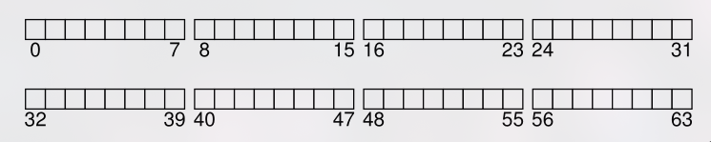
How to access data on the disk?
The disk is simply a linear array of memory. But unlike RAM, each byte doesn’t have its own address. Rather, they’re segmented into blocks (a contiguous segment of typically 512B or 4kB) and each block has its own address.
To read or write data, you just give the block address and the data to read/write.

Slide 4
/home/crowtum/Desktop/balls.jar
????
Block 48 on disk 1
Notes:
We will need some way to translate from file/directory names to block addresses on the disk.

Slide 5
????
The filesystem
Software that runs as part of your kernel

Slide 6
Very simple filesystem (VSFS)
Notes:
We will start by looking at the implementation of a very simple file system. This is the implementation that can be found in OSTEP as well.

Slide 7
inode
The most fundamental data structure in the filesystem.
Short for index node, this is the data structure which contains metadata about all files and directories.
Metadata includes last access time, last modification time, permissions, and more.
struct inode {
uint64 ctime, atime, mtime;
short permissions;
.......
}
what else?

Slide 8
inode
This struct also needs to be stored on the disk.
Therefore we will classify disk blocks into data blocks (where data is stored) and inode blocks (where inodes are stored).
struct inode {
uint64 ctime, atime, mtime;
short permissions;
.......
}

Slide 9
Files extend beyond a single data block
The block size is at most 4kB and we’d like to have larger files than that.
We can’t simply increase block size since if you have 1GB blocks and a 2MB file, you’re wasting 998MB on disk.
Notes:
Let’s start by talking about files. Obviously, their data must be stored in the blocks on the disk.

Slide 10
struct inode {
uint64 ctime, atime, mtime;
short permissions;
int startblock, endblock;
.......
}
Notes:
We also need to store where the corresponding data blocks of a file are. We can store that in the inode. However, storing the start and end assumes that the file’s data blocks are continuous.

Slide 11
Notes:
There’s a problem with requiring continuity. Say my disk is full. There’s one huge file which occupies half my disk (i was just lazy to put so many colors), and some other smaller ones. I want to clear up some space, so i delete some files that are useless to me.

Slide 12
We don’t want data blocks to necessarily be continuous
Notes:
So now I have 7 blocks free. But if a new file that i download requires 6 blocks, I don’t have 6 continuous blocks. I don’t want that. What do you mean I have 6 GB free but can’t download a 5 GB file? Ridiculous, right? Do you see where I’m going with this? Segmentation. What’s the alternative?

Slide 13
struct inode {
uint64 ctime, atime, mtime;
short permissions;
int datablocks[];
.......
}
Notes:
Paging! We will maintain the addresses of each data block.

Slide 14

struct inode {
uint64 ctime, atime, mtime;
short permissions;
int datablocks[N];
uint64 size;
.......
}
Max file size = N * block size
= 12 (in ext2/3) * 4kB = 48kB
To support 1GB files, you’d have to have increase the number of data blocks at least 20 times. This will inflate the size of the inode.
Notes:
I also need to know where the content of a file ends within a block, and how many data blocks are actually being used. For this, I will maintain the size as an integer. 32-bit lets the file be a maximum size of around 4GB. We want bigger files, so we will go with 64-bit. But more importantly, this doesn’t mean a file can be that large. File size is actually limited by the number of data blocks!

Slide 15
Indirect blocks
struct inode {
int datablocks[N];
uint64 size;
int indirectblock;
.......
}
The equivalent of multi-level page tables!
The inode contains a pointer to a block which contains pointers to blocks.
Notes:
How is this any different, though? You said don’t place the pointers in the inode, but now you’re just placing them in another block. Make it make sense.
The difference is that this indirect block is only allocated ON DEMAND.

Slide 16
Indirect blocks
You can go even further and make doubly indirect blocks (blocks containing pointers to blocks containing pointers to data blocks) or even triply indirect blocks.

Slide 17
struct inode {
int datablocks[N];
uint64 size;
int indirectblock;
char name[]; ???
.......
}
Surely we’d need to store the name too, right?
Not necessarily.

Slide 18
Directories
To store a directory on disk, we just need to store the inodes of its members!
But since those inodes don’t contain the names of those files, we will store them along with the inode number.
Where do we store this list of [File/directory name, inode number]?
We would ideally like to avoid making a separate type of inode for directories. So we will store it in the data blocks itself.
This will be more clear when we look at xv6’s code.

Slide 19
Directories
However, we need to have a differentiating factor between a file’s inode and a directory’s inode, as their data blocks have different meanings. The kernel should be aware of this.
Hence, we add a type field.
struct inode {
int datablocks[N];
uint64 size;
int indirectblock;
short type; // T_DIR or T_FILE
.......
}

Slide 20
Block allocation
How do we know which blocks are free to allocate?
Two possible solutions:
Free list
Bitmap
Free list is how xv6 maintains track of free physical RAM (recall struct run from the paging tutorial). Because of how the disk and RAM work, a bitmap is a better choice for the disk.

Slide 21
Bitmap block
If the nth block on disk is free, we set the n^{th} bit of the bitmap block to 1. Else it’s 0.
If n is more than the size of the block (BSIZE), we move to the next bitmap block and check the (n % BSIZE)^{th} bit.

Slide 22
Bringing it all together
To build a filesystem, we have seen that we need 3 types of blocks: inode, data, and bitmap.
It is up to us to decide how many of each type we want. Under the obvious constraint that there are enough bitmap blocks to describe all inode and data blocks on the disk.
These numbers depend on how much the actual capacity of the disk is.
Which means that when the kernel connects to this disk, it needs some way of knowing how the disk is partitioned into inode, bitmap and data blocks.

Slide 23
Superblock
We will store this metadata about the filesystem in the starting* block of the disk, called the superblock.
You will get a better idea of the superblock once we look at xv6’s implementation.
The superblock also likely includes a magic number, indicating the type of filesystem.
* this is a simplification. The superblock need not be the starting block, but must have a fixed location regardless of disk.

Slide 24
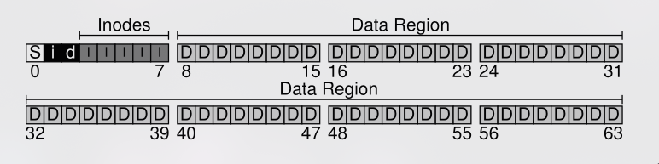
Final filesystem
Notes:
OSTEP splits bitmap blocks into inode bitmaps and data bitmaps. It’s not necessary to do so, though.

Slide 25
Links
Now that we have a functional filesystem, let’s see what other cool stuff we can do with it!

Slide 26
Hard links
Consider the inode and data for the following directories:
/home/crowtum
/home/ristiavdaatnso
a.txt 25
a.txt 87
b.txt 87
b.txt 144
Same inode numbers! Is something wrong?

Slide 27
Hard links
This means that these two files share the same blocks on disk. Therefore writing to one will also update the other file.
Useful in situations where you want to keep multiple files synced with each other.
/home/crowtum
/home/ristiavdaatnso
a.txt 25
a.txt 87
b.txt 87
b.txt 144

Slide 28
Hard links
This means that these two files share the same blocks on disk. Therefore writing to one will also update the other file.
Useful in situations where you want to keep multiple files synced with each other.
This is called a hard link.
When you delete one file, the other one still points to the same inode and data and won’t get affected.
The link() system call links a path to an inode.

Slide 29
Soft links
There’s another type of link: the soft link, a.k.a symbolic link.
This points to a file/directory itself, rather than to the inode.
The metadata of this symlink is stored in a separate inode as opposed to a hard link where the inode is shared.
This means that if the destination of the symlink were to get deleted, the symlink is no longer valid.

Slide 30
Hard vs soft links
file1
file2
file1
file2
inode
inode
Notes:
The figure on the right is a soft link, and the figure on the left is a hard link.

Slide 31
Hard vs soft links
file1
file2
file1
file2
inode1
inode2
inode
More accurate
Kind of an oversimplification

Slide 32
The xv6 filesystem

Slide 33
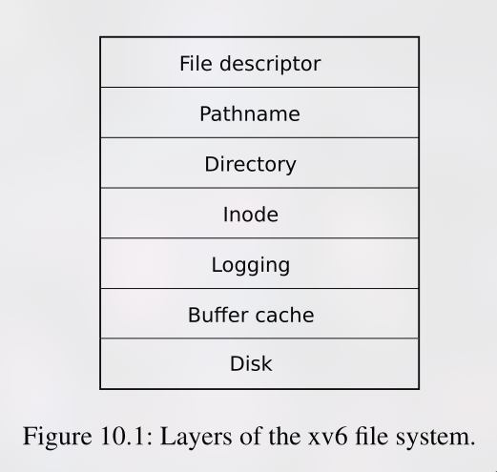
Notes:
The logging and buffer cache layer are pretty significant, but are out of the scope of this tutorial. We will abstract that out and see how the inode layer interacts with the disk. We will touch up on some parts of the logging and bcache layers that are needed for your mp3.

Slide 34
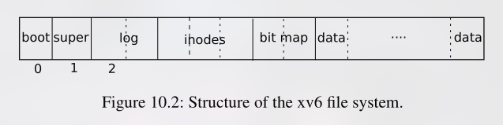
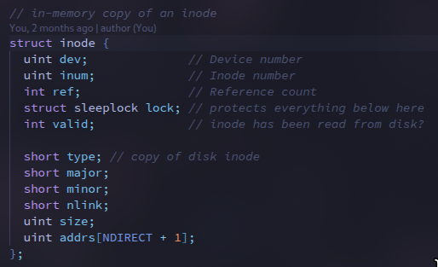
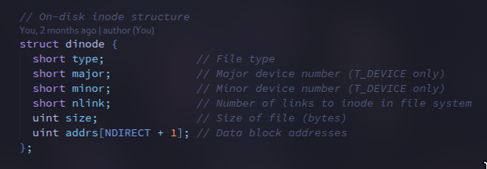
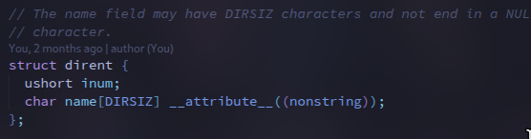
Notes:
NDIRECT+1 because the 1 is an indirect block. The [file name, inode number] we talked about is a struct dirent. Notice how in-memory inode references have a lock.

Slide 35
The read() system call
} else if (f->type == FD_INODE) {
ilock(f->ip);
if ((r = readi(f->ip, 1, addr, f->off, n)) > 0)
f->off += r;
iunlock(f->ip);
} else {
int readi(struct inode *ip, int user_dst, uint64 dst, uint off, uint n) {
...
for (tot = 0; tot < n; tot += m, off += m, dst += m) {
uint addr = bmap(ip, off / BSIZE);
...
bp = bread(ip->dev, addr);
m = min(n - tot, BSIZE - off % BSIZE);
...
brelse(bp);
}
return tot;
}

Slide 36
The write() system call
} else if (f->type == FD_INODE) {
...
int max = ((MAXOPBLOCKS - 1 - 1 - 2) / 2) * BSIZE;
int i = 0;
while (i < n) {
int n1 = n - i;
if (n1 > max)
n1 = max;
begin_op();
ilock(f->ip);
if ((r = writei(f->ip, 1, addr + i, f->off, n1)) > 0)
f->off += r;
iunlock(f->ip);
end_op();
if (r != n1) {
// error from writei
break;
}
i += r;
}
ret = (i == n ? n : -1);
} else {
int
writei(struct inode *ip, int user_src, uint64 src, uint off, uint n) {
...
for (tot = 0; tot < n; tot += m, off += m, src += m) {
uint addr = bmap(ip, off / BSIZE);
...
bp = bread(ip->dev, addr);
m = min(n - tot, BSIZE - off % BSIZE);
...
log_write(bp);
brelse(bp);
}
...
// write the i-node back to disk even if the size didn't change
// because the loop above might have called bmap() and added a new
// block to ip->addrs[].
iupdate(ip);
return tot;
}

Slide 37
inode functions
readi, writei - read and write to inodes
itrunc - truncate an inode (make it an empty file basically)
namei - takes in a path name and gives corresponding inode (unlocked)
dirlookup - takes in a reference to a directory inode and looks for a name in it.
ilock, iunlock - lock and unlock an inode
iput - drop a reference to an inode (inode is taken out of memory if no references to it)
iunlockput - unlock and drop a reference. In what order?
iupdate - copy a modified in-memory inode to disk
begin_op, end_op - begin and end a transaction (a transaction is a series of disk operations that is atomic) (all operations that involve writing to disk must be wrapped in a transaction)

Slide 38
Further topics, if you want to explore
RAIDs (Redundant array of independent/inexpensive disks)
Disk partitioning (MBR, GPT)
Disk access protocols (SATA, NVMe)
Journaling/write-ahead logging
Network filesystems
Filesystem in userspace (FUSE)
Character devices, block devices, and mounting
initramfs
Permissions, ownership, access control lists
Other filesystems like btrfs, ext4, ntfs, etc.

Slide 39
thx

