Slide 1
The Youtube Algorithm
Belhaj Mohammed

Slide 2
Plan
Introduction
The Youtube Algorithm : Why?
The Youtube Algorithm : How?
The Youtube Algorithm : And then?
Conclusions

Slide 3
Notes:
The youtube algorithm is the computerized system that determines what people see when they’re on the site. It gives the user what they want to see, or at least what the algorithm thinks they want to see.

Slide 4
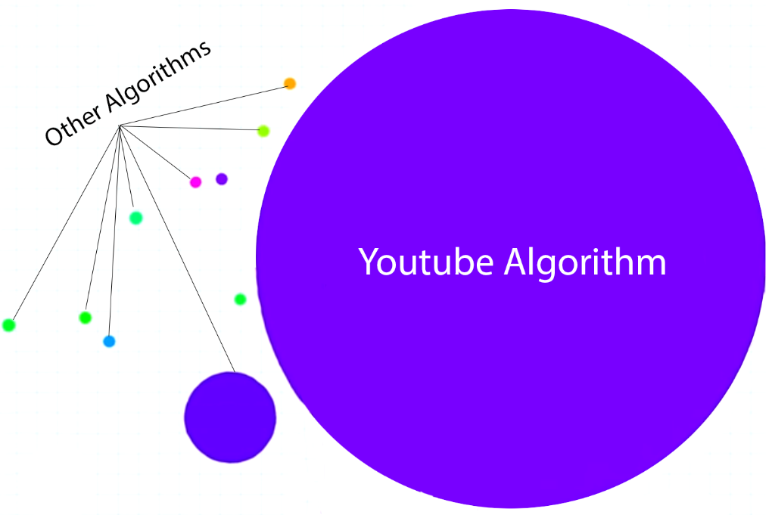

WHY?
Scale
Freshness
Noise

Slide 5

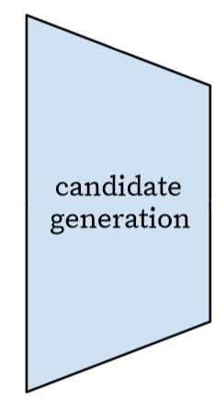
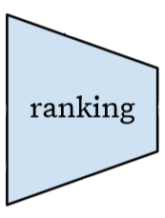
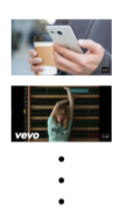
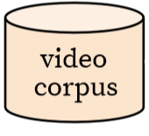

HOW?
Millions
Hundreds
Dozens

Slide 6



HOWEVER
Dead body over here
Algorithm abuse to generate more views, and thus more money
Algorithm can’t differentiate between morally good and bad content, only metrics matter
Bad recommendations

Slide 7

CONCLUSIONS

