Slide 1
Bionic robot : a great tool for the future?
05/10/2018

Slide 2

Introduction

Slide 3
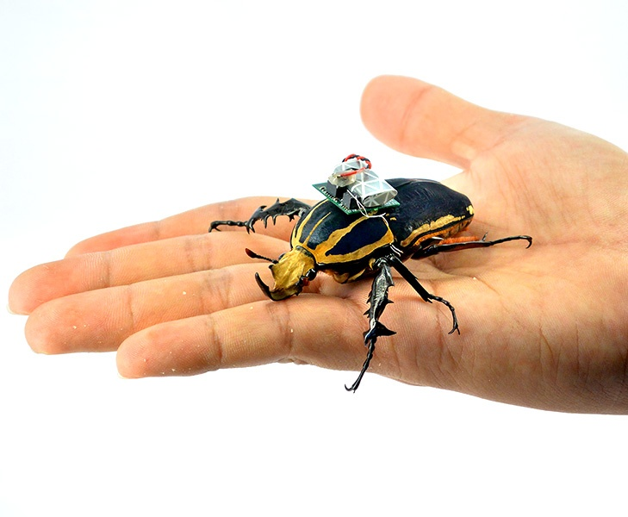
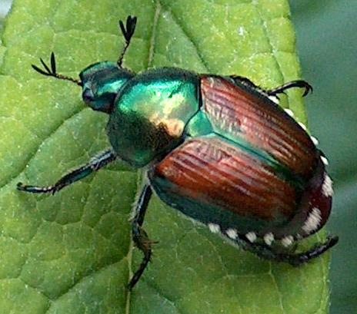
Concepts
Bionic = combining biology and electronics
Biorobotics = making biological organisms as controllable and functional as robots through the integration of man-made parts

Slide 4
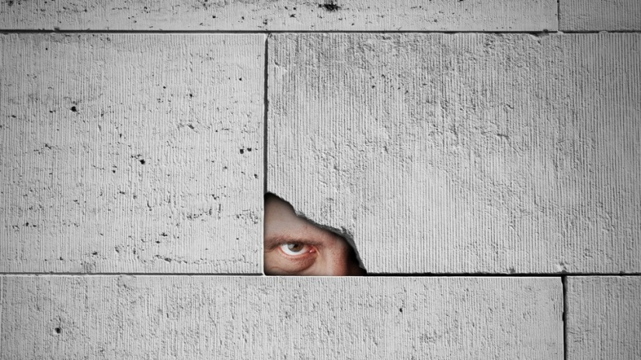
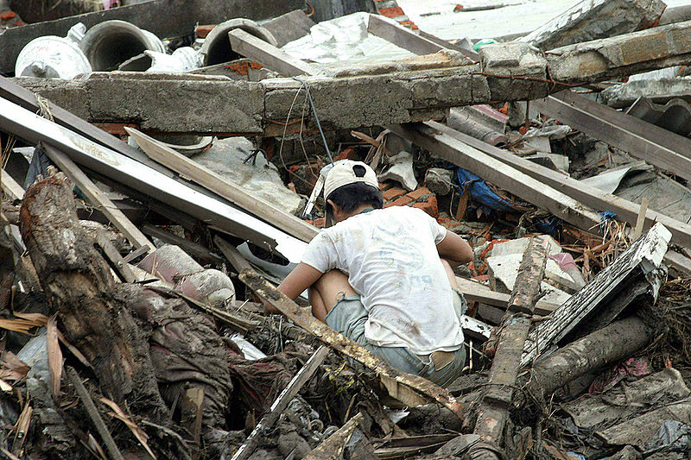
…why doing this?
Go in small holes ← efficiency
Less sensitive to air turbulences
Cheap ← no building robots
Low battery constraints
Intelligence
Seach-and-locate

Slide 5
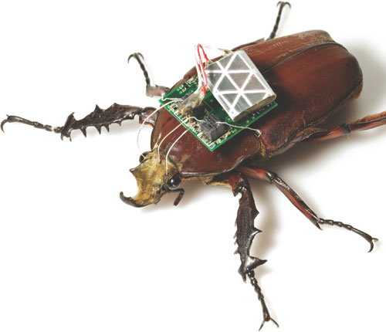
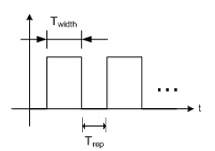
How do we do this?
Hirotaka Sato (Nanyang Technical University in Singapore)
Tested insects: beetles
Electrodes in 4 of their flight muscles
Discontinuous electrical pulses : 2x 150 ms , 50 ms spacing
Frequency of pulses: speed regulation.
Accuracy: 80%
Hovering, altitude: work in progress

Slide 6
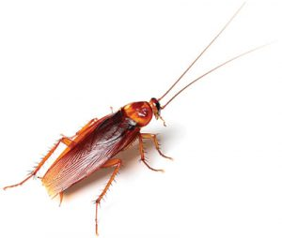
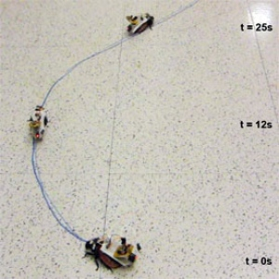
How does it work? (2)
Alper Bozkurt (North Carolina State University)
Tested insects: cockroaches
Receivers in their antennas
Behavior prompted by wifi pulses (obstacle simulation)
Accuracy to be improved, direct backwards movement still a work in progress.

Slide 7
Conclusions and Perspectives
Great tool for the future:
paired with IR sensors to search and locate
paired with miniaturized microphones and camcorders for intelligence
Ethical dilemma raised: are the insects feeling pain?
→ Lifespan preserved (3-6months)
Perspective research: other insects to be used? First tries at bees

Slide 8
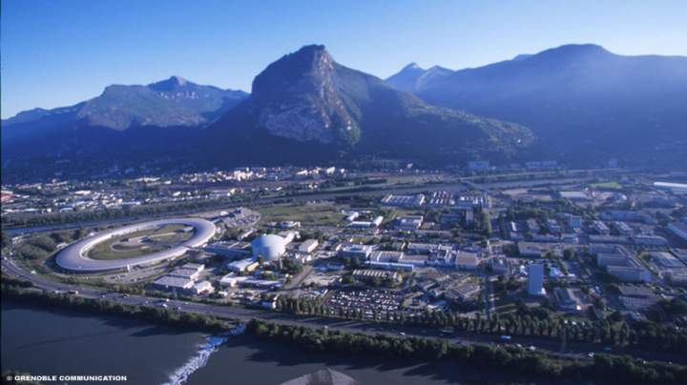
Thank you for your attention!

Slide 9
Video sources
https://www.youtube.com/watch?v=iljHXpE4LG8
https://www.youtube.com/watch?v=UhPbln4vnvw
https://www.nature.com/news/remote-controlled-roaches-to-the-rescue-1.11403

