Slide 1
Quantum
Computing
Noureddine KARRI

Slide 2
Plan
Classic computers & Quantum computers
Why Quantum computing?
CPU & Transistor
Qubit
Applications & Advantages & Problems
Conclusion

Slide 3
Classic computers & Quantum computers
A classical computers process information in units called bits, which can represent one of two possible states 0 or 1
A quantum computers use quantum bits, or qubits.
Qubits can represent 0 or 1.
Can also be both a 0 and 1 at the same time.
0
1

Slide 4
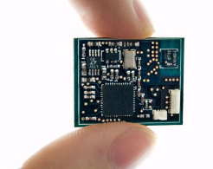
Why Quantum computing?
CPU: small as the tip of our fingers
the CPU is the most important element of a computer system. It is the brains of the computer where most calculations take place.

Slide 5
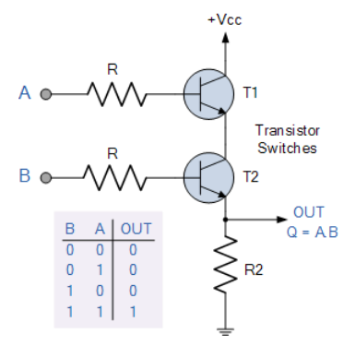

Transistor
The role of a switch is to provide the states 1 and 0,
These transistors make logic gates, This logic gates work with 1 or 0 states, for processing
Fig: AND gate

Slide 6
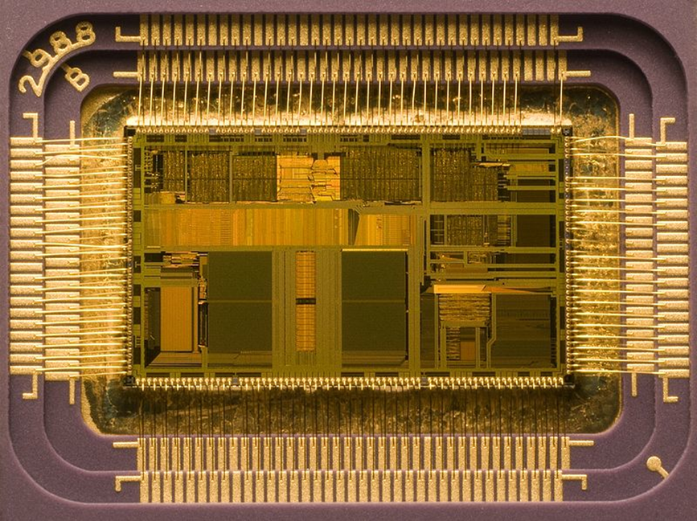
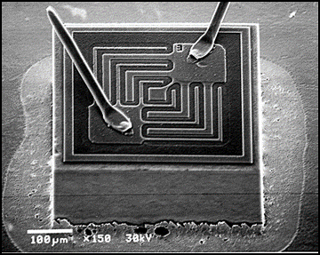
Why Quantum computing?
Intel processor capable of performing 1,000,000,000 (1 billion) mathematical operations per second!
It is composed of ~500,000,000 individual Transistors
The typical size of a transistor in the picture is about
1nm

Slide 7
Quantum Tunnelling
but if we exceed the size of 1 nanometer, the switches lose their performance and can’t emit a 0 state, which is Due to a weird phenomenon called "Quantum Tunnelling".
This hold us back from increasing the computation power of our computers.

Slide 8
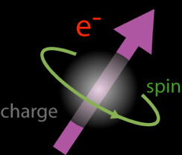
Transistor :
That's why scientists are working directly on electrons instead of transistors.
Particles like electrons They stop obeying some of the laws of physics. they operate on a completely new set of laws: called "Quantum Physics"

Slide 9

The Qubit
Quantum computing is based on a principle of quantum mechanics for data and processing.
which can represent:
1 or 0
represent both 0 and 1 at the same time =>
Superposition
Wave function: A superposition of all possible state could take an electron
α and β: complex numbers.

Slide 10
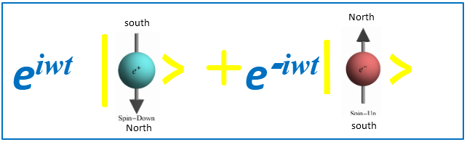
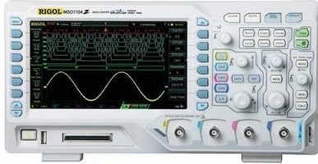

Wave function
Calculate the probability for each quantum state
The electron take only tow states: down and up

Slide 11
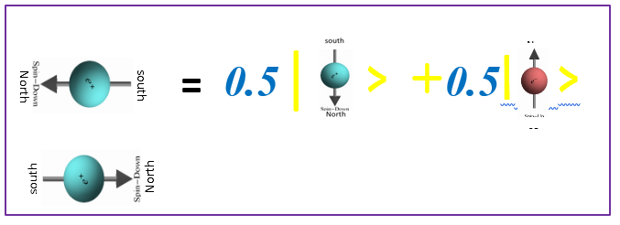
In the laboratory
The idea is to build the device in the lab that allows us to switch the maximum spin of the electron to minimum spin
-
Qubit 0
Qubit 1

Slide 12
Applications
• Encryption Technology
• Improved Error Correction And Error Detection
• Molecular Simulations
• True Randomness
• Cryptography
• Searching
• Factorization
• Simulating
• Encryption Problem & Quantum Chemistry Problem

Slide 13
Advantages
• Could process massive amount of complex data.
• Ability to solve scientific and commercial problems.
• Process data in a much faster speed.
• Capability to convey more accurate answers.
• More can be computed in less time.
• These are used to protect secure Web pages, encrypted email

Slide 14
Problems
These quantum computers can’t be used on a wide range of applications.
Scientists have only been able to keep qubits in a quantum state for fractions of a second.

Slide 15
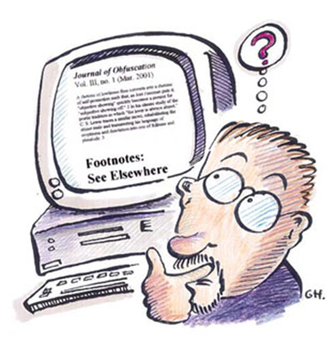
Where a classical computer would take 5 trillion years to factor a 5,000 digit number, a quantum computer could finish in 2 minutes.
Quantum computer work on a million computations at once,
while our classical computer works on one.!!

Slide 16
Among the quantum computers built so far:
Google has the biggest, with 72 qubits, while
IBM and Intel have created ones with about 50 qubits,
The IBM-Q Experience is an online platform, that gives users access to a set of IBM's prototype quantum processors:
https://quantumexperience.ng.bluemix.net/qx/editor

Slide 17
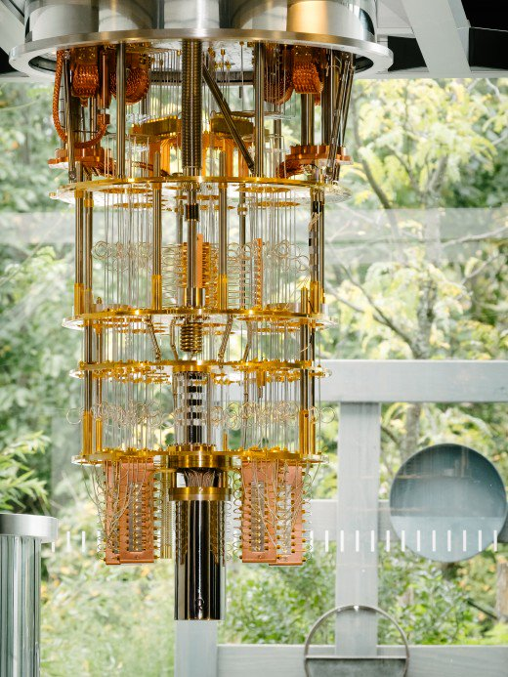
Conclusion
Very Advance Technology
Very Faster & Powerful
Implementation is Difficult
Quantum Computer

Slide 18
Thank you …

