Slide 1
Flash Memory
How to overcome its limitations?
Cédric Mannequin. Etude des commutations de résistance de l’oxyde d’hafnium. Science des matériaux [cond-mat.mtrl-sci]. Université de Grenoble, 2014. Français. <NNT : 2014GRENY004>. <tel- 01558153>

Slide 2
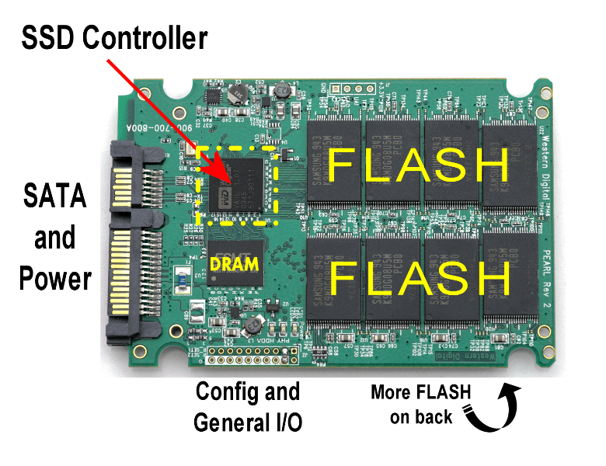
What is Flash memory ?
Advantages over Hard disk
Faster
Heat less
Need less power
Shock proof
QUIET !!!!
USB key
Flash based SSD

Slide 3

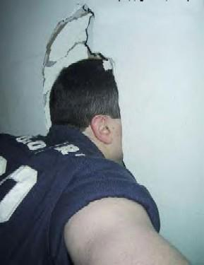
Few definitions
Digital memory
Bit 0 and 1
Physical memory
Presence or not of electrons
Oxyde
Electrical insulator
Tunnel oxyde : 2 states
unconstrained = insulator
constraint = conductor
Concept of critical thickness

Slide 4
Flash memory :
MOS architecture
MOS :
Metal / Oxyde / Semiconductor
Information (electrons) trapped
in the floating gate
Critical thickness
of the tunnel oxyde

Slide 5
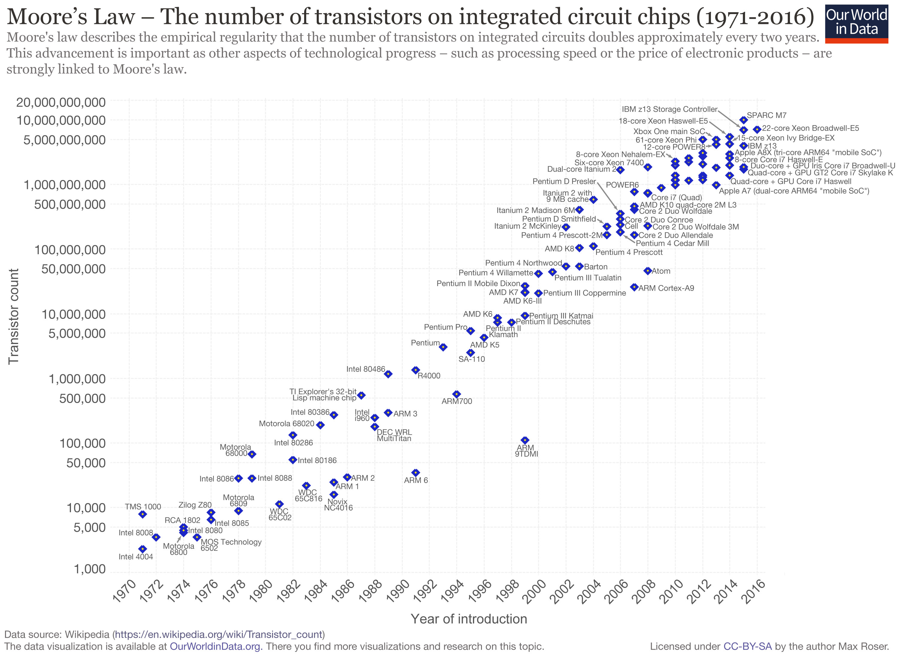
Evolution of microelectronic
Always denser and smaller
What about flash memory ?
Critical thickness
of the tunnel oxyde :
Physical limitation
Need to find a new architecture

Slide 6

ReRAM :
MIM-memristors
Same material with two behavior
No more tunnel oxyde
Notion of threshold voltage

Slide 7
ReRAM really better?
Flash
ReRAM
Critical thickness
Treshold voltage
Various possible values of LRS/HRS
Only 2 states available
Still under development
BUT
Coming soon
Very mature technology

Slide 8


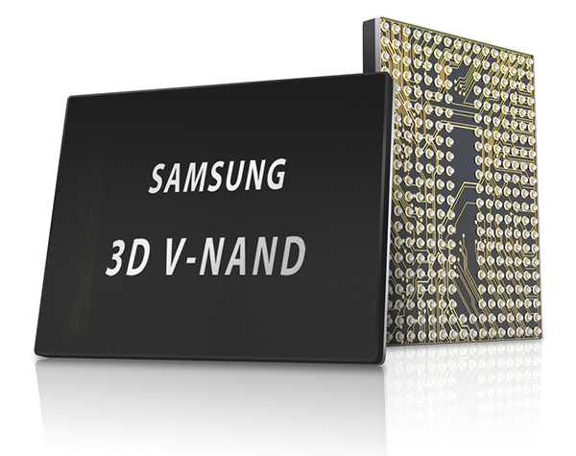
The End?

