Slide 1
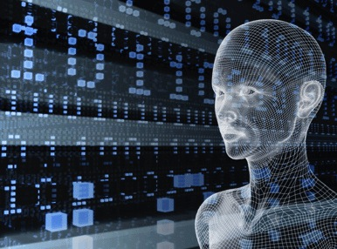
Artificial Intelligence
–AlphaGo Zero–
<numéro>
Notes:
<numéro>
Part 1: Introduction – Learn a bit about computer science Slides 1-7 (Lecture)
Slide 1
Introduce yourself and thank your host for inviting you to visit.
You might tell the class you are excited because it’s a chance to share information about an area of life and work that people don’t know a lot about, but is really powerful and exciting – Computing and Computer Science.
You might ask them about this first slide– what seems “computery” about it?
They might say things like, It looks futuristic, 0’s and 1’s are binary code, the image of the woman might be the basis for CGI (computer-generated imagery) for a movie– don’t go into detail just acknowledge their statements and encourage them to keep wondering aloud about what they hear and see in the presentation.

Slide 2
PLAN
Introduction
The Go Game
AlphaGo Zero
AlphaGoZero VS AlphaGO
Monte Carlo Tree Search
Conclusion
<numéro>
Notes:
Part 1: Introduction – Learn a bit about computer science Slides 1-7 (Lecture)
Slide 2
Say: Here is an agenda for our hour together. [Expand on each a bit ]
<numéro>

Slide 3
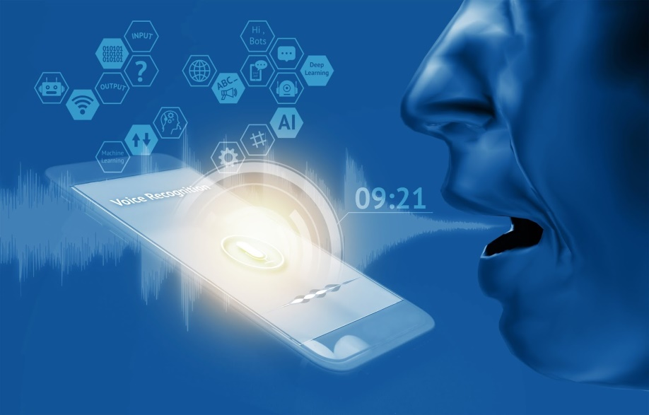
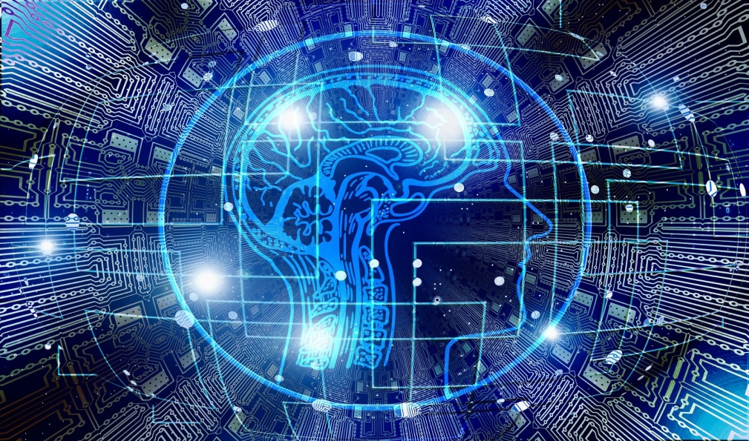
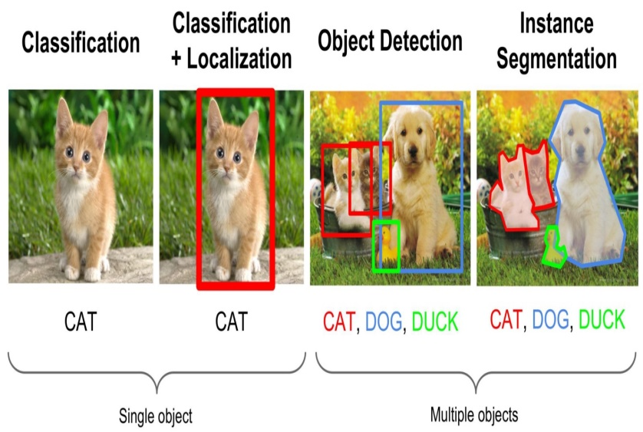
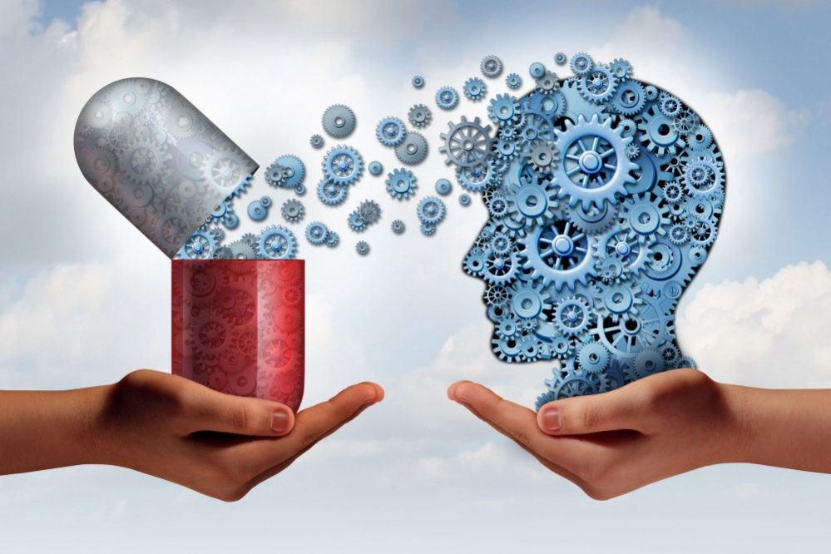
Introduction
<numéro>

Slide 4
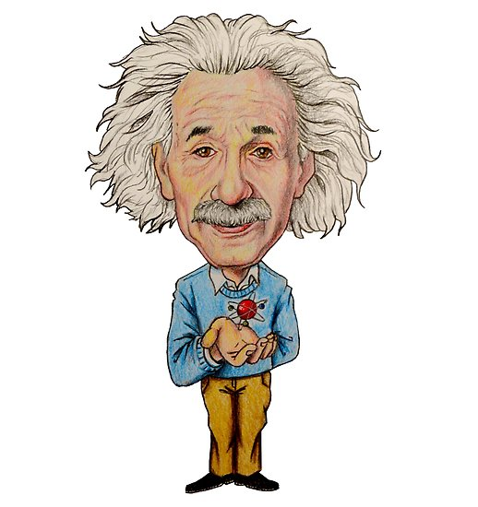
Introduction
Unavailable
Expensive
<numéro>

Slide 5
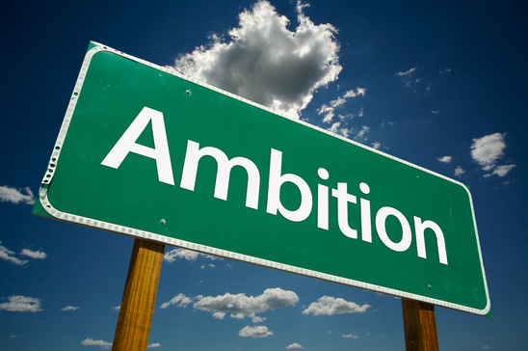
Introduction

Slide 6
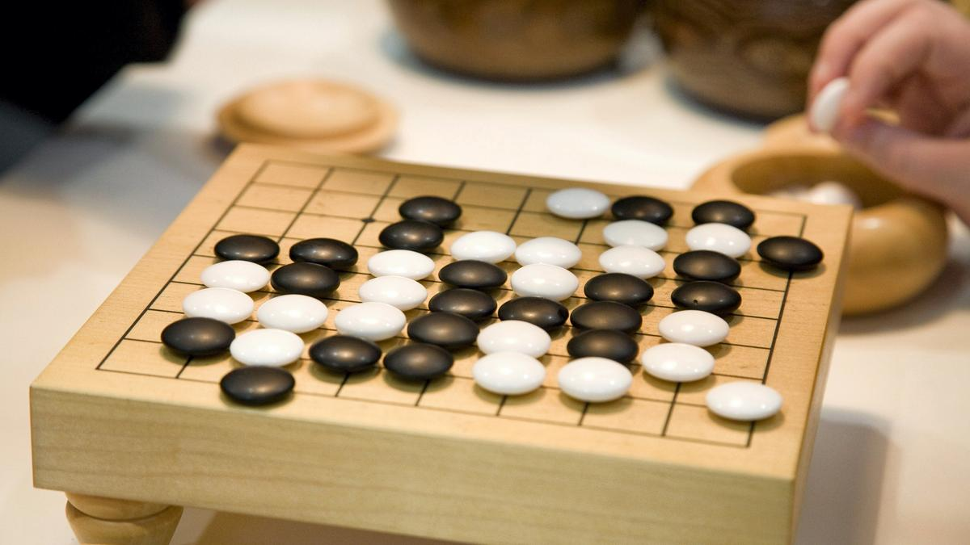




The Go Game
<numéro>

Slide 7
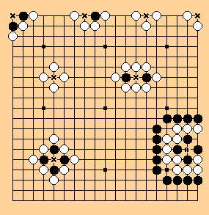
Description Of The Board
Size Of The board ?
Stones Number ?
The main objective ?

Slide 8
How To Play GO ?
Step1 :Place a black stone
Step2 :Your opponent place a white stone
Step3 :Take turns,Try to place your stones adjacent
Step4 :Play until neither you nor your opponent can capture any more territory
Step5 :Tally the score ,1 point for surrounded territory and 1point for captured stone

Slide 9

What is AlphaGo Zero ?

Slide 10

What makes AlphaGo Zero special ?

Slide 11
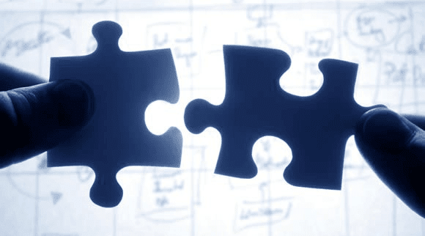
What makes AlphaGo Zero special ?
Reinforcement Learning
Neural Network
Algorithm

Slide 12







AlphaGo Vs AlphaGo Zero
Differences | AlphaGo | AlphaGo Zero
Human Expertise
Number Of Machines
Neural Network
Rollout -Fast
Learning Period

Slide 13
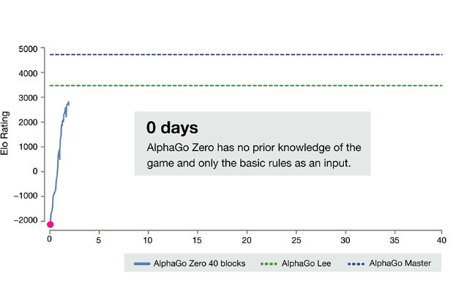
Cycle Of Evolution Of AlphaGo Zero

Slide 14
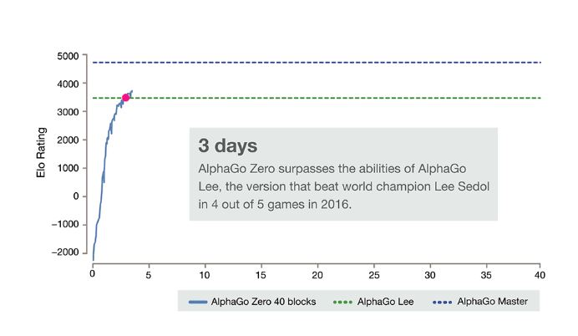
Cycle Of Evolution Of AlphaGo Zero

Slide 15
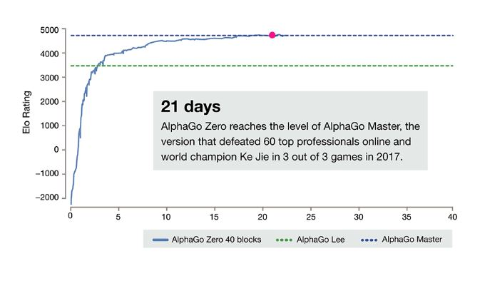
Cycle Of Evolution Of AlphaGo Zero

Slide 16
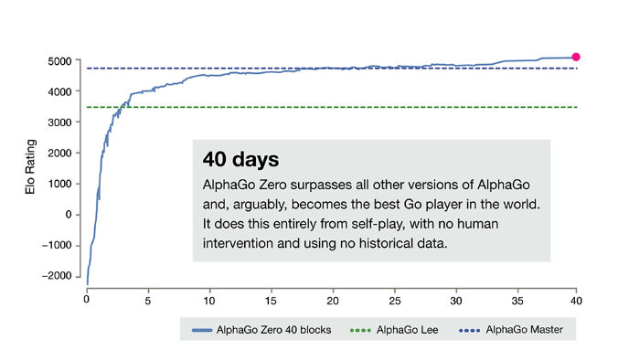
Cycle Of Evolution Of AlphaGo Zero

Slide 17
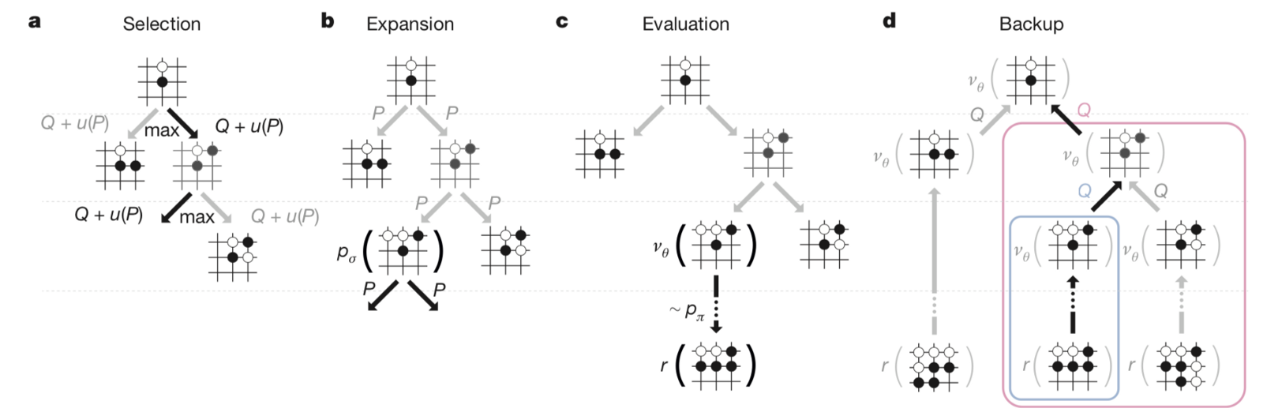
Monte Carlo Tree Search
1600 Expansions
Combining the knowledge of all of this nodes
Better distribution

Slide 18


Slide 19


