Slide 1
IRISVISION

Slide 2
Outline
The Problem to solve: Macular Degeneration
How Irisvision cures the problem ?
Device Composition
Advantages
Drawbacks
Prospects
Conclusion

Slide 3

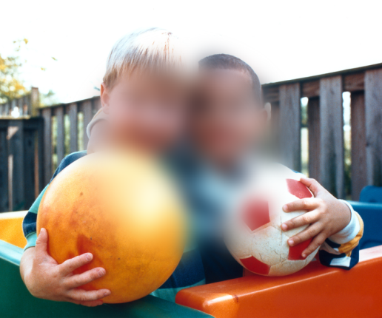
The Problem to solve: Macular Degeneration
It is an age-related condition.
It results in blurred or no vision in the center of the visual field (Blind Spot at the center of the eye).
The peripheral vision is not affected.

Slide 4
How Irisvision cures the problem ?
Recording the person’s surroundings.
Displaying them in real time with the possibility of magnifying the peripheral image.
Eliminating the blind spot.

Slide 5
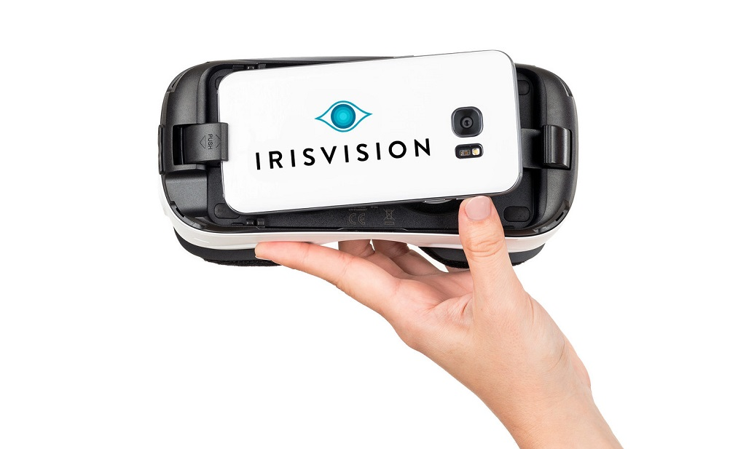
Device Composition
VR headset.
Samsung galaxy 7 phone
Virtual reality software

Slide 6
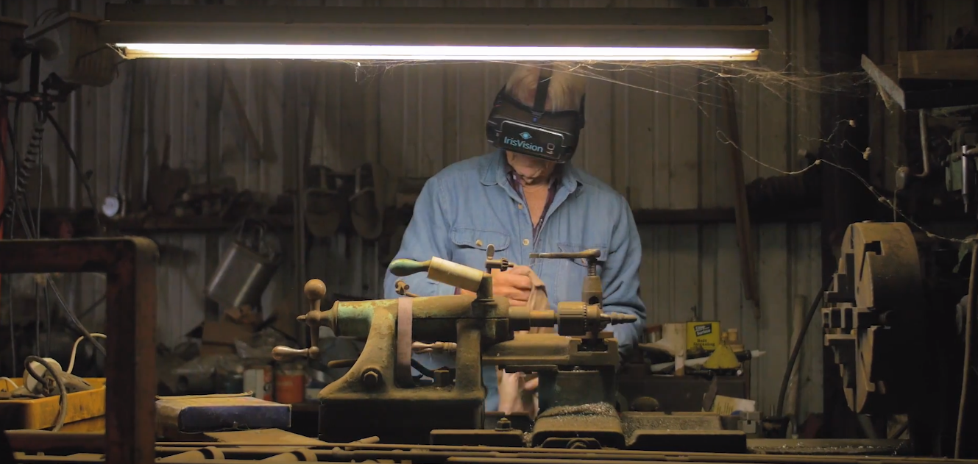
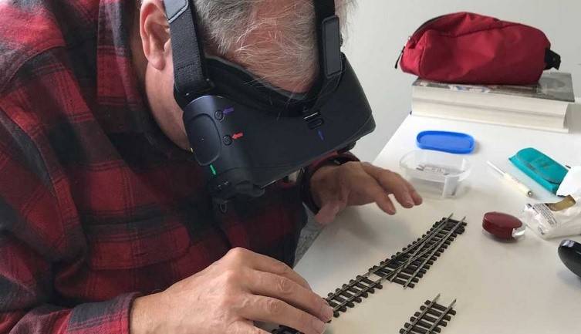
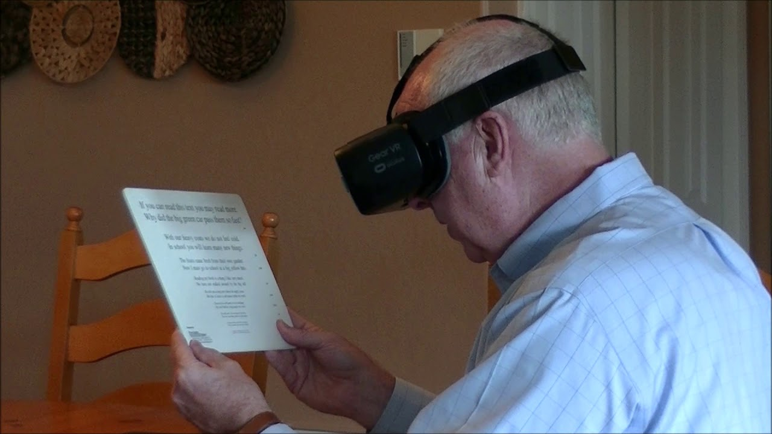
Advantages

Slide 7
Drawbacks
Headset weight.
Cost.
Temporary solution.

Slide 8
Prospects
Expanding the application of the Irisvision device
Improving the device features

Slide 9

Conclusion
This apparatus is a miraculous tool to restore vision and to help people recovering their old life and doing their daily activities by themselves..

Slide 10
Thank You For Your Attention

