Slide 1
Psychometric profiling and online manipulation
Marco Bolloli

Slide 2
The segregation of online information
“…people will forget what you said, will forget what you did, but will never forget how you made them feel.”
M. Angelou
Contrast between data and people’s personal beliefs
Echo-chambers
Filter-bubbles
How could they know our personality?
Could someone else manipulate our decisions?
How could the manipulation take place?
Robson D., The myth of the online echo chamber, BBC Future (consulted in 12/2018)
Van Der Linden S., Psychological Weapons of Mass Persuasion, Scientific American, 2018 (consulted in 12/2018)

Slide 3

Summary
2. Online behaviour manipulation
1. Data retrieval and profiling
3. One idea to counter this

Slide 4
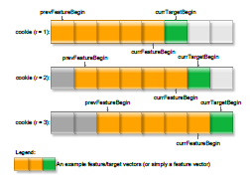
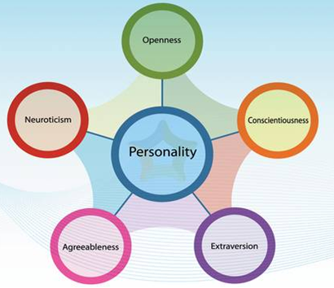
Data retrieval and profiling
Psychometric profile
Common analytical method
Many precise subcategories
Many possible inputs
Data retrieving algorithms
Adapted to sort large amount of data
In 2008 Yahoo logged 9 Terabytes/month of ad data
Profile = function (data, model)

Slide 5
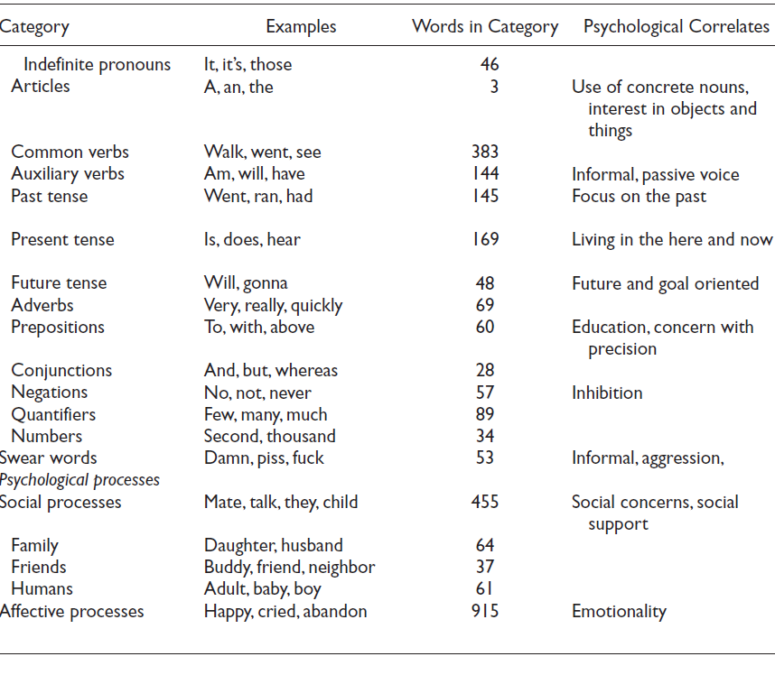
LIWC-based analysis
Linguistic Inquiry and Word Count
Processing routine + dictionaries
Customizable word categories
Weighing parameters
Tausczik Y.R. et al, DOI: 10.1177/0261927X09351676

Slide 6
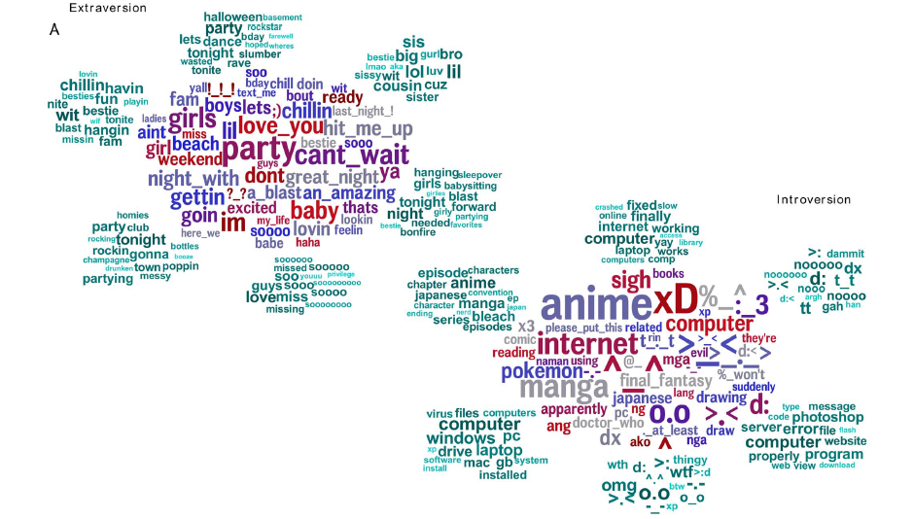
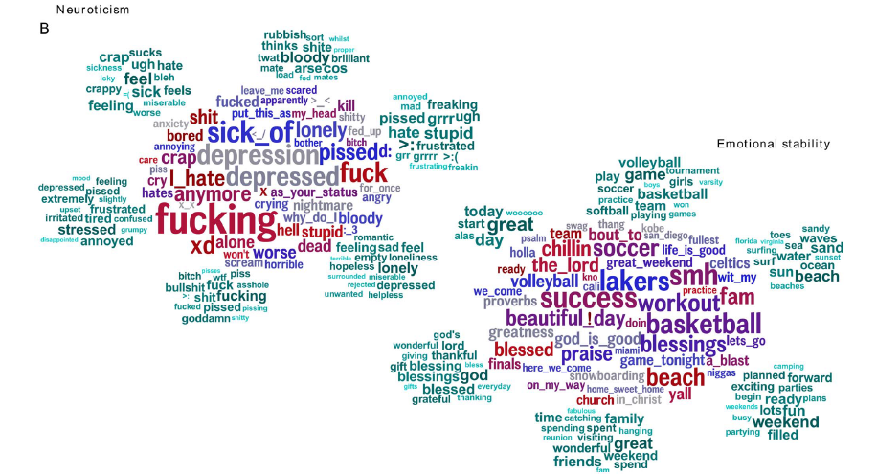
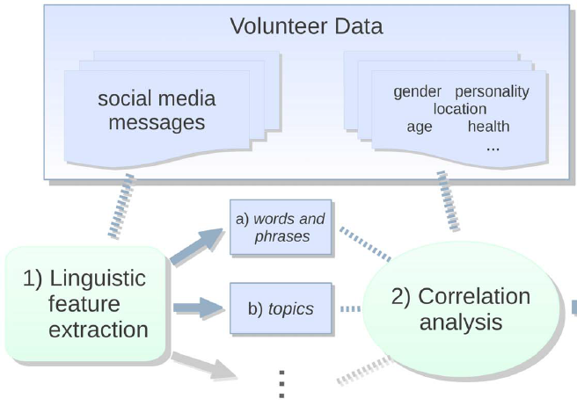
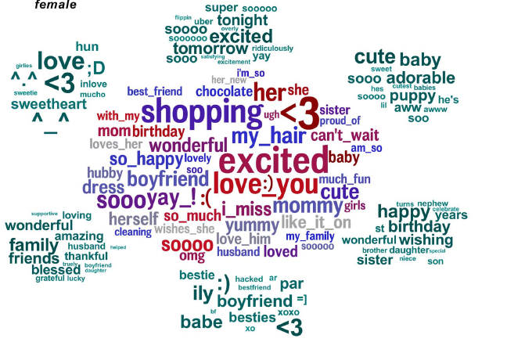
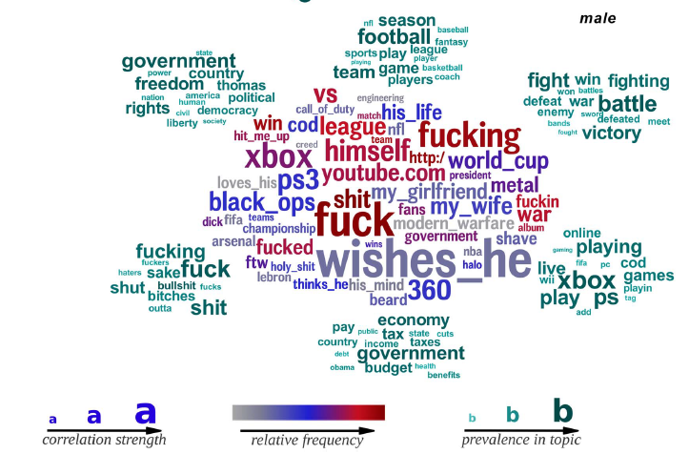
Correlation results
@ Upenn
≈ 130,000 contributors
Facebook posts + personality test
Schwartz H.A. et al, DOI:10.1371/journal.pone.0073791

Slide 7
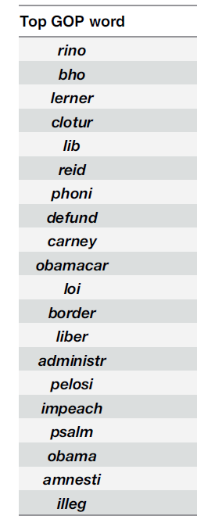
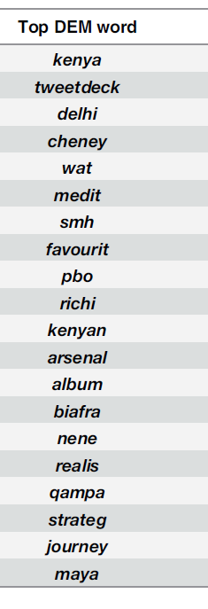
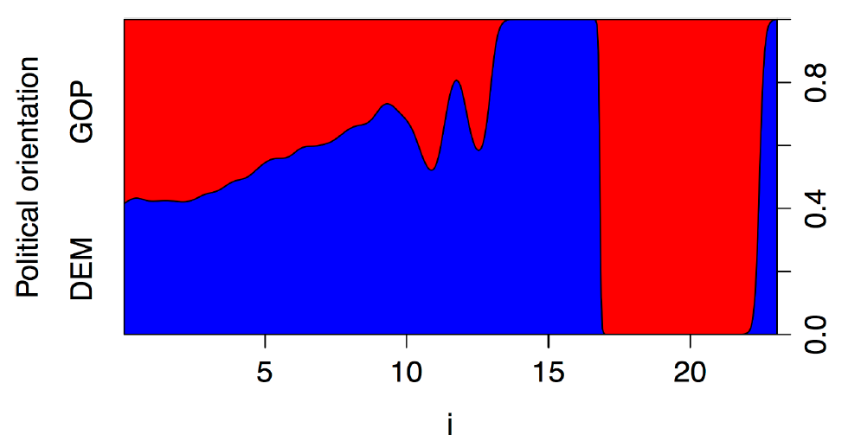
Predictive results
2015 study on 700,000 US users
@ Democratic or GOP official Twitter groups
Semantic analyses: different top words
Different use of pronouns
Sylwester K.. et al, DOI: 10.1371/journal.pone.0137422

Slide 8
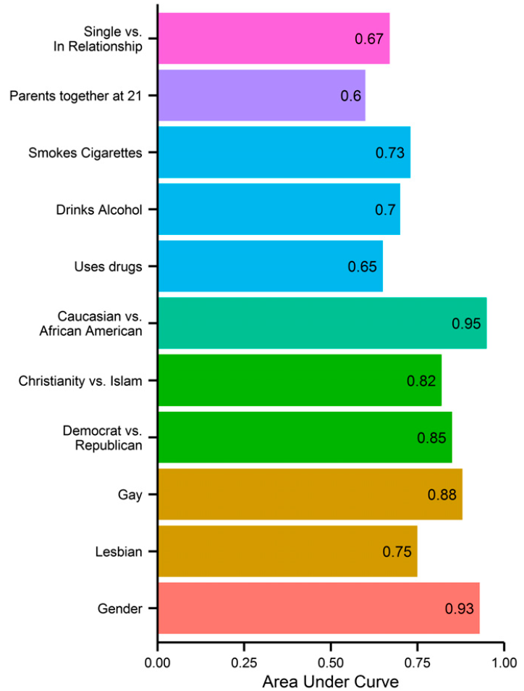
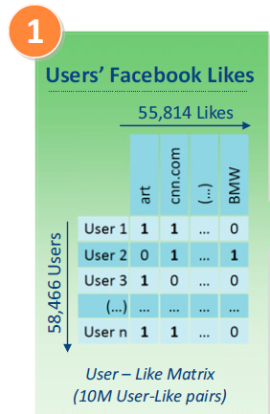
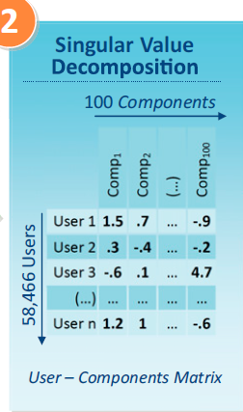
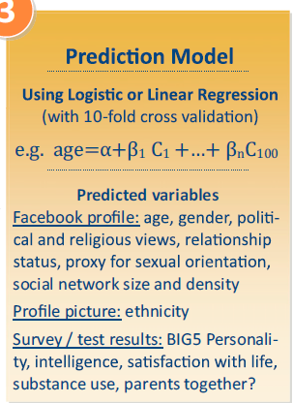
The case of Cambridge Analytica
2010s: illegal harvesting and profiling of millions of FB users
Controversy over the real effects of this profiling
Company closed in 2018
Cambridge –based company
Different sorting algorithms
First studies on Facebook Profiles in 2000s
≈60,000 users profiled – avg 170 likes
Kosinski M. et al., DOI:10.1073/pnas.1218772110
Chang A., The Facebook and Cambridge Analytica scandal, explained with a simple diagram,Vox.com (consulted in December 2018)

Slide 9
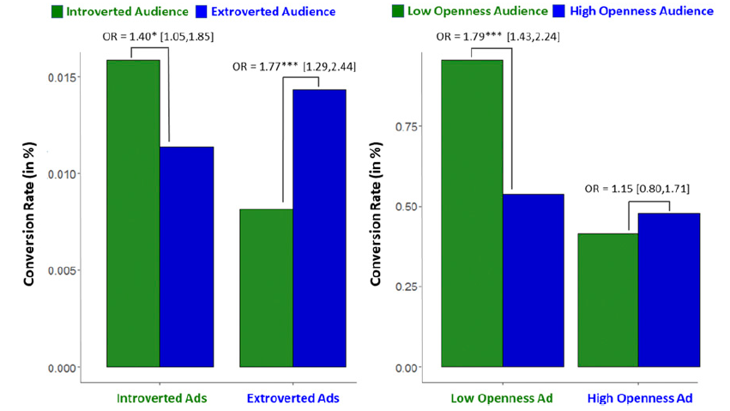
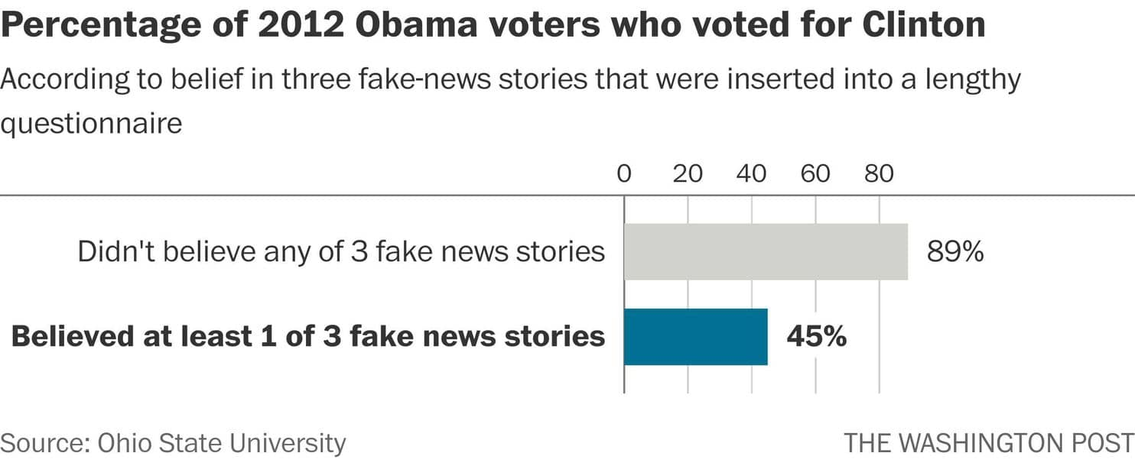
Online behaviour manipulation
Direct effect on the user
  Direct response
  Sparks/removes interest
Social contagion:
behaviour copied through the network
Mats S.C. et al, DOI: 10.1073/pnas.1710966114
McClure L., Need to know: About Facebook’s emotional contagion study, Ideas.Ted.Com, (consulted in 12/2018)

Slide 10
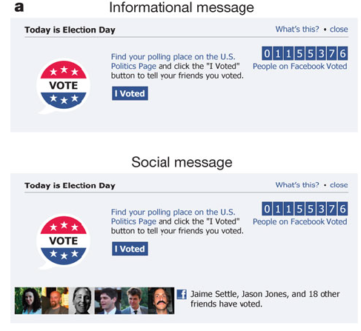
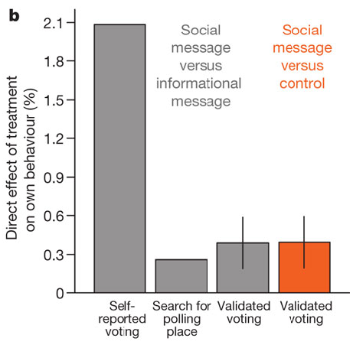
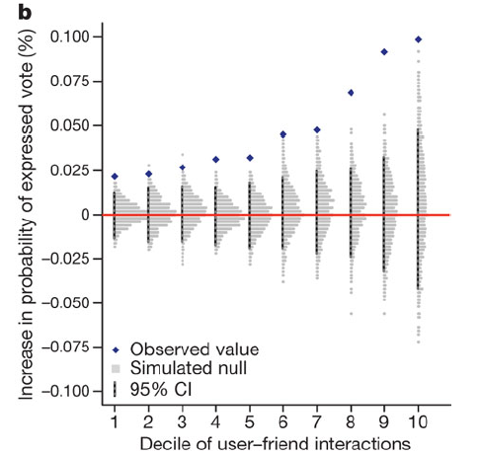
Social contagion
Election Day, November 2010
≈ 60M users who connected to FB
Stats based on self-reporting and public records
Bond R.M. et al, DOI: 10.1038/nature11421

Slide 11
To sum this up…
Psichometric profiling is widespread
  All data entry can be used towards this
Manipulation can be achieved in multiple ways
  Users can be exploited to pass a contagion

Slide 12
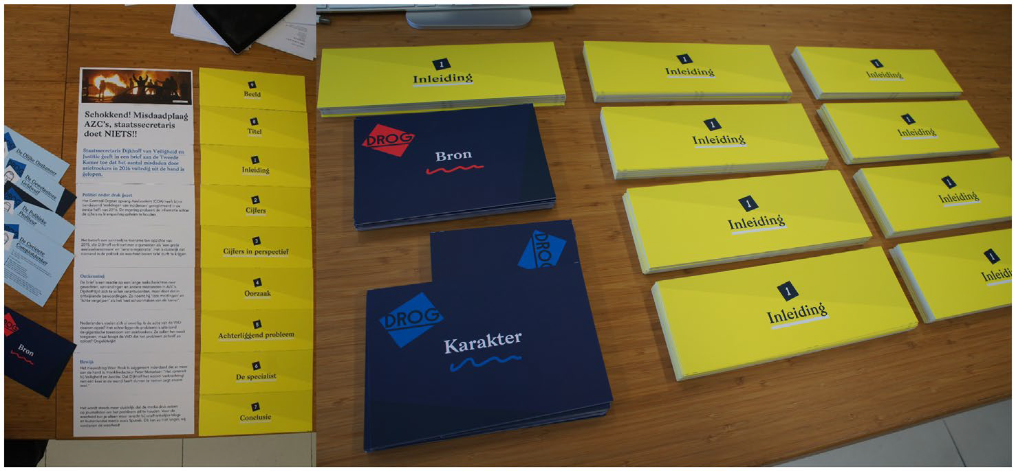
A way to counter it: the “vaccine”
At first: card games tested on high schoolers
Multiple roles and goals
Impact of the game:
questionnaire before and after the game
https://www.cam.ac.uk/research/news/fake-news-vaccine-online-game-may-inoculate-by-simulating-propaganda-tactics
(consulted in 12/2018)

Slide 13
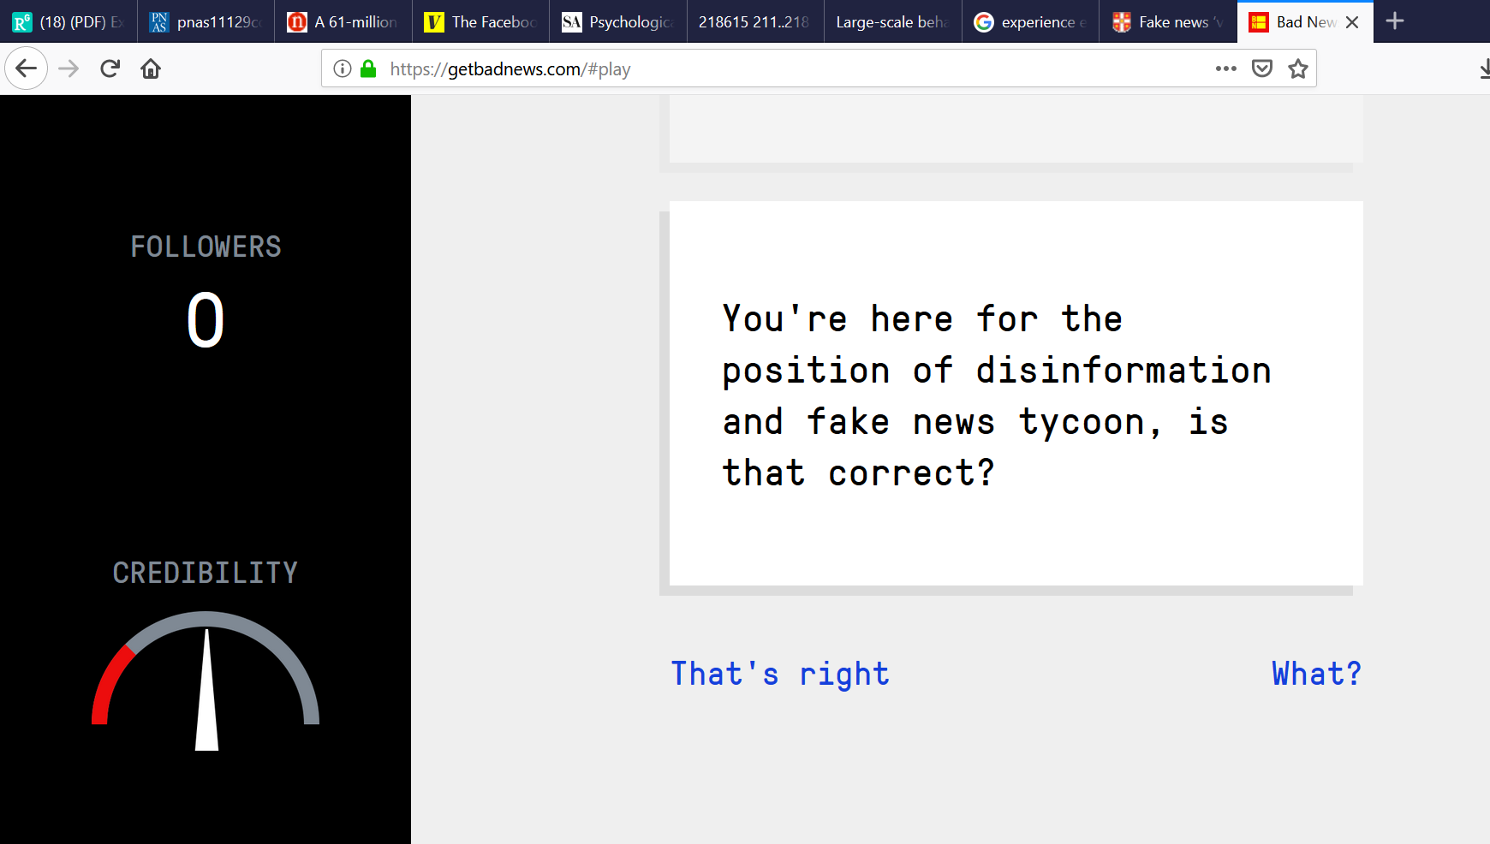
https://getbadnews.com/

Slide 14

Thank you for your attention!

Slide 15
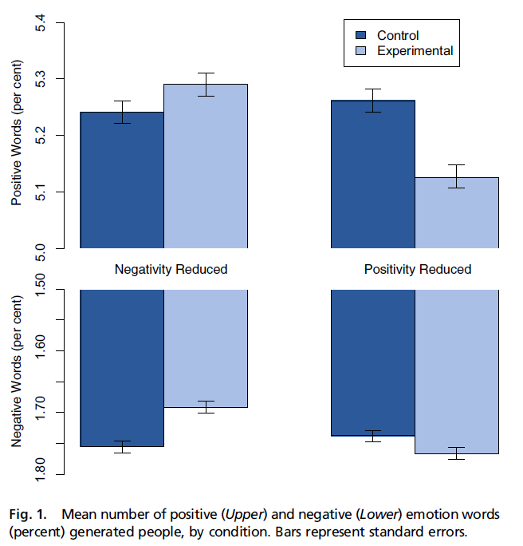
Social contagion (1)
1 week of experiment, January 2012
≈ 160k users effectively participating
NewsFeed altered
  Feeds choice: LIWC2007 software
Kramer A.D.I. et al, DOI:10.1073/pnas.1320040111

