Slide 1
Merchant - Customer
Mobile Application
E-Commerce Mobile App Proposal

Slide 2
Team
Founders
Neelakantan Narasimman (Neel)
Rakesh S P

Slide 3
Pain / Benefits (Merchants)
Gap to Publish - To notify patrons on fresh made or arrival of fresh stock
Enhance visibility – Publish flag ship product to masses among clustered shops
Reduce wastage – Broadcasting last minute deal to clear stocks before closing
Reduce Advertising cost – Promote flag ship products among masses at peak time benefiting small players.

Slide 4
Pain / Benefits (Shoppers)
Knowledge or urge to buy fresh made or stocks
Grab last minute deals
Identify best among clustered businesses

Slide 5
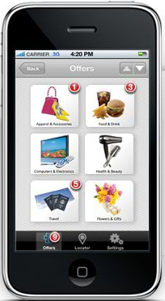
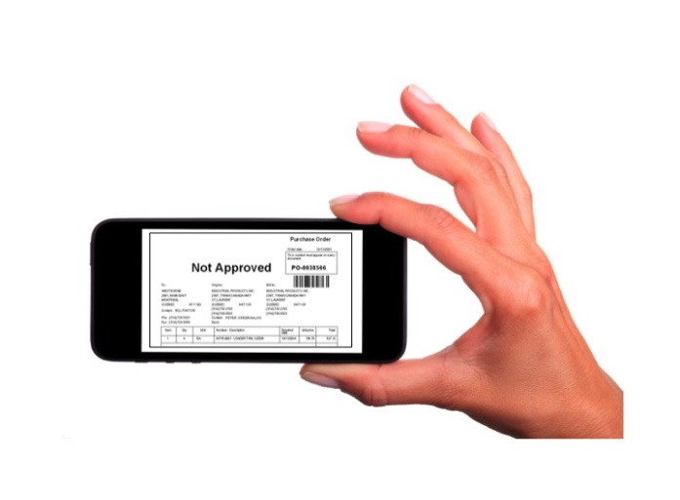
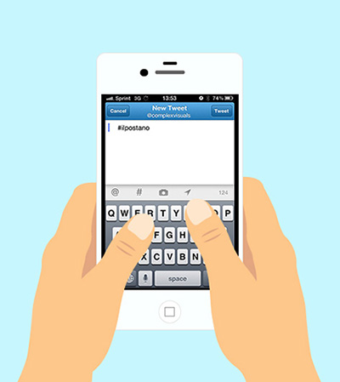


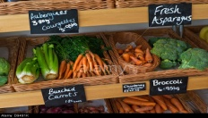
Solution
Grocery / vegetables; Snack/Juice/Café bars
Shopper receives product notifications from stores
Merchant takes the photo of the item to be notified
Post the offer/notification
Shopper gets personalized
set of offers & notifications in the locality

Slide 6

Solution
Infini-tote
Infini-tote
*Fresh spinach
* Thai Mango
Notify Me
………
--------
Yes
No
Yes
No
Shopper creates a notify list for a store
Merchant acknowledge
Direct channel between customer & Merchant
Mini chat platform which enables customer to chat with Merchant
Get product availability, enquire details etc..

Slide 7
Minimum Viable Product
App with shopper
Receive notifications / offers from stores
Make a notify me list ; Chat with the merchant
Search for products in locality (needed?)
App with Merchant
Post notifications
Chat with customers

Slide 8
Features needed
Merchant
Manual registration by our admin
Post photo of products
Give description like ; item quantity, price, deal expiry etc
Option to receive chat
If yes, the provision to chat
View his own product listing
Present and Past

Slide 9
Features needed
Customer
Social media login
View store wise and product wise list in tabs
Option to follow a store page
Option to like or love a product listing
Initiate a chat
Share a product/shop listing in social media with friends and family

Slide 10
Technology Stack
Hybrid Mobile App supporting IOS, Andriod and Windows and web based.
HTML5, CSS3, Angular JS, Bootstrap (Initial Proposal)
Rest API services Web layer and Application server.
J2EE based components for Application server.
Security feature.
Mongo DB.
AWS for PAAS.

Slide 11
Deliverables
Fully customizable code
Technical Architecture diagram / Specs
Data flow / ER diagram
Security features
Deployment and API documentations
Scalability proposals
Performance matrix

Slide 12
Thank You ☺

