Slide 1
MovieLens Recommendation System
Collaborative Filtering • Full Stack • Cloud Deployment
Notes:
“Hi my name is Mehrshad Bagherebadian, and I’m a fourth-year Computer Science major. With concentration in AI and minors in data science and CMSE Today I’ll be presenting my project on a MovieLens recommendation system. This project focuses on building a collaborative filtering model to generate personalized movie recommendations, along with deploying it as a full-stack application in the cloud. I’ll walk through the dataset, the modeling approach, key challenges, and the final results.”

Slide 2

Problem & Objective
Predict
Predict user movie preferences
Compare
Compare CF models
Deploy
Deploy full system
Notes:
The goal of this project is to build a recommendation system that can predict user movie preferences based on past ratings. We use collaborative filtering to learn patterns from user interactions with movies. In addition to prediction, we compare different collaborative filtering approaches, specifically user-based and item-based models, to determine which performs better. Finally, the objective is to deploy the entire system as a working application, demonstrating not just the model, but a complete end-to-end solution.

Slide 3

Dataset Overview
100,836 ratings
610 users
9,700+ movies
Sparse matrix
Table | Purpose
ratings | User-movie rating records
movies | Movie title and genre metadata
movies_genres | Movie metadata with one-hot encoded genres
ratings_with_movies | Merged ratings and movie metadata
Notes:
“For this project, I used the MovieLens dataset, which is a widely used benchmark for recommendation systems. It contains over 100,000 ratings from 610 users across more than 9,700 movies. Each rating represents a user’s preference for a specific movie on a scale from 1 to 5.
In addition to the ratings data, the dataset includes movie metadata such as titles and genres. I structured the data into multiple tables, including ratings, movies, and a processed version where genres are one-hot encoded. I also created a merged dataset that combines user ratings with movie information, which is what the model ultimately uses.
One of the most important characteristics of this dataset is that it forms a very sparse user-item matrix. This means that most users have rated only a small fraction of the available movies, leaving the majority of the matrix empty.
This sparsity is a key challenge in recommendation systems, and it directly impacts how well different models perform, especially when comparing user-based and item-based collaborative filtering.”

Slide 4
Data Preprocessing
Cleaned data
Merged tables
One-hot genres
Converted timestamps
Notes:
“Before building the models, I performed several preprocessing steps to transform the raw data into a format suitable for collaborative filtering. First, I cleaned the data by removing inconsistencies and ensuring all ratings and movie entries were valid.
Next, I merged the ratings and movies tables to create a unified dataset that links each user rating with the corresponding movie information, such as title and genres. This step is important because the model needs both user interactions and item metadata.
I then applied one-hot encoding to the movie genres. This converts categorical genre information into a numerical format, allowing it to be used for analysis and potential feature-based extensions.
Finally, I converted the timestamps into a readable datetime format. While timestamps are not directly used in the basic collaborative filtering model, they provide useful temporal context and make the dataset easier to interpret and analyze.
Overall, these preprocessing steps were critical to ensuring the data was clean, structured, and ready for building accurate recommendation models.”

Slide 5
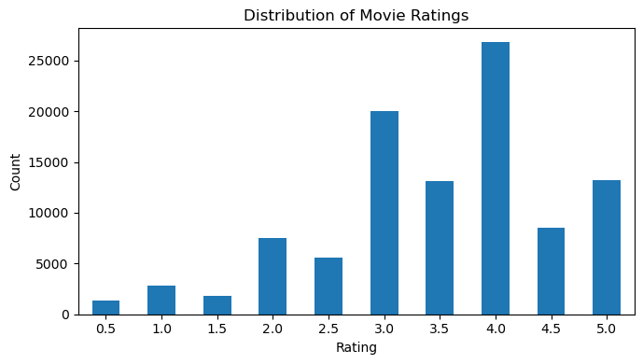
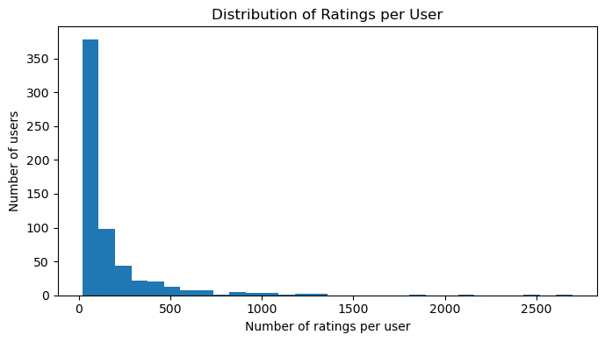
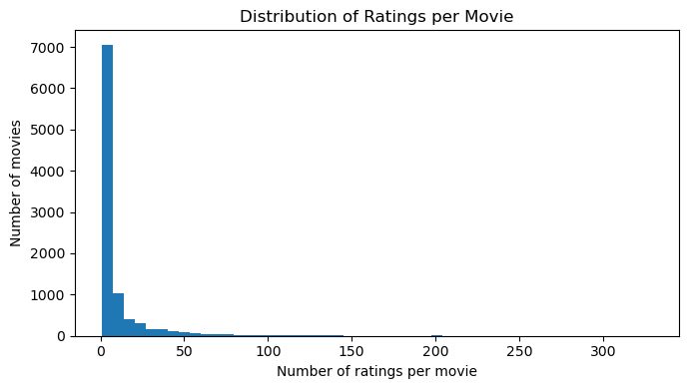
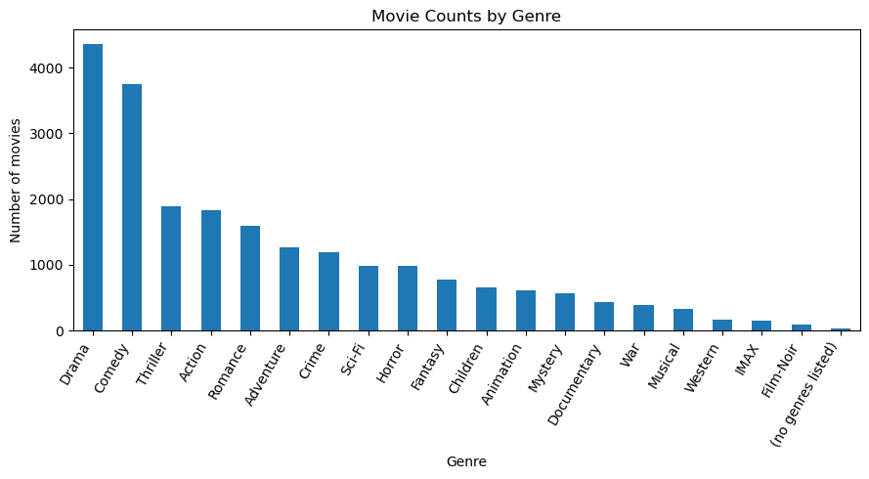
Exploratory Visualizations
Notes:
Here are some exploratory visualizations to better understand the dataset before modeling.
In the top left, we see the distribution of ratings. Most ratings are concentrated between 3 and 5, which shows a positive bias—users tend to rate movies they like.
On the top right, we see the distribution of ratings per user. This is highly skewed, meaning a small number of users rate a lot of movies, while most users rate very few.
Similarly, in the bottom left, the number of ratings per movie is also skewed. A few popular movies receive many ratings, while most movies receive very few.
Finally, the bottom right shows the distribution of movies by genre, with genres like Drama and Comedy being the most common.
Overall, these plots highlight the sparsity and imbalance in the dataset, which is an important challenge for collaborative filtering models.”

Slide 6
Models Compared
Baseline
User-Based CF
Item-Based CF
Notes:
We compared three models using train-test split and evaluated them using RMSE and MAE.

Slide 7
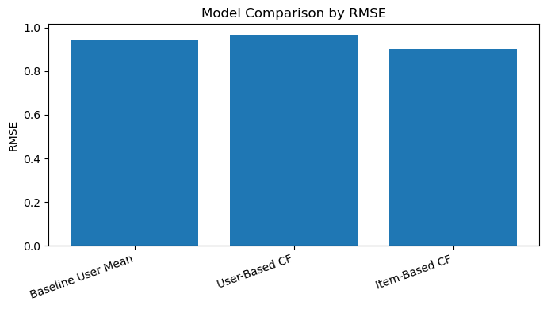
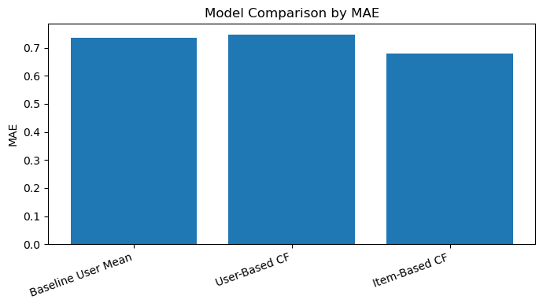
Model Results
Baseline RMSE: 0.94
User CF RMSE: 0.97
Item CF RMSE: 0.90 (best)
Notes:
Item-based collaborative filtering performed best due to data sparsity and more stable similarities.

Slide 8
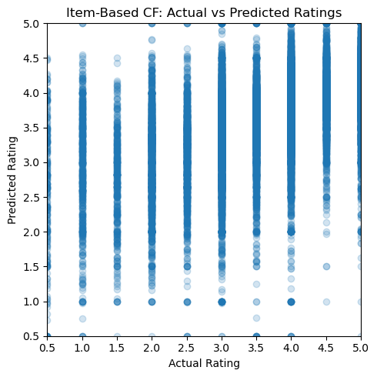
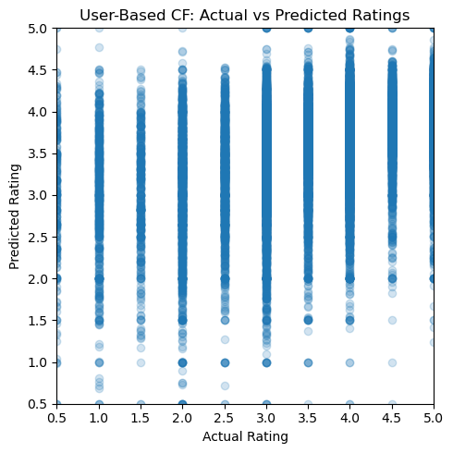
Key Insight
Item-based > User-based
Due to sparsity
Notes:
“One of the most important findings from our project is that item-based collaborative filtering outperformed user-based collaborative filtering.
On the right, we see plots comparing actual ratings to predicted ratings for both models. Ideally, predictions should align closely with actual values.
The item-based model shows tighter clustering and more consistent predictions, while the user-based model shows more spread and variability, indicating less accurate predictions.
The main reason for this difference is data sparsity. In this dataset, most users rate only a small number of movies, which makes it difficult to reliably compute user-to-user similarity.
In contrast, movies tend to accumulate more ratings overall, so item-to-item similarities are more stable and better estimated.
As a result, the item-based model was able to achieve lower error and better overall performance.”

Slide 9
System Architecture
React frontend
Flask backend
MySQL DB
Cloud Run
Notes:
The system is fully containerized and deployed on Google Cloud Run with a backend API and frontend UI.

Slide 10

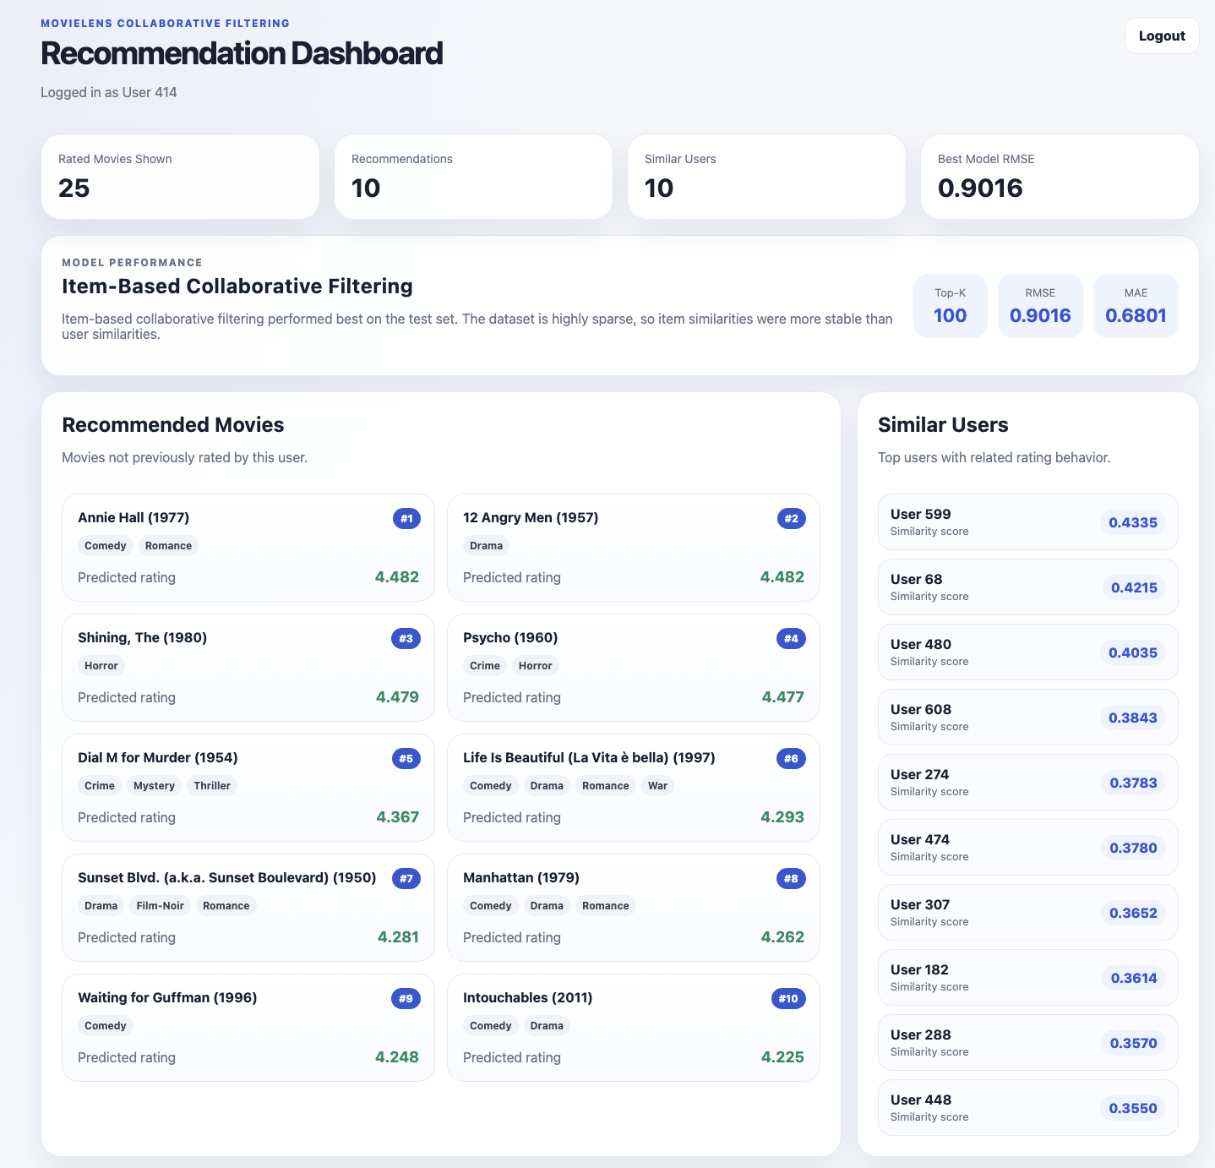
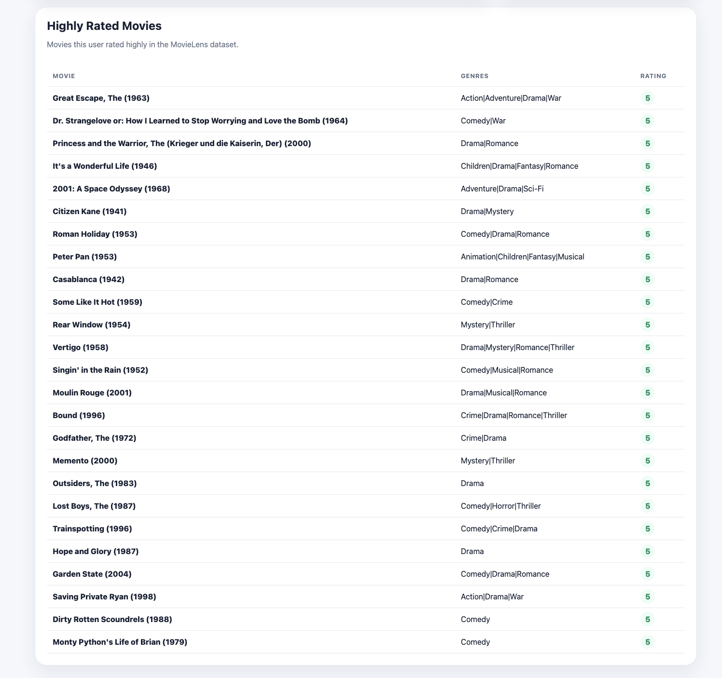
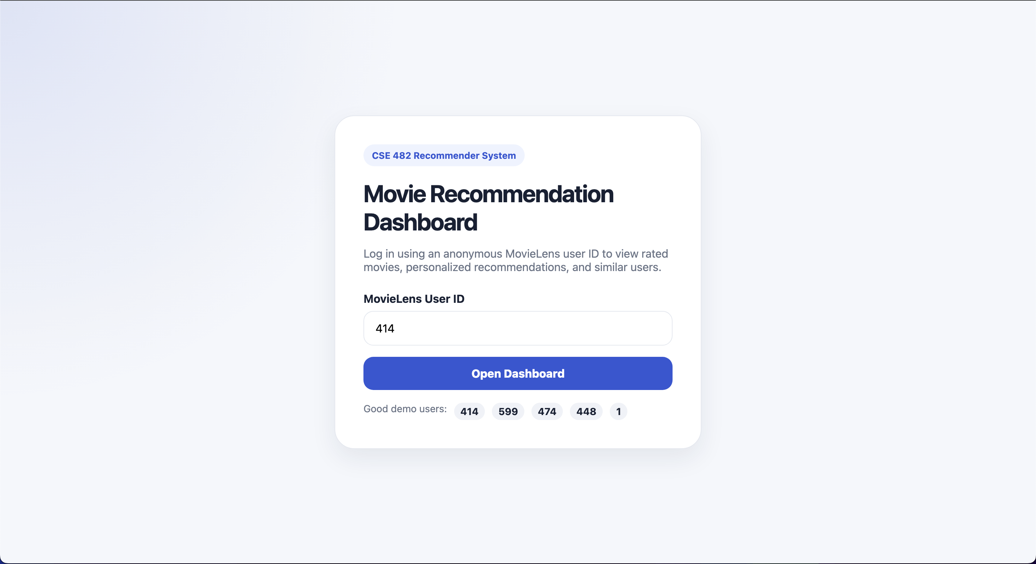
Web Application
https://cse482-frontend-816507479795.us-central1.run.app/
Notes:
The dashboard allows login, viewing rated movies, receive recommendations for movies they like, and see similar users who also reviewed the same as them.

Slide 11
Challenges
Highly Sparse Dataset (~98% missing values)
Cold Start Problem for New Users and Movies
Unstable User Similarity due to Limited Overlap
Sensitivity to Hyperparameters (Top-K neighbors)
Scalability Challenges in Similarity Computation
Notes:
“A major challenge in this project was the high sparsity of the dataset, with about 98% missing values, making it difficult to learn reliable patterns.
We also faced the cold start problem, where new users or movies have little to no data, so recommendations are less accurate.
Another issue was unstable user similarity, since most users have very little overlap in rated movies.
The models were also sensitive to hyperparameters like the number of neighbors, which affected performance.
Finally, scalability is a concern, since computing similarity matrices can be expensive for large datasets.
These challenges are why item-based methods performed better in our case.”

Slide 12
Conclusion
Item-Based Collaborative Filtering Outperformed Alternatives (Lowest RMSE/MAE)
Dataset Sparsity Was the Dominant Factor Affecting Model Performance
User-Based Filtering Suffered from Sparse User Overlap
Preprocessing and Feature Engineering Significantly Improved Model Stability
The Model Successfully Learned Meaningful User Preferences from Limited Data
Notes:
“In conclusion, we found that item-based collaborative filtering consistently outperformed user-based methods, achieving the lowest RMSE and MAE.
The main reason for this was dataset sparsity, which made user-based similarity unreliable due to limited overlap between users.
We also saw that preprocessing and feature engineering played an important role in improving model stability and performance.
Despite the sparsity, the model was still able to learn meaningful patterns in user preferences and generate useful recommendations.
Overall, this project demonstrates how collaborative filtering can still be effective, even with limited and sparse data, when the right approach is chosen.”

