Slide 1
Maven

Slide 2
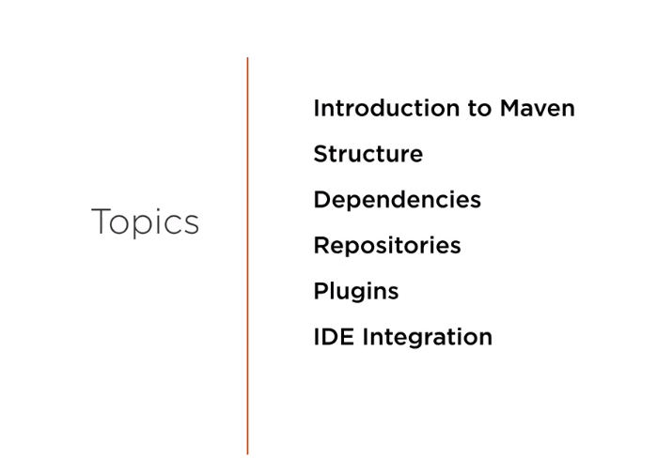

Slide 3
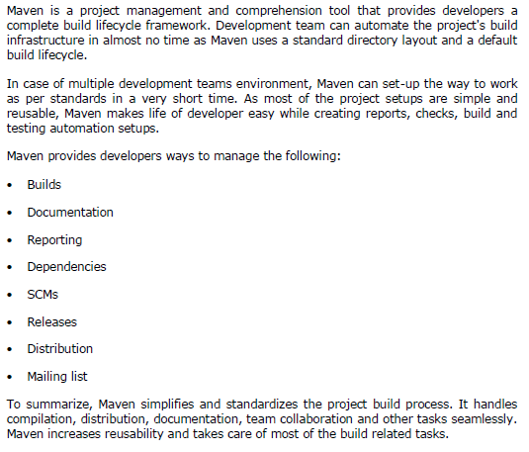
What is Maven?

Slide 4
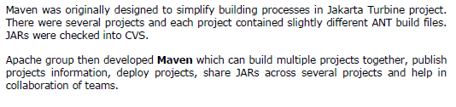
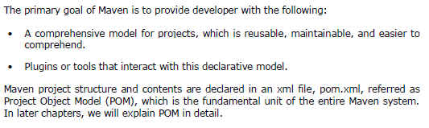
Objective

Slide 5
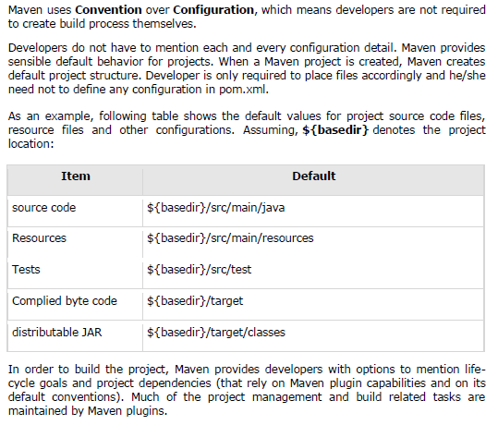
Convention over Configuration
Notes:
Developers can build any given Maven project without the need to understand how the individual plugins work.

Slide 6
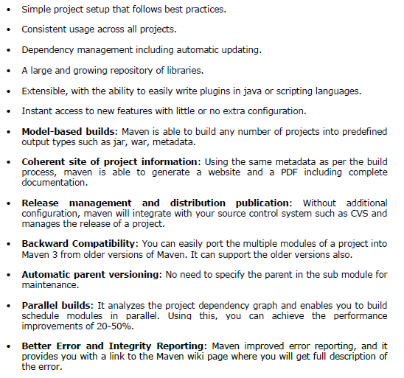
Features of Maven

Slide 7
Installing on windows
1. Get Maven:
Download the maven archive from here: http://maven.apache.org/download.cgi
Unzip it to a folder. In this article, we are using C:\opt\apache-maven-3.6.3
2. Add MAVEN_HOME system variable:
> In “Environment variables” dialog, System variables, Clicks on the New... button and
add a MAVEN_HOME variable and point it to C:\opt\apache-maven-3.6.3\
> Add %MAVEN_HOME%\bin To PATH:
In system variables, find PATH, clicks on the Edit... button.
In “Edit environment variable” dialog, clicks on the New button and add this %MAVEN_HOME%\bin
3. Verification: mvn -version

Slide 8
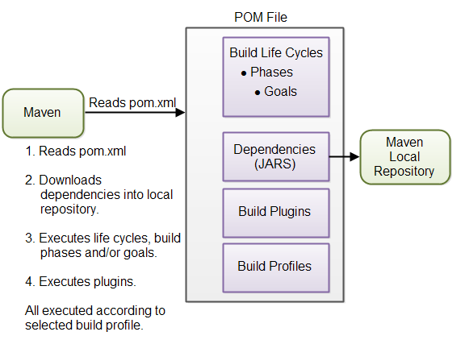
Overview of Maven core concepts.

Slide 9
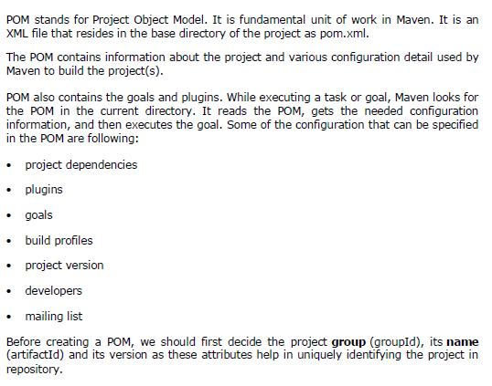
APACHE MAVEN — POM

Slide 10
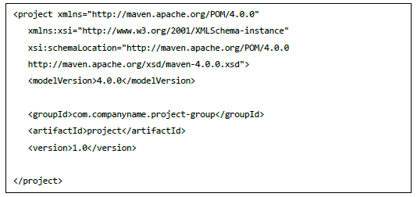
POM Example

Slide 11
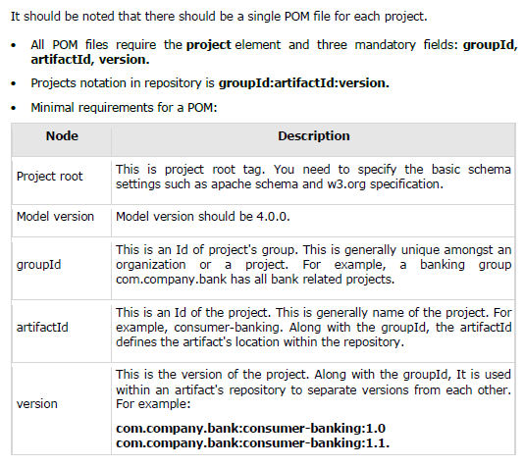
POM Example

Slide 12
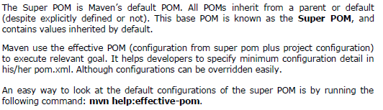
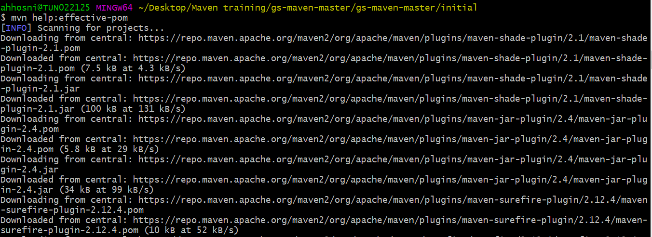
Super POM

Slide 13
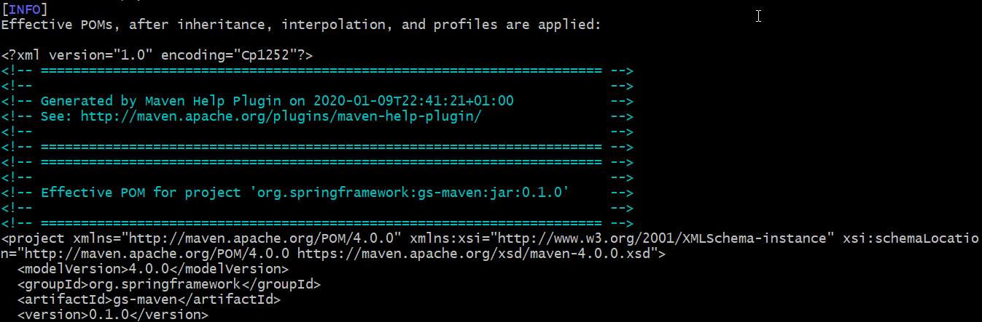
Super POM
Maven will start processing and display the effective-pom:

Slide 14
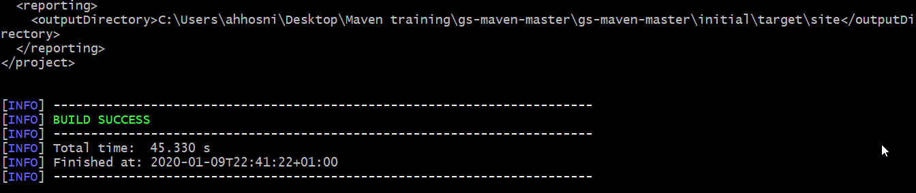
Super POM
In the displayed pom.xml, you can see the default project source folders structure, output directory, plug-ins required, repositories, reporting directory, which Maven will be using while executing the desired goals.
Maven pom.xml is also not required to be written manually. Maven provides numerous archetype plugins to create projects, which in order, create the project structure and pom.xml

Slide 15
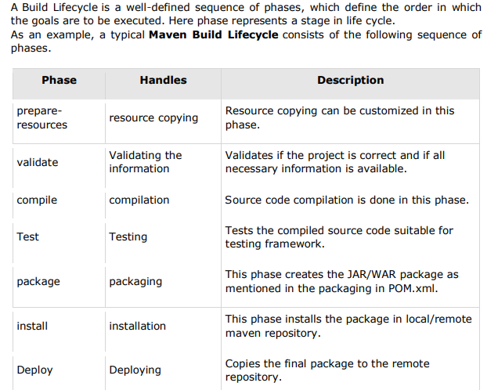
APACHE MAVEN — BUILD LIFE CYCLE

Slide 16
APACHE MAVEN — BUILD LIFE CYCLE
There are always pre and post phases to register goals, which must run prior to, or after a particular phase. When Maven starts building a project, it steps through a defined sequence of phases and executes goals, which are registered with each phase.
Maven has the following three standard lifecycles:
clean
default(or build)
site
A goal represents a specific task which contributes to the building and managing of a project. It may be bound to zero or more build phases.
A goal not bound to any build phase could be executed outside of the build lifecycle by direct invocation.

Slide 17
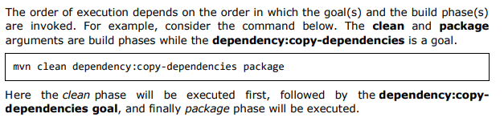
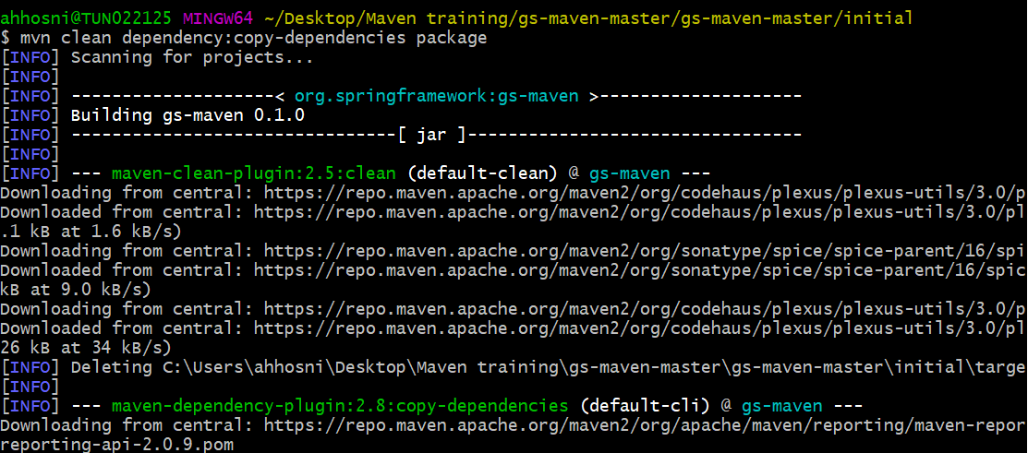
APACHE MAVEN — BUILD LIFE CYCLE

Slide 18
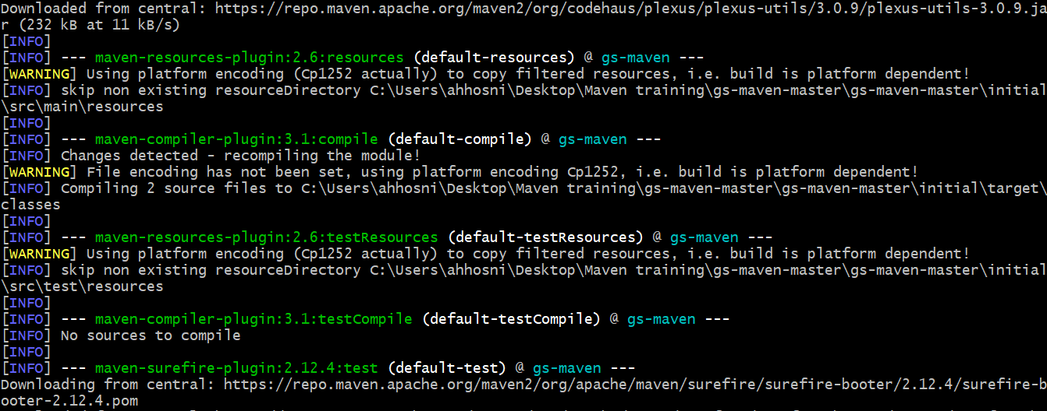
APACHE MAVEN — BUILD LIFE CYCLE

Slide 19
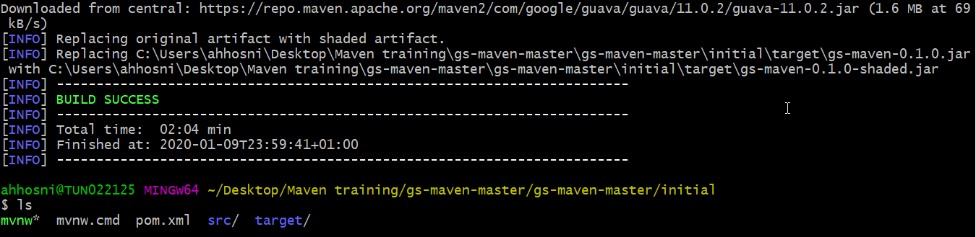
APACHE MAVEN — BUILD LIFE CYCLE

Slide 20
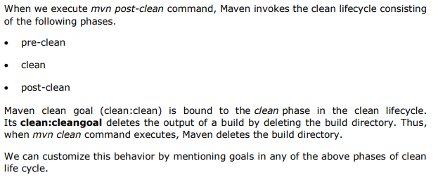
Clean Lifecycle

Slide 21
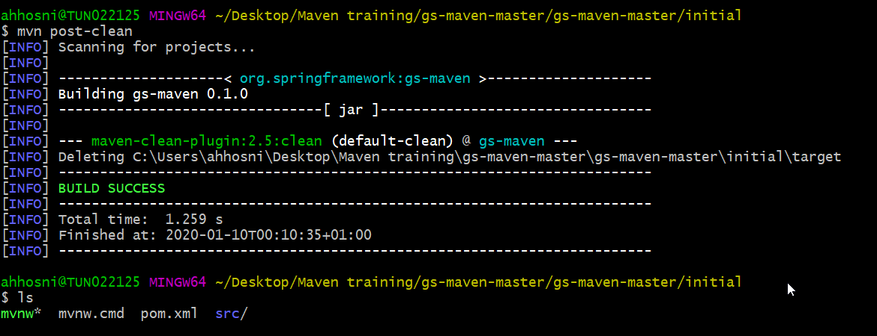
Clean Lifecycle
Notes:
You can try tuning mvn clean command, which will display pre-clean and clean. Nothing will be executed for post-clean phase

Slide 22
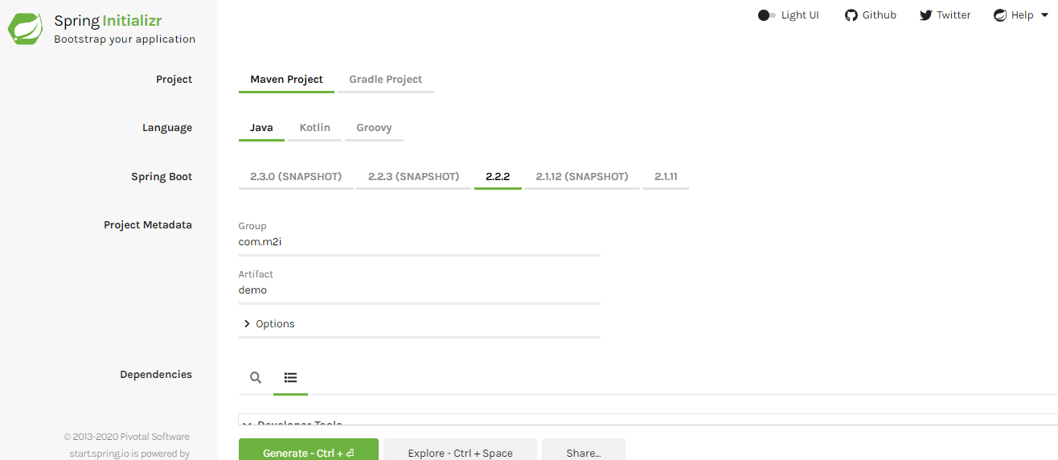
Hello World using Spring initializer
Notes:
Go to https://start.spring.io/

Slide 23
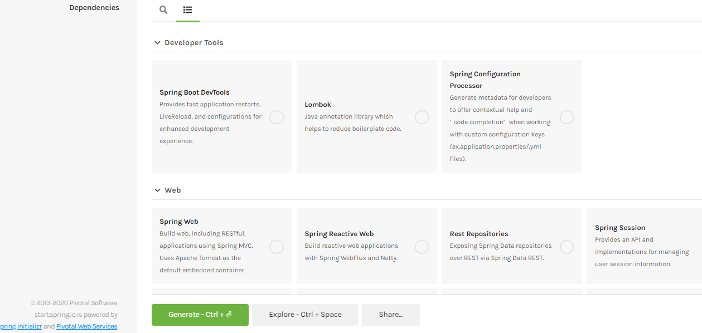
Hello World using Spring initializer

Slide 24
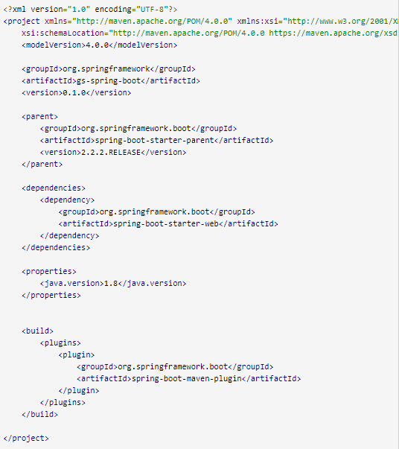
Hello World using Spring initializer: pom.xml

Slide 25
Hello World using Spring initializer: pom.xml

