Slide 1
Weekly Progress · Updates Since 5/28
Per-genus 13-mer Exp F · GitHub migration · Nano4 H200 (free) brought online
楊明儒 · 2026-06-02
Since 5/28 advisor meeting:
• Earlier this week: MT alignment fix · in-DB Table 4.30 · genus-level inversion · thesis 139 pp · TWCC budget exhausted
• This week (5/31–6/2): Per-genus 13-mer Exp F result · GitHub repo published · Nano4 H200 onboarding
Today's deck: progress update, blocker status, decision tracker.

Slide 2
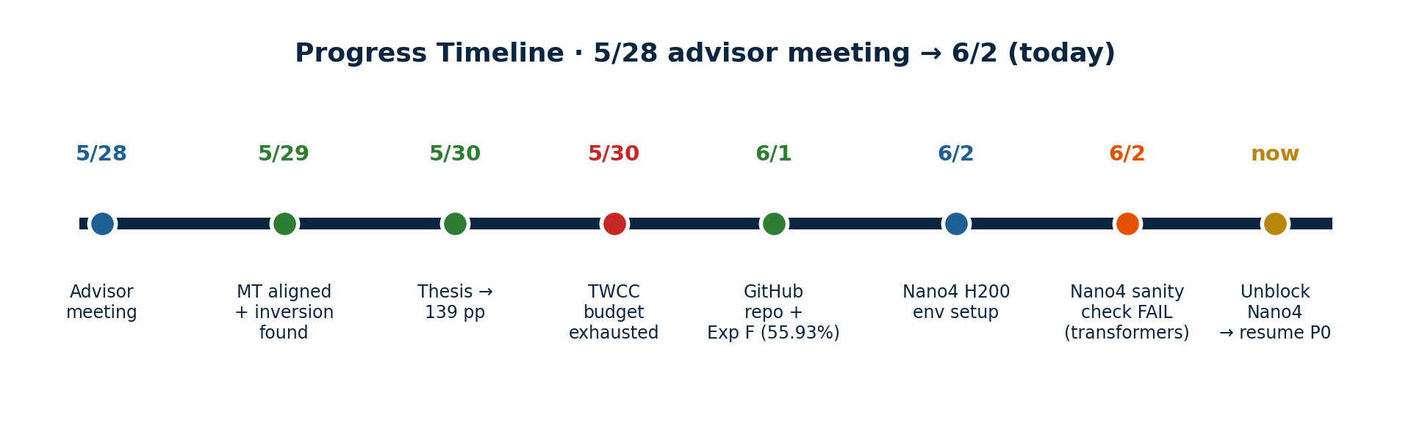
Progress Timeline · 5/28 → 6/2
Week 1 (5/28-30): MT aligned (5/6), in-DB Table 4.30, genus inversion finding, thesis 139pp · TWCC wallet exhausted
Week 2 (5/31-6/2): GitHub repo (4 envs synced) · Per-genus 13-mer (55.93%, 3rd router data point) · Nano4 onboarded
Current blocker: Nano4 sanity check fails on transformers version (NT-v2 ESM model uses removed API).
Fix: pip install transformers==4.35.2 in Nano4 gfm env. ETA ~1 hr to unblock.
2 / 10

Slide 3
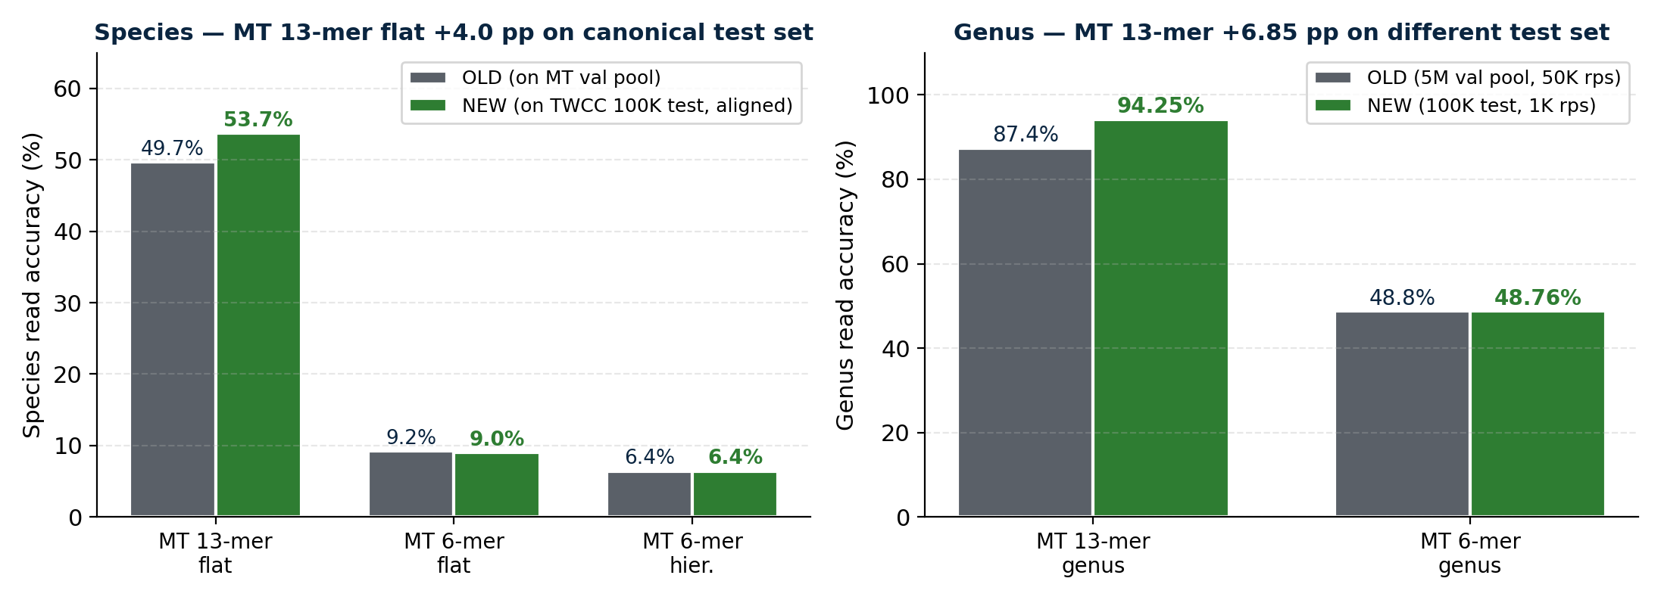
MT Predictions · Read-Order Alignment Fix
Why old numbers were wrong · Previous MT predictions came from MT's val_dir (multi-file FASTA, sorted by filename). The read order did NOT match TWCC's canonical reads_100K.fa. Re-ran on Taiwana-2 with reads in single-file order → labels now 1:1-aligned to NT-v2 / Kraken2 references.
All MT in-DB metrics now correctly computed on the canonical 100K test set
3 / 10

Slide 4
New Finding · Species/Genus Performance Inversion
Same Kraken2 DB, same test set, same protocol — Kraken2 wins species; MT 13-mer wins genus
4 / 10

Slide 5
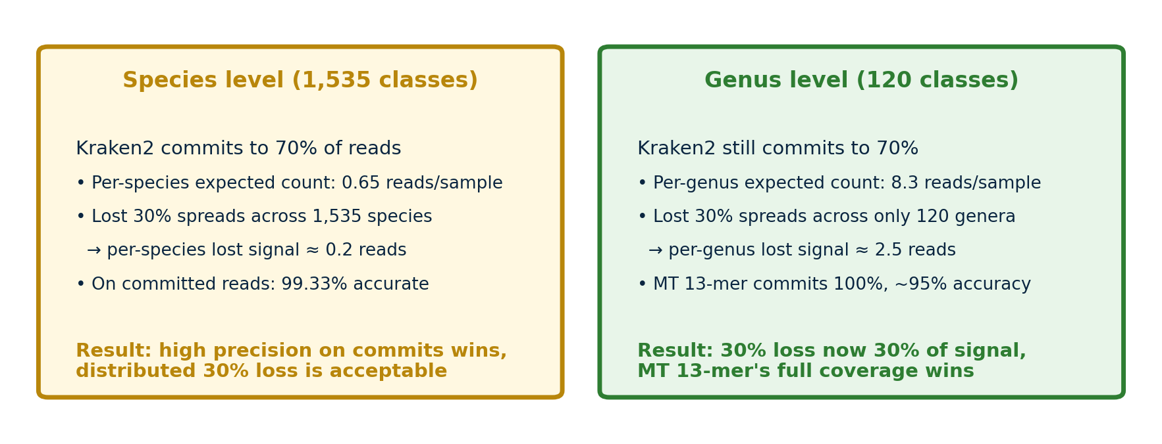
Why the Inversion · Commit-Rate × Task Cardinality
Theoretical implication · Kraken2's 30% abstention is a precision-vs-recall trade-off. At high task granularity (1,535 species), the precision wins. At low granularity (120 genera), the recall loss dominates. This adds nuance to the thesis's complementary positioning: they are not just "in-DB vs OOD" — they trade off across task cardinality.
5 / 10

Slide 6
Thesis Updates Summary
What changed
What was added
• Table 4.29 MT rows updated to aligned values
— MT 13-mer flat: 49.7% → 53.7% / r 0.46 → 0.50
— MT 6-mer flat/hier: minor (9.0% / 6.4%)
— MT 13-mer hier: N/A (checkpoint corrupted)
• Hierarchical-masking paragraph: removed broken MT 13-mer hier reference;
revised to 2 routers (NT-Genus 66%, MT 6-mer 49%) + reference to read-level 3 points
• OOD framing fixed: was "neural retains OOD signal";
now "deployment coverage asymmetry" (the 219 species are in-distribution)
• Thesis page count: 137 → 139
• New Table 4.30: Fair-restricted comparison
on in-DB 85,819 reads (species + genus panels)
• New paragraph: "Coverage-restricted fair comparison"
explains why restrict to 85,819 reads + interpretation
• New paragraph: "Sharp inversion between species
and genus levels" — describes the new finding
with commit-rate × cardinality mechanism
• New paragraph: "Kraken2 dependence on database
coverage" — corrected deployment vs OOD framing
6 / 10

Slide 7
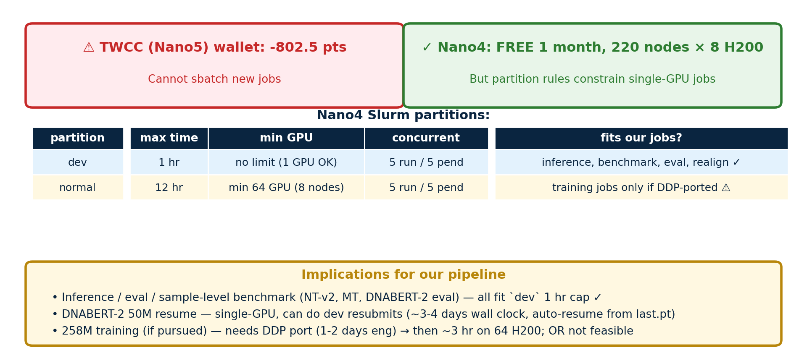
Blocker · TWCC Budget Exhausted on 5/30
Need decision: budget top-up, or accept partial DNABERT-2 + defer remaining tasks
7 / 10

Slide 8
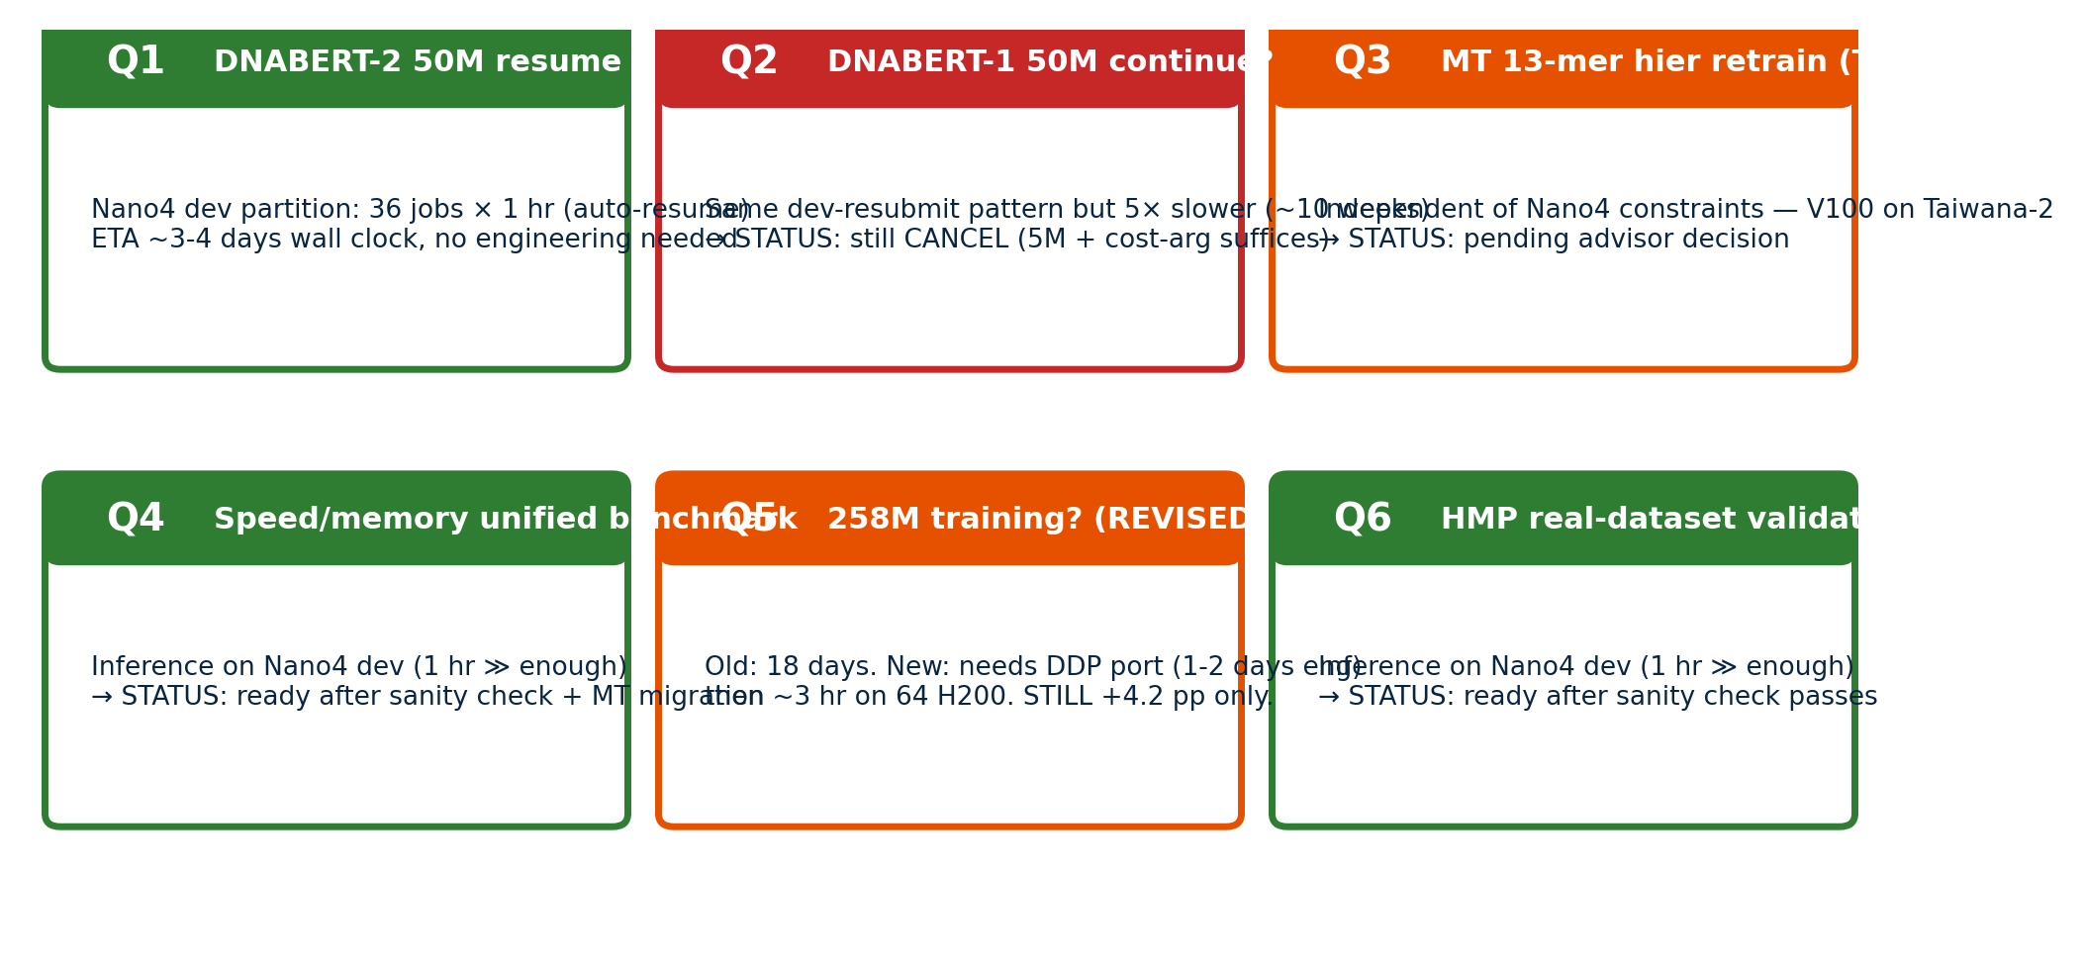
6 Open Decisions · Status Update
8 / 10

Slide 9
Recommended Priorities · Next 2 Weeks
Now (Taiwana-2 / CPU — no Nano4 needed)
• Realign Per-genus 13-mer (Exp F) on Taiwana-2 → integrate Table 4.30
• Thesis figure regeneration with aligned MT numbers (53.7%, 94.25%)
• Section 4.13 proofreading + format check · optional MT 13-mer hier retrain (Q3)
Fits Nano4 dev partition (1-hr jobs, single-GPU)
• Sanity check NT-Species inference (BLOCKED — fix transformers==4.35.2 first)
• DNABERT-2 50M resume — 36 dev resubmits w/ auto-resume from last.pt (~3-4 days)
• Speed/memory unified benchmark on H200 (~30 min wall clock)
• HMP mock community real-dataset inference (~30 min) — paper prep
Requires DDP port (1-2 days eng) for Nano4 normal partition
• 258M training (genus +species) — DDP code rewrite, then ~few hr on 64 H200.
Value: log-fit predicts +4.2 pp, does NOT cross tokenisation gap (MT 13-mer 87.4%)
→ Cost-benefit: 1-2 days engineering for marginal acc improvement
Not doing — DNABERT-1 50M (300 GPU-hr / 5× slower than DNABERT-2 — single dev partition impractical, ~10 weeks)
9 / 10

Slide 10
Asks for Today's Meeting
Three decisions I need from you today:
1
Use Nano4 dev partition for our pipeline
Nano4 normal needs 64 GPU min (DDP-only). Plan: all our inference + DNABERT-2 resume go on dev (1-hr jobs, auto-resume). Speed benchmark / HMP / Per-genus realign all fit. OK?
2
258M training — DDP port worth it?
Nano4 normal makes 258M technically viable: 1-2 days DDP port + few hours on 64 H200. Predicted gain: +4.2 pp (log-fit), does NOT cross tokenisation gap. Pursue or skip?
3
Per-genus 13-mer Exp F integration
Once Taiwana-2 sends realigned predictions, add 4th row to Table 4.30 showing 55.93% (3rd router-quality data point validating monotonic theorem). OK?
10 / 10

