Slide 1
Weekly Progress Update
Token-Level Metagenomic Classification · NT-v2 + LoRA
June 9, 2026
Nano4 H200 onboarded · DNABERT-2 50M resume ready · MT benchmark ready
YMJ · M2 Lab · NTU CSIE

Slide 2
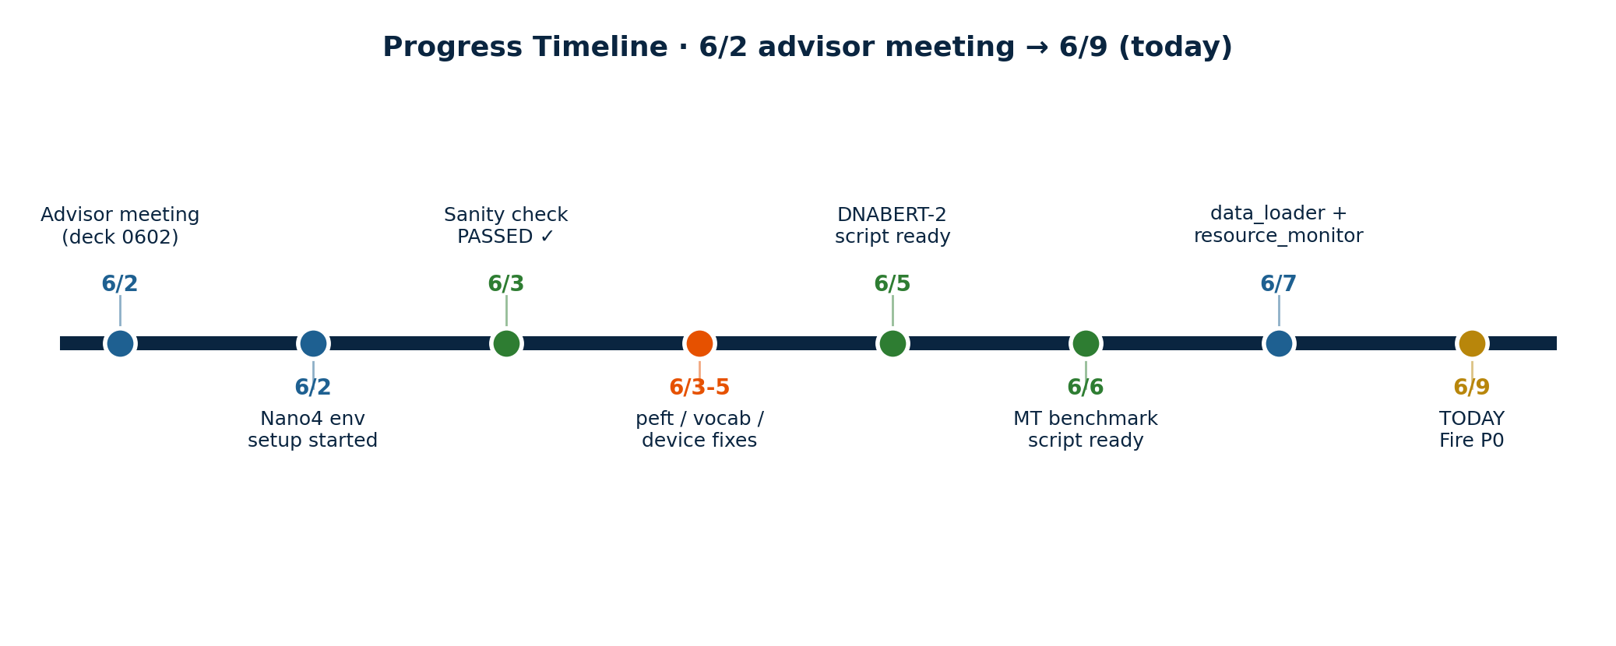
Progress Timeline · 6/2 → 6/9
6/2 Advisor meeting (deck 0602) — 3 open questions
6/3 Nano4 sanity check PASSED — NT-Sp 17.83% matches TWCC exactly
6/3–7 6 engineering commits: peft compat, vocab fix, data_loader, benchmark script
6/9 TODAY — scripts ready, waiting to fire P0 jobs

Slide 3
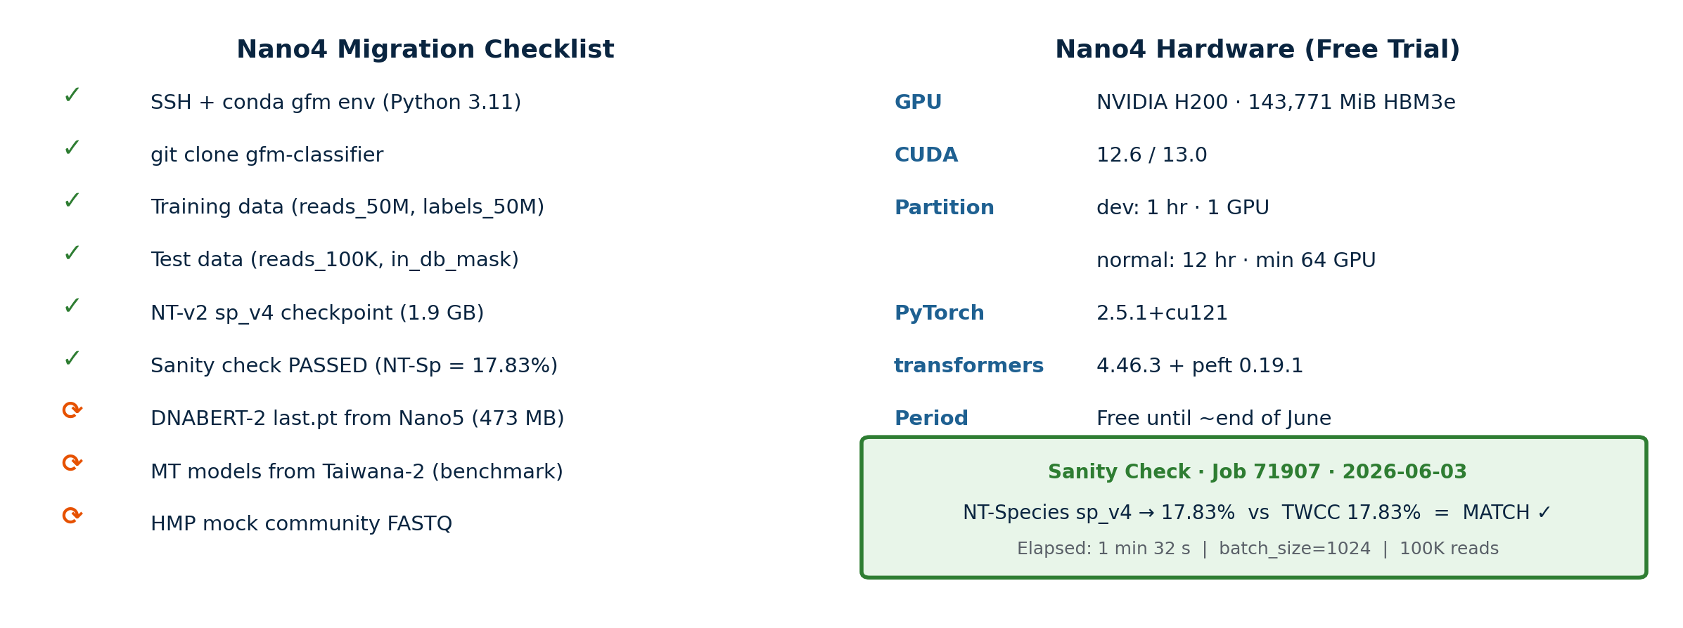
Nano4 H200 — Migration Complete
Free 1-month trial · dev 1hr · normal 12hr (min 64 GPU)

Slide 4
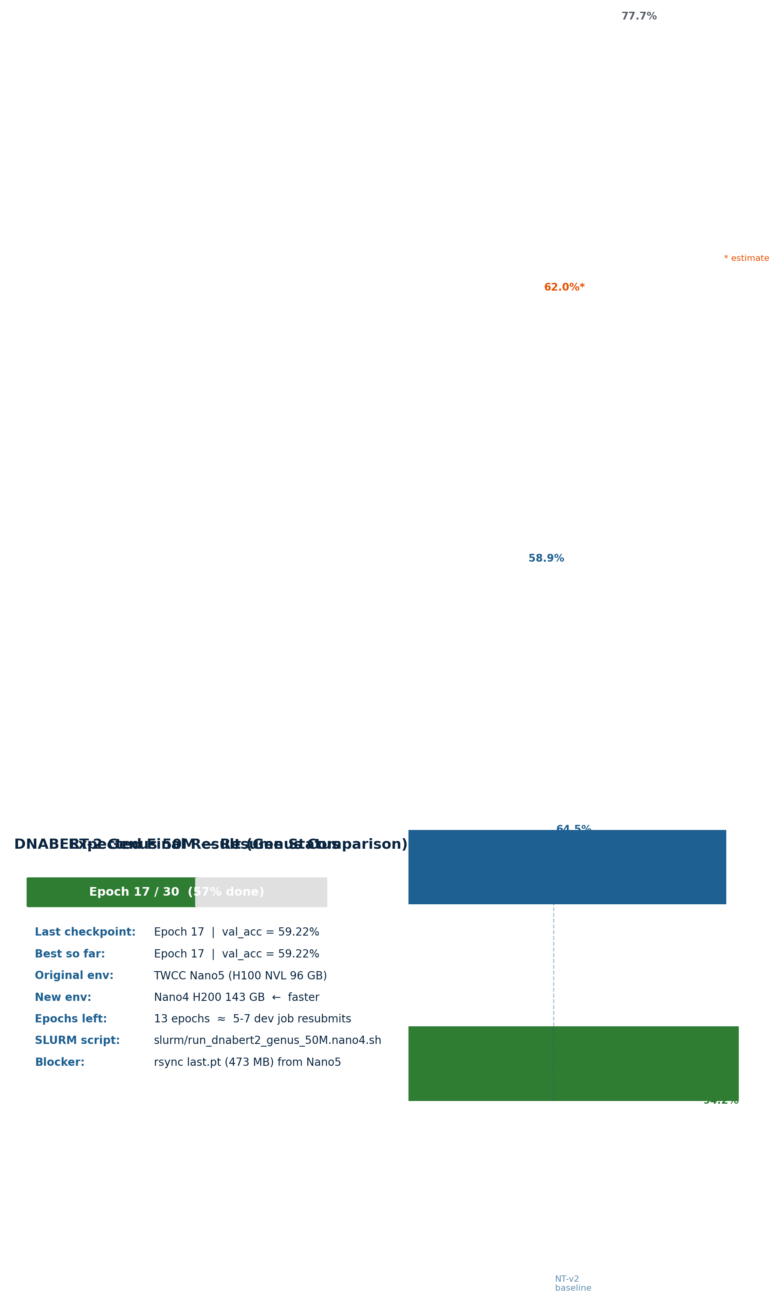
P0-A: DNABERT-2 50M Resume
Epoch 17/30 · val_acc 59.22% · ~7 dev-job resubmits to complete

Slide 5
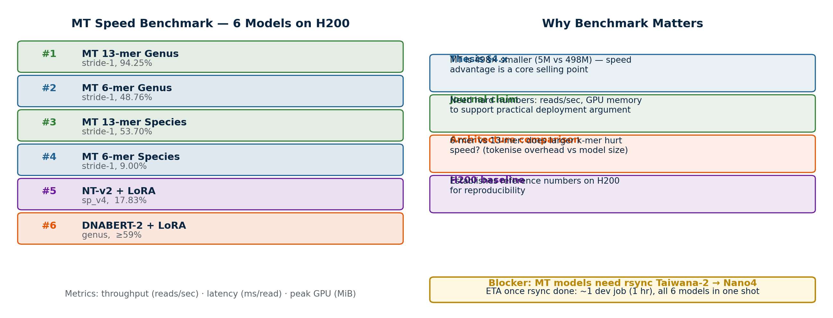
P0-B: MT Speed / Memory Benchmark
6 models · H200 · 100K reads · throughput + peak GPU

Slide 6
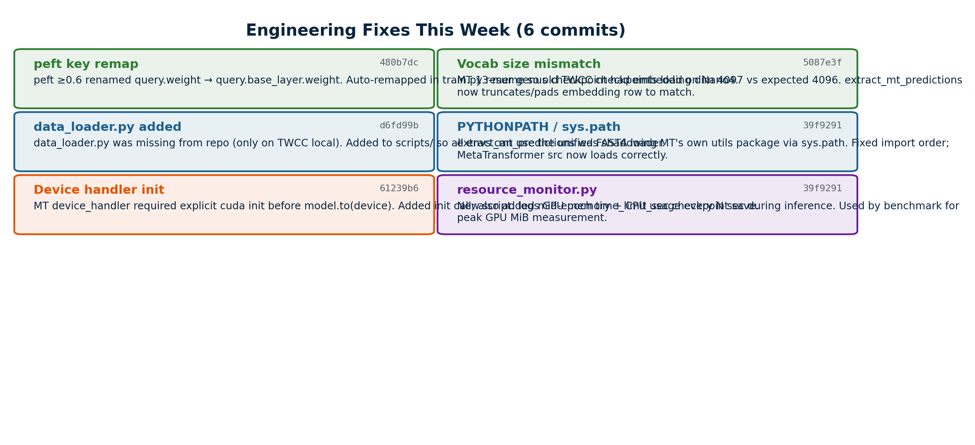
Engineering Highlights (6 commits this week)

Slide 7
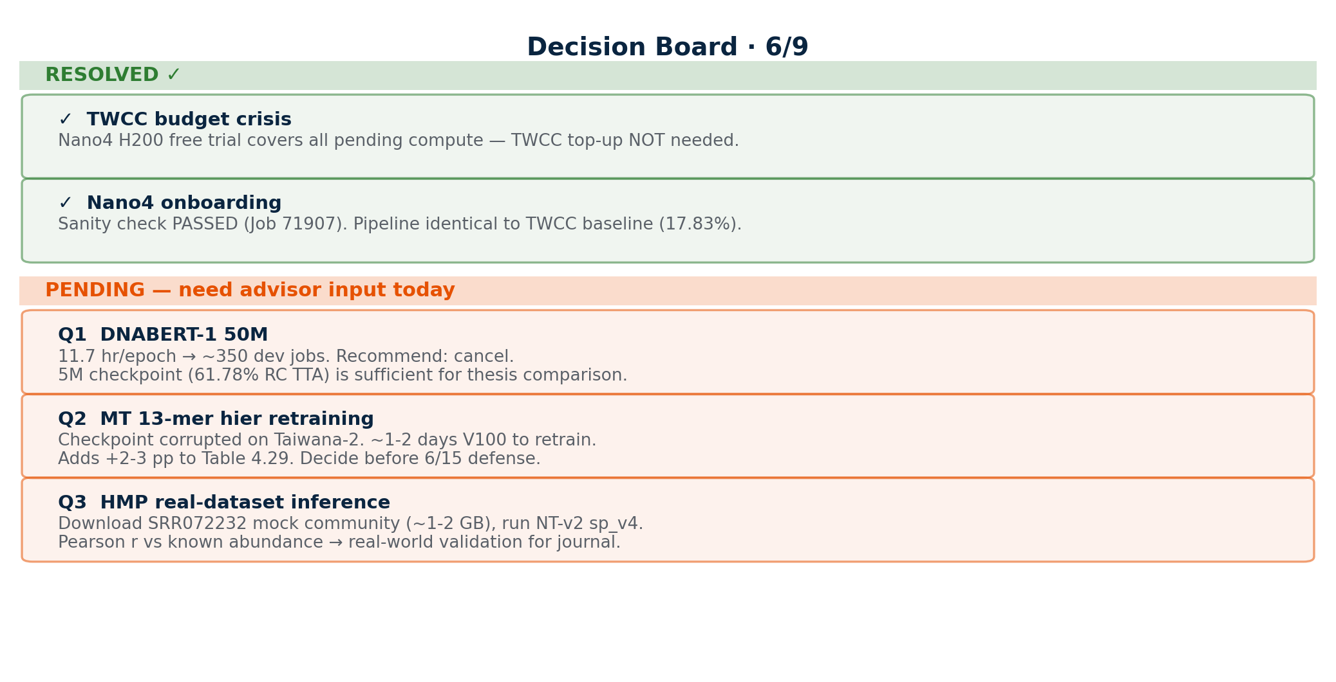
Decision Board · 6/9

Slide 8
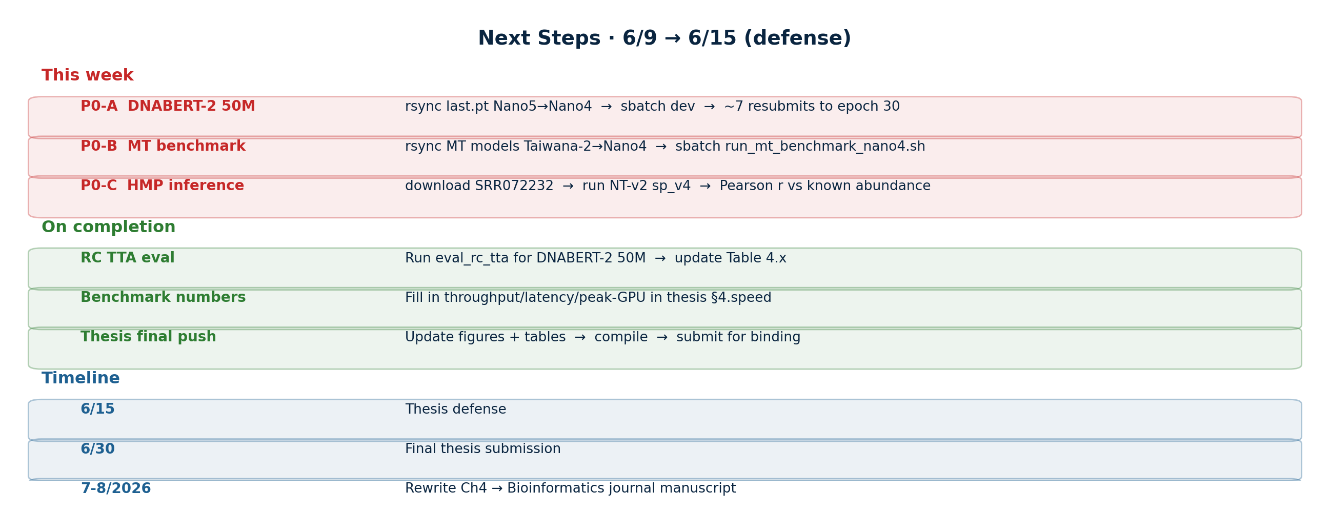
Next Steps · 6/9 → 6/15 (defense)

