Slide 1
Weekly Progress Update
Scaling NT-v2 Genus 50M → 258M · debugging a 22 pp regression
June 19, 2026
5× data → −22 pp · wrong dataset (3507 sp.) + reader bug (60 bp) · baseline was leaky
YMJ · M2 Lab · NTU CSIE

Slide 2
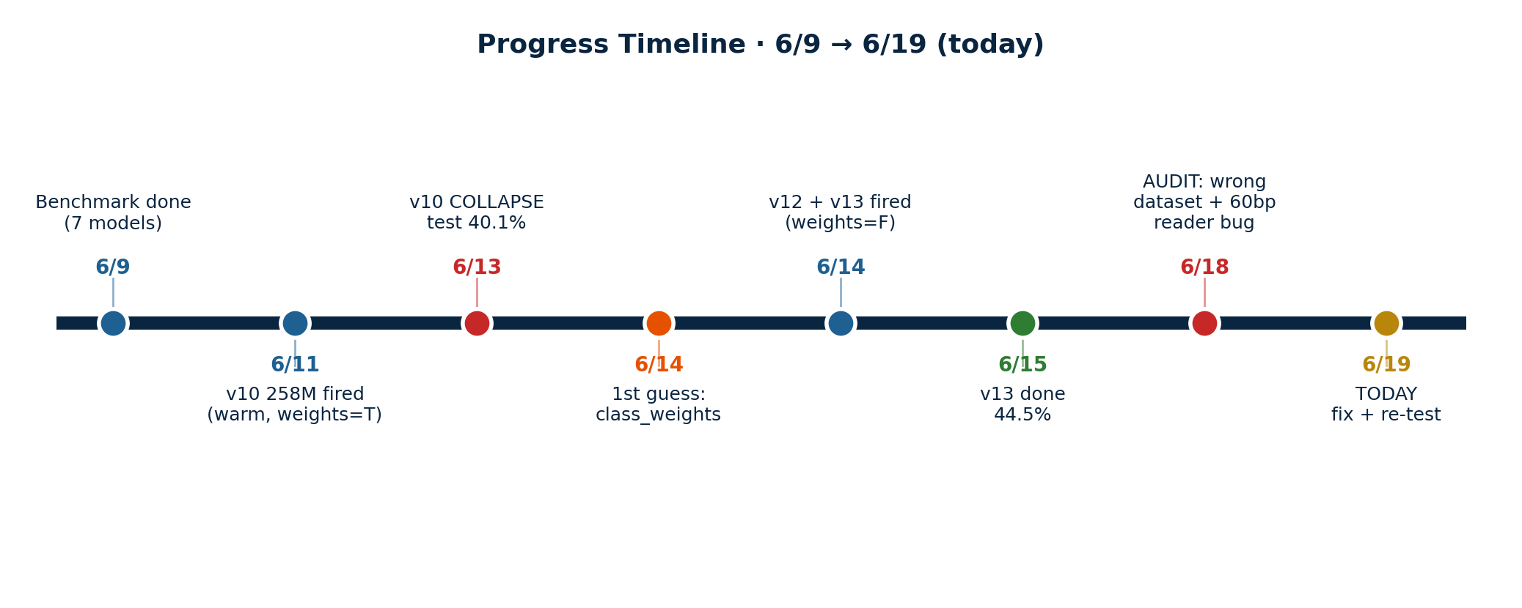
Progress Timeline · 6/9 → 6/19
6/11 Fired v10 — 258M, warm-start from v9, class_weights=TRUE
6/13 v10 collapsed: 100K test 40.1% (vs v9 66.6%)
6/14 First guess: class_weights → fired v12 (warm) + v13 (scratch), both weights=false
6/15–18 Both plateau ~44.5% → audit found TWO bugs: wrong dataset (HPC 3507sp) + reads truncated 150→60 bp

Slide 3
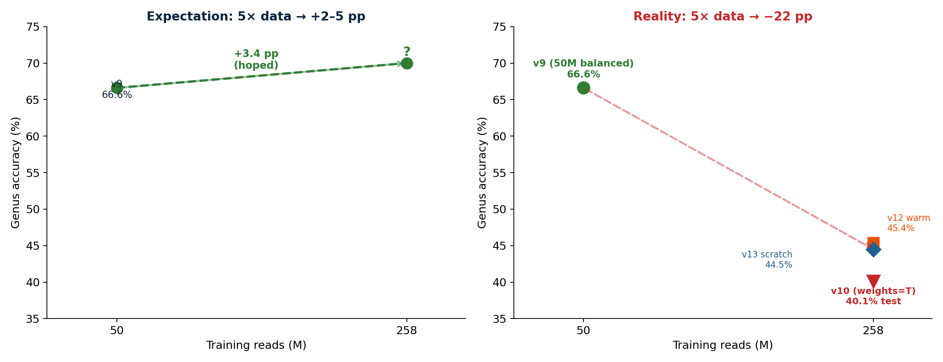
The Scaling Paradox
We expected more data to help. It hurt.

Slide 4
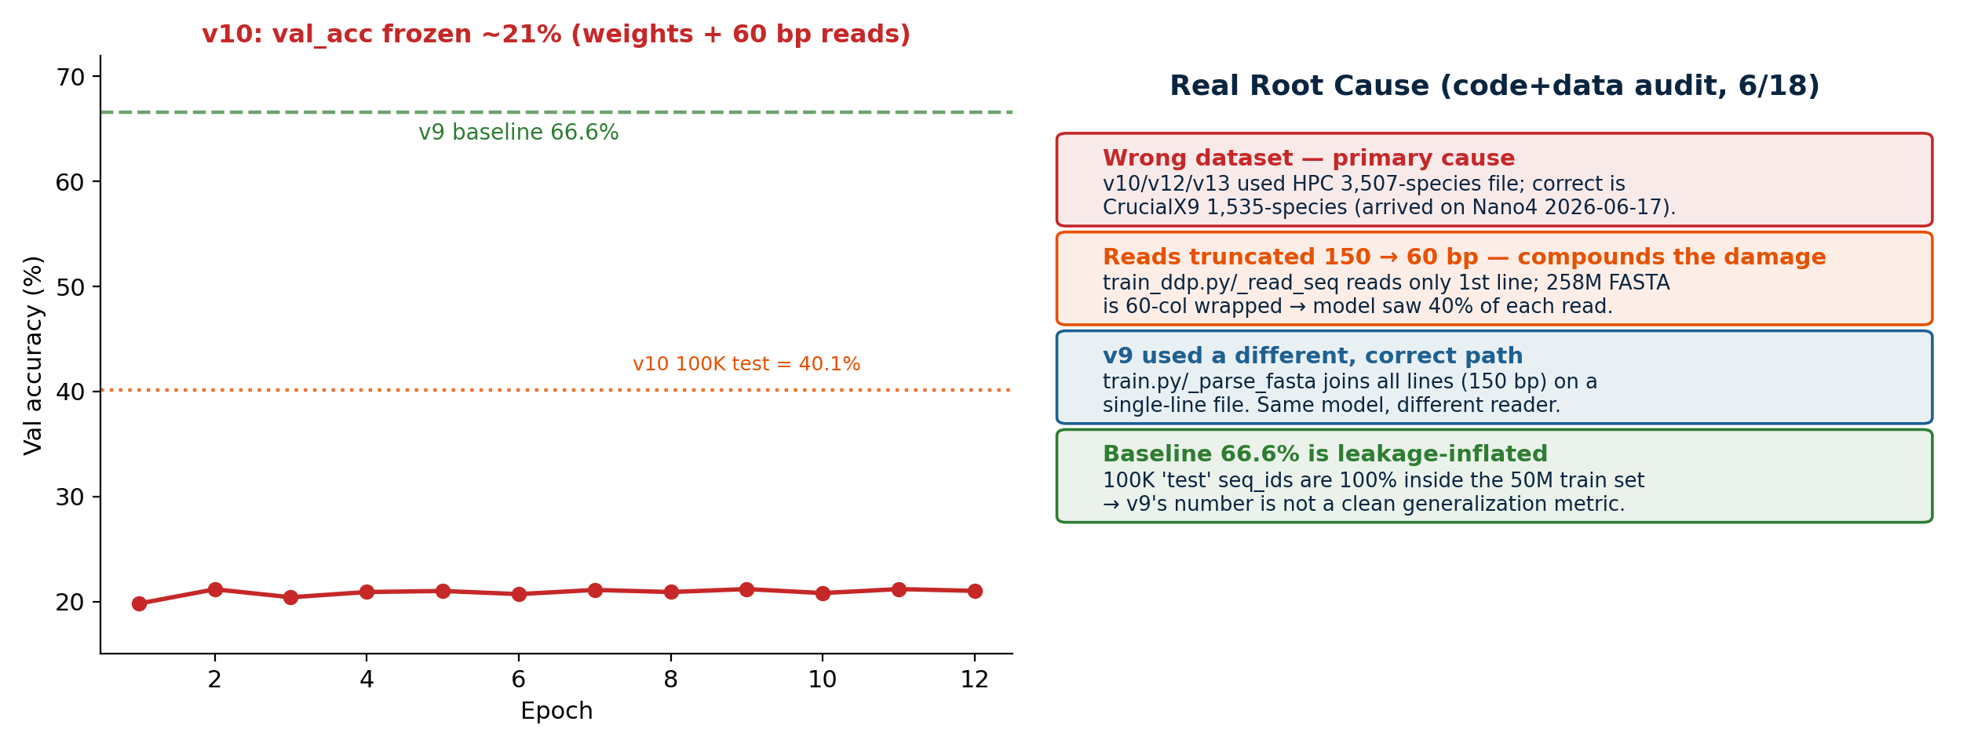
v10 Collapse → Real Root Cause
Two bugs: wrong dataset (HPC 3507 sp.) + reads truncated 150→60 bp

Slide 5
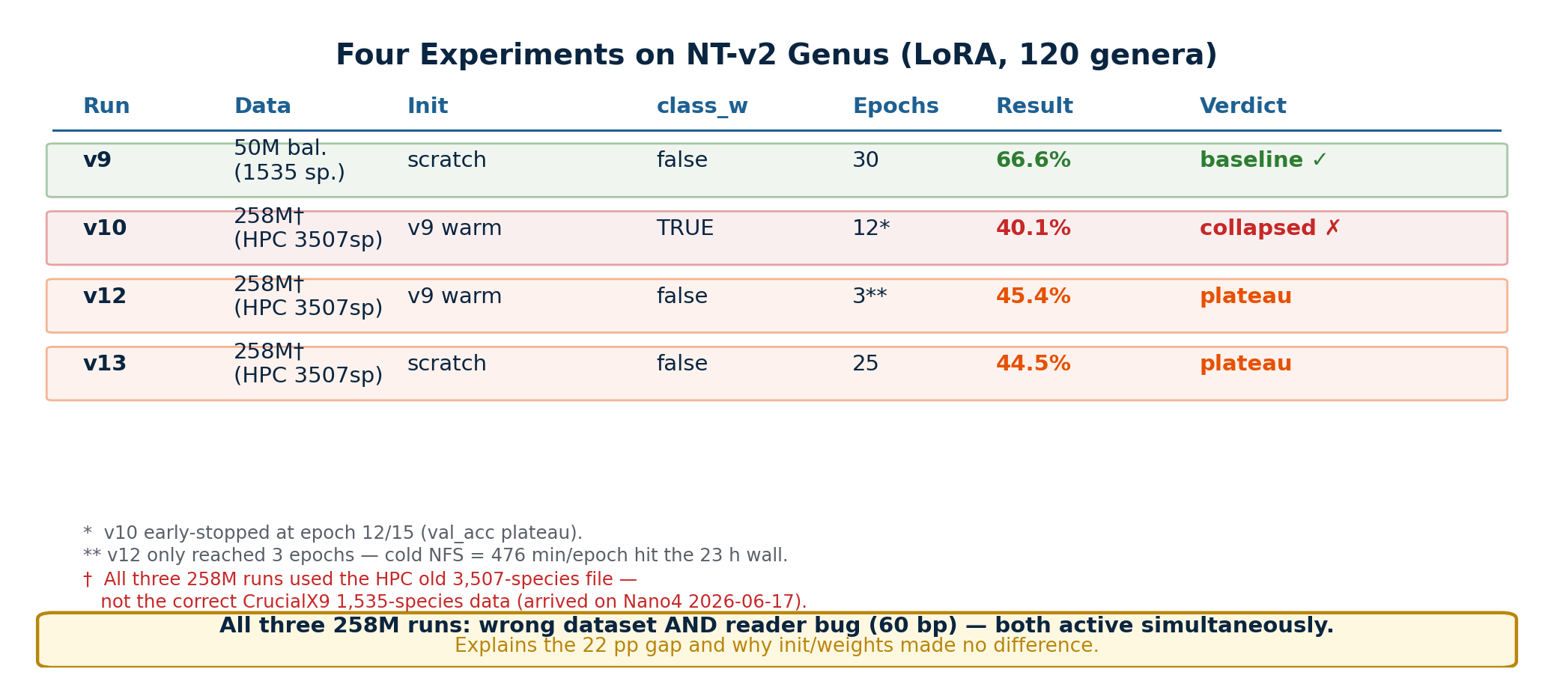
Four Experiments, One Conclusion

Slide 6
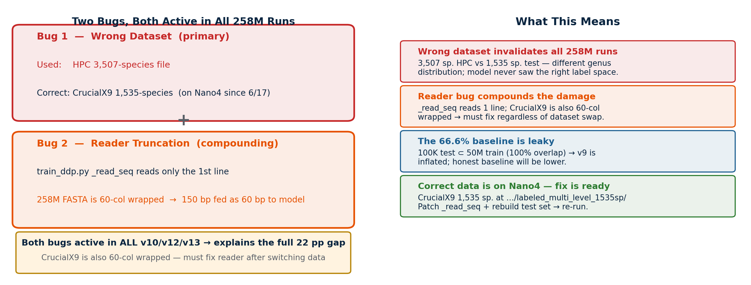
Key Finding: Two Compounding Bugs
Wrong dataset (HPC 3507 sp.) + reader truncation — fix ready before any volume/balance claim

Slide 7
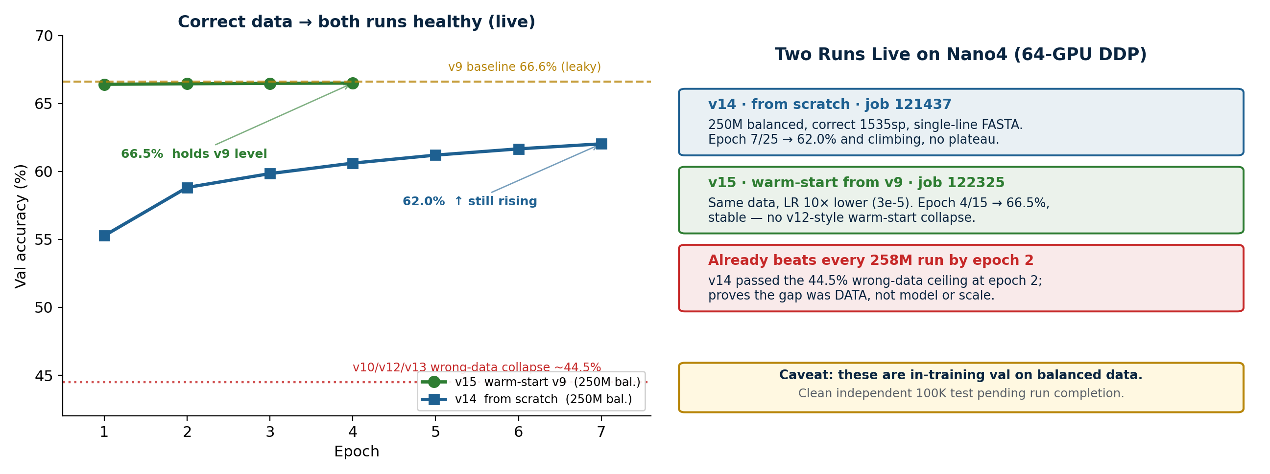
Fix in Action — Live Training
Correct 1535sp data + single-line FASTA: v14 (scratch) climbing, v15 (warm) holds 66.5%

Slide 8
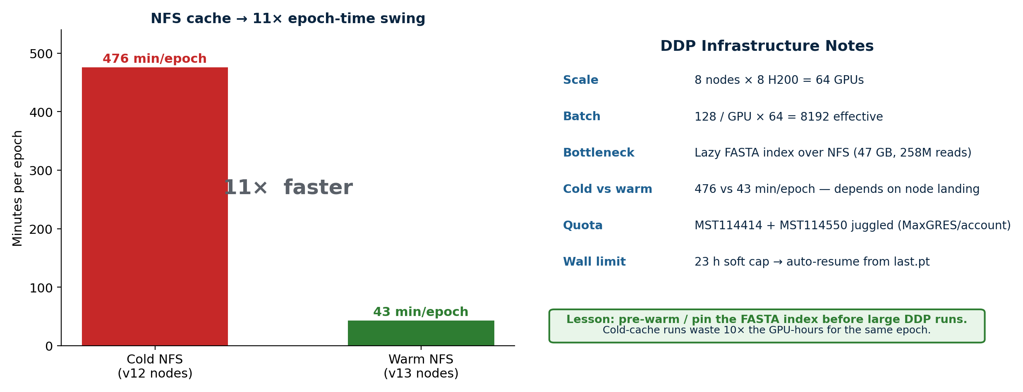
Infrastructure Lessons (64-GPU DDP)

Slide 9
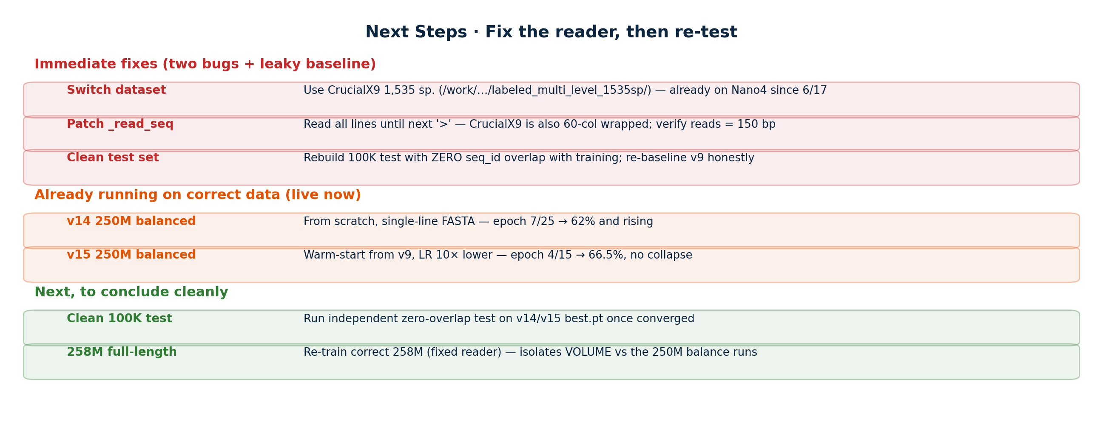
Next Steps · Fix the Reader, then Re-test
Patch _read_seq + clean test set before any volume/balance claim

