Slide 1
BRIEFINGS IN BIOINFORMATICS · PROBLEM-SOLVING PROTOCOL
Full Manuscript Walkthrough
How should genomic foundation models be evaluated for
metagenomic taxonomic classification?
A controlled benchmark of pre-training, tokenization, and data scaling
Tokenization — not backbone pre-training — sets the performance ceiling for 150bp read classification
Ming-Ju Yang · GIBEB, National Taiwan University · 2026-07-14
GFM Metagenomic Benchmark · BIB Problem-solving Protocol
01 / 19

Slide 2
ABSTRACT
The Abstract
Background → Methods → Results → Conclusion

Slide 3
ABSTRACT · BACKGROUND
Motivation
Genomic foundation models (GFMs) show promise across many genomic tasks
But their value for 150bp, signal-sparse metagenomic taxonomic classification is poorly characterized
It's unclear whether pre-training, tokenization, or data scale actually governs performance
This is the central question the manuscript systematically decomposes
GFM Metagenomic Benchmark · BIB Problem-solving Protocol
03 / 19

Slide 4
ABSTRACT · METHODS
Approach
Reads simulated from a unified human-gut genome catalogue: 120 genera, 1,535 species
Four axes varied one at a time: data scale (500K–250M reads), pre-training (498M pretrained vs. random-init), tokenization (6/12/13-mer), evaluation level
Three evaluation levels: read-level accuracy, sample-level abundance, binary detection
Benchmarked against the alignment-free classifier Kraken2 (raw and Bracken-corrected)
GFM Metagenomic Benchmark · BIB Problem-solving Protocol
04 / 19

Slide 5
ABSTRACT · RESULTS
Headline Findings
Overlapping 13-mer tokenization sets the ceiling: 87.4% from scratch vs. 67.1% for a pretrained 6-mer model
The 6-mer model nearly saturates past 50M reads (+0.22pp); the 13-mer model keeps climbing to 98.7%
With tokenization fixed, pre-training still contributes +13.2pp
Abundance: a 67%-accurate model reaches r=0.99; raw Kraken2 is r=0.82, Bracken-corrected reaches r=0.997
On a real mock community, every method collapses to r≈0.4–0.6 — no clear winner
GFM Metagenomic Benchmark · BIB Problem-solving Protocol
05 / 19

Slide 6
KEY POINTS
Five Headline Findings
① Data scaling benefit is tokenizer-dependent
50M→250M yields ~0 gain for 6-mer (+0.22pp) but +11pp for 13-mer
② Tokenization, not pre-training, sets the ceiling
13-mer from scratch (87.4%) beats a 498M-parameter pretrained 6-mer model (67.1%)
③ Pre-training is still an independent, real factor
Contributes +13.2pp at fixed tokenization — the two factors are separable and both matter
④ Read-level and sample-level utility diverge
67%-accurate model reaches r=0.99 simulated, but that ranking doesn't transfer to a real mock community
⑤ Practical, use-case-specific recommendations
Future microbial foundation models should be pretrained with overlapping long-k tokenization
GFM Metagenomic Benchmark · BIB Problem-solving Protocol
06 / 19

Slide 7
BODY
Section-by-Section Walkthrough
§1 framing → §8 honest limitations

Slide 8
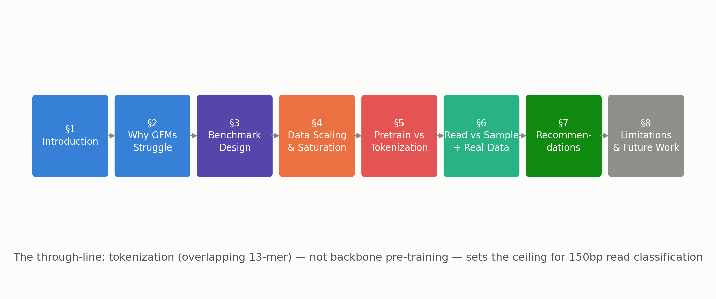
MANUSCRIPT STRUCTURE
How Nine Sections Build One Argument
GFM Metagenomic Benchmark · BIB Problem-solving Protocol
08 / 19

Slide 9
§1–2 · FRAMING
Why Short-Read Classification Is an Uphill Battle for GFMs
Alignment-free tools (Kraken2/Centrifuge) are fast and accurate in-database but fail on novel organisms; GFMs excel elsewhere — can they help here?
① Short reads make long-range context modeling — GFMs' main strength — irrelevant
② Tokenization determines signal retention: NT-v2's non-overlapping 6-mers split motifs vs. Kraken2's overlapping long k-mers
③ A 120–1,535-way, long-tailed label space — the metric you pick changes who "wins"
GFM Metagenomic Benchmark · BIB Problem-solving Protocol
09 / 19

Slide 10
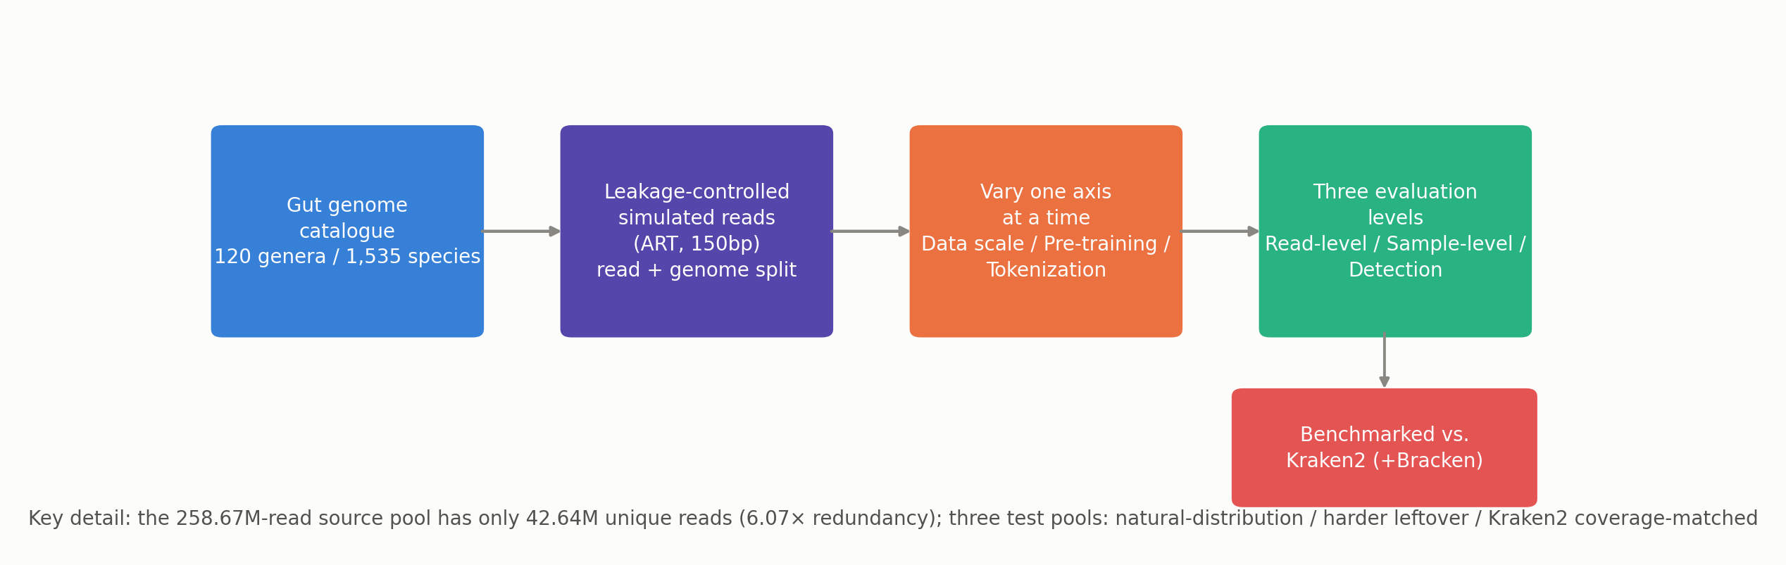
§3 · BENCHMARK DESIGN
Design and Evaluation Protocol
Key detail: the 258.67M-read source pool has only 42.64M unique reads (6.07× redundancy); three test pools: natural-distribution / harder leftover / Kraken2 coverage-matched
GFM Metagenomic Benchmark · BIB Problem-solving Protocol
10 / 19

Slide 11
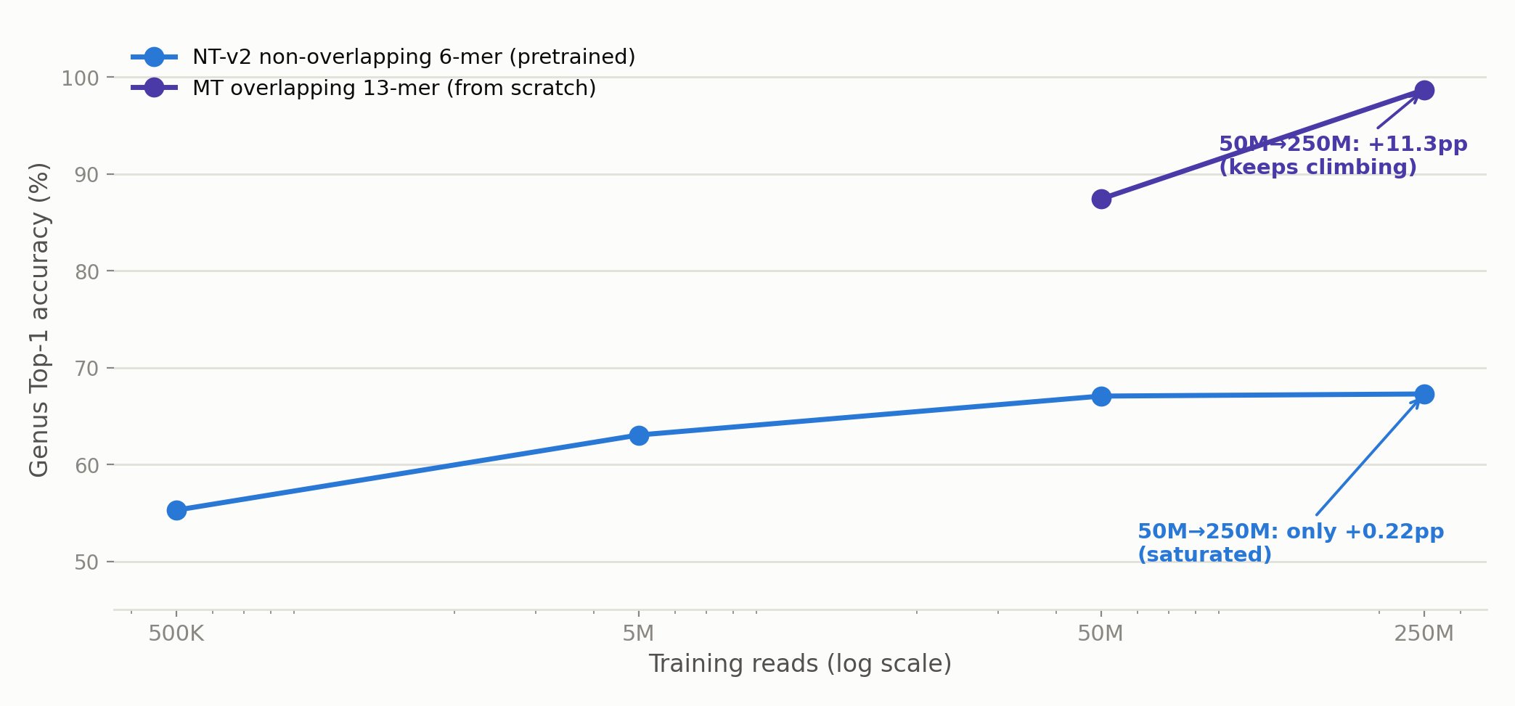
§4 · DATA SCALE
Data Scaling and the Saturation Effect
Further evidence: the 6-mer model can't even fit its own training set past ~66% (train≈val) — a representational, not optimization, ceiling
GFM Metagenomic Benchmark · BIB Problem-solving Protocol
11 / 19

Slide 12
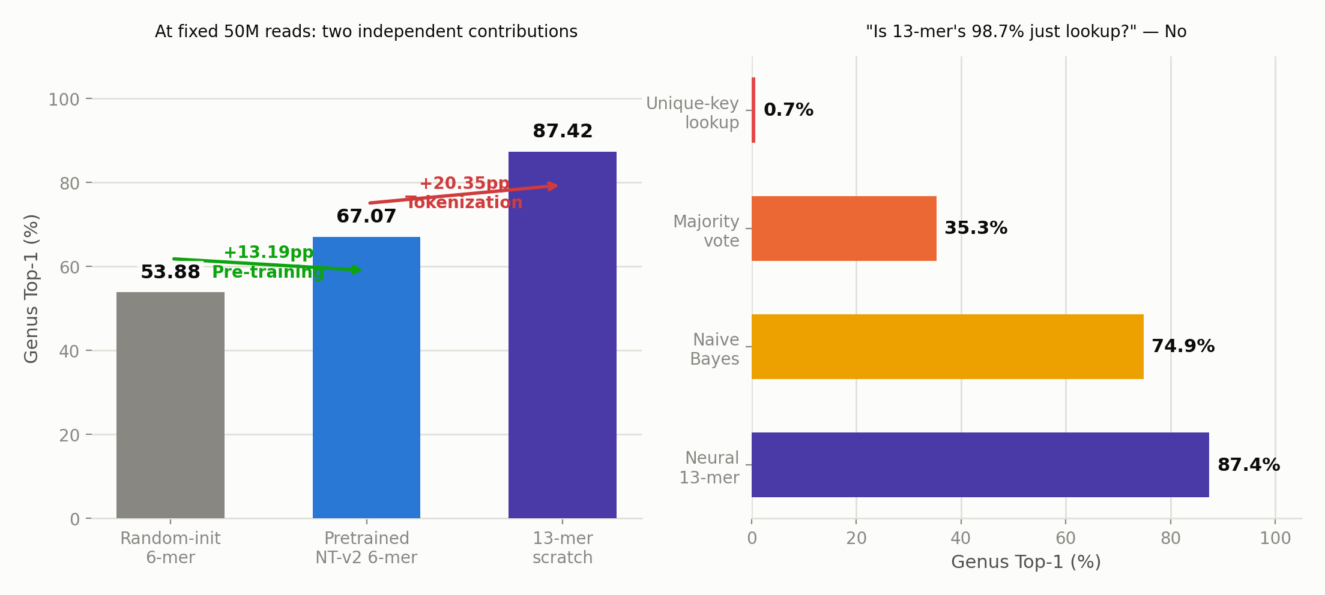
§5 · CAUSAL DECOMPOSITION
Pre-training vs. Tokenization
The test chain: exact-match lookup gets only 0.72% → the neural net adds +13pp over naive Bayes → conclusion: it learns composition, not memorization
GFM Metagenomic Benchmark · BIB Problem-solving Protocol
12 / 19

Slide 13
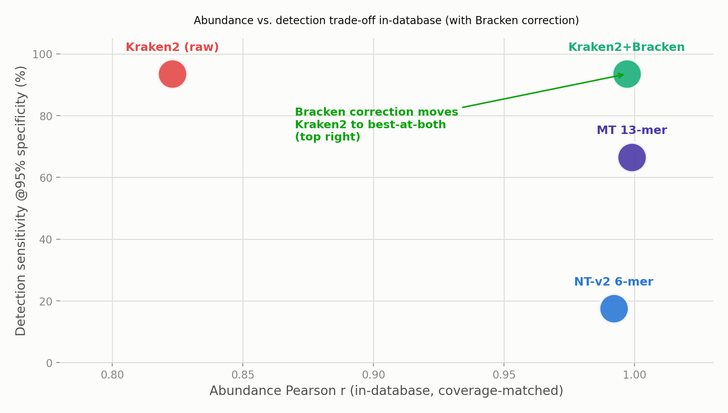
§6A · SAMPLE-LEVEL UTILITY
The Trade-off vs. Kraken2
GFM Metagenomic Benchmark · BIB Problem-solving Protocol
13 / 19

Slide 14
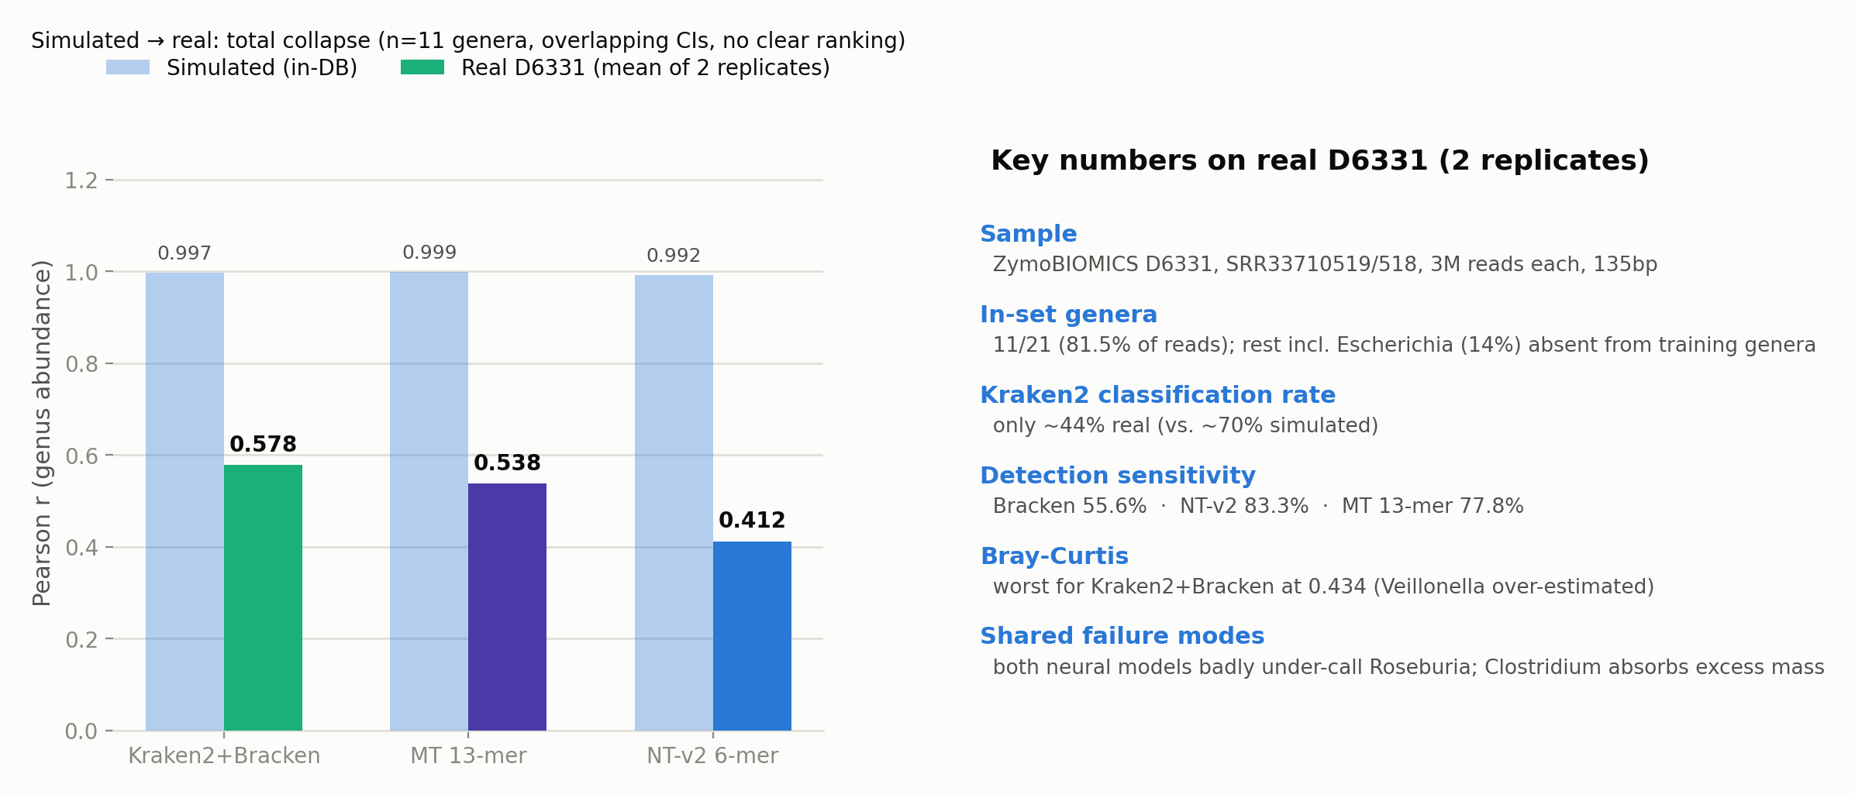
§6B · REAL-WORLD TRIAL
ZymoBIOMICS Mock Community (D6331)
§6's closing message: neural models hold no sample-level abundance advantage over a properly configured classical pipeline in-database; their real value is read-level accuracy and out-of-database robustness
GFM Metagenomic Benchmark · BIB Problem-solving Protocol
14 / 19

Slide 15
CLOSING
Recommendations, Limitations & Summary
§7–§8 + Supplementary + Summary

Slide 16
§7 · PRACTICAL RECOMMENDATIONS
Protocol, Decision Guide & Advice for Model Builders
Box 1: an 8-step reusable evaluation protocol (each step carries its own rationale/pitfall)
Fix read length first → split by read AND genome → count unique reads → change one axis at a time → evaluate 3 levels separately → use both raw and corrected classical baselines → unify the RC-TTA protocol → validate on real data and release everything
Box 2 decision guide: use Kraken2 for low-abundance detection; favor a long-k model for closed-set read classification; don't expect data scale to save a 6-mer-only GFM; no stable winner yet for real-community abundance
For model builders: tokenization is the highest-leverage design choice — future microbial FMs should pretrain with overlapping 12–13-mers; the engineering challenge is that a long-k vocabulary implies a multi-billion-parameter embedding table
GFM Metagenomic Benchmark · BIB Problem-solving Protocol
16 / 19

Slide 17
§8 · DISCLOSED PROACTIVELY
Limitations and Future Directions
P0: closed-set evaluation — the 98.7%/r≈1 headline numbers are all in-catalogue; shown to be "learned composition," not lookup, but out-of-genome generalization remains the most important open item
Simulated-read limits: ART simulation may favor alignment/k-mer methods; the real mock-community probe already shows the gap, but it's still one standard / 11 genera
Baseline breadth: only Kraken2 (raw + Bracken) compared; recommend adding Centrifuge and others
Single read length: simulation uses 150bp, mock uses 135bp, other lengths untested; RC-TTA applied only to NT-v2 (disclosed, doesn't affect qualitative conclusions)
GFM Metagenomic Benchmark · BIB Problem-solving Protocol
17 / 19

Slide 18
SUPPLEMENTARY + TO-DO
Supplementary Contents & Pre-Submission Checklist
Supplementary (S1–S8): dataset/splits · training configs · other backbone comparisons · full results · train-fit ceiling · lookup analysis · compute cost · real mock-community detail
✅ Filled in: conflicts of interest, code availability (GitHub repo), AI-use disclosure
⚠️ Still pending: funding amount/grant number, data DOI, second author + ORCID + CRediT initials, acknowledgments list
⚠️ Still pending: re-confirm the optimizer/scheduler names in Supplementary S2
The science is complete and consistent; administrative info is the only remaining "non-scientific" gap
GFM Metagenomic Benchmark · BIB Problem-solving Protocol
18 / 19

Slide 19
SUMMARY
The Whole Paper on One Slide
Core contribution
Separates three usually-entangled factors — data, pre-training, tokenization — with a rigorous one-factor-at-a-time design, and finds tokenization is the decisive variable
Most honest part
Proactively added the Bracken baseline to retract an over-claimed abundance advantage, and added a real mock community that exposes the simulated-to-real gap
Biggest to-do
The out-of-genome generalization experiment (P0) + author/funding/DOI administrative info
Next: run the P0 experiment, then complete the administrative info, then submit
GFM Metagenomic Benchmark · BIB Problem-solving Protocol
19 / 19

