Slide 1
Weekly Progress Update
0519 | 楊明儒 (資工所碩二)

Slide 2
This Week's Highlights
1 Genus-level: all 3 tokenization variants evaluated at sample level
MT 13-mer genus: Pearson r = 0.9993, BC = 0.028 ← near-perfect
NT-Genus: Pearson r = 0.9932, BC = 0.094 | MT 6-mer: r = 0.984, BC = 0.167
Pearson r saturates ≥ 0.98 for ALL; Bray-Curtis is the discriminating metric at genus level
2 Species-level: MT 13-mer crosses the practical utility threshold
MT 13-mer flat: Pearson r = 0.466, ROC AUC = 0.966 | hier: 0.478, 0.967 ← useful
NT-Species flat r = 0.135, hier r = 0.106 | MT 6-mer: 0.034–0.065 ← all below threshold
3 Hierarchical masking direction is router-dependent (monotonic in router accuracy)
MT 13-mer router 87.5% → +0.012 r, +0.0015 ROC, +1.12 pp acc (consistent gain)
NT-Genus router 66% → −0.029 r, +0.002 ROC, −2.0 pp acc (4 of 5 metrics hurt)
MT 6-mer router 48.9% → −0.031 r, −0.023 ROC, −2.8 pp acc (largest degradation)
4 Tokenization effect holds at sample level — not just read accuracy
13-mer BC 0.028 (genus) / 0.369 (species) vs 6-mer 0.167 / 0.686 — systematic gap
5 Next: MT per-genus classifiers (Taiwana2) — expected to improve species detection

Slide 3
Genus-Level: Tokenization Stratifies Abundance Quality

Slide 4
Genus Sample-Level Evaluation — 3 Models (5M pool, 120 genera, 50K reads/sample)
Model Read Acc Pearson r Bray-Curtis Spearman r ROC AUC
─────────────────────────────────────────────────────────────────────────────
MT 13-mer genus 87.4% 0.9993 0.0279 0.9778 0.900 ✓
NT-Genus 67.1% 0.9932 0.0937 0.9312 0.705
MT 6-mer genus 48.8% 0.9840 0.1666 0.8537 0.569
─────────────────────────────────────────────────────────────────────────────
Observations:
Pearson r ≥ 0.984 for ALL three — genus-level is forgiving (only 120 classes)
Bray-Curtis clearly separates: 0.028 → 0.094 → 0.167 — BC is the better discriminator
ROC AUC reflects class-level detection; low for 6-mer (many genera with few predictions)
Why genus is forgiving:
120 genera: expected abundance per genus ≈ 1/120 = 0.83% → much more reads per class
Even 50% classifier correctly places most reads near the right genus
Key finding: tokenization still stratifies quality — better tokenizer → lower BC dissimilarity

Slide 5
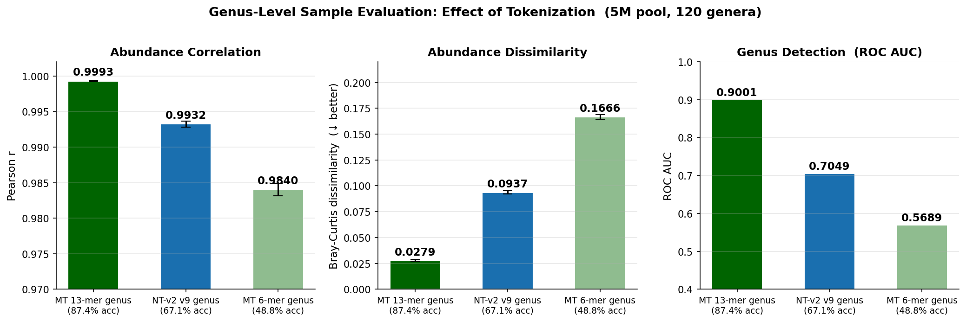
Genus-Level: Effect of Tokenization on Abundance Quality (5M pool, 120 genera)
All 3 models achieve Pearson r ≥ 0.984; Bray-Curtis clearly separates (0.028 / 0.094 / 0.167)

Slide 6
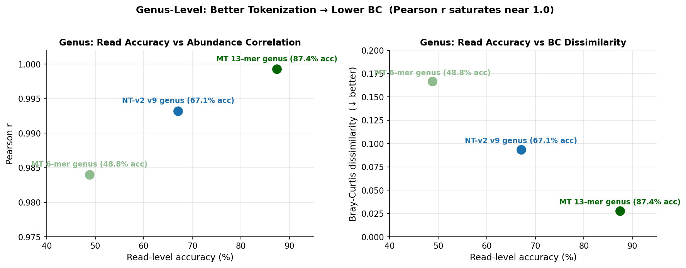
Genus: Read Accuracy vs Abundance Quality (BC degrades, Pearson r saturates)
Pearson r near-saturated across all models; Bray-Curtis is the sensitive metric at genus level

Slide 7
Species-Level: MT 13-mer Enables Practical Detection

Slide 8
Species Sample-Level Evaluation (1535 species, reads_per_sample=1000)
Model Read Acc Pearson r Bray-Curtis ROC AUC
─────────────────────────────────────────────────────────────────
NT-Species flat 17.8% 0.135 0.589 0.794
NT-Species hier. 15.8% 0.106 0.608 0.796
─────────────────────────────────────────────────────────────────
MT 6-mer flat 9.2% 0.065 0.654 0.690
MT 6-mer hierarchical 6.4% 0.034 0.686 0.667
─────────────────────────────────────────────────────────────────
MT 13-mer flat 49.7% 0.466 0.378 0.966 ✓
MT 13-mer hierarchical 50.9% 0.478 0.369 0.967 ✓ best
─────────────────────────────────────────────────────────────────
All models: 100K independent test set, 1K reads/sample
Key observations:
1. NT-Species 17.8% → Pearson r = 0.135 — noise floor constrains r; 3.4× below MT 13-mer
2. MT 13-mer achieves Pearson r 0.47 and ROC AUC 0.967 — practically useful
3. MT 6-mer: higher read acc (9.2%) than hier. (6.4%) but both unusable (r < 0.07)
4. Hier masking effect monotonic in router quality: 87.5%→help, 66%→hurt, 48.9%→hurt more

Slide 9
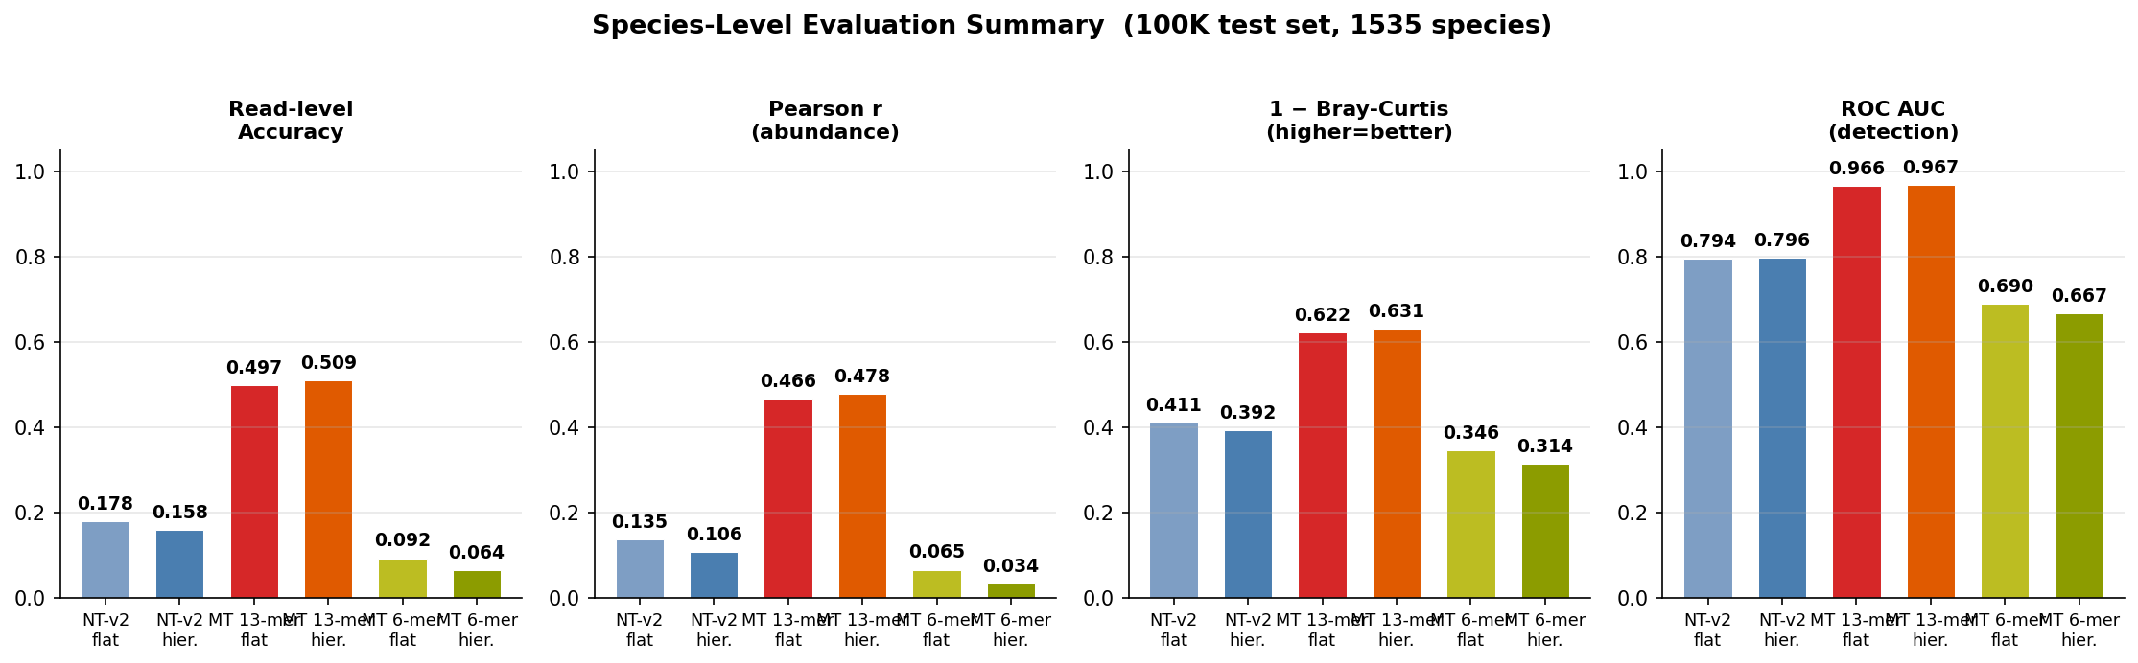
Species-Level Metrics: All 4 Dimensions (100K test, 1535 species)
Read accuracy, Pearson r, 1 − Bray-Curtis, ROC AUC — all favor MT 13-mer

Slide 10
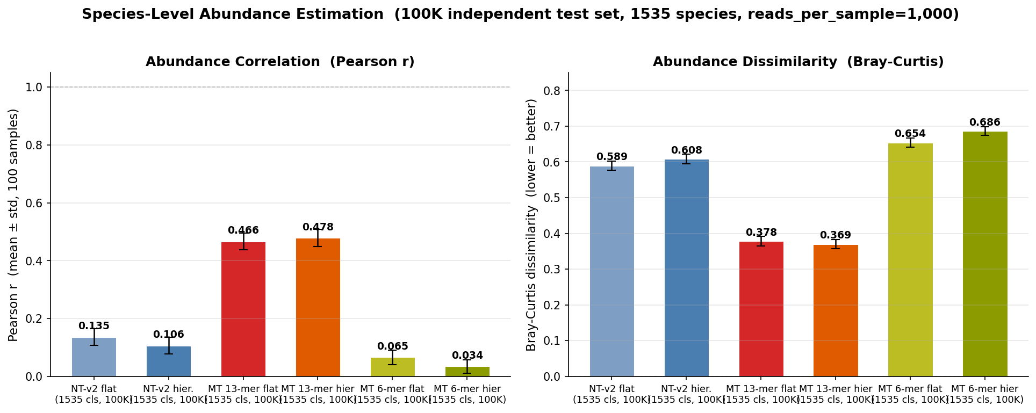
Abundance Correlation and Dissimilarity Across All Models
All models evaluated on 100K independent test set (1535 species, reads_per_sample=1K)

Slide 11
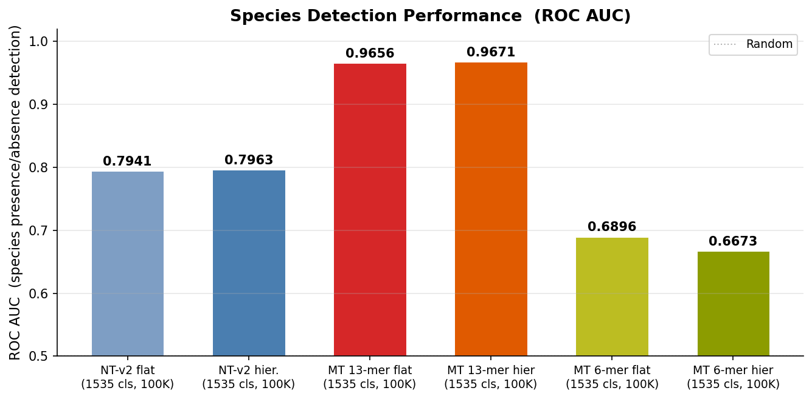
Species Detection Performance: ROC AUC Comparison
MT 13-mer 0.966–0.967 vs NT-Species flat 0.794 / hier 0.796 (only metric not hurt) vs MT 6-mer 0.667–0.690

Slide 12
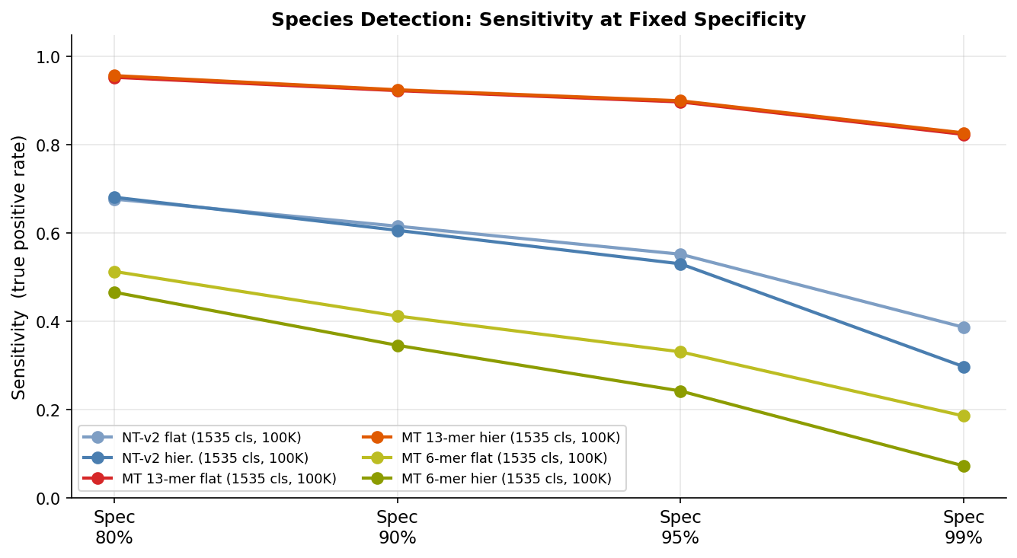
Species Detection: Sensitivity at Fixed Specificity (ROC Operating Points)
At 90% specificity: MT 13-mer hier. sens=92.5% vs NT-Species sens=55.8% vs MT 6-mer flat sens=41.2%

Slide 13
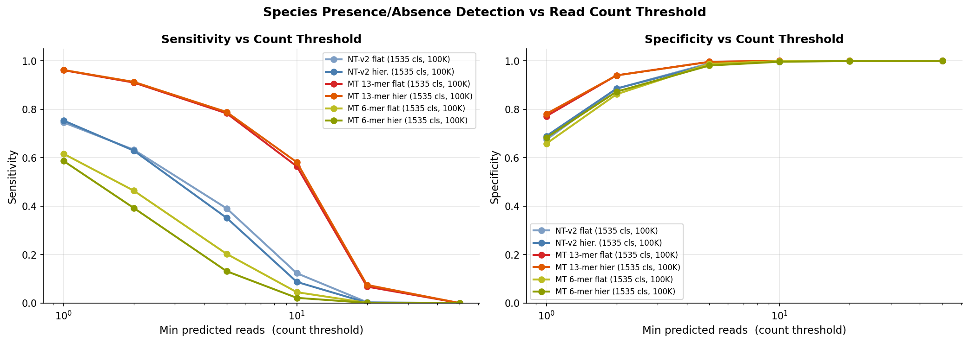
Species Detection: Sensitivity & Specificity vs Read Count Threshold
MT 13-mer flat: sens=78.4% / spec=99.6% at ≥5 reads | MT 6-mer: 20.3% / 98.8% — poor recall

Slide 14
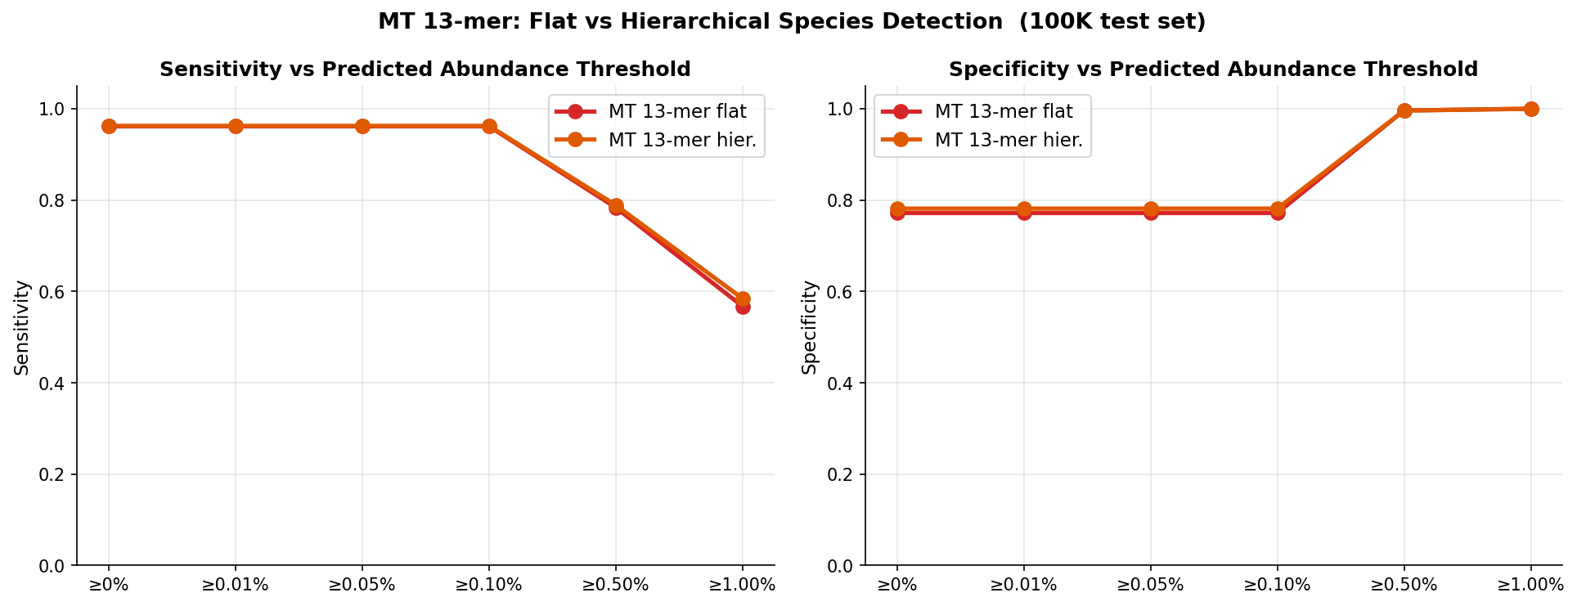
MT 13-mer: Flat vs Hierarchical — Abundance Threshold Detection
Hierarchical consistently better at all thresholds — gains most at ≥1% abundance (sens 56.7% → 58.4%)

Slide 15
Why Read Accuracy → Abundance Quality

Slide 16
Connecting Read Accuracy to Sample-Level Utility
Rule of thumb from the data:
< ~20% read acc → Pearson r low (noise floor limited) (NT-Species: 17.8% → 0.135, 6-mer: 9.2% → 0.065)
~50% read acc → Pearson r ≈ 0.47 (MT 13-mer flat: 49.7% → 0.466)
~67% read acc → Pearson r ≈ 0.99 (NT-v2 genus: 67.1% → 0.993) — but only 120 classes
The non-linear jump (≈ 0.466 at 50%) makes sense:
1535 species: true abundance per species = 1/1535 ≈ 0.065% → each misclassification heavily dilutes
A 50% classifier correctly assigns half the reads → abundance vector is partially recoverable
A 9% classifier assigns 91% of reads to wrong species → abundance vector is dominated by noise
Practical threshold for metagenomics: ~40–50% top-1 read accuracy needed
NT-v2 architecture cannot reach this with 6-mer tokenization (ceiling: 15.9% NT-Species)
MT 13-mer already crosses it (49.7%); overlapping tokenization is the key design choice
Conclusion: tokenization design is not just a classification metric — it determines practical utility

Slide 17
Next Steps

Slide 18
Remaining Experiments & Timeline
On TWCC (done / running):
✓ NT-Genus sample-level evaluation (Pearson r = 0.993)
✓ NT-Species flat sample-level evaluation
✓ MT 13-mer / 6-mer species (flat + hierarchical) sample-level evaluation
On Taiwana2 (in progress):
Step 2: Inspect MT 6-mer training config for per-genus training command
Step 3: Split 45M reads by genus (split_by_genus_mt.py)
Step 4: Train 81 MT 6-mer per-genus species classifiers
Step 5: Extract per-genus predictions on reads_remapped.fa → scp to TWCC
After Taiwana2 per-genus results arrive:
TWCC: run per-genus ensemble + sample-level eval (Exp B/C/F)
Expected: oracle per-genus routing may unlock >50% species detection
After all experiments complete: §4.13 sample-level section in thesis
Write-up: abundance estimation, ROC AUC, detection thresholds, practical utility section

Slide 19
Complete Results — Updated Numeric Reference (as of 2026-05-17)
Genus (120 classes, RC TTA)
NT-Genus (50M) → 67.07% | NT-Genus-5M (5M) → 63.05% | Shallow-Genus → 53.88%
Tokenization ablation (MT, 50M, genus)
13-mer s=1 → 87.42% | 12-mer s=1 → 78.83% | 6-mer s=1 → 48.87% | 6-mer s=6 → 38.47%
Species (1535 classes, 100K test set)
MT 13-mer flat → 49.74% | MT 13-mer hierarchical → 50.86%
NT-Species flat → 15.51% | MT 6-mer flat → 9.22% | MT 6-mer hier. → 6.41%
Sample-level — genus (5M pool, 120 genera)
MT 13-mer: r = 0.9993, BC = 0.028 | NT-Genus: r = 0.9932, BC = 0.094 | MT 6-mer: r = 0.984, BC = 0.167
Sample-level — species (100K pool, 1535 classes)
MT 13-mer flat: Pearson r = 0.466, BC = 0.378, ROC AUC = 0.966
MT 13-mer hier: Pearson r = 0.478, BC = 0.369, ROC AUC = 0.967 ← best species
NT-Species flat: Pearson r = 0.135, BC = 0.589, ROC AUC = 0.794 (100K test set)
MT 6-mer flat/hier: Pearson r = 0.034–0.065 ← unusable
Hierarchical (subgenus routing): 13.2–13.6% ← FAILED (sil. = 0.03)

Slide 20
Backup / Reference

Slide 21
Sample-Level Evaluation Methodology
Two sampling strategies (evaluate_sample.py):
1. Random partition samples: non-overlapping subsets of test pool
2. Sparse community samples: replace=False from present-genera pool (simulates low-diversity env)
Abundance vector: predicted class count histogram / reads_per_sample
Metrics per sample, then mean ± std across 100 samples:
Pearson r: linear correlation between true and predicted abundance vectors
Bray-Curtis dissimilarity: ecological β-diversity metric (0=identical, 1=no overlap)
ROC AUC: binary detection at species level, threshold on predicted abundance
Parameters (species, 100K pool):
reads_per_sample=1000, n_partition_samples=100, n_sparse_samples=200, genera_present=50
Constrained by pool size: 100K reads / 1535 species ≈ 65 reads/species
Parameters (genus, 5M pool):
reads_per_sample=50000, n_partition_samples=100, n_sparse_samples=200, genera_present=60
Caveat: genus/species metrics are NOT directly comparable (different pool sizes & reads_per_sample)

Slide 22
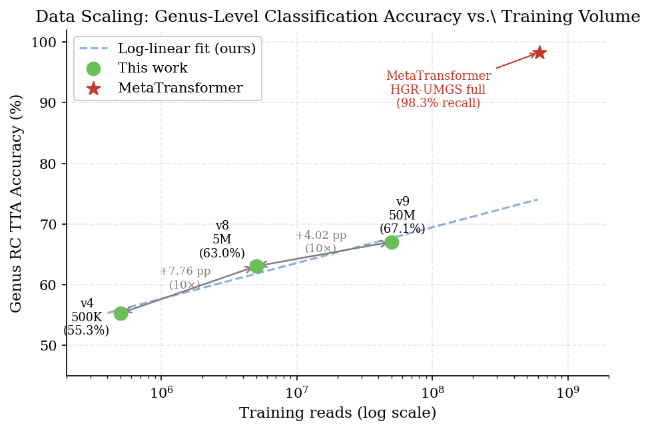
Data Scaling — Genus RC TTA Accuracy vs Training Volume
500K→5M: +7.76 pp | 5M→50M: +4.02 pp

Slide 23
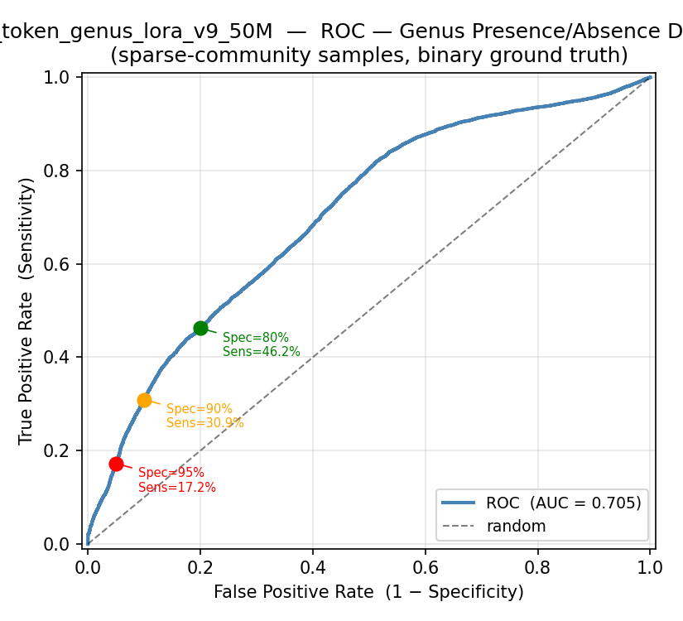
NT-Genus — ROC Detection Curve (species presence/absence at genus level)
AUC = 0.705 — low because all 120 genera present in every sample (detection trivially high)

Slide 24
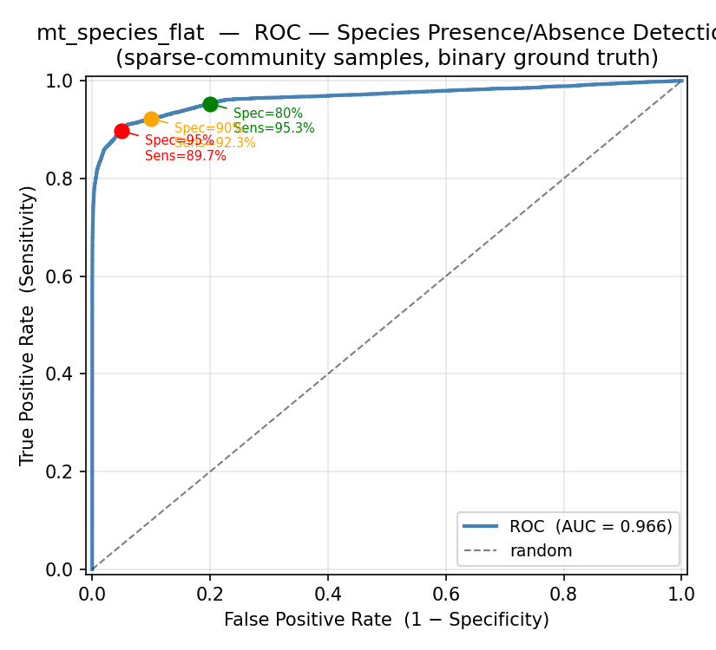
MT 13-mer Flat — ROC Detection Curve (100K test, 1535 species)
AUC = 0.966 — high discriminative power for species presence/absence

Slide 25
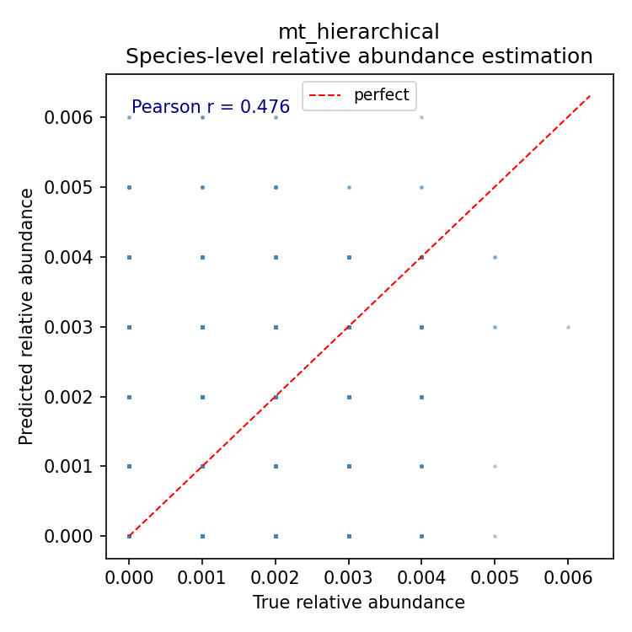
MT 13-mer Hierarchical — Abundance Scatter (100K test, 1535 species)
Pearson r = 0.478 — predicted abundance correlates with true abundance at species level

