Slide 1
Genomic Foundation Models for
Metagenomic Read Classification
Thesis review & publication discussion
楊明儒 (Ming-Ju Yang) · 國立臺灣大學 資工所碩二
2026-05-26
Section 1: The Research Question · Section 2: Six Key Findings
Section 3: Synthesis · Section 4: Publication Direction

Slide 2
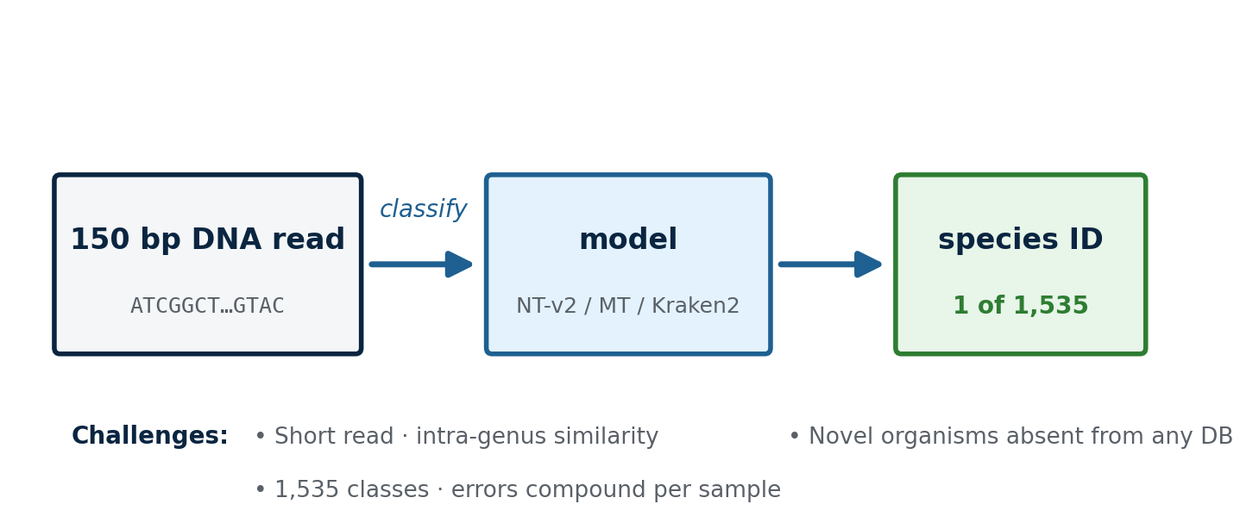
The Problem · Why Metagenomic Read Classification Matters
Why it matters · Per-sample species abundance underlies microbiome diagnostics, infectious disease, ecology. Existing k-mer tools (Kraken2/Bracken) fail on novel organisms — motivating learned representations.
2 / 16

Slide 3
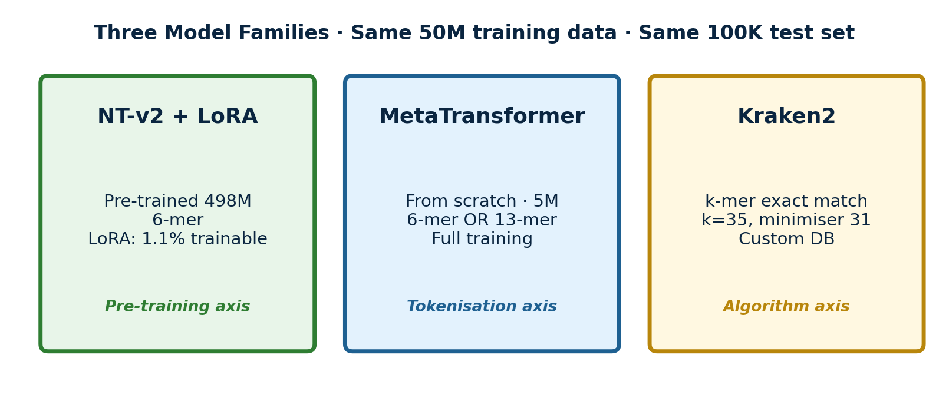
The Comparison · Three Model Families on Identical Data
Orthogonal axes · tokenisation × pre-training × routing · all on same 50M training reads · same 100K independent test set · same 2,505-genome reference inventory
Evaluation: read-level Top-1 + 5 sample-level metrics (Pearson r · Spearman ρ · Bray-Curtis · ROC AUC · Sens@95%spec)
3 / 16

Slide 4
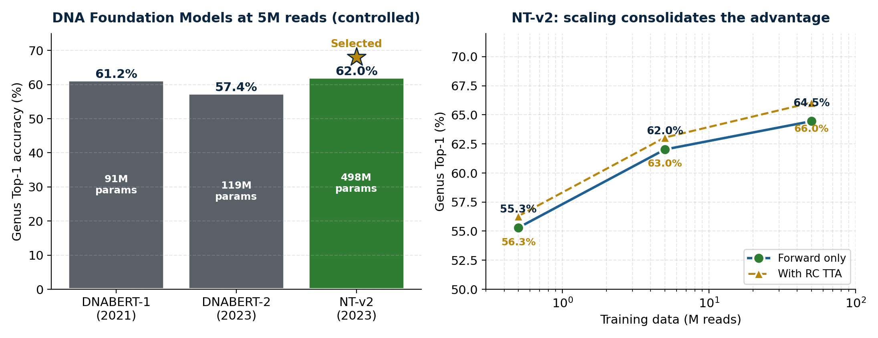
Backbone Selection · Why NT-v2 Among DNA Foundation Models
Controlled 5M comparison (left)
• Same data · same task · same head
• Only backbone varies — fairest possible test
• NT-v2 narrowly leads at 5M (+0.8 pp vs DNABERT-1)
Why the lead widens at scale (right)
• NT-v2 has 498M params · room to absorb 50M data
• DNABERT-1/2 plateau earlier; we chose the model
with the steepest scaling slope · validated at 50M
4 / 16

Slide 5
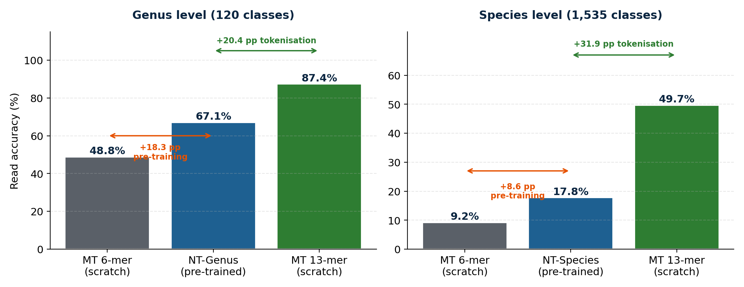
Finding 1 · Tokenisation Dominates Pre-training
Pre-training contributes, but cannot rescue an inadequate tokenisation at species granularity
5 / 16

Slide 6
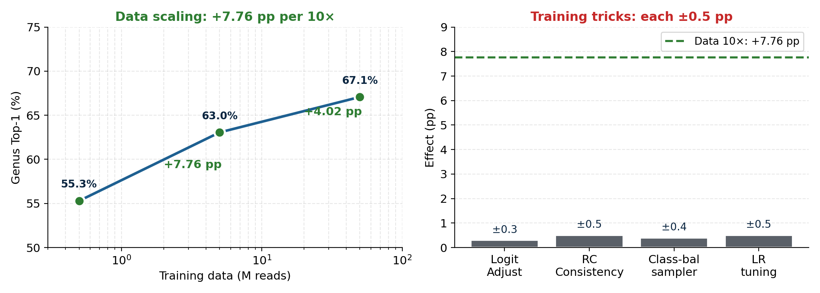
Finding 2 · Data Volume Dominates Training Tricks
Data scaling beats hyperparameter tuning by 10× · invest engineering effort in data, not tricks
6 / 16

Slide 7
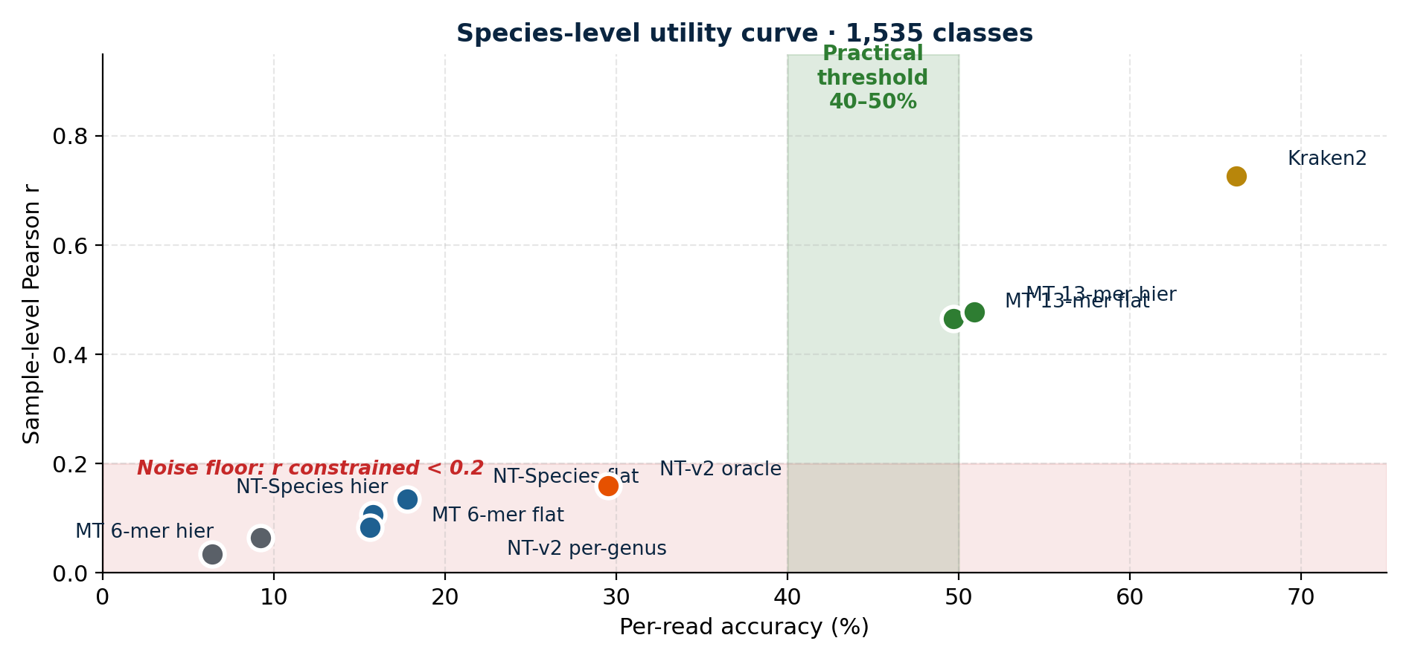
Finding 3 · Species-Level Practical Utility Threshold
Noise floor mechanism
1,535 species · 1K reads / sample
Expected signal per species: 0.65 reads
At 17.8% accuracy: ~0.54 spurious
reads/species → SNR ≈ 1
At 50% accuracy: noise drops to
0.33/species → signal dominates
Threshold: ~40-50% accuracy
Species abundance becomes useful only past ~40-50% read accuracy · 6-mer NT-v2 cannot reach this
7 / 16

Slide 8
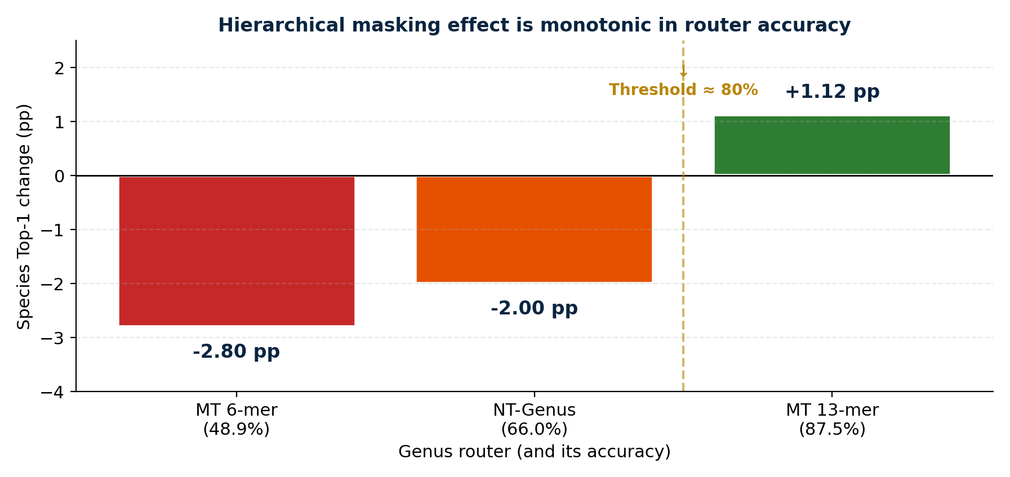
Finding 4 · Hierarchical Masking Is Router-Dependent (Monotonic)
Intuition
Router right → mask removes
wrong candidates (good)
Router wrong → mask excludes
the true species (catastrophic)
Net effect = average of these
weighted by router accuracy
Crossover near ~80% router
Hierarchical pipelines need router > ~80% to be net positive · not a free-lunch optimisation
8 / 16

Slide 9
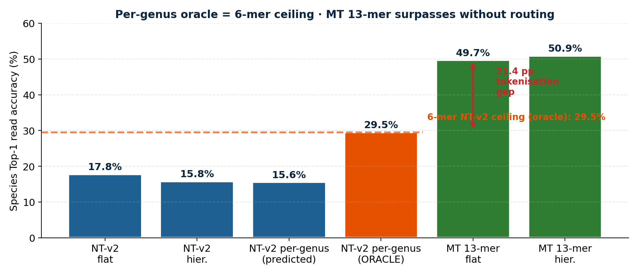
Finding 5 · Per-Genus Oracle Quantifies the Tokenisation Gap
Even with PERFECT genus routing, 6-mer NT-v2 ceiling = 29.5% · MT 13-mer 49.7% (no routing) → +20 pp tokenisation gap
9 / 16

Slide 10
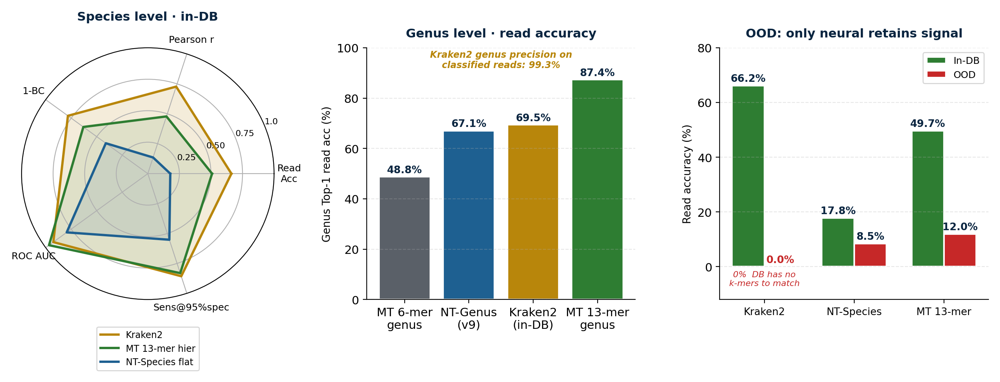
Finding 6 · Kraken2 Wins In-DB · Fails on Novel Organisms (OOD)
Learned methods complement, not replace, k-mer matching · different deployment regimes (in-DB vs OOD)
10 / 16

Slide 11
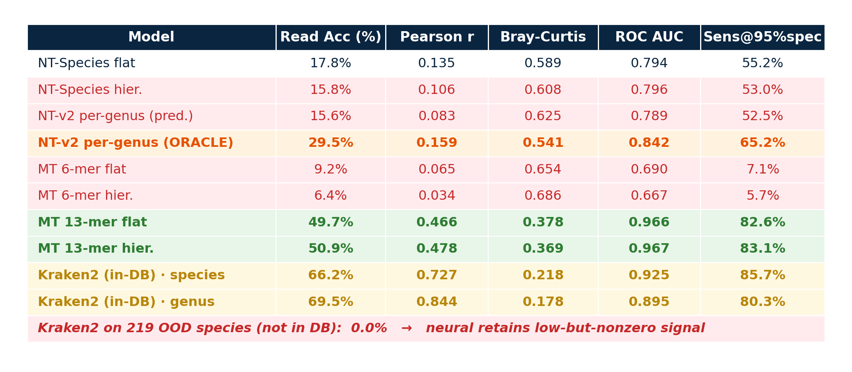
Complete Results · Sample-Level Evaluation Matrix
Independent 100K test · 1K reads/sample · 100 partition samples · same DB, same data, same protocol
11 / 16

Slide 12
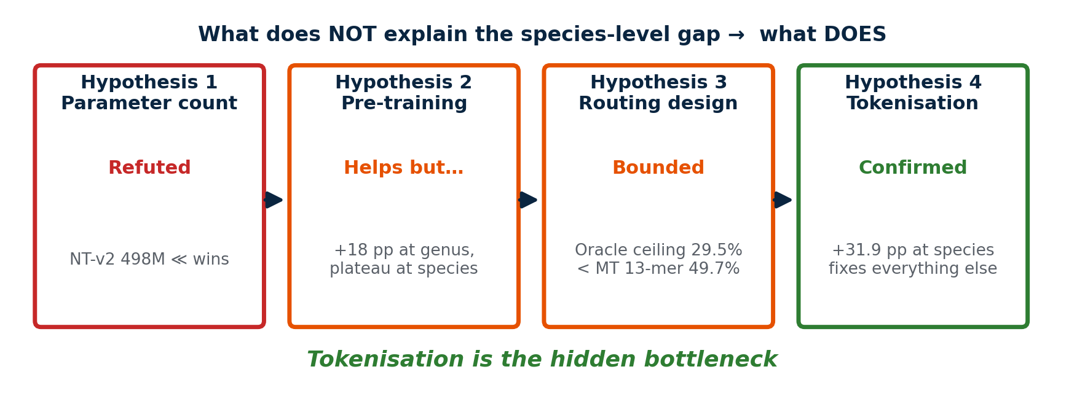
The Unifying Story · Tokenisation Is the Hidden Bottleneck
Foundation-model literature emphasises scale & pre-training · our study isolates tokenisation as decisive at species granularity
12 / 16

Slide 13
What This Work Contributes · Four Standalone Findings
(1)
Controlled 3-axis ablation
(2)
Quantitative noise-floor analysis
Same 50M data · same test · same protocol
Isolates tokenisation as dominant at species level
Non-linear utility curve · ~40-50% threshold
Mechanistic explanation via SNR model
(3)
Router quality threshold theorem
(4)
Same-DB Kraken2 + OOD analysis
Monotonic across 3 router qualities
~80% accuracy required for net positive
Kraken2 wins in-DB (66%) · fails on OOD (0%)
Positions learned methods as complementary
13 / 16

Slide 14
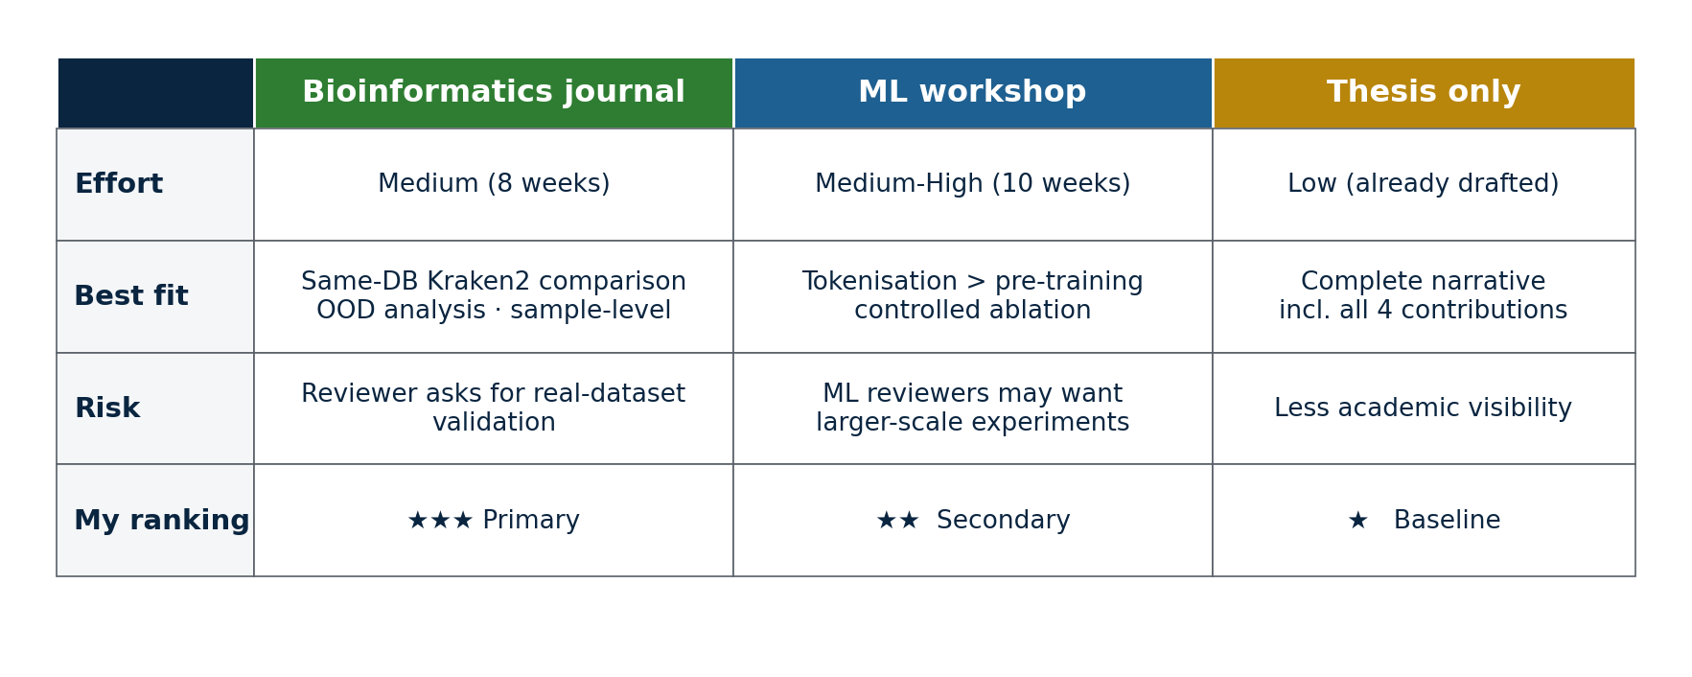
Publication Direction · Candidate Venues
Recommended: Bioinformatics journal (primary) → ML workshop if rejected → Thesis as baseline
14 / 16

Slide 15
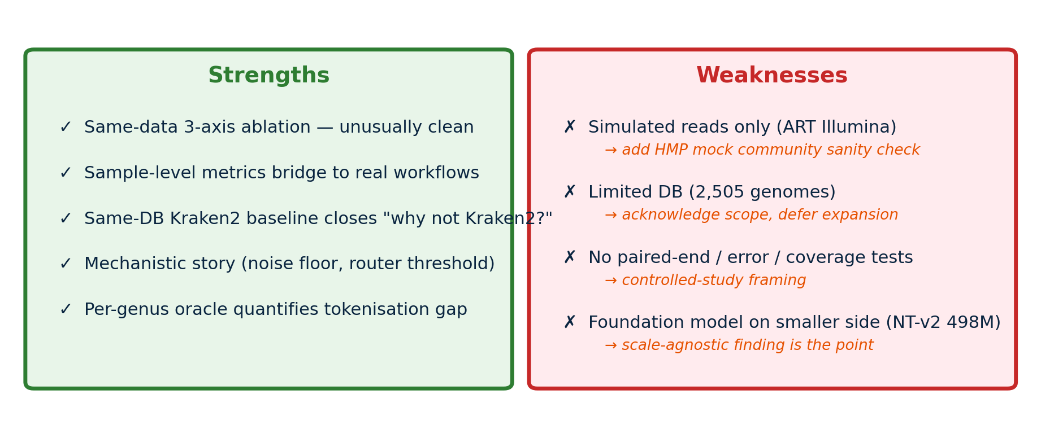
Honest Assessment · Strengths & Weaknesses (with mitigations)
Position as "controlled comparison study" · add 1 real-dataset sanity check (e.g., HMP) before submission
15 / 16

Slide 16
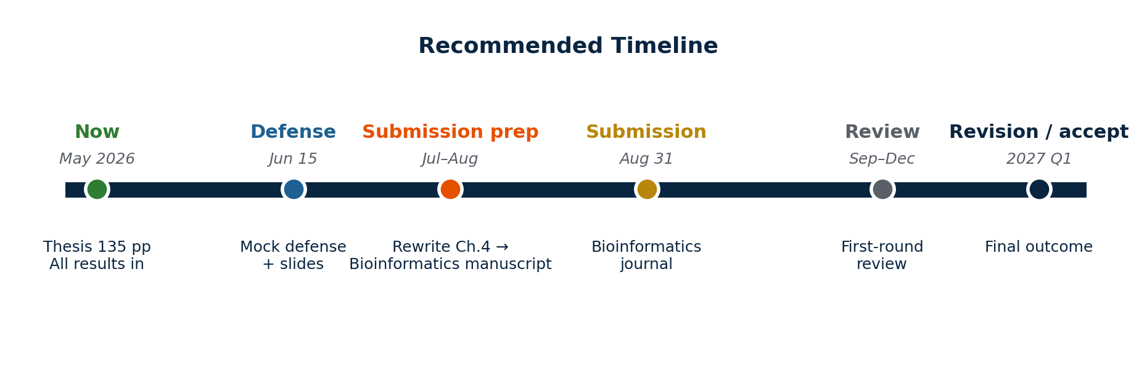
Next Steps & Questions for You
Q1
Bioinformatics journal as primary venue — agreed?
Q2
Real-dataset validation before submission, or post-defense?
Q3
ML workshop (Option B) worth the effort?
Q4
Collaborators / datasets you would want included?
16 / 16

