Slide 1
Weekly Progress · Updates Since 5/28
MT alignment fix · in-DB fair comparison · genus-level inversion
楊明儒 · 2026-05-31
Last advisor meeting: 5/28
Open decisions then: 6 items (DNABERT, MT alignment, 258M, speed benchmark, ...)
Today's deck: status of those 6, plus one major unexpected finding.

Slide 2
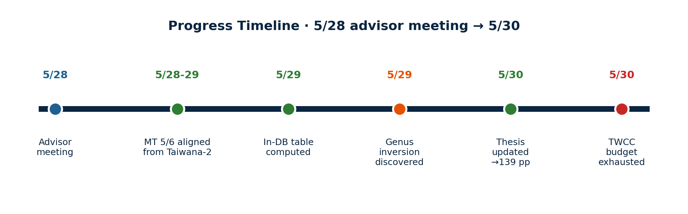
Progress Timeline · 5/28 → 5/30
Three things accomplished:
1. MT predictions order-aligned via Taiwana-2 (5/6 success; MT 13-mer hier checkpoint corrupted)
2. In-DB fair-comparison Table 4.30 added to thesis (species + genus, both levels)
3. Unexpected finding: at genus level, MT 13-mer surpasses Kraken2 by +17 pp
One blocker: TWCC iService wallet exhausted on 5/30 (sbatch returns -802.521 credits)
2 / 10

Slide 3
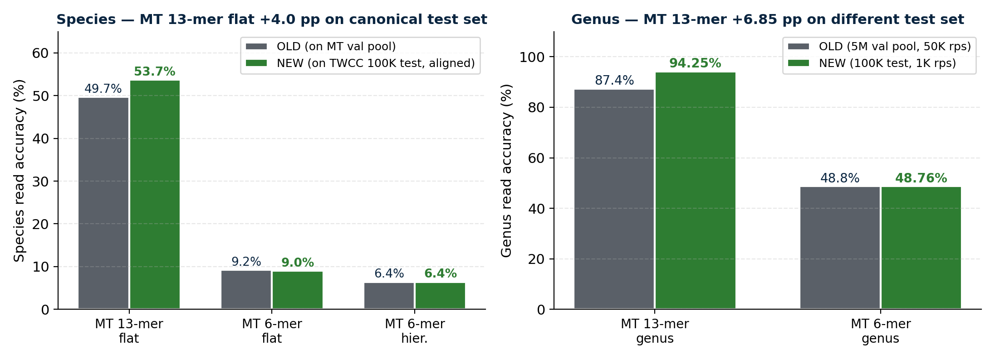
MT Predictions · Read-Order Alignment Fix
Why old numbers were wrong · Previous MT predictions came from MT's val_dir (multi-file FASTA, sorted by filename). The read order did NOT match TWCC's canonical reads_100K.fa. Re-ran on Taiwana-2 with reads in single-file order → labels now 1:1-aligned to NT-v2 / Kraken2 references.
All MT in-DB metrics now correctly computed on the canonical 100K test set
3 / 10

Slide 4
New Finding · Species/Genus Performance Inversion
Same Kraken2 DB, same test set, same protocol — Kraken2 wins species; MT 13-mer wins genus
4 / 10

Slide 5
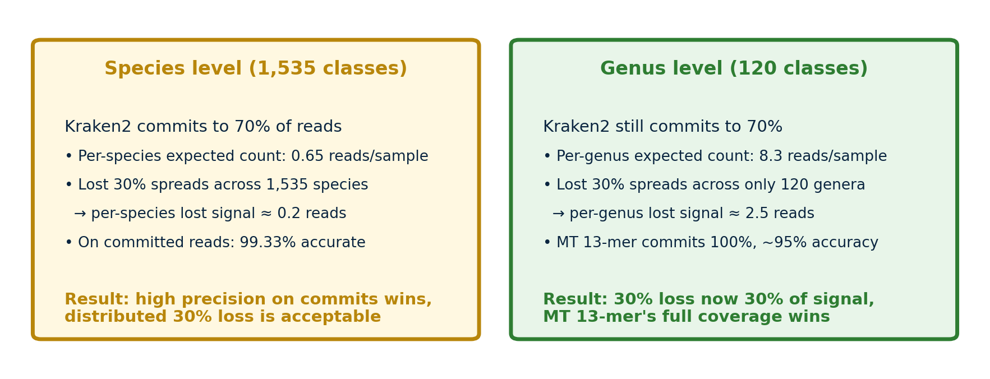
Why the Inversion · Commit-Rate × Task Cardinality
Theoretical implication · Kraken2's 30% abstention is a precision-vs-recall trade-off. At high task granularity (1,535 species), the precision wins. At low granularity (120 genera), the recall loss dominates. This adds nuance to the thesis's complementary positioning: they are not just "in-DB vs OOD" — they trade off across task cardinality.
5 / 10

Slide 6
Thesis Updates Summary
What changed
What was added
• Table 4.29 MT rows updated to aligned values
— MT 13-mer flat: 49.7% → 53.7% / r 0.46 → 0.50
— MT 6-mer flat/hier: minor (9.0% / 6.4%)
— MT 13-mer hier: N/A (checkpoint corrupted)
• Hierarchical-masking paragraph: removed broken MT 13-mer hier reference;
revised to 2 routers (NT-Genus 66%, MT 6-mer 49%) + reference to read-level 3 points
• OOD framing fixed: was "neural retains OOD signal";
now "deployment coverage asymmetry" (the 219 species are in-distribution)
• Thesis page count: 137 → 139
• New Table 4.30: Fair-restricted comparison
on in-DB 85,819 reads (species + genus panels)
• New paragraph: "Coverage-restricted fair comparison"
explains why restrict to 85,819 reads + interpretation
• New paragraph: "Sharp inversion between species
and genus levels" — describes the new finding
with commit-rate × cardinality mechanism
• New paragraph: "Kraken2 dependence on database
coverage" — corrected deployment vs OOD framing
6 / 10

Slide 7
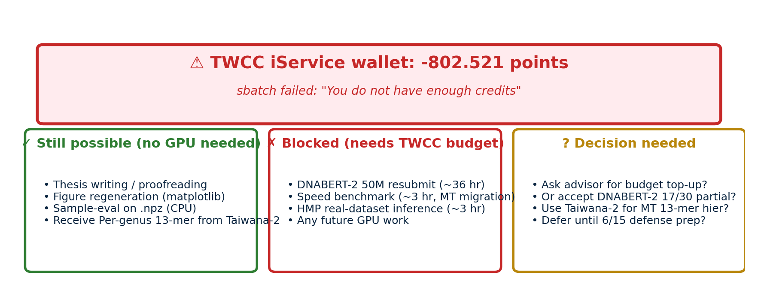
Blocker · TWCC Budget Exhausted on 5/30
Need decision: budget top-up, or accept partial DNABERT-2 + defer remaining tasks
7 / 10

Slide 8
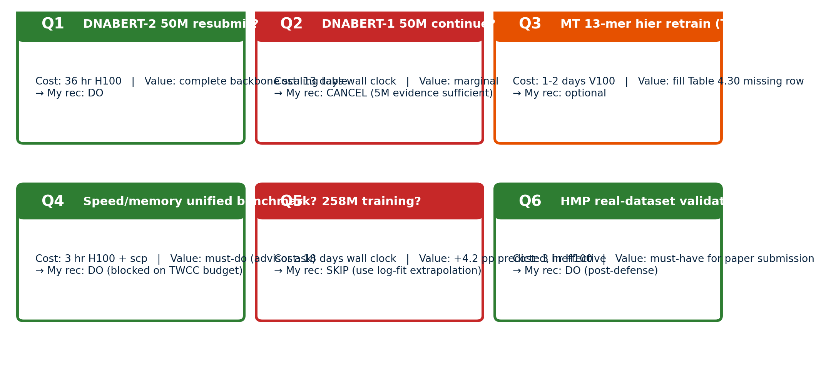
6 Open Decisions Recap (from 5/28)
8 / 10

Slide 9
Recommended Priorities (next 2 weeks)
Immediate (no TWCC GPU needed)
• Receive Per-genus 13-mer (Exp F) results from Taiwana-2 → integrate into thesis Table 4.hier-prelim
• MT 13-mer hier retraining on Taiwana-2 (decide Q3)
• Thesis figure regeneration with new aligned MT numbers
• Thesis proofreading + format consistency check
Needs TWCC budget top-up (~45 GPU-hr total)
• DNABERT-2 50M resubmit (36 hr) — complete backbone scaling table
• MT models migration + speed/memory unified benchmark (3 hr) — must-do, advisor ask
• HMP mock community real-dataset inference (3 hr) — post-defense, paper submission prep
Recommended NOT to do (explicit advisor decision needed if disagree)
• DNABERT-1 50M continue: ~300 GPU-hr, 13 days — 5M evidence + training cost argument is sufficient
• 258M training: ~290 GPU-hr, +4.2 pp predicted (log-fit), does not cross tokenisation gap
9 / 10

Slide 10
Asks for Today's Meeting
Three concrete decisions I need from you today:
1
TWCC budget
Top up so I can resubmit DNABERT-2 (36 hr) + run speed benchmark (3 hr)? Or defer both?
2
DNABERT-1 50M
Confirm cancel. Use the 5M data + per-epoch cost (11.7 hr vs NT-v2's 2.8 hr) as deployment-limitation argument?
3
MT 13-mer hier retraining (Taiwana-2)
Worth ~1-2 days V100 to fill Table 4.30 missing row? Or accept N/A given read-level 3-point story is intact?
10 / 10

