Slide 1
Weekly Progress Update
Bug fixed → data saturates at 50M · the ceiling is tokenization
June 26, 2026
50M → 250M = +0.22 pp · 66% is NOT leakage (distribution) · MT 13-mer 87% > NT-v2 67%
YMJ · M2 Lab · NTU CSIE

Slide 2
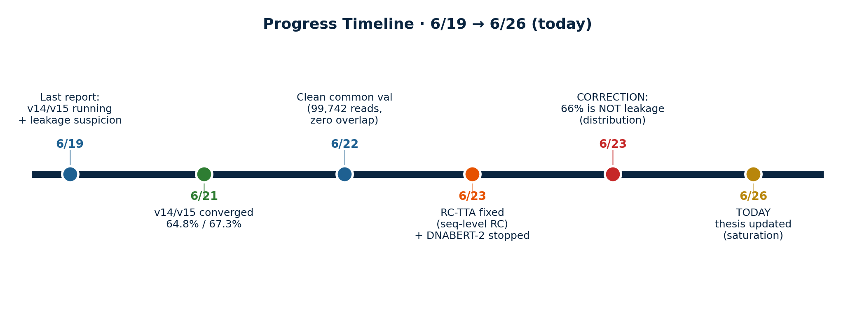
Progress Timeline · 6/19 → 6/26
6/21 v14/v15 converged on correct data — 64.8% / 67.3% (RC-TTA)
6/22 Built clean common val: 99,742 reads, zero seq_id overlap with 50M AND 250M training
6/23 Fixed RC-TTA (true sequence-level RC); stopped stuck DNABERT-2 run
6/23–26 Retracted the leakage claim (it's distribution); updated thesis with the saturation result

Slide 3
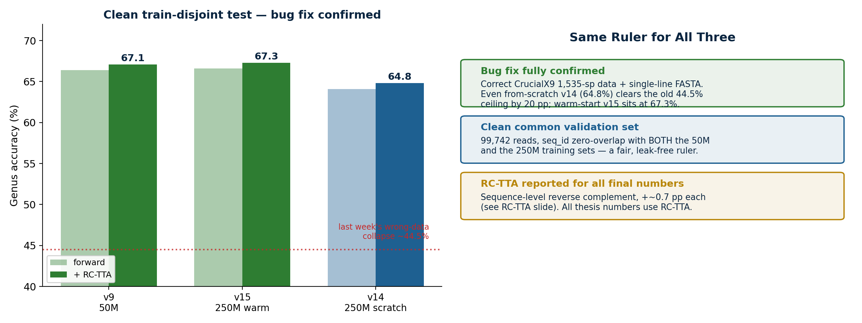
Fix Confirmed — Clean Numbers
Train-disjoint test, RC-TTA: v9 67.1% · v15 67.3% · v14 64.8% (vs last week's 44.5% collapse)

Slide 4
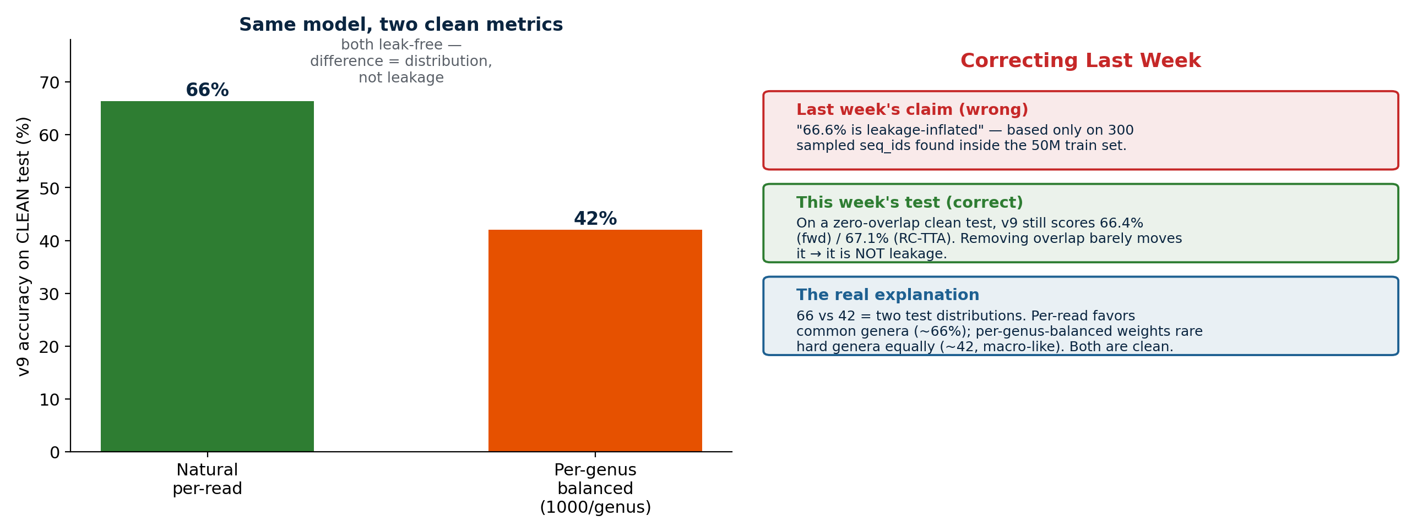
Correction: 66% is NOT Leakage
Retracting last week's claim — the 66-vs-42 gap is a test-distribution artifact, not data leakage

Slide 5
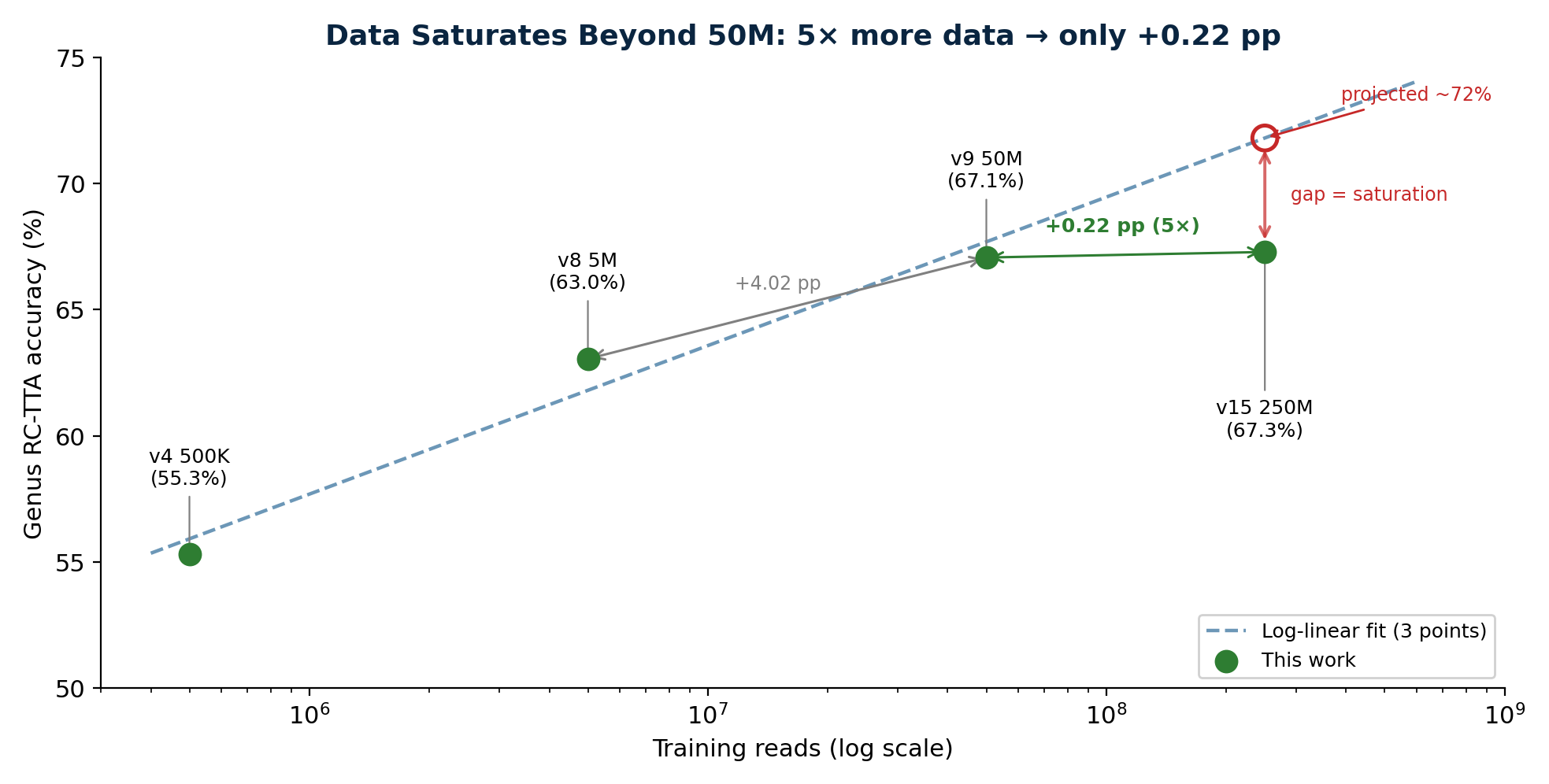
The Real Finding: Data Saturates
5× more balanced data (50M → 250M) moves accuracy only +0.22 pp — refutes the log-linear projection

Slide 6
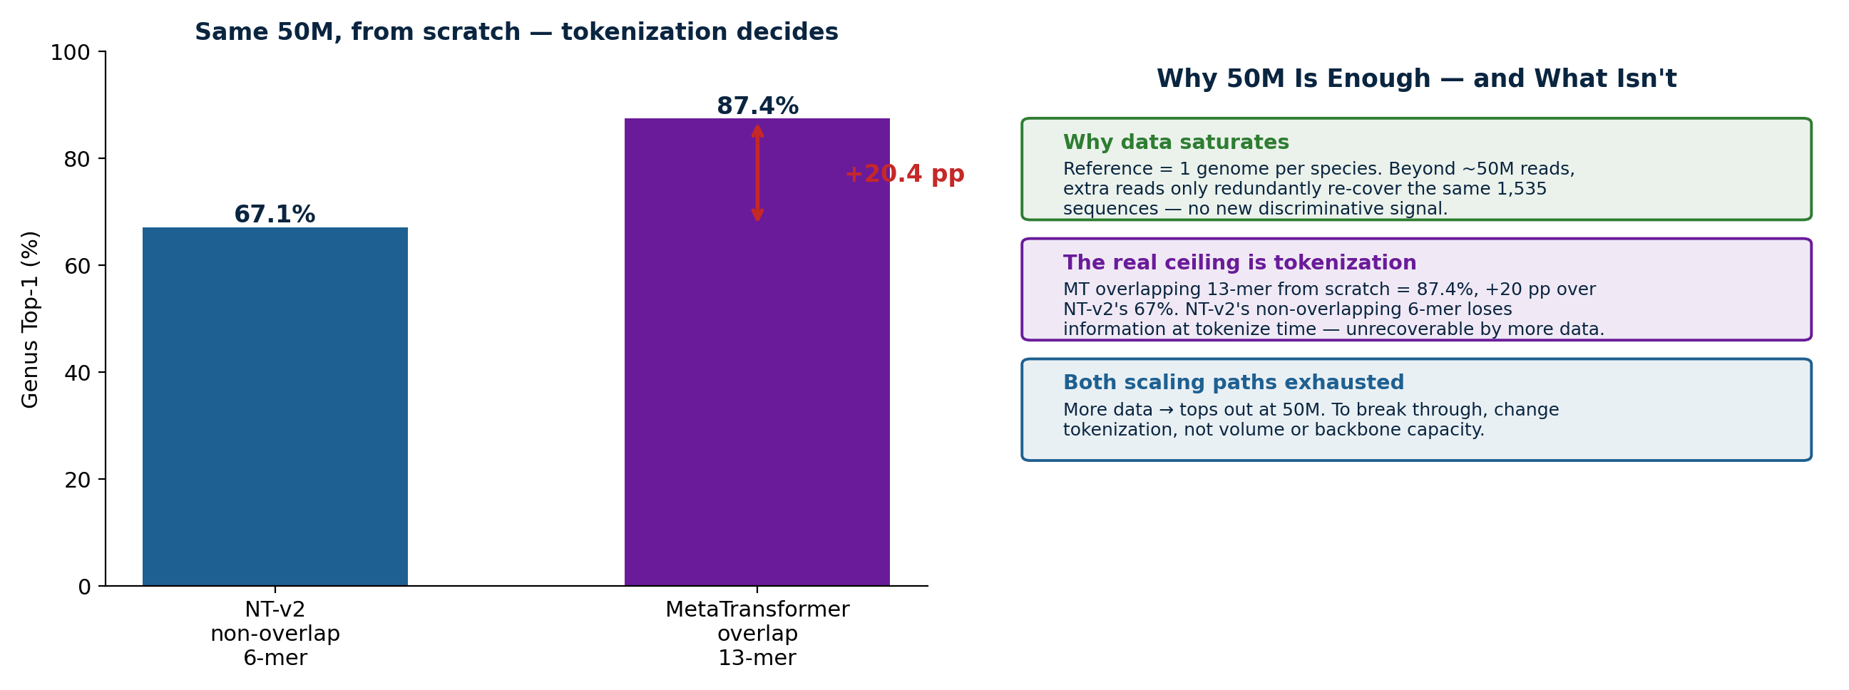
Why It Saturates → Tokenization is the Ceiling
1 genome/species → 50M is enough · MT overlap 13-mer 87% vs NT-v2 6-mer 67% (+20 pp)

Slide 7
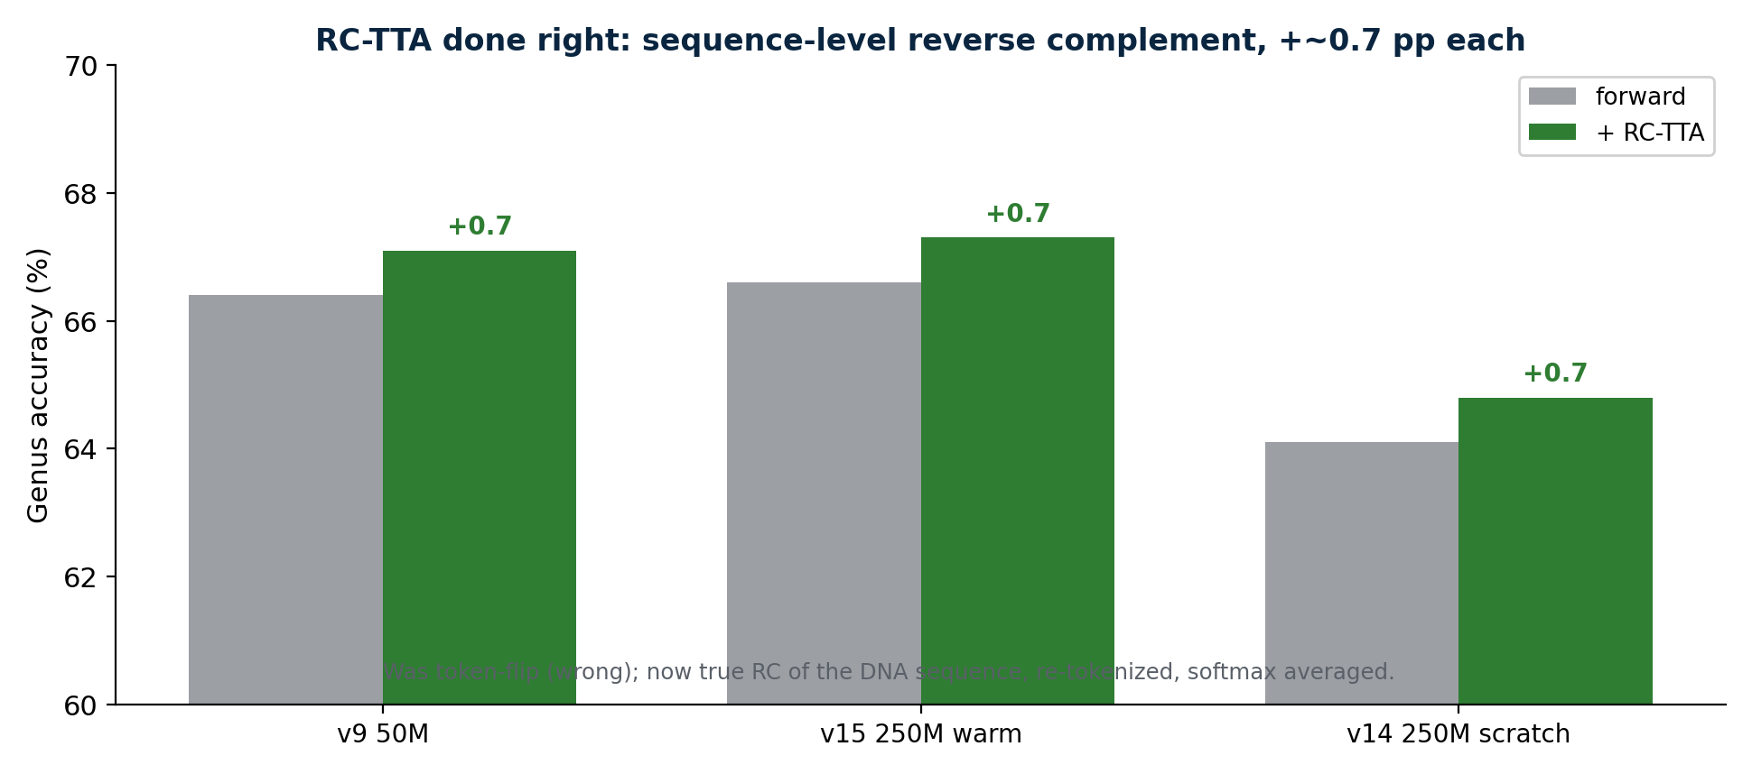
RC-TTA Done Right
Sequence-level reverse complement (was token-flip) — consistent +~0.7 pp, zero training cost

Slide 8
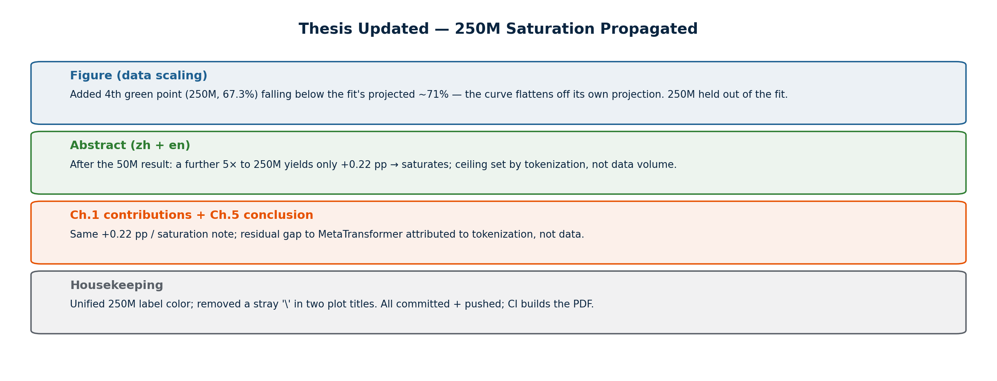
Thesis Updated

Slide 9
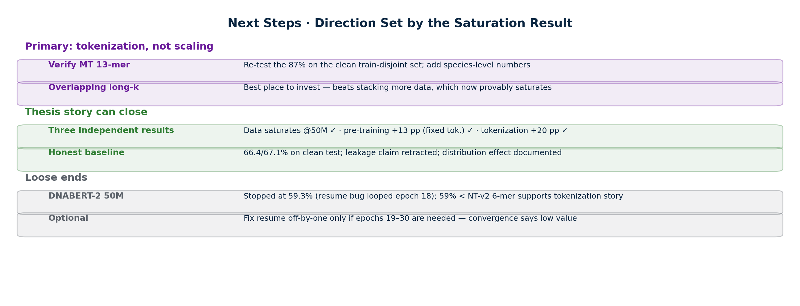
Next Steps

