Slide 1

Optimization and Constraint
Hoda Duy Mikle
HDMi team
Binaei Nguyen Kudriavtsev

Slide 2
Content
Problem
Approaches
Result

Slide 3
Interview assignment process
Students – Companies
Assign interviews based on students’ preference marks about companies
Need to satisfy some conditions (constraints)

Slide 4
Graph approach
students
companies
1
1
2
2
3
3
..
..
n
Only 3 connections
m

Slide 5
Minimum cost flow
students
companies
1
1
Constraint
Constraint
2
2
3
3
..
..
n
m

Slide 6
Minimum cost flow
students
companies
1
1
Constraint
Constraint
2
2
3
3
..
..
n
m

Slide 7
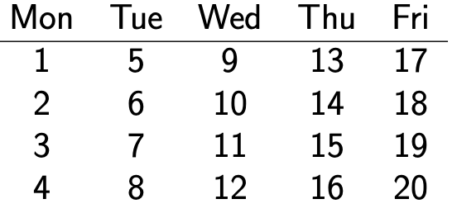
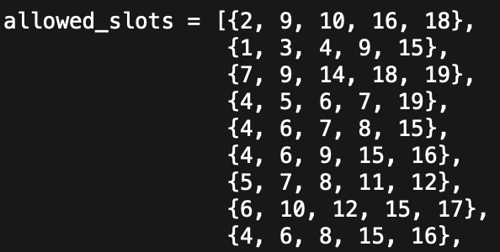
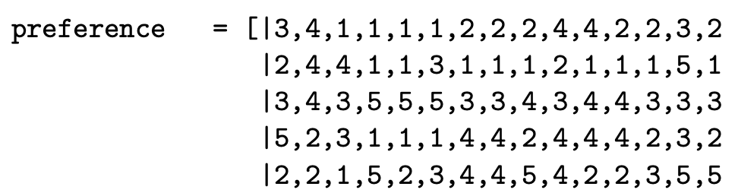
Main constraints
1 student has 3 interviews
Students have interviews in their registered times only (1 student / 5 times)
1 student can only have 1 interview / 1 time
Students will have interviews with their preference companies only (regret score)

Slide 8
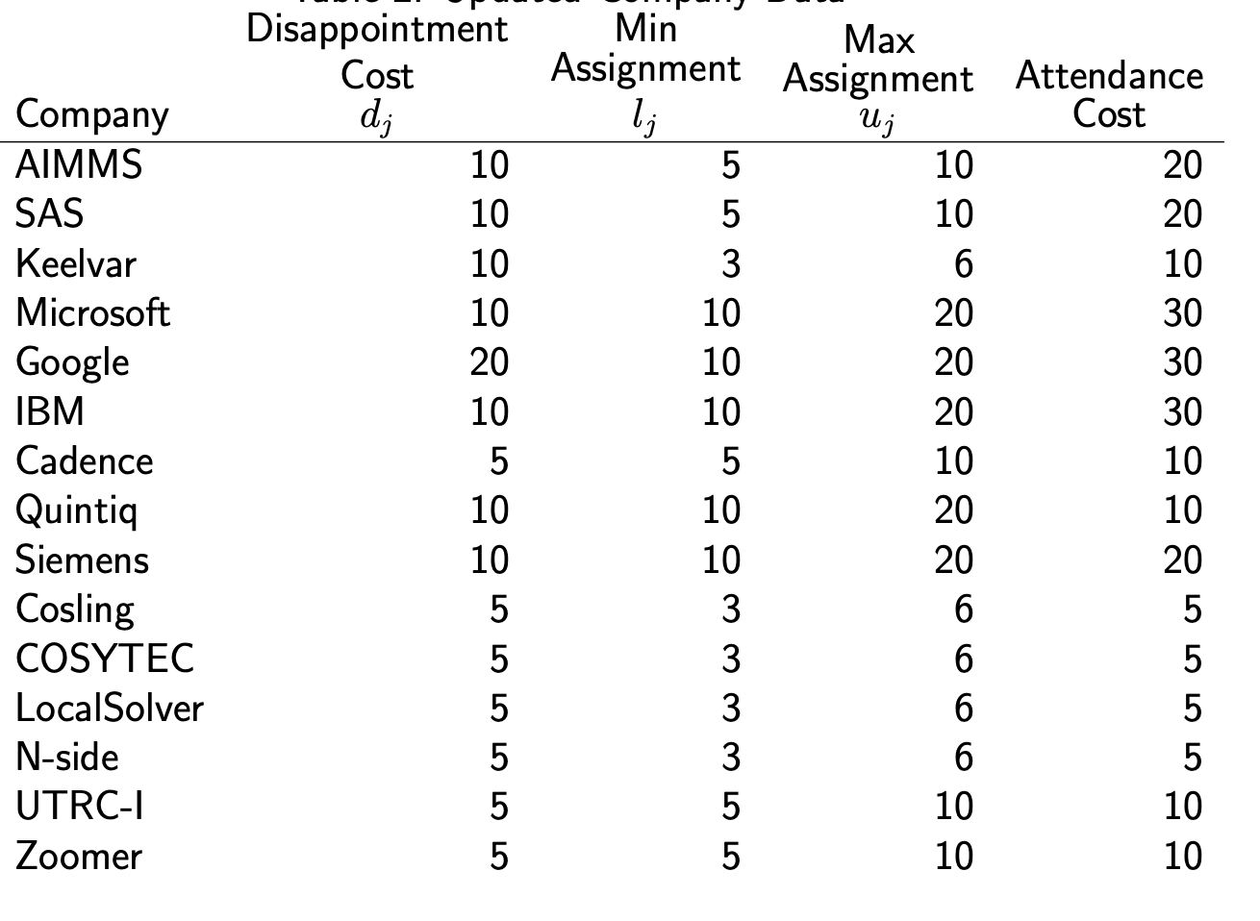
Main constraints
1 company can have 2 interviews / 1 time
1 company will have number of interviews in their range min/max_assignment
1 interview / 1 room / 1 time
Information
37 Students – 15 Companies
12 rooms available with 200$ for each
Daily attendance cost for each company

Slide 9
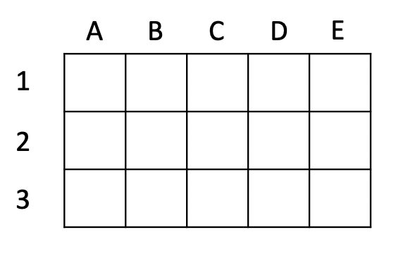
Ideas
Extended 0/1 Solution
Using 3 2d-arrays with size of [number of students, number of companies]
Interviews
Times Slots
Rooms
Companies
Students
A
B
C
D
E
1
0 | 1 | 1 | 1 | 0
0 | 0 | 1 | 1 | 1
1 | 0 | 1 | 0 | 1
2
3
Interview: {0, 1}
Times: {0, 1..20}
Rooms: {0, 1..12}
Notes:
Add about graph theory

Slide 10
Ideas - Constraints
0. Mapping information between 3 arrays
A
B
C
D
E
If Interview[i,j] == 0
Then Times[i,j] = Rooms[i,j] = 0
1
0 | 1 | 1 | 1 | 0
0 | 0 | 1 | 1 | 1
1 | 0 | 1 | 0 | 1
2
Interview: {0, 1}
1. Each student has 3 interviews
3
Sum of each row in Interview == 3
1
2
4
2. Each student registers 5 time slots
Times: {0, 1..20}
Values in row i in Times ∈ allowed_slot[i]
(except 0)
3. Student has 1 interview / 1 time
For each row i in Times
alldifferent_except_0(row i)
Rooms: {0, 1..12}

Slide 11
Ideas - Constraints
4. Regret score for each student ≤ 1
For each student
Calculate best preference point (bp)
Calculate assigned preference point (ap)
|bp - ap| ≤ 1
A
B
C
D
E
1
0 | 1 | 1 | 1 | 0
0 | 0 | 1 | 1 | 1
1 | 0 | 1 | 0 | 1
2
Interview: {0, 1}
3
5. Each company can have 2 interviews / 1 time
For each column in Times
Number of occurrence of each value ≤ 2
(except 0)
1
2
4
2
Times: {0, 1..20}
6. Company capacity
≠2
Sum of each column j in Interview ∈ [min_assignment[j], max_assignment[j]]
1
1
1
7. 1 interview / 1 room / 1 time
≠1
Rooms: {0, 1..12}
1. Flatten Times and Rooms into 1d-arrays
2. If Times[i] == Times[j]
then Rooms[i] != Rooms[j]

Slide 12
Ideas – How to calculate objective score
A
B
C
D
E
1
0 | 1 | 1 | 1 | 0
0 | 0 | 1 | 1 | 1
1 | 0 | 1 | 0 | 1
2
Interview: {0, 1}
3
Objective function
Preference Score
Rooms rental fee
Companies attendance cost
1
2
4
2
Times: {0, 1..20}
≠2
1
1
1
≠1
Rooms: {0, 1..12}

Slide 13
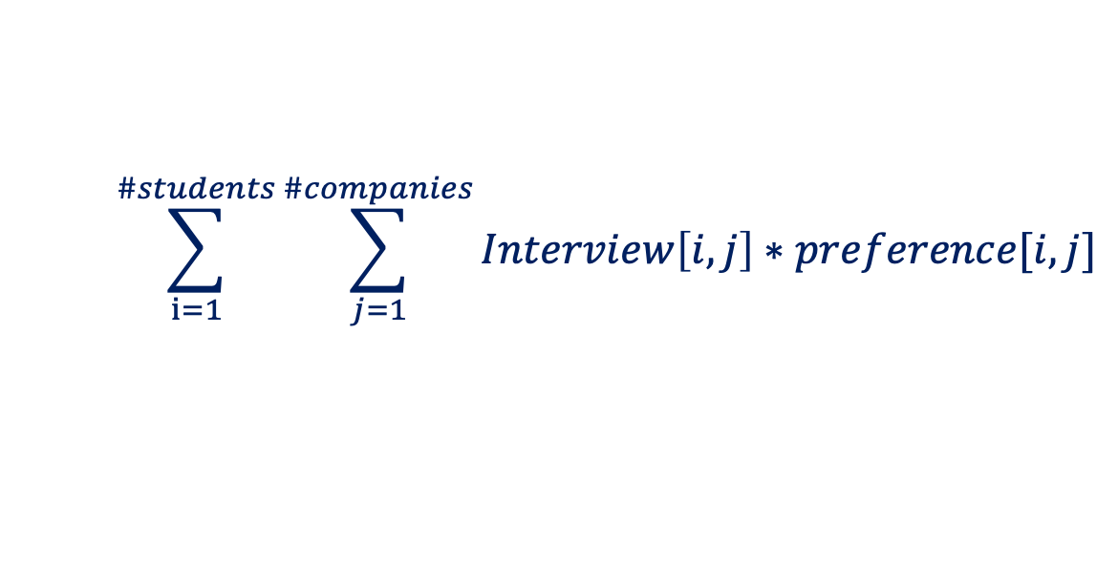
Ideas – How to calculate objective score
A
B
C
D
E
1
0 | 1 | 1 | 1 | 0
0 | 0 | 1 | 1 | 1
1 | 0 | 1 | 0 | 1
2
Interview: {0, 1}
3
Preference Score
1
2
4
$$\sum_{i=1}^{\#students}{\sum_{j=1}^{\#companies}{Interview\left[i,j\right]∗preference[i,j]}}$$
2
Times: {0, 1..20}
≠2
1
1
1
≠1
Rooms: {0, 1..12}

Slide 14
Ideas – How to calculate objective score
A
B
C
D
E
Rooms Score
1
0 | 1 | 1 | 1 | 0
0 | 0 | 1 | 1 | 1
1 | 0 | 1 | 0 | 1
2
Interview: {0, 1}
Cost_room * number of unique values in Rooms
(except 0)
3
1
2
4
2
3
1
Times: {0, 1..20}
10
15
7
1
1
1
2
2
3
Rooms: {0, 1..12}
1
1
1

Slide 15
Ideas – How to calculate objective score
A
B
C
D
E
Attendance Score
1
0 | 1 | 1 | 1 | 0
0 | 0 | 1 | 1 | 1
1 | 0 | 1 | 0 | 1
Calculate Company j cost (using column j in Times)
Find max of col j
Find min of col j (except 0)
Total_days = 1 + ceil(max/4) – ceil(min/4)
Company_Cost = Total_days * daily_rate[j]
Score_Attendence = Sum of all company cost (all column in Times)
2
Interview: {0, 1}
3
1
2
4
2
3
1
Times: {0, 1..20}
10
15
7
1
1
1
2
2
3
Rooms: {0, 1..12}
1
1
1

Slide 16
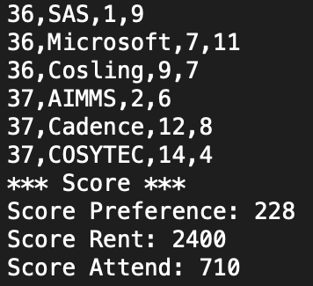
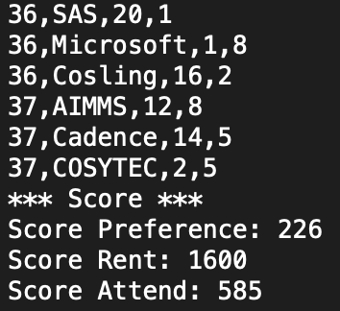
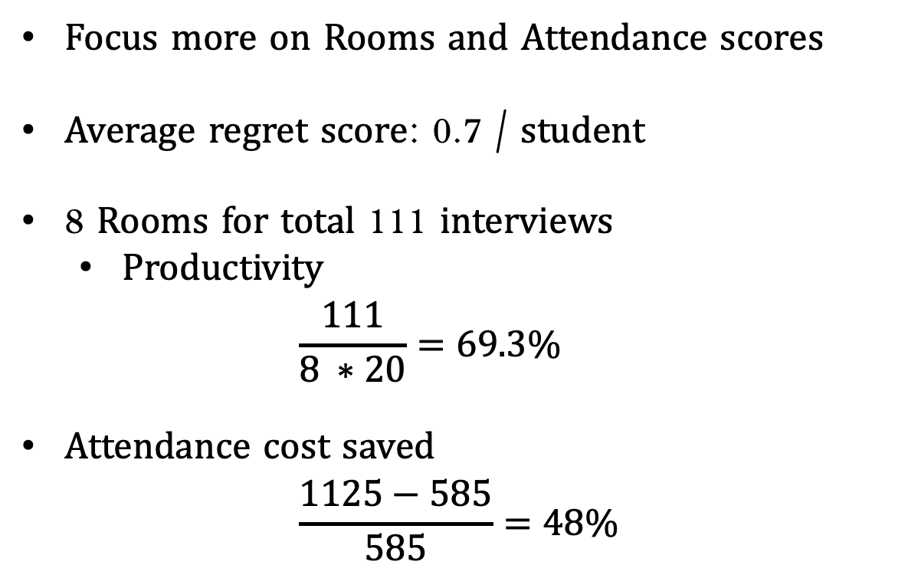
Result
1st Optimize
Focus more on Rooms and Attendance scores
Average regret score: 0.7 / student
8 Rooms for total 111 interviews
Productivity
$$\frac{111}{8 ∗20}=69.3\%$$
Attendance cost saved
$$\frac{1125−585}{585}=48\%$$
n^{th} Optimize
(still running)

Slide 17
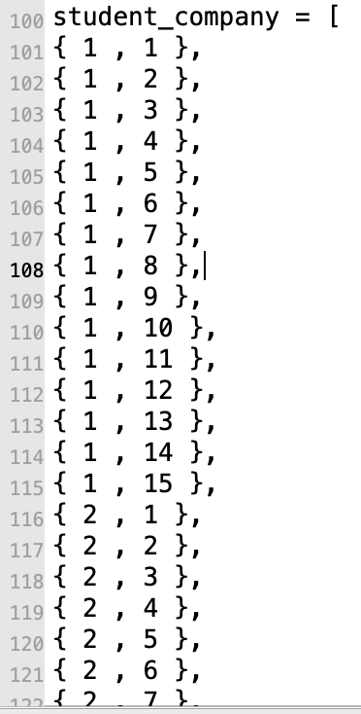
Appendix P – Projection approach
All possible interviews
interviews
Additional input
Student # | company
1 | Google
1 | IBM
1 | Keelvar
1 | …
n | Google
n | IBM
n | Keelvar
n | …
St_Cp
1
2
3
4
5
…
Number_of_students * number_of_companies
0 – no interview

Slide 18
Suits and timeslots projection
All possible combinations
Time and place
Suit # | Timeslot
1 | 1
1 | 2
1 | …
1 | 20
12 | 1
12 | 2
12 | …
12 | 20
Time_place
1
2
3
4
5
…
12*20

Slide 19
Array of var
array [1..number_of_suites*number_of_slots] of var 0..number_of_students*number_of_companies: time_place;
12 | 24 | 0 | 0 | 32 | 12 | 0 | 0 | 1 | 2
Interview #
student : company
From #0 to number_of_students*number_of_companies

Slide 20
Result

Slide 21
Thank you for your attention

