Slide 1
Findings on ‘Prudential Life Insurance Assessment’
By Matthew Ng

Slide 2

Imagine the following…
You and your friend have applied for a life insurance plan
30 days later → The insurance company declined your coverage
Offered a higher premium rate instead

Slide 3



But why…?
You and your friend shared so many things in common
Why declined?
Why higher risk?
Why so slow?

Slide 4

The twilight!
"Prudential Life Insurance Assessment“ on Kaggle !?!?
Challenge accepted!
Develop something that
predicts applicants’ risk based on their information
gives applicants interpretable rejection reasons
shortens the time of risk assessment
Okay, beat me

Slide 5
First things first…
What is your primary goal?
Predicts applicants’ risk based on their information
Is that enough?
NO
INSTEAD: Predicts applicants’ risk based on their information with interpretable reasons

Slide 6
If the primary goal seems okay to you…
What do the training data look like?
59381 samples
1 response variable + other 126 variable
7 types of variables
Medical-related variables account for ~71% of the data set
Employment information
Product information
Insured information
Insurance history
Family history
BMI, age, weight, and height
Medical information

Slide 7
First things first…
How do you achieve the primary goal?
See how variables varies across risk levels
See how risk levels vary across each level in some categorical variables
By doing so…

Slide 8
Other fundamental questions to ask
What do the ‘1’ and ‘8’ in the response variable indicate?
Is applicants’ risk level associated with their
age?
BMI?
product type?
non-/missingness in certain variables?
number of medical keywords?
medical history?

Slide 9
Questions to be settled
What do the ‘1’ and ‘8’ in the response variable indicate?
Risk associated with age?
Risk associated with BMI?
Risk associated with product type?
Risk associated with non-/missingness?
Risk associated with # medical keywords?
Risk associated with medical history?

Slide 10
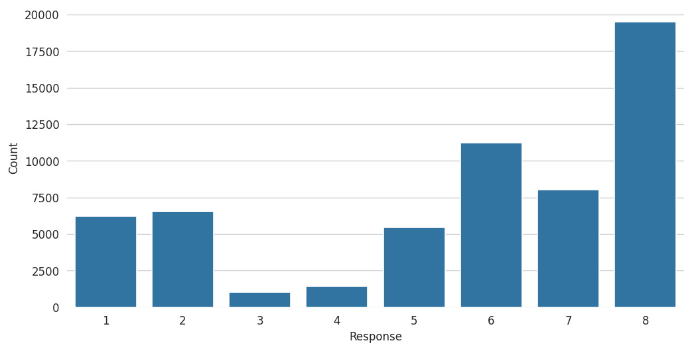
Response variable: risk level
The response is an ordinal variable
Does ‘1’ represent the highest or the lowest risk?
Risk level 8 has the highest count
Relatively unlikely to get risk levels 3 or 4

Slide 11
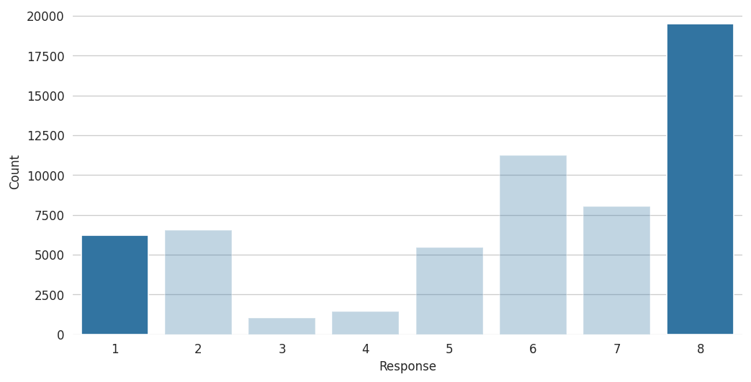
Response variable: risk level
Let’s focus on risk levels 1 and 8…
Appear more often than risk level 1
Appear less often than risk level 8
Reasonable to assume that risk level 1 indicates the highest risk and risk level 8 indicates the lowest risk

Slide 12
Questions to be settled
What do the ‘1’ and ‘8’ in the response variable indicate?
Risk associated with age?
Risk associated with BMI?
Risk associated with product type?
Risk associated with non-/missingness?
Risk associated with # medical keywords?
Risk associated with medical history?

Slide 13
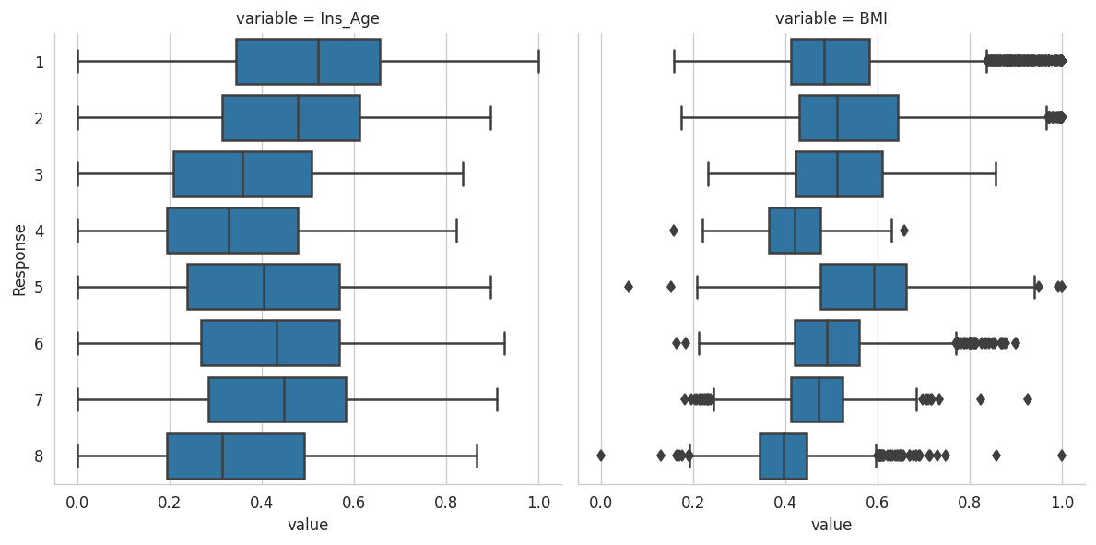
Risk associated with Age/BMI?
Ins_Age is the normalized age of applicant
BMI is the normalized body mass index of applicant

Slide 14
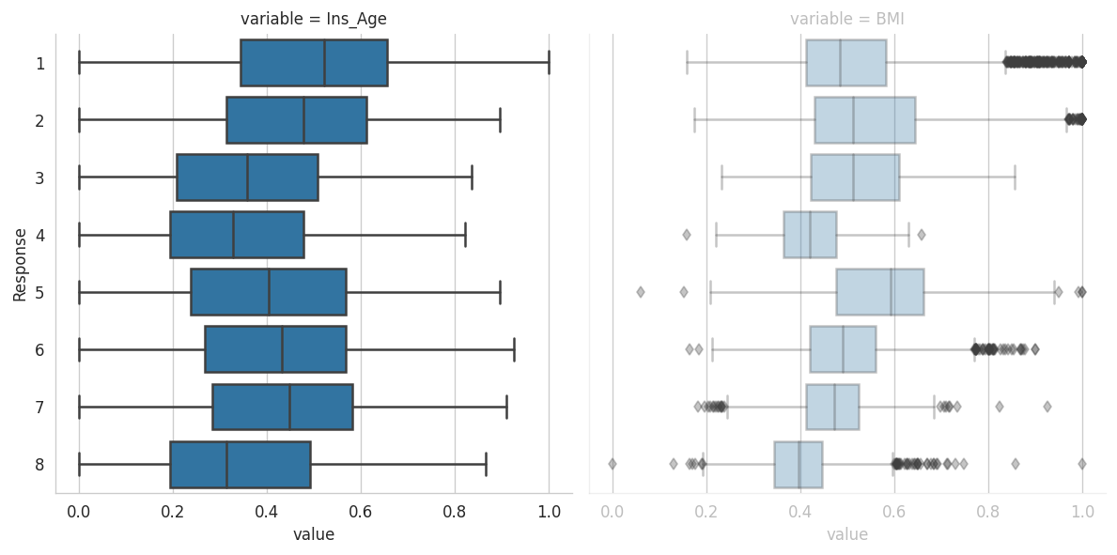
Risk associated with Age/BMI?
Medians of age share a similar trend with the maxima across the risk levels

Slide 15
Risk associated with Age/BMI?
All risk levels have at least one sample with the minimum age across the whole training data

Slide 16
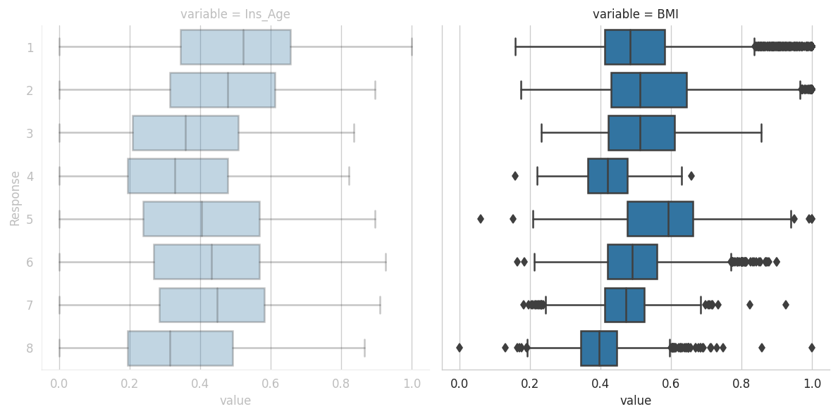
Risk associated with Age/BMI?
Some positive trends present in the medians of BMI
But the trends are less interpretable than those in age

Slide 17
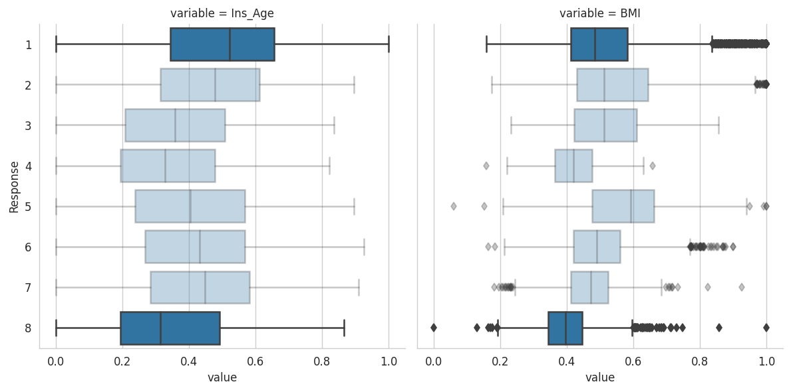
Risk associated with Age/BMI?
Again, let’s focus on risk levels 1 and 8
Median of age and BMI in risk 1 is higher than that in risk 8

Slide 18
Risk associated with Age/BMI?
Again, let’s focus on risk levels 1 and 8
Age and BMI vary more in risk 1 than in risk 8

Slide 19
Questions to be settled
What do the ‘1’ and ‘8’ in the response variable indicate?
Risk associated with age?
Risk associated with BMI?
Risk associated with product type?
Risk associated with non-/missingness?
Risk associated with # medical keywords?
Risk associated with medical history?

Slide 20
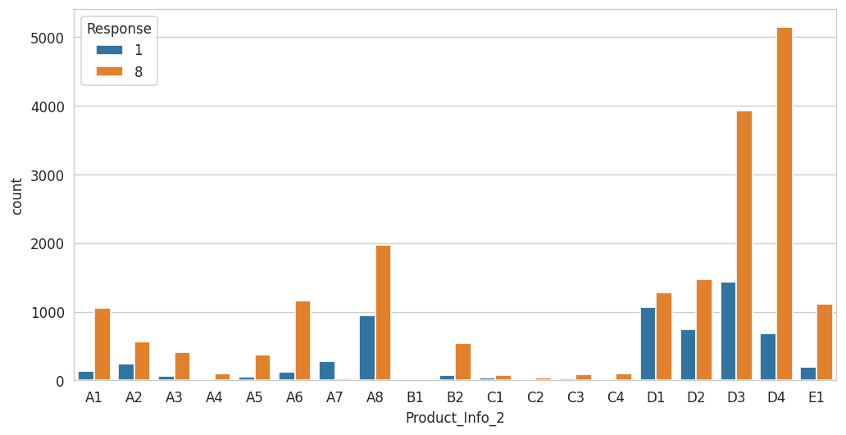
Risk associated with product type?
To reduce the complexity overhead, let us focus on risk levels 1 and 8 here when considering product type
Product_Info_2 is probably the type of product the applicant applied for

Slide 21
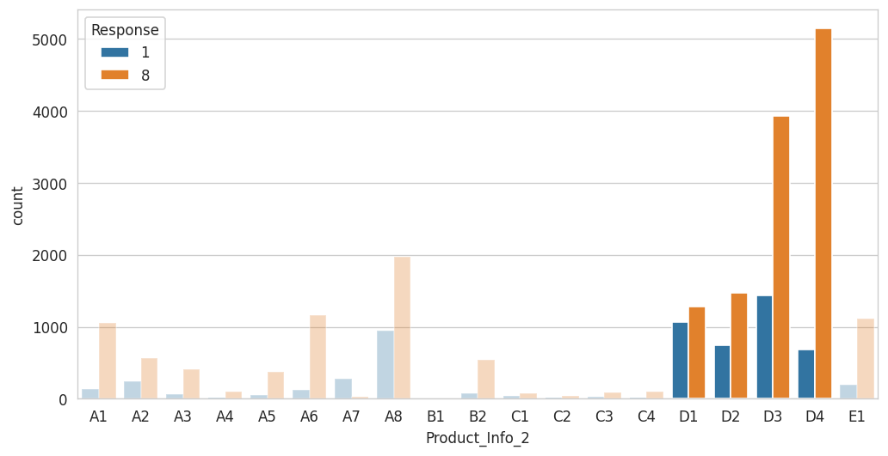
Risk associated with product type?
~64%
~64%
Category D accounts for ~64% of the products that applicants applied for
~28%
Is there any association between extreme risks and any plan in category D?

Slide 22
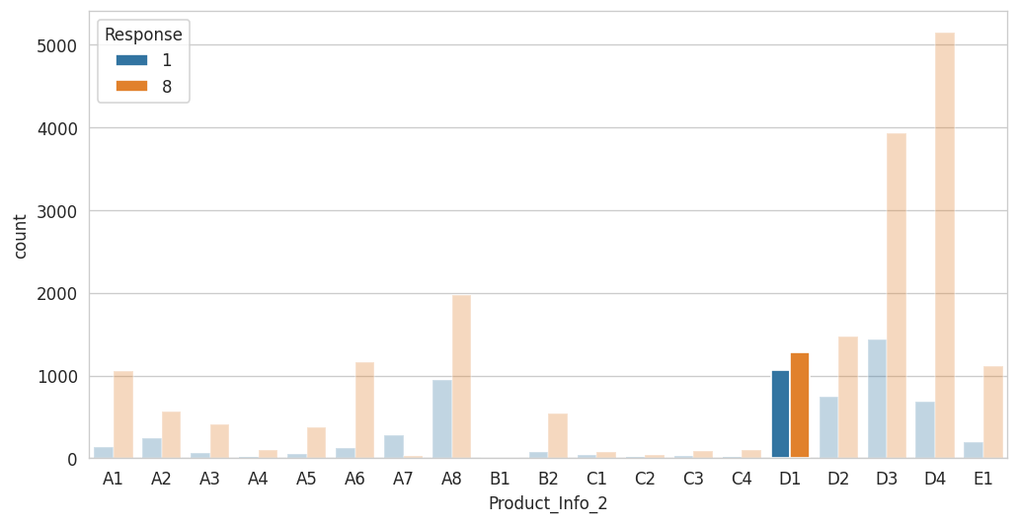
Risk associated with product type?
Note that, generally, the ratio between number of samples in risk level 1 and 8 is less than 1:2
The ratio here is almost 1:1
More likely to observe someone getting the highest risk among applicants choosing D1

Slide 23
Questions to be settled
What do the ‘1’ and ‘8’ in the response variable indicate?
Risk associated with age?
Risk associated with BMI?
Risk associated with product type?
Risk associated with non-/missingness?
Risk associated with # medical keywords?
Risk associated with medical history?

