Slide 1
Findings on ‘Prudential Life Insurance Assessment’
By Matthew Ng

Slide 2

Imagine the following…
You and Peter have applied for a life insurance plan
30 days later → The insurance company determined you to have a high risk
Offered you a higher premium rate instead
Not the case for Peter

Slide 3



But why…?
You were confused and angry
You and Peter shared so many things in common
e.g. health status, employment information, etc.
Why did you have a higher risk?

Slide 4

The twilight!
‘Prudential Life Insurance Assessment’ on Kaggle!?!?
Partner with me
Goals
find interpretable connections between applicants’ risk and their information
build a machine learning model to accurately predict applicant’s risk
shorten the time of risk assessment
Okay, beat me

Slide 5
First things first…
What is your primary goal?
Predict applicants’ risk based on their information
Is that enough?
NO

Slide 6
Instead, the primary goal is to …
predict applicants’ risk based on their information with interpretable reasons

Slide 7
If the main goal seems okay to you…
What do the training data look like?
59381 samples
1 response variable + other 126 variables
7 types of variables
Medical-related variables account for ~71% of the data set
Values of almost all variables are encoded
Employment information
Product information
Insured information
Insurance history
Family history
BMI, age, weight, and height
Medical information

Slide 8
First things first…
How do you achieve the goals?
See how variables vary across risk levels
See how risk levels vary across each level in some categorical variables

Slide 9
Other fundamental questions to ask
What do the ‘1’ and ‘8’ in the response variable indicate?
Is applicants’ risk level associated with their
age?
BMI?
product type?
non-/missingness in certain variables?
number of medical keywords?
medical history?

Slide 10
Questions to be settled
‘THE QUESTION’
Simple hypotheses
What do the ‘1’ and ‘8’ in the response variable indicate?
Risk associated with age?
Risk associated with BMI?
Risk associated with product type?
Risk associated with non-/missingness?
Risk associated with # medical keywords?
Risk associated with medical history?
A not so simple hypothesis
Main interest, but not so simple

Slide 11
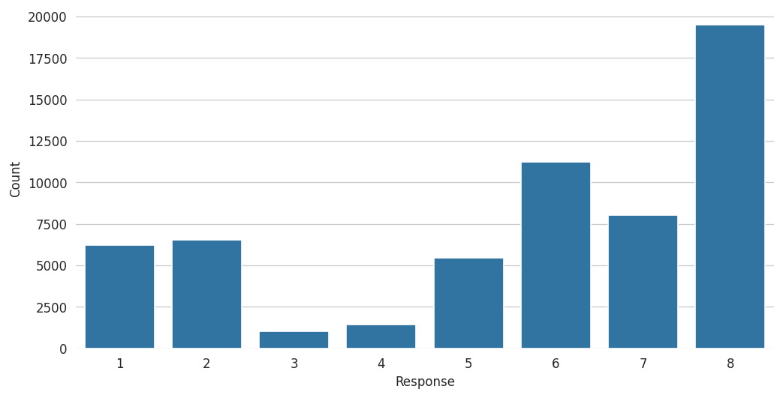
Response variable: risk level
The response is an ordinal variable
Does ‘1’ represent the highest or the lowest risk?
Risk level 8 has the highest count
Relatively unlikely to get risk levels 3 or 4

Slide 12
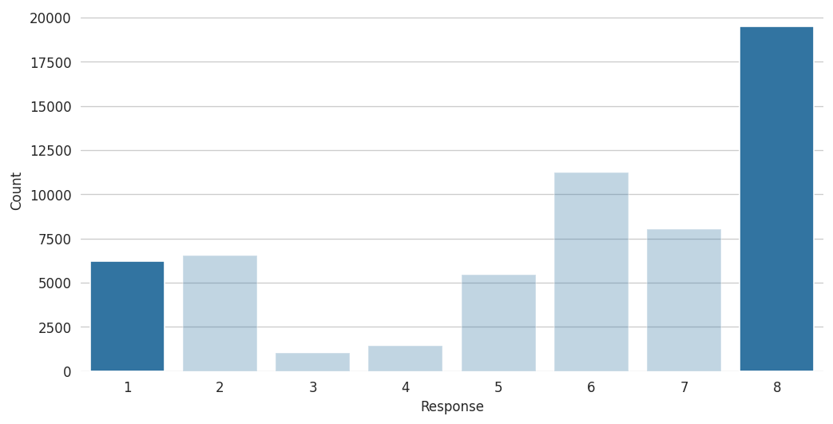
Response variable: risk level
Let’s focus on risk levels 1 and 8…
Appear more often than risk level 1
Appear less often than risk level 8
Reasonable to assume that risk level 1 indicates the highest risk and risk level 8 indicates the lowest risk

Slide 13
Questions to be settled
What do the ‘1’ and ‘8’ in the response variable indicate?
Risk associated with age?
Risk associated with BMI?
Risk associated with product type?
Risk associated with non-/missingness?
Risk associated with # medical keywords?
Risk associated with medical history?
1: highest risk
8: lowest risk

Slide 14
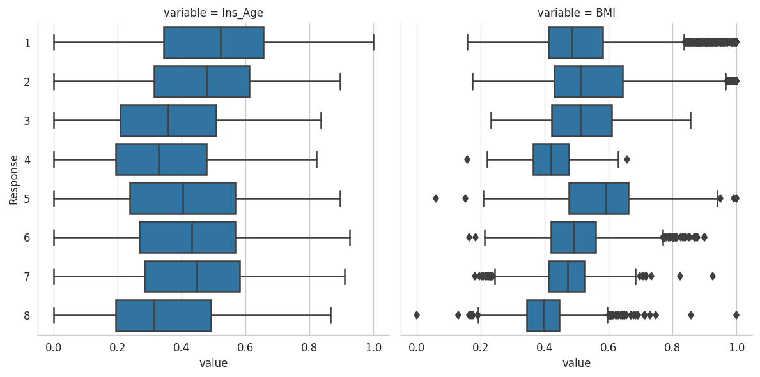
Risk associated with Age/BMI?
Ins_Age is the normalized age of applicant
BMI is the normalized body mass index of applicant

Slide 15
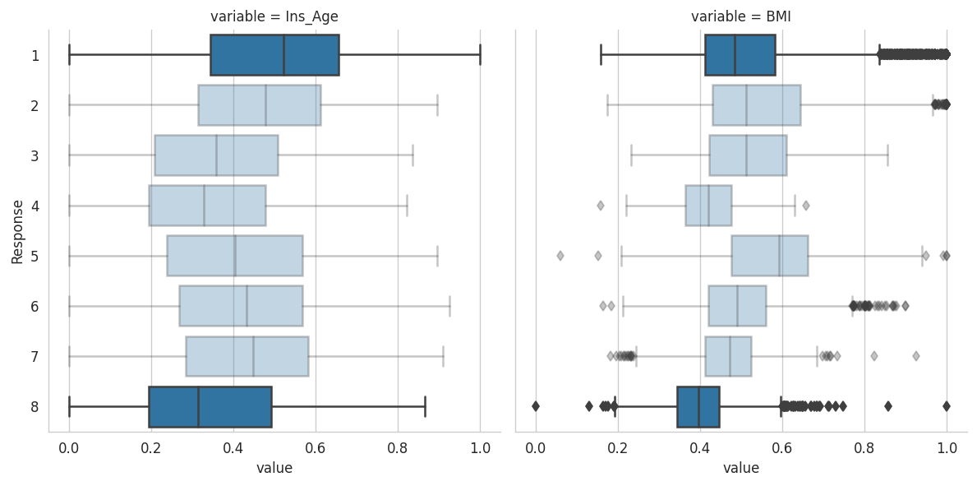
Risk associated with Age/BMI?
Again, let’s focus on risk levels 1 and 8
Median of age and BMI in risk 1 is higher than that in risk 8
The order of these two medians further strengthens our assumption

Slide 16
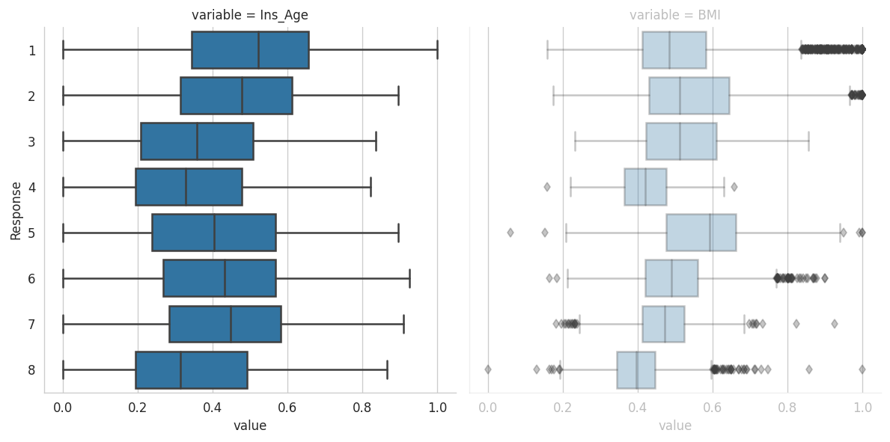
Risk associated with Age/BMI?
Medians follow a zig-zag trend
The median ages are not linear to the risk levels
Be careful!

Slide 17
Risk associated with Age/BMI?
All risk levels have at least one sample with the minimum age across the whole training data

Slide 18
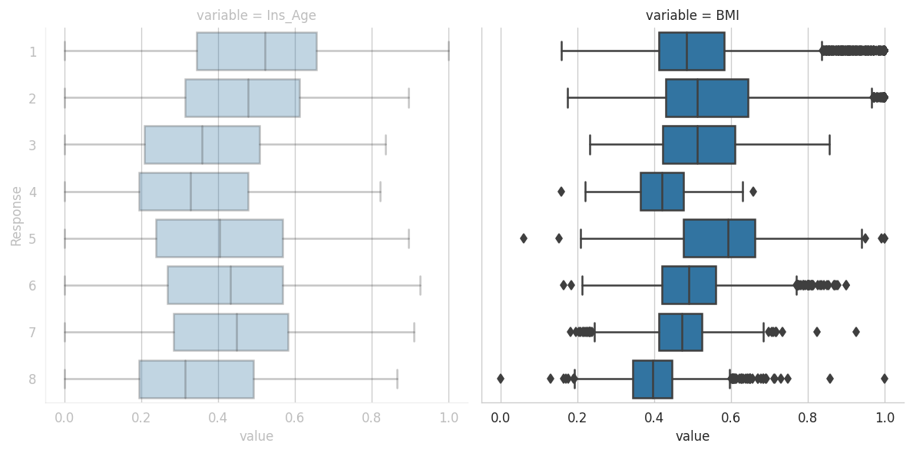
Risk associated with Age/BMI?
Some positive trends present in the median BMIs
But again, the median BMIs are not exactly linear to the risk levels

Slide 19
Risk associated with Age/BMI?
Again, let’s focus on risk levels 1 and 8
Age and BMI vary more in risk 1 than in risk 8

Slide 20
Questions to be settled
What do the ‘1’ and ‘8’ in the response variable indicate?
Risk associated with age?
Risk associated with BMI?
Risk associated with product type?
Risk associated with non-/missingness?
Risk associated with # medical keywords?
Risk associated with medical history?
1: highest risk
8: lowest risk
Somehow associated, but the associations are non-linear

Slide 21
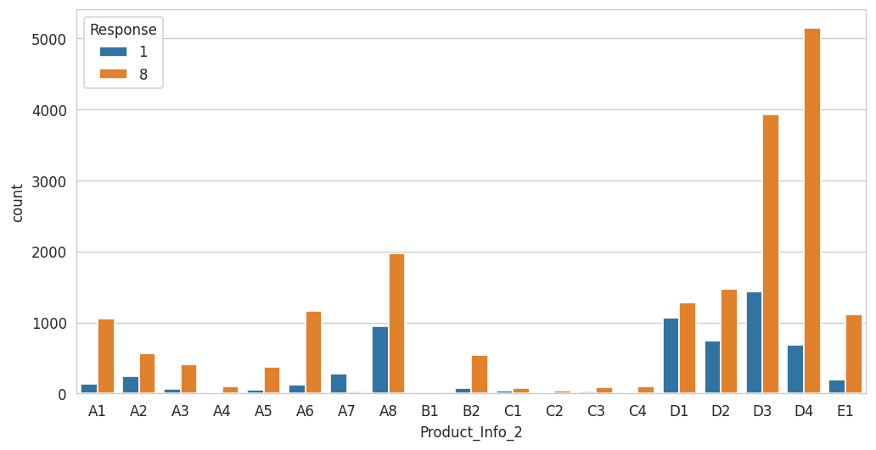
Risk associated with product type?
To reduce the complexity overhead, let us focus on risk levels 1 and 8 here when considering product type
Product_Info_2 is probably the type of product the applicant applied for

Slide 22
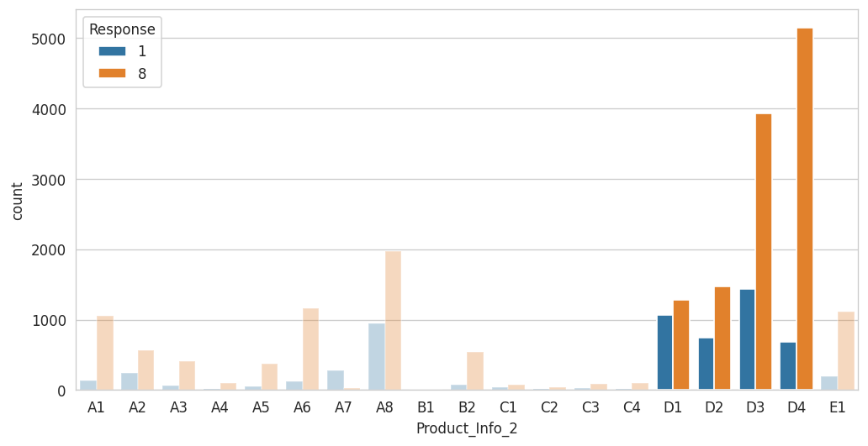
Risk associated with product type?
Risk associated with product type?
~64%
Category D accounts for ~64% of the products that applicants applied for
Is there any association between extreme risks and any product in category D?

Slide 23
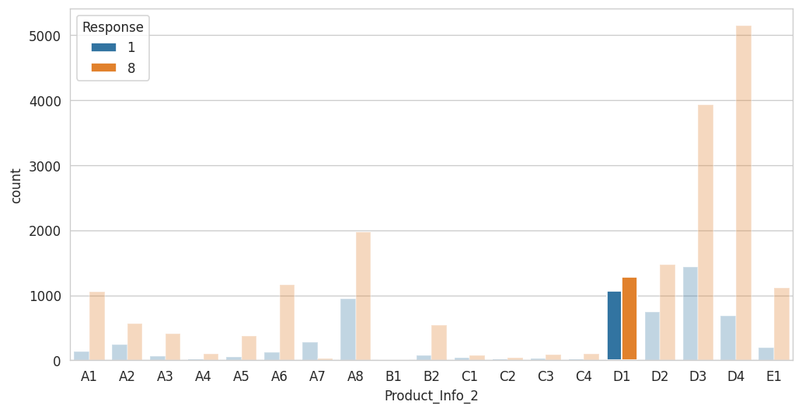
Risk associated with product type?
Note that, generally, the ratio between number of samples in risk level 1 and 8 is less than 1:2
The ratio here is almost 1:1
More likely to observe someone getting the highest risk among applicants choosing D1

Slide 24
Questions to be settled
What do the ‘1’ and ‘8’ in the response variable indicate?
Risk associated with age?
Risk associated with BMI?
Risk associated with product type?
Risk associated with non-/missingness?
Risk associated with # medical keywords?
Risk associated with medical history?
1: highest risk
8: lowest risk
Somehow associated, but the associations are non-linear
Product D1 and risk level 1

Slide 25
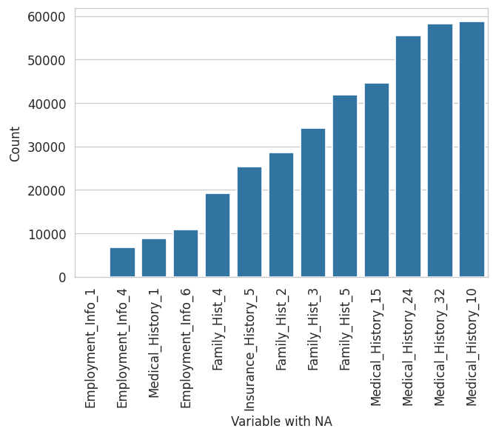
Risk associated with non-/missingness?
Beware of the variable 'Employment_Info_1', which has only 19 missing values
All other variables have more than 6700 missing values

Slide 26
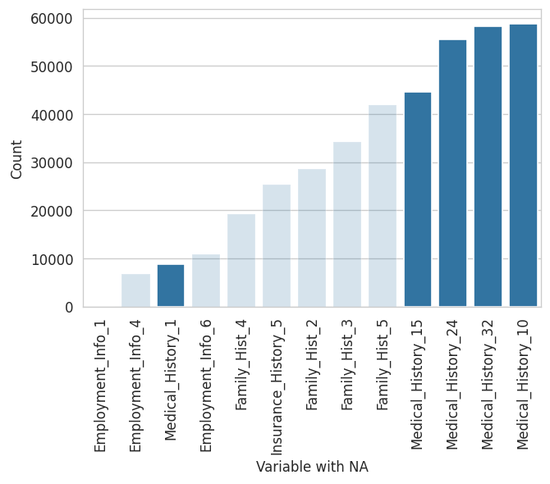
Risk associated with non-/missingness?
Most variables related to medical history have plenty of missing values
The highlighted medical history variables on the rightmost of the figure account for at least 75% of total training samples

Slide 27
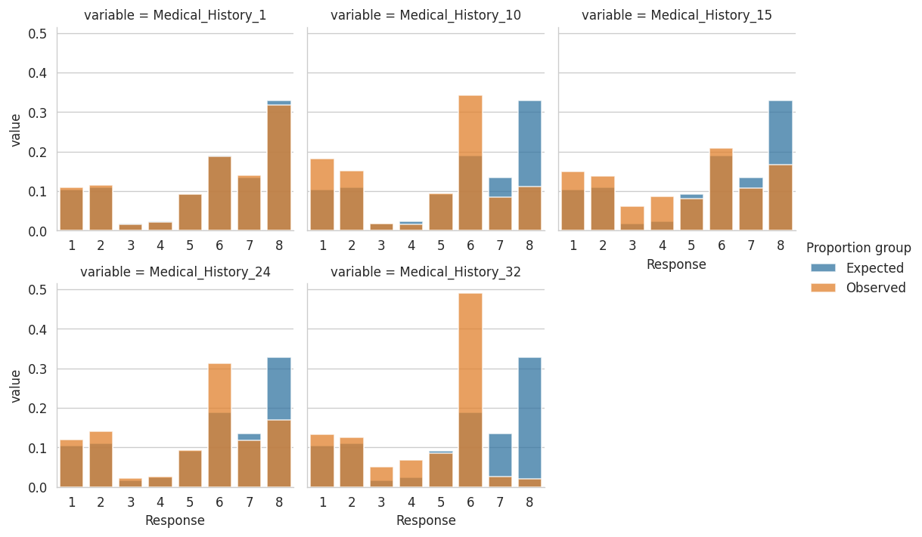
Risk associated with non-/missingness?
We first focus on the non-missingness of variable related to medical history
Each blue histogram indicates the proportion of non-missing values of each risk level in terms of the whole training set
Each orange histogram shows the proportion of non-missing values of each risk level in terms of the non-missing samples of the variable.

Slide 28
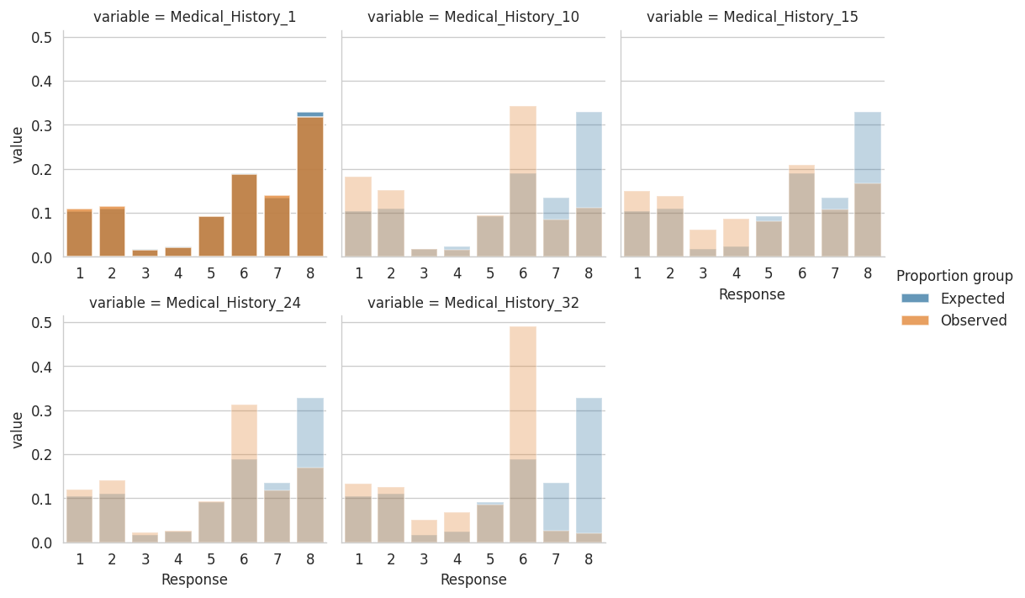
Risk associated with non-/missingness?
How do you know the non-missingness of a variable is NOT associated with risk levels?
You know that is true if you observe orange bars almost overlapped with blue bars as in the highlighted figure
If an orange bar is taller than its blue counterpart, then…
If an orange bar is shorter than its blue counterpart, then…

Slide 29
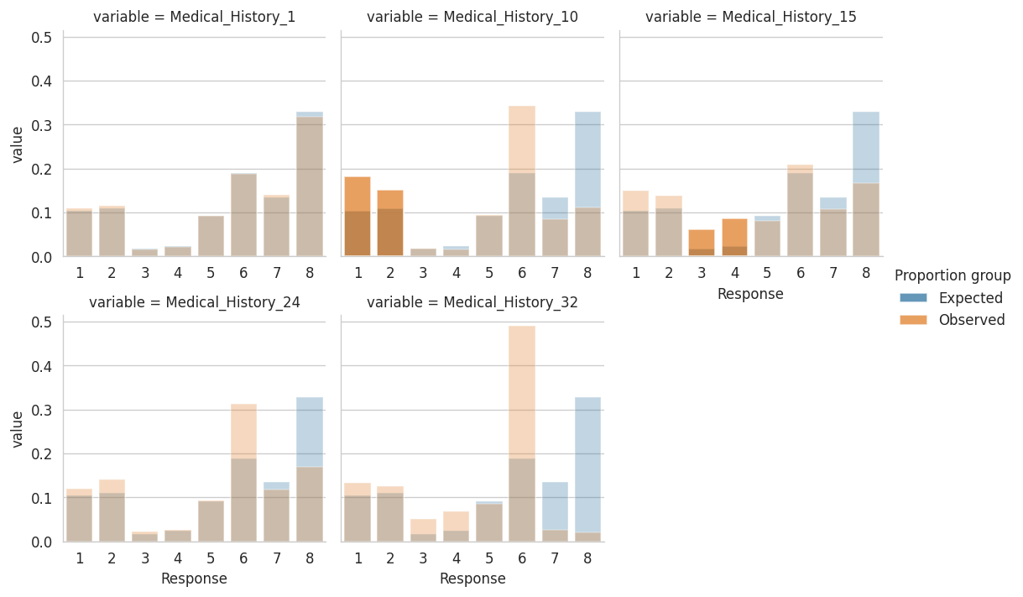
Risk associated with non-/missingness?
Focus on risk levels 1-4
The non-missingness of 'Medical_History_15’ is associated with a higher chance of getting risk level 3-4
The non-missingness of 'Medical_History_10' is associated with a higher chance of getting risk levels 1-2

Slide 30
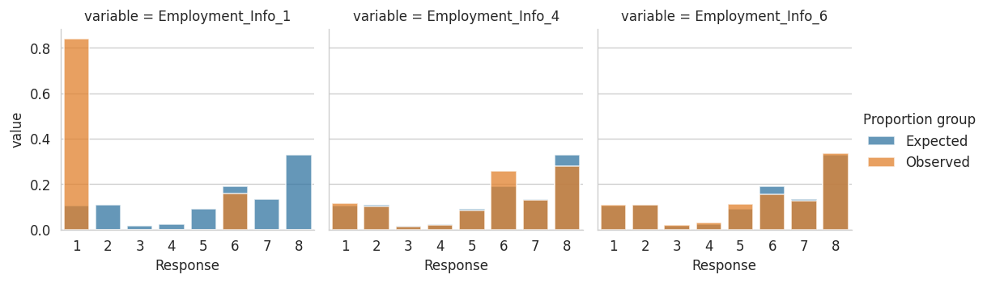
Risk associated with non-/missingness?
We shift our focus to the missingness of variable related to employment information
Each blue histogram indicates the proportion of missing values of each risk level in terms of the whole training set
Each orange histogram shows the proportion of missing values of each risk level in terms of the missing samples of the variable.

Slide 31
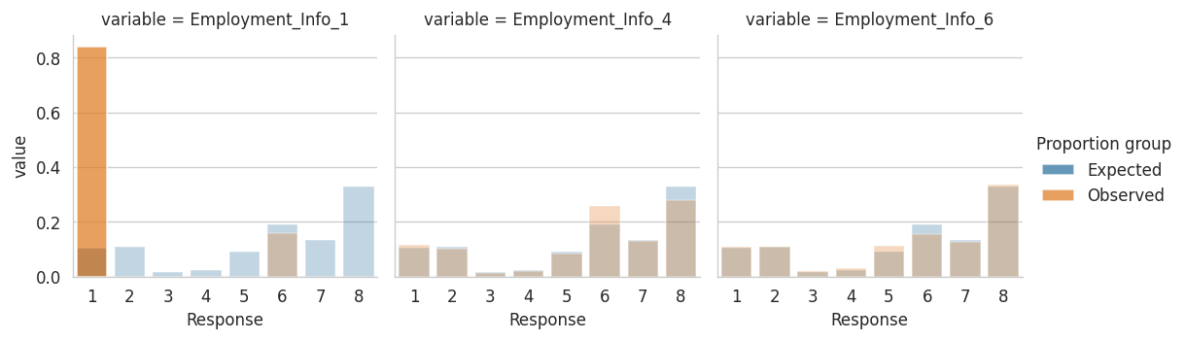
Risk associated with non-/missingness?
Although 'Employment_Info_1' has only 19 missing values, it is still worth noting the significant difference in terms of the proportion
The missingness of 'Employment_Info_1’ is associated with a higher chance of getting risk level 1

Slide 32
Questions to be settled
What do the ‘1’ and ‘8’ in the response variable indicate?
Risk associated with age?
Risk associated with BMI?
Risk associated with product type?
Risk associated with non-/missingness?
Risk associated with # medical keywords?
Risk associated with medical history?
1: highest risk
8: lowest risk
Somehow associated, but the associations are non-linear
Product D1 and risk level 1
Yes for certain variables related medical history and employment information

Slide 33
Risk associated with # medical keywords?
Variables Medical_Keyword_1-48
are one-hot variables
indicate the presence of certain medical keywords.
Do you think it is good for you to have so many medical keywords present in your record?

Slide 34
Risk associated with # medical keywords?
Having more medical keywords someone’s record is very likely to be associated of presence of problems/symptoms/diseases in his/her body.

Slide 35
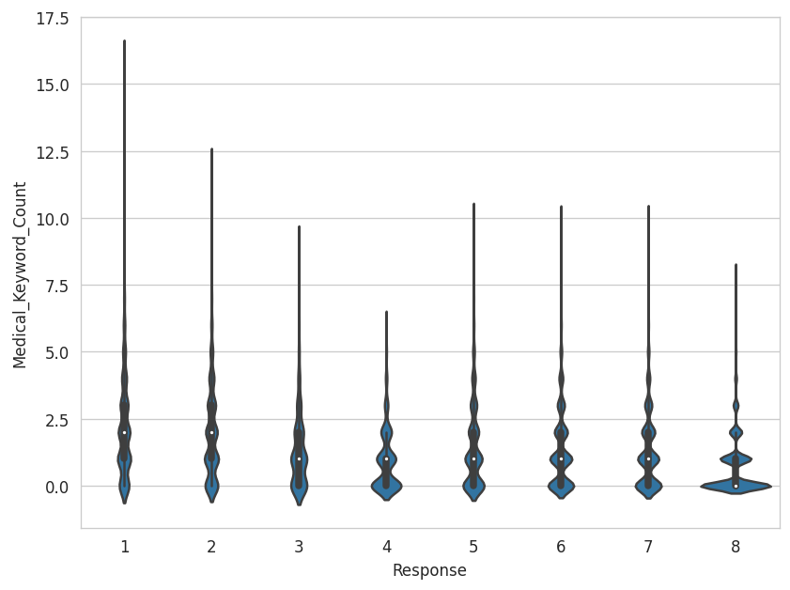
Risk associated with # medical keywords?
The figure is a violin plot that shows the distribution of number of medical keywords from the risk assessment forms
Each violin corresponds to different risk level

Slide 36
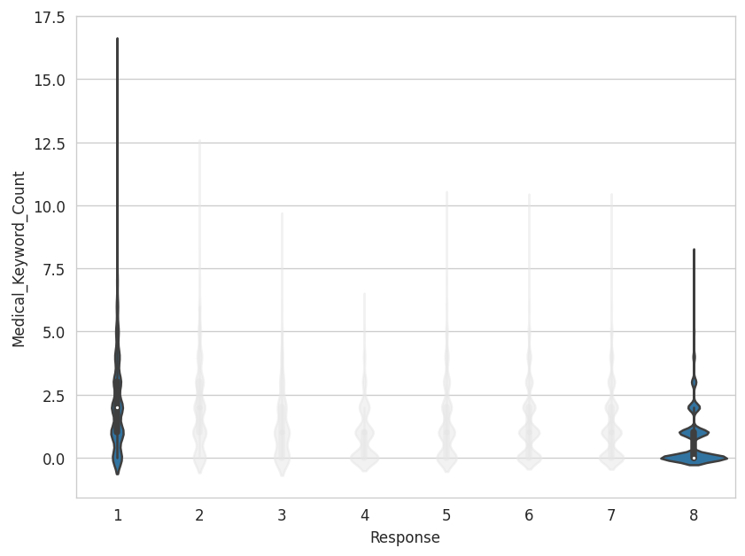
Risk associated with # medical keywords?
Let us focus again on risk levels 1 and 8
The highest number of medical keywords the violin neck of risk level 1 can get is around 17.5, almost a double of the maximum reach of risk level 8.
The highest number of medical keywords the violin neck can get is around 8
However, the violin body of risk level 1 is much slimmer, indicating the number of medical keywords in risk level 1 varies more than that in risk level 8
The violin body of risk level 8 is fatter at zero medical keywords
Having more medical keywords is likely to be associated with having the highest risk

Slide 37
Questions to be settled
What do the ‘1’ and ‘8’ in the response variable indicate?
Risk associated with age?
Risk associated with BMI?
Risk associated with product type?
Risk associated with non-/missingness?
Risk associated with # medical keywords?
Risk associated with medical history?
1: highest risk
8: lowest risk
Somehow associated, but the associations are non-linear
Product D1 and risk level 1
Yes for certain variables related medical history and employment information
More medical keywords and risk level 1

Slide 38
Risk associated with medical history?
Consider 35 variables related to medical history
These variables have at most 3 levels
The official data description claimed that these variables are all nominal variables
the order of possible values in a nominal variable has no meaning by definition

Slide 39
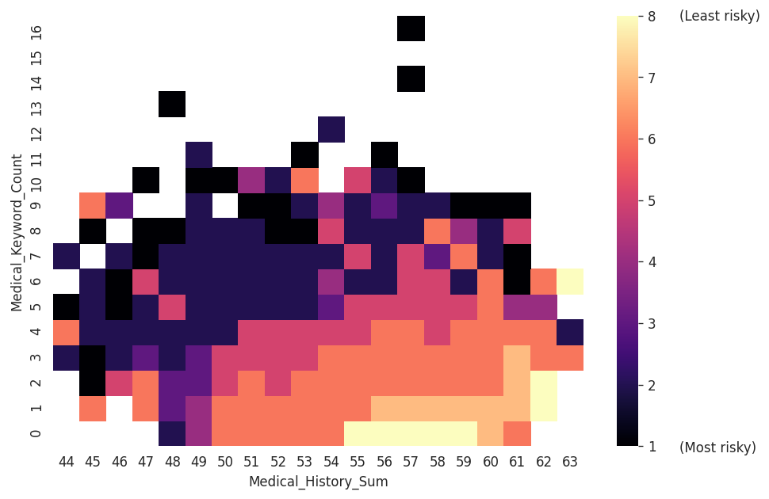
Risk associated with medical history?
The heatmap shows how median risk level varies along medical keyword count and along ‘medical history sum’
‘Medical_History_Sum’ is the sum of all values in those 35 variables related to medical history

Slide 40
Risk associated with medical history?
The median risk level of applicants with ‘Medical_History_Sum’ equal to 53 and ‘Medical_Keyword_Count’ equal to 4 is 5
White cells indicate that there are no applicants with those specific combinations of ‘Medical_Keyword_Count’ and ‘Medical_History_Sum’

Slide 41
Risk associated with medical history?
Is it possible to separate median risk levels 1-4 and median risk levels 5-8?

Slide 42
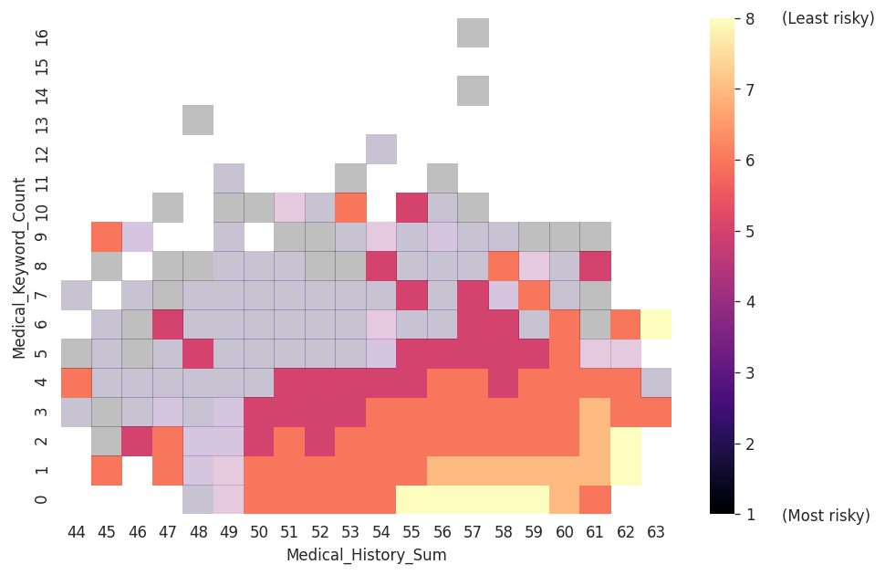
Risk associated with medical history?
At least 50% chance to observe someone less risky in applicants with large ‘Medical_History_Sum’ and a few of medical keywords

Slide 43
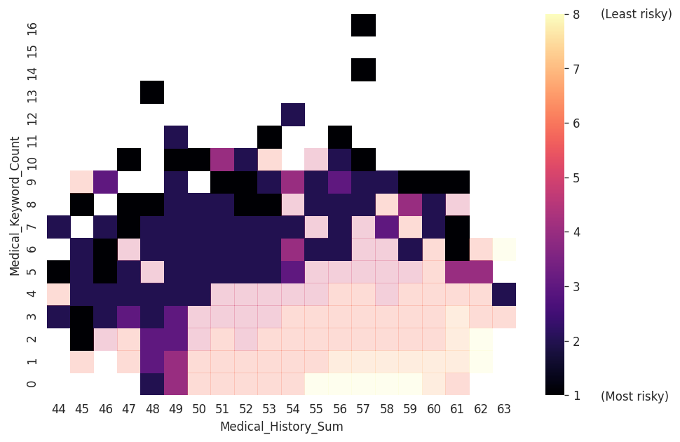
Risk associated with medical history?
At least 50% chance to observe someone more risky in applicants with many medical keywords
or with small ‘Medical_History_Sum’ even though he/she has a few of medical keywords

Slide 44
Questions to be settled
What do the ‘1’ and ‘8’ in the response variable indicate?
Risk associated with age?
Risk associated with BMI?
Risk associated with product type?
Risk associated with non-/missingness?
Risk associated with # medical keywords?
Risk associated with medical history?
1: highest risk
8: lowest risk
Somehow associated, but the associations are non-linear
Product D1 and risk level 1
Yes for certain variables related medical history and employment information
More medical keywords and risk level 1
Yes but slightly weaker than # medical keywords

Slide 45
Q&A

